Slide 1
Leadership at the Spallation Neutron Source
Stuart Henderson, Director
Research Accelerator Division
July 7, 2009

Slide 2
Bob Siemann as Advisor
Chair, SNS Accelerator Advisory Committee 1998-2006

Slide 3
Spallation Neutron Source History
1984 – National Academy of Sciences “Major Facilities for Materials Research and Related Disciplines” (Seitz-Eastman Panel) delivered a prioritized list of recommendations for major new research facilities:
A 6-GeV Synchrotron Radiation Facility (✓APS)
An Advanced Steady-State Neutron Facility (✗ANS)
A 1-2 GeV Synchrotron Radiation Facility (✓ ALS)
A High-Intensity Pulsed Neutron Facility (✓ SNS)
1986 – DOE Memo: Secretarial Site Selection Decisions on Specific Energy Research Projects
RHIC – BNL
1-2 GeV SR Facility – LBNL
6-GeV SR Facility – ANL
Steady-State Research Reactor – ORNL
1993 – Basic Energy Sciences Advisory Committee (Kohn Panel) reaffirmed need for both Reactor and Accelerator-based Neutron Sources

Slide 4
Spallation Neutron Source History
1995 - Advanced Neutron Source cancelled
1995 – Congress appropriates $8M for conceptual design of accelerator-based neutron source
1996 – BESAC (Russell Panel) strongly recommended that a 1-MW pulsed spallation neutron source, with upgrade capability into the multi-MW range, be constructed.
1996 - Five DOE Laboratory Collaboration Established
August 1996 – CD-1 Approval
May 1997 - Conceptual Design Report issued
December 1997 CD-2 Approval
October 1998, First Accelerator Systems Advisory Committee Meeting

Slide 5
Spallation Neutron Source Project: Challenges
Multi-laboratory collaboration (LBNL, BNL, LANL, ANL, ORNL, and later JLAB) with ORNL having Project Management responsibility
Several partner labs already had advanced designs
Built at a laboratory on a green-field site without a large accelerator infrastructure or culture
Construction model called for partner lab design and ORNL installation, commissioning and operation
Baseline was not optimized
Large project: $1.4B, 7 year construction
Technical goals were well beyond the state-of-the-art:
1-2 MW beam power baseline was a factor of ~10 beyond existing short pulse neutron sources
Beamloss criteria a factor of ~10 better than achieved

Slide 6
David Moncton, Former Director of APS and SNS
“I have great respect for Bob, his integrity, his work ethic, and his strong sense of commitment to physics beyond his own field. I knew him since the early 80's when he began to get involved in the accelerator issues associated with 3rd generation synchrotron sources. He led the first "strawman" design of APS. Subsequently he was strongly involved in the accelerator advisory committee to APS. He had such a talent for seeing both the forest and the trees! And when he focused on a potential problem area, he was always right about the importance of that particular issue, and he never missed an important issue. Finally he had a gift for expressing his concern in such a way that motivated people to focus on the issue and solve it. He created a sense of urgency without creating panic. If you are building an accelerator, and if you solve the problems and address the issues he raises, then the machine will work as planned. At least that was my experience. So he was a great comfort to have on your side. Having had this experience with APS it was a no-brainer to invite him to play the same role in SNS, which he did with remarkable effectiveness for three meetings, I believe, while I was SNS director. Please express my sincere admiration and condolences. “

Slide 7
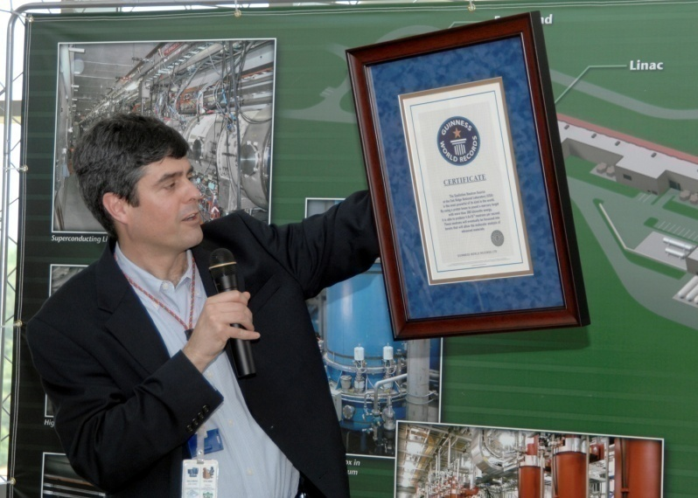
Thom Mason, Oak Ridge National Laboratory Director, and Former Director of SNS
“Bob was with the project all the way through. To some extent his role was to help us navigate the turmoil through start-up and management changes without losing sight of the tactical basis of what we were doing. I think he went beyond that in the sense that he was very helpful in providing advice of a more informal nature on people, roles, and responsibilities and realities. In addition I think he was able to function in a way that had sufficient standing with the accelerator folks across the multi-lab partnership, so that once we had ASAC buy-in, any dissent on a decision was largely behind us – people bought in.”

Slide 8
SNS: A Dynamic Environment (1997-2006)
ORNL Contractors: 2
ORNL Directors: 3
SNS Project Directors: 3
SNS Accelerator Division Directors: 2
SNS Conventional Facilities Directors: 2
SNS Experimental Facilities Directors: 3
LBNL SNS Team Leaders: 2
LANL SNS Team Leaders: 5
BNL SNS Team Leaders: 2
JLAB SNS Team Leaders: 1
ANL SNS Team Leaders: 1
ASAC Committee Chairman: 1

Slide 9
SNS Accelerator Systems Advisory Committee Members 1998-2006
Bob Siemann, Chair (SLAC)
Matt Allen (SLAC)
Daniel Boussard (CERN)
Alex Chao (SLAC)
David Finley (Fermilab)
Bob Jameson (LANL)
Bill McDowell (Argonne)
Gerry McMichael (Argonne)
Graham Rees (Rutherford Appleton Lab)
Paul Schmor (TRIUMF)
Jean-Louis LaClare (CEA/Saclay)
Dieter Proch (DESY)
Mike Harrison (BNL)
And later…..
Bob Kustom (Argonne)
Helen Edwards (Fermilab)
Frank Zimmerman (CERN)
Yoshishige Yamazaki (J-PARC)

Slide 10
Key Themes and Technical Issues
The need for a conservative and flexible design
The need to focus on reliability and operability in the design stage
The need to focus on beamloss as the single over-riding technical issue
The need to build a strong team at ORNL to take ownership of the machine

Slide 11
The Major Issues: ASAC Report 1, October 1998
“…The SNS Project is in an unusual state outside much of our experience in that it is a construction project with significant money appropriated and yet there remain issues at the conceptual design level that need to be resolved. Three particular areas that should be given attention by the SNS collaboration and management are reliability, beam loss, and the implications of the transition from a multi-laboratory construction project to an operating accelerator at Oak Ridge National Laboratory…”

Slide 12
Need for Strong ORNL Leadership: ASAC Report 1, October 1998
“…The SNS is being designed and constructed by a five laboratory collaboration. Oak Ridge has a central role in this collaboration. It has the responsibility of integrating the accelerators delivered by the other laboratories. It will participate in the commissioning, and then it must operate and improve the SNS. This has implications now.
The design and construction will require trade-offs between the accelerators that are the responsibilities of the other laboratories. Some of these trade-offs will be complex and will have to be made with only partial information. This will require strong, experienced leadership at Oak Ridge to deal with the other laboratories and, in addition, to recruit and lead the people who will commission, operate and improve the SNS.
Documentation must be at an unprecedented level for an accelerator project because ORNL will not have the equipment designers and builders in residence to diagnose and repair equipment. Documentation must be exceptional, and, in addition, there could be significant value in having ORNL people involved in the construction and design at various collaborating laboratories…”

Slide 13
Flexibility: ASAC Report 1, October 1998
“…There are no reliable beam physics models which can credibly predict losses at this small level, and it is unlikely that such models will be developed before the design is finalized. Therefore, the linac and accumulator ring designs must be conservative by today’s understanding, and they must be flexible…”

Slide 14
Flexibility: ASAC Report 3, October 2000
“…There is one situation that needs immediate attention and is highlighted here. The Drift Tube Linac (DTL) design has permanent magnet quadrupoles, and this feature is close to being frozen…This planned use of permanent magnet quadrupoles is neither conservative nor does it provide tuneability and flexibility. Space charge is most important at lower energies, and the present plan is to provide no focusing adjustment to 90 MeV. This concern was raised at the last ASAC meeting, and at this meeting it was stated in response to questions that fixed quadrupole gradients are preferable so people couldn’t readjust gradients. But this could be necessary and is exactly our concern - study of phase and quadrupole laws in the high-energy end of the linac are to continue, but results of this work could not be applied later to a DTL with permanent magnet quadrupoles.”

Slide 15
Reliability and User Expectations: ASAC Report 6, February 2002
“A high level of reliability is a priority for the neutron scattering community. The ultimate goal for SNS operation is 5000 hours per year at full beam power of 1.4 MW with 95% reliability. In past reports we have stated our opinion i) that reliability did not appear to be an important consideration in the design, and ii) that it was important to develop realistic goals for the initial reliability and for the rate of improvement over the first years of operation.”

Slide 16
Operability: ASAC Report 6, February 2002
“The emphasis on Project Completion is appropriate, but care is needed, as decisions made now will affect the project over its full lifetime. Options that are inexpensive now but costly to retrofit should be implemented if possible. Site engineering designs should concentrate on long term issues associated with ease of access and ease of maintenance of active accelerator components, including vacuum leak testing and replacement of faulty items. Exposure of staff to radiation during maintenance in the tunnels can be greatly reduced by the standardization”

Slide 17
Beamloss: ASAC Report 3, October 2000
“The SNS has stringent beam loss requirements. The linac design must minimize beam halo generation, potential beam loss along the linac itself, and deterioration in output beam quality to the HEBT and ring. The underlying physics depends on space charge and its nonlinear interactions via the system resonances. The linac dynamics has never been presented to us in a framework of space-charge physics, e.g., in terms of transverse and longitudinal tunes at low and high currents, tune trajectories along the linac, tune spreads, relation to structure resonances and potential unstable modes, and the effects of errors in this framework.…There is brute force running of simulation codes and simplistic evaluation of results by comparing phase-space scatter plots or RMS quantities, without relation to the underlying physics. The best strategy to continue making progress with incomplete understanding of the physics is to 1) make conservative decisions and 2) provide tuneability and flexibility so there will be the ability to respond to either improved understanding from future physics studies or experience gained during commissioning.”

Slide 18
Evolution of SNS Design

Slide 19
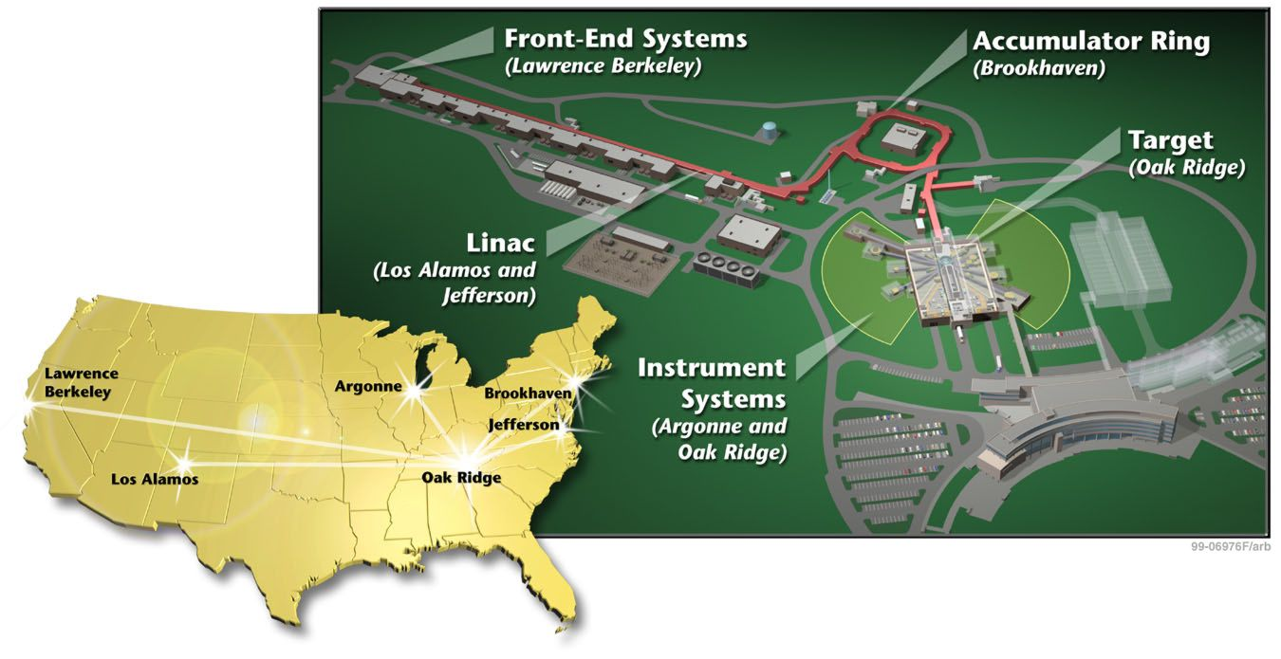
Evolution of SNS Design

Slide 20
Adoption of Superconducting Technology: ASAC Report 2, December 1999
“…Superconducting RF has already been accepted for intense, light-ion cw applications. Its technical application to pulsed light-ion applications, such as the SNS linac, awaited confidence that the RF fields and phases could be controlled precisely with Lorentz force detuning and microphonics present. This control has been developed and demonstrated at the TESLA Test Facility, and the TESLA design seems adequate to fulfill the SNS needs…The SNS design study clearly indicates that superconducting RF is economically and schedule competitive. With superconducting technology also applicable to pulsed high-intensity accelerators, it is clear that superconductivity is the technology of choice for many future linacs….In summary, we give a strong endorsement for the use of superconducting technology.”

Slide 21
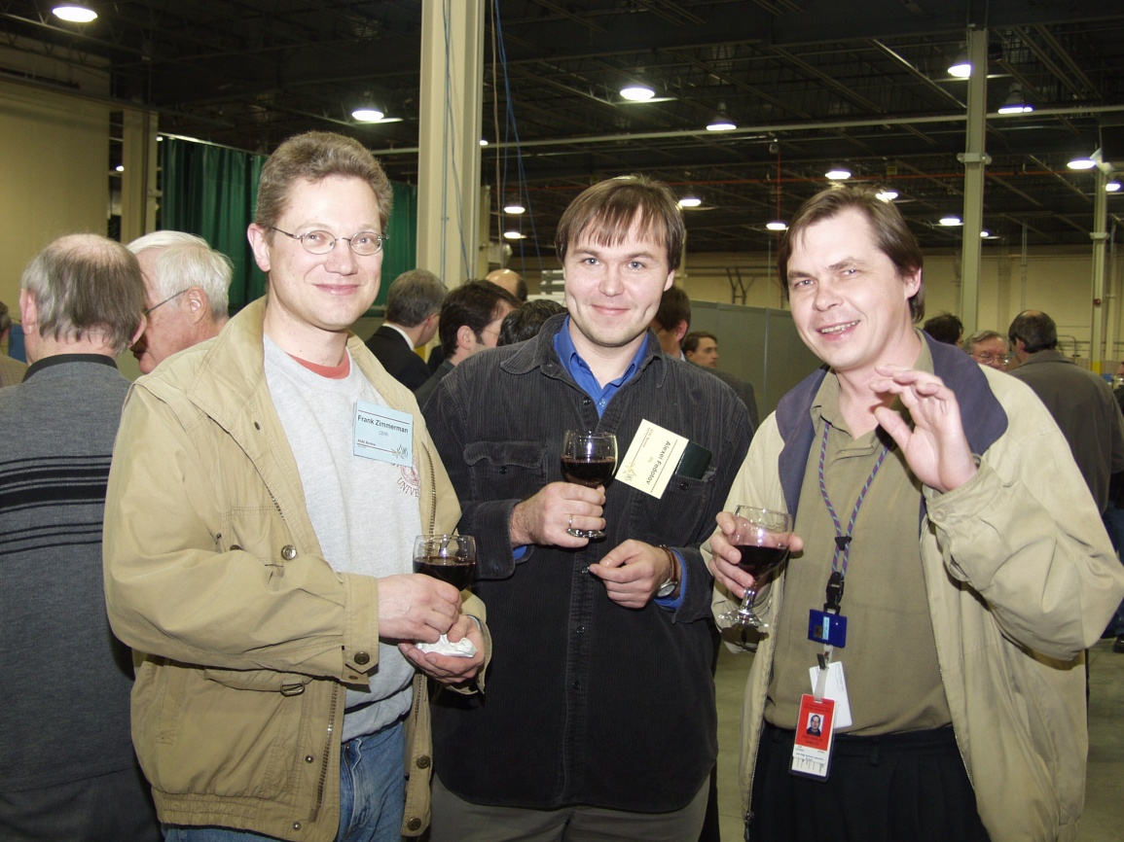
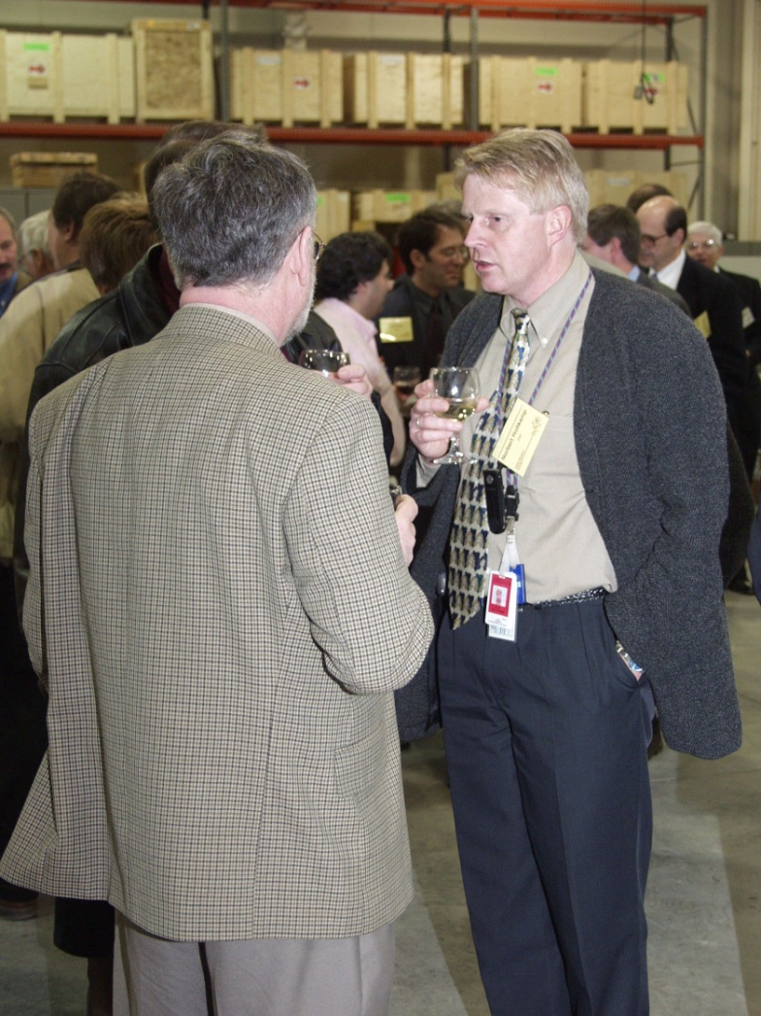
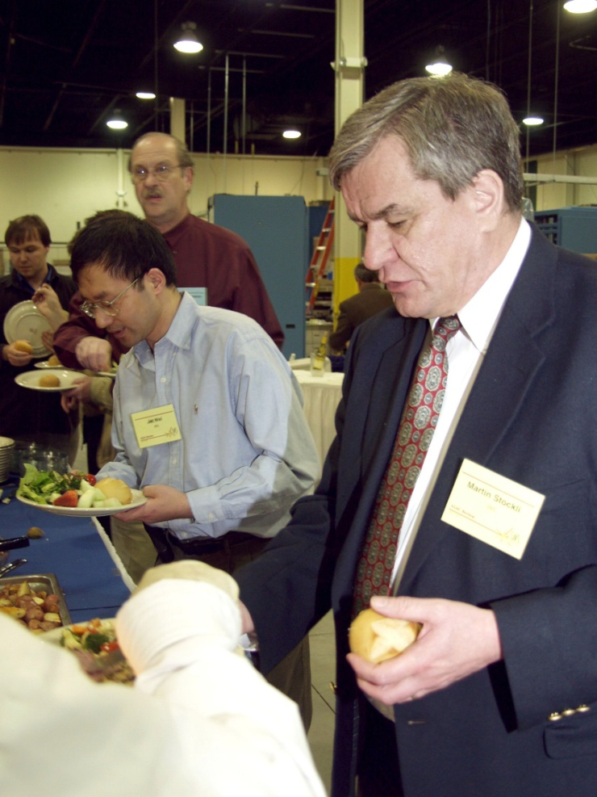
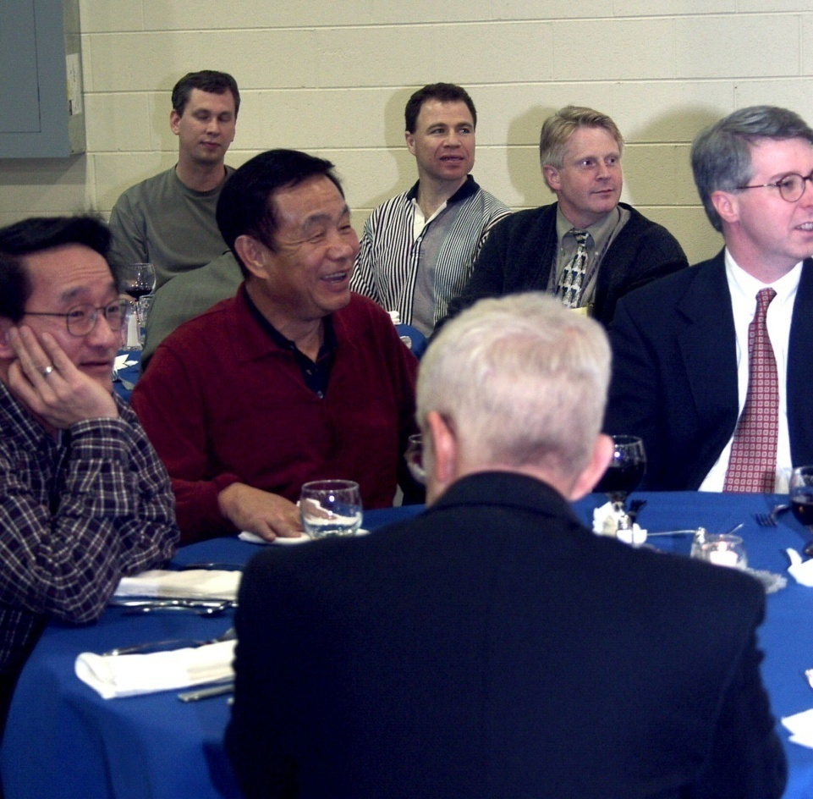
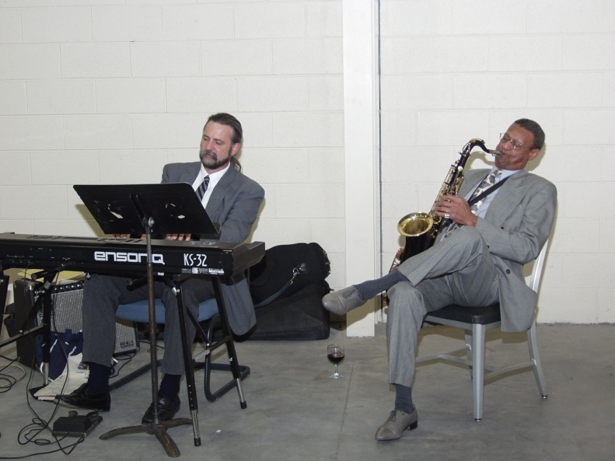
ASAC Dinners….

Slide 22
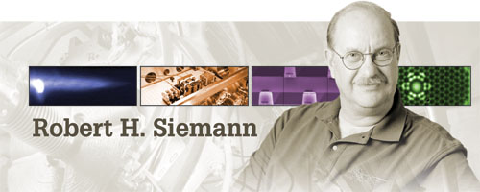
Personal Reflections
Chair, SNS Accelerator Advisory Committee 1998-2006

Slide 23
SNS Ramps-Up
Integrated Beam Power (MW-hr)
Beam Power on Target (kW)

