Slide 1
Lawrence Livermore National Laboratory
Positron Creation Using Ultra-intense Lasers
Scott C. Wilks
Physics Division, LLNL
For presentation to
SLAC Workshop
Palo Alto, CA
July 9, 2009
This work was performed under the auspices of the U.S. Department of Energy by the University of California, Lawrence Livermore National Laboratory under Contract DE-AC52-07NA27344.
LLNL-PRES-414505

Slide 2
Acknowledgements
Hui Chen, Jim Bonlie, Sophia Chen, Cliff Chen, Jeff Gronberg, Lee Elberson, Roger van Maren, Dwight Price, Marilyn Schneider, Ronnie Shepherd, Riccardo Tommasini,
Peter Beiersdorfer, Bob Cauble, Mark Eckart, Bob Heeter, Andrew Ng and Don Correll
Lawrence Livermore National Laboratory
Philip Nilson, Jason Myatt, Christian Stoeckl and
David Meyerhofer
LLE, Rochester University
Edison Liang
Rice University
Gianluca Gregori
Oxford university

Slide 3
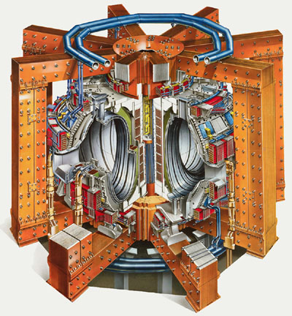
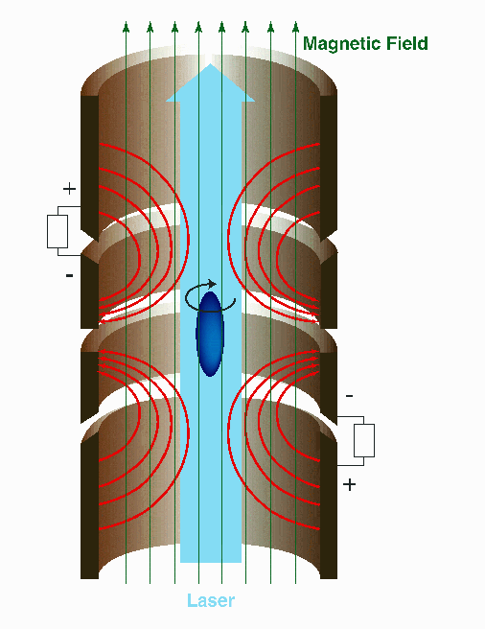
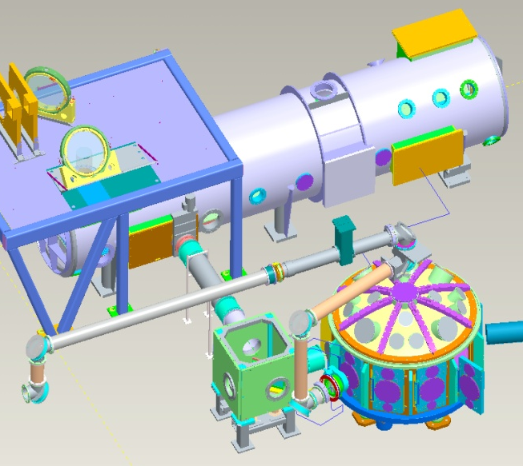
Introduction
Motivation
Hot Electrons
Pair Production
Sheath Fields
Conclusion
Original goal of this work: Study basic plasma physics by creating dense pair plasmas and jets.
Tokamaks
Penning-Malmberg Traps
Ultra-intense Lasers
Theory only
Titan laser
N_{e+} ~ 8x10¹⁴
V ~ 2.7 x 10⁷ cm³
N_{e+} ~ 8x10⁷
V ~ 6 cm x 1 mm(D.)
Experimental
N_{e+} ~ 10¹¹
V ~ 1 mm x 1 mm(D.)
3.3 x 10⁷ cm⁻³
4 x 10⁹ cm⁻³
1 x 10¹⁴ cm⁻³
Could lasers create the highest density of positrons in the laboratory, by creating a large number in a short time (~ picosecond) ?

Slide 4
Simulations of ultra-intense laser-solid interfaces show that generation of mildly relativistic electrons was possible.
Introduction
Motivation
Hot Electrons
Pair Production
Sheath Fields
Conclusion
Non-relativistic Case (low laser irradiance Iλ² < 10¹⁸ μm² W/cm², v_{osc}/c < 1 )
y
Incident laser pulse
Overdense
plasma
x
Electrons “wiggle” along surface,
never penetrating into overdense.
Relativistic Case (high laser irradiance Iλ² > 10¹⁸ μm² W/cm², p_{osc}/m₀c > 1 )
Transverse component ~ longitudinal component
electrons
Overdense
plasma
S. C. Wilks, et. al. Phys. Rev. Lett. (1992)
Some electrons with enough excursion are non-adiabatically accelerated into solid.
Scaling verified by Particle-In-Cell simulations as well experiments on LLNL PetaWatt.
Multi-MeV electron energies are generated when ultra-intense pulses hit solids.

Slide 5
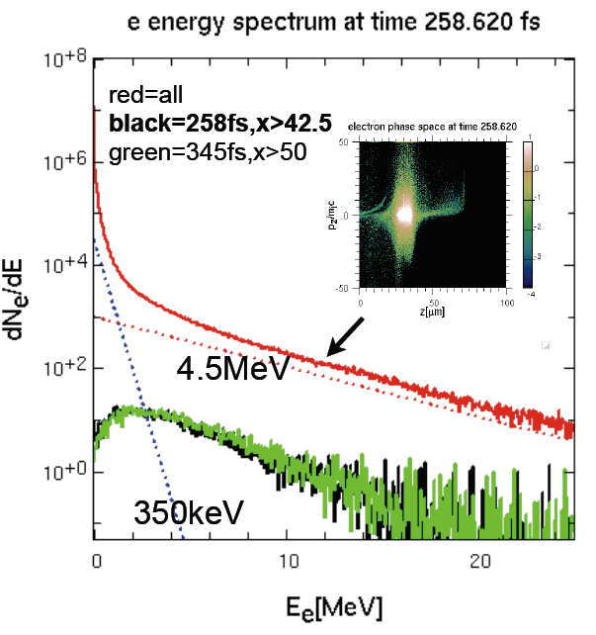
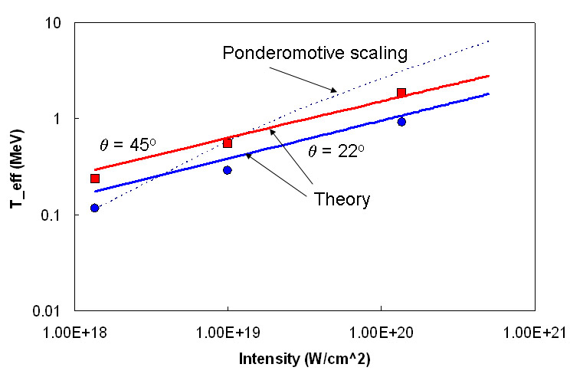
Important to realize that this is not a mono-energetic beam of electrons, but broad spectrum.
Introduction
Motivation
Hot Electrons
Pair Production
Sheath Fields
Conclusion
Hot electron scaling with intensity
“Relatively low” energy electrons creating the pairs would mean that positron density in target would be high.

Slide 6
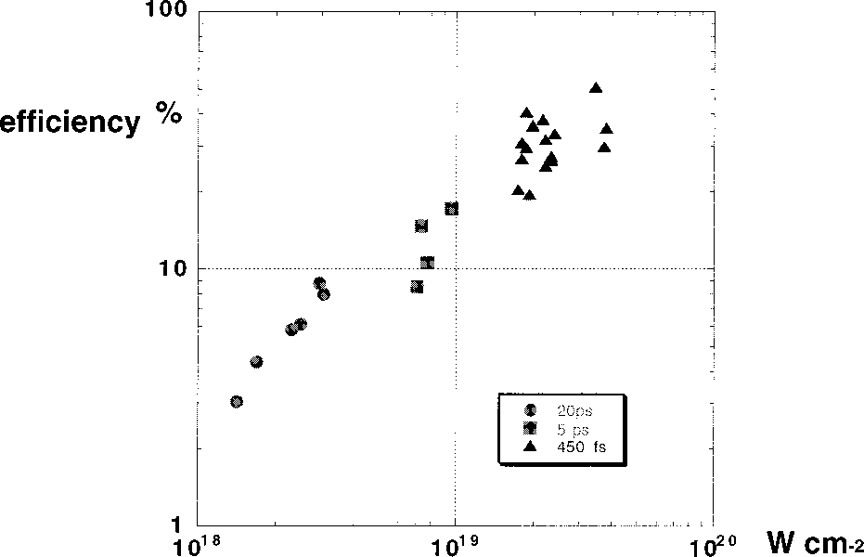
Estimates on the conversion efficiency of laser energy into hot electrons range from 15-50%.
Introduction
Motivation
Hot Electrons
Pair Production
Sheath Fields
Conclusion
Currrent Ultra-intense Lasers
RAL Petawatt – 600 J in 1 ps
Omega EP – 800 J in 10 ps
Titan – 120J in 1 ps
        250J in 10 ps
Typical use is Fast Ignition research.
Roughly, the fraction of E converted to bremsstrahlung in a thick target :
Laser to Hot Electron Efficiency
“Hot electron production and heating by hot electrons in fast ignitor research” M. Key, et. al., Phys. Plasmas 5, 1966 (1998)
I/E ~ 0.0007*Z*T_{hot}
Example: Au, Omega EP, coupling 30% into 1.5 MeV hots ➔ 20 J of Bremsstrahlung!
A considerable amount of energy can be converted into photons, then pairs, in < 20 ps. Downside? Rep. rate measured in hours.

Slide 7
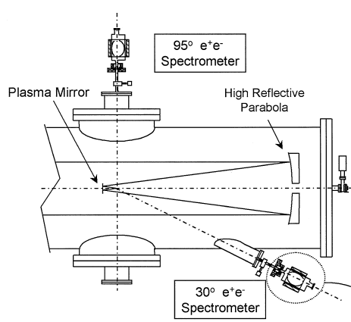
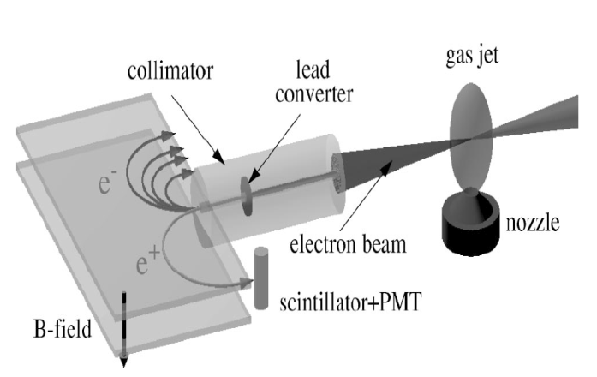
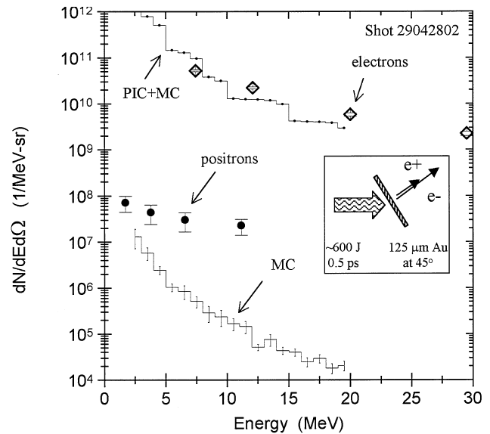
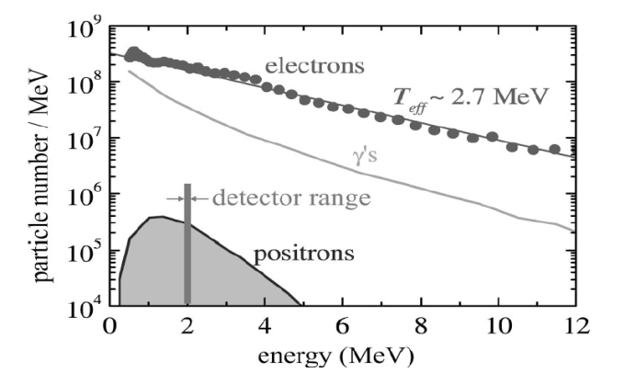
Introduction
Motivation
Hot Electrons
Pair Production
Sheath Fields
Conclusion
Prior art: Substantial theoretical studies, but very little experimental data existed.
Theoretical/Modeling
LLNL NOVA PetaWatt Exp.
Accelerator Electron Beam
Shearer et al. 1973
Liang et al. 1995, 1998
Shkolnikov et al. 1997
Gryaznykh et al. 1998
Shen & Meyer-ter-Vehn, 2001
Nahashima & Takabe, 2002
Wilks et. al., 2005
Berezhiani et al., 2007
Myatt et al., 2009
……
Assume a T_{hot}, it was
predicted for 100 J laser
10⁷ - 10⁹ positrons would
be produced
(depending on mechanisms
target Z, thickness,
Laser parameter etc. )
Cowan et al. (1999)
Gahn et al. (2002)
<100 were detected
e+/e- ~ 10⁻⁴
~30/shot at 2 MeV
e+/e- <10⁻³

Slide 8
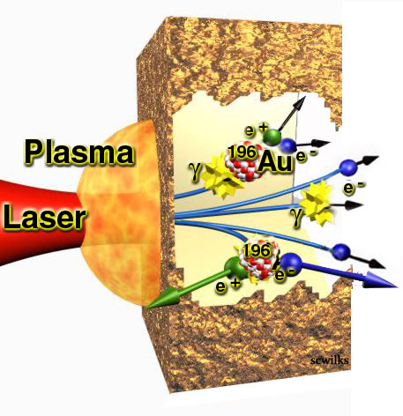
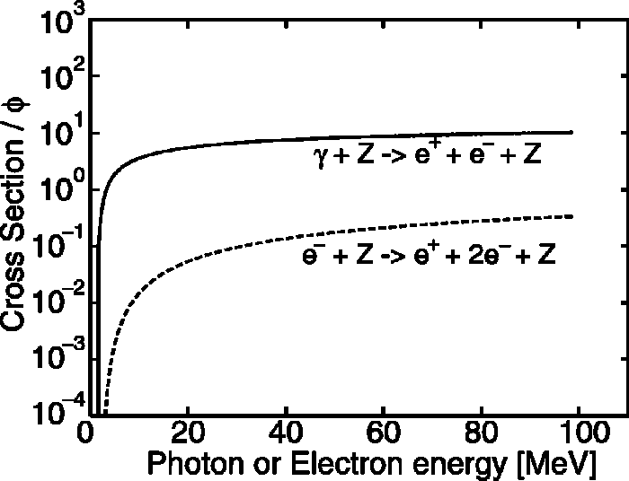
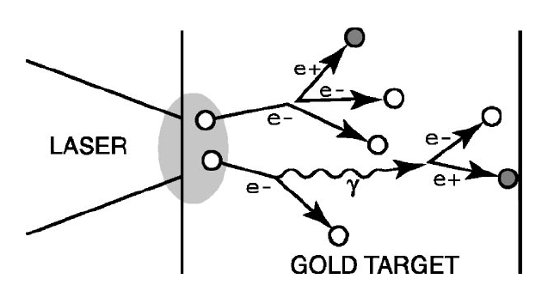
Two main processes involved in laser positron creation in the presence of high-Z nucleus
Introduction
Motivation
Hot Electrons
Pair Production
Sheath Fields
Conclusion
1. Direct (Trident) pair production
e⁻ + Z ➔ 2e⁻ + e⁺ + Z
(Z: nucleus)
Indirect (Bethe-Heitler) pair production:
  e⁻ + Z ➔ γ + e⁻ + Z
  γ + Z ➔ e⁻ + e⁺ + Z
  (γ: Bremsstrahlung)
2
1
1
K. Nakashima and H. Takabe,
Phys. Plasmas, 1505, 9 (2002)
2
High energy (>MeV, relativistic) e⁻s are the key to both processes

Slide 9
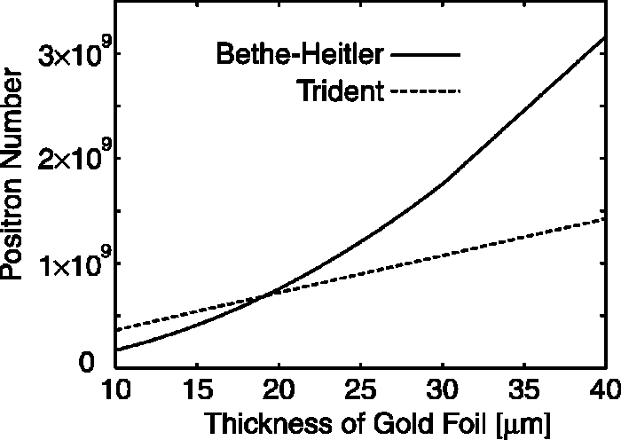
Which mechanism dominates depends strongly on target thickness.
Introduction
Motivation
Hot Electrons
Pair Production
Sheath Fields
Conclusion
Laser Energy 280 J, Intensity 10²⁰ W/cm²
(Assuming no electron refluxing.)

Slide 10
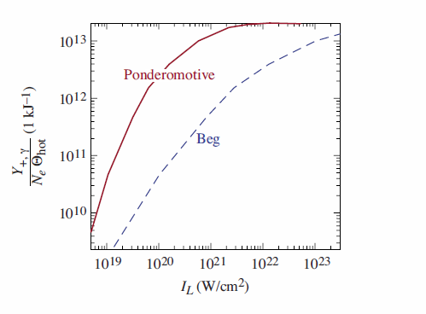
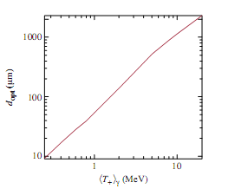
How many pairs can be made when both trident and B-H mechanisms are considered?
Introduction
Motivation
Hot Electrons
Pair Production
Sheath Fields
Conclusion
Helpful guide to design an experiment
Positron yield/kJ of hots
Optimal thickness (Au)
J. Myatt, et. al., PRE 79 066409 (2009)
However, we find that there is an additional thing we can do to increase yield…

Slide 11
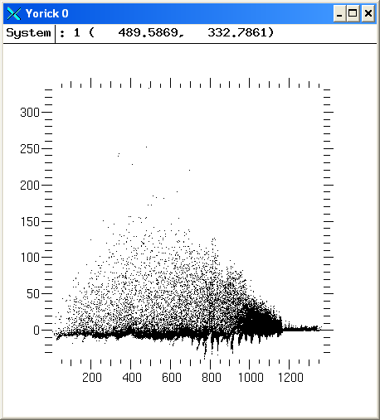
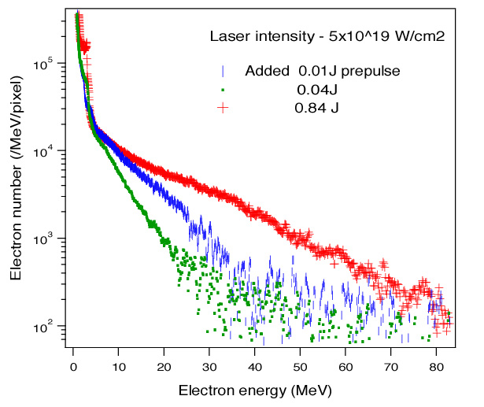
Maximizing the hot electron energy and number increases the positron production
Introduction
Motivation
Hot Electrons
Pair Production
Sheath Fields
Conclusion
Hotter electrons from underdense pls.
Measured super hot electrons
Underdense
acceleration
Ponderomotive
heating
~1 MeV
γβ
16 MeV
5 MeV
8.6 MeV
x (c/w₀)
We found that maximizing pre-plasma increases positron signal.

Slide 12
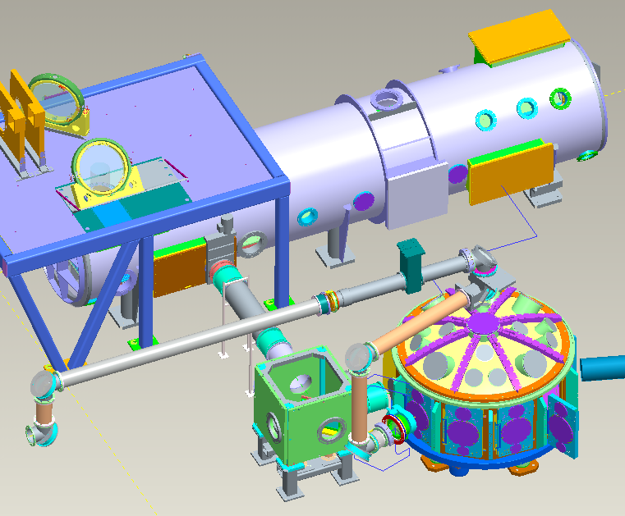
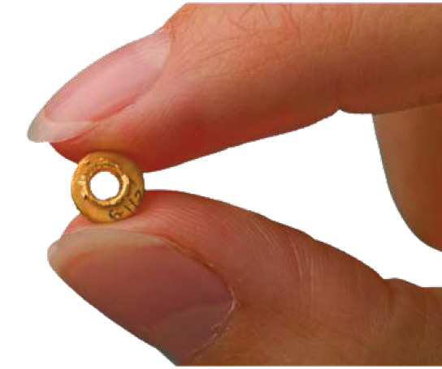
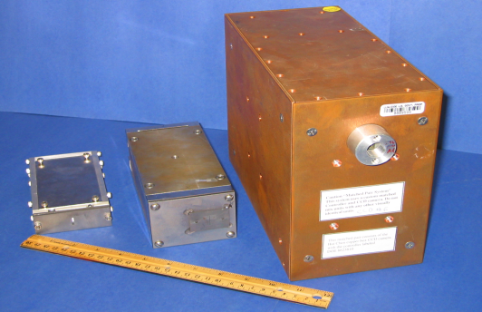
We performed positron experiments on LLNL Titan laser in May and September 2008
Introduction
Motivation
Hot Electrons
Pair Production
Sheath Fields
Conclusion
LLNL Titan two-beam laser
Experimental setup
2w, 50 - 150 J, 1-3 ns
Spot: 600 um
1w, 120 - 250 J
0.7 - 10 ps
Spot: 8-10 um
~150J,~ps
f/3
~150J, ~ns
Timing for the two beams
Targets
EPP Spectrometers
I
Short-pulse
Long-pulse
t
Al, Cu, Sn, Ta, Au
Thickness: 0.1 - 3.1 mm
Chen et al. RSI 08

Slide 13
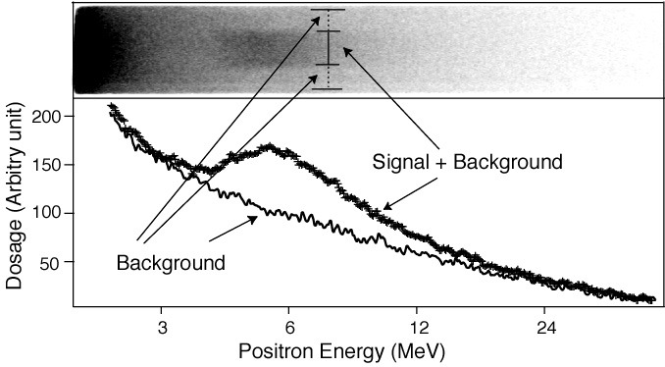
Introduction
Motivation
Hot Electrons
Pair Production
Sheath Fields
Conclusion
Positron signal was observed and verified experimentally
Raw positron data image (Au, 1mm)
Positron signal was verified using
various Z targets and thicknesses.
Positrons from lower Z undetected
Electrons
Au
Au
Positron energy: ~3 to 20 MeV (relativistic)
Equivalent of about 10⁶ positrons were
observed in the detector - 4 to 5 orders of magnitude more than previously observed
Cu,Sn

Slide 14
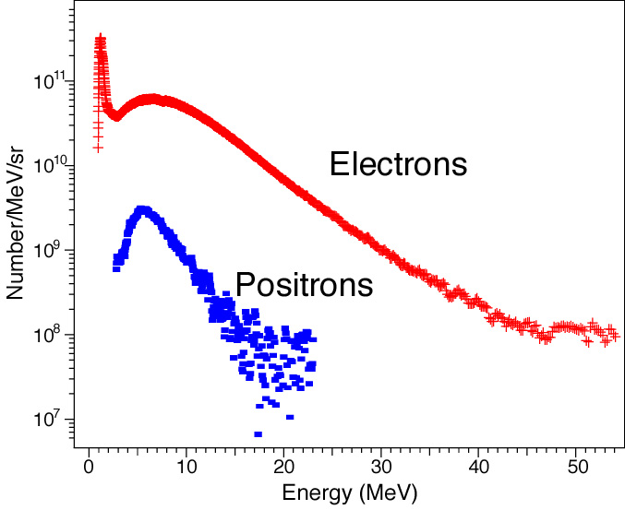
First detailed positron energy spectra reveal important physics
Introduction
Motivation
Hot Electrons
Pair Production
Sheath Fields
Conclusion
EPP spectrometer data (target rear)
1mm Au
Laser
EPPS
Super hot electrons (~9 MeV temperature)
Colder positrons (~4 MeV)
Positron/Electron ratio >10⁻² (about 10⁻⁴ from NOVA)
Cowan et al. (1999)

Slide 15
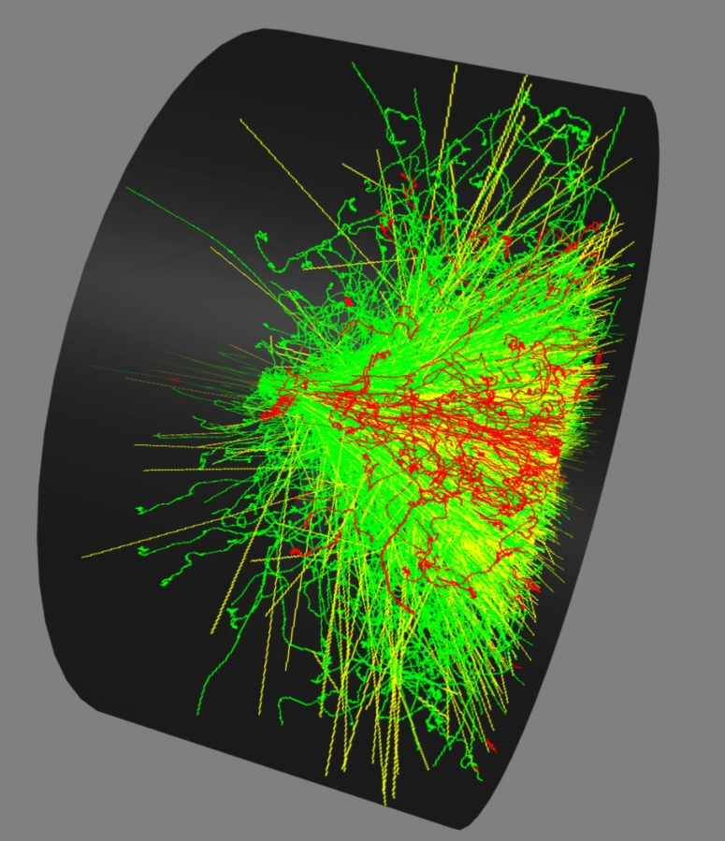
Modeling is used to confirm relative electron and positron signal levels seen in experiment.
Introduction
Motivation
Hot Electrons
Pair Production
Sheath Fields
Conclusion
Example. Electrons injected at 25 MeV
(green ➔ e-, yellow ➔ photons, red ➔ e+)
We employ EGS (NRC version).
Steps taken to compare with experiments.
Generate an initial electron f_{in}(E).
Run it through target (e.g., 3 mm Au.)
Attempt match w/ observed f_{out}(E) signal.
Modify f_{in}(E) until f_{out}(E) match occurs.
Compare positron signal with exp’t.

Slide 16
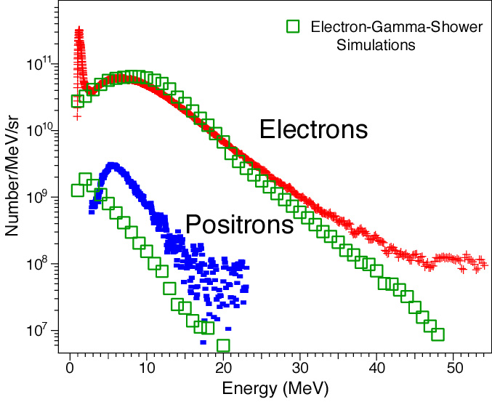
First detailed positron energy spectra reveal important physics
Introduction
Motivation
Hot Electrons
Pair Production
Sheath Fields
Conclusion
EPP spectrometer data (target rear)
(EGS)
Proton spectrum
~4 MeV
~1 - 4 MeV
Chen, et al. PRL 2009
Observed ~ 1e10 from rear of target, 1e8 from front.
Explanation of the energy shift of positron peak:
The same acceleration field for protons (sheath field)

Slide 17
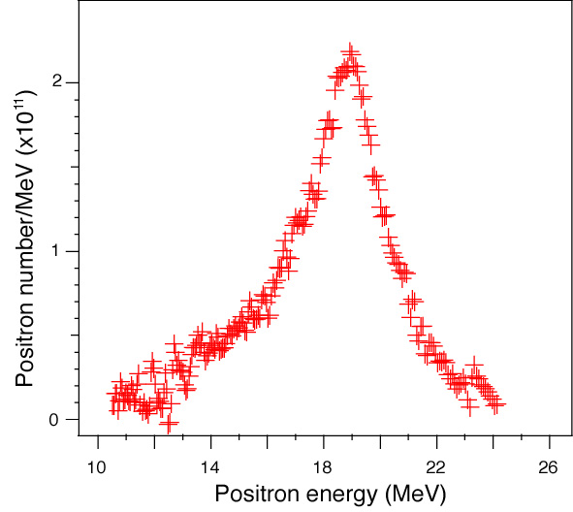
Recent experiments at Omega EP indicate nonlinear scaling with laser energy.
Introduction
Motivation
Hot Electrons
Pair Production
Sheath Fields
Conclusion
EPPS positron shot #5082 (812 J, 10ps)
~2×10¹¹ positrons inferred.
~3 time more positrons than the linear scaling based on Titan 10ps shots predicted.
High rate of positron production: ~ 2x10²² e+/s
Near monoenergetic positron jet observed: due to large energy shift?

Slide 18
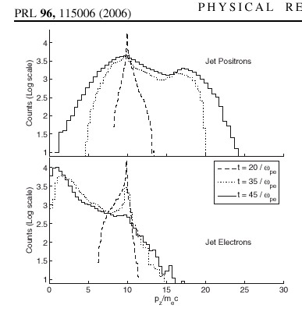
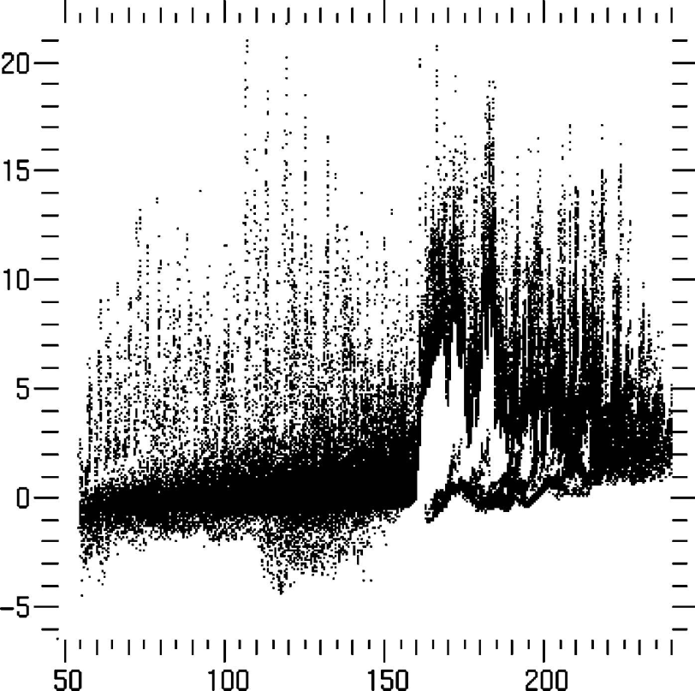
Interestingly, similar shift was observed in simulations by us and SLAC in 2006 for e+-e- jets.
Introduction
Motivation
Hot Electrons
Pair Production
Sheath Fields
Conclusion
Figure 5. Positrons leaving the thin slab completely out the
rear of the target.
S. C. Wilks, et. al.“Electron-Positron Plasmas Created by
Ultra-Intense Laser Pulses Interacting with Solid Targets”,
Astrophysics and Space Sciences, 298, pp 347-355 (2005).
“Inductive and ES Acceleration in Relativistic Jet-Plasma Interactions”,
J. S. Ng and R. J. Noble, PRL 96, 115006 (2006).
Acceleration of positrons and de-acceleration of electrons seen in 3-D simulations of pair jets into both vacuum and plasma.

Slide 19
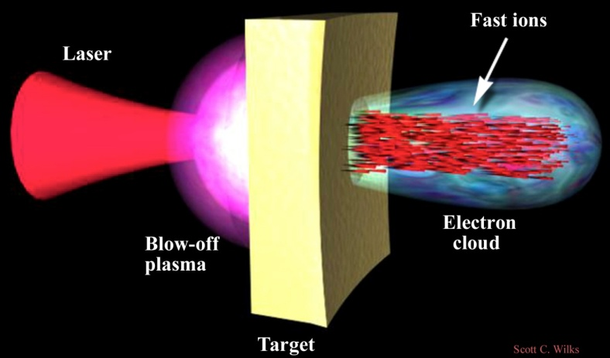
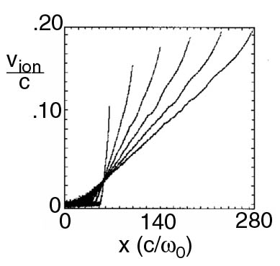
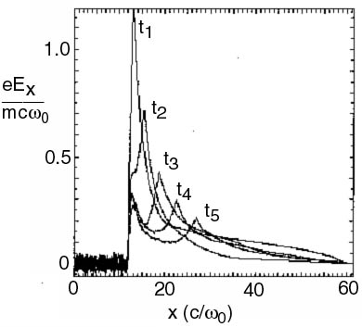
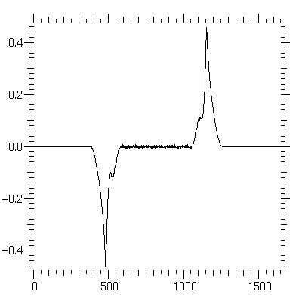
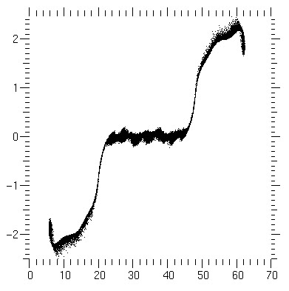
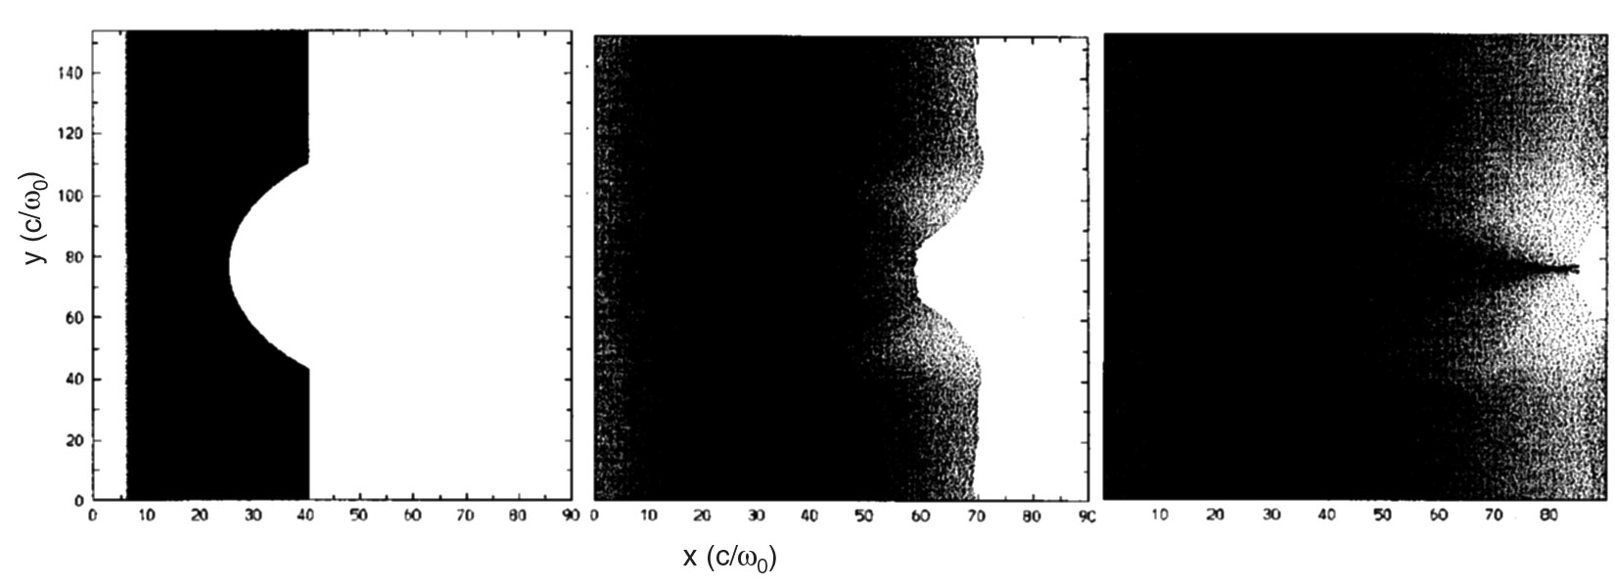
We attribute this to ion acceleration (via TNSA*) that is known to occur for ultra-intense laser-solid interactions.
Introduction
Motivation
Hot Electrons
Pair Production
Sheath Fields
Conclusion
Accelerating field
Ions accelerated
1.2 MeV/μm
3.0 μm
Accelerating field
Positron γβ
Ions can be focused by shaping target
Positron spectra was expected to shift to higher energies for thin targets. Could focusing also occur for the positrons?
*S. C. Wilks, et. al., “Ion Acceleration Mechanisms in Ultra-Intense laser-Plasma Interactions”, Physics of Plasmas, 8, 542 (2001).

Slide 20
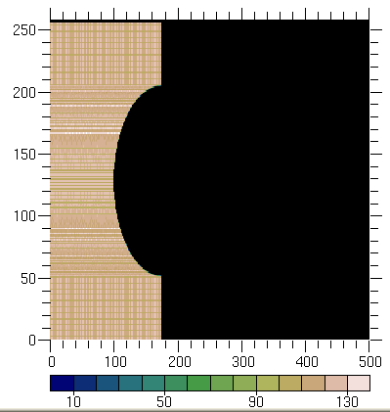
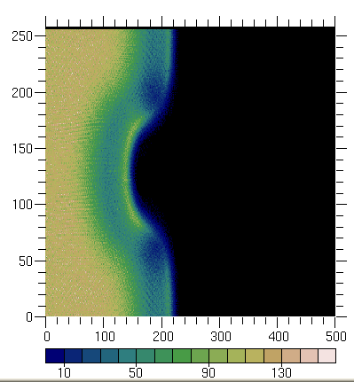
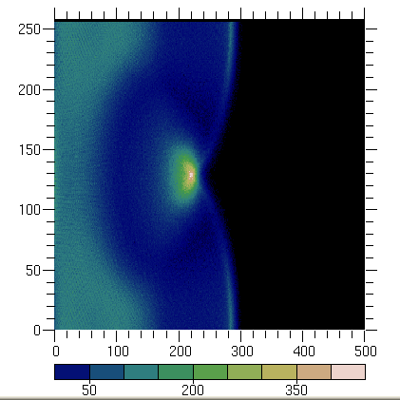
This led to interesting idea: can we focus the positrons using a shaped target?
Introduction
Motivation
Hot Electrons
Pair Production
Sheath Fields
Conclusion
t=0
t=10 ω₀⁻¹
t=20 ω₀⁻¹
y (c/ω₀)‏
x (c/ω₀)‏
Initial target composition:
Electron fraction 1.001
Ion fraction 1.0
Positron fraction 0.001
Positrons are focused with the
same electric field that is
responsible for proton
acceleration.
Results in a positron density
that is 4 times higher than the
initial positron density in the
target.
Only a small, proof-of-principle simulation. More research required to confirm this.

Slide 21
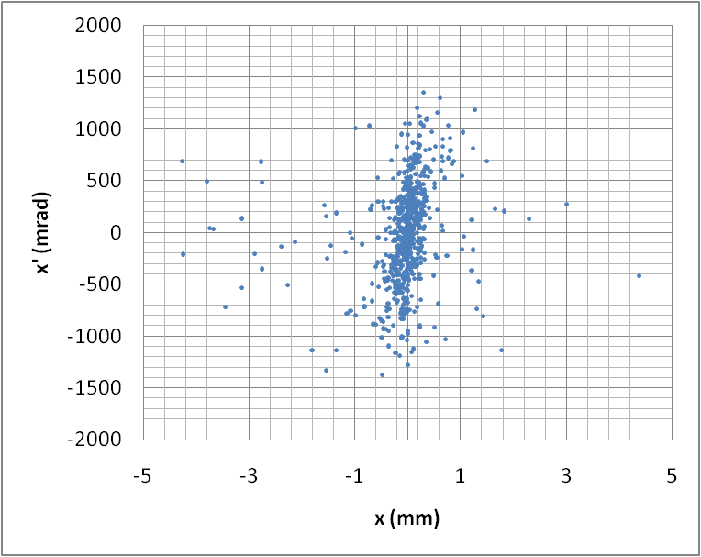
The emittance was not measured experimentally, but estimates from the modeling give about 500 mm*mrad.
Introduction
Motivation
Hot Electrons
Pair Production
Sheath Fields
Conclusion
Emittance from EGS simulation of 1 mm Au target
Future experiments will attempt to measure emittance.

Slide 22
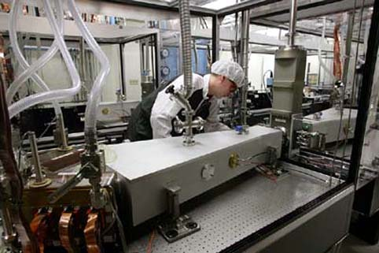
Higher Rep-rate short pulse lasers are being built and tested.
Introduction
Motivation
Hot Electrons
Pair Production
Sheath Fields
Conclusion
As of mid-2008, Mercury has been able to run continuously for several hours (300,000 shots), firing ten times a second at more than 50 joules per shot, each shot lasting just 15 nanoseconds (billionths of a second).

Slide 23
Summary
Introduction
Motivation
Hot Electrons
Pair Production
Sheath Fields
Conclusion
~120 J laser produced positrons
Other positron sources
From the back of the target
~1×10¹⁰ e+/shot; ~ 10⁸ in the front
Radioactive isotopes: 10⁶⁻¹²/s
(High Flux requires reactor.)
Estimating the interaction volume with 20° half-angle and 1 mm thick target, V = 10⁻⁴ cm³, which gives
n₊~ 10¹⁵ cm⁻³ inside Au target
Electron Linacs: 10⁶⁻¹²/s
(ILC design: 10¹⁰/bunch)
Observed positron: ~0.01 J
(EGS: escaping/total ~10%)
Total produced positron: ~ 0.1 J
Total positron E/Laser E: ~0.1%

