Slide 1
FACET Safety and Procedures
Christine Clarke
August 29th 2011

Slide 2
Contents
(Current) SLAC structure and contacts
FACET Users
FACET Experiments and Operations
Communication

Slide 3
Contents
(Current) SLAC structure and contacts
FACET Experiment Team
FACET Beam Delivery Team
FACET Users
FACET Experiments and Operations
Communication

Slide 4
Accelerator Research Division

Slide 5
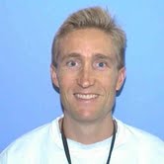
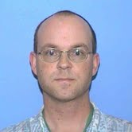
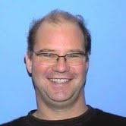
FACET Experiment Program
Mark Hogan - FACET Scientific Leader
Christine Clarke - FACET User Support
Joe Kenny - FACET Safety Officer
Carsten Hast – Test Facilities Department Head
Test Facilities Staff:
Keith Jobe
Doug McCormick
Mike Dunning
Zen Szalata
Juan Cruz
Carl Hudspeth

Slide 6
Org Chart – Accelerator Directorate

Slide 7
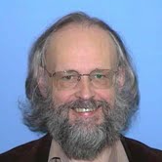
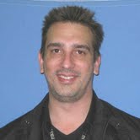
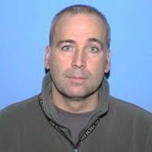
FACET Beam Delivery
S0-20
Division Head: Uli Wienands
Deputy Head: Jerry Yocky
Area Manager: Al Owens
Accelerator Operations
Division Head: Roger Erickson

Slide 8
Contents
(Current) SLAC structure and contacts
FACET Users
The process to become a User
Training
Computer accounts
FACET Experiments and Operations
Communication

Slide 9
How to become a FACET User
Coordination of experiment’s PI necessary
PI gives instructions to experimenters to become Users
PI must confirm names with User Support
Users register with SLUO – do this early!
DOE FACTS questionnaire
T4 countries takes > 3 months to process
Sensitive Countries not a problem if on site < 30 days/ year

Slide 10
Web-based Training
Can use “Skillport” – only need SLAC ID#
SLAC Training Assessment (STA) tool is used to track training status
Course 219 or course 396: ESH orientation course is mandatory for everyone except escorted visitors
Course 115: GERT allows unescorted access in RCAs (eg FACET User Trailer B244). Pre-req for…
Course 116: Radiation Worker 1. Required for access to FACET
Course 120: Overview of the work planning and control (WPC) process.

Slide 11
Practical Training
Course 116PRA (Radiation Worker 1)
Required to access FACET
Regular classes twice a week
Can schedule additional classes within normal work hours
FACET Safety Orientation for Experimenters
Required for unescorted access to FACET
Emergencies, WPC, PPE, working practices etc.
FACET needs to be in access state for this course
Some restrictions on activities permitted at FACET but facility is designed with User safety in mind

Slide 12
Computing Accounts
Users apply for Windows and Unix accounts
Needed to access:
FACET elog
Data
Controlled Documents and resources
VPN and Citrix accounts for remote access
Can get SLAC email address
Apply before arrival so there is no delay
Cyber-security training required
Visitor wireless provides internet access without need for computing account

Slide 13
Contents
(Current) SLAC structure and contacts
FACET Users
FACET Experiments and Operations
Experiment Safety
Transport of equipment
Installation of equipment
Operation of experiment
Data Acquisition
Communication

Slide 14
Safety
SLAC is committed to protecting the health and safety of our staff, the community, and the environment.
Safety guidelines for Test Facilities are provided to all Users.
Electrical
Hazardous energy
Compressed gases
Lasers
Chemicals
Advice is available from Test Facilities staff and Subject Matter Experts at SLAC.

Slide 15
Experiment Safety Review
Users must make a satisfying case that the experiment is safe to operate and that there are no radiation concerns.
Hazard analysis and mitigation is required.
A full apparatus description must be shared with Test Facilities.
All materials that are provided are reviewed by the FACET Safety Officer, FACET User Manager and invited SLAC Subject Matter Experts
Feedback will be offered and there may be a demand for changes for reasons of safety or improved operation.
Experiment is reviewed by safety experts in a manner commensurate with the apparatus and risks involved.

Slide 16
Transporting to SLAC Test Facilities
Experimental equipment must arrive 2 weeks prior to installation (the earlier the better!)
Assemble before delivery to Test Facilities in case parts do not fit or items are missing
Leak check and RGA (if appropriate)
Ship to FACET User Manager
Be wary of Customs time and charges (delays arrival by a week)
Pack well (document state)
We need to make special arrangements for hazardous substances

Slide 17
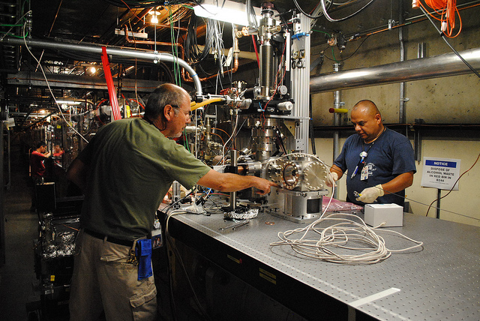
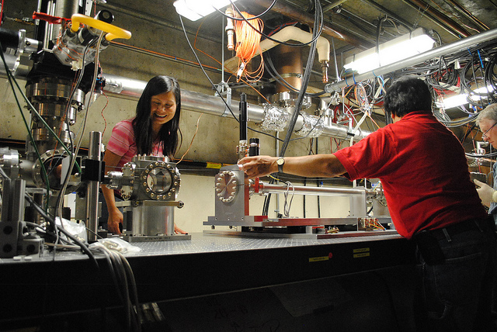
Installation of Experiment
We use qualified vacuum technicians and Test Facilities staff for the installation
Users provide expertise in specialist equipment

Slide 18
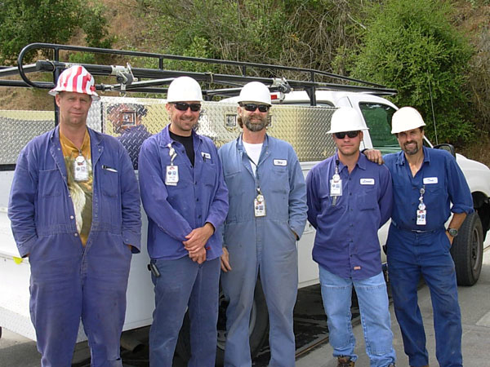
Installation of Experiment
Large, heavy and awkward items rigged down into accelerator tunnel with a crane
Installation requires extended downtime planned in advance
Specific installation periods blocked out on calendar

Slide 19
Experimental Operation
Post-installation, one final review is conducted
→ Experimental Readiness Review
To gain beam time, there must be the consensus that the experiment is safe and ready to operate from:
Experiment PI
FACET Safety Officer
FACET User Manager
Head of Test Facilities Department
Request made to Operations and Sector 0-20 for beam to be delivered.

Slide 20
Experimental Operation
Shifts operate 24/7: owl, day and swing
Experimenters work closely with Operators to get desired beam
During commissioning, work with beam physicists is invaluable
Daily reports of User activities at 8am meeting
There are daily meetings for Users

Slide 21
Access to FACET
FACET is in accelerator tunnel at S20 and accessed by staircase in S19
1 hour mandatory cool-down before RP survey
Due to lack of Experimental PPS zone, there is a burden on the operators
Accesses should be <30 minutes duration
Work requires RP approval
Practice ALARA in the tunnel
Multiple experiments means multiple experimenters- work planning necessary (pre-job briefings)
Make the best use of time

Slide 22
Data Acquisition
We provide computers with access to controls data (current state of machine, access to diagnostics)
Two control systems: SCP and EPICS
Data stored in EPICS archiver if requested
We also provide, for experimenter use:
VME crate and NIM crate with gated ADCs and 105 MHz ADCs
TTL/NIM timing signals at beam rate or fixed rate
Remote controlled power distribution in tunnel
Coaxial cable infrastructure
Network infrastructure

Slide 23
User DAQs
Users bring their own bespoke DAQs
User laptops are on visitor network
Information needs to travel both ways- Users want beam data, we want User data.
Users can use VPN to get from visitor network (or hotel or coffee shop wireless) to SLAC
Then use Accelerator Integrated Data Access (AIDA) from matlab
http://www.slac.stanford.edu/grp/cd/soft/aida/
Can get database data, model data, history data
Alternate methods eg run aida commands on SLAC controls network and pass data through http server
Recording and archiving User data in development for 2012

Slide 24
Contents
(Current) SLAC structure and contacts
FACET Users
FACET Experiments and Operations
Communication
Publications
Website

Slide 25
Publications
All written results of SLAC work must be properly tracked, collected, and made publicly accessible.
This applies to all work performed at SLAC.

Slide 26
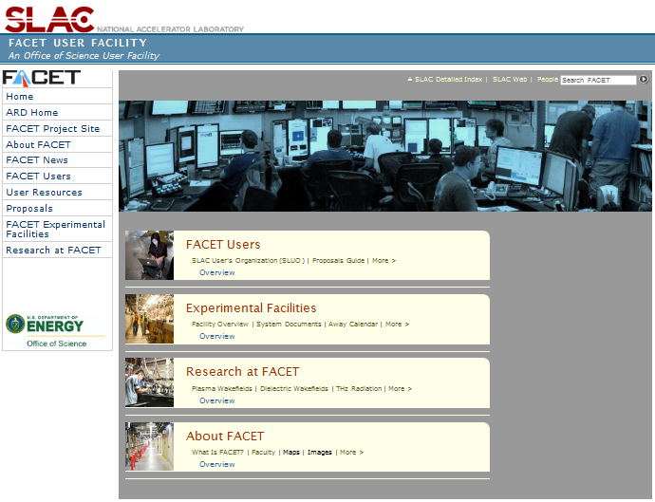
Website
https://slacportal.slac.stanford.edu/sites/ard_public/facet/

Slide 27
Questions?
Safety…?
Procedures…?
Communication…?

