Slide 1
Introduction to this Workshop
Christine Clarke August 29th 2011

Slide 2
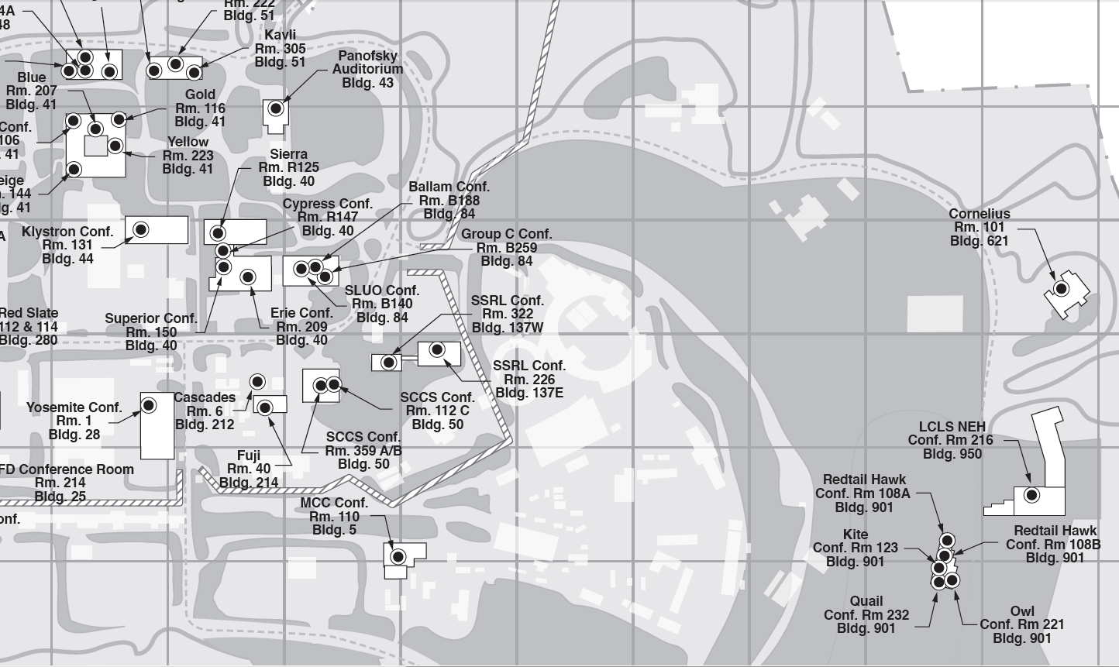
Logistics
Exit to Sand Hill
You are here
Cafeteria

Slide 3
FACET Status
Last User Meeting March 2010.
Last SAREC review January 2011.
FACET commissioning began June 16th.
First experiments installed July 27th.
Completion of (first round of) experimental installations August 25th.
5 experiments in total!

Slide 4
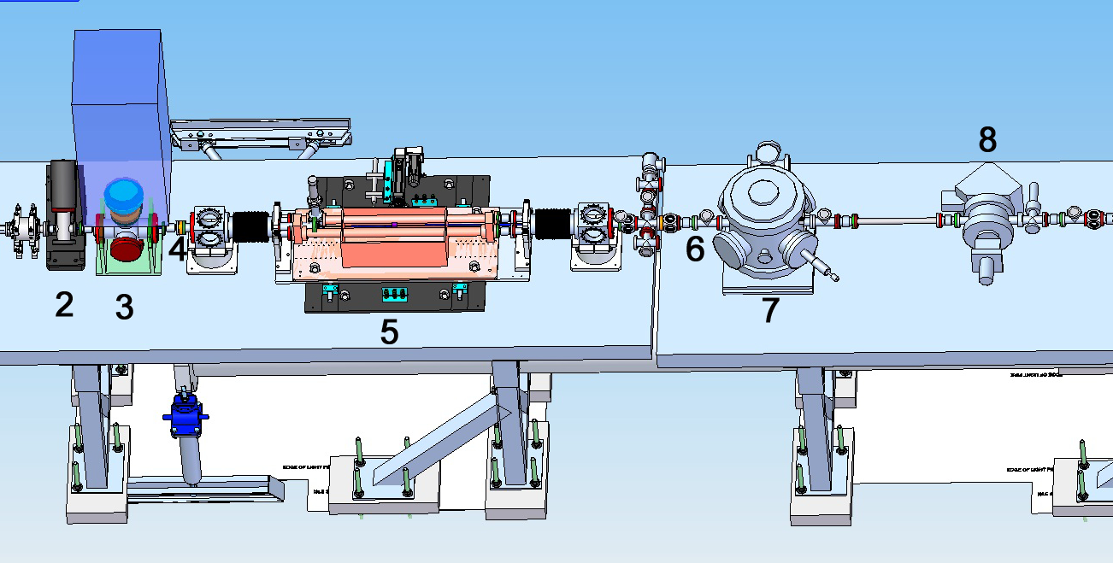
Experiments
E-202 E-200 E-201 E-203
Plus THz upstream…

Slide 5
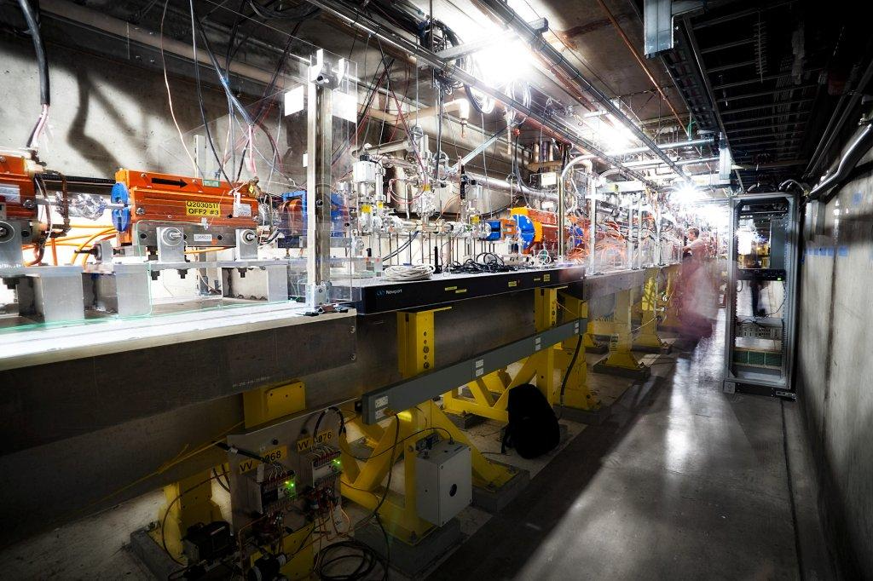
Photo interlude…

Slide 6
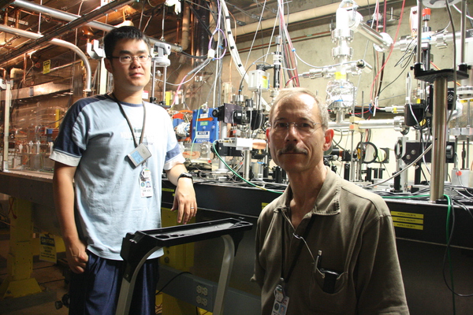
Photo interlude…

Slide 7
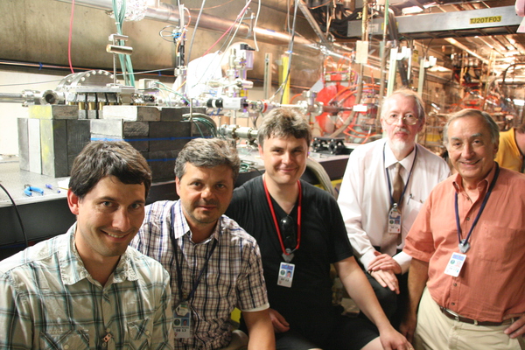
Photo interlude…

Slide 8
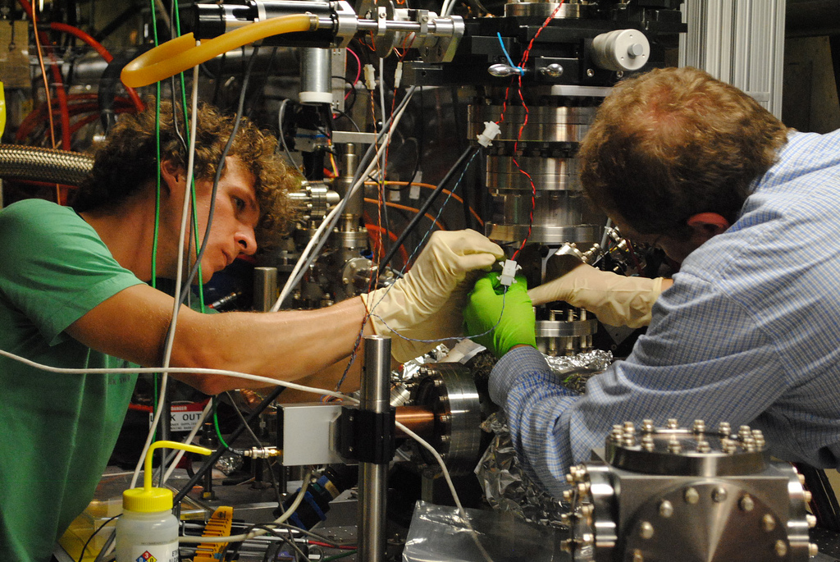
Photo interlude…

Slide 9
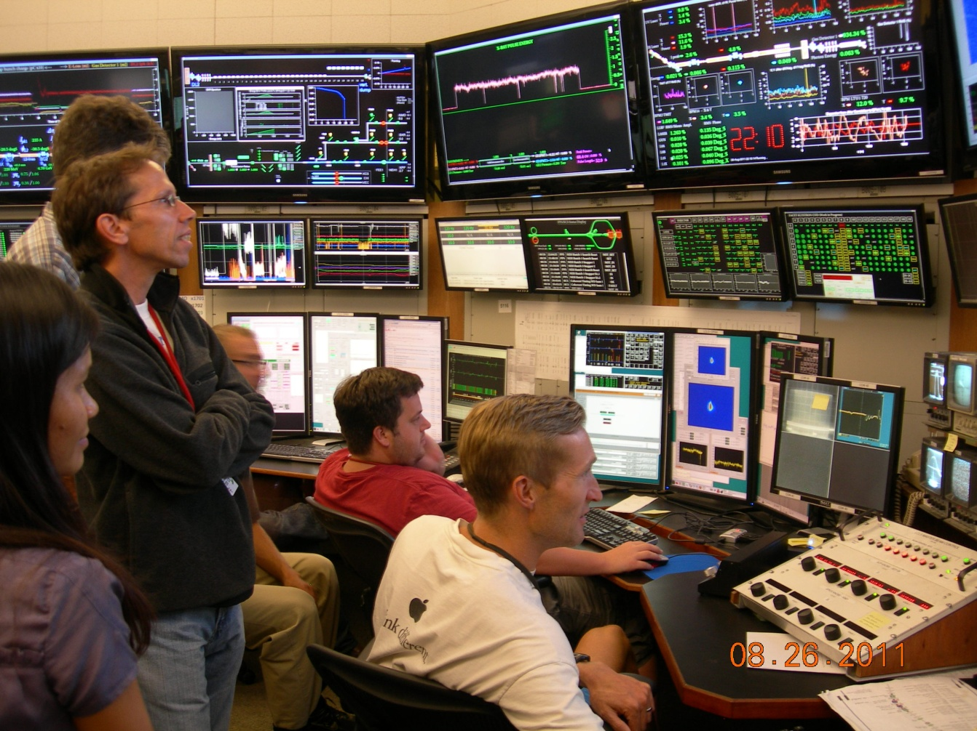
Photo interlude…

Slide 10
FACET Status
Last User Meeting March 2010
Last SAREC review January 2011
FACET commissioning began June 16th
First experiments installed July 27th
Completion of (first round of) experimental installations August 25th
5 experiments in total!
Plus a new FACET User Trailer

Slide 11
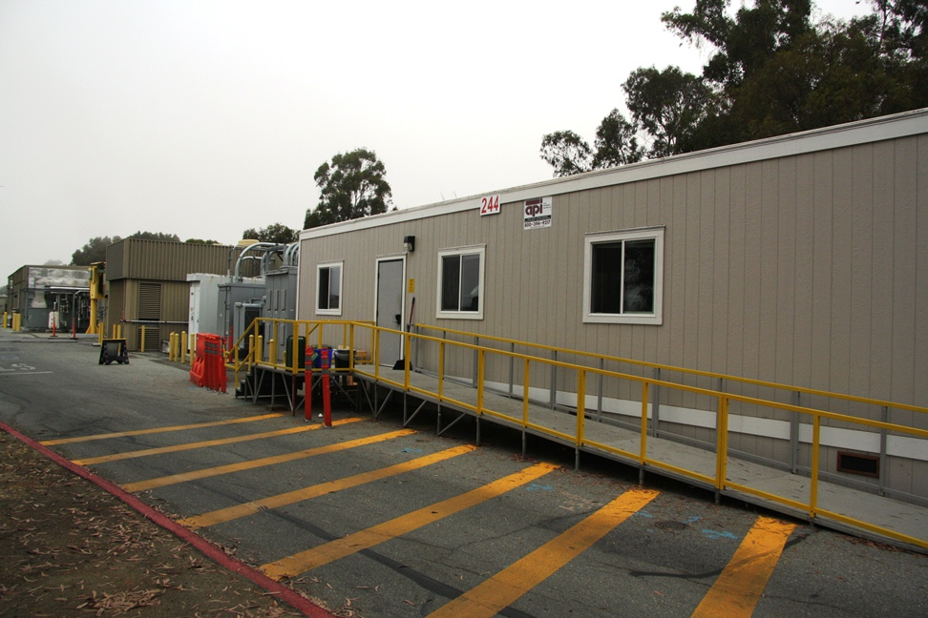
User Trailer

Slide 12
FACET Status
Last User Meeting March 2010
Last SAREC review January 2011
FACET commissioning began June 16th
First experiments installed July 27th
Completion of (first round of) experimental installations August 25th
5 experiments in total!
Plus a new FACET User Trailer
Now… User Meeting August 2011
New round of proposals in October
Upgrades to FACET are coming

Slide 13
Program Monday
8:50 a.m. | Introduction to this Workshop | Christine Clarke, SLAC
9:00 a.m. | Beam Commissioning Status | Uli Wienands, SLAC
9:45 a.m. | First Measurements Smith-Purcell (E-203) | Armin Reichold, Oxford
10:30 a.m. | Coffee
11:00 a.m. | First Measurements EM Ultra Fast Switching (E-202) | Ioan Tudosa, SIMES/SLAC
11:45 a.m. | First Measurements THz (T-500) | Ziran Wu, SLAC
12:30 p.m. | Lunch
1:30 p.m. | First Measurements PWFA (E-200) | Patric Muggli, MPI
2:15 p.m. | First Measurements Dielectric Fibers (E-201) | Sergey Antipov, Argonne
3:00 p.m. | FACET Safety, Practical Considerations | Christine Clarke, SLAC
4:00 p.m. | Coffee
4:30 p.m. | FACET a National User Facility | Carsten Hast, SLAC
4:50 p.m. | Coming Upgrades to FACET | Mark Hogan, SLAC
5:10 p.m. | Charge to Working Groups | Mark Hogan, SLAC
5:30 p.m. | Adjourn
6:00 p.m. | Run End Party | BBQ at Carsten's Home in Los Altos

Slide 14
Program Tuesday
8:30 a.m. | Coffee & Pastries
9:00 a.m. | First User Run February 2012 | Christine Clarke, SLAC
9:15 a.m. | Expectation from SAREC | Tor Raubenheimer, SLAC
9:30 a.m. | The Proposal Process with Q & A | Carsten Hast, SLAC
9:45 a.m. | New Proposal: CLIC FACET experiments | Erik Adli, University of Oslo
10:15 a.m. | Crystal Channeling and Beam Collimation at FACET | Uli Wienands, SLAC
10:30 a.m. | Coffee Break
11:00 a.m. | Working Groups
12:00 p.m. | Summary Preparation
12:30 p.m. | Lunch
1:30 p.m. | Machine Performance Expectations & Desires | WG leaders
3:00 p.m. | Open Discussion | Mark, Christine, Carsten, Uli
3:30 p.m. | Coffee
4:00 p.m. | Adjourn or Tour of User Trailer with introduction to infrastructure

