Slide 1
Installation and Initial Experimental Experience for
Dielectric Wakefield Acceleration (E-201) at FACET
FACET Users’ Meeting, SLAC
August 29, 2011
G. Andonian, J. Rosenzweig*, S. Antipov, D. Stratakis, O. Williams
on behalf of E-201 Collaboration
*Project Spokesperson

Slide 2
Outline
Motivation
Background
Prior results
E-201 description
E-201 experimental goals
  Setup
  Sample inventory
  Simulations
  Measurements
Improvements
Conclusions / outlook

Slide 3
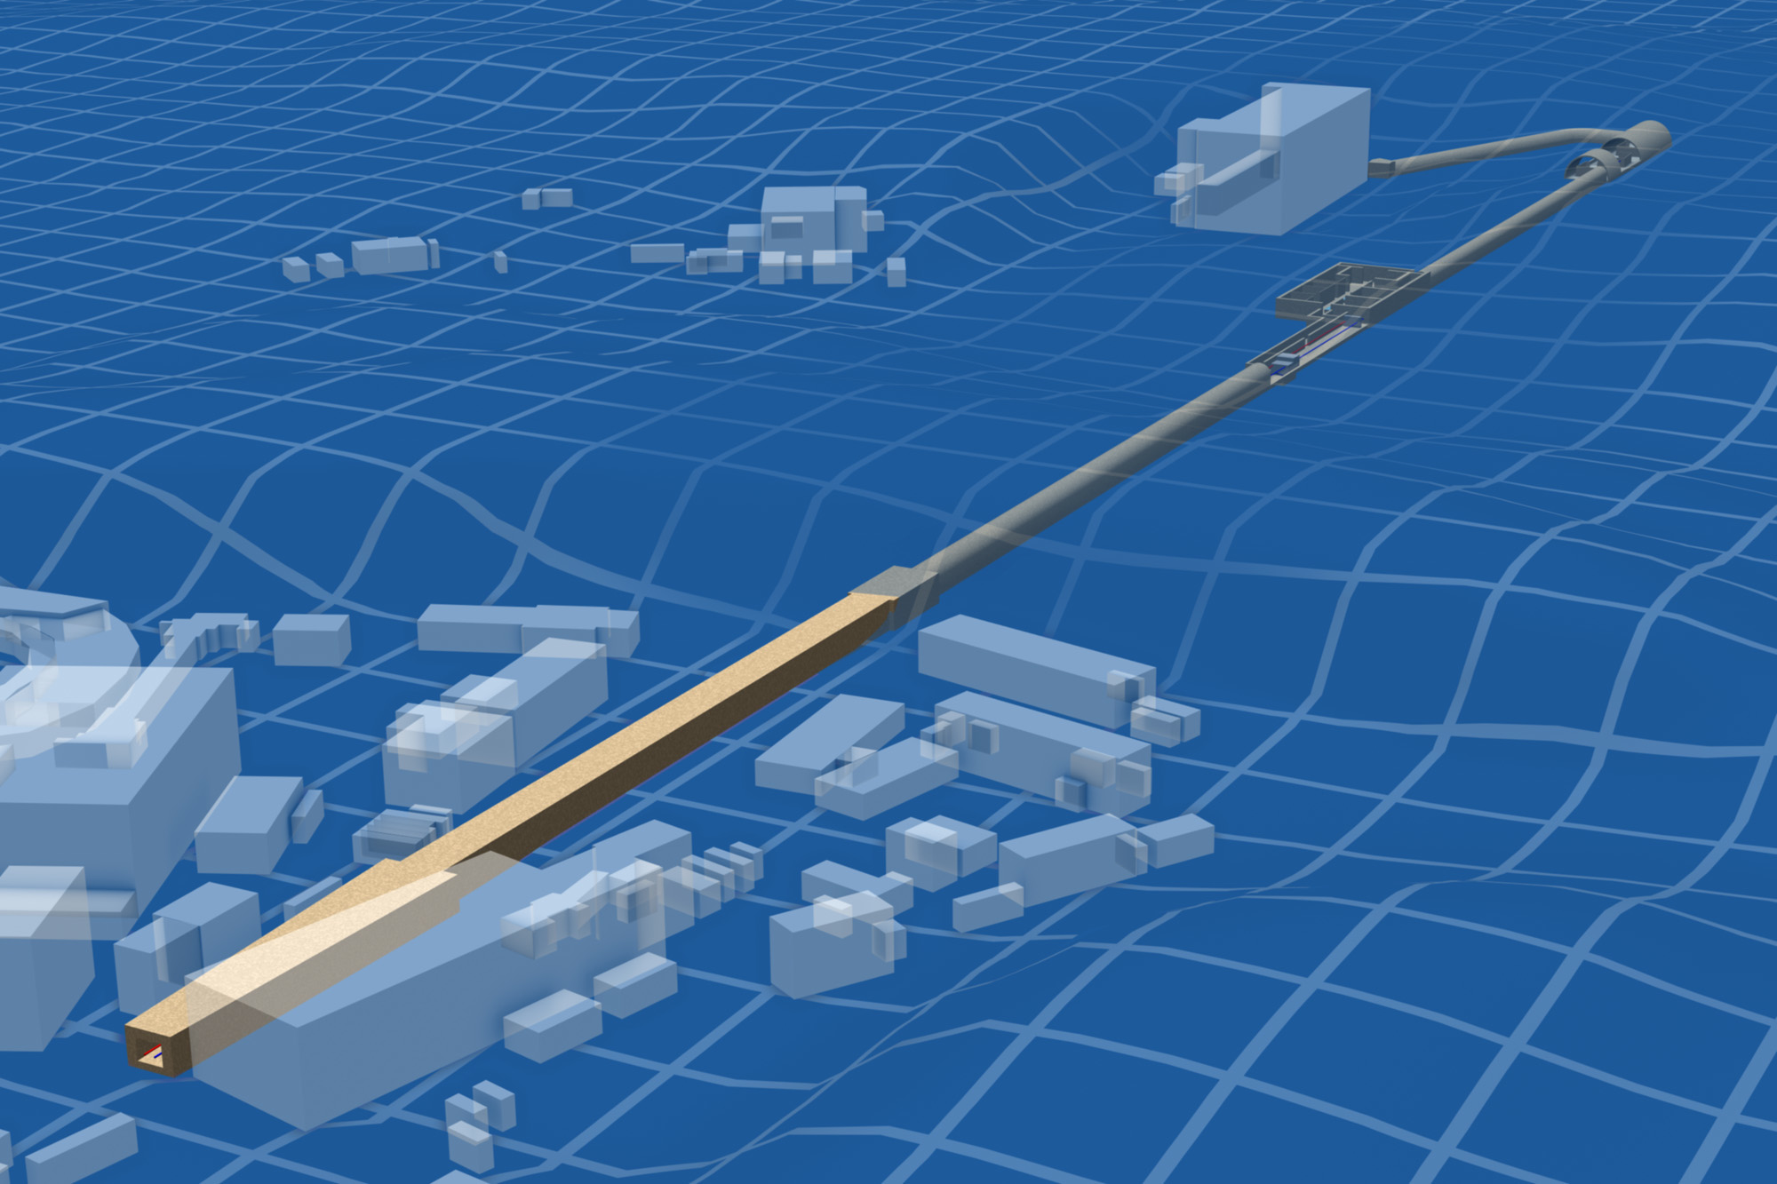
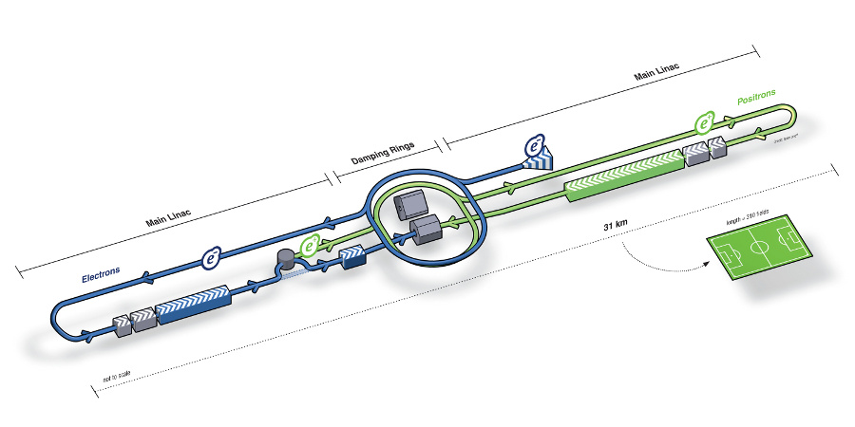
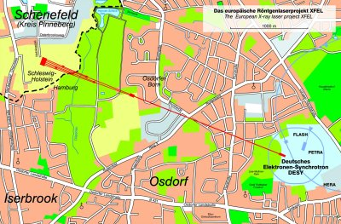
Miniaturize Big $cience
Other accelerator applications
too different in size/$
The original behemoth: ~TeV linear collider
The LCLS, artistically
50 Km/$10¹⁰ seem unitary limits
XFEL>3 km, 10⁹ €

Slide 4
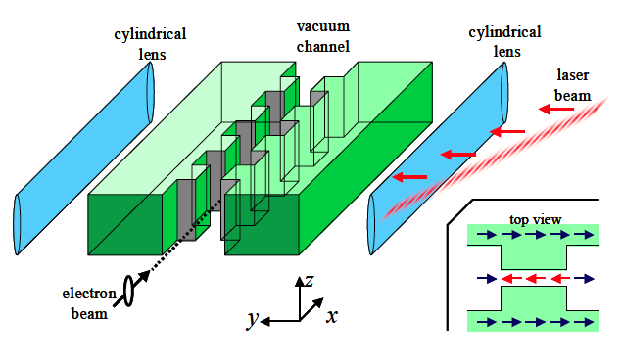
How to scale the accelerator size?
Start with solid structures… return to plasma later
Lasers produce copious power (~J, >TW)
  Scale in λ by 4 orders of magnitude (ε, Q, dynamics)
  Reinvent resonant structure using dielectric
  GV/m fields possible, breakdown limited… quanta are large
GV/m allows major reduction in size, cost of FEL, LC
To jump to GV/m, mm-THz may be better:
  Beam dynamics(!), breakdown scaling
  Need new power source…
Dielectric few-cycle
laser-excited structure; sub-ps pulse breakdown advantage (Plettner, et al.)

Slide 5
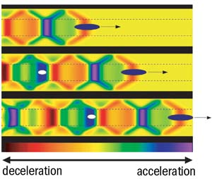
Motivation
High gradient DWA applications
  HEP
  Radiation Source (THz)
  Advanced accelerator for future FEL
    ~GV/m fields reduce size of machine
    “Afterburner” for existing linacs
    Larger scales (mm-THz), relaxed emittance, higher charge beams
Relevant Issues in DWA research
  Determine achievable field gradients
  High energy gain in acceleration
  Transformer ratio enhancement
  Resonant excitation of structure
  Dielectric/metal heating issues
  Cladding composition, thickness
  Periodic structure development
  Novel materials, meta-materials
  Alternate geometries (slab)
  Transverse modes and beam-breakup
Accelerating gradient scales with high charge, short beams

Slide 6
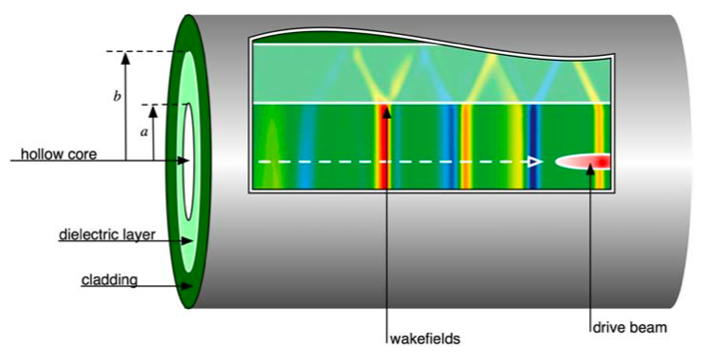
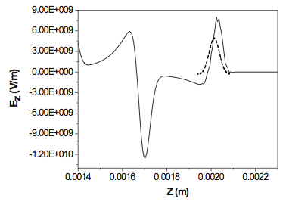
Dielectric Wakefield Accelerator
Electron bunch (β ≈ 1) drives wake in cylindrical dielectric structure
  Dependent on structure properties
  Generally multi-mode excitation
Wakefields accelerate trailing bunch
Design Parameters
Peak decelerating field
Extremely good
beam needed
Transformer ratio (unshaped beam)
Ez on-axis, OOPIC

Slide 7

E-201 Collaboration (at FACET)
UCLA
G. Andonian^{α}, S. Antipov^{ζ}, H. Badakov^{α}, S. Barber^{α}, M. Berry^{β}, C. Clarke^{β}, M. Conde^{ζ}, A. Cook^{n}, F.-J. Decker^{β}, R.J. England^{β}, W. Gai^{ζ}, R. Iverson^{β}, M. Hogan^{β}, A. Kanareykin^{ε}, N. Kirby^{β}, P. Muggli^{γ}, P. Niknejadi^{α}, B. D. O’Shea^{α}, J. B. Rosenzweig^{α}, D. Stratakis^{α}, G. Travish^{α}, A. Valloni^{α}, O. Williams^{α}, Y. Xie^{α}, D. Walz^{β}, X.Wei^{α}, J. Zhou^{α}
^{α}Department of Physics and Astronomy, University of California, Los Angeles, ^{β}Stanford Linear Accelerator Center, ^{γ}Max Planck Institute, ^{ζ}Argonne National Laboratory, ^{n}Massachussetts Institute of Technology, ^{δ}Manhattanville College, ^{h}RadiaBeam Technologies, LLC, ^{ε}Euclid TechLabs, LLC
Collaboration spokespersons

Slide 8
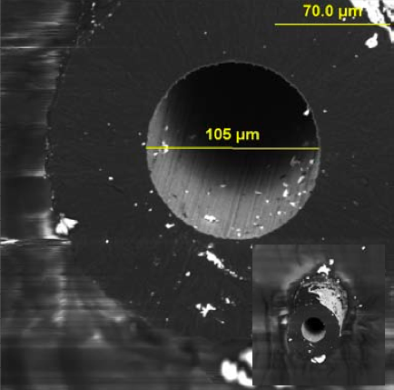
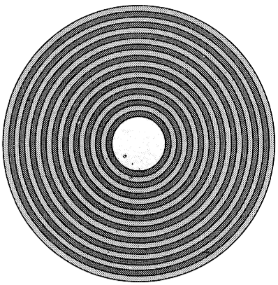
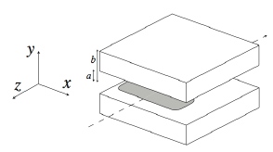
E-201 at FACET: outlook
Research GV/m acceleration scheme in DWA
Goals
    Explore breakdown issues in detail
      Extend to positron beam (unique to FACET)
    Determine usable field envelope
    Coherent Cerenkov radiation measurements
    Varying tube dimensions
      Impedance, group velocity dependences
    Explore alternate materials
    Explore alternate designs and cladding
      Slab structure (permits higher Q, low wakes)
      Radial and longitudinal periodicity…
    Observe acceleration ?
FACET collaboration
  UCLA, Euclid, MPI (via USC), SLAC, et al.
CVD deposited diamond
Bragg fiber
Slab dielectric structure (like optical)

Slide 9
E-201: Finding the Field Envelope
Complete breakdown study
explore (a, b, σ_{z}) parameter space
Alternate cladding
Alternate materials (e.g. CVD diamond)
Explore group velocity effect
σ_{z} | ≥ 20 μm
σ_{r} | < 10 μm
U | 23 GeV
Q | 3 .3 nC
Group velocity effects
Wave train, v_{g} effect
High field exposure time controlled by v_{g}
Explore varying tube length
We may want to greatly decrease v_{g} for beam loading…
FACET beam parameters for E169: high gradient case

Slide 10
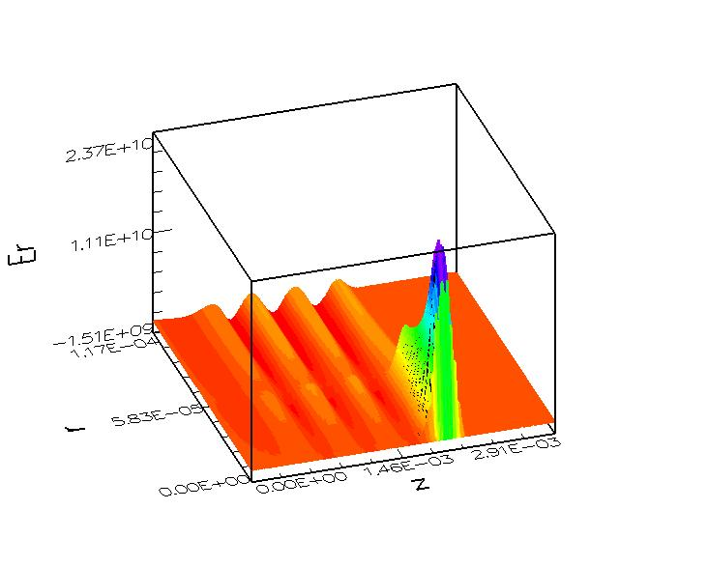
Breakdown studies with e+ beams
Unique to FACET
e⁺s stimulate e- field emission at dielectric ID
Radial field peaks at beam passage
  Up to 13 GV/m
Radial electric field profile for
FACET positron acceleration case:
23 GV/m peak at beam edge; 6 GV/m
at beam z position, dielectric bdry r=a.

Slide 11
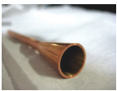
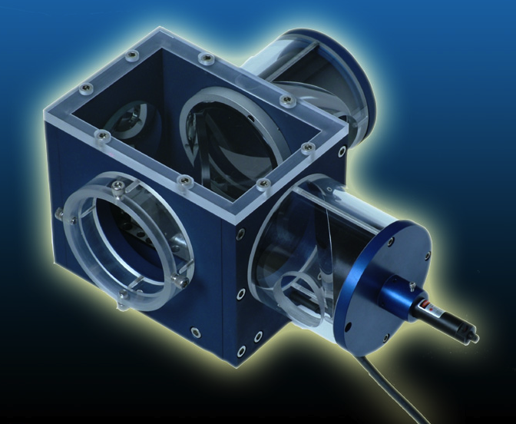
CCR Measurements at FACET
DWA tube with
CCR launcher
Total energy gives peak field measure
Quasi-optical launcher for THz wave
Autocorrelation/FFT
Transverse modes have signature f
Harmonics are sensitive σ_{z} diagnostic (non-destructive)
Augments CTR/CER
RadiaBeam Tech.
Beam splitting interferometer

Slide 12
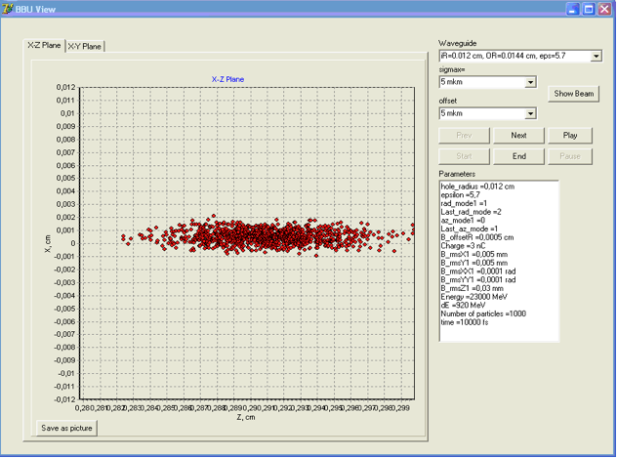
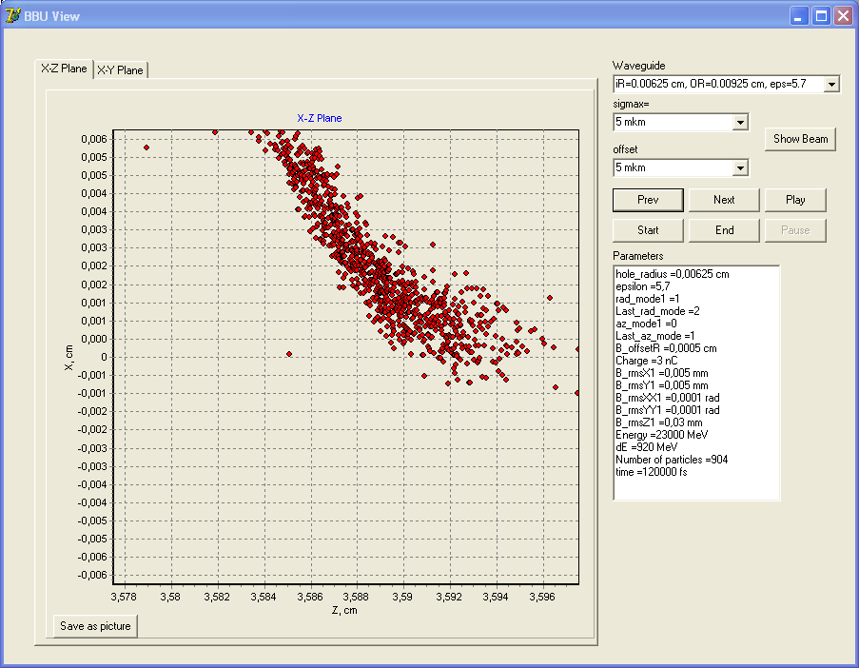
Transverse wakes and BBU
Transverse wakes with cylindrical tube
  Transverse mode coherent Cerenkov radiation
  Observable BBU at >10 cm
Slab structures can mitigate transverse wakes?
A. Tremaine, J. Rosenzweig, P. Schoessow, Physical Review E 56, 7204 (1997),
A. Chao et al., Proc. 1996 DPB/DPF SummerStudy on New Directions for High-Energy Physics ~Stanford Univ. Publ, Palo 1997)
Simulated BBU @ FACET, Initial, 10.7 cm distribution
(courtesy AWA collaboration)

Slide 13
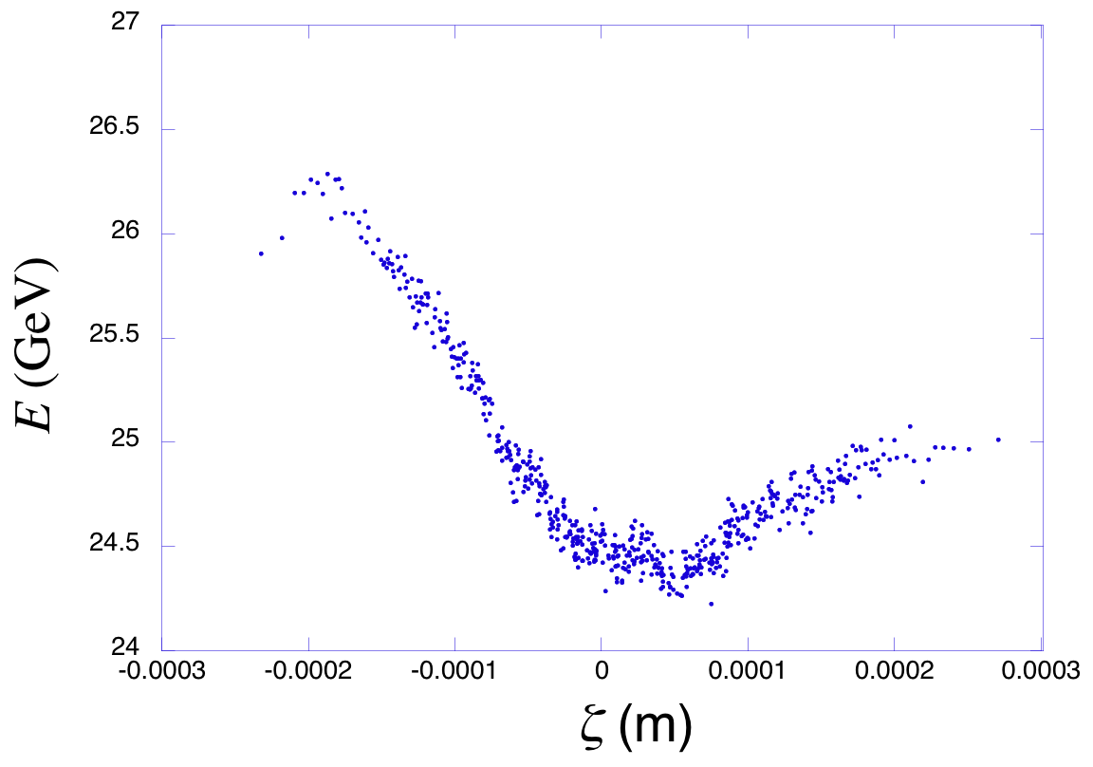
FACET: DWA energy gain/loss
σ_{z} | 50-150 μm
σ_{r} | < 10 μm (a=5σ)
U_{b} | 23 GeV
Q | 3.3 nC
Observe acceleration
10-33 cm tube length
longer bunch, acceleration of tail
“moderate” gradient, ≤3 GV/m
single mode operation
1.2 GeV energy gain in 33 cm
FACET beam parameters for E201: acceleration case
Accelerated beam quality
Witness beam (pulse shaping in general)
Beam loading (longitudinal self-wakes)
Transverse wakes
Alignment and BBU
Momentum distribution after 33 cm (OOPIC)

Slide 14


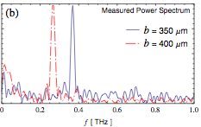
Previous UCLA experimental experience
SLAC FFTB 2008
SLAC FFTB (T-481)
  Study breakdown limits
  Q~3nC, E=28.5GeV, σ_{z}~20µm
  SiO₂, a=100,200µm, b=325µm, L=1cm
  Beam can excite fields up to 13GV/m
UCLA Neptune
  CCR as a tunable THz source
  Q~200pC, E=14MeV, σ_{z}~200µm,
  PMQs to focus down to σ_{r}~80µm
  Varied outer radius (b=350µm,400µm),L=1cm
  ~10µJ of THz, narrowband
BNL ATF
  Bunch train driver
  Resonant excitation of high-order mode
  Slab symmetric geometries
UCLA experience in…
  Short focal length PMQ
  Preparation and fabrication of DWA structures,
  Mounting, alignment of structures
  Collection and measurement of emitted CCR
Attribute lessons learned to FACET
M. Thompson, et al., PRL 100, 214801 (2008)
UCLA Neptune 2009
A. Cook, et al., PRL 103, 095003 (2009)

Slide 15
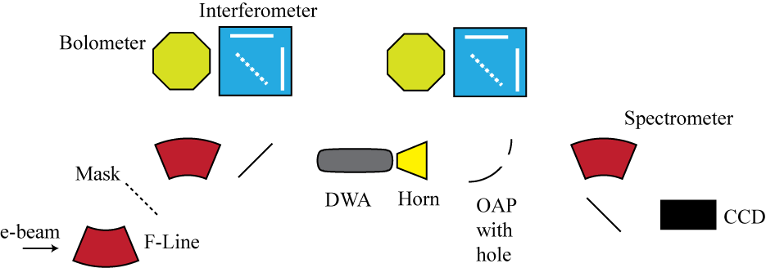
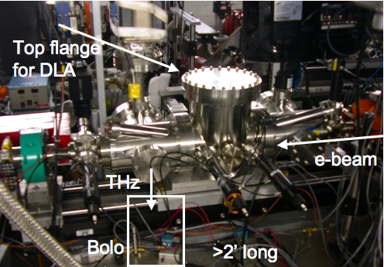
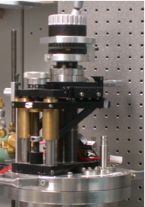
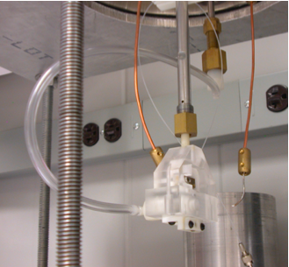
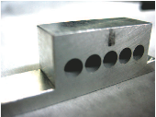
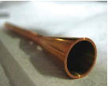
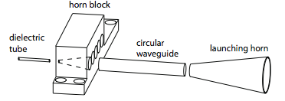
Experiment description at BNL ATF
Pulse train generated in F-line with mask
Phase feedback loop (0.5deg)
CTR measurement of multipulse bunch spacing
DWA mount and alignment in old plasma chamber
CCR measurement
Hole in OAP allows simultaneous energy spectrum measurement
Top view
Actuator
Capillary mount + horn

Slide 16
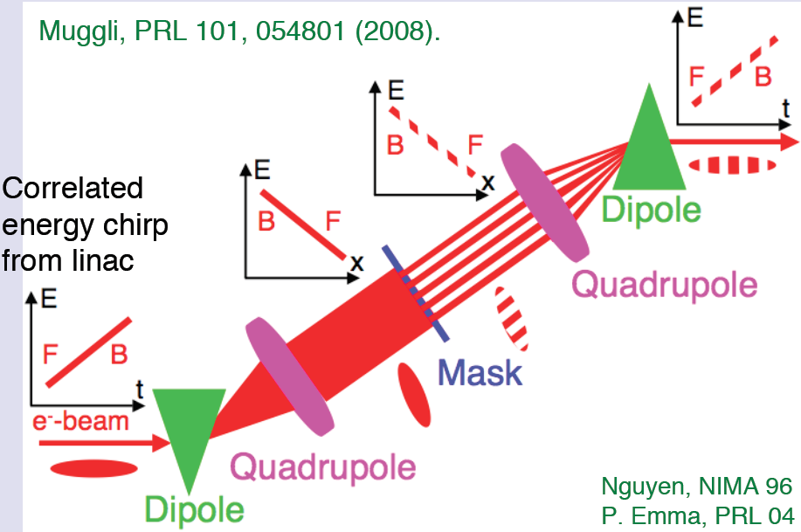
Recent CCR studies at BNL ATF
Parameters
  SiO2, Al coated (vapor deposition)
  a=100µm, b=150µm
  Q~25pc, σ_{z}~80μm, E=60MeV
Fundamental excitation
  Bunch spacing set to ~500µm
  CTR interferometry used to confirm spacing (Muggli, et al.)
  490µm fundamental
  3 bunches + witness
  Sextupole correction
Attempted to observe acceleration simultaneously
  Figures inconclusive
Bunch train generation
OOPIC for multibunch + witness, Peak field = 55MV/m
Spectrometer image (3 bunches)
CCR interferogram and spectrum (peak ~500µm)

Slide 17
Recent results from resonant excitation of higher-order modes at BNL ATF
Used rigid mask in high dispersive area to generate train
Wakes without mask (long bunch) give only fundam. λ
  ~490 μm, per prediction
Resonant wake excitation, CCR spectrum measured
  Excited with 190 μm spacing (2nd “harmonic”=TM₀₂)
  Suppression of fundamental
  Misalignments yield deflecting mode?
    TM12 ~ 900GHz
    Follow-on research
  BBU studies enabled
  G. Andonian, et al., Appl. Phys. Lett. 98, 202901 (2011)
CCR autocorrelation
2nd harmonic
deflecting mode
Fundamental (@noise level)
Frequency spectrum

Slide 18
Goals for Initial FACET run
Summer 2011
Experimental Goals
  Rigorous study of breakdown in SiO2, diamond tubes
    Large, multi-tube arrays
  CCR measurements in high field environement
  Slab symmetric structures with metallic/Bragg mirrors (SiO2, diamond)
  Initial steps to BBU
  Energy modulation
Operational Goals
  In support of physics near and short term
  Develop team (7 UCLA, 2 Euclid, 1 MPI, SLAC) w/ FACET expertise
  Ready full array of samples, CCR, break-down, BBU measurement capabilities
  Obtain experience in beam tuning
  Run full experiments (establish T481, Neptune/ATF methods at FACET)

Slide 19
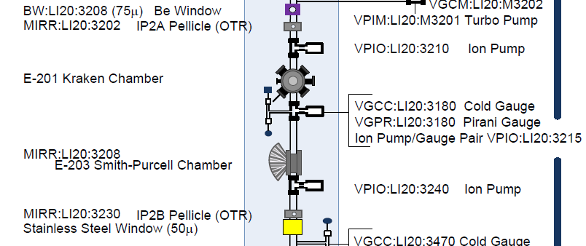
E-201: beamline map
e-beam

Slide 20
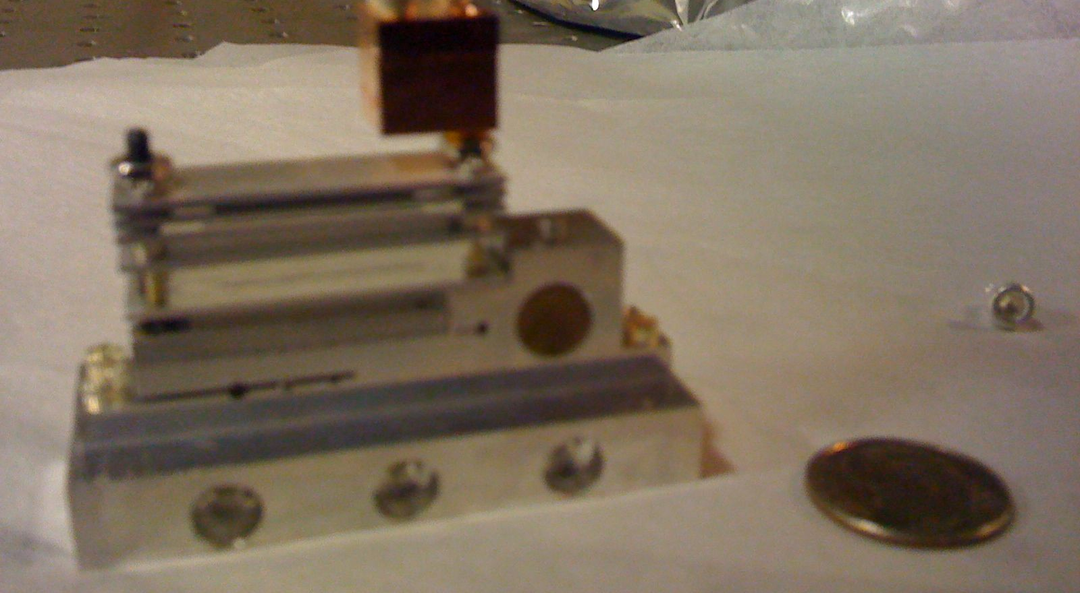
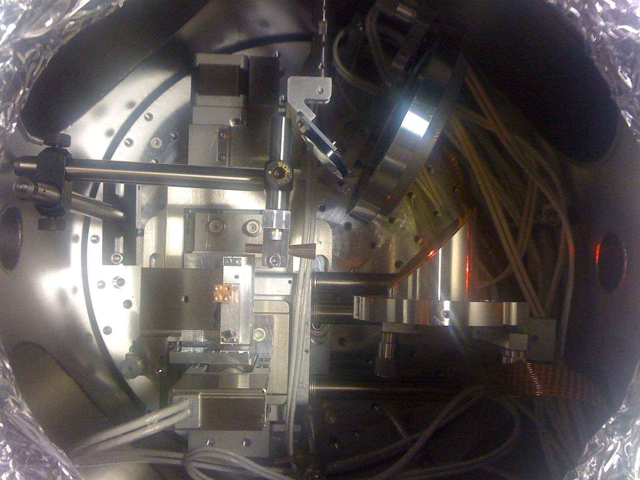
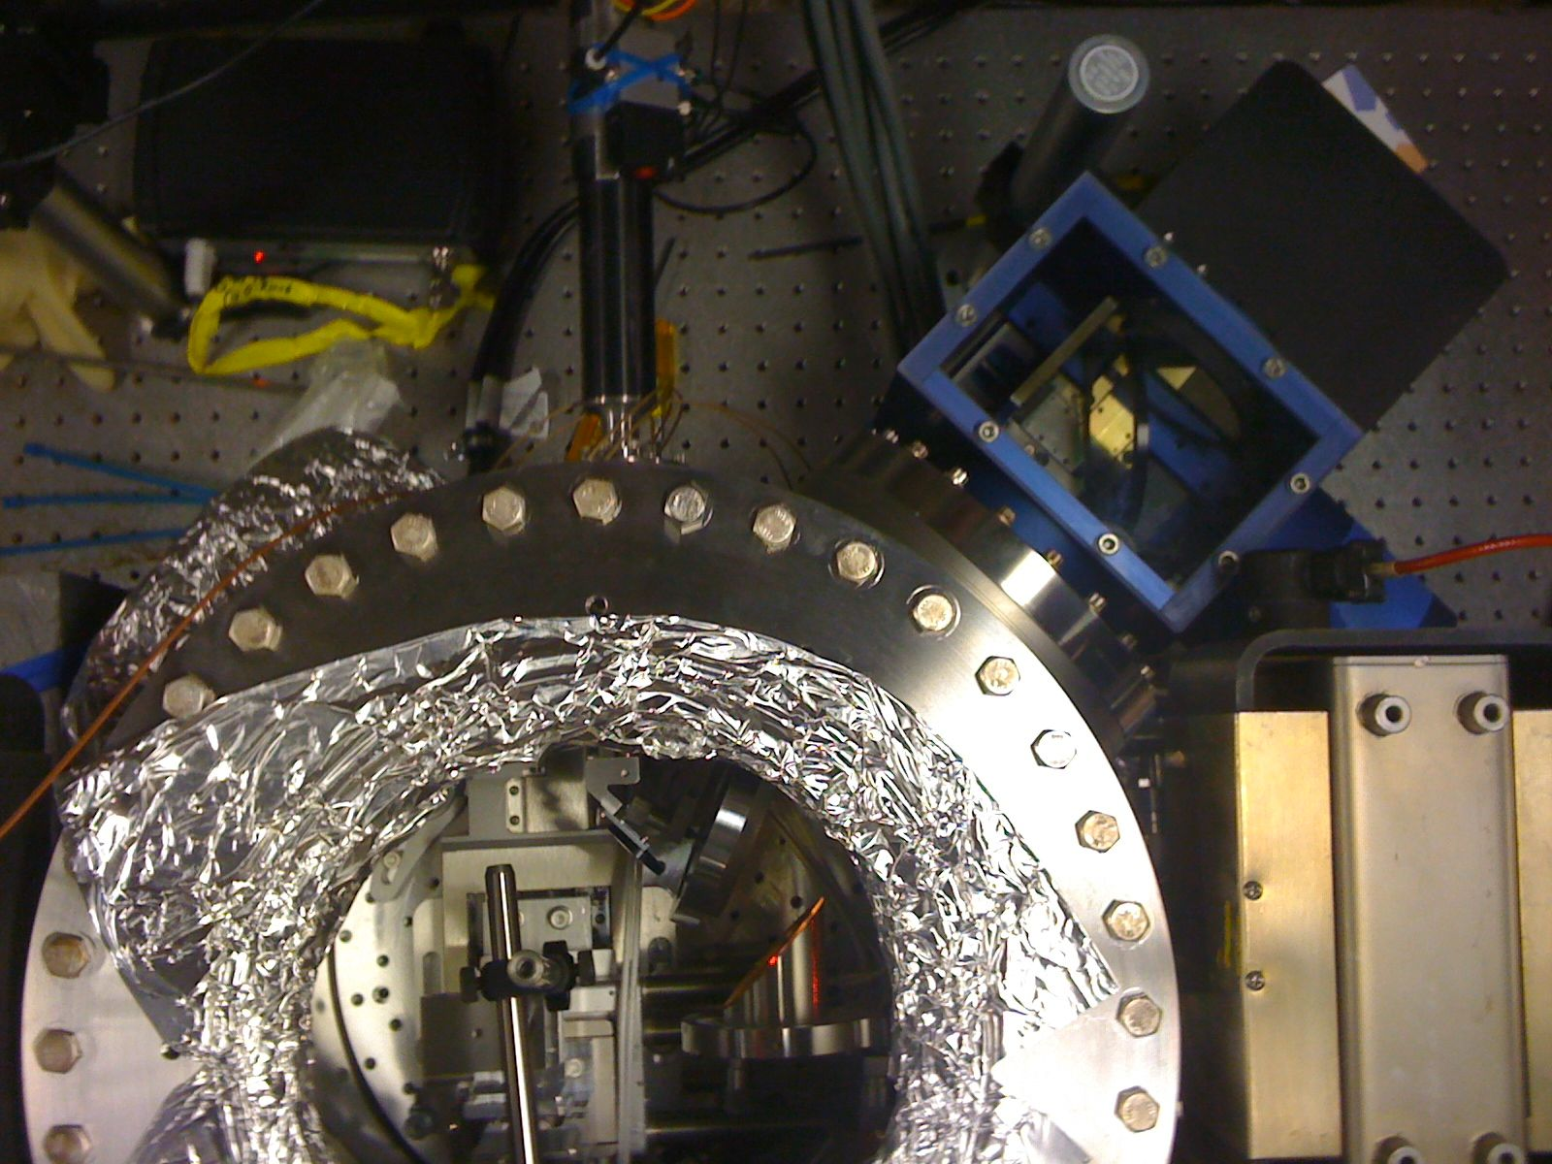
E-201 Installation
Sample holder ->
Top views of “kraken” chamber
Holder,
With 5-axis
Motor stages
Horn
OAP w/ hole
Interferometer alignment

Slide 21
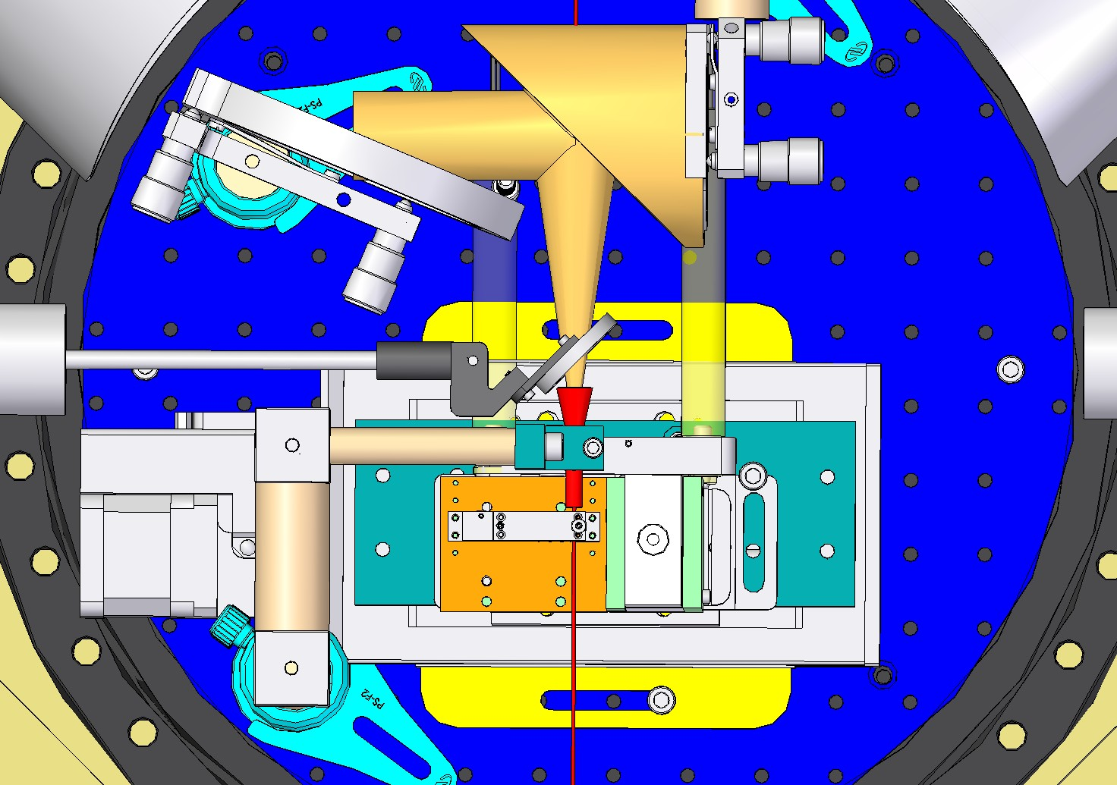
Kraken detail
OAP w/ 3mm hole
Horn has 4mm aperture
Top view

Slide 22
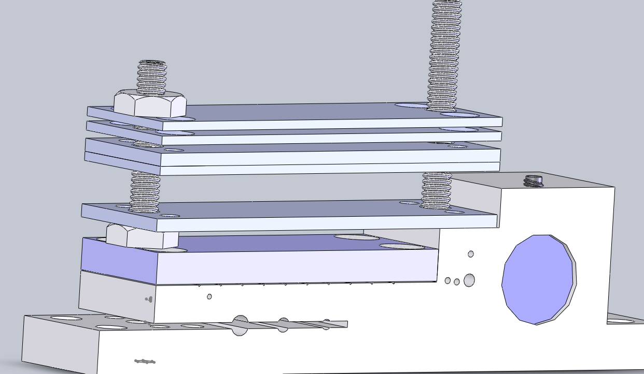
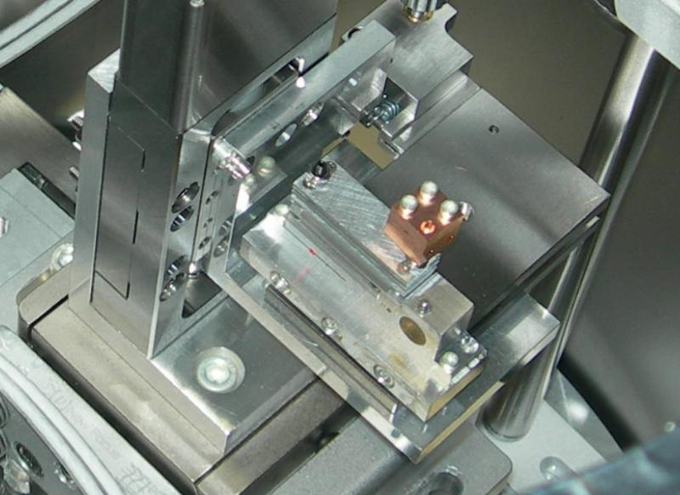
Sample holder detail

Slide 23
Inventory of samples
11 tubes total
1) black diamond 105 x 165 micron (< 1 cm), leaf cladded, (4 of these)
2) fused silica 100 x 162 micron (1 cm), Al metallization (4 of these)
3) alumina 510 x 810 and 760 x 1600 (1 cm)
4) sapphire 790 x 1110 (1 cm)
3 slab structures
1) fused silica 180 um thick, 240 um gap (1 cm)
2) Bragg, 50 um LiTa and 210 um fused silica, 5+5 on each side = 20 pieces, 240 um gap
3) diamond 150 um, 240 um gap
Modular design allows for add’l tube materials and geometries
Notes:
SiO₂ (ID/OD 100/162 micron)
>20 prepared
Thicker Al metallization
Diamond tubes
Black diamond, short tubes, leaf cladding
Sapphire and Alumina large bore
BBU

Slide 24
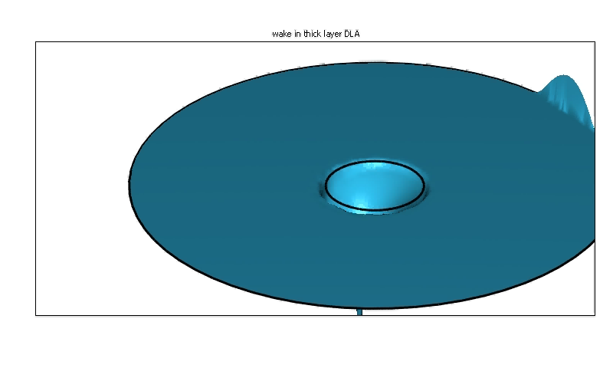
Multimode structures
Thermal management:
High peak field
Low average field

Slide 25
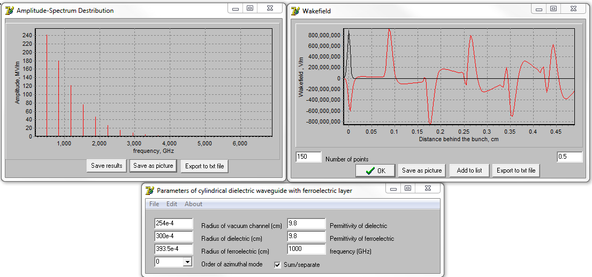
Alumina tube 508μm ID;
Multi-mode, BBU sample
Installed two of these tubes
Metallization had been noticed to peel – will have to revisit with CNM / ANL where metallization was done
S. Antipov (Argonne/Euclid)

Slide 26
Alumina, ε = 9.8; ID = 508µm, OD = 790µm,
1nC beam, Azimuthally symmetric modes
30um, 300MV/m
150um, 97MV/m
Azimuthal number = 0.
F₁ = 182 GHz;
F₂ = 504.5 GHz;
F₃ = 839.7 GHz;
F₄ = 1181.5 GHz;
F₅ = 1528 GHz;
F₆ = 1879 GHz;
F₇ = 2232 GHz;
F₈ = 2587 GHz
60um, 215MV/m
200um, 72MV/m
100um, 145MV/m
250um, 56MV/m

Slide 27
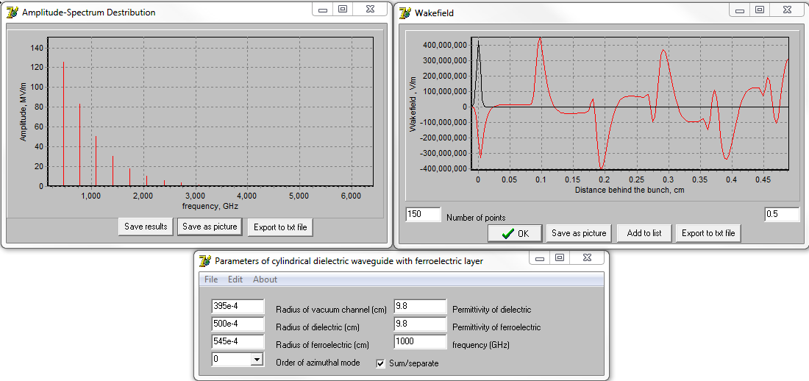
Sapphire tube 790μ ID.
did not fit in its place – possibly dimensions were a little bit off.
brittle
wrapped the tube in foil and insert it in place of a larger alumina tube

Slide 28
Sapphire, ε = 9.8 (anisotropy neglected - wakefield);
ID = 790µm, OD = 1090µm, 1nC beam,
Azimuthally symmetric modes
Azimuthal number = 0.
F₁ = 160 GHz;
F₂ = 453 GHz;
F₃ = 761.8 GHz;
F₄ = 1079.5 GHz;
F₅ = 1403 GHz;
F₆ = 1731 GHz;
F₇ = 2061 GHz;
F₈ = 2393 GHz
30um, 150MV/m
150um, 60MV/m
60um, 117MV/m
200um, 47MV/m
100um, 85MV/m

Slide 29
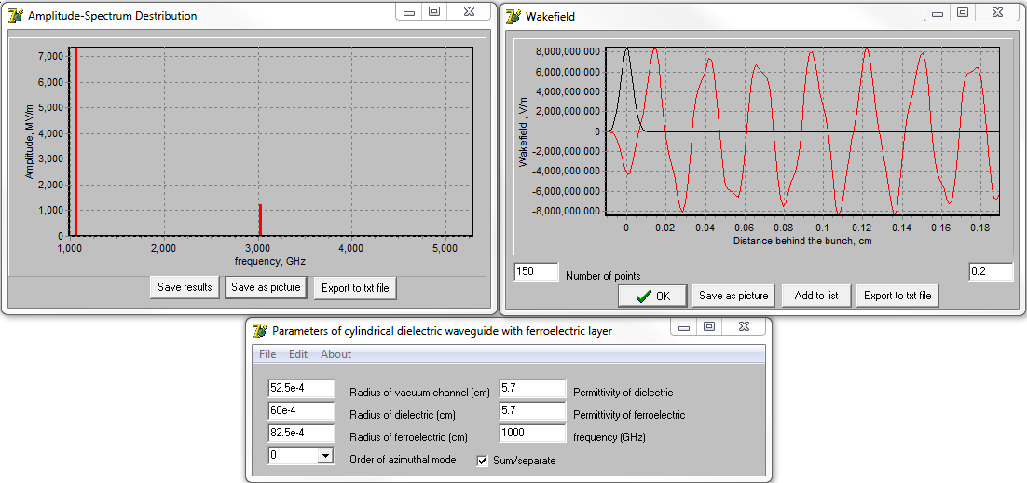
Diamond tube 105μm ID. ε = 5.7
leaf cladded
4 installed
L <1cm

Slide 30
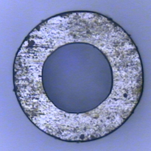
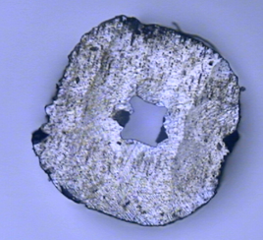
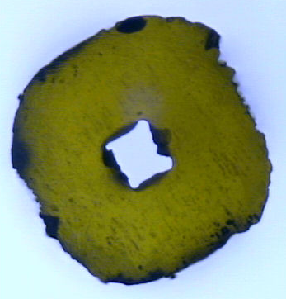
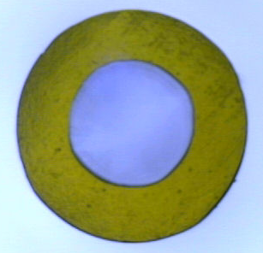
Tube 3
Sumitomo Single Crystal Diamond
L = 3.65 mm
Laser cut from a single piece
311 microns
528 microns id
Transmitted light

Slide 31
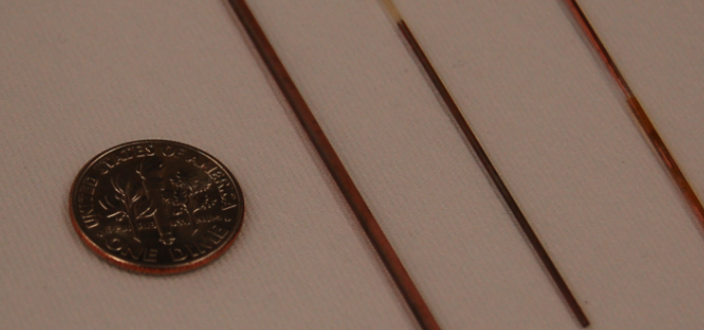
Large aperture structures
Sapphire
790μ ID
Alumina
508μ ID
Alumina
762μ ID
Metallization was done via EBCVD
Plans to study metallization process

Slide 32
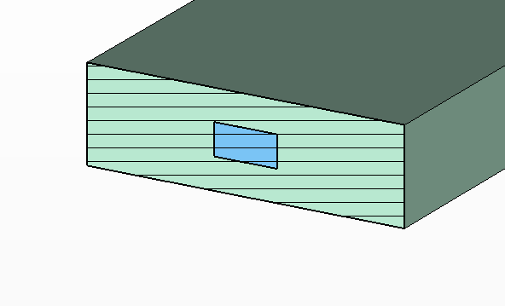
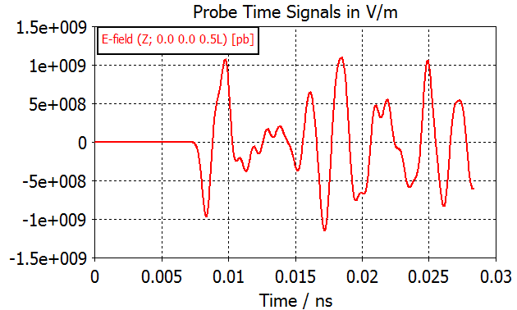
Rectangular diamond structure
300 x 1000 micron² waveguide aperture
100 x 200 micron² beamhole
Usable beam: σ_{r} = 150µm/6 = 25 µm
Wake generated by 3 nC
σ_{z} = 100micron beam.
*Facet beam goal is ~ 30 micron

Slide 33
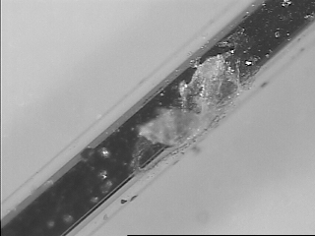
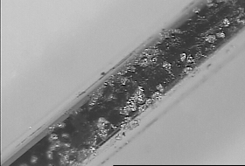
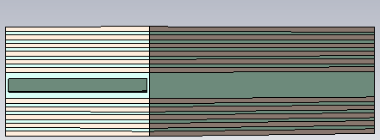
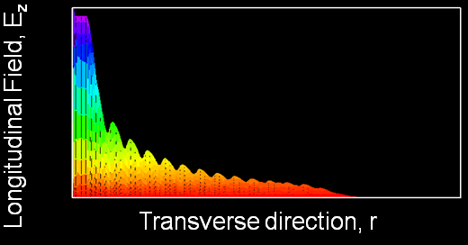
Slab symmetric Bragg structure
Motivation
  T-481 experiment showed that an electron beam can vaporize the aluminum cladding in a quartz-made DWA
  Explore alternate designs that allow mode confinement without metal: Bragg fibers
  Explore more robust materials i.e. diamond
T-481
Planar Bragg accelerator (PBA)
OOPIC simulation
that shows 1/1000
drop of the E-field
D. Stratakis (UCLA)

Slide 34
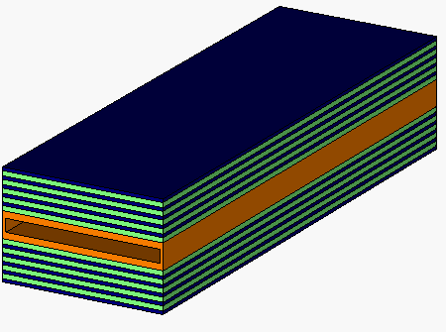
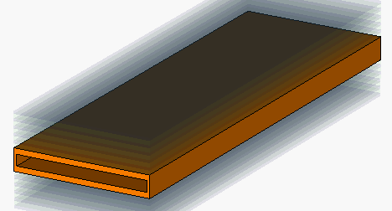
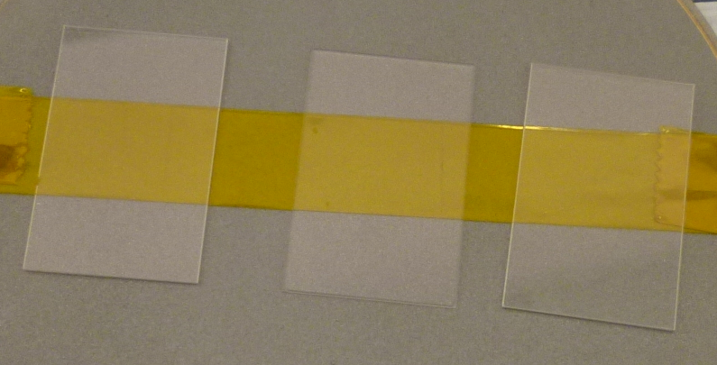
Testing the Bragg Concept at FACET
Multi-layer stack of alternate high and low index films
All reflected components from the interfaces interfere constructively, which results in a strong reflection.
The strongest reflection occurs when each material of the two is chosen to be a quarter of wavelength thick
Design two slabs: (1) with metal cladding and (2) with Bragg cladding
Bragg
Metal
Orange: Quartz (180 µm) or diamond (145 µm)
Green: Lithium Tantalate (50 µm)
Blue: Quartz (210 µm)
Gap: 240 µm

Slide 35




Slab with metal cladding
Single Peak
at 210 GHz

Slide 36




Slab with Bragg Cladding
Longitudinal Field drops along the transverse direction by 3 orders of magnitude!
210 GHz, single mode,
as metal cladding without
metal requirement
Long. El. Field
Transverse direction

Slide 37
Coherent Radiation Interferometry
UCLA CCR system designed and deployed
  New launching horns
  Collecting OAP with 3 mm beam hole
Quasi-optical transport
  TPX windows, all other optics reflective
  Broad range of THz signals
THz interferometry (UCLA/SLAC) for CCR and CTR (bunch length)

Slide 38
First Impressions at FACET and
Outlook
Exercise of readying for run valuable in team-building, experience
  Beam performance at IP meets requirements for mid-large ID structures
  Need smaller beams (no halo) for 100um ID structures
  fixed horn/OAP obstructive to running
  No data, Diminishing returns with available beam
Wish list to accommodate “commissioning quality” beam
  Mark beam on IP2A and IP2B – establish beam vector
  Use HeNe (focussed ?) for alignment through tubes
  DAQ Software for interferometer and data logging
  Knobs for flat beams (different aspect ratios) and varying bunch lengths
  Admin: User Beam Scheduling
Collaboration homework
  Modification of sample holder to allow for more materials, geometries, lengths
  Retractable OAP/horn modification
Ready for program next run
  CCR measurements
  Breakdown measurements
  Initial BBU
  Acceleration (Energy modulation)?

