Slide 1
First THz Measurements at FACET
Ziran Wu, Alan Fisher, Henrik Loos
FACET 2011 Users Meeting
2011-08-29

Slide 2
The Terahertz Gap
“Terahertz” is the gap between mm waves and mid-infrared
  1 mm to 10 µm, or 0.3 to 30 THz
  Few sources, few optical components, and poor instruments
    Pulse energy is difficult to measure: Joulemeters are uncalibrated
Laser-based THz sources are insufficient for pump-probe
  Broadband, nearly unipolar pulses are made by:
    Photoconductive switching
    Optical rectification
    Laser-gas interactions
    Typical fields of 20 MV/m; pulse energies of 20 µJ
  Difference-frequency mixing makes a high-field, few-cycle transient
    Fields as high as 10 GV/m; pulse energies again of 20 µJ
We want a quasi-unipolar pulse of ~10 GV/m and >100 µJ

Slide 3
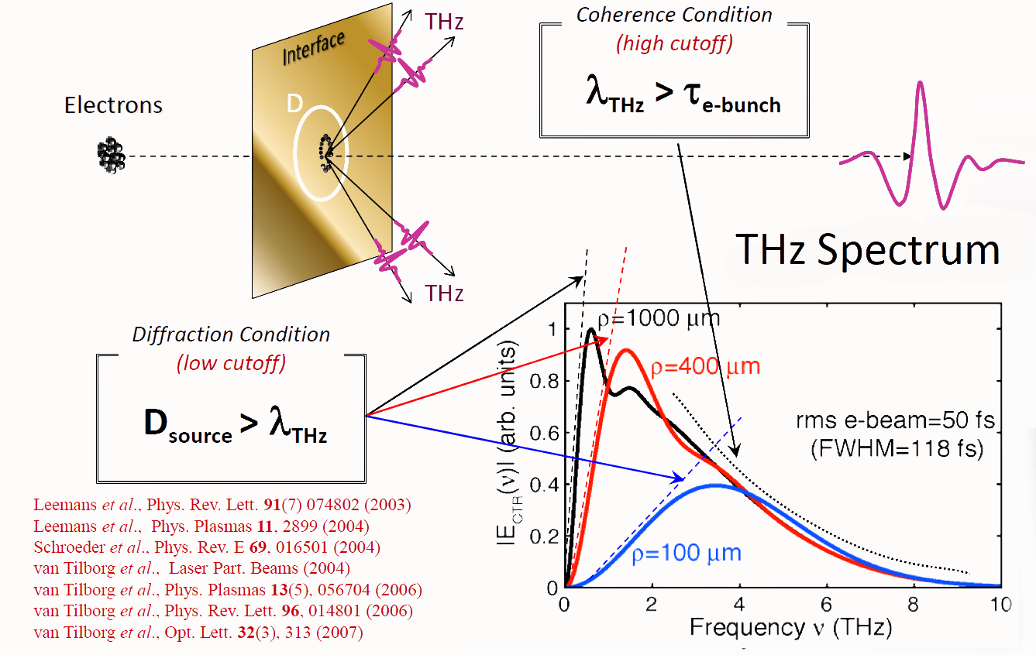
Coherent Transition Radiation
σ_{e-bunch}

Slide 4
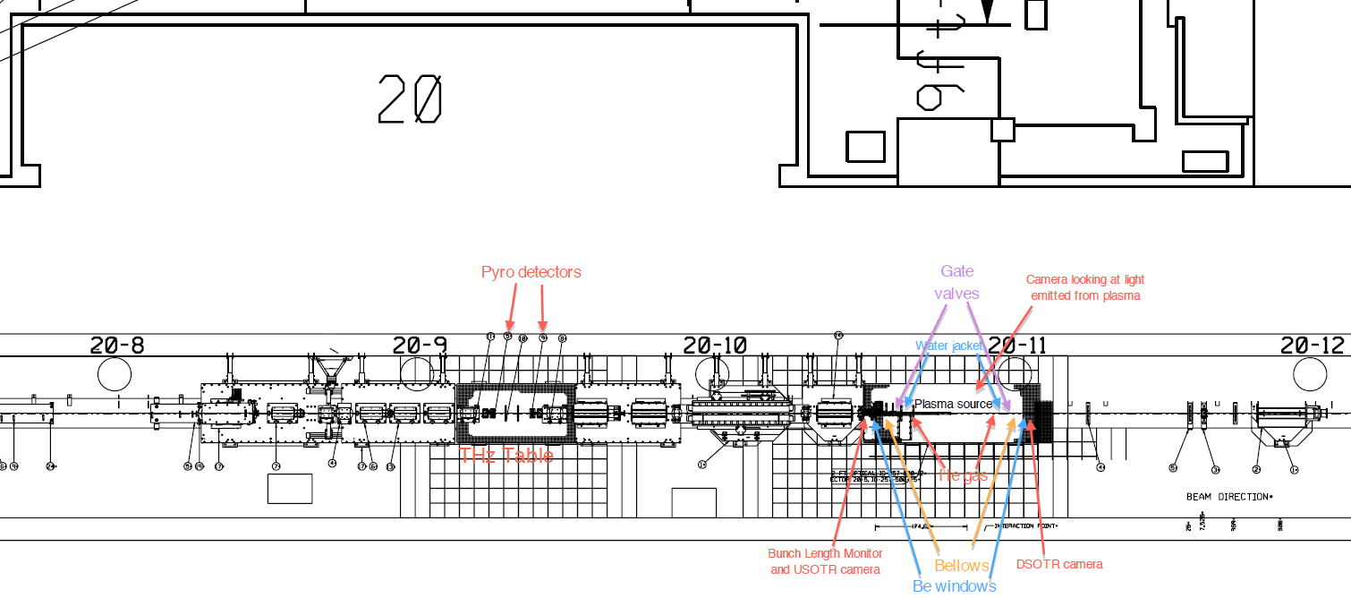
FACET Beamline
High peak-current beam yields strong THz field
Bunch length ideal for 0.1 ~ 2 THz generation

Slide 5
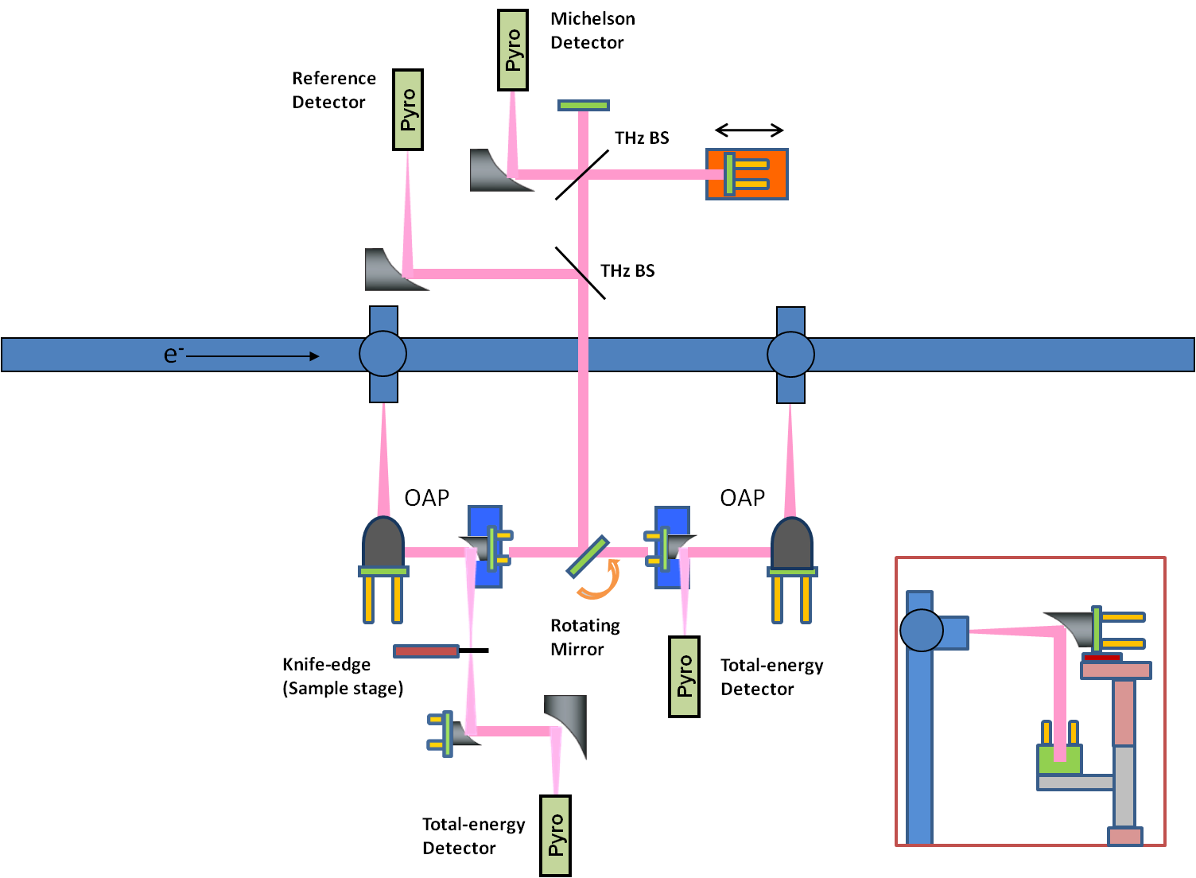
THz Table Layout

Slide 6
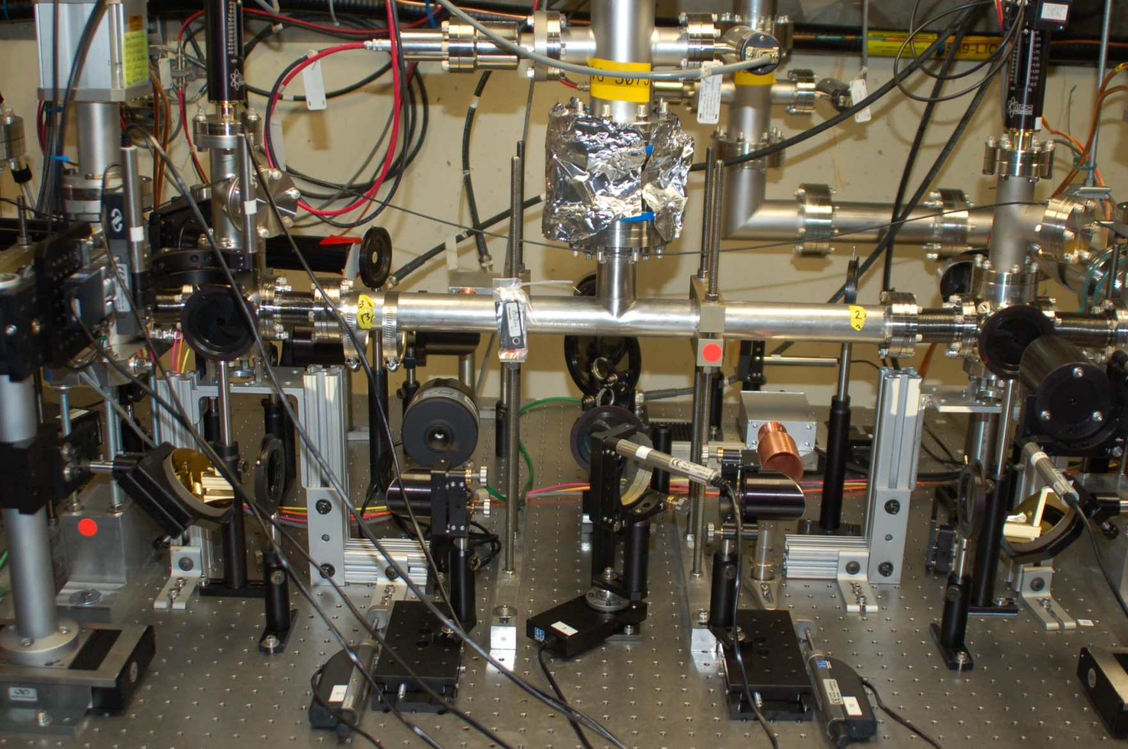
THz Table Setup

Slide 7
Bunch Length Measurement
σ = 45 um
x₀ = -1.56 mm
Electron bunch length σ_{z} = 45 um *2 / sqrt(2) = 63.6 um

Slide 8
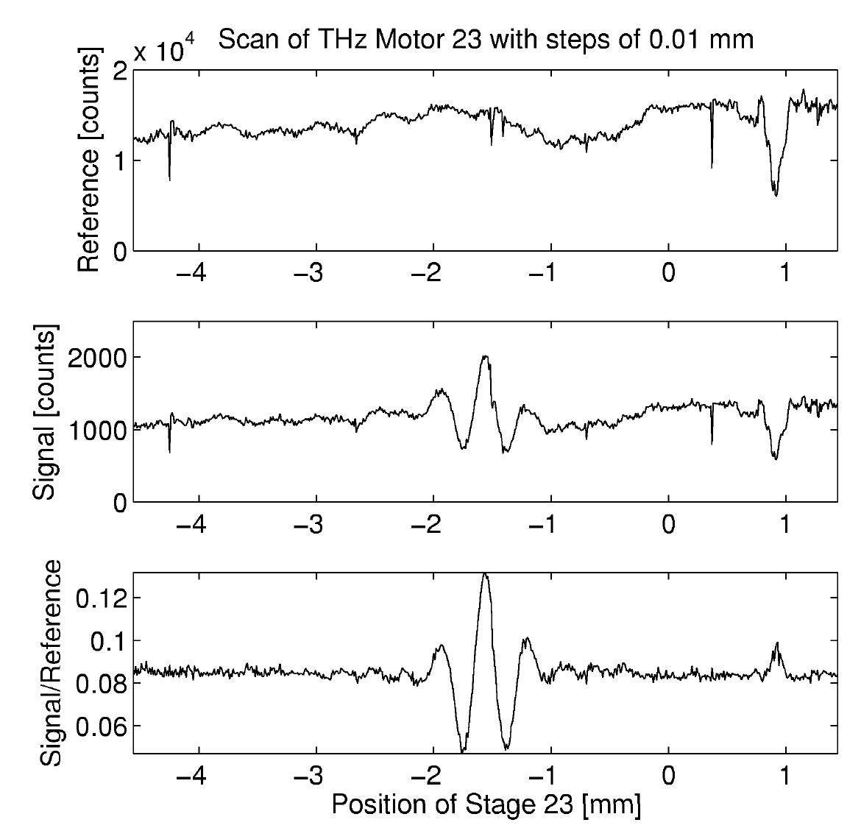
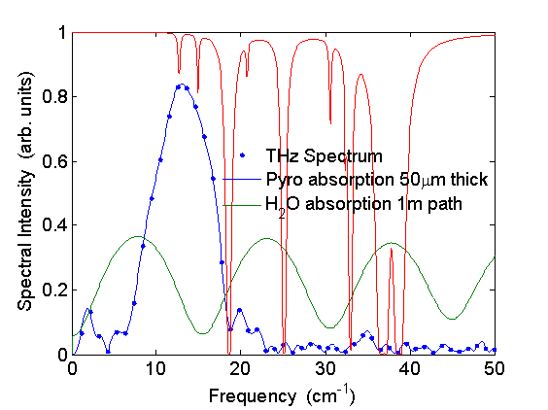
THz Spectrum
Peak at ~400 GHz
High-end cutoff at ~700 GHz (429 um)
σ_{z} ≈ 429 um /2π = 68.2 um

Slide 9
Beam Size at Focus
Beam waist (radius): ~3.5 mm horizontal and ~2 mm vertical
Consistent with ~1 mm peak radiation wavelength
Coincide with e-beam having much larger horizontal size at THz table

Slide 10
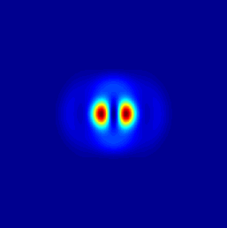
Simulated Beam Size
50
λ = 1 mm
Vertical
Horizontal
10
40
5
mm)
30
0
Counts
y (
20
-5
-10
10
0
-10
0
10
-10
0
10
x (
mm)
x or y (
mm)
Vertical size 2.4 mm, single peak
Horizontal size 2.9 mm, double peak (Can we see it in knife edge scan?)
Using sigma_z = 100 um in the simulation

Slide 11
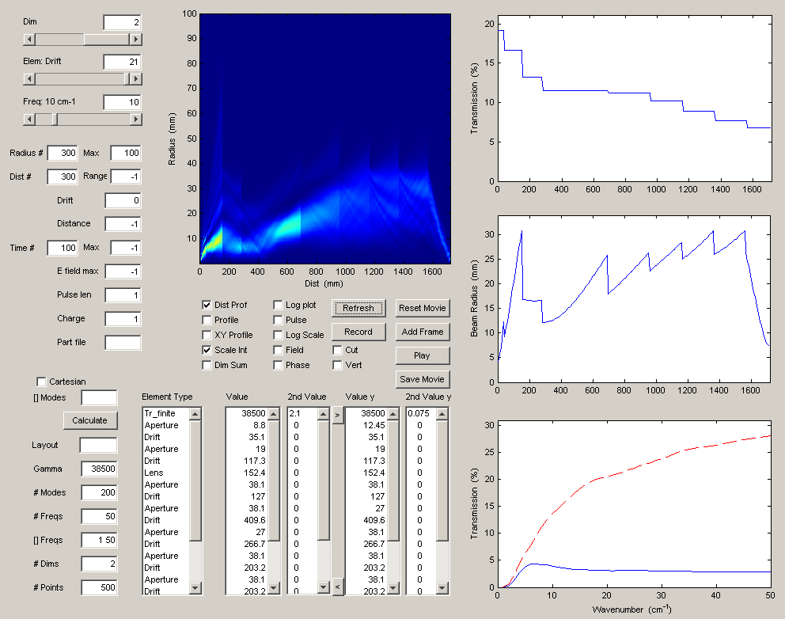
Simulated THz Propagation
Vert. polarization
λ = 1 mm
100
Field at detector
Radius
Transmission
50
Electric Field (MV/cm)
Distance
0
-50
-15
-10
-5
0
5
10
15
Time (ps)
Beam radius
e-Beam size 2.1 mm x 75 µm
100
Vertical transmission
Bunch form factor
Radiation spectrum
80
Horizontal pol.
Vertical pol.
60
Formfactor (%)
40
20
0
0
10
20
30
40
50
-1
Main contribution from vertical pol. due to flat beam
Wavenumber (cm
)

Slide 12
Comparison with Experiment
Measured spectrum
Simulated spectrum
Water absorption
Low and high roll-off frequencies don’t quite agree
Highly depend on e- bunch length
Detector responsivity spectrum is desired

Slide 13
At Different Bunch Compressions
BLEN pyro signal
as direct indication
of bunch length
Larger pyro read
Shorter bunch
Filters in the way:
Si viewport (3mm)
Nitrocellulose BS (2um)
Pyro detector
(50um crystal and coating)
Transverse bunch size

Slide 14
Diagnostics to Be Done
Per-pulse total energy measurement
Peak field estimation based on bunch length and focal size
A different detector for the autocorrelator? Characterize the current pyro
Bunch length and transverse e-beam size variations
Downstream foil measurements
Possible formation length study

Slide 15
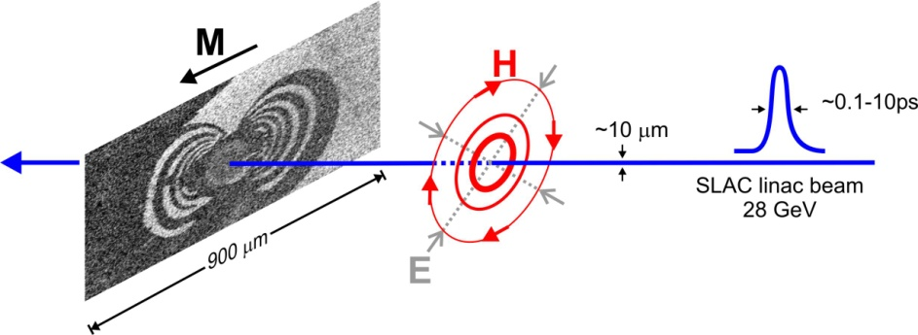
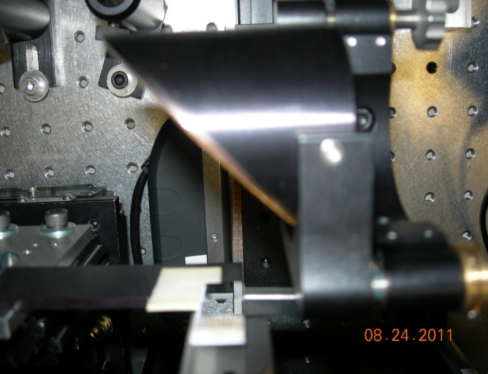
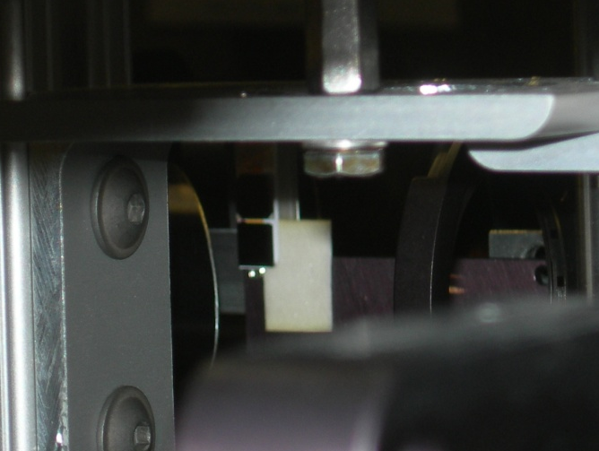
Inducing Magnetic Anisotropy
Need strong B field for magnetic switching
in a thin-film metallic ferromagnet
FACET THz beam may provide short and
intense enough pulse
Sample ready for THz exposure; Arrangement
required for single shot per sample
(Single-shot operation or chop at sub-1Hz)

Slide 16
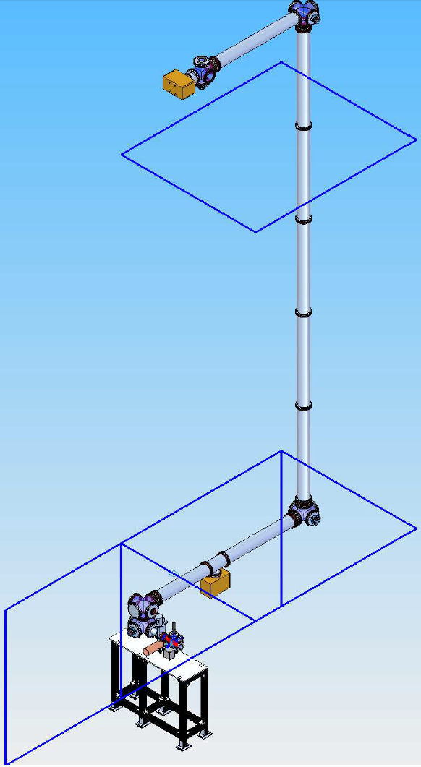
R&D to Bring THz to Laser Room
Ideal for THz-optical pump probe experiment
Needs 10s’ of meters THz transport line
Relay imaging system with large and frequent
OAPs (~200 mm dia., ~5 m EFL, every ~10 m)
Experience gain of long-distance THz
transportation
Possibility of bring laser onto THz table too

Slide 17
Thank You !

Slide 18
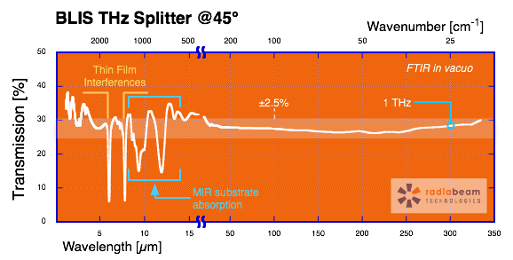
Curves
Silicon Viewport

