Slide 1
Wakefield Acceleration in Dielectric Structures
J.B. Rosenzweig
UCLA Dept. of Physics and Astronomy
FACET Workshop
SLAC, March 18, 2010

Slide 2
Scaling the accelerator in size
Lasers produce copious power (~J, >TW)
Scale in λ by 4 orders of magnitude
λ < 1 μm gives challenges in beam dynamics
Reinvent resonant structure using dielectric (E163, UCLA)
GV/m fields possible, breakdown limited…
GV/m allows major reduction in size, cost
To jump to GV/m, mm-THz better? …dynamics!
Must have new source…
Resonant dielectric laser-excited
structure (HFSS simulation, UCLA)

Slide 3
Promising paradigm for high field accelerators: wakefields
Coherent radiation from bunched, v~c, e⁻ beam
Any impedance environment
Powers more exotic schemes: plasma, dielectrics
Non-resonant, short pulse operation possible
High average power beams can be produced!
Tens of MW, present advantage over lasers
Intense beams needed by other fields
X-ray FEL
X-rays from Compton scattering
THz sources

Slide 4
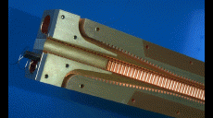
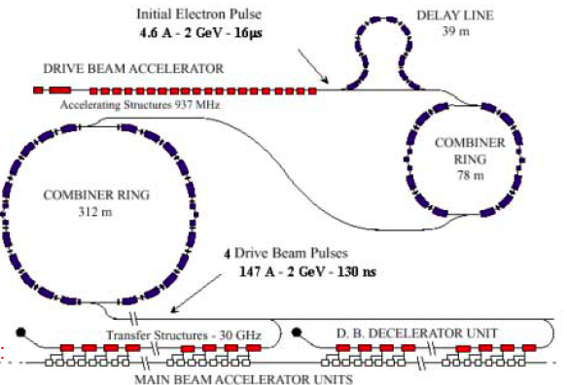
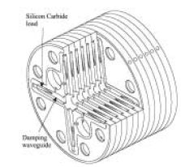
High gradients, high frequency, EM power from wakefields: CLIC @ CERN
CLIC drive beam extraction structure
CLIC wakefield-powered resonant scheme
Power
CLIC 30 GHz,
150 MV/m structures
J. Rosenzweig, et al., Nucl. Instrum. Methods A 410 532 (1998). (concept borrowed from W. Gai…)

Slide 5
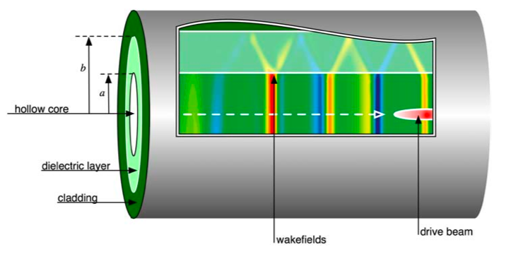
The dielectric wakefield accelerator
High accelerating gradients: GV/m level
Dielectric based, low loss, short pulse
Higher gradient than optical? Different breakdown mechanism
No charged particles in beam path…
Use wakefield collider schemes
CLIC style modular system
Afterburner possibility for existing accelerators
Spin-offs
High power THz radiation source

Slide 6
The “wake” mechanism: coherent Cerenkov radiation
Cerenkov angle
Radiation
Maximum frequency favored, minimum bunch length

Slide 7
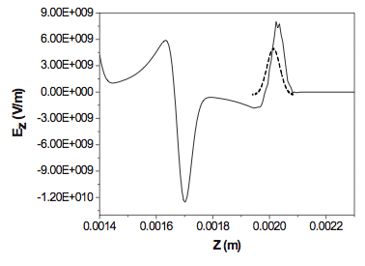
Dielectric Wakefield Accelerator Overview
*
Electron bunch (β ≈ 1) drives Cerenkov wake in cylindrical dielectric structure
Dependent on structure properties
Multimode excitation
Wakefields accelerate trailing bunch
Mode wavelengths (quasi-optical
Design Parameters
Peak decelerating field
Extremely good
beam needed
(FACET!)
Transformer ratio (unshaped beam)
Ez on-axis, OOPIC

Slide 8
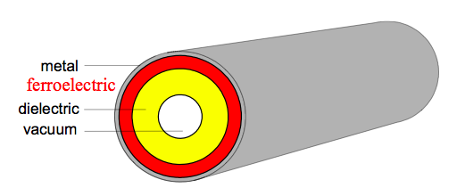
Experimental History Argonne / BNL experiments
ΔE vs. witness delay
Proof-of-principle experiments
(W. Gai, et al.)
ANL AATF
Mode superposition
(J. Power, et al. and S. Shchelkunov, et al.)
ANL AWA, BNL
Transformer ratio improvement
(J. Power, et al.)
Beam shaping
Tunable permittivity structures
For external feeding
(A. Kanareykin, et al.)
Tunable permittivity
Gradients limited to <100 MV/m by available beam

Slide 9
T-481: Test-beam exploration of breakdown threshold
Go beyond pioneering work at ANL
Much shorter pulses, small radial size
Higher gradients…
Leverage off E167
Goal: breakdown studies
Al-clad fused SiO₂ fibers
ID 100/200 μm, OD 325 μm, L=1 cm
Avalanche v. tunneling ionization
Beam parameters indicate E_{z} ≤11GV/m can be excited
3 nC, σ_{z} ≥ 20 μm, 28.5 GeV
48 hr FFTB run
T-481 “octopus” chamber

Slide 10
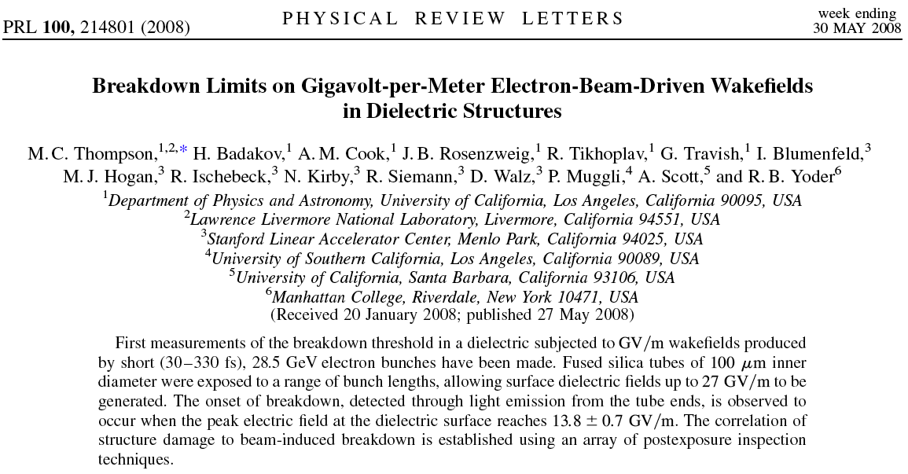
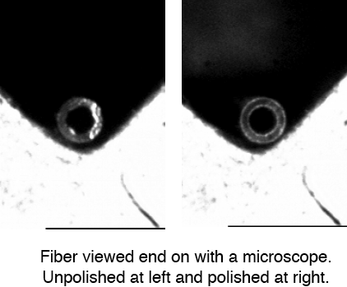
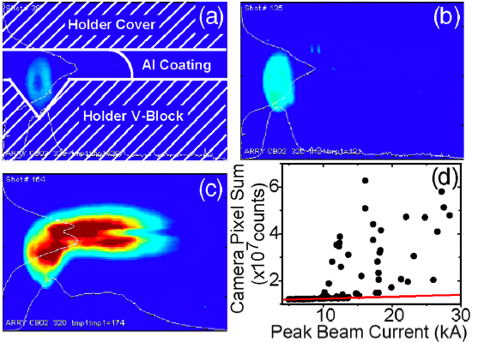
T481: Methods and Results
Multiple tube assemblies
Scanning of bunch lengths for wake amplitude variation
Vaporization of Al cladding… dielectric more robust
Observed breakdown threshold (field from simulations)
13.8 GV/m surface field
5.5 GV/m deceleration field
Multi-mode effect?
Correlations to post-mortem inspection

Slide 11
T481: Beam Observations
View end of dielectric tube;
frames sorted by increasing peak current

Slide 12
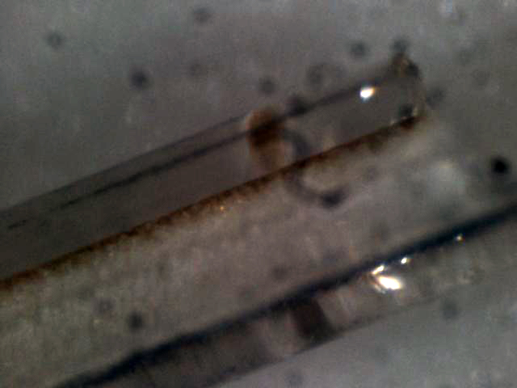
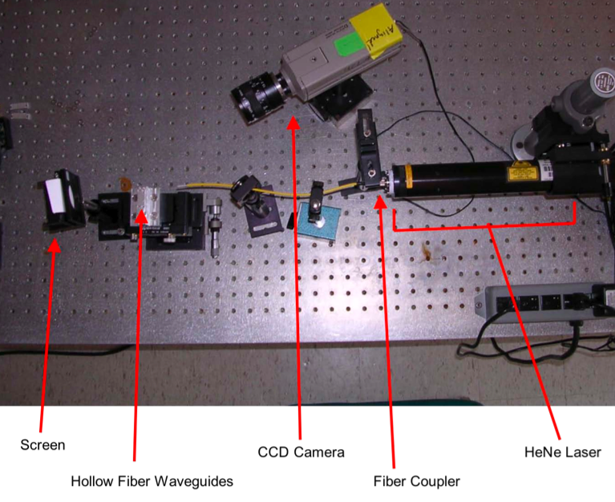
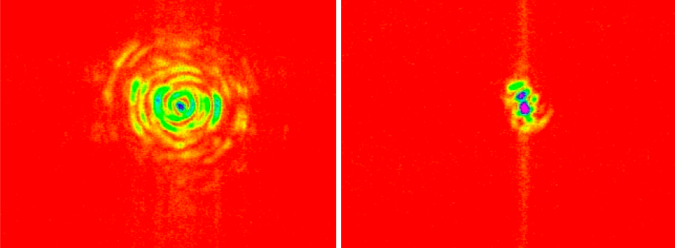
T-481: Inspection of Structure Damage
Damage consistent with beam-induced discharge
ultrashort
bunch
Bisected fiber
longer
bunch
Aluminum vaporized from pulsed heating!
Laser transmission test

Slide 13
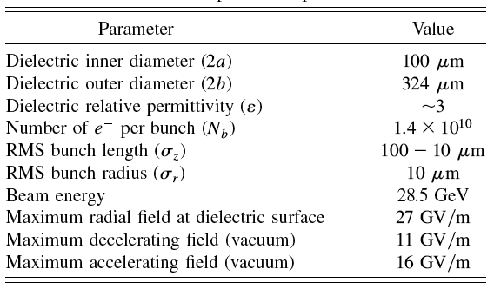
OOPIC Simulation Studies
Parametric scans for design
Heuristic model benchmarking
Show pulse duration in multimode excitation… hint at mechanism
Determine field levels in experiment: breakdown
Gives breakdown limit of 5.5 GV/m deceleration field
Multi-mode excitation – short, separated pulse
Example scan, comparison to heuristic model

Slide 14
E169 Collaboration
H. Badakov^{α}, M. Berry^{β}, I. Blumenfeld^{β}, A. Cook^{α}, F.-J. Decker^{β}, M. Hogan^{β}, R. Ischebeck^{β}, R. Iverson^{β}, A. Kanareykin^{ε}, N. Kirby^{β}, P. Muggli^{γ}, J.B. Rosenzweig^{α}, R. Siemann^{β}, M.C. Thompson^{δ}, R. Tikhoplav^{α}, G. Travish^{α}, R. Yoder^{ζ}, D. Walz^{β}
^{α}Department of Physics and Astronomy, University of California, Los Angeles
^{β}Stanford Linear Accelerator Center
^{γ}University of Southern California
^{δ}Lawrence Livermore National Laboratory
^{ζ}Manhattanville College
^{ε}Euclid TechLabs, LLC
Collaboration spokespersons
UCLA

Slide 15
E-169 Motivation
Take advantage of unique experimental opportunity at SLAC
FACET: ultra-short intense beams
Advanced accelerators for high energy frontier
Plasma and dielectric wakefields 1st in line…
Extend successful T-481 investigations
Multi-GV/m dielectric wakes
Complete studies of transformational technique

Slide 16
E169 at FACET: overview
Research GV/m acceleration scheme in DWA
Goals
Explore breakdown issues in detail
Determine usable field envelope
Coherent Cerenkov radiation measurements
Explore alternate materials
Explore alternate designs and cladding
Radial and longitudinal periodicity…
Varying tube dimensions
Impedance change
Breakdown dependence on wake pulse length
Approved experiment (EPAC, Jan. 2007)
Awaits FACET construction
Already explored at
UCLA Neptune

Slide 17
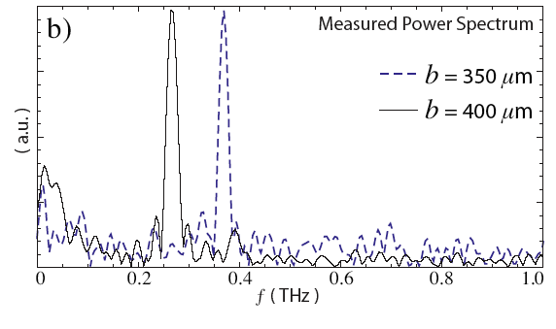
Observation of THz Coherent Cerenkov Wakefields @ Neptune
Chicane-compressed (200 μm) 0.3 nC beam
Focused with PMQ array to σ_{r}~100 μm (a=250 μm)
Single mode operation
Two tubes, different b, THz frequencies
Horn-launched quasi-optical transport
Autocorrelation in Michelson interferometer

Slide 18
E-169: High-gradient Acceleration Goals in 3 Phases
Phase 1: Complete breakdown study (when does E169->E168!)
Coherent Cerenkov (CCR) measurement
σ_{z} | ≥ 20 μm
σ_{r} | < 10 μm
U | 25 GeV
Q | 3 - 5 nC
explore (a, b, σ_{z}) parameter space
Alternate cladding
Alternate materials (e.g. CVD diamond)
Explore group velocity effect
Total energy gives field measure
Harmonics are sensitive σ_{z} diagnostic
FACET beam parameters for E169: high gradient case

Slide 19
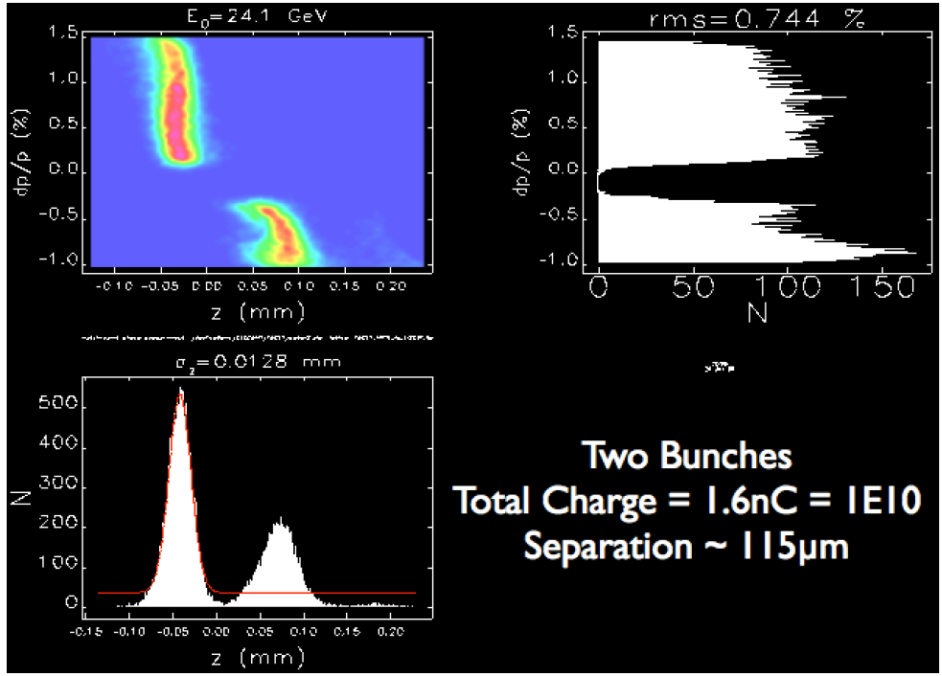
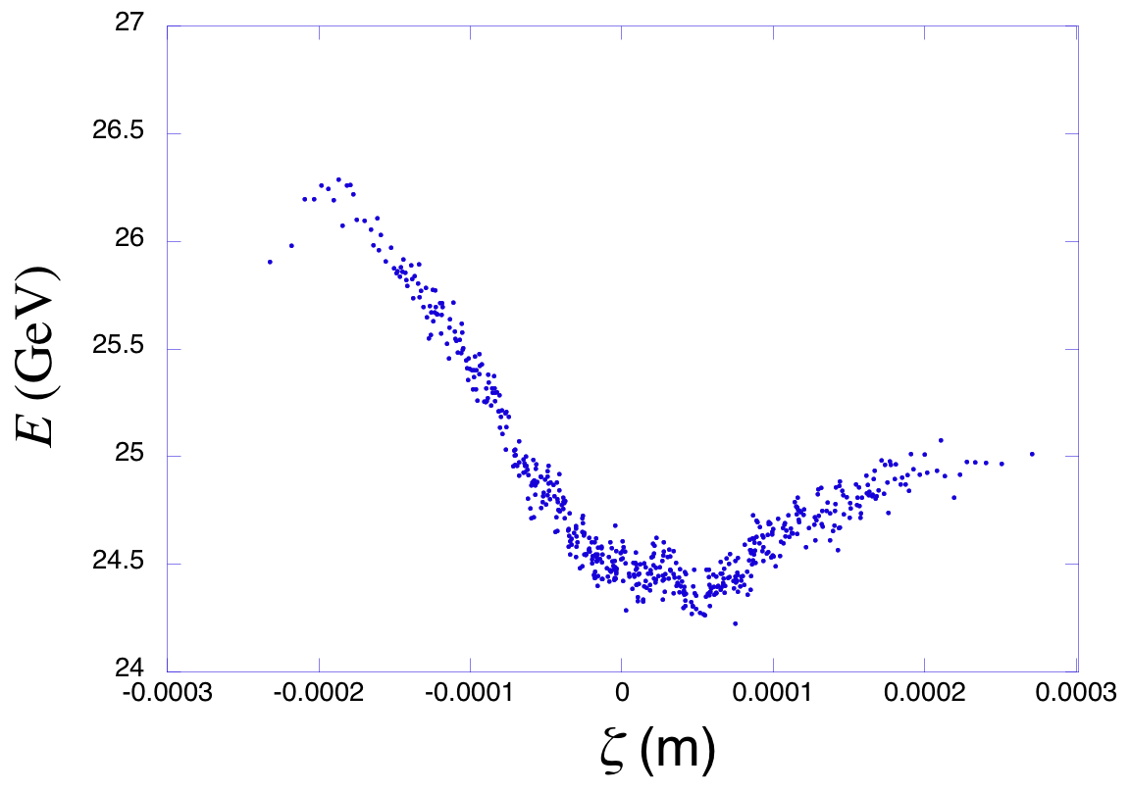
E-169 at FACET: Phase 2 & 3
Phase 2: Observe acceleration
10-33 cm tube length
longer bunch, acceleration of tail
“moderate” gradient, 1-3 GV/m
single mode operation
σ_{z} | 50-150 μm
σ_{r} | < 10 μm
E_{b} | 25 GeV
Q | 3 - 5 nC
Phase 3: Accelerated beam quality
Witness beam
Alignment, transverse wakes, BBU
Group velocity & EM exposure
Positrons. Breakdown is different…
FACET beam parameters for E169: acceleration case
Momentum distribution after 33 cm (OOPIC)
Witness beam, acceleration and BBU

Slide 20
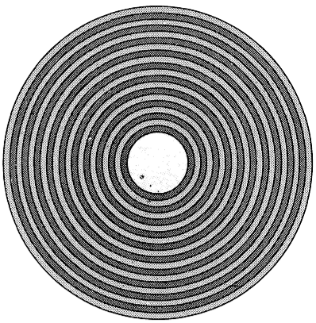
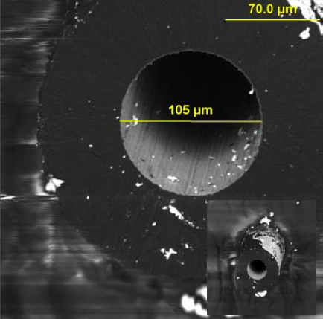
Experimental Issues: Alternate DWA design, cladding, materials
Aluminum cladding in T-481
Dielectric cladding
Bragg fiber?
Low HOM, LR BBU stabilized?
Alternate dielectric: CVD diamond
Ultra-high breakdown threshold
Doping gives low SEC
First structures from Euclid Tech.
Vaporized at moderate wake amplitudes
Low vaporization threshold; low pressure
and thermal conductivity of environment
Bragg fiber
Lower refractive index provides internal reflection
Low power loss, damage resistant
A. Kanareykin
CVD deposited diamond

Slide 21
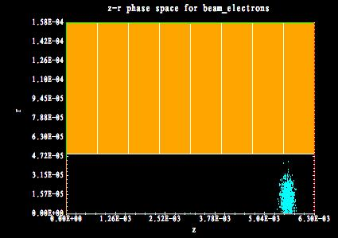
Control of group velocity with periodic structure
For multiple pulse beam loaded operation in LC, may need low v_{g}
Low charge gives smaller, shorter beams
Can even replace large Q driver
Use periodic DWA structure in ~π-mode
Accelerating beam
Driving beam
Example: SiO₂-diamond structure

Slide 22
Analytical and simulation approach to zero VG structure
Matrix treatment of E_{z} and its derivative
Evaluate through period, set phase advance μ=π
Check, optimize with OOPIC simulation

Slide 23
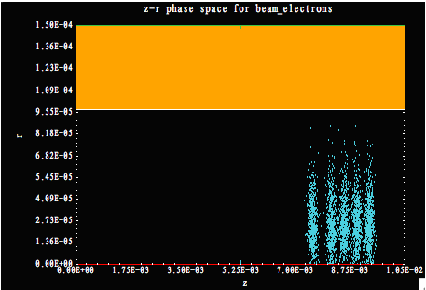
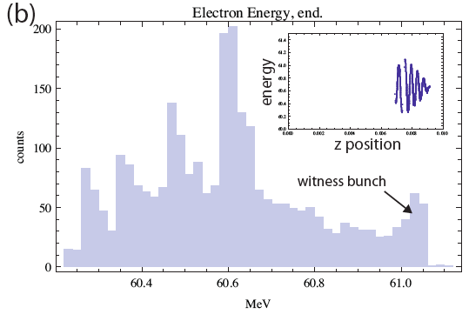
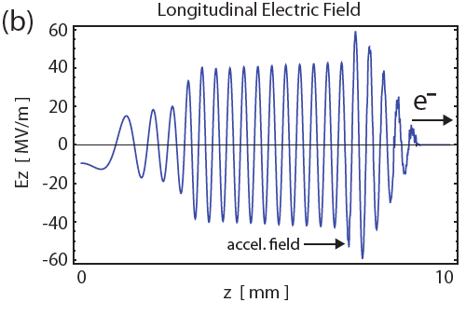
Initial multi-pulse experiment: uniform SiO₂ DWA at BNL ATF
Exploit Muggli’s pulse train slicing technique
400 μm spacing, micro-Q=25 pC, σ_{z}=80 μm
DWA dimensions: a=100 μm, b=150 μm

Slide 24
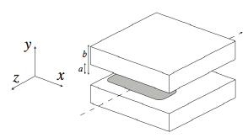
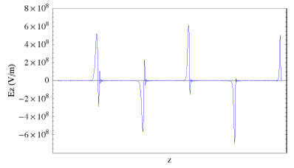
Alternate geometry: slab
Slab geometry suppresses transverse wakes*
Also connects to optical case of interest at E163
Price: reduced wakefield
Interesting tests at FACET
Slab example, >600 MV/m
*A. Tremaine, J. Rosenzweig, P. Schoessow, Phys. Rev. E 56, 7204 (1997)

Slide 25
A High Transformer Scenario using Dielectric Wakes
Pulse train may not be needed or desirable…
Instead, look for enhanced transformer ratio with ramped beam
Does this work with multi-mode DWA?
Scenario: 500-1000 MeV ramped driver; 5-10 GeV FEL injector in <10 m
Symmetric beam R<2
Ramped beam R>>2

Slide 26
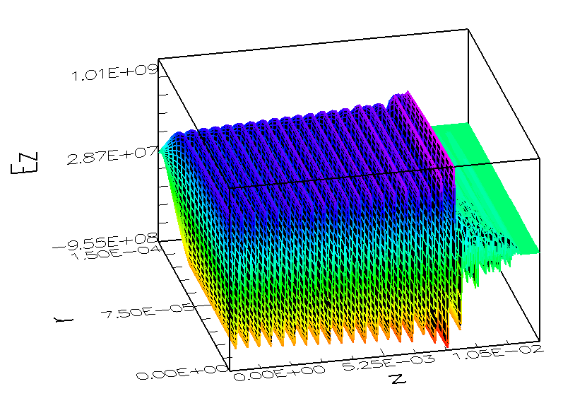
A FACET scenario
Charge: 3 nC
Ramp: L=2.5 mm
Energy: 1 GeV
Structure: a=100 μm,
b=100 μm, ε=3.8
Fundamental f=0.74 THz
Performance: >GV/m accel., R=9-10 (10 GeV possible)
Ramp achieved at UCLA Neptune. Examine ATF, FACET
Longitudinal phase space
after 1.3 m DWA (OOPIC)
Sag in wake due to multi-mode

Slide 27
Conclusions
Very promising technical approach in DWA
Physics surprisingly forgiving thus far
Looks like an accelerator!
FACET and ATF provide critical test-beds
Need to explore more:
Breakdown, materials
Acceleration and beam stability
Advanced geometries

