Slide 1
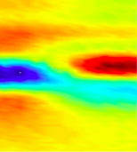
Materials in extreme THz fields at FACET
SLAC, March 18, 2010
FACET Workshop
Aaron Lindenberg
Department of Materials Science and Engineering, Stanford University
PULSE Institute, SLAC National Accelerator Laboratory

Slide 2
Collaborators and Acknowledgements
The SPPS Collaboration
Stanford University
H. Wen, D. Daranciang, T.A. Miller, E. Szilagyi, J. Goodfellow, J. Wittenberg
Lawrence Berkeley National Laboratory
N. Huse, R.W. Schoenlein
Advanced Photon Source
M. Highland, P. Fuoss, B. Stephenson
MIT
B. Perkins, N. Brandt, M. Hoffman, K. Nelson

Slide 3
Overview
-Introduction and motivation for generation of intense single cycle THz fields as a means of manipulating and controlling materials:
-Previous measurements at the Final Focus Test Beam at SLAC (2003-2006)
-EO sampling for timing information for ultrafast x-ray experiments
-Femtosecond magnetism: What are the speed limits for switching?
-Some proposed experiments
-Lab-scale THz generation
-Parallel source after LCLS undulator

Slide 4
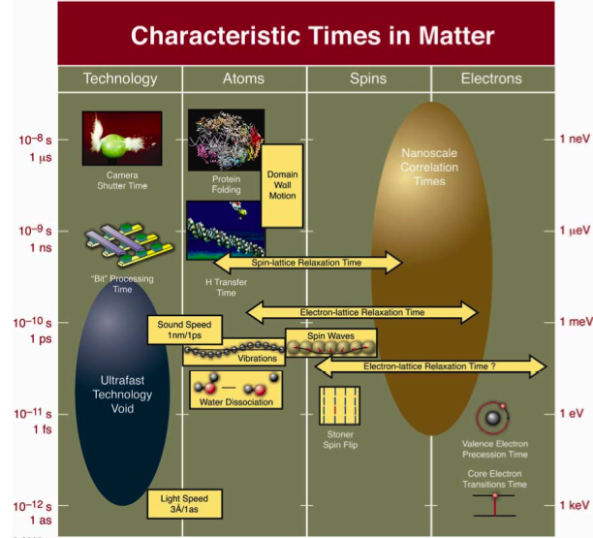
1 μs
1 ns
1 ps
1 fs
1 as

Slide 5


Slide 6
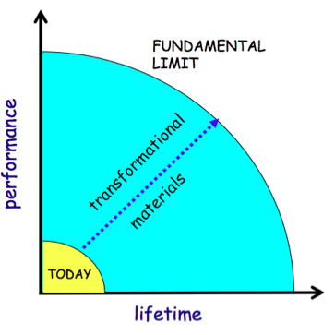
Materials under Extreme Electromagnetic Fields
-Extreme electric fields: First steps in dielectric breakdown. What is the maximum field
strength a material can withstand?
-Long-distance transmission lines
-Extreme fields in nanoscale devices, integrated circuitry
-Magnetic fields: Highest peak fields generated in destructive explosive devices (~1000 T)
-Superconducting materials: Critical fields and currents.
G. Crabtree et al.

Slide 7
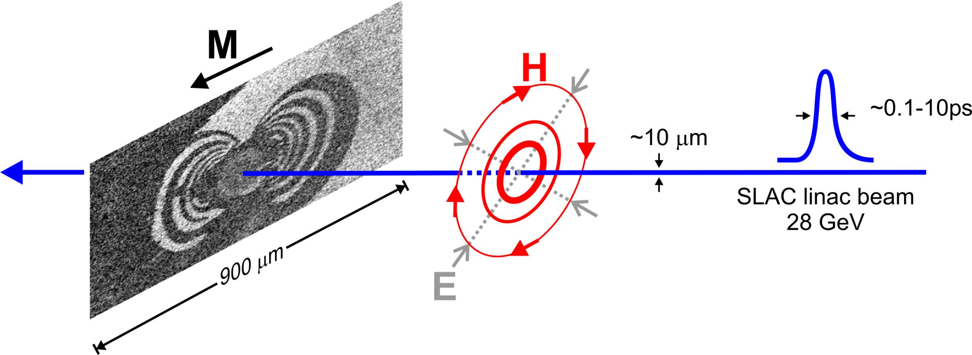
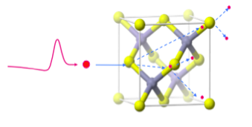
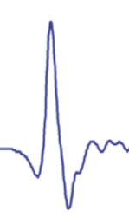
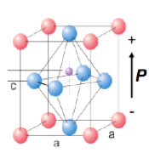
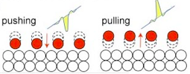
All-optical manipulation of materials at the level of atoms, spins, and electrons
Visualizing and directing atomic-scale processes, and channeling the flow of energy between degrees of freedom
Spin
Electrons
Polarization/Ionic displacement
Notes:
Unique properties of the slac linac

Slide 8
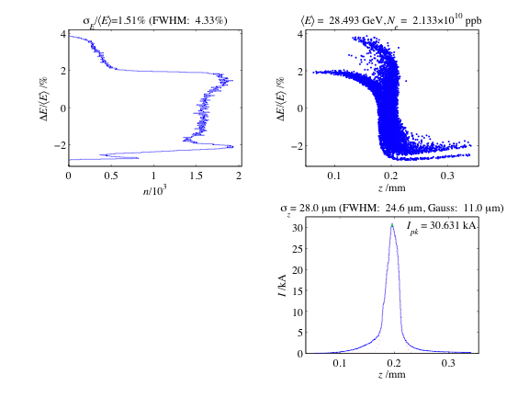
The Sub-Picosecond Pulse Source (SPPS)
50 ps
RTL
SLAC Linac
FFTB
1 GeV
9 ps
0.4 ps
20-50 GeV
<100 fs
Existing bends compress to <100 fsec
1.5%
~1 Å
30 kA
28 GeV
80 fsec FWHM
(10⁷ x-ray photons/pulse at 9 keV, 10 Hz)

Slide 9
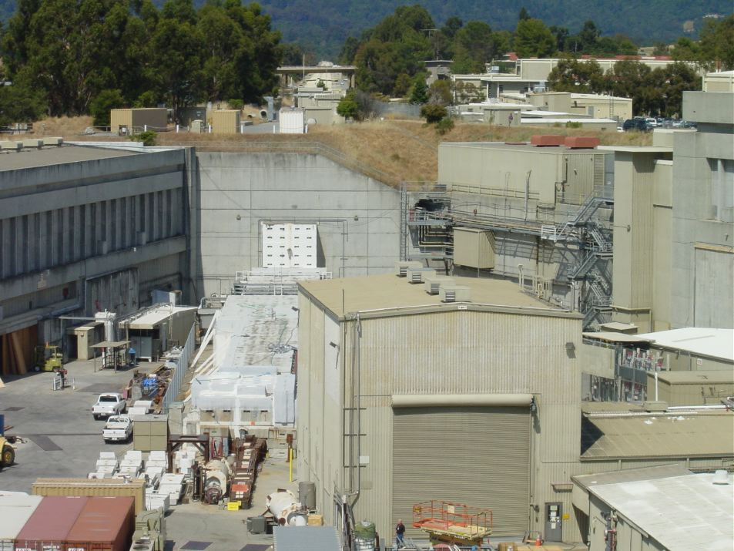
The SLAC Research Yard

Slide 10
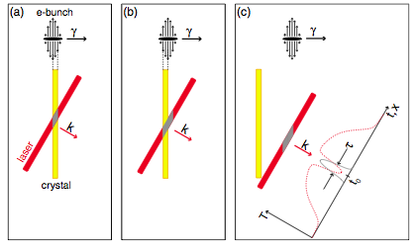
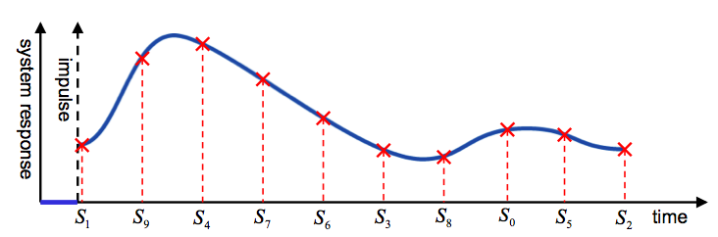
Single-shot timing measurements

Slide 11
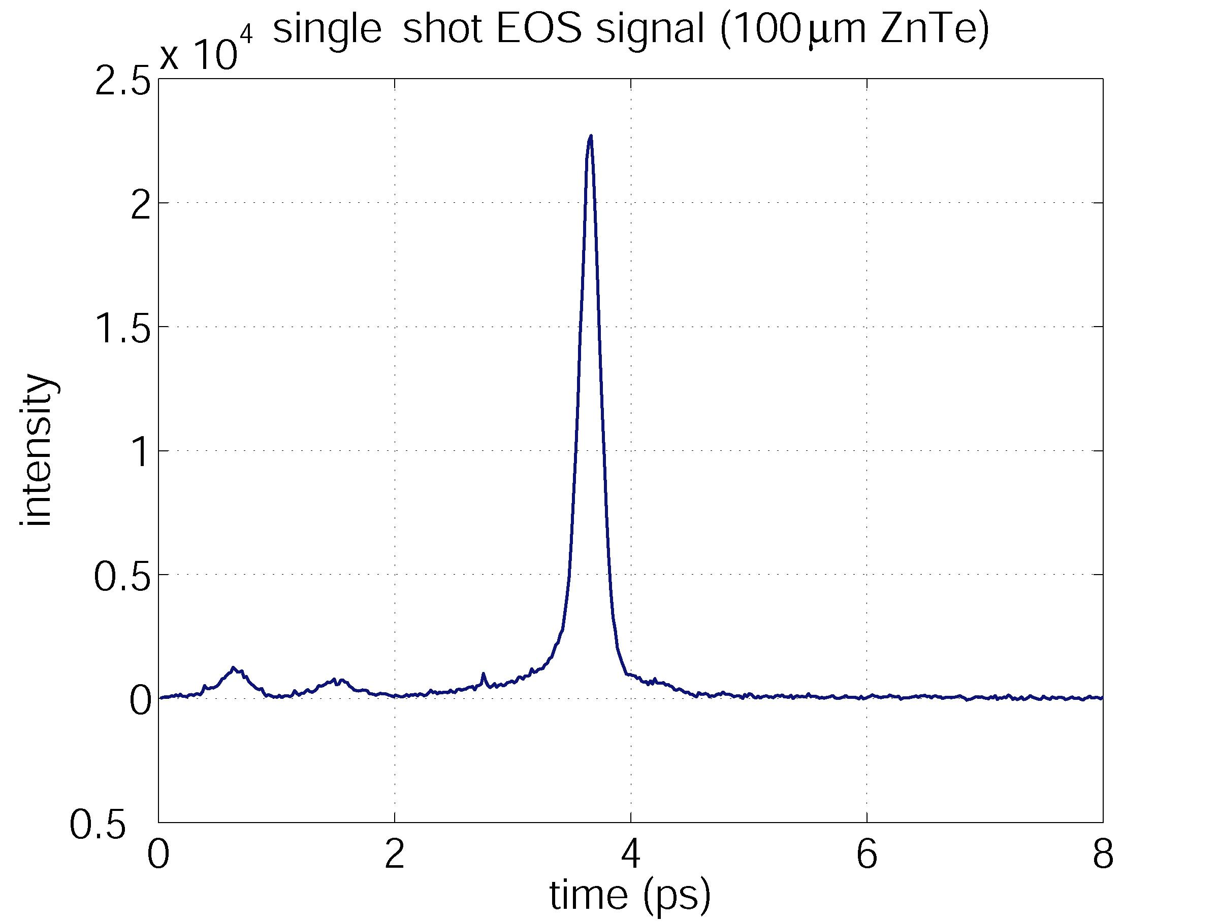
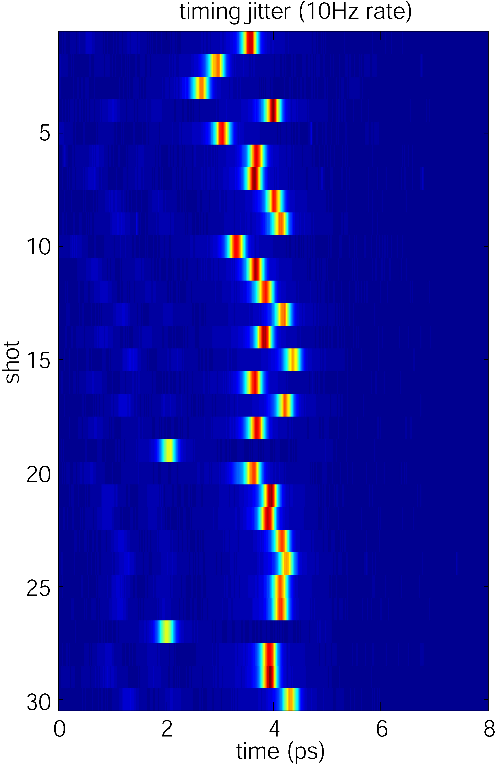
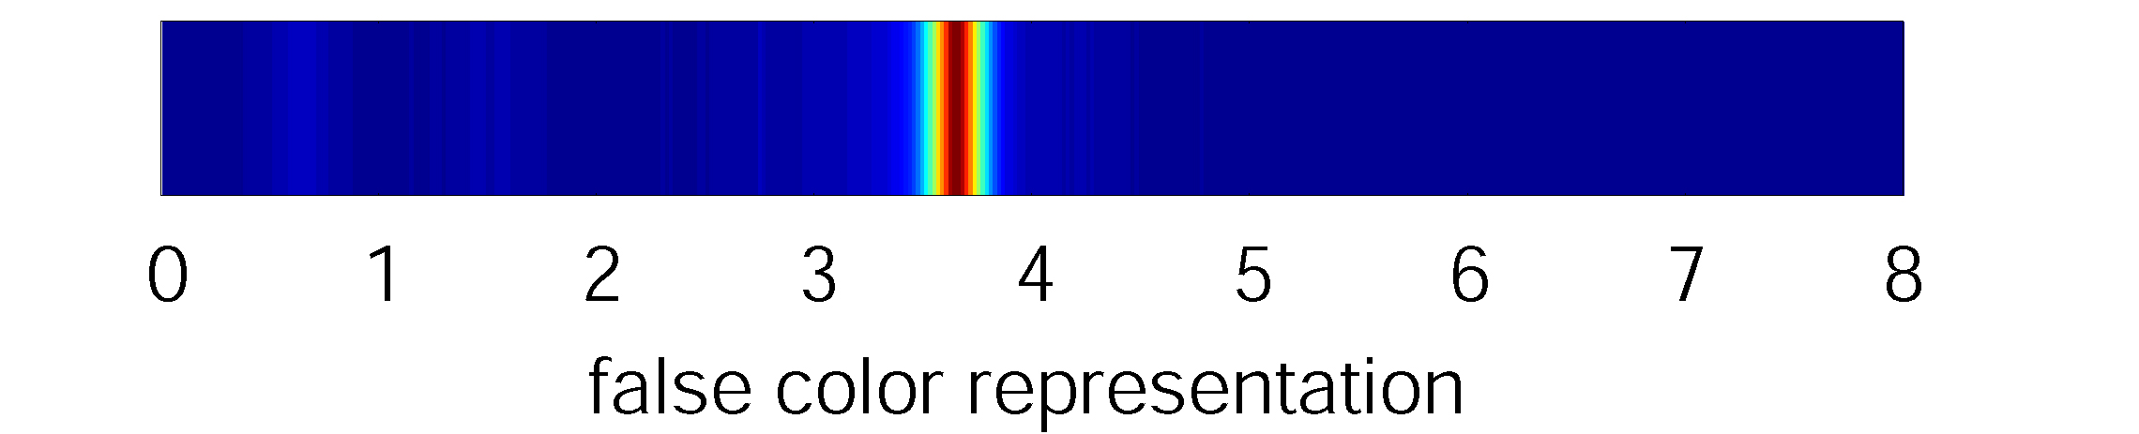
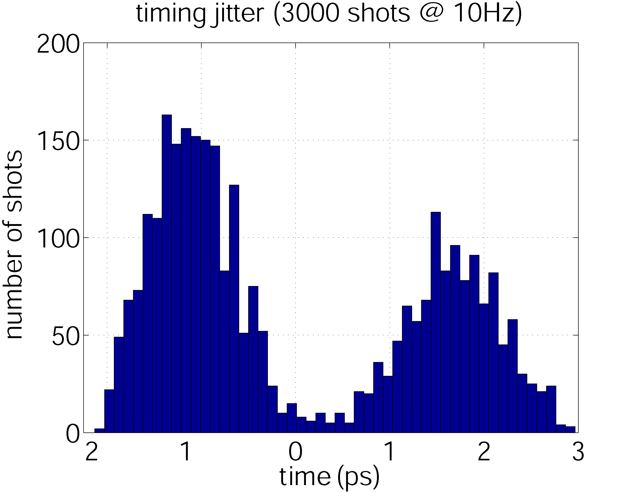
Single-Shot EOS Data at SPPS (100µm ZnTe)

Slide 12
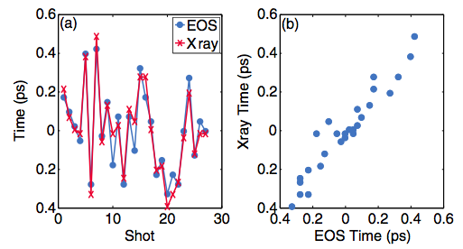
Single shot timing measurements and correlation with x-ray timing
Cavalieri et al., PRL (2005)

Slide 13
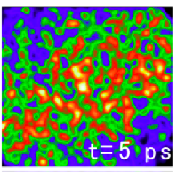
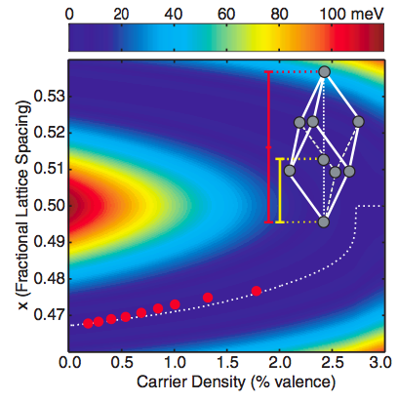
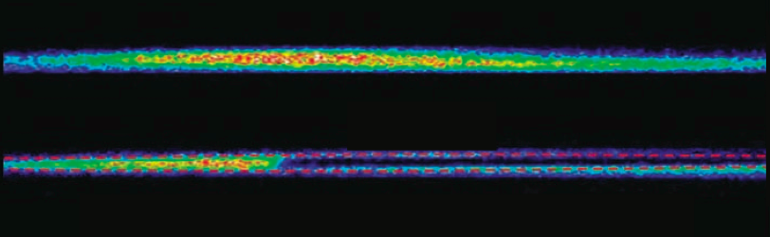
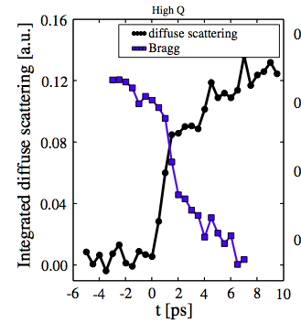
Experiments
Fritz et al. Science (2007)
Lindenberg et al. PRL (2008)
Lindenberg et al. Science (2005)

Slide 14
High-Field Effects in Metallic Ferromagnets on the Femtosecond Timescale
Goals:
1. Study ultrafast magnetization
dynamics induced by ultrastrong
magnetic and electric fields
2. Study electrical transport and high field
radiative effects excited by the fast,
strong field pulses
Previous SLAC and FFTB Publications:
1. S.J. Gamble et. al., Electric field induced magnetic anisotropy in
a ferromagnet, PRL 102, 217201 (2009)
2. J. Stöhr et. al., Magnetization switching without charge or spin
currents, APL 94, 072504 (2009)
3. C. Stamm et. al., Dissipation of spin angular momentum in
magnetic switching, PRL 94, 197603 (2005)
4. I. Tudosa et. al., The ultimate speed of magnetic switching in
granular recording media, Nature 428, 831 (2004)
5. C.H. Back et. al., Magnetization reversal in ultrashort magnetic
field pulses, PRL 81, 3251 (1998)
6. C.H. Back et. al., Minimum field strength in precessional
magnetization reversal, Science 285, 864 (1999)
7. H.C. Siegmann et. al., Magnetism with picosecond field pulses,
J. Mag. Mag. Mat. 151, L8 (1995)
Gamble, Stohr et al.

Slide 15
Open Questions
Magnetism:
1. Do the properties of the electric field induced magnetoelectronic anisotropy change in different
in-plane magnetic materials?
2. Can we demonstrate the presence of a magnetoelectronic anisotropy in perpendicular materials?
Heating:
Magnetic Contrast
Topographic
zooms
The longer, lower field picosecond length bunch heats the sample leading to the formation of stripe domains.
The picosecond bunch also ablates the sample and/or changes its chemical properties at the point of bunch impact.
The femtosecond pattern does not heat and is damage free
Why???

Slide 16
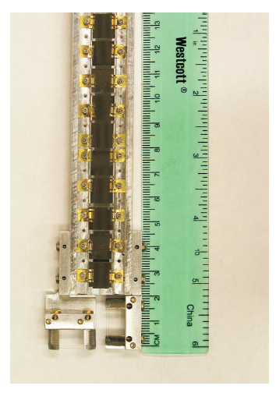
Set-Up and Wish List
Previous Set-Up at the FFTB
Wish List (in rough order of importance):
For the beam:
- Extremely well focused and well
characterized pulses (essential!)
- Ideal transverse beam size:
<1-5 microns
- Variable bunch lengths:
10⁻¹² – 10⁻¹⁵ seconds
- Variable bunch charge
- 1 Hz repetition rate for sample exposure (30 Hz
for measuring the transverse focus)
For the tunnel:
- Ability to insert our set-up at the point of
tightest beam focus
- Downstream gamma ray detector
for measuring the transverse beam
profile (measuring the beam is essential!)
- Sufficient ceiling height to insert our present
manipulator and six-way cross (~6 feet)
- Solid angle detector to measure emitted
radiation from films in the backward
direction
All of our experiments are single shot, and do
not require an in-situ measurement technique –
ie, with a well characterized beam we don’t
need that much time per experiment!
Manipulator arm and
motor controllers for
sample movement
The beam and the
samples pass
through the
six-way cross
Direction of the
electron beam
Sample Fork:
10 samples are mounted at a time
Example sample parameters:
0.5 mm insulating substrate (eg, MgO)
10 nm thick magnetic thin film
Wire Scanners to measure
the transverse beam profile

Slide 17
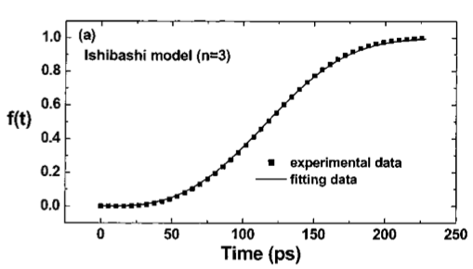
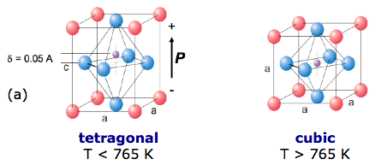
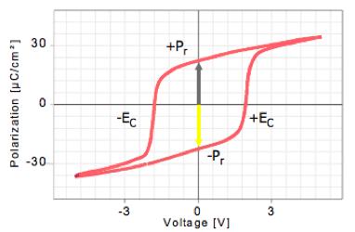
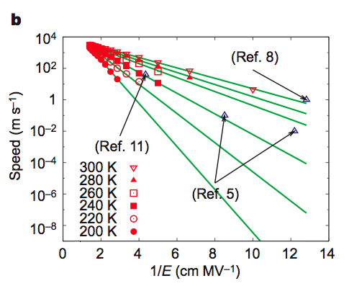
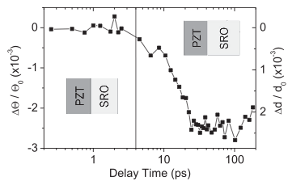

All-optical Control of Ferroelectric Materials
Li et al., APL (2004)
Korff Schmising et al., PRL (2007)
Shin et al. Nature (2007)
-Ferroelectrics for non-volatile memory storage, sensors. What are the speed limits for switching?
-Phase transition behavior at the nanoscale
-Development of all-optical (electrode-less) techniques for manipulating and controlling materials
Notes:
Polarization associated with shift of Pb and Ti cations with respect to oxygen cage. 10 nm at sound velocity is 2 ps.

Slide 18
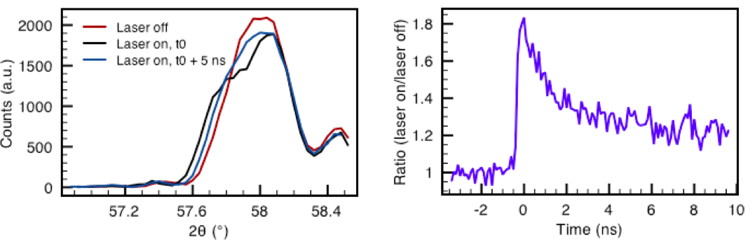
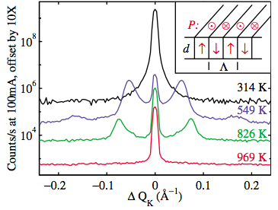
T=550 C (nanoscale stripe phase)

Slide 19
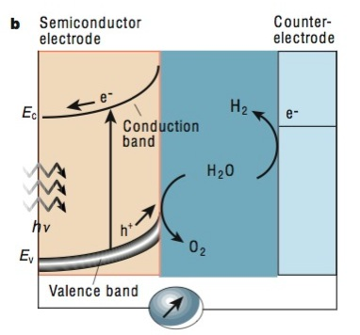
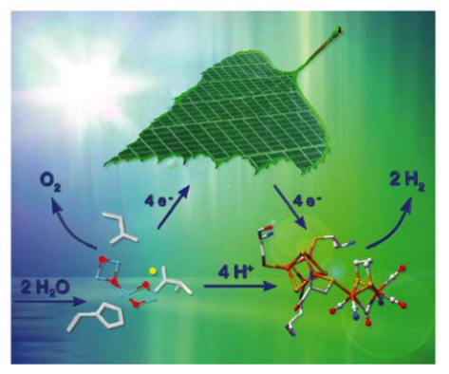
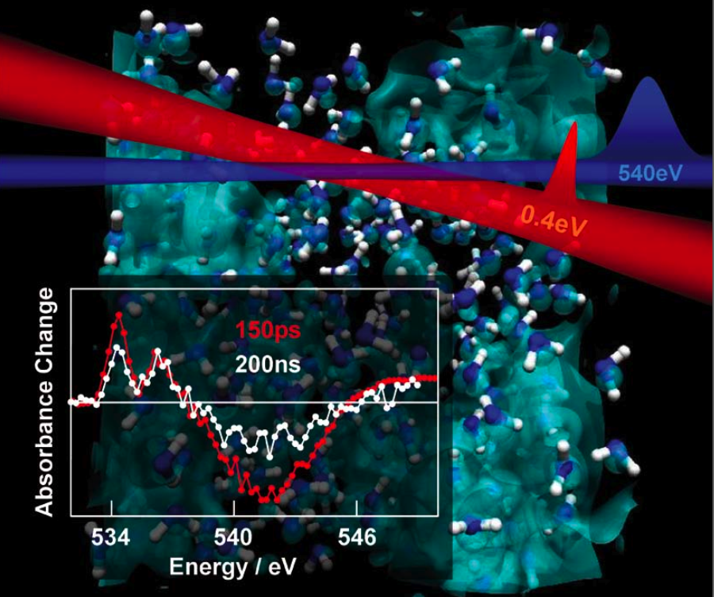
THz-assisted charge transfer in the water splitting reaction
-Ultrafast charge transfer processes at the heart of operation of photoelectrochemical cells
-Apply fields on the order of the interfacial fields to control, manipulate charge transfer processes.

Slide 20
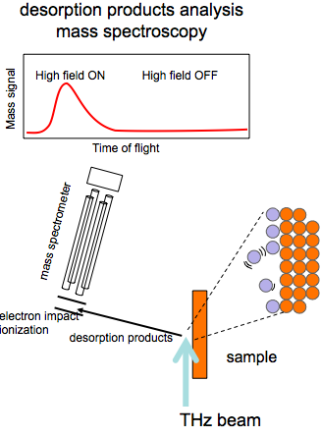
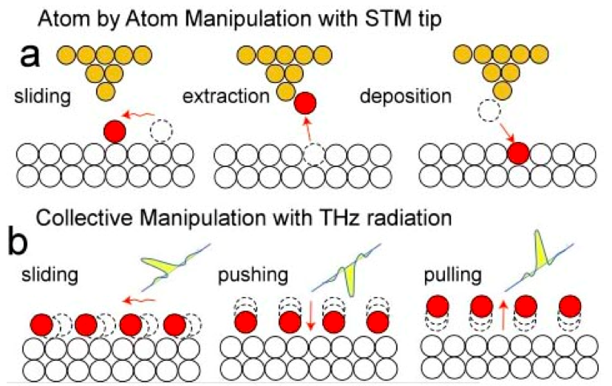
THz control of reactions on surfaces
time
Nilsson, Ogasawara et al.

Slide 21
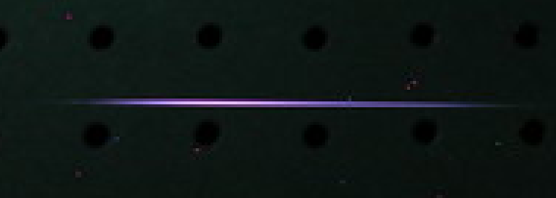
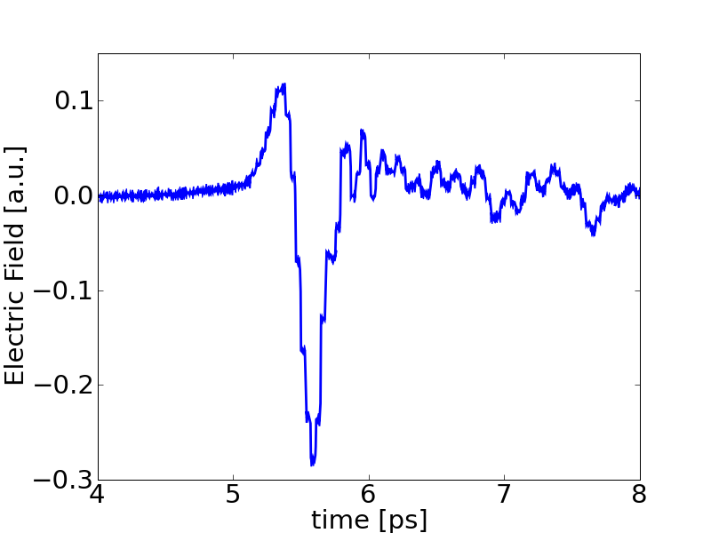
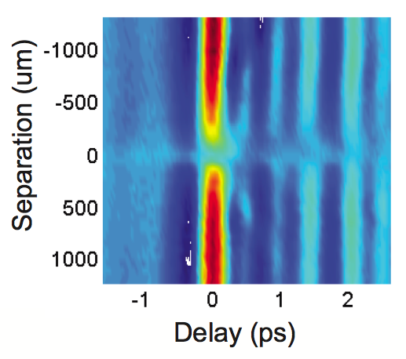
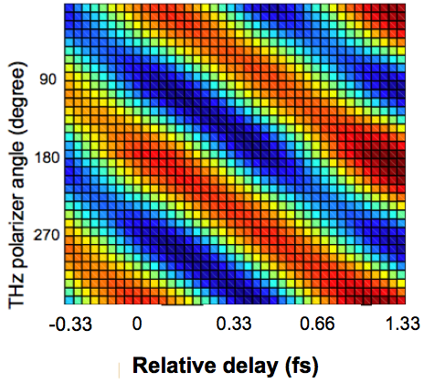
Terahertz Plasma Photonics
800uJ, 800nm, 50fs
BBO
plasma
Half-cycle field
Attosecond polarization control
Plasma interactions
H. Wen, M. Wiczer, A.M. Lindenberg, Phys. Rev. B, 78, 125203 (2008)
H. Wen, A.M. Lindenberg, Phys. Rev. Lett., 103, 023902 (2009)
H. Wen, D. Daranciang, A.M. Lindenberg, Appl. Phys. Lett. (2010).

Slide 22
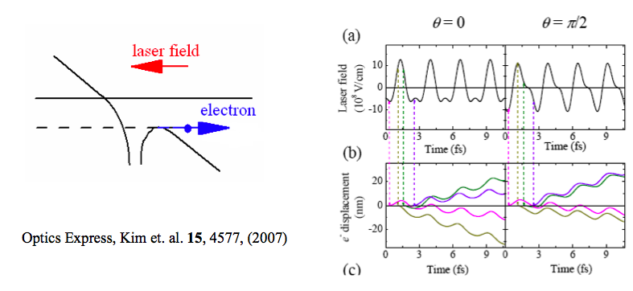
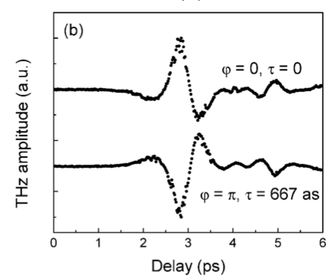
1D model of electron in asymmetric field
Phase control of THz polarity:
Xie et al., PRL (2006)

Slide 23
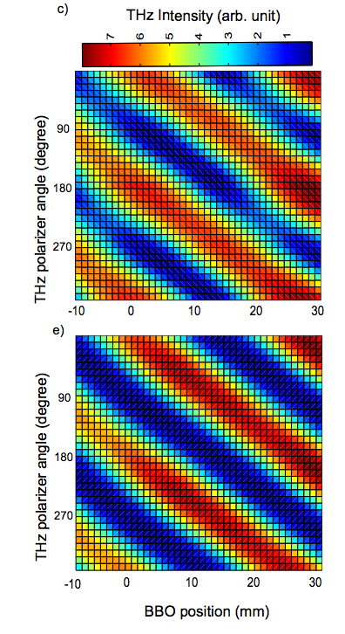
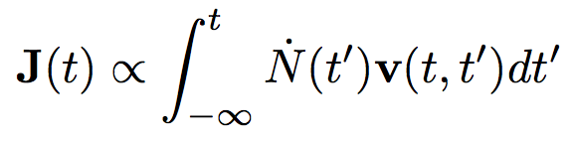
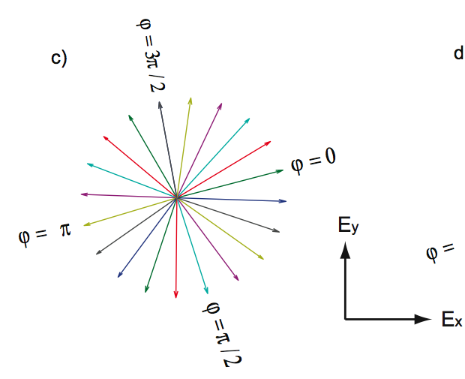
Electron trajectories in transverse plane
(sum over electron birth times)
Experiment
Theory

Slide 24
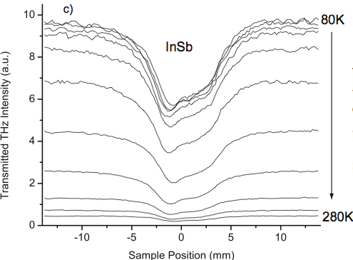
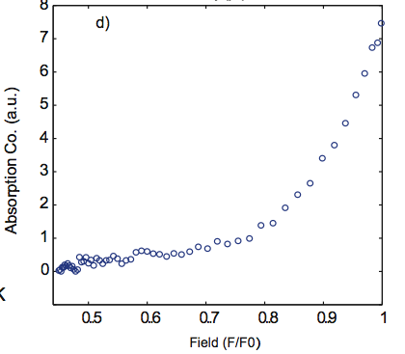
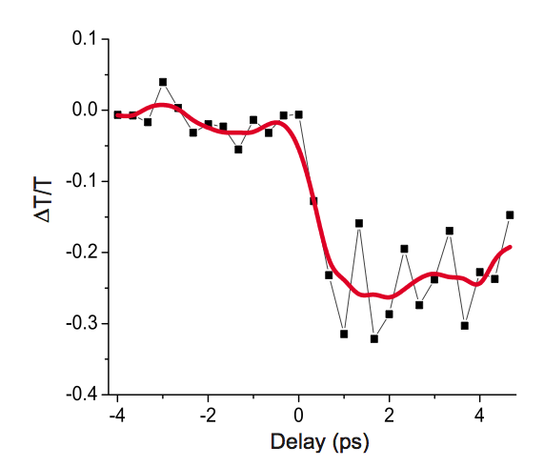
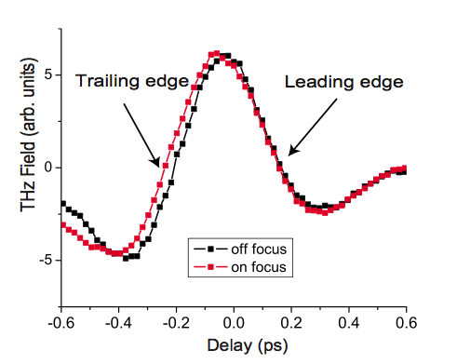
THz-induced breakdown processes/Directing charges in materials
H. Wen et al. PRB (2008)

Slide 25
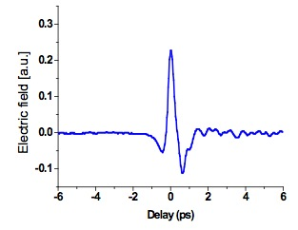

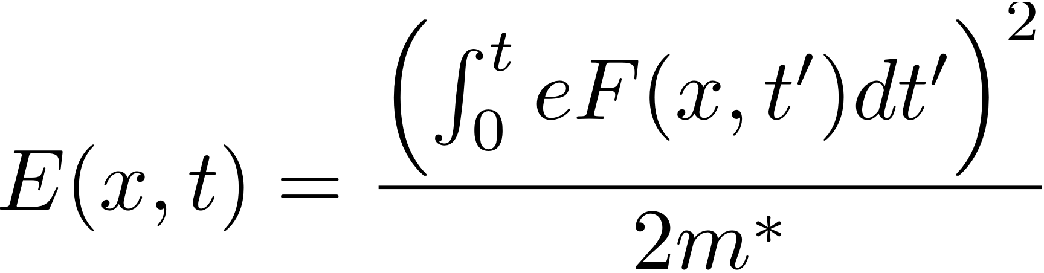

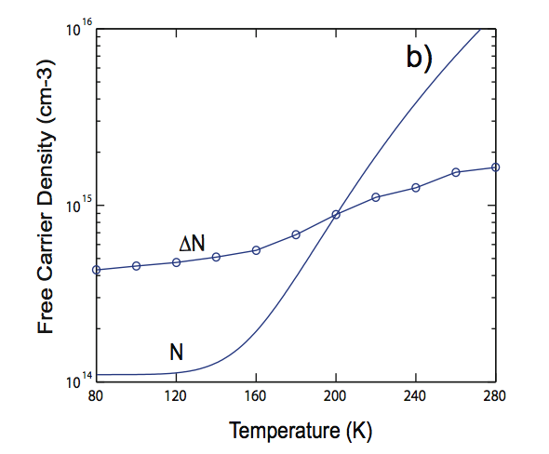

Microscopic model of avalanche processes in THz field.
distribution function
ionization rate

Slide 26



High harmonic generation in periodic solids
nonlinear conductivity in the limit of a single cosine-band
Odd harmonics cutoff scales with electric field
THz
NIR
efficiency
2Δ
2π/a
Harmonic #
-Nonlinearity associated with periodic potential.
-Permits measurement of electronic potential energy surface.
Reis, Ghimire et al.

Slide 27

Extraction of intense THz fields from relativistic electron bunches after the LCLS undulator
Coherent transition radiation from x-ray transparent foil
Electric fields approaching 300 MV/cm
Peak magnetic fields of order 300 T
Couple to LCLS x-ray experiments with THz transport line

Slide 28

Beamline with Optical Table
Existing bellows and stand
Be
foil
Pneumatic
drive
Optical table
Existing beampipe, relocated
Relocated stand
Diamond window
New beampipe
Earthquake braces (4X)
Cantilevered support
Half rack
Chiller

Slide 29
Simulations of THz field at focus
1 nC, 60 fs
Calculations by H. Loos et al.

Slide 30
1 nC, 30 fs

Slide 31
1 nC, 20 fs

Slide 32
Conclusions
Unique opportunities for THz-manipulation of materials, using electromagnetic fields of strength not achievable in the laboratory
Experiments will be carried out using samples placed directly in the electron beam as well as through use of extracted THz fields
Real-time measurements are critical: Development of THz pump/optical probe; THz pump/THz probe geometries.

