Slide 1
PWFA WG
> 25 participants

Slide 2
5 presentations:
A. Krasnykh, A Proposal for Study of Structure and Dynamics of Energy/Matter Based on Production of γ-Ray at SLAC Facility
P. Muggli, Interaction of a “fireball Beam” with a Plasma (studies of beam filamentation instability)
W. An, Some simulation results related to FACET Two Bunches Electron Acceleration
K. Marsh, On laser preionization.
W. Lu, Some Possible Experimental Topics on FACET

Slide 5
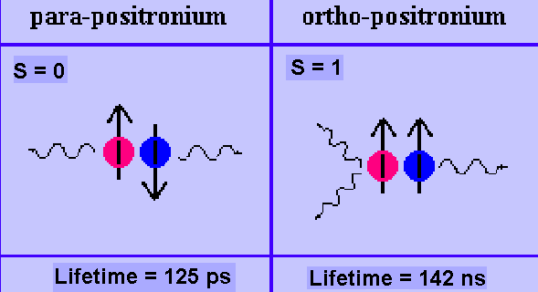
Basic Physics
There are two cases for e+e- scattering
A total spin of e+e- is zero (S=0)
Two γ- rays are created.
(a lifetime is 733 nsec @ 3GeV,
and 4.89 usec @ 20 GeV)
A total spin of e+e- is not zero (S=1)
Three γ- rays are created
(Culled from the published articles)

Slide 9
Some Possible Experimental Topics on FACET
Optimal Plasma Density for Gradient and Transformer Ratio
Large Transformer Ratio PWFA with Shaped Bunches
Self-modulation of e-/e+ (acceleration, micro-bunching )
W. Lui

Slide 13
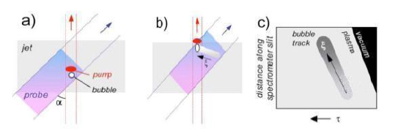
UT Austin, R. Zgadzaj
Frequency–Domain Streak Camera. (a) Snapshot of pump and chirped probe overlapping at angle α; (b) same at later time, showing how
the evolving "bubble" sweeps out a "streak" imprinted on probe; (c) reconstructed phase shift. The co–propagating reference pulse is not shown.

Slide 14
The list
Plasma
Start with Li upgrade to Cs
Laser ionization
Enclosure for laser
Laser for
plasma ionization,
fast diagnostic,
future experiments upgradable
Time diagnostics:
EOS
Streak camera
Deflector cavity
Sail boat chicane for positrons and electrons overlap.

