Slide 1
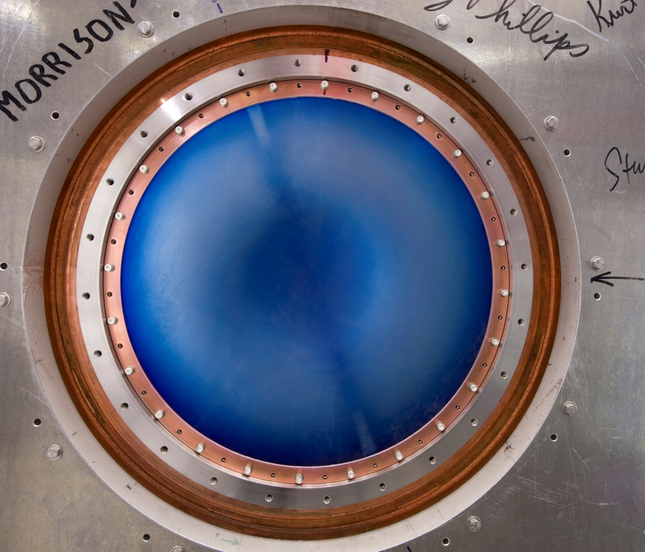
The Muon Accelerator Program “High”-Gradient Normal Conducting RF R&D
Meeting the RF in Magnetic Field Challenge

Slide 2
Outline
The “RF Challenge”
At least “Our” RF Challenge
Current Program (Where we are)
MAP’s RF Test Facility
MuCool Test Area (MTA) at Fermilab
Summary

Slide 3
Normal Conducting RF R&D Issues for MAP and Present Status
Muon bunching, phase rotation and cooling requires Normal Conducting RF (NCRF) that can operate at “high” gradient within a magnetic field strength of up to approximately 6T
Required gradients (15-18MV/m) easily obtainable in absence of magnetic field
And since we are primarily considering pillbox structures, 15-18MV/m is also the max surface gradient

Slide 4
Muon Cooling Channel & RF

Slide 5
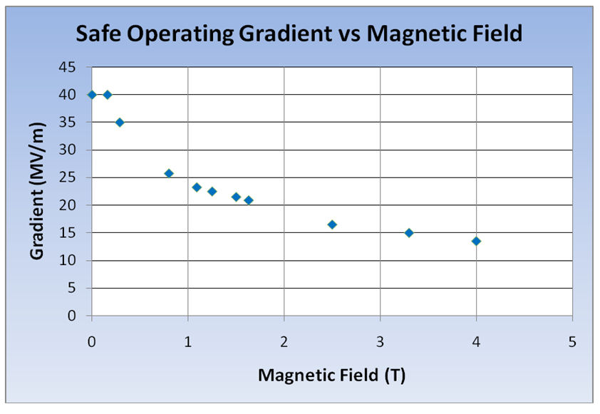
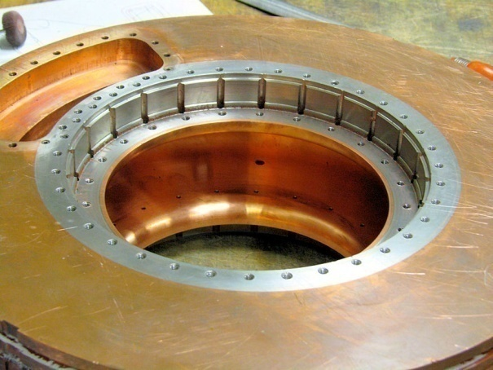
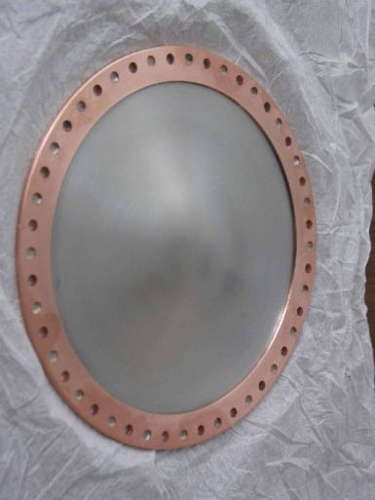
“Our” RF Challenge
Significant degradation in maximum stable operating gradient with applied B field
805 MHz RF Pillbox data
Curved Be windows
E parallel B
Electron current/arcs focused by B
Degradation also observed with 201 MHz cavity
Qualitatively, quite different

Slide 6
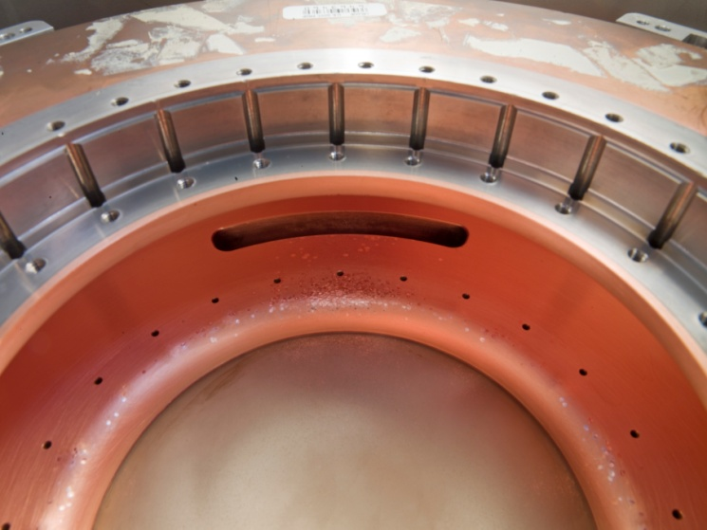
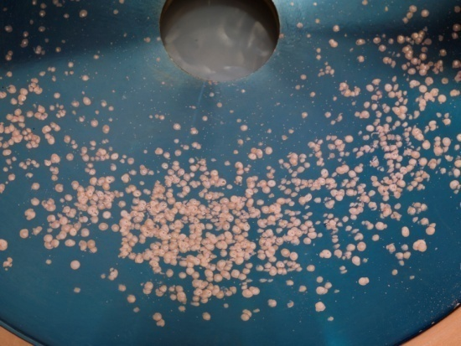
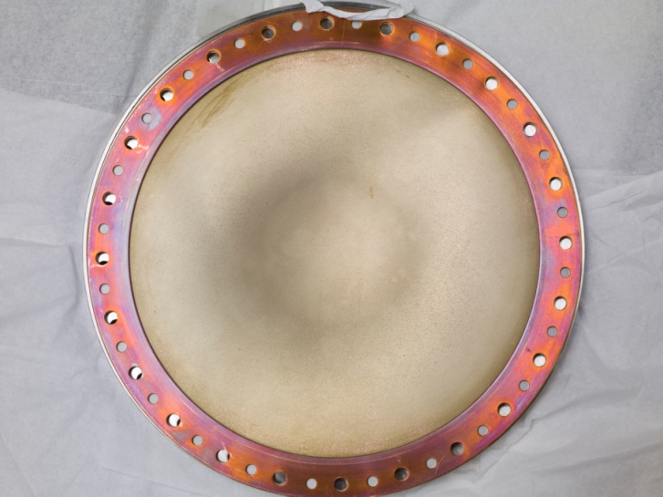
805 Pillbox Post-Mortem
Significant damage observed
Iris
RF coupler
Button holder
However
No damage to Be window

Slide 7
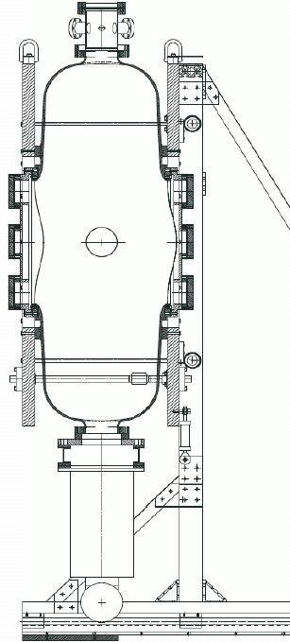
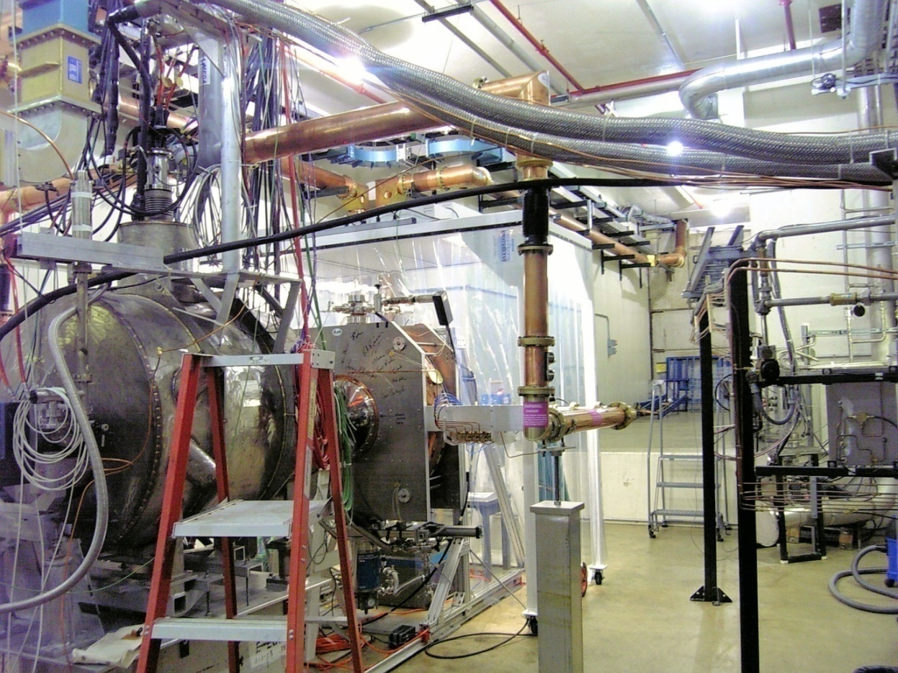
201 MHz Cavity Test Treating NCRF cavities with SCRF processes
The 201 MHz Cavity – Achieved 21 MV/m
Design gradient – 16MV/m
At 0.75T reached 10-12 MV/m

Slide 8
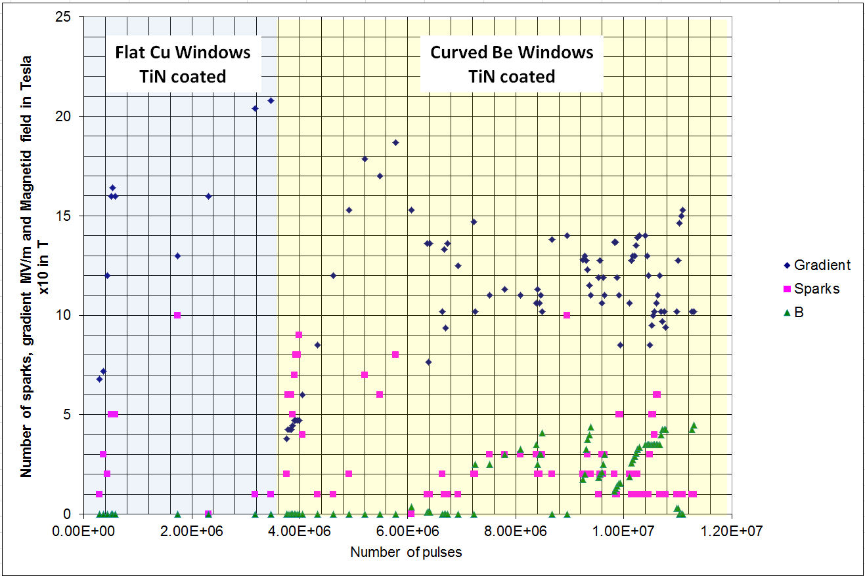
201 MHz Cavity Running
Design Gradient

Slide 9
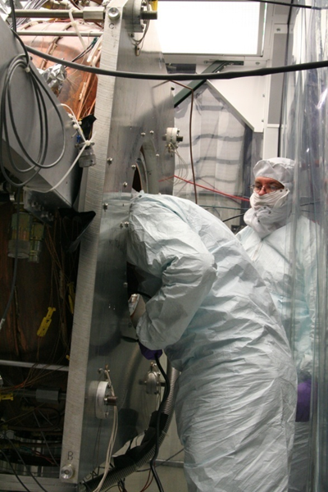
201 MHz Prototype
However, Observed no damage in cavity ( - except in coupler)

Slide 10
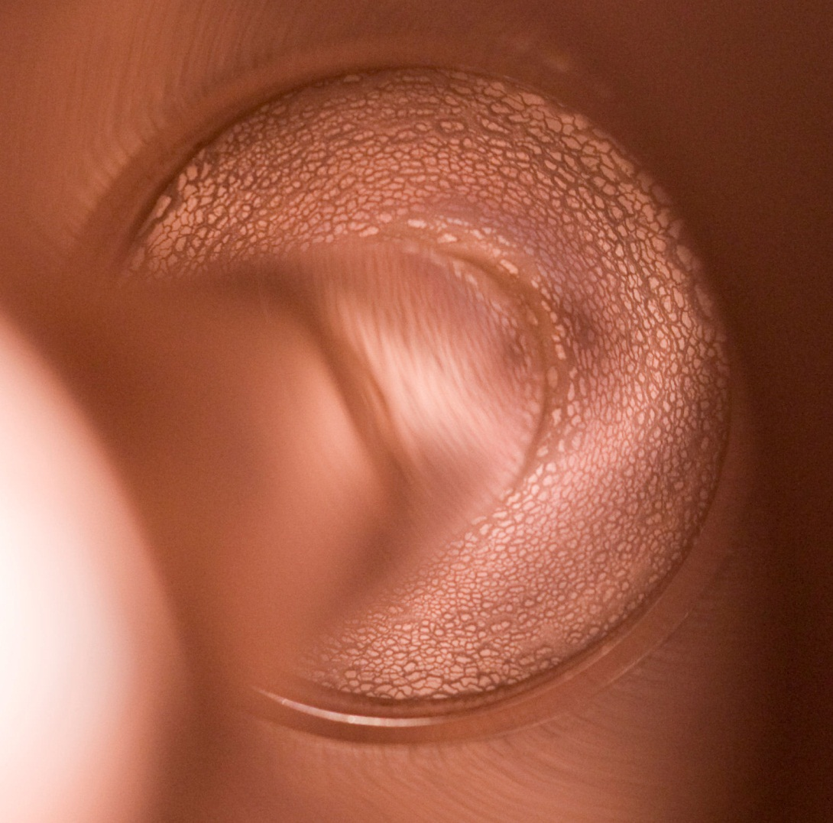
201 MHz Cavity Coupler
Arcing at loop
Cu deposition on TiN coated ceramic RF window

Slide 11
RF Breakdowns
Are not all equal
NCRF conditioning (B=0), process allows for higher gradient operation (“conditioning”)
Both our 805 MHz and 201 MHz followed the conventional wisdom here
NCRF (B ≠ 0), process can cause damage and require re-conditioning at lower gradient in order to reach the same gradient attainable before breakdown
805 MHz cavity was severely damaged
201 MHz was “altered”
At quite low B

Slide 12
RF Operation in Vacuum 805 MHz Imaging
Hot Spot Arc forms
Cavity Energy
W=1/2 CV²
≈ 1-5 joule
All goes into melting Cu
B
Surface Field Enhancement
Initiates the event & B focuses the e⁻ current
which causes damage
12

Slide 13
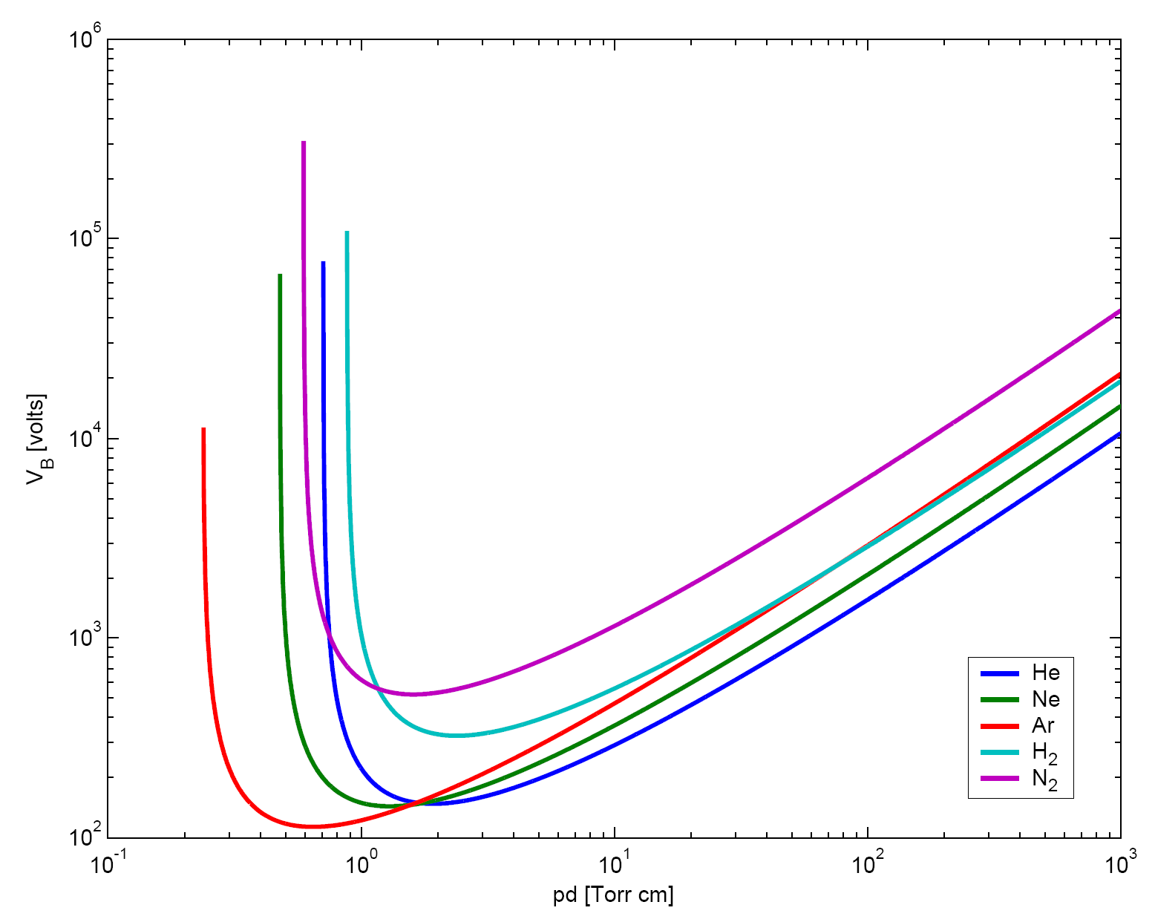
Operate in Gas μ give us this option
RF cavities filled with High-Pressure H₂
Paschen’s Law
Rolland Johnson
Shelter Island 2002

Slide 14
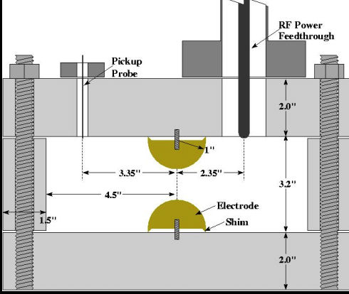
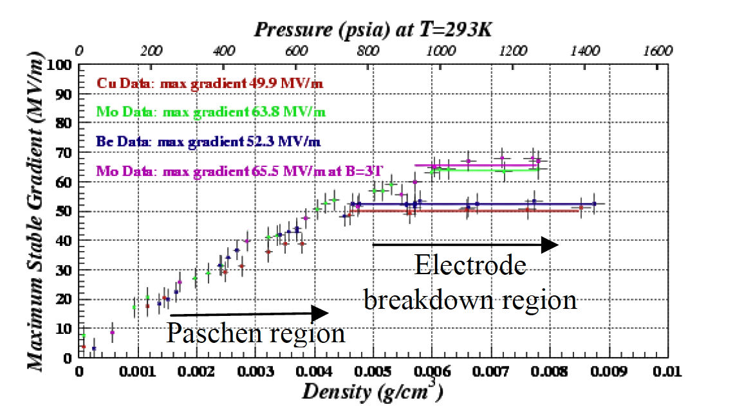
High Pressure H₂ Filled Cavity Work with Muons Inc.
High Pressure Test Cell
Study breakdown properties of materials in H₂ gas
Operation in B field
No degradation in M.S.O.G. up to ≈ 3.5T
Next Test – Repeat with beam
No Difference
B=0 & B=3T
Well beyond gradient requirement for HCC

Slide 15
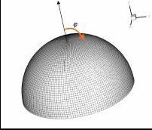
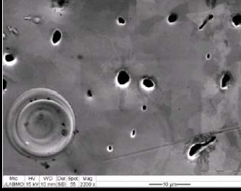
High Pressure H₂ Filled Cavity Results In Surface Breakdown Regime
Pit distribution fit to E_{max} (ANSYS)
≈ Fowler-Nordheim

Slide 16
The MAP NCRF Program R&D Strategy
Technology Assessment (continuation of existing multi-pronged program & explore new ideas)
Surface Processing
Reduce (eliminate?) surface field enhancements
SCRF processing techniques
Electro-polishing (smooth by removing) + HP H₂O rinse
More advanced techniques (Atomic-Layer-Deposition (ALD))
Smooth by adding to surface (conformal coating @ molecular level)
Materials studies: Use base materials that are more robust to the focusing effects of the magnetic field
Cavity bodies made from Be or possibly Mo
Magnetic Insulation
Inhibit focusing due to applied B
High-Pressure Gas-filled (H₂) cavities
Vacuum

Slide 17
Testing Queue
Primary goal is to collect a lot more data with as many test vehicles as possible (And understand/fix coupler issues) [Next 12-18 months]
805 pillbox (modified & refurbished)
Fixed coupler port and will retest
With Cu and Be windows
New series of materials & processing (Cu) tests with Buttons
Initial test of HP button cavity with proton beam
201 MHz cavity coupler repair and re-test
2nd HPRF beam test as needed
Rectangular box cavity with B ǁ E
2nd rectangular box cavity with B ⊥ E
New pillbox is near ready (Muon’s Inc.)
Can operate under pressure or vacuum
Has capability to replace end-walls (Be)
ALD cavity
Special-purpose cavity for processing in-situ with Atomic Layer Deposition
Test MICE production 201 MHz cavity in realistic B field [> 18 months out]

Slide 18
Recent R&D Highlights

Slide 19
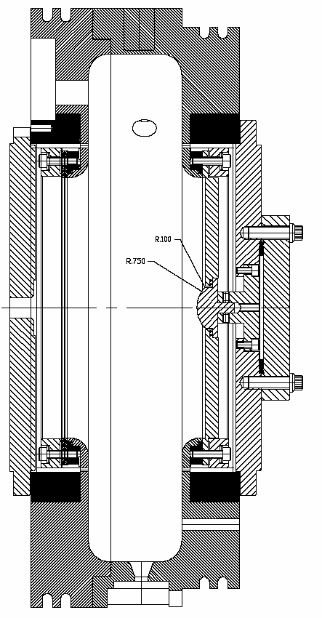
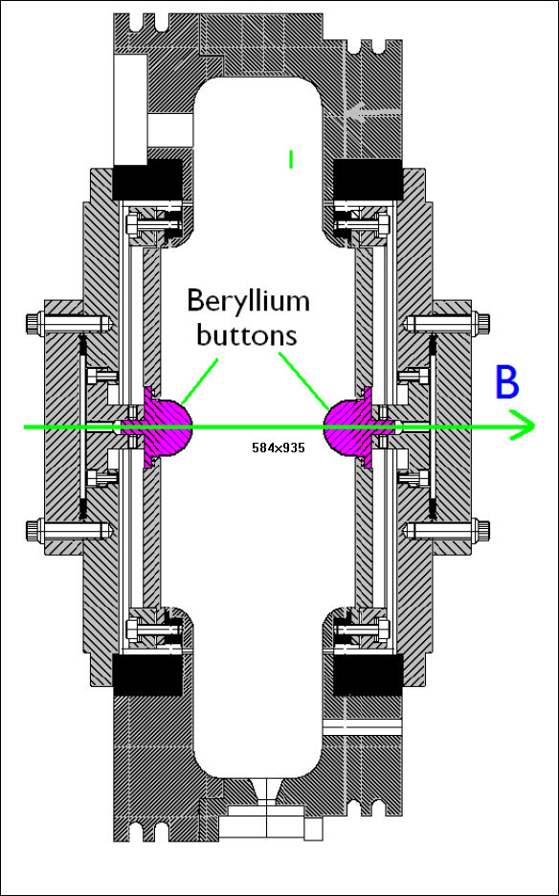
Material Studies
Pillbox cavity refurbished & “Button” system redesigned.
Note: Results to date did indicate that Mo can improve performance at a given B field by somewhat more than 50% & that TiN helped
16.5MV/m → 26MV/m
But, lots of scatter in data
(1.7x field enhancement factor on button surface)
Molybdenum buttons
New - FE ≈ 3

Slide 20
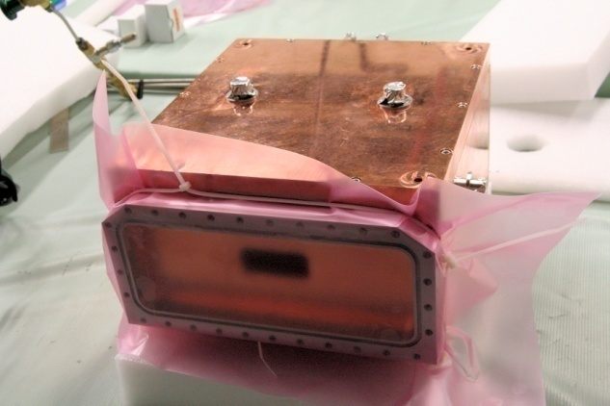
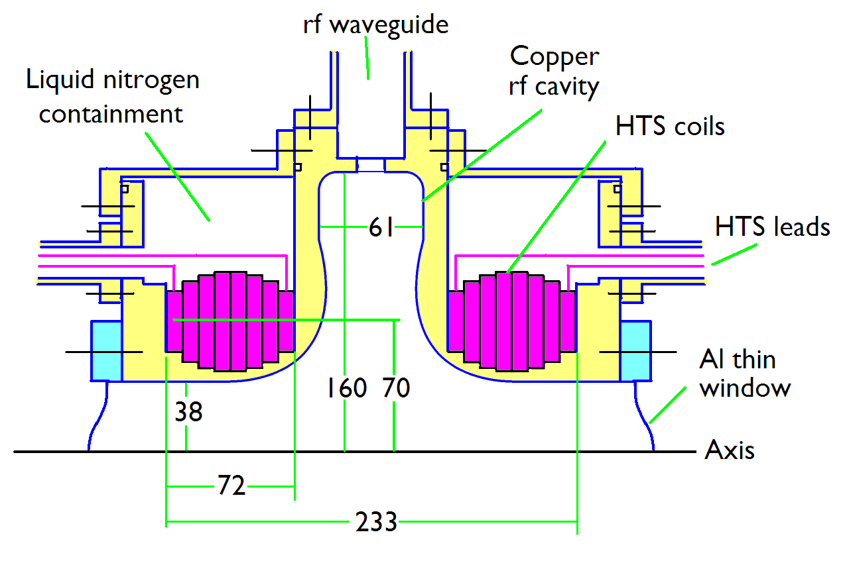
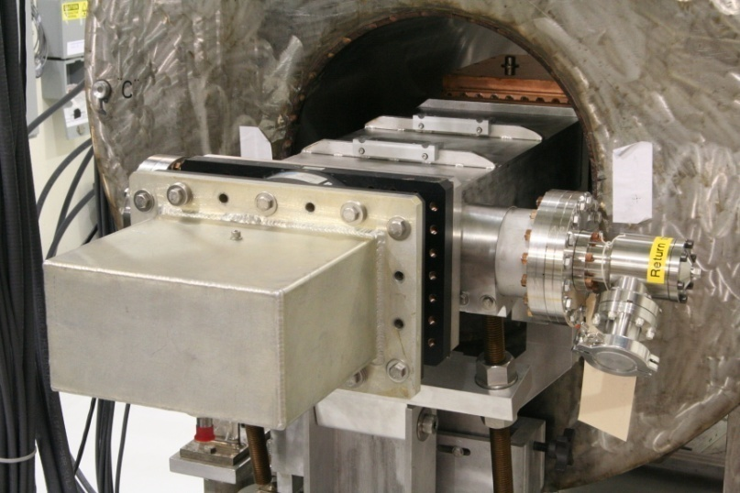
Magnetic Insulation
Conceptual Design
Although lattices that employ magnetic insulation have drawbacks with respect to the required RF power, we are studying the concept using a newly completed 805 MHz box cavity

Slide 21
Box Cavity in Solenoid
Max angle w/r to horizontal ≈ 12⁰
E at 78º w/r to B
Max Gradient (B=0)
50MV/m

Slide 22
Box Cavity Preliminary Data
Notes
B=0 running stable at ≈ 50 MV/m
Boroscopic inspection did not indicate much damage
May elect to cut open for detailed analysis
Follow-on
Test B ǁ E version of this cavity

Slide 23
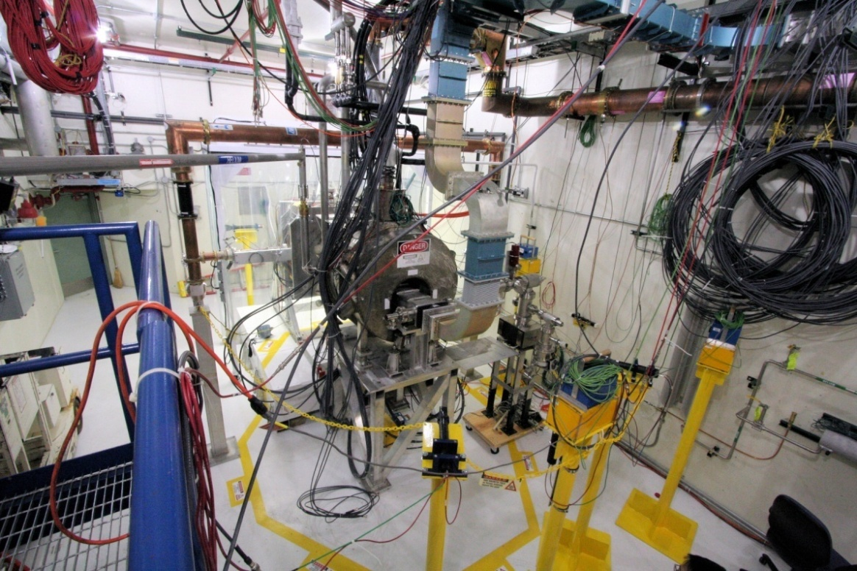
MAP RF Test Facility
MuCool Test Area (MTA)
RF power
201 MHz (5MW)
805 MHz (12 MW)
Class 100 clean room
4T SC solenoid
250W LHe cryo-plant
Instrumentation
Ion counters, scintillation counters, optical signal, spectrophotometer
400 MeV p beam line

Slide 24
MTA Layout

Slide 25
MTA Hall – Clean Room

Slide 26
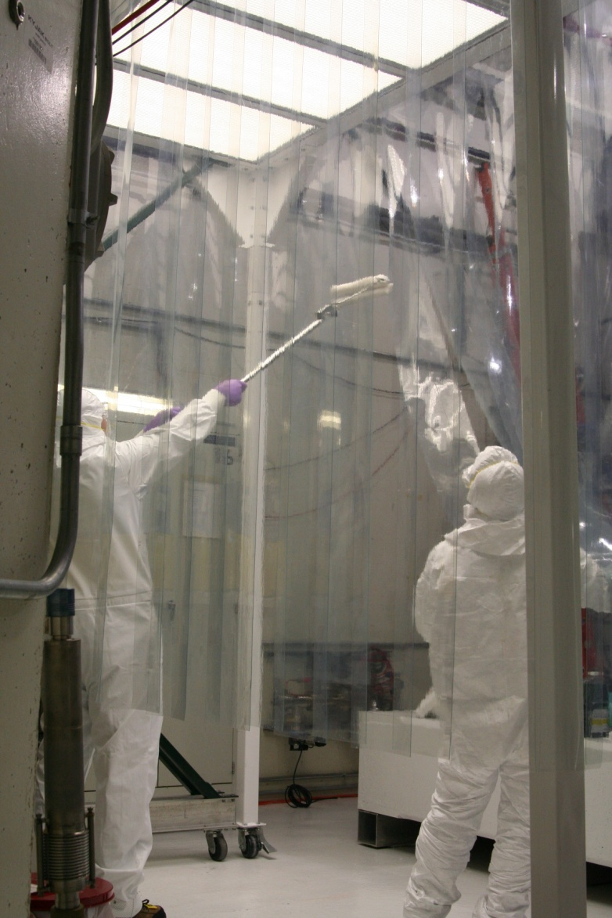
MTA Hall – Clean Room II
Goal for Clean room : Class 100
Achieved better than Class 10
Even with 3 people inside: Class 40
Goal for Hall: Class 1000
Achieved Class 500

Slide 27
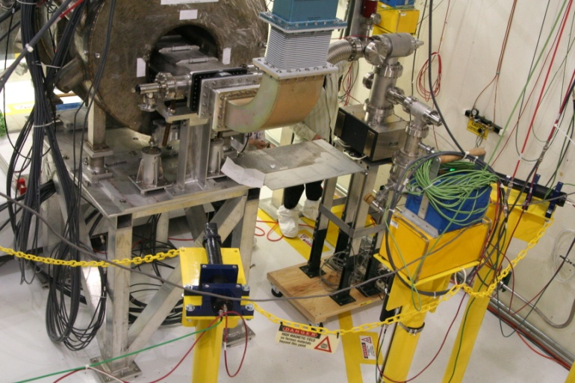
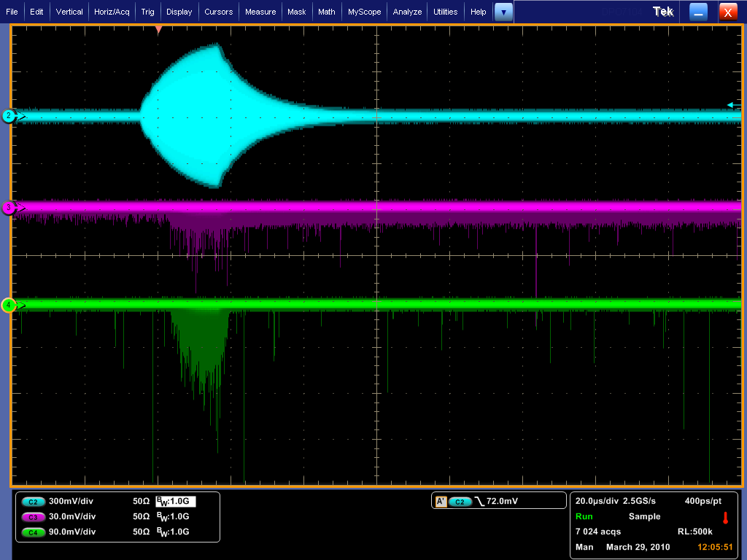
MTA Instrumentation
Optical Diagnostics
Counters
RF Pickup
X-ray
Optical
Acoustic diagnostics
Planning to explore utilizing acoustic “imaging’
use instrumentation developed for COUPP
DAQ

Slide 28
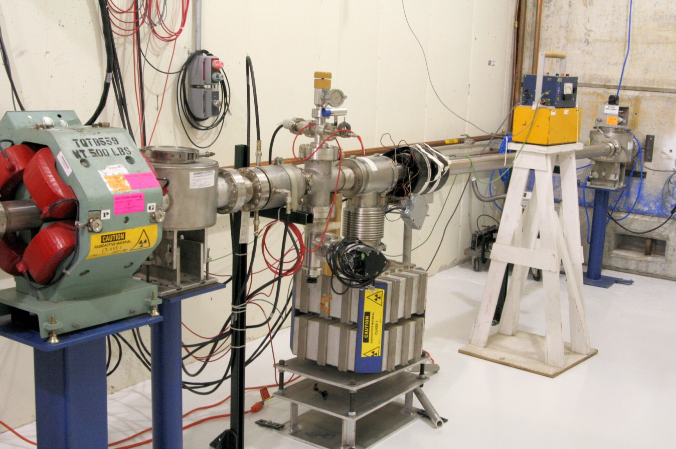
MTA Beam Line Status
Beam Line Installation
Complete
Beam Line commissioning to first beam stop.
Complete
Radiation assessment submitted to DOE
First beam experiments by March
The MTA is a World-Class Facility (& Unique):
High-Power RF; High-Intensity Beam; H₂ handling, SC Magnet

Slide 29
Testing 201 MHz Cell in realistic B

Slide 30
Summary
We have a comprehensive program aimed at developing a solution to our“RF Challenge”
The experimental program is now coming on strongly and is backed by simulation efforts.
Although the US High Gradient Research Collaboration is addressing different issues/problems, some are of a fundamental nature and lessons learned in your endeavor can likely aid us in solving the MAP RF problem.

Slide 31
End-Note
This was my first time at one of your meetings and after listening to many interesting talks yesterday on a topic that I have little knowledge, I can at least take solace in the fact that
“Misery likes company.”

Slide 32
END

