Slide 1
Recent Work on Multipacting and Dark Current Simulation with the Analyst Code*
U. S. High Gradient Research Collaboration Workshop
SLAC, February 9-10, 2011
John DeFord
STAAR/AWR Corporation
* Work supported DOE Office of Science SBIR Program

Slide 2
Outline
Numerical methods.
Examples:
  SNS cavity.
  FNAL Project X cavity.
Future work.

Slide 3
Particle integration
Position:
Normalized momentum:
where the field quantities are evaluated at the particle n+1 time/position:
and the α_{i} are coefficients of the integration scheme.
We use Newton-Raphson iteration to solve coupled equation for each time-step, and also start/stop at element boundaries.

Slide 4
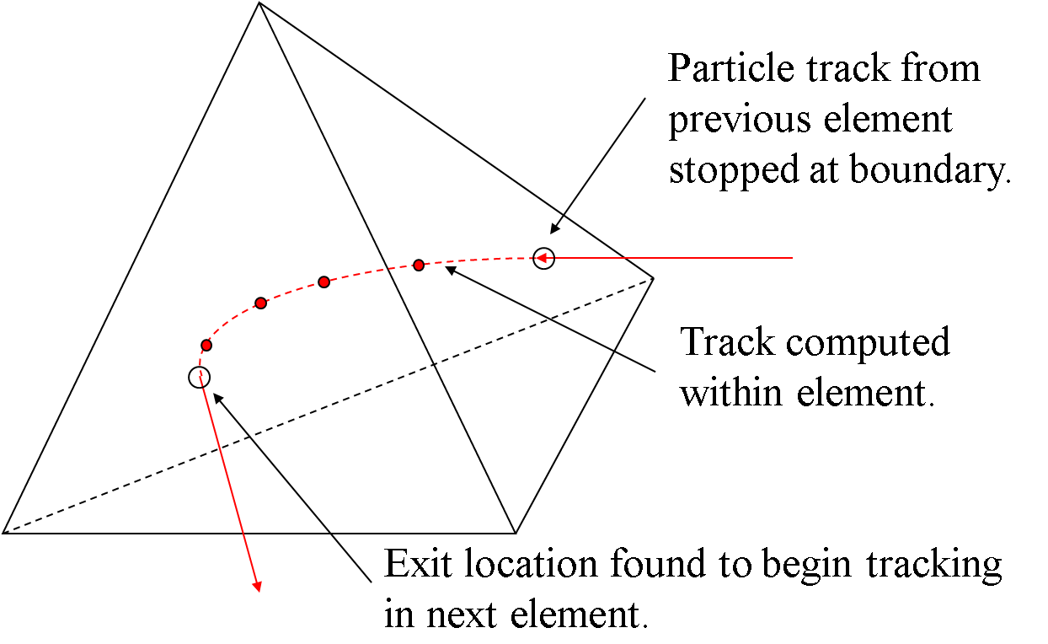
Integration done over each element
E and H field are the finite-element representation of the fields on the element – no interpolation is performed.

Slide 5
Furman-Pivi model¹
Phenomenological/statistical model for secondary emission.
Distinct models for “true”, re-diffused, and backscattered secondary particles.
Multiple emissions per impact, with distributed angles and energies.
Published parameters for copper and stainless steel.
Primary
θ
Surface normal
True secondary
Backscattered secondary
Surface
¹ M. Furman and M. Pivi, "Simulation of Secondary Electron Emission Based on a Phenomenological Probabilistic Model," LBNL-52807, SLAC-PUB-9912, June, 2003.

Slide 6
“True” SEY model
Yield curve parameterization:
Number of secondary particles generated by impact is given by sampling binomial distribution:
Emission angles are uniformly distributed in azimuth, and have a cosine polar angle (θ) distribution.
Incident angle dependence is 1/cos(θ).
Emission energies have incomplete gamma distribution.

Slide 7
Particle initiation
Volumetric: primaries seeded in volume with random velocities (uniform random variable for each Cartesian component of γβ).
Surface: primaries emitted from surface only, with random velocities.
Monitor statistics and launch additional particles if necessary.
Tend to need 10s to 100s of particles per cell in volumetric launch, 1s to 10s in surface launch.

Slide 8
Pruning the secondary “tree”
Primary
Secondary generation 1
Secondary generation 2
n
…
Secondary generation m
Follow branch to terminus (red).
Randomly chose generation number 0<n<m.
Follow new branch (green) from generation n.

Slide 9
H-field accuracy
Analyst solver uses E-field finite-element formulation.
H-field is normally obtained from E-field solution:
Therefore, H-field loses one order of accuracy, e.g., if linear basis functions are used to represent E, then H is constant within each element.
Potential for orbit inaccuracies, particularly for low-order solutions.

Slide 10
Alternative H-field extraction method
Apply weighted-residual method to the curl E Maxwell equation and using the same basis functions for E and H:
yielding the following matrix equation (solvable using PCG):
where

Slide 11
Results for simple pillbox

Slide 12
Field along sample line

Slide 13
Possible extension
Present scheme is a projection operation.
Alternatively, one could introduce the separate H-field unknowns into the original problem, i.e., minimize
subject to the weak form of

Slide 14
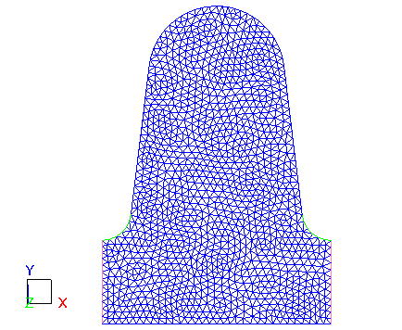
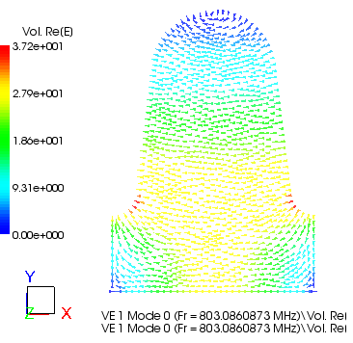
Example 1: 2D SNS cavity

Slide 15
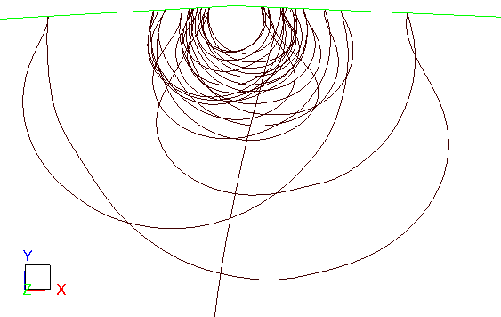
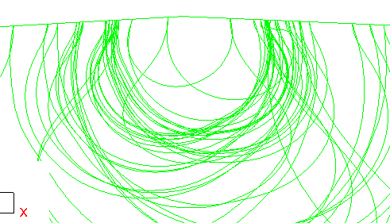
Uniform and non-uniform emission
Non-uniform emission.
Higher level of repeatability for uniform emission parameters.
Particle count growth vs. time.

Slide 16
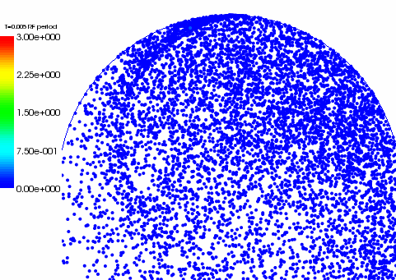
Particle animation

Slide 17
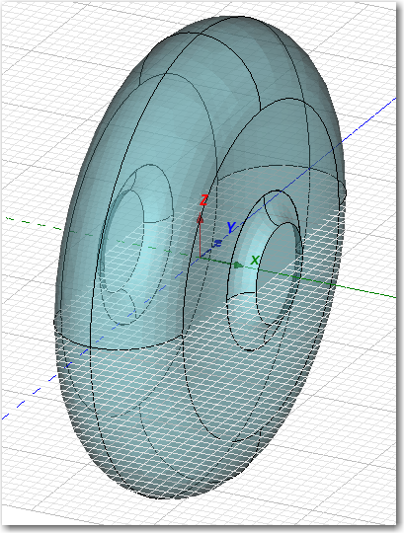
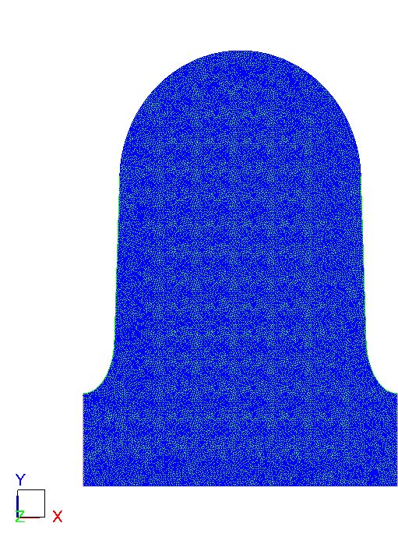
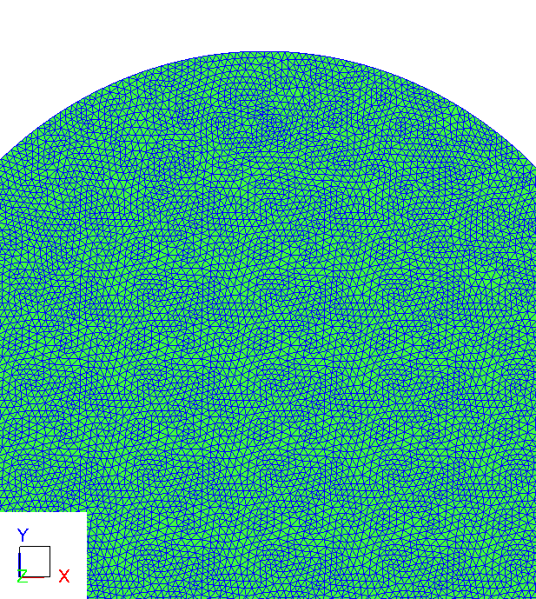
Project X cavity under study at FNAL* (beta = 0.61) – 2D model
Equator
1mm cells - 54.7K elements, H1.5
*I. Gonin, et al.

Slide 18
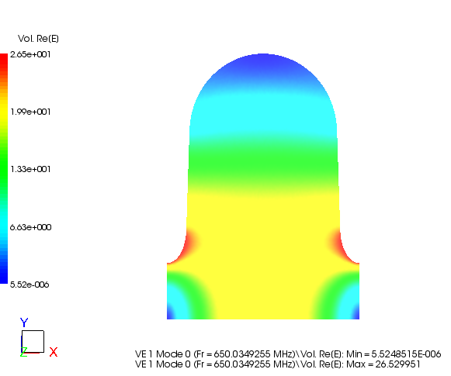
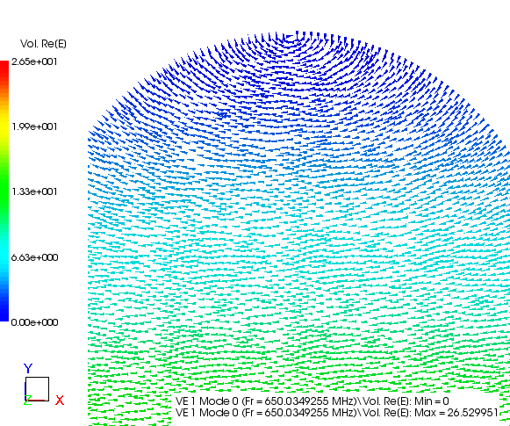
Mode electric field
650 MHz

Slide 19
Yield curves
True SEY (0 degrees inc.)
Average SEY (all impacts)
True, re-diffused, and backscattered secondary emission all enabled in Furman-Pivi model for copper.

Slide 20
Gain statistics
Note this curve is >0 in range 21-39 MV/m – suggests sustained MP.
(from px2d5)

Slide 21
Particle count vs. time for 30 MV/m

Slide 22
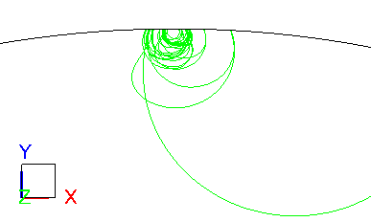
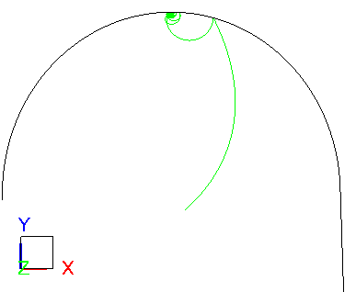
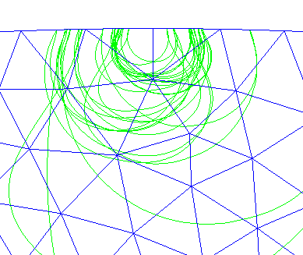
Representative orbit at 30 MV/m
Note ~1mm orbit radius!
(cavity radius ~20cm)

Slide 23
Higher voltage analysis (40-80 MV/m)
No gain apparent, although a broad peak in 50-60 MV/m.

Slide 24
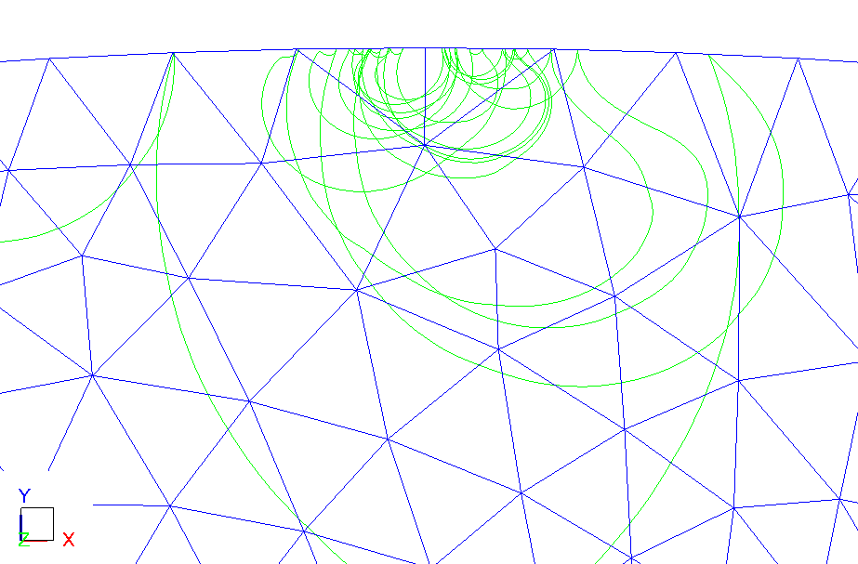
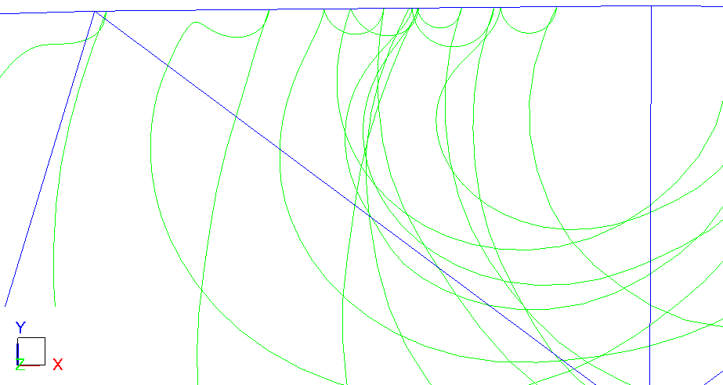
Orbit at 60 MV/m
May need finer mesh to nail down these resonances.

Slide 25
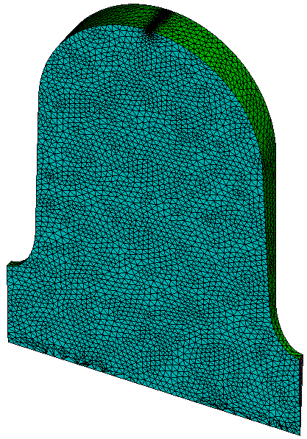
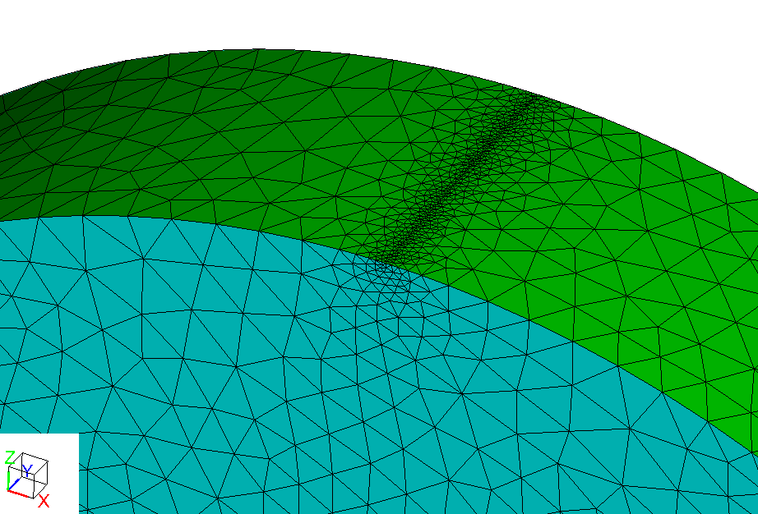
3D mesh (5 degree wedge)
Local mesh refinement on equator.

Slide 26
3D results using linear basis functions
Total particle count growth rates.
Shows excellent agreement with 2D result.

Slide 27
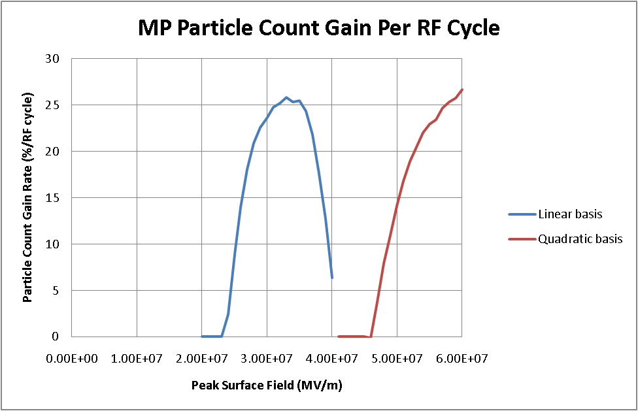
3D results using quadratic basis functions
Predicted MP zone shifts upward in field strength.

Slide 28
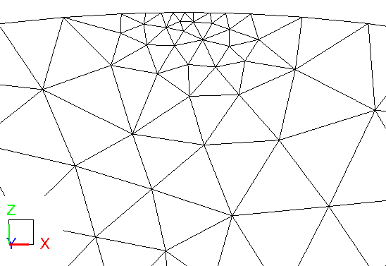
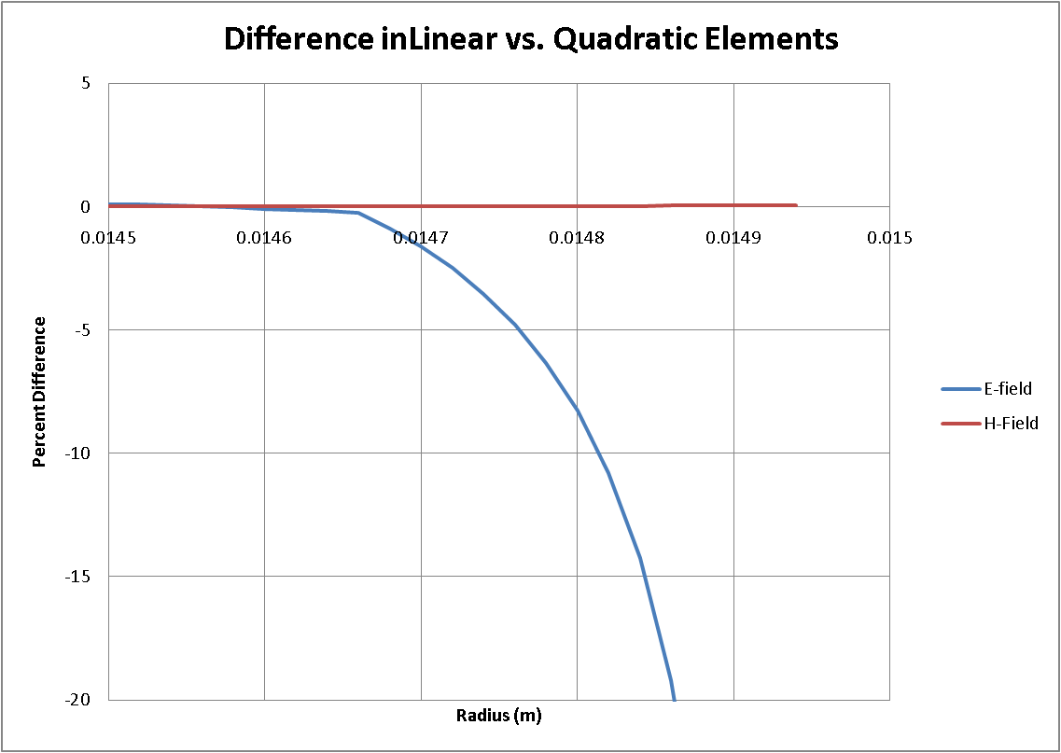
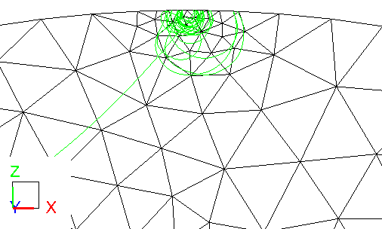
Why? Difference in fields near “equator”
0.5mm
H
E
Typical orbit @ 30 MV/m

Slide 29
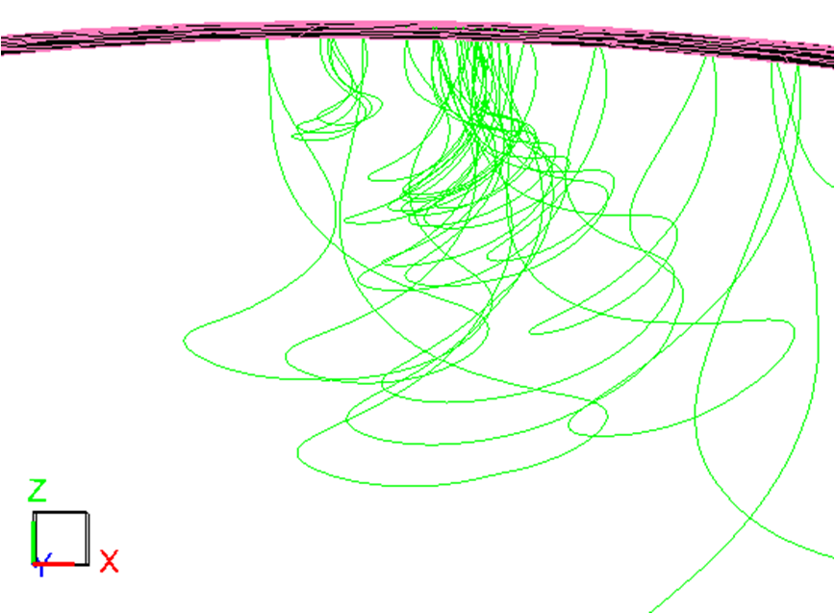
Three different orbits
<25 MV/m (no gain)
25-60 MV/m - MP
>60 MV/m (no gain?)

Slide 30
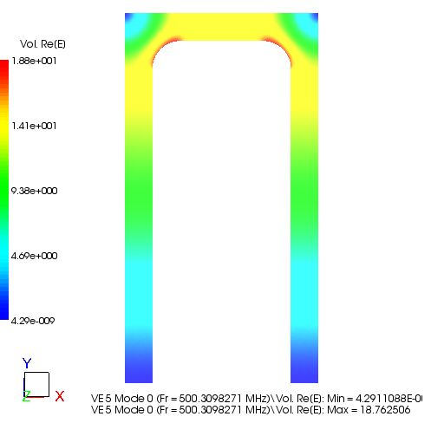
2D XY version of parallel-plate
Gap = 10mm
F_{r} = 500MHz
SE model configured to emit all particles normally with zero velocity.

Slide 31
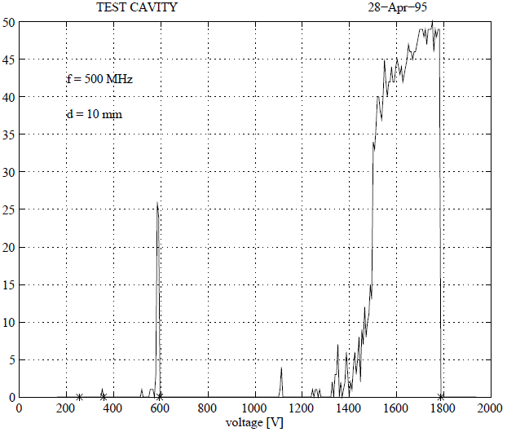
EC vs. Gap Voltage
¹ E. Somersalo, “Analysis of multipacting in coaxial lines,” Proc. of PAC 95, 1996, pp. 1500-1502.

Slide 32
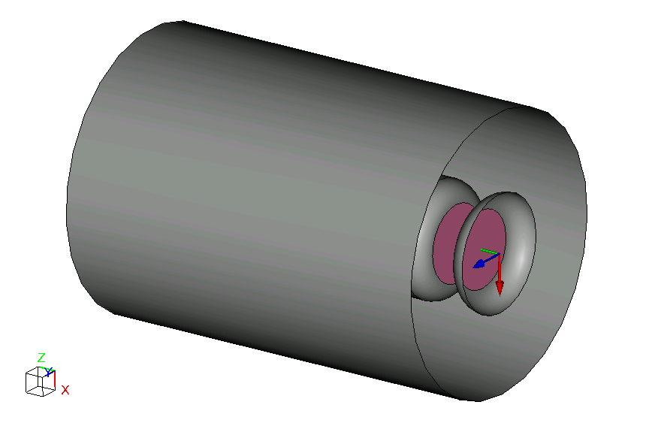
3D parallel plate problem
1 cm gap
2.1 cm inner radius
5 cm outer radius
0.713 cm fillet radius (= offset of gap surface from end of coax)
14.053 cm length -> 500 MHz resonant frequency when coax is shorted at both ends

Slide 33
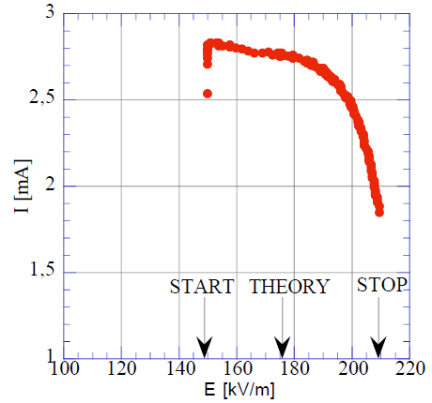
Counter functions vs. measurement
Measured data (Ti on Cu)
¹ D. Proch, et al., “Measurement of multipacting currents of metal surfaces in RF fields," PAC-95, 1995, pp. 1776-1778.

Slide 34
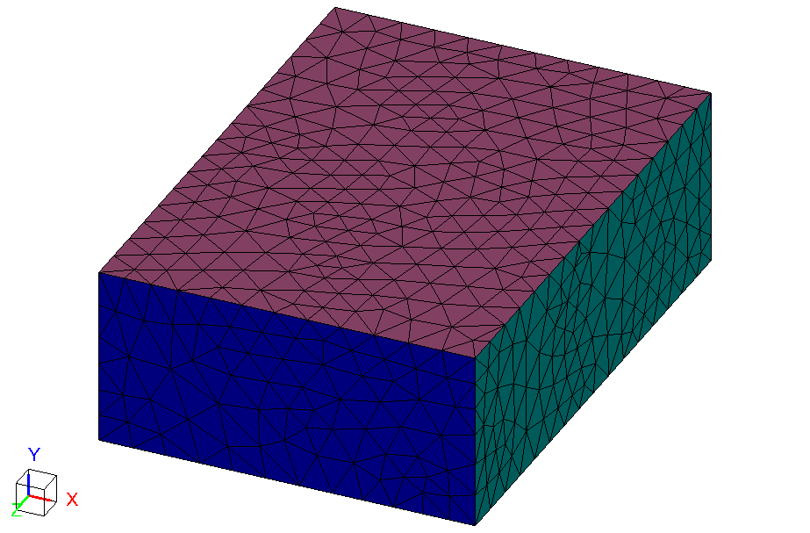
Example 2: CESR waveguide¹
500 MHz traveling wave problem.
Ports
Symmetry plane
4”
17”/2
¹ V. Shemelin, “Multipactor discharge in a rectangular waveguide with regard to normal and tangential velocity components of secondary electrons," SRF010322-03, 2003.

Slide 35
SEY model parameters
Comparison of low-energy portion of secondary yield curve representation used by Shemelin with the Analyst model.
s=1.38, E_{m}=200eV, δ_{m}=1.88
Yield
Impact energy (eV)

Slide 36
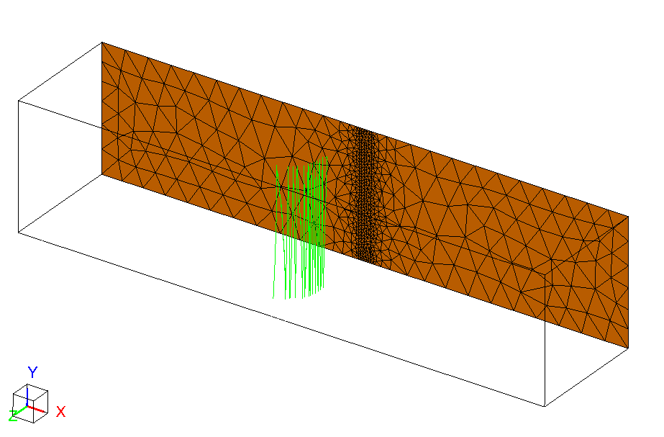
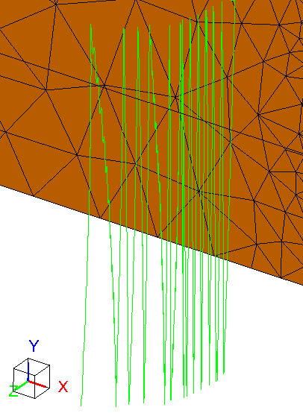
Results for CESR waveguide
Resonant particle orbit (40 impacts)

Slide 37
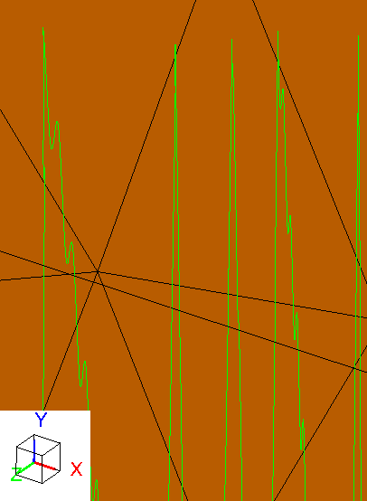
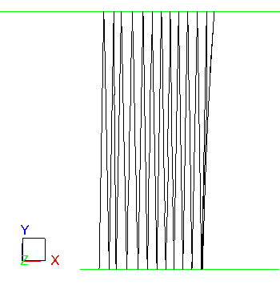
Close-up of orbit
Exact nature of these features depends on emission parameters.
2D orbit

Slide 38
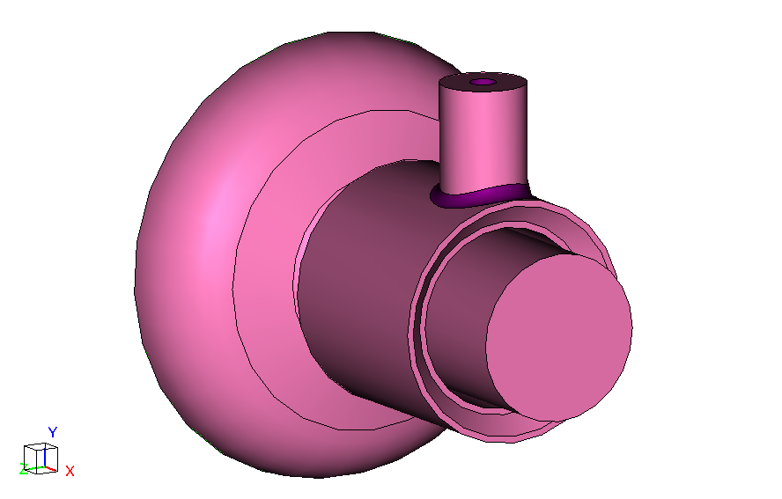
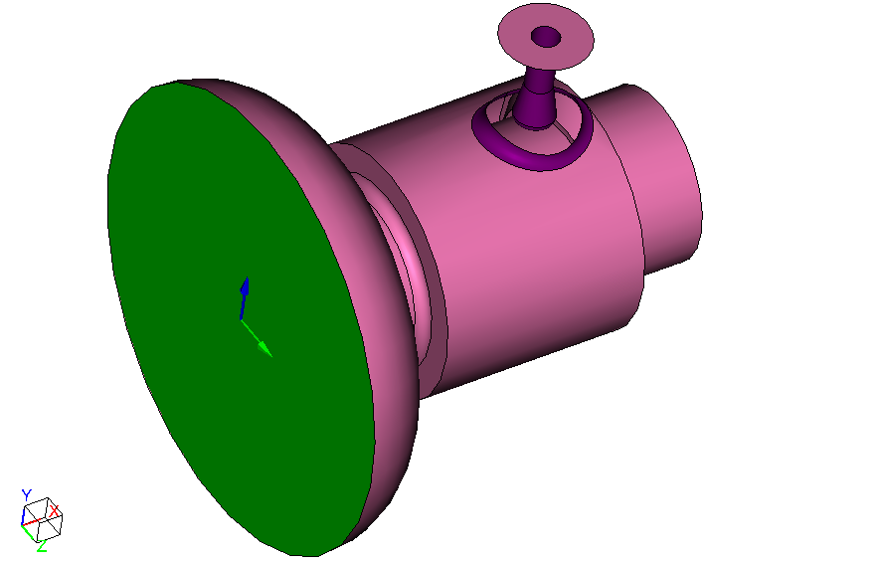
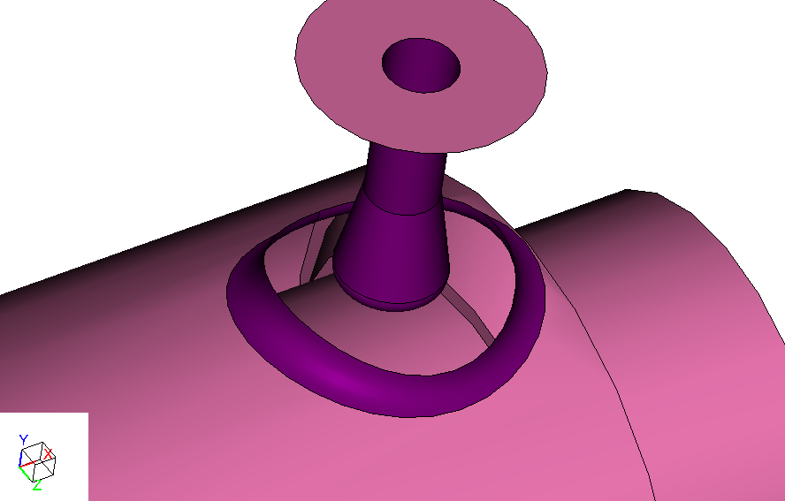
Example 3: Coaxial coupler
1.3 GHz mode (2nd mode)

Slide 39
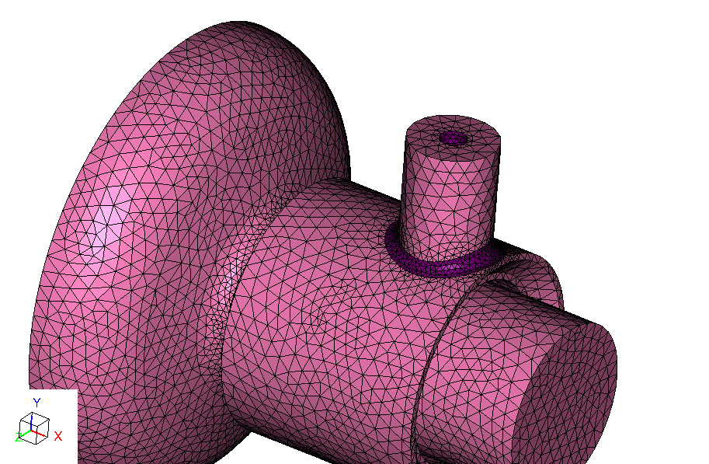
Mesh
227K elements
H1.5 basis set

Slide 40
Effective yield curve

Slide 41
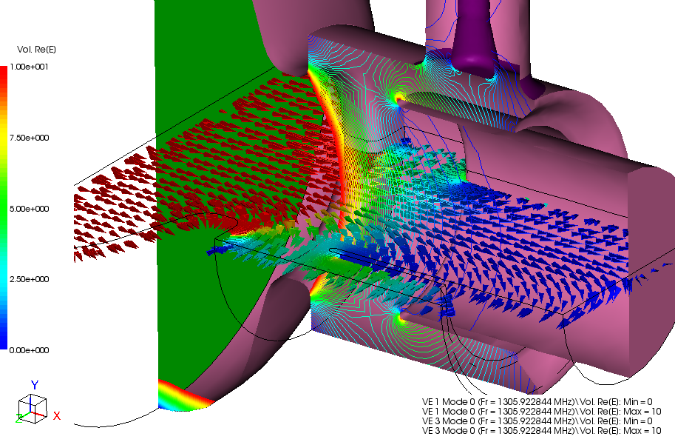
Field pattern for 2nd mode
E-field for 1.3 GHz mode

Slide 42
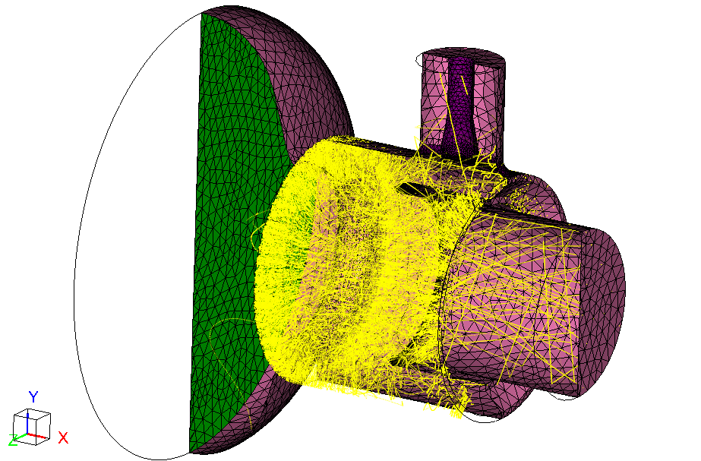
MP at 37.5 MV/m surface field
Only particles that wind up being in resonant orbits are shown (30 impacts).
Primary MP sites

Slide 43
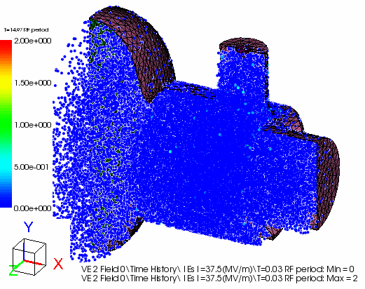
Particle animation

Slide 44
Statistical measures

Slide 45
Conclusions and future work
Recent improvements made to particle tracker:
  Secondary emission algorithm.
  Additional statistical measures.
  Higher order tracker.
  Volumetric particle launch.
  Animation capabilities.
Ongoing/future work:
  Emission from curvilinear boundary elements.
  Domain decomposition.
  Dark current statistics.
  UI extensions.

