Slide 1
X-band Structures Test Results at NLCTA
Faya Wang
Chris Adolphsen, Christopher Nantista
9-Feb-11

Slide 2
Structure Performance Summary
Time | Structure | Note | Performance
12/09 -4/10 | TD18vg2.3-Disk SLAC_1 | Cells by KEK, Assembled at SLAC | Fair: after 1000 hours, 79 MV/m, 230 ns at LC DBR spec – no hot cells
8/10 – 9/10 | T18vg2.6-Disk CERN_2 | CERN Built | Fair: after 550 hours, 85 MV/m, 230 ns at LC DBR spec – no hot cells
9/10 – 12/10 | T24vg1.8Disk SLAC_1 | SLAC Built | Fair: after 600 hours, 82 MV/m, 230 ns at LC DBR spec – no hot cells
11/10 | Dual-Mode Cavity – 1st Run | SLAC Built | OnlyTEM mode, Heavily detuned
2/11 | Dual-Mode Cavity – 2nd Run | Re-tuned, two modes are at 11.424 | TBD
LC DBR = 4e-7 pulse/m

Slide 3
T18
T24
TD18
100 MV/m, Average Gradient
18 series, strong tapering
24 series, high efficiency

Slide 4
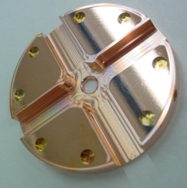
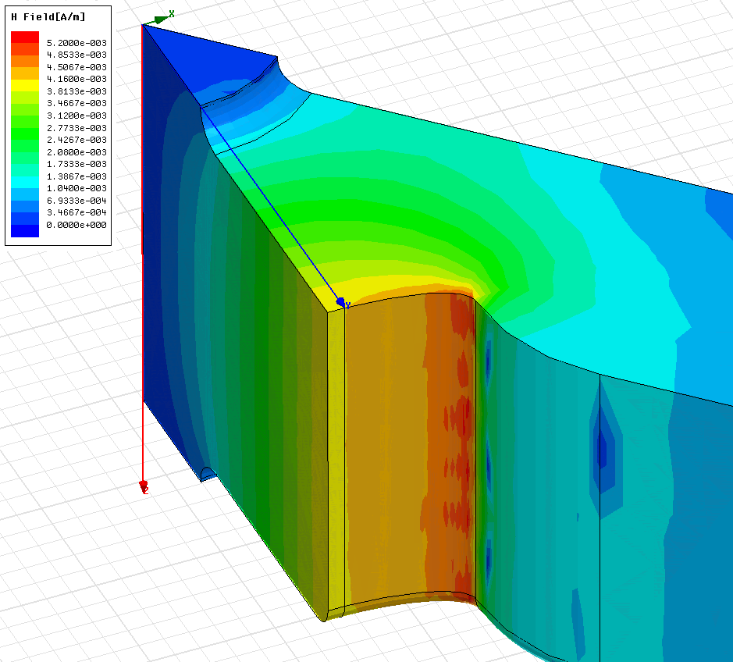
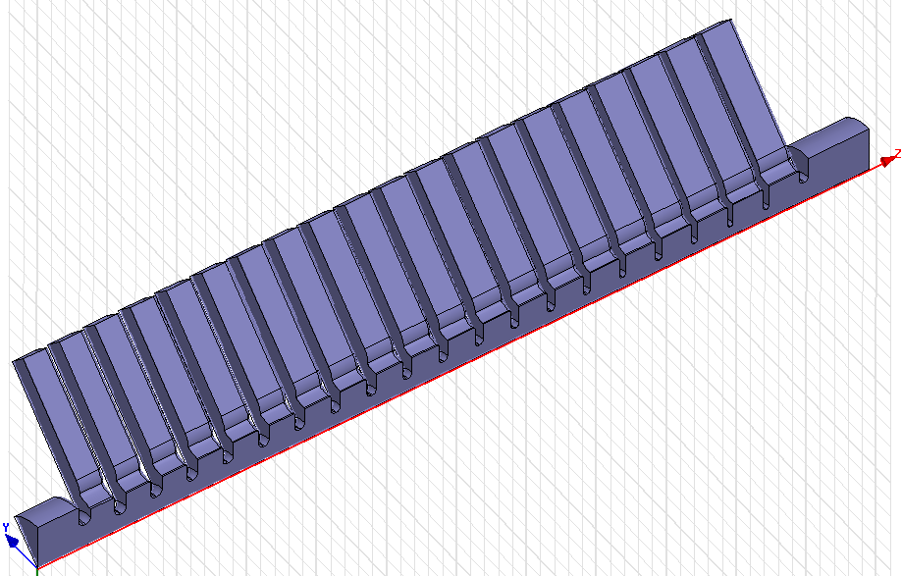
Surface Magnetic Field of TD18

Slide 5
BDR Pulse Heating Dependence of TD18
110 MV/m
Notes:
It is very interesting to see the BDR at 50ns for TD18, which is about 56 degC of peak pulse heating in last cell.

Slide 6
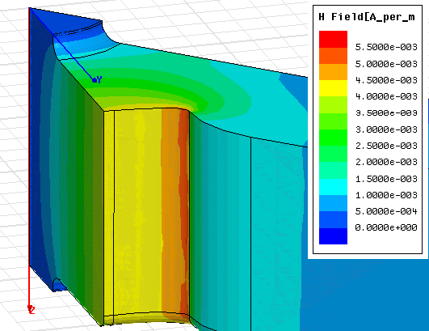
Difference between T and TD18 explained?
W. Wuensch
CLIC ACE
2-2-2011
Damping waveguide
Points of enhanced breakdown rate in TD18 tested at SLAC probably identified.
Location is point of maximum surface current.
Inner cell
Origin of problem thought to be current carrying capacity of bond joint.
TD24 has lower surface current and joint is receiving renewed scrutiny.

Slide 7
Breakdown sequence statistics
Both sets of measurements were made on TD18s
SLAC: 100 MV/m @ 200ns

Slide 8
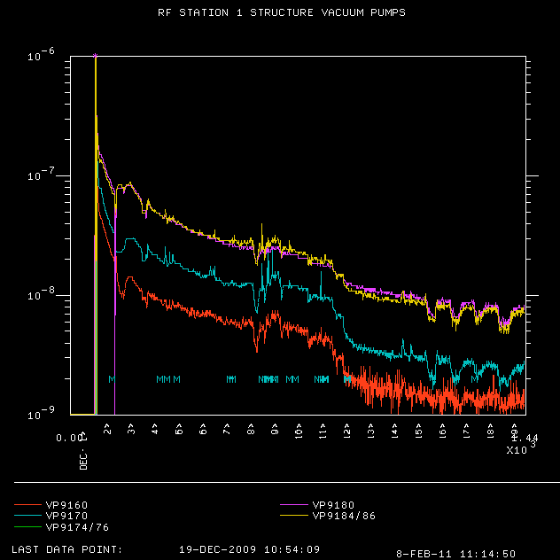
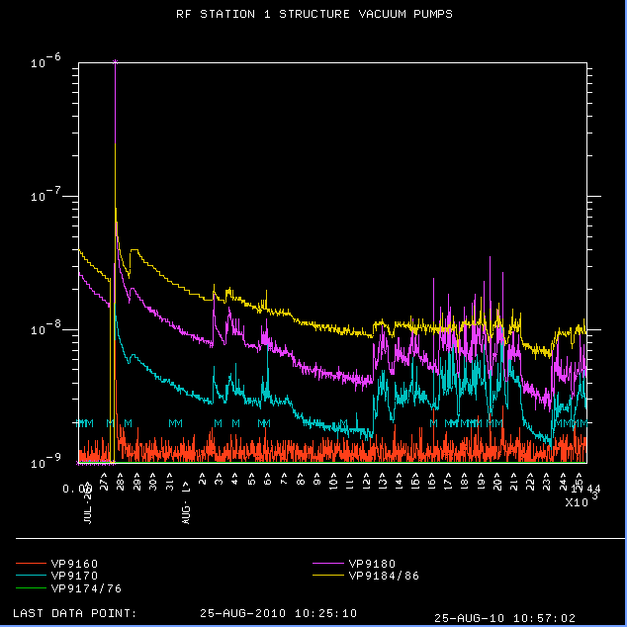
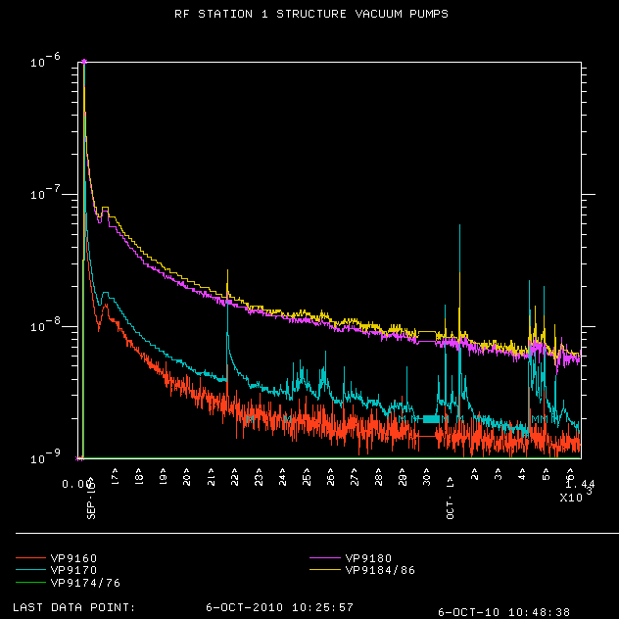
Vacuum History
Start of Operation 03/12/09
T18_CERN_2
TD18_SLAC
Start of Operation 08/02/10
Start of Operation 09/21/10
T24_SLAC
9172: for input load
9186: structure
9180: right output load
9184: left output load
9160: WG to structure

Slide 9
Breakdown Location distribution
TD18_SLAC
T18_Cern_2
T24_SLAC

Slide 10
Structure Performance Summary at 230 ns
4e-7 pulse/m

Slide 11
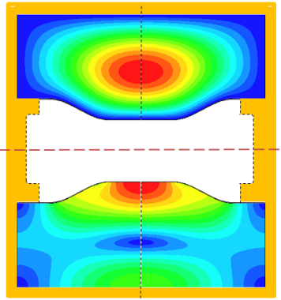
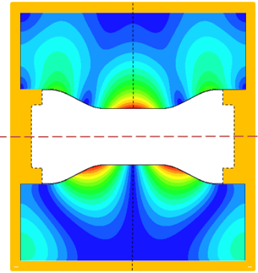
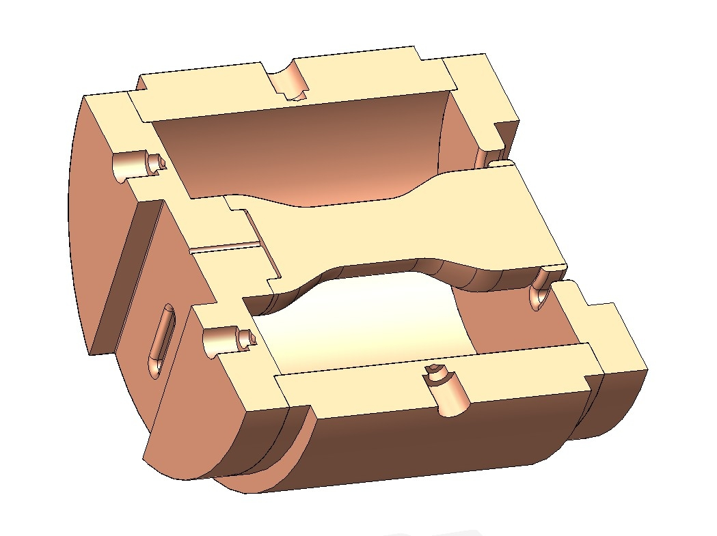
X-band Dual-Mode Cavity
TE₀₁₁
TEM
E-field
B-field
TEM
TE₀₁₁
Chris Nantista

Slide 12
Tuning Cold Test Data
Chris Nantista
Minimum S₁₁: -12.17 dB (6.07%) @ 11.4260 GHz
Minimum S₂₂: -25.33 dB (0.293%) @ 11.4260 GHz
Crosstalk: -22.75 dB (0.531%)
TE
f_{r} = 11.426 GHz
Q₀ = 14,935
Q_{e} = 24,913
Q_{L} = 9,337.5 (β = 0.5995)
TEM
f_{r} = 11.426 GHz
Q₀ = 9,334.8
Q_{e} = 8,334.2
Q_{L} = 4,403.1 (β = 1.1201)

Slide 13
TE011 and TEM3 modes are simultaneously excited

Slide 14
TEM High Power Test

Slide 15
Dual-moded Cavity 1st Run with TEM3 Mode
Not Real Breakdown Cavity heavily detuned

Slide 16
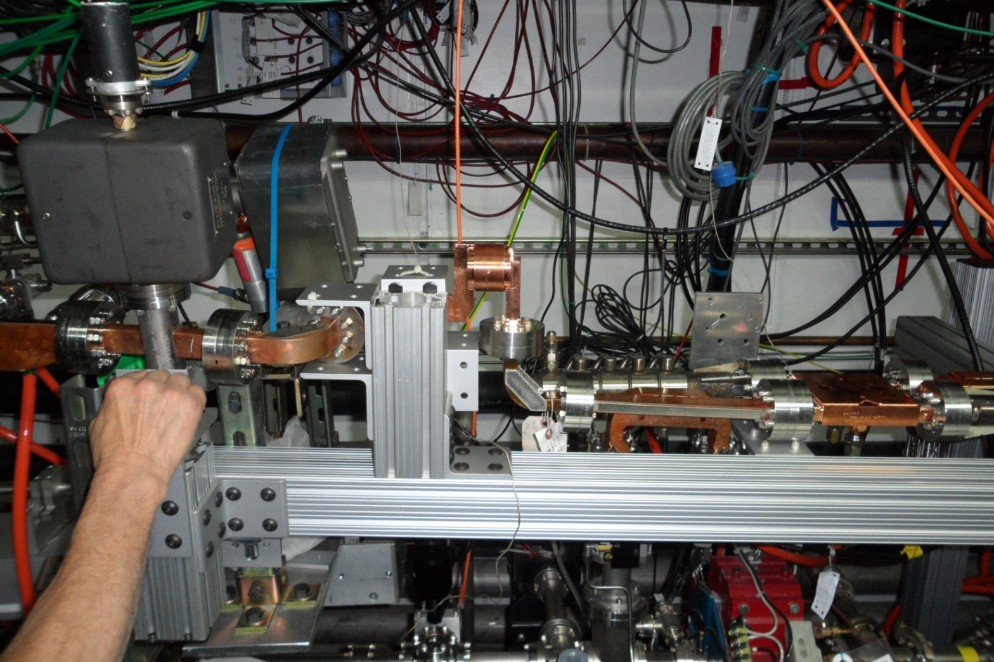
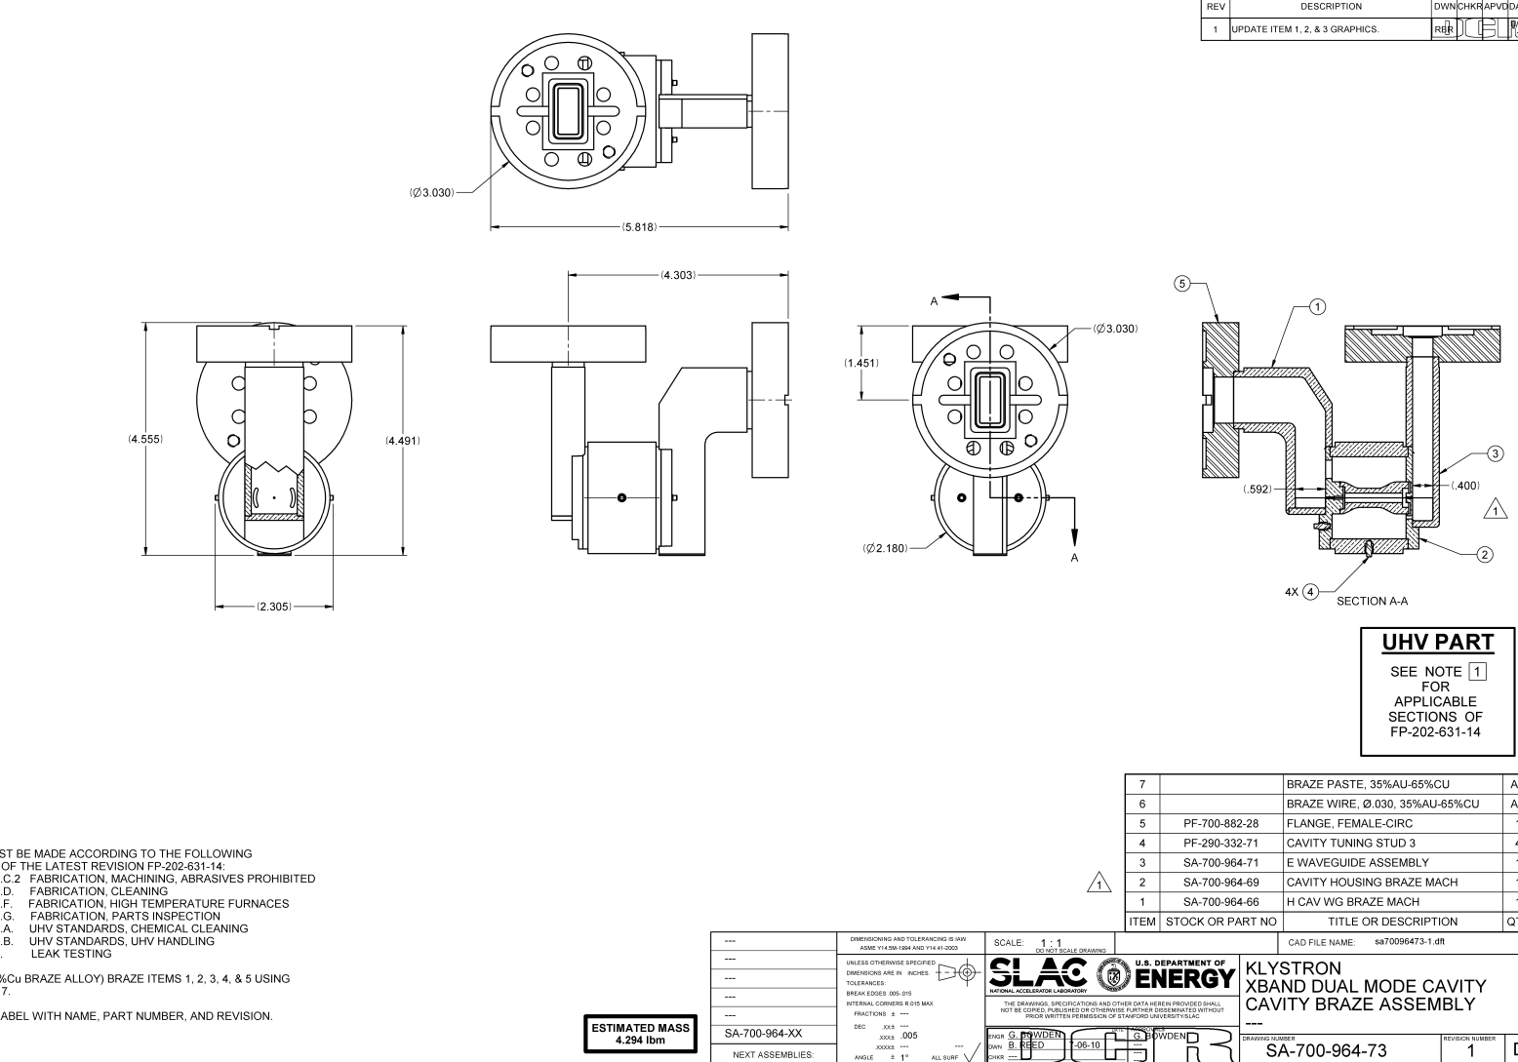
X-band Dual-Mode Cavity Test Setup
TE₀₁₁
TEM

Slide 17
TE011 High Power Test

Slide 18
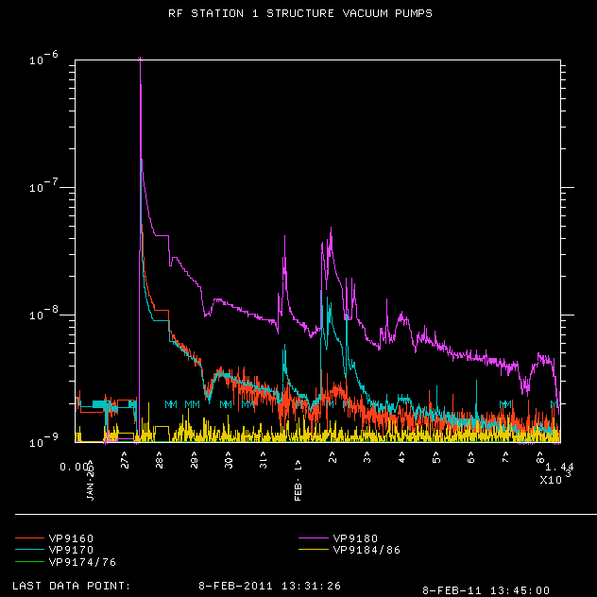
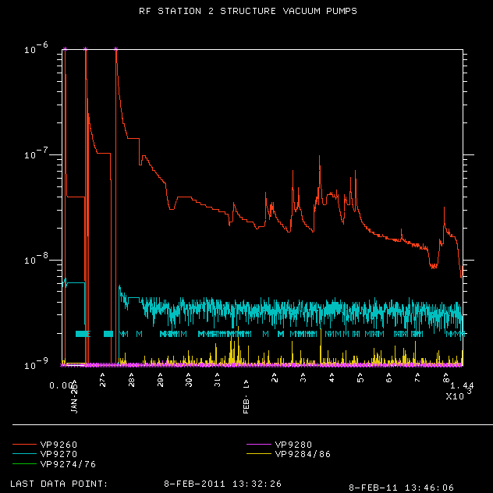
Vacuum History
Start of Operation 31/1/11
Start of Operation 31/1/11
TE – STN1
TEM – STN2
Pulsed heating is 50 K by TE011, and 63 K by TEM.
The peak surface field from TEM is 200 MV/m.

Slide 19
Summary
. Although only 600 hrs of operation, the performance of T24_SLAC is worse than T18_SLAC even though it has lower pulsed heating.
. Surface contamination or vacuum leakage may limit the performance of T18_CERN_Disk_2.
. So far, no evidence of a BDR enhancement from the added 50 deg TE mode pulsed heating in the dual-mode cavity with 200 MV/m peak TEM surface electric fields

