Slide 1
US High Gradient Research Collaboration Meeting
Norbert Holtkamp
Feb 9, 2011

Slide 2
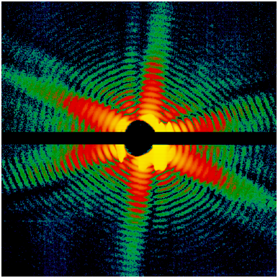
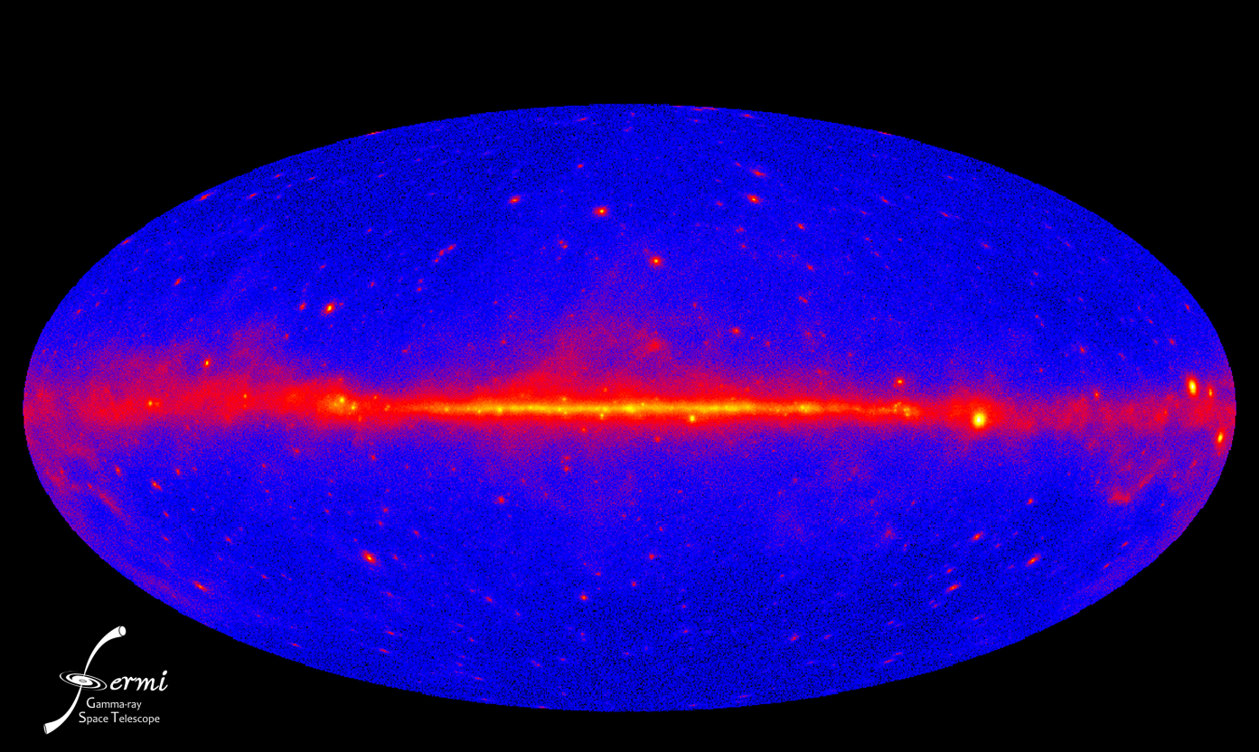
Our Lab Agenda—Where we are going
Mission
Grow into the premier Photon Science Laboratory
Maintain our position as the premier [electron] accelerator laboratory
Build targeted programs in particle physics, particle astrophysics & cosmology

Slide 3
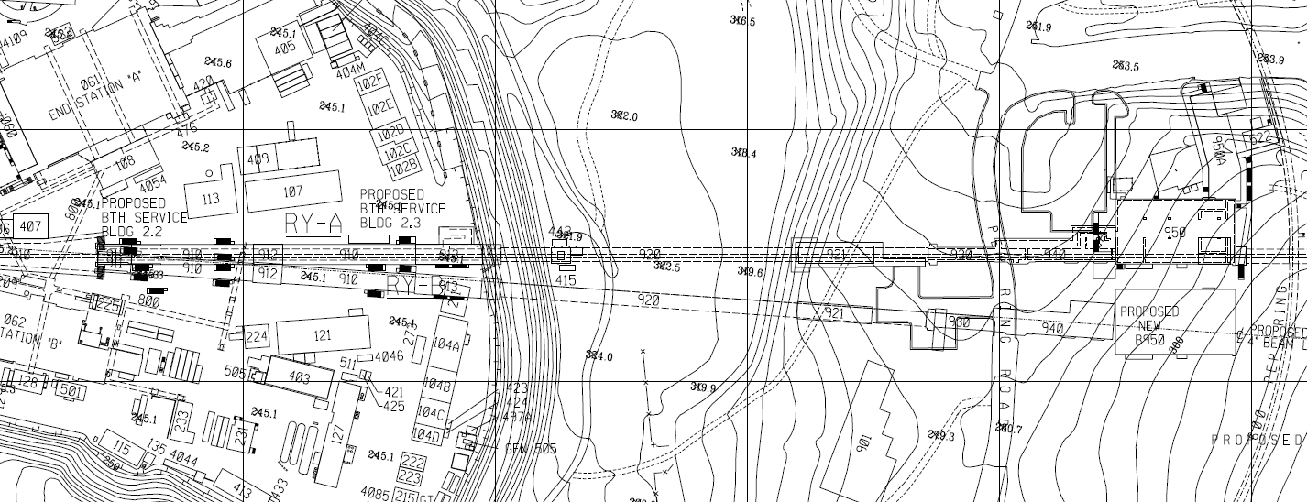
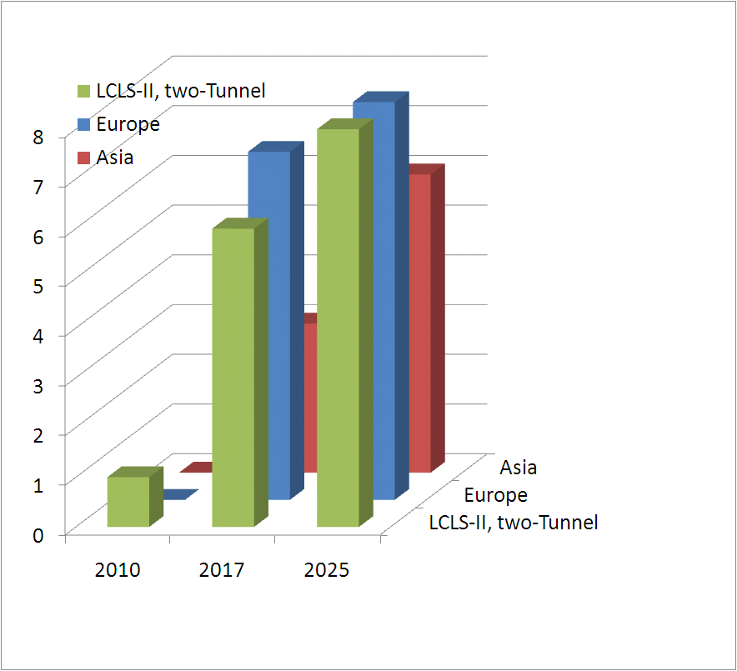
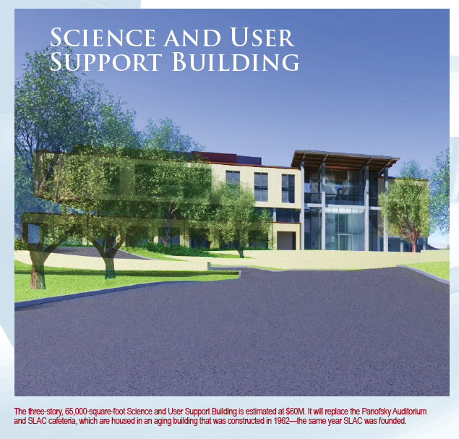
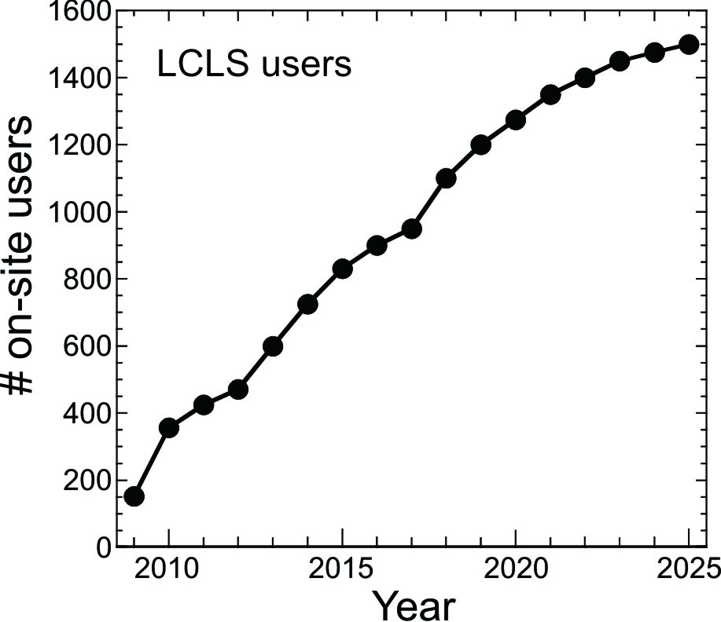
Build Internationally Leading Photon Science Facilities
Keep LCLS competitive through 2025
Current operations outstanding
Do R&D that changes the landscape
Vision for LCLS-2025
Operate LCLS-II
Think about LCLS III
present LCLS
NEH
Hall
FEH
Hall
Projected LCLS user growth
Number of hard x-ray stations
LCLS II
complete
LCLS I
complete
10x

Slide 4
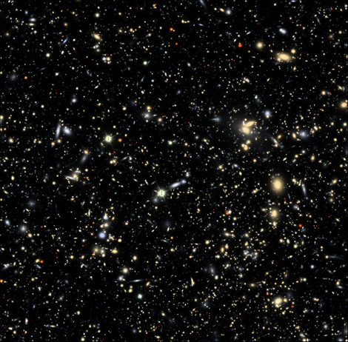
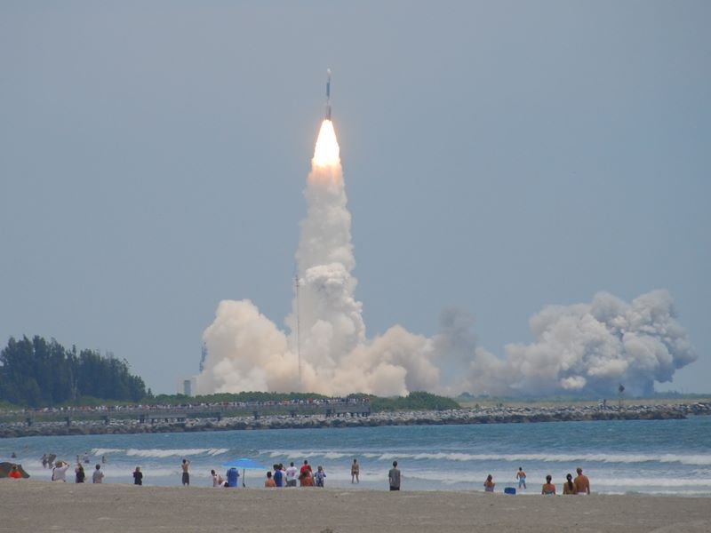
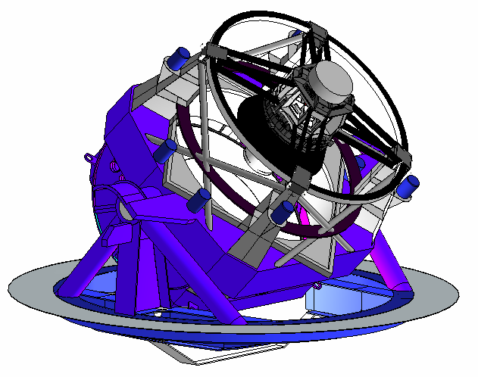
Build targeted Programs in Particle Physics and Astrophysics
Fermi Gamma Ray Space Telescope in orbit
Large Synoptic Survey Telescope—first light 2018
KIPAC—Joint campus/SLAC institute

Slide 5
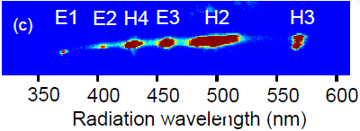
Maintain our status as the premier electron accelerator laboratory
Innovative technologies for accelerators
NC high gradient acceleration
Dielectric
Plasma
NC accelerator for DOE (and worldwide)
ECHO 4
Novel approach for high brightness beams
Beam generation
Beam/ ε-manipulation
Laser-Beam manipulation/diagnostics
FACET

Slide 6
The Laboratory Mission-The Accelerator Role
Grow into the premier Photon Science Laboratory | Maintain our position as the premier [electron] accelerator laboratory | Build targeted programs in particle physics, particle astrophysics & cosmology
Seeding schemes that will change FEL designs | R&D Program @LCLS | LC, Beam Manipulation
Next Generation Injectors | Injector Test Infrastructure | LC, Super KEKB,
Ultra short pulses | Diagnostics. Timing/Synchronization | LC
User adapted applications | Linac designs for specific needs | LC, MC
Enabling Technology | RF Power (at any band) and new power sources | LC, MAP, Project X, everywhere
The “ultimate” storage ring | Beam Dynamics and Feedback systems | Super B / Super KEK B
“Doubling the energy” | Plasma Wake Field Acceleration | FACET and its experimental program

