Slide 1
High gradient features from Nextef on recent CLIC prototype structures
US-HG workshop, SLAC
9 February 2011
T. Higo representing X-band group of KEK

Slide 2
Topics
TD18 evaluations with various pulse types
Double pulse operation
Hopping among three power levels
Non stopping after breakdown pulse
T24 processing results
Comparison among prototype structures

Slide 3
Recent key members for Nextef
Accelerator
S. Matsumoto, T. Abe, K. Yokoyama, K. Kakihara, T. Higo, S. Fukuda
Mechanical engineering center
Y. Higashi, T. Takatomi, K. Ueno
Material science laboratory
X. Zhang

Slide 4
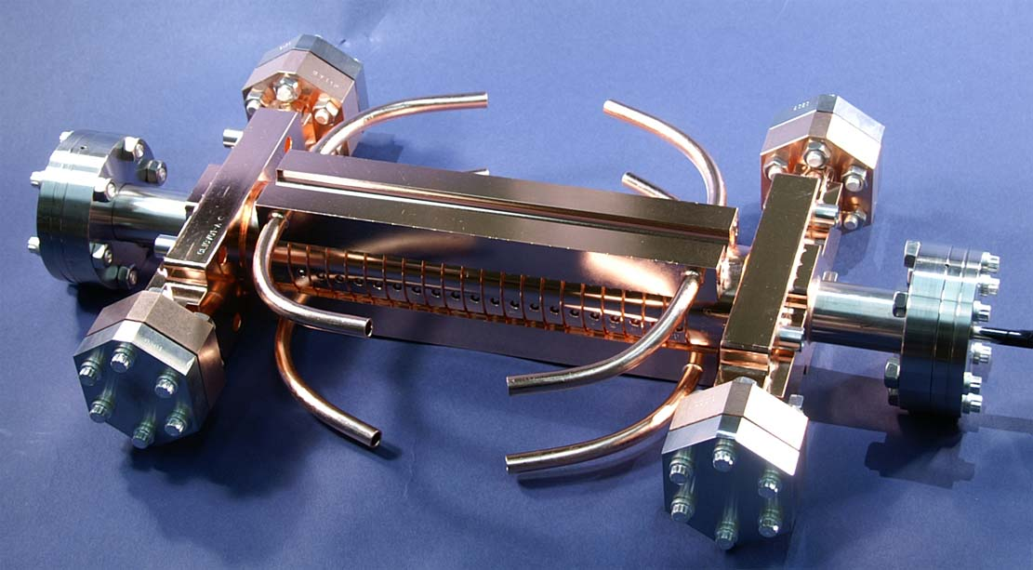
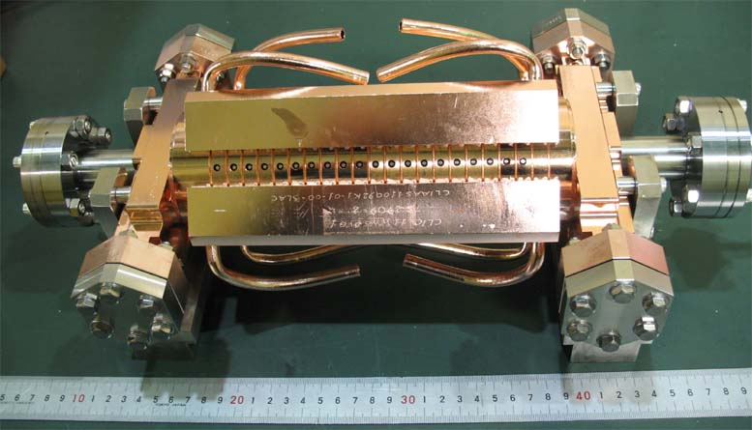
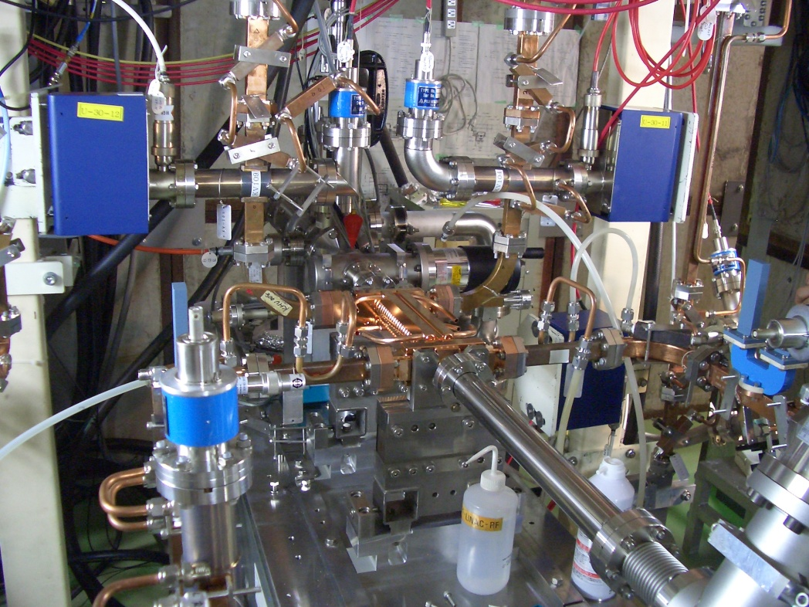
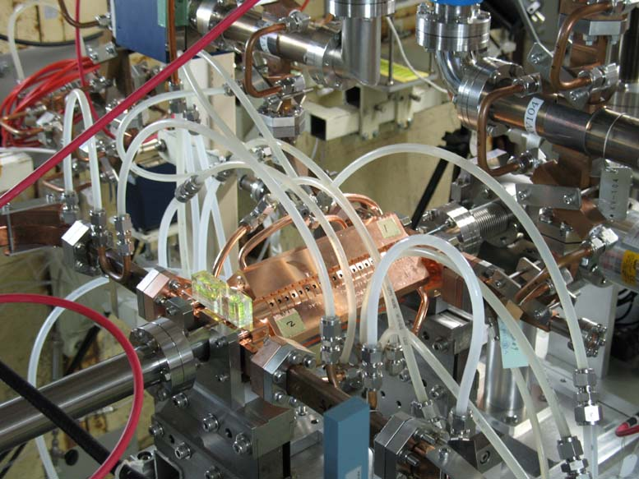
Structure test for CLIC study
T18_Disk_#2
TD18_Disk_#2

Slide 5
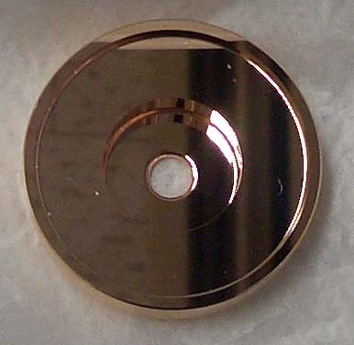
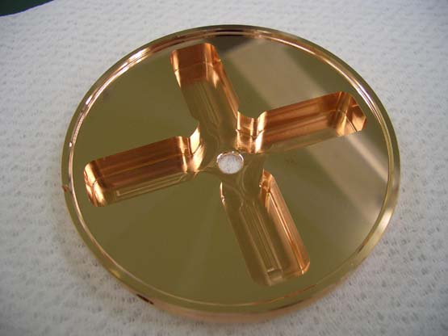
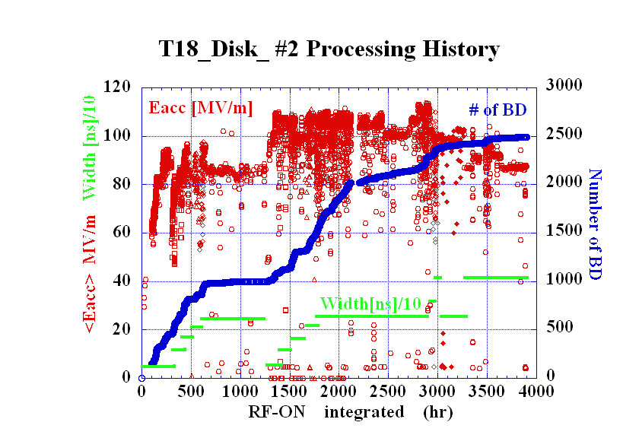
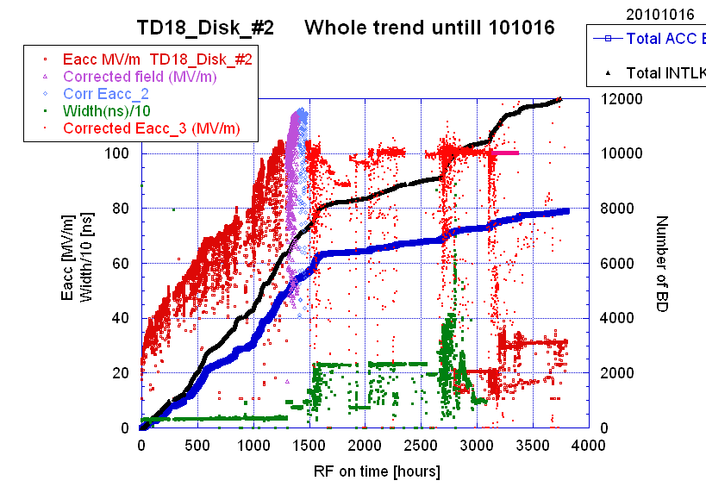
T18_Disk_#2 in 2009
Undamped disk-based
TD18_Disk_#2 in 2010
Damped disk-based

Slide 6
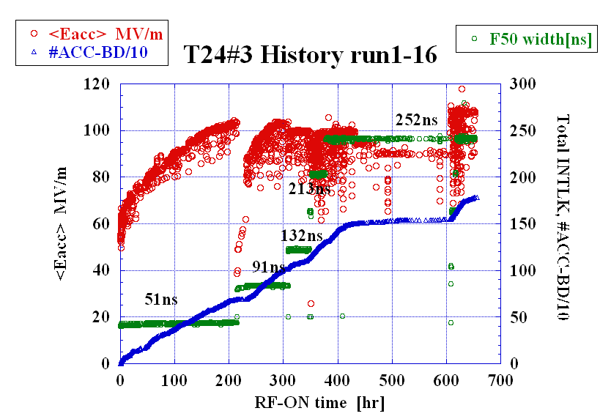
T24_Disk_#3 proceeding now in 2011
Now operated for 1000 hrs. as of Feb. 8
Easily reached 100MV/m, 412ns
Evaluated BDR at 412ns
Now start various pulse shapes at 105mV/m

Slide 7
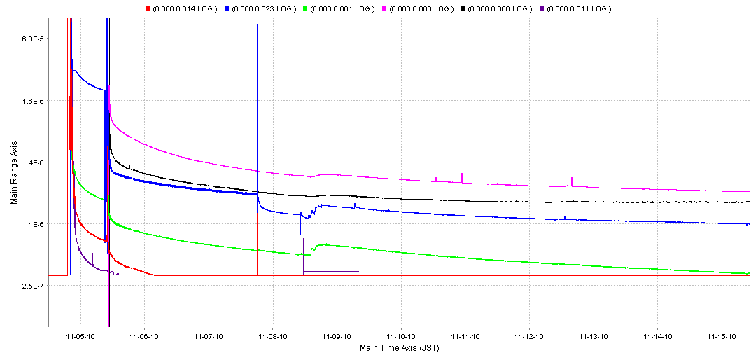
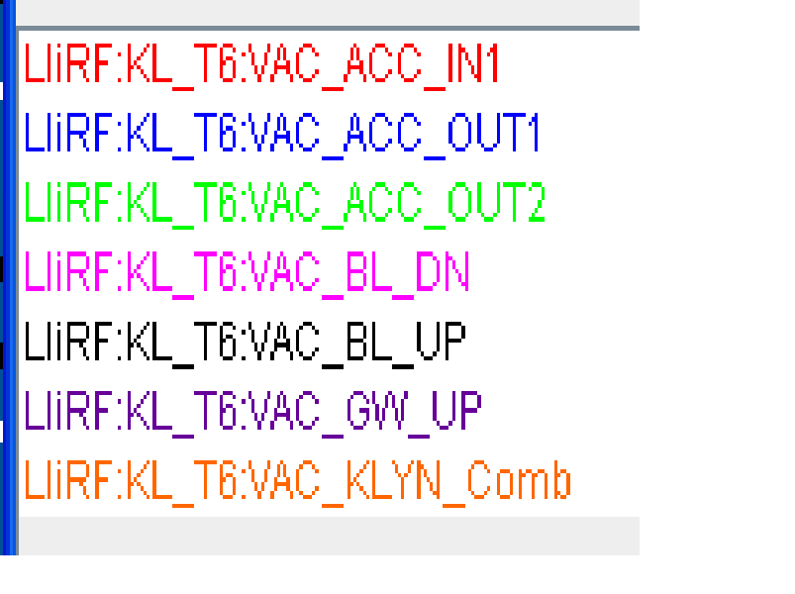
Comparison of the early (20day) trend of vacuum of three acc structures
T18
TD18
6.3E-5
T24
4.0E-6
1.0E-6
2.5E-7
Roughly the same for all in their vacuum trend in early and full history of vacuum level.

Slide 8
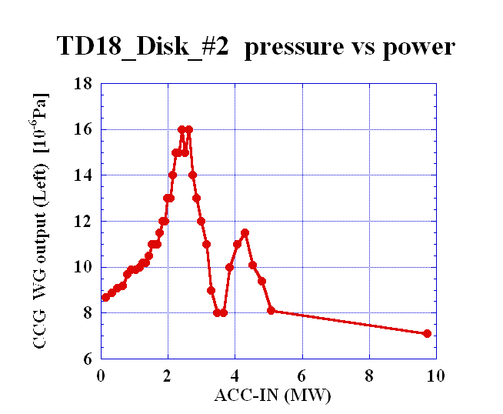
TD18: Pressure increase at low power level
Even after running at top power, the vacuum gets worse when it decreases power.
ACC-IN power
VAC@IN-WG
Even a few hour stop of RF pulses makes the vacuum level worse in the next startup, because the recovery usually passes through this region.
It is not very evident in T24.

Slide 9
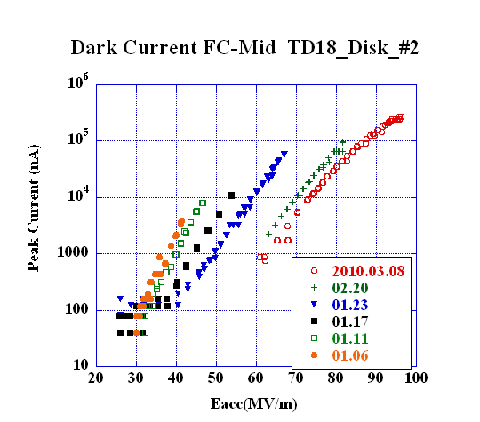
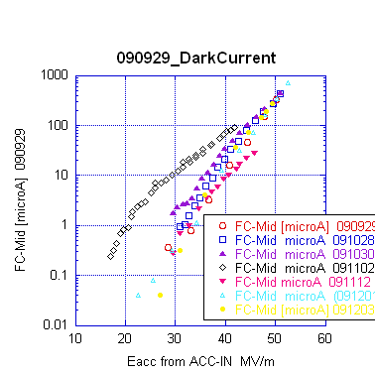
Presented to IPAC10
Comparison of dark current
T18_Disk
TD18_Disk
TD18_Quad
TD18_Quad
Eacc for peak dark current of 10 μA
90MV/m 70MV/m 40MV/m
The same comparison should be made for T24#3.

Slide 10
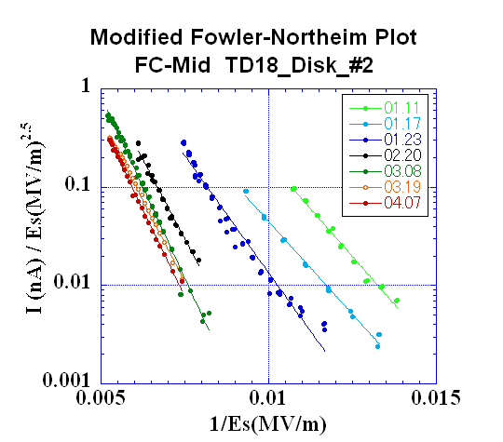
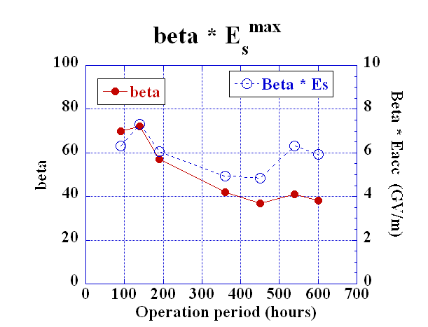
Evolution of dark current till early April
in TD18_Disk
IPAC10
Dark current reduced by three order of magnitude.
It followed roughly modified F-N formula.
β reduced from 70 to 40.
β * E_{s}^{max} ~ 5~7 GV/m

Slide 11
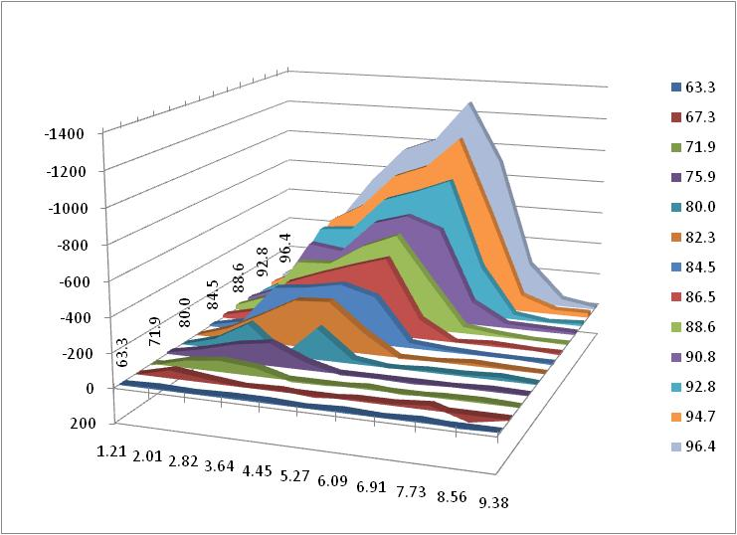
TD18 Dark Current Energy Spectrum
252ns RF, 50pps; 56MW==100MV/m
Averaged Gradient
(MV/m)
Peak Current
(nA)
MV/m
Electron Energy (MeV)

Slide 12
BDR evaluations
Usual breakdown rate measurement
BDR vs Eacc
BDR vs pulse width
Trials tasted with TD18_#2
Double pulse with equal height separated in various spacing
Power switching among three Eacc in every 1 sec
9 following pulses just after breakdown without stopping

Slide 13
TD18_#2 at 252 ns
TD18_Disk_#2 BDR~ 1.3 x 10⁻⁵ /pulse/m]
during Run 51&52 (60MW, 252ns)
as of the total RF-ON period of 2255 hours
# BD
BDR
10^-6 /pulse/m
Still decreasing in a logarithmic time scale BDR ~ t^-0.38

Slide 14
T24#3 Run16 goal 110MV/m at 252nsec
BDR vs time

Slide 15
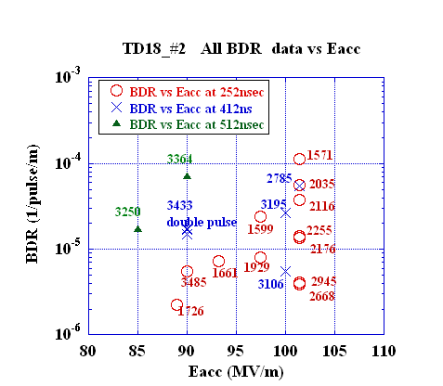
TD18_#2 all data on BDR vs Eacc
BDR evaluation
It seems difficult to get a smooth curve as function of Eacc by collecting all data points scattered in time and in operation parameter space.
Usually we obtain a smooth curve by measuring intentionally by taking data in a short period.

Slide 16
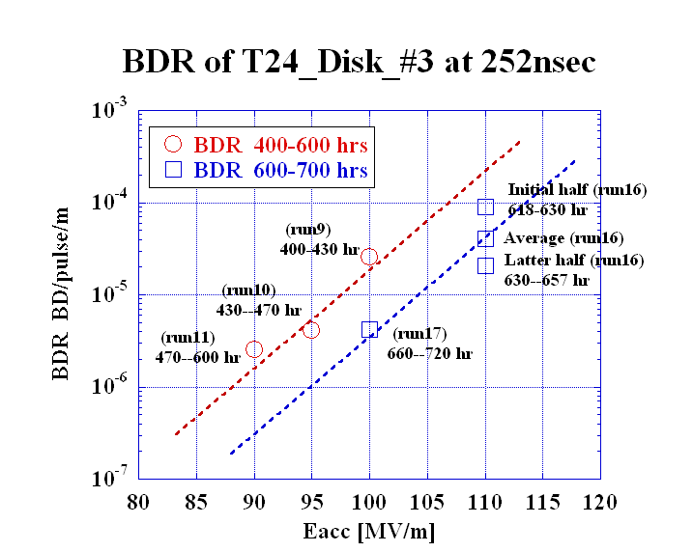
T24_Disk_#3 BDR vs Eacc at 400—700 hours

Slide 17
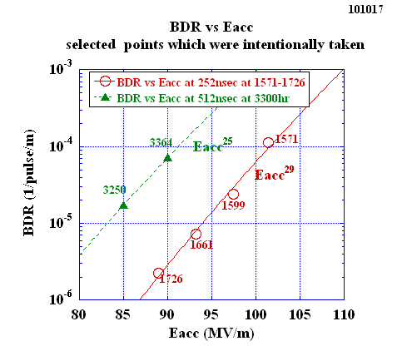
TD18 typical data points of BDR vs Eacc
T24_#3
BDR vs Eacc
Slope
T18 > TD18 > T24(?)

Slide 18
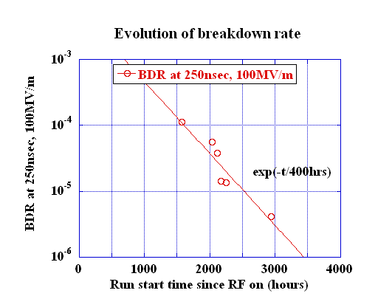
TD18_#2 and T24_#3 Evolution of breakdown rate
T24
TD18
T24_#3 data manually plot
Keep decreasing, but slow or already saturated?

Slide 19
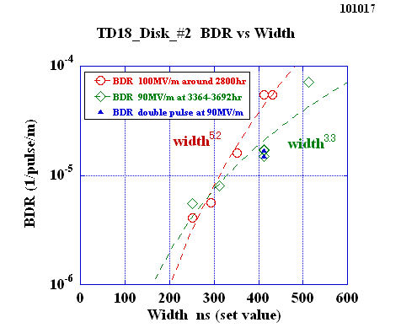
TD18_#2 BDR versus width at 100MV/m around 2800hr and at 90MV/m around 3500hr
Similar dependence at 90 and 100 if take usual single pulse?

Slide 20
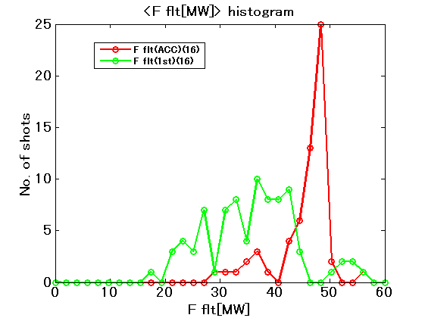
First-pulse breakdown
T24#3 Input power during run16
Many times breakdown happens from the first pulse, even reducing the power level.
It frequently appears especially in the longer pulse operation such as 200ns or more.
ACC-BD
1st-pulse BD

Slide 21
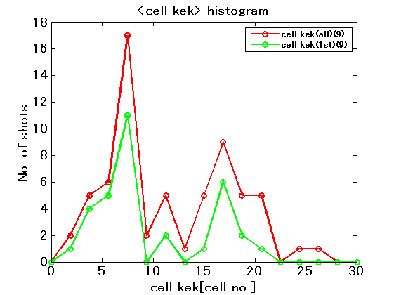
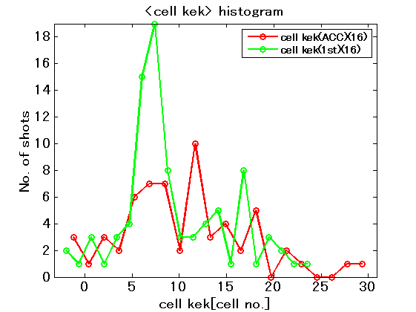
T24#3 BD location
Run 9 RF-ON=400-430 hrs
100MV/m at 252ns just after reaching
Run 16 RF-ON=620-660 hrs
During ramping to
110MV/m at 252ns

Slide 22
T24#3 Run16 BD location (RF-ON=620-660hrs) during ramping to 110MV/m at 252ns
From this and the previous page,
we suspect some bad features may exists near cell 7.
1st-pulse BD
ACC-BD

Slide 23
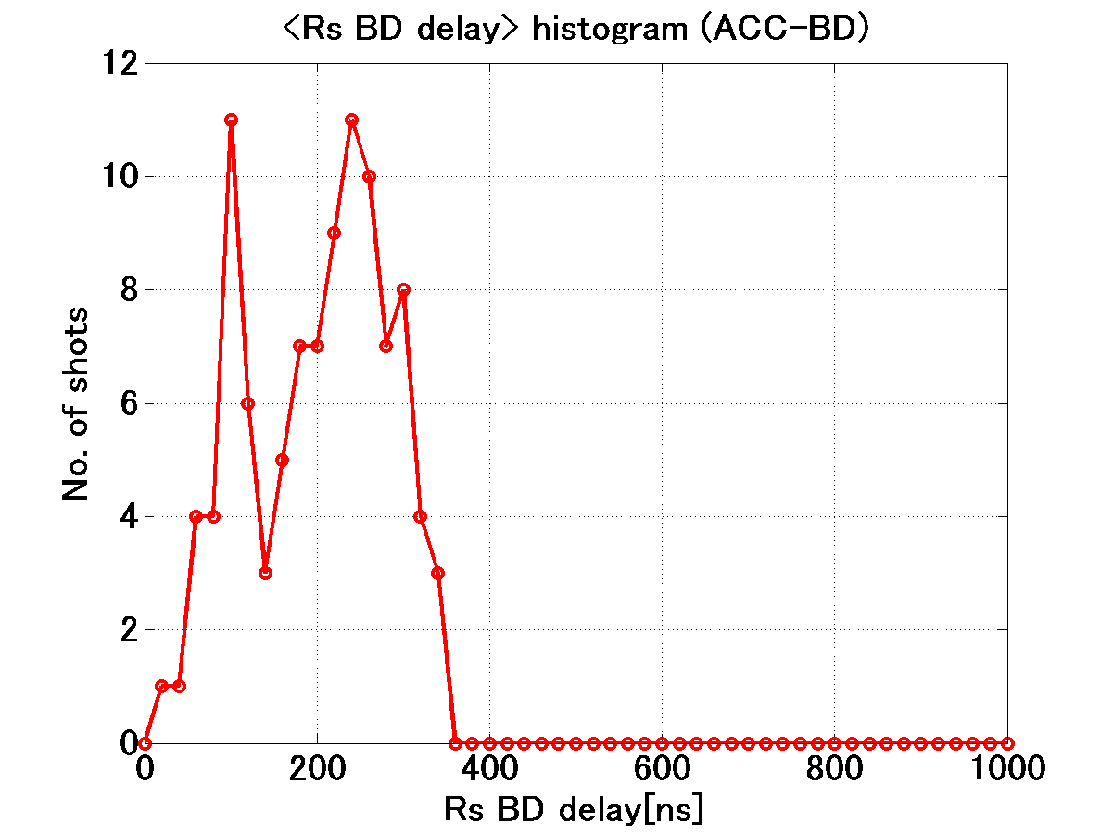
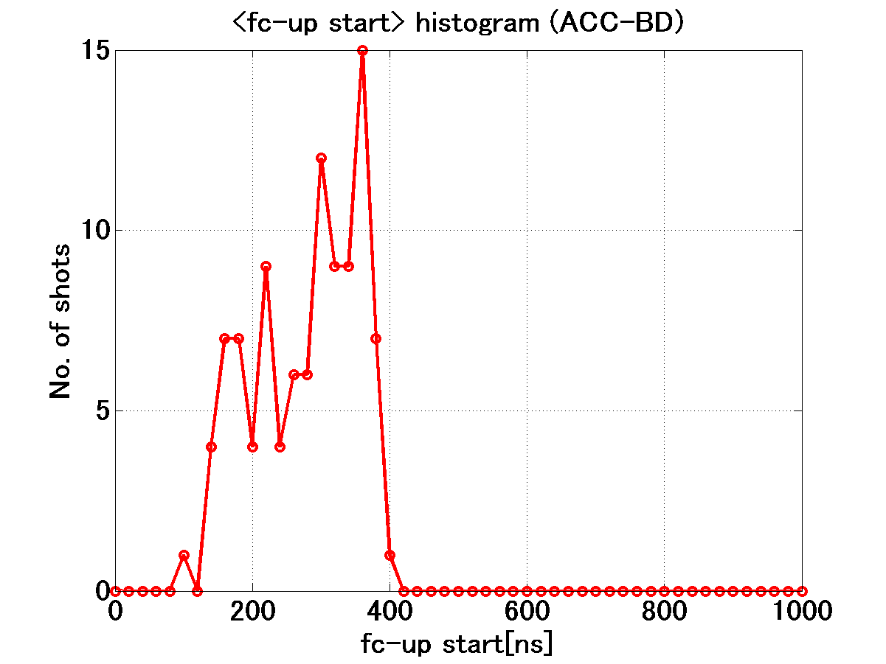
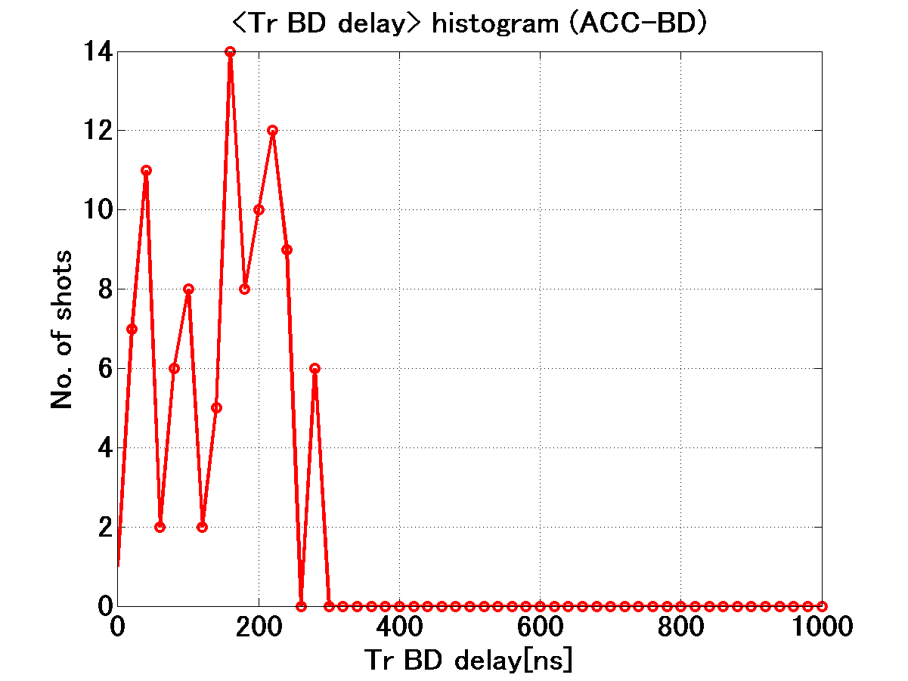
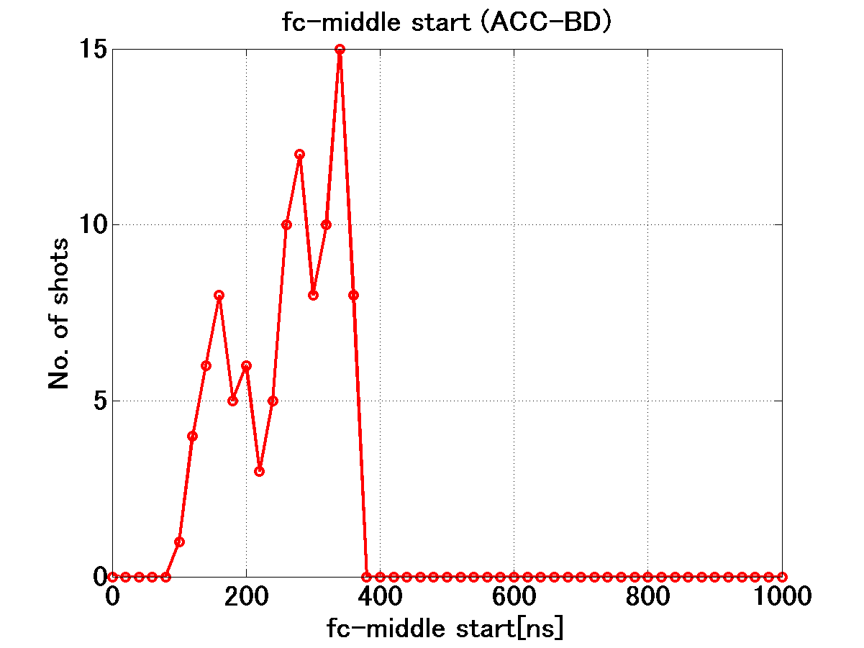
BD start timing in Run 51+52: 252nsec pulse BD start timing
Rs delay
FC-UP delay
Tr delay
FC-Mid delay
Roughly judging that
fc-mid, Tr-delay = ramping as time
→ trigger is building up as time?

Slide 24
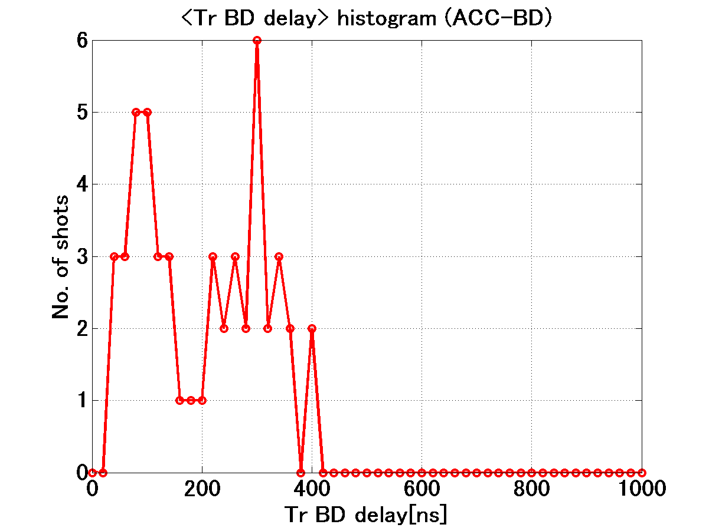
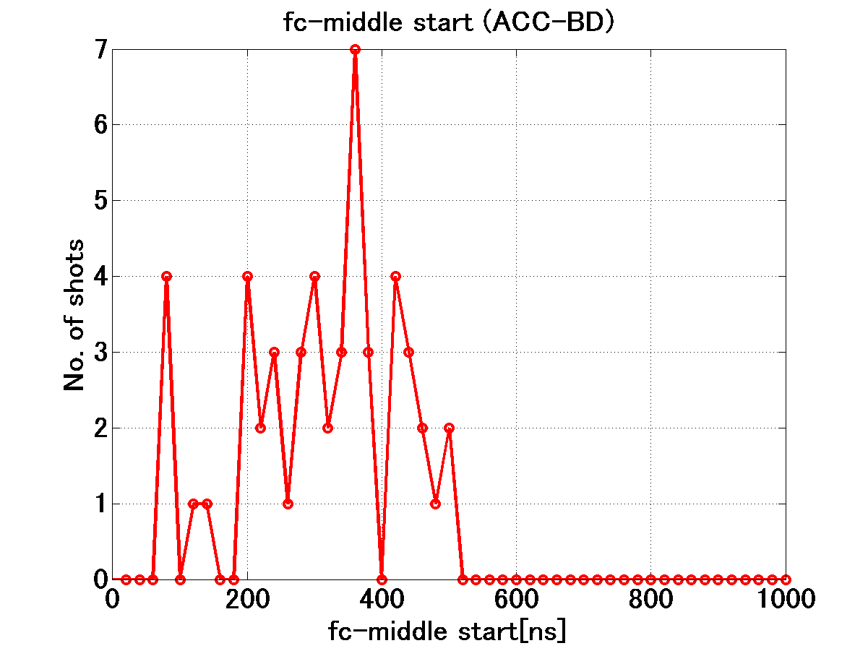
BD start timing in Tr and FC-Mid TD18#2 Run 82: 412ns
These data does not show such high sensitivity as those shown in the previous page with 252nsec.
At any rate, BDR does not so heavily rise as the BDR vs pulse width such as width^{5~6}.

Slide 25
Features investigated by double pulse operation
Period
Width
200ns
LE
5ns
TE
5ns
200 + 10 + 200
200 + 210 + 200
FG set value
Period=210ns
Width=200ns
FG set value
Period=410ns
Width=200ns
Double (200+10+200)
= Single (410ns eq.)
in TD18 Run 71
(30 June – 1 July ---)
Double (200+210+200)
= Single (2000 or 400ns eq.??)
in TD18 Run 72, 73, 74, 89, …

Slide 26
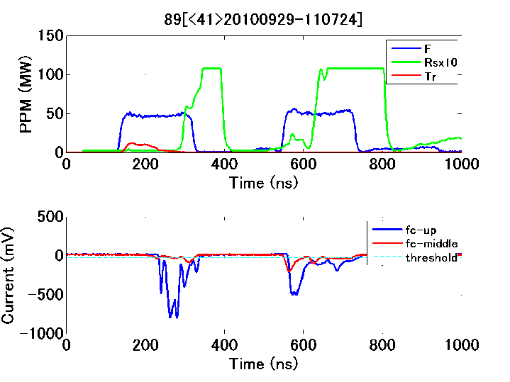
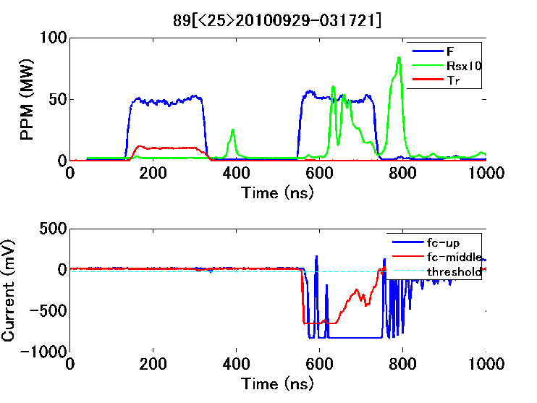
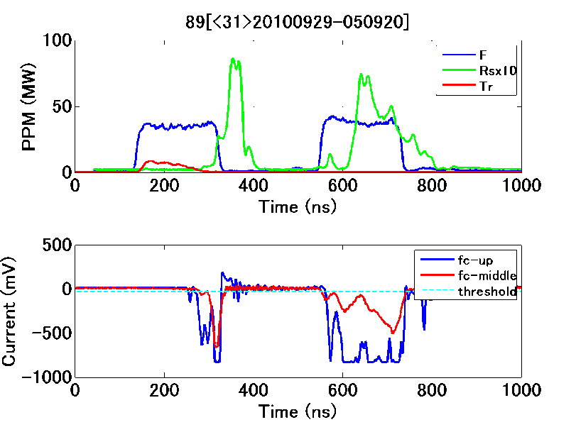
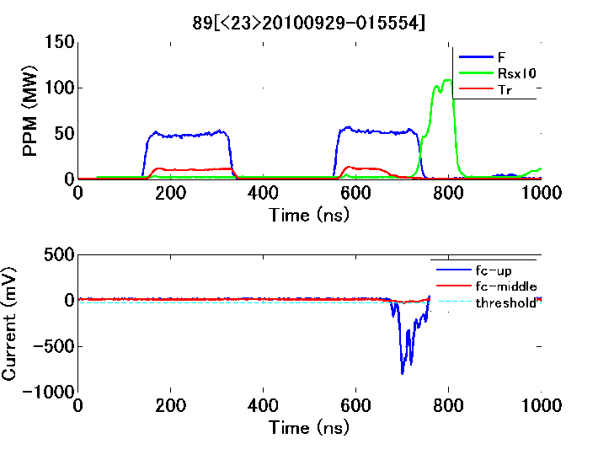
TD18 Run 89 Well separated double pulse at 90 MV/m

Slide 27
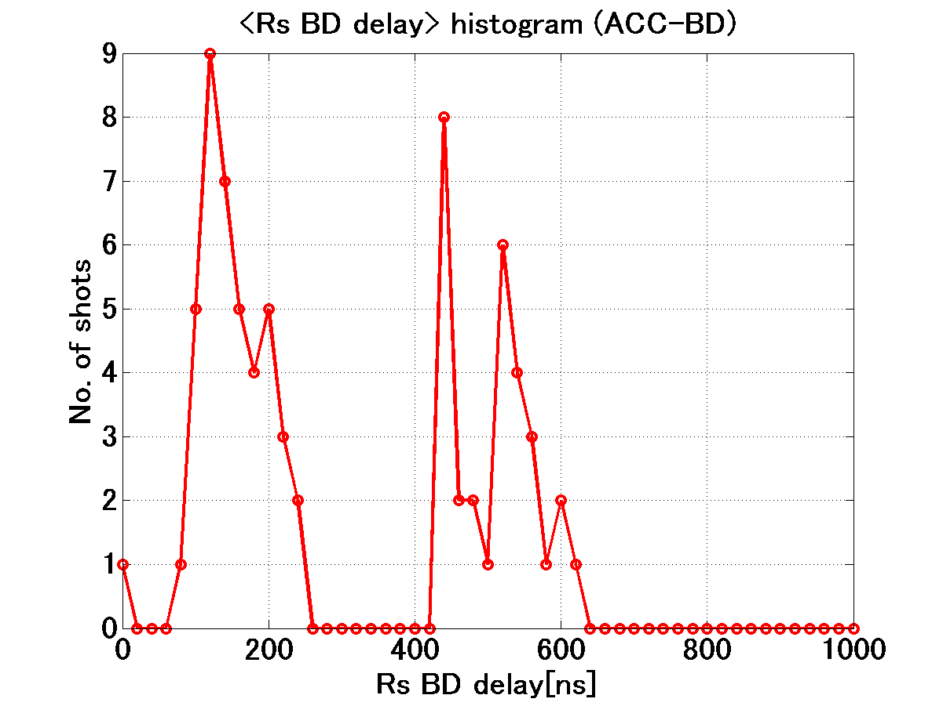
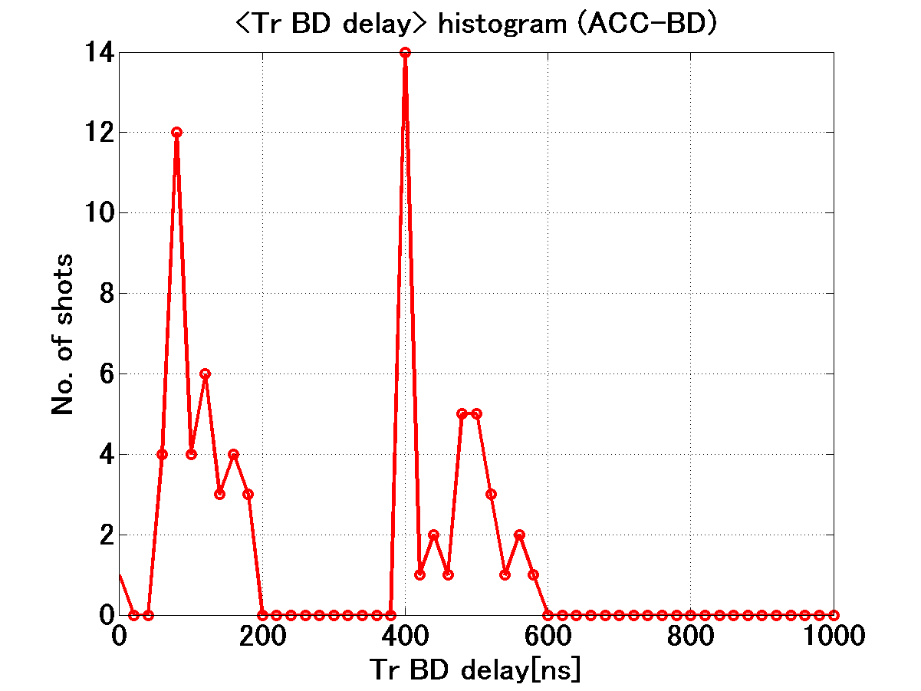
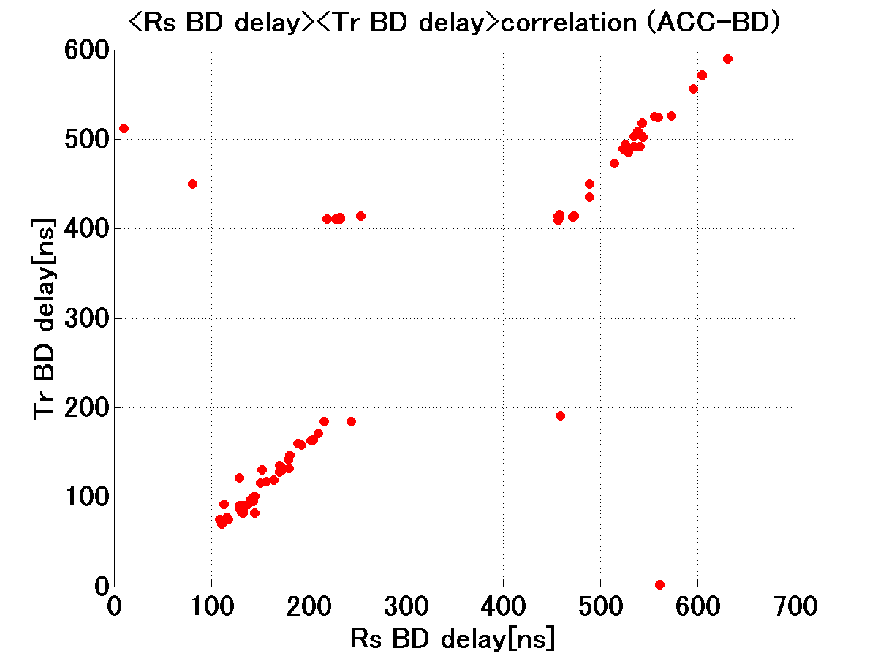
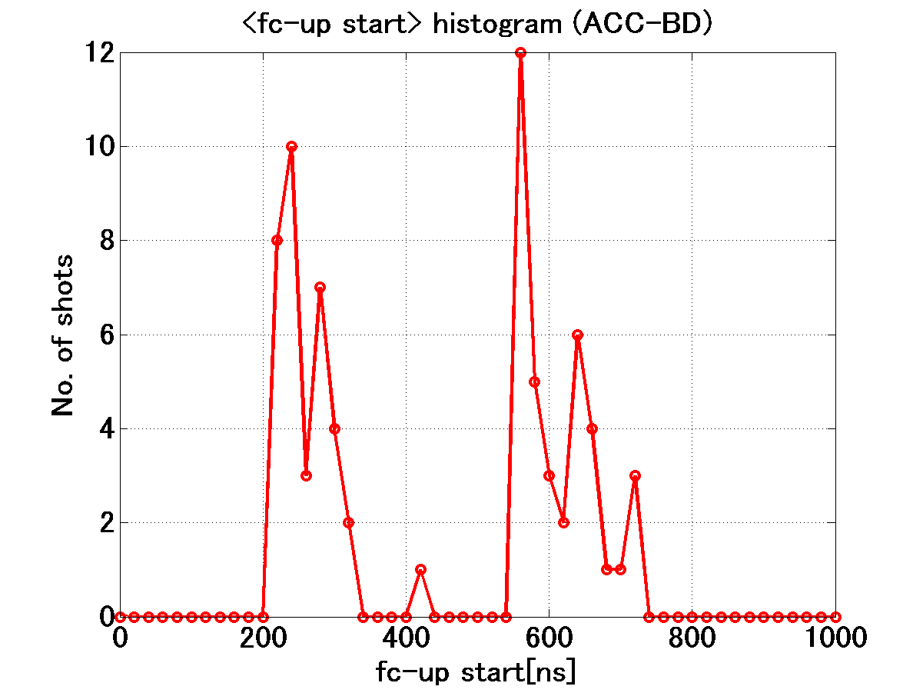
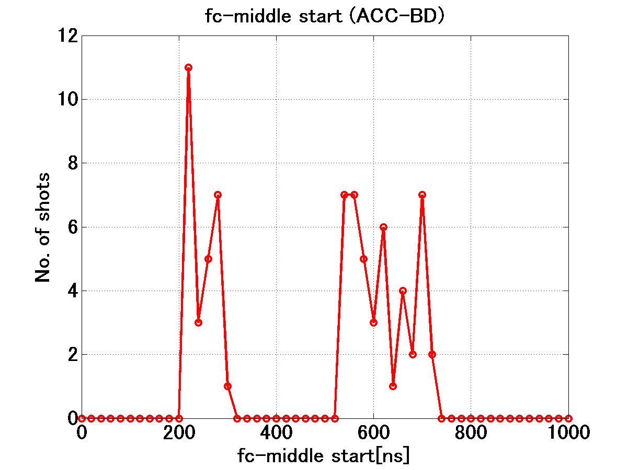
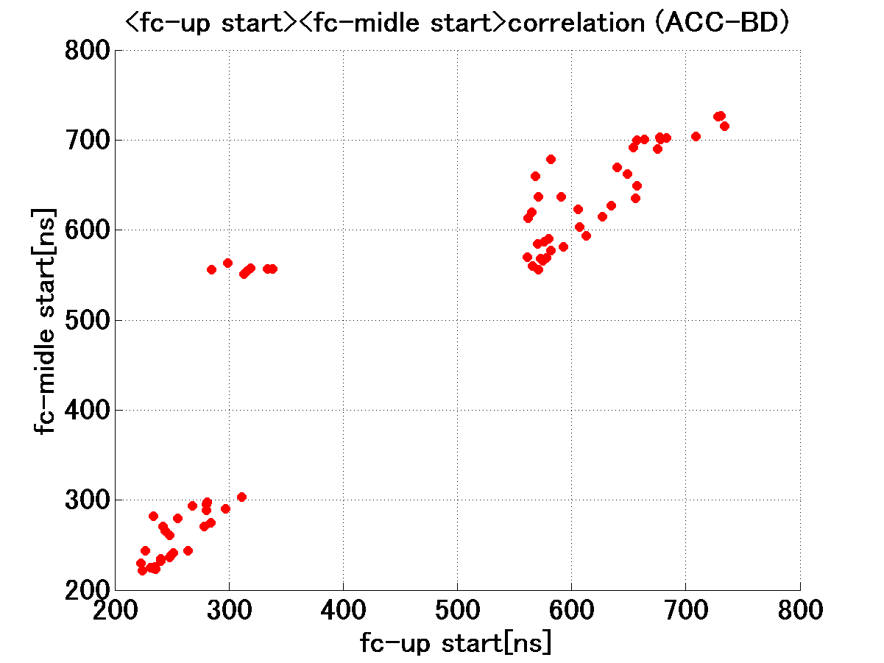
BD trigger timings are equally distributed in the former and latter pulse
Rs delay
Tr delay
Tr delay vs Rs delay
UP delay
Mid delay
UP delay vs Mid delay

Slide 28
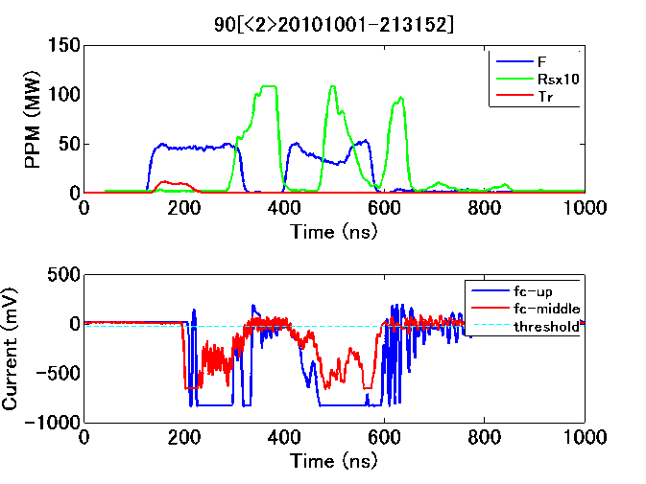
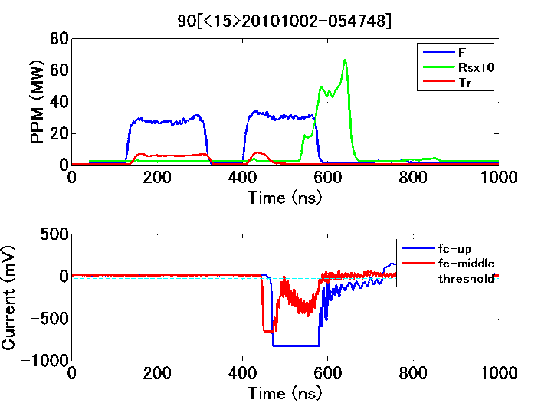
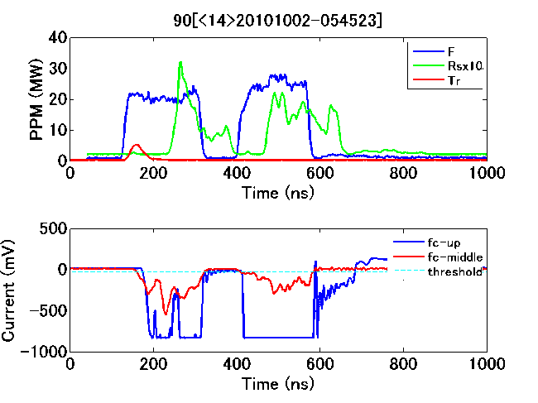
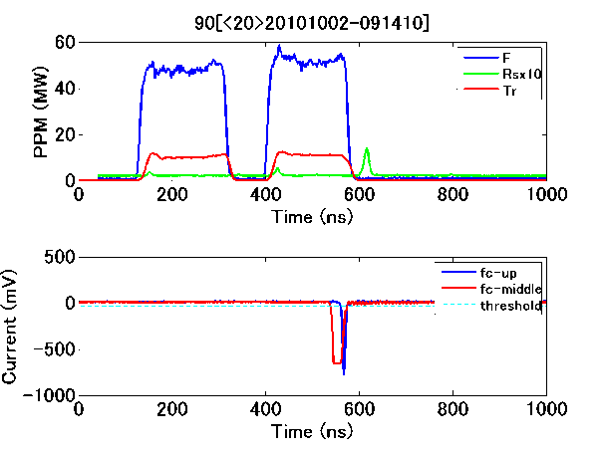
TD18 Run 90 Close double pulse at 90 MV/m

Slide 29
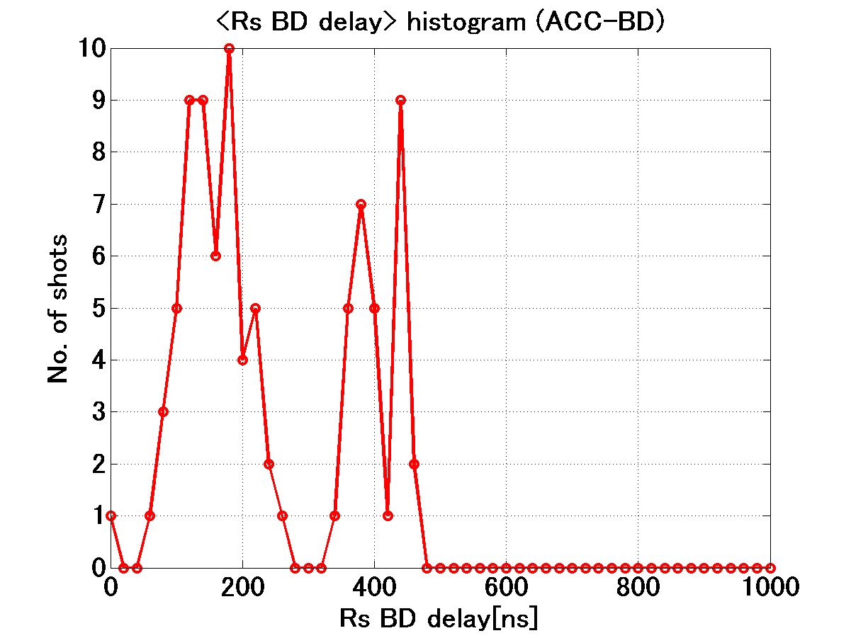
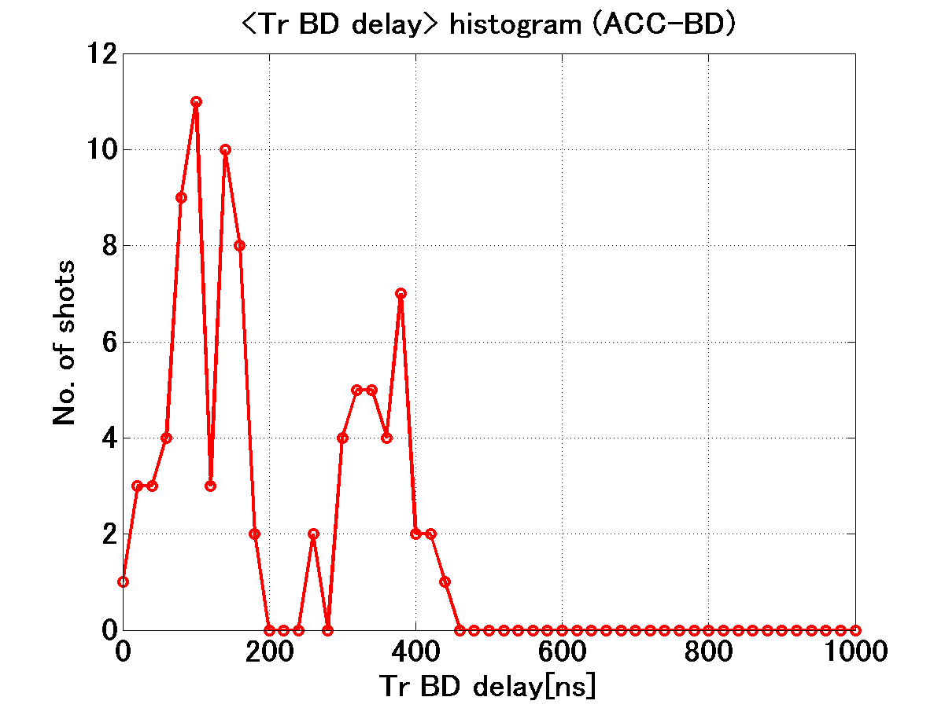
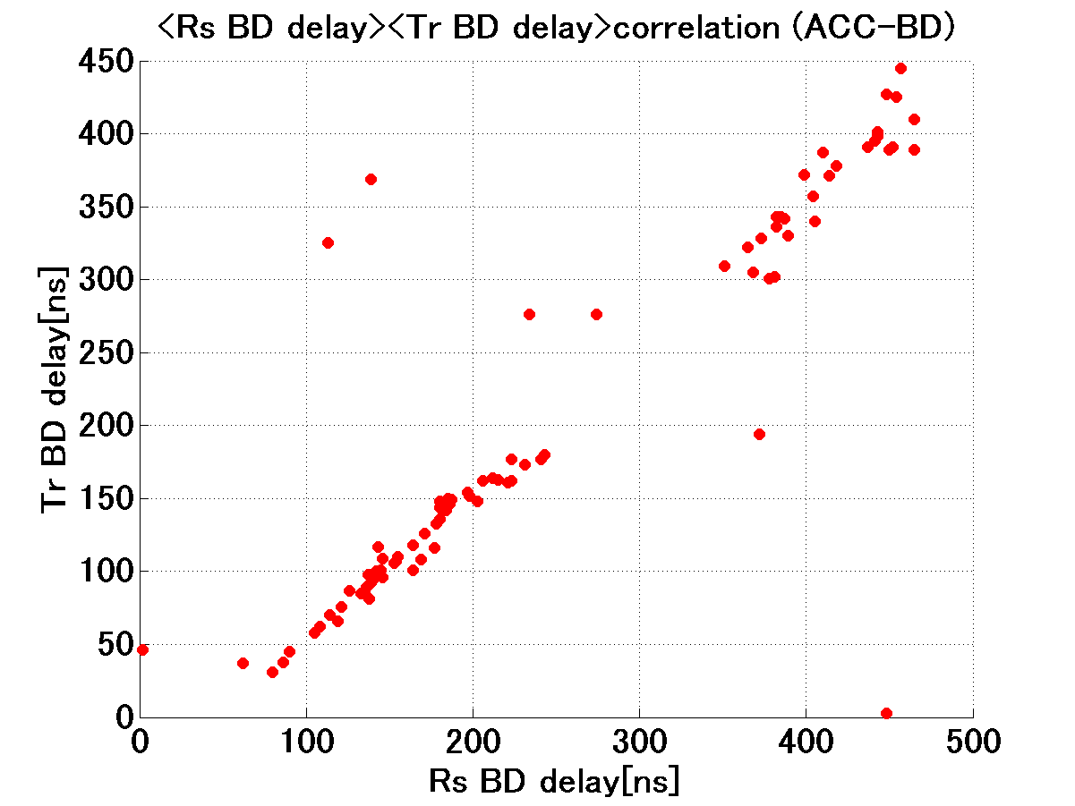
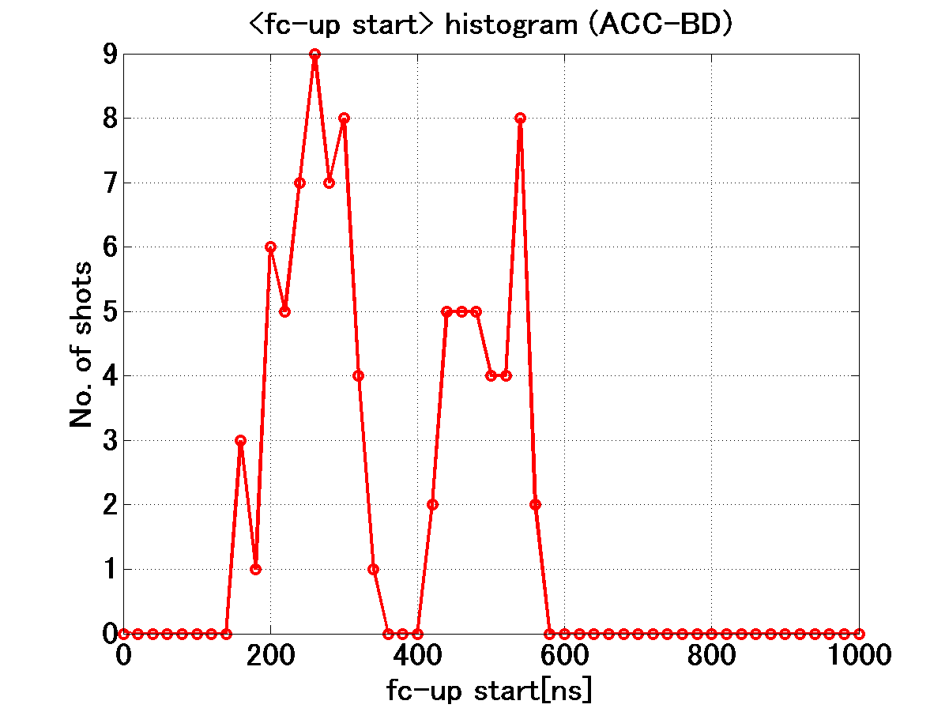
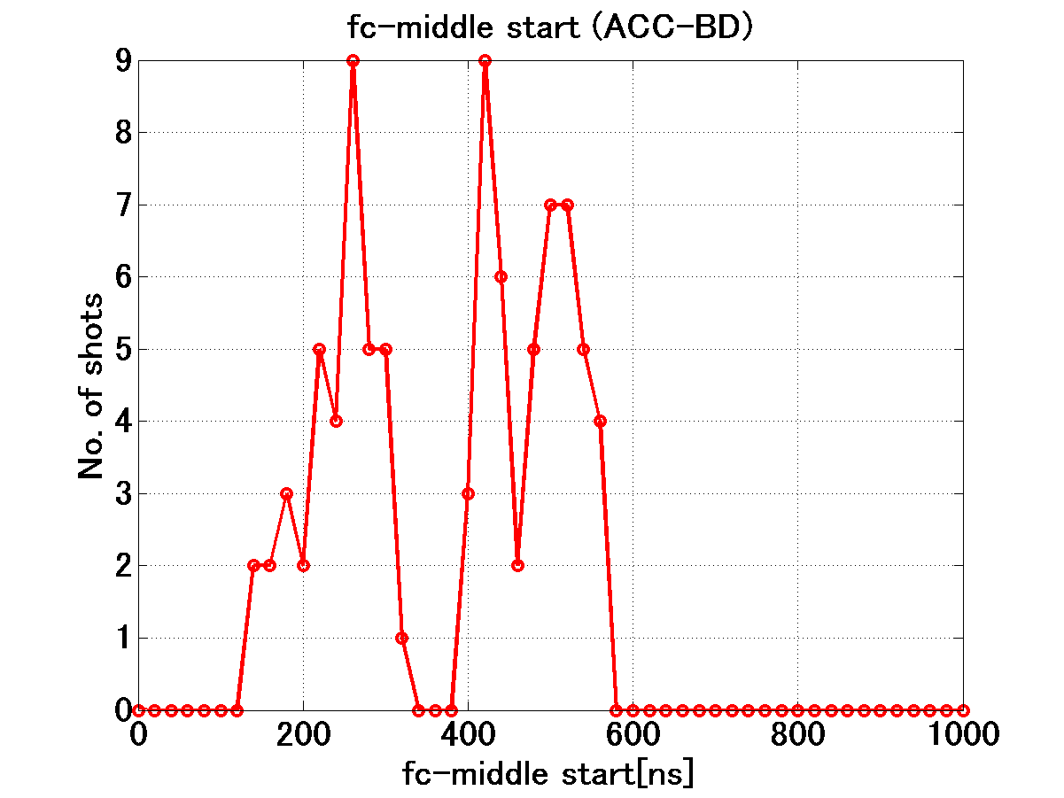
BD trigger timings are again equally distributed in the former and latter pulse
Rs delay
Tr delay
Tr delay vs Rs delay
UP delay
Mid delay
UP delay vs Mid delay

Slide 30
TD18 Run 90 200+50+200 90MV/m double pulse
#BD vs time
BDR vs time
BD pulse shape confirmed by eye BDR unit=[*10⁻⁵ BD/pulse/m]
BDR_Former pulse = 31BD/93hrs → 1.0
BDR_latter pulse = 26BD/93hrs → 0.84
BDR_total = 57BD → 1.84
Almost the same BDR for each pulse, former and latter

Slide 31
TD18 Double-pulse BDR at 90 MV/m
BDR unit=[*10⁻⁵ BD/pulse/m]
TD18 run# | Run 89 | Run 90
ON-OFF-ON ns | 200+210+200 | 200+10+200
BDR of former pulse | 1.5 | 1.0
BDR of latter pulse | 1.9 | 0.84
BD identified roughly → it should be confirmed well.
Almost the same BDR for each pulse
Former/latter
narrow/broad separation
within a factor 2

Slide 32
TD18 Run 98 switching in three power levels in every second for 46.2 hours
Histogram of pulses in terms of Eacc
Input power (MW)
Input power (MW)
90 – 95 – 100 MV/m
RF pulse counts
Power level population
Pulse width=252ns

Slide 33
TD18 BD’s in Run 98
43
Higher power pulse makes bigger BDR.
We compare this result to the usual BDR plot… see next page
8
1
3.3*10⁻⁶ / 2.6*10⁻⁵ / 1.4*10⁻⁴ [BD/pulse/m]

Slide 34
TD18 Result of BDR in hopping three power levels comparing to the usual BDR vs Eacc
Data points from jumping among three levels
No big change appears!
Each individual pulse determines its own breakdown probability

Slide 35
TD18 Run 100, at 100 MV/m Behavior of nine pulses after BD
→More than 50% of breakdowns are not accompanied by any breakdown in following pulses, and 50% do follow.
→Correlation between number of consecutive breakdowns and the hardness of the initial breakdown should be evaluated.

Slide 36
Rs reflection phase varies along structure
The phase decreases about 60deg while the Rs-Tr time increases from 0ns to 120ns (about double filling time) ;
One-pass phase shift increases about 30deg for the structure;
→Roughly +5 degC if due to body temperature rise.
Rs phase
20110108~20110117,pulse width 252ns;
Red point is ACC BD, green is 1st BD;

Slide 37
What caused phase drift in Rs?
IQ drift due to amplitude variation is within a few degrees, → << 60deg.
Body temperature ~ +1degC may give 5 degree/structure → << 30deg.
The frequency of the structure changed → a MHz level?
We measured total phase along structure T24#3. We can compare with that of SLAC as of tuning and that after HG test.
Anything else???

Slide 38
What to do from now till TD24
Expand pulse width up to 400ns →1week?
252→293→352→412 finished in <<1 day
Take BDR vs width at 100MV/m→1week
Take final BDR vs Eacc at 252ns →1week
Dark current
Amount vs Eacc, spectrum measurement →3day
Double pulse operation →1 week
Power calibration as a final work → 1day
Check vacuum performance by removing load lines
Prepare for TD24 installation
Better vacuum, etc.

Slide 39
Nextef expansion is being proceeded
Pulse compression and
KT1~B line
inMarch~April
Nextef
X-band
KT-1
X-band
B
A
KT-2
C-band

Slide 40
Fundamental study with SLAC is kept going in Higashi / Dolgashev studies such as Mo/Cu or SUS/Cu and Moly
We are thinking to start the similar experimental study at moderate gradient level as 80-100MV/m early JFY2011 with mode launcher made by SLAC.

Slide 41
Basic study with coupon and single-cell setup
Coupon
For surface evaluation
such as
Cutting, HIP, purity, heat treatment, CP, EP, etc.
Single-cell setup
Both undamped and damped cell configurations

Slide 42
Nextef summary
Nextef
T24#3
Initial processing up to 110MV/m done
Various HG features are being studied
TD24
Preparing to start as soon as we get from SLAC
Will start building a new power line to shield-B soon
Basic study
SLAC-KEK single-cell program is extensively ongoing
Started basic study of surface features on material and treatment
Preparing a single-cell test setup to be starting in early JFY 2011
Field-emission microscope development is kept

