Slide 1
Recent results on CP violation from the B factory experiments
SLAC Summer Institute
July 27, 2011
J. Chauveau
LPNHE
Université Pierre et Marie Curie, Paris-VI
On behalf of the BABAR Collaboration

Slide 2
Context
Motivation for the B factories
The BABAR Physics Book SLAC-R-504 (1998)
  Primary goal:
  To test the Cabibbo-Kobayashi-Maskawa model for CP Violation ( K vs B)
  Overconstrain the Unitarity Triangle, the “UT” (sides, angles)
    Does it close ?
    Is there New Physics Beyond the Standard Model?
    (CKM not enough for A(baryon))
  Other goals
  What now ?

Slide 3
Outline
CP-violation (CPV) and the CKM model
The B factories
The angles of the UT (hadronic B decays)
  β/φ₁
  γ/φ₃
The sides (semileptonic/leptonic) B decays
Rare hadronic/radiative B decays
Search for CPV in charm and τ decays
Outlook
B charmonium K⁰
B (D or D) K
B φφK

Slide 4
CP violation in (B) meson decay
At least 2 amplitudes for CP violation to occur.
3 types of CP violation:
Direct charged and neutral B strong phases
In mixing neutral suppressed
In the interference neutral golden modes
between mixing and decay + others.
One or several types.
CP
mixing
decay

Slide 5

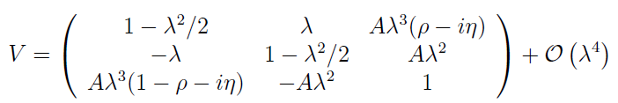
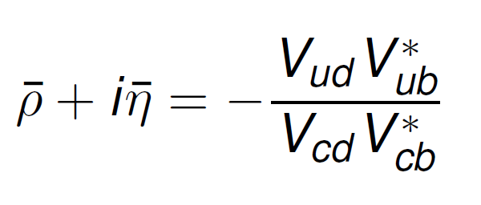
CKM: the matrix and the triangle
di
W⁻
Vij
uj
Wolfenstein parameterization
/ϕ₂
/ϕ₃
/ϕ₁

Slide 6
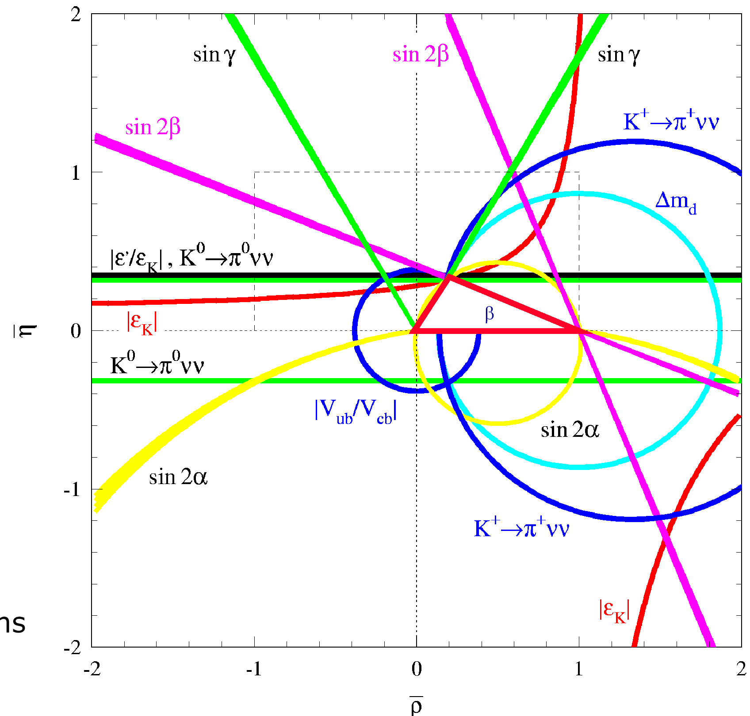
CKM matrix and the UT
CKMfitter: http://ckmfitter.in2p3.fr , UTfit: http://www.utfit.org/UTfit/

Slide 7

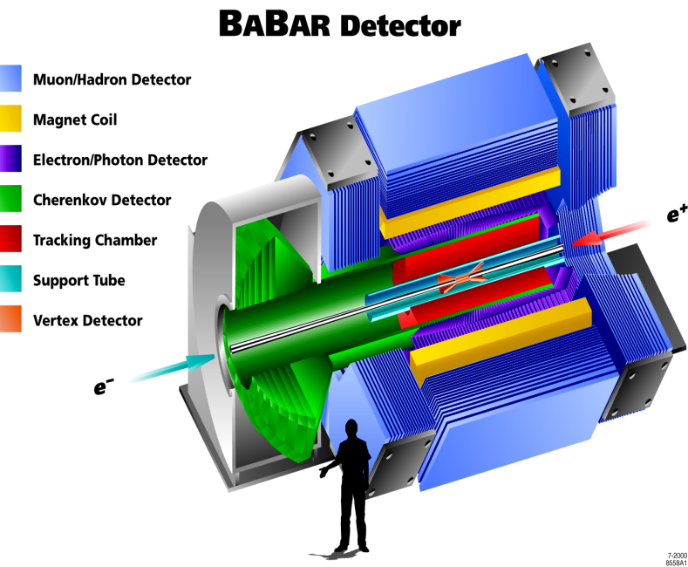
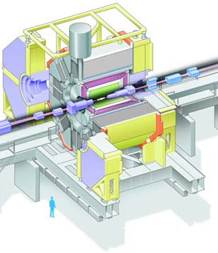
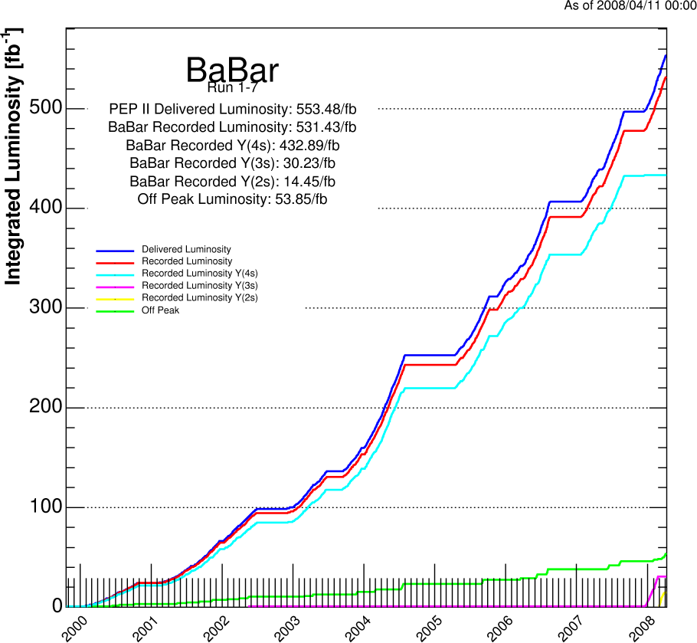
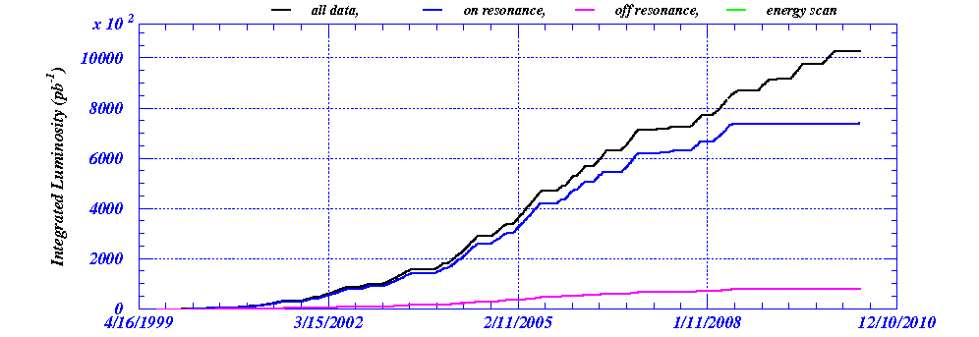
B factories
SLAC PEP-II
KEK-B
BELLE
1031 fb⁻¹
770 M BB
531 fb⁻¹
470 M BB

Slide 8
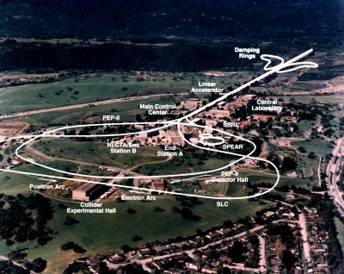
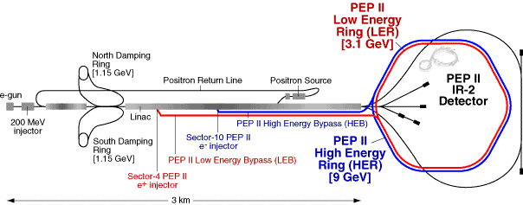
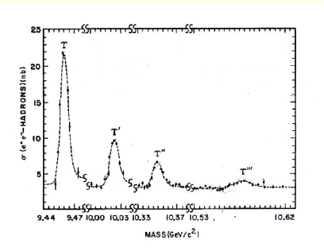
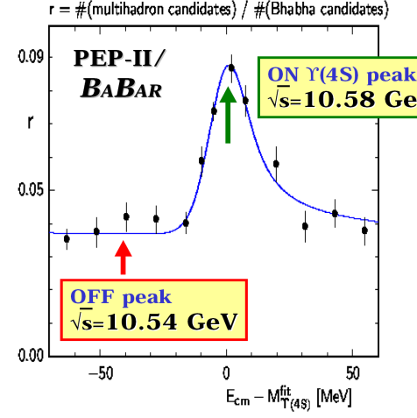
PEP-II and BABAR
Asymmetric energies, Y(4S) boosted, βγ=0.56
ON Υ(4S) peak
√s = 10.58 GeV
OFF peak
√s = 10.54 GeV

Slide 9
BABAR Collab. B. Aubert et al., Nucl.Instrum.Meth.A479:1-116,2002

Slide 11
The angles
/ϕ₂
/ϕ₃
/ϕ₁

Slide 12

Time dependent CP Asymmetries
(the angle β/φ₁)
b
d(s)
K_{S}(Ф)
b
c
B_{(s)}⁰
t
d(s)
s
CP
c
J/ψ
mixing
B_{(s)}⁰
c
J/ψ
decay
s
d(s)
c
d(s)
d(s)
K_{S}(Ф)
t
b
V*_{td(s)}
For B decaying to f_{CP} (CP eigenstate) .
Im λ_{f}=η_{CP} sin 2β

Slide 13
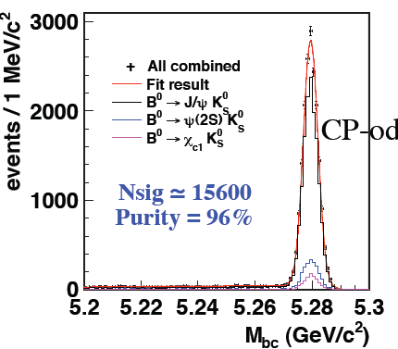
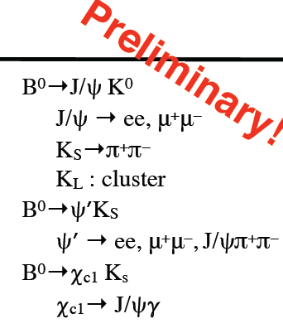
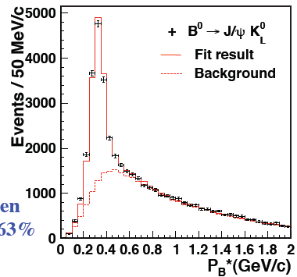
B charmonium K⁰
770 M BB
H. Sahoo at FPCP-2011
New Belle Result on full dataset
# events
12681  114
10041  154
1981  46
943  33

Slide 14
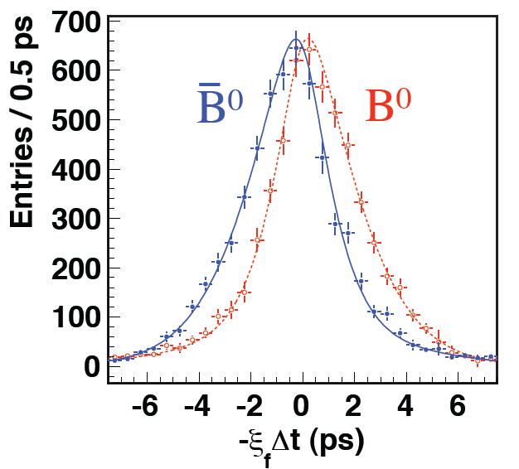
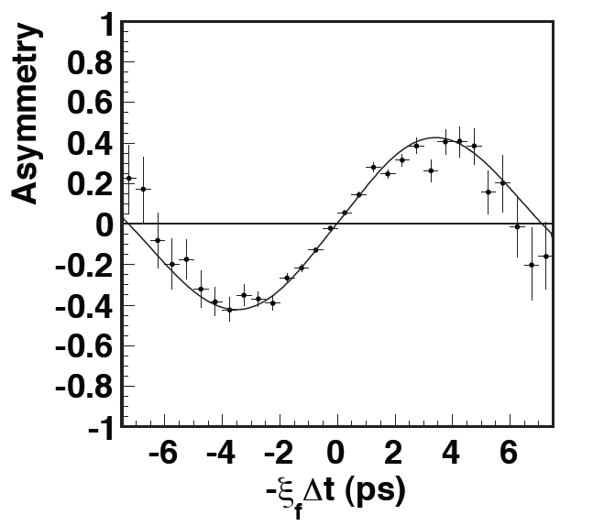
b → (c cbar) s
S=0.666 ± 0.031 ± 0.013
C=0.016 ± 0.023 ± 0.018
Phys.Rev.D79:072009,2009
S=0.668 ± 0.023 ± 0.013
C=0.007 ± 0.021 ± 0.014
PRELIMINARY (Moriond EW )
465 MBB
772 MBB
J/ψ K_{S}
J/ψ K_{L}

Slide 15
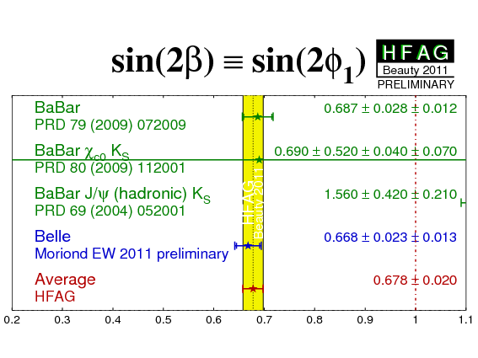
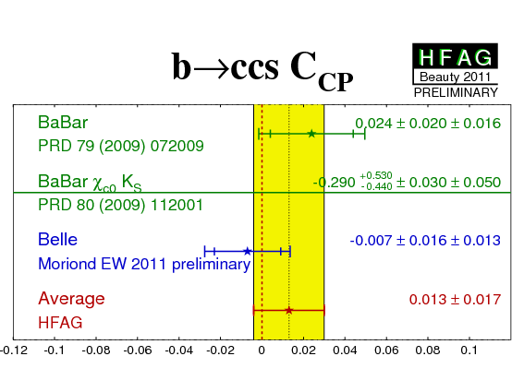
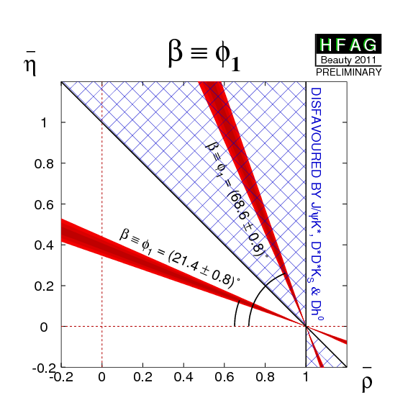
The angle β (bccs)
In SM, expect, S=ηsin2β, C=0
sin2β= 0.678  0.020
β=(21.4  0.8) ⁰

Slide 16
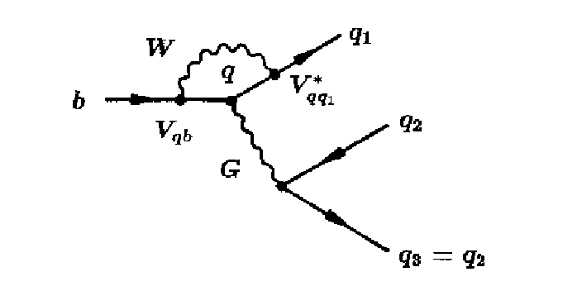
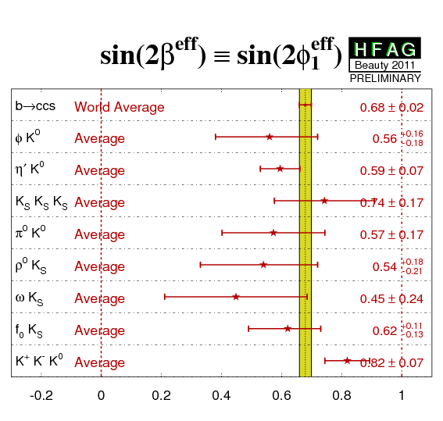
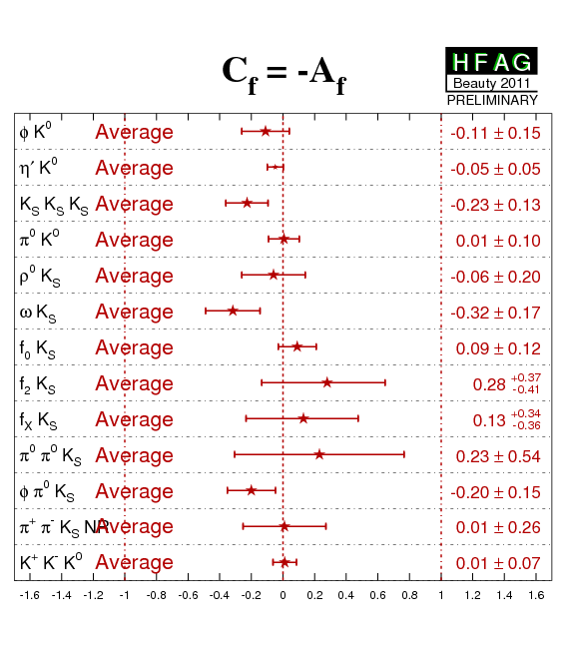
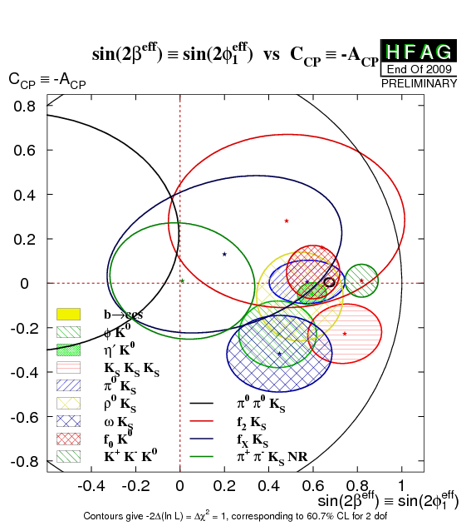
The angle β (bs penguin)
loop
b  sss same weak phase as b  ccs
only approximate: depends on hadronic
parameters
  often increasing β_{eff}
  often small.

Slide 17
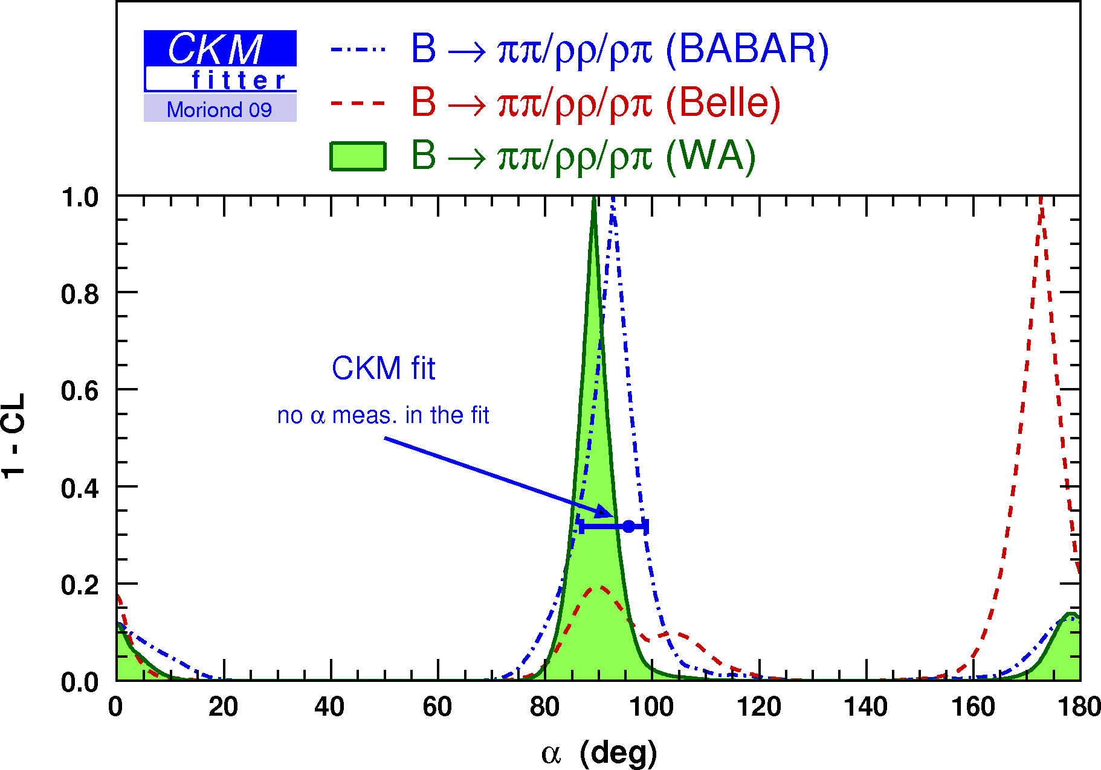
The angle α/φ₂
V*_{td}
d
π ⁻
d
u
V_{ub}
π⁺
d
b
u
u
B⁰
t
V*_{ub}
π⁺
b
u
b
d
d
B⁰
π ⁻
d
d
t
Most sensitive results are not recent, not described here.
In a nutshell:
TDCP more complex because of the Penguin pollution.
Solvable in 2-body (ππ) or quasi-2-body (ρρ) using isospin (Gronau-London [GL] method)
Dalitz analyses of the ρπ channels also sensitive
The ρρ channel using GL is the most sensitive
(Penguin amplitude small and well measurable)

Slide 18
The angle γ/φ₃
s
b
u
K⁺
D⁰
u
V_{ub}
c
b
c
B⁺
B⁺
D⁰
s
u
u
u
K⁺
u
B→ D(*)K(*),D or D* D
  same D final state, hence b → uW and b →cW interfere (arg[V_{ub}]=-γ).
  Pure Tree processes!
  Large uncertainties because disparate magnitudes (color suppression)
  Works for charged (and neutral) B’s.

Slide 19
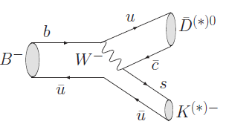

φ₃/γ methods
Gronau London Wyler: D  CP eigenstates
  R±_{CP}= 1 + r_{B}² ±2r_{B}cos(δ_{B})cos(φ₃),
  A±_{CP}= ±2r_{B}sin(δ_{B})sin(φ₃) / R±_{CP}
Atwood Dunietz Soni: DCSD(bc) + CA(bu) new results
  R_{ADS} = r_{B}² + r_{D}² + 2 r_{B} r_{D} cos(δ_{B} + δ_{D}) cos(φ₃),
  A_{ADS} = 2 r_{B} r_{D} sin(δ_{B} + δ_{D}) sin(φ₃) / R_{ADS}
Giri Grossman Soffer Zupan: Dalitz 3-body D decays new results
  x⁺ = r_{B} cos(δ_{B}+φ₃ ) y⁺ = r_{B} sin(δ_{B}+φ₃ )
  x⁻ = r_{B} cos(δ_{B}−φ₃ ) y− = r_{B} sin( δ_{B}−φ₃)
Benefits from charm measurements (CLEO-c)
r_{B}, δ_{B}, δ_{D}, φ₃

Slide 20
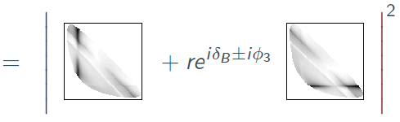

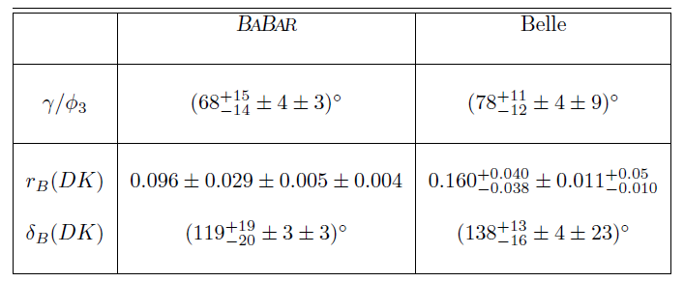
The angle γ/φ₃ (GGSZ)
Assuming no CPV in D decays and neglecting D mixing,
s₋
s₊
s₊
s₋
Measure Dalitz plot from D*⁺ Dπ⁺ in the same data sample with
Dalitz plot model to describe the δ_{D}(s₊,s₋) phase motion brings dominant systematics
PRL 105, 121801 (2010)
Phys. Rev. D 81, 112002 (2010)
HFAG-2010

Slide 21
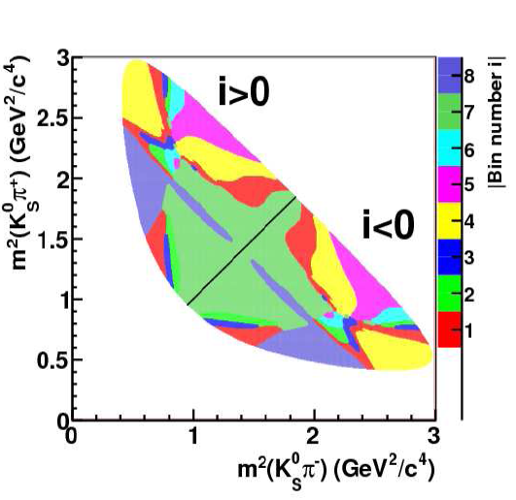
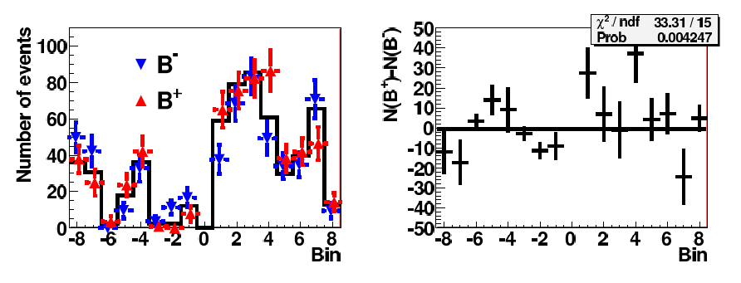
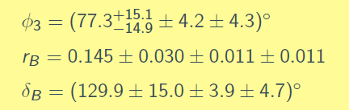
New GGSZ result
Giri, Grossman, Soffer, Zupan, PRD 68 05418 (2003)
A. Bondar, Y Poluetkov, PRD70, 072003 (2004)
J. Dalseno (Belle) EPS 2011
to remove model systematics, use optimal binning in the Dalitz plot (DP)
Uses the CLEO (eventually BES-III) quantum correlation in e+e- → DD at Psi ‘’
(s₊)
(s₋)
DP systematics reduced by one half
lose statistical precision,
  irrelevant for 10 ab⁻¹ samples
Preliminary

Slide 22
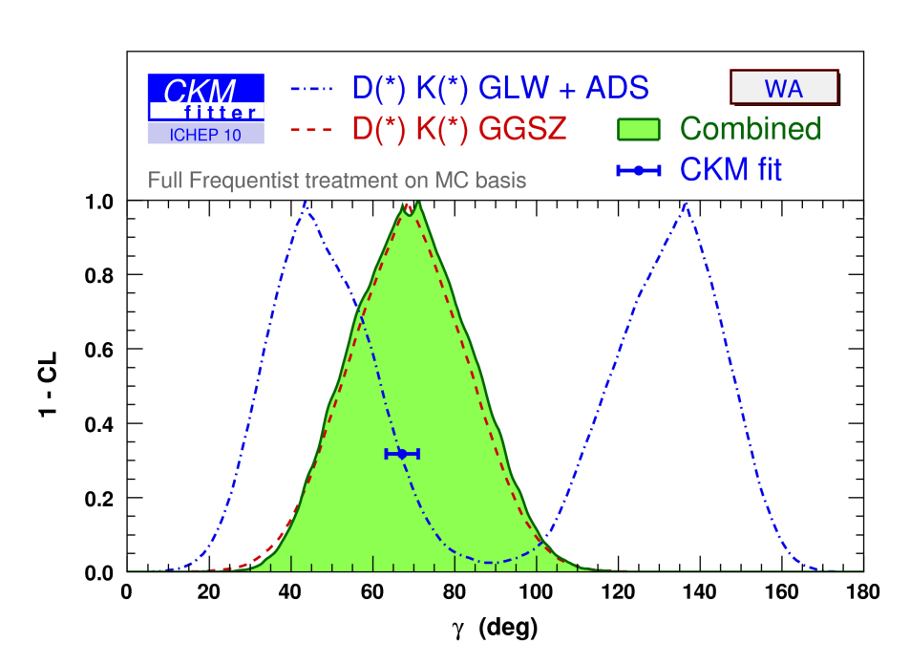
The angle γ/φ₃
γ = (71 ⁺²¹ )⁰
⁻²⁵
The only angle with experimental
precision worse than the fit.
Great expectations from LHCb.
Recall, pure tree processes.

Slide 23

The sides
ν
ν_{τ}
q
l
l(τ)
b
W⁻
b
W⁻
V_{cb} or V_{ub}
c or u
V_{ub}
u
h/X
u,d

Slide 24
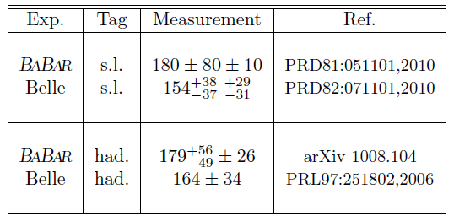
(Semi)leptonic B decays
R. Kowalewski at Beauty 2011
|Vcb| (10⁻³)
  Exclusive 38.9  1.1
  Inclusive 41.9  0.7
  Average 41.0  1.3
  scale factor 2.2
  in CKMfitter: 40.89 0.38 0.59
|Vub| (10⁻³)
  Exclusive 3.25  0.12  0.28
  Inclusive 4.25  0.15  0.20
  Average 3.97  0.43
  scale factor 2.0
  In CKMfitter: 3.92  0.09  0.45
BR (B  τν_{τ}) (10⁻⁶)
In CKMfitter: 168  31

Slide 25
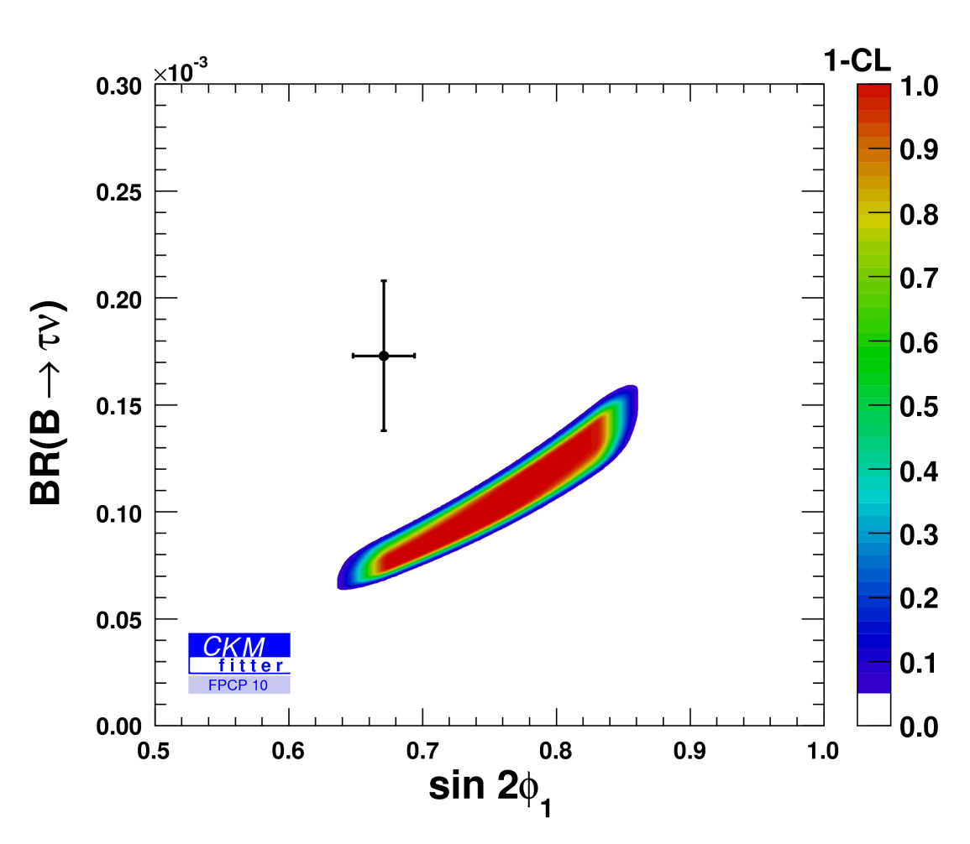
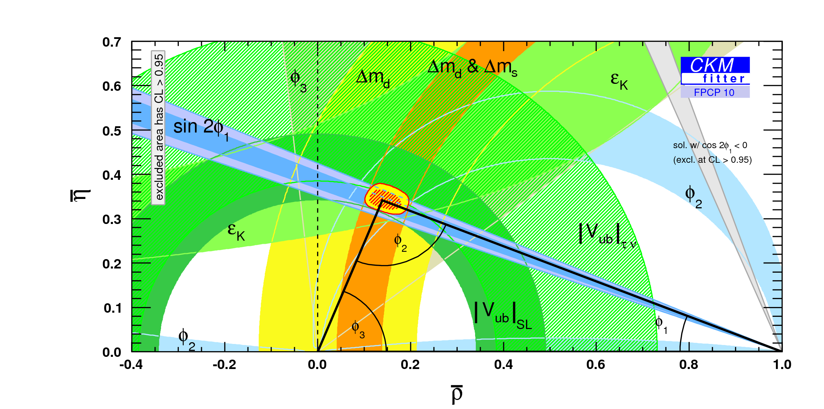
Vub, Vub/Vcb, status
  Marginal agreement between inclusive and exclusive measurements both for Vub and Vcb
  Vub from τν exceeds Vub from semileptonics

Slide 26
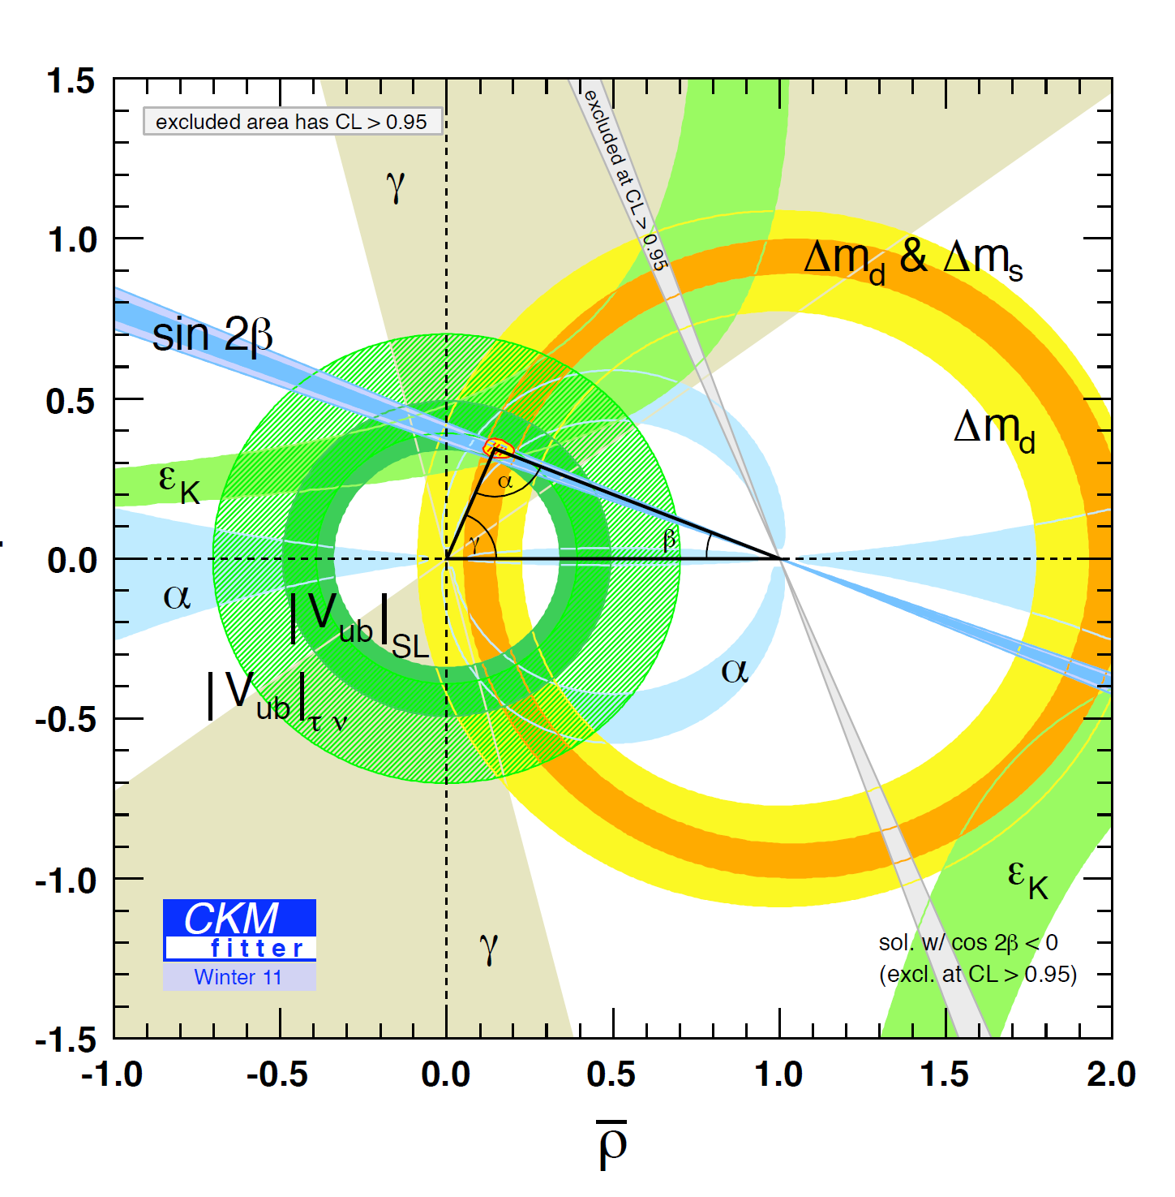

Global CKM fits
Where is the new physics?
CKMfitter: http://ckmfitter.in2p3.fr , UTfit: http://www.utfit.org/UTfit/
CKMfitter Input:
|Vud|, |Vus|, |Vcb|, |Vub|,
BR(B ◊ τν)
Δmd, Δms, εK, sin2β, α, γ.
Roadmap
CL=95,45%
SM p-value 3.3% (or 2.1σ)
arXiv:1106.4041v1 [hep-ph]
Pure tree processes to determine the SM parameters. γ!
loops (mixing, FCNC (penguins)) to determine same parameters and look if they are different.
acceptable consistency
there are tensions
Look for New Physics
in quantum fluctuation processes
aka loops

Slide 27
Loops…
Charmless hadronic B decays (gluonic Penguins)
  3-body e.g. B  PPP
  quasi 2-body like B  VV, polarization puzzle
  final states with even more multiplicity
  An example is BφφK
Rare radiative decays (EW Penguins)

Slide 28
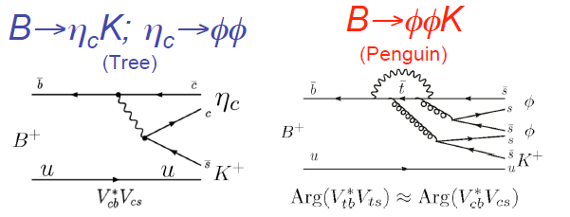
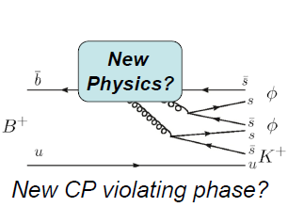
B  φ φ K (1)
SM physics in the two diagrams, can be considered a single weak
amplitude, hence no CP-asymmetry predicted by the SM.
A ‘New Physics’ diagram may carry a non trivial phase, models predict
A_{CP} as high as 40% [M. Hazumi PLB583, 285 (2004)]
This analysis:
measure the B⁺ and B⁰ branching fractions below and under the η_{c}
measure the corresponding CP-asymmetries
understand the partial waves at play

Slide 30
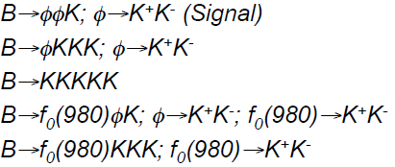
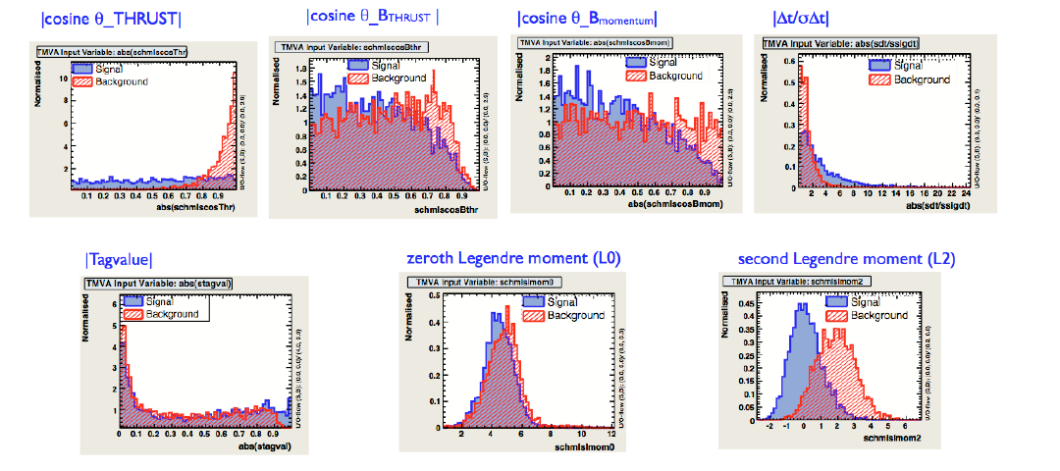
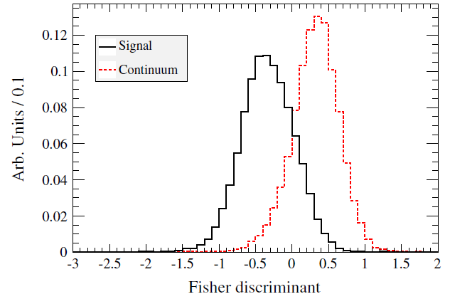
B  φ φ K (2)
Signal: B to five kaons
backgrounds
  peaking from B decays
  continuum
1
Zones in (m_{φ1}, m_{φ2}) plane
4
3
2
5
multivariate techniques to fight the contimuum background. Here: a Fisher discriminant
Signal continuum

Slide 31
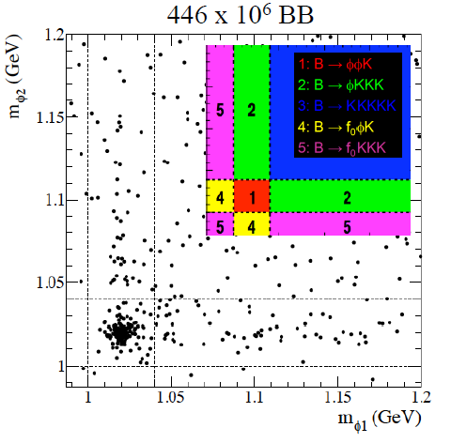
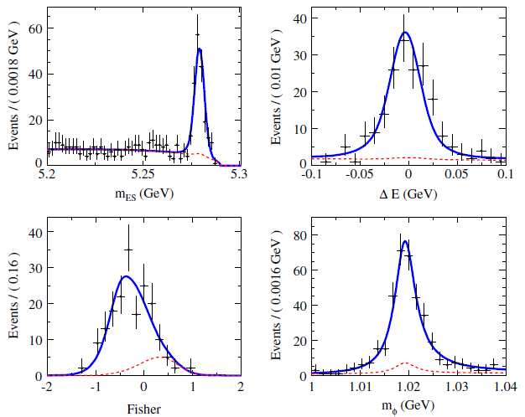
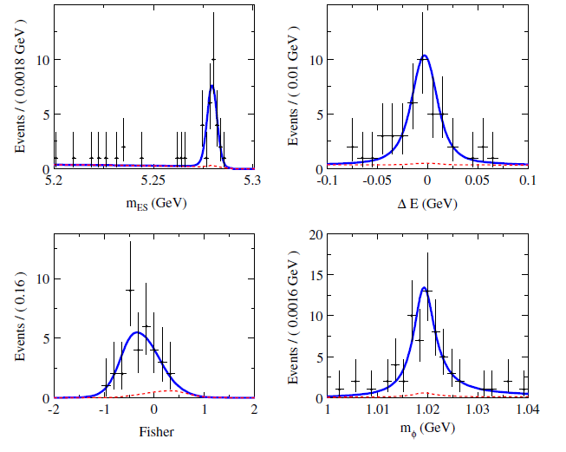

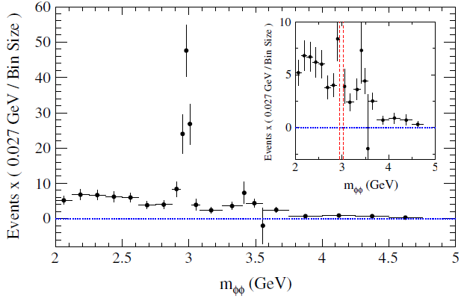


B  φ φ K (3)
PRD84, 012001 (2011)
A_{CP} (m_{φφ} <2.85 GeV) = -0.10  0.08  0.02
A_{CP} (m_{φφ} in [2.94, 3.02] GeV) =
η_{c}
χ_{c}
A_{CP} ~0 consistent with SM

Slide 32
Search for CPV in τ/charm
Charm
  D mixing established
  Is CPV next?
    In mixing?
    In decay?
  Huge statistics and favorable S/B in decays
    2-body
    3-body
    Triple product asymmetries
    Rare decays
Taus
  Recent measurements by Belle and BABAR of
  A_{CP} in τK_{s} π ν_{τ}
Nothing significant yet

Slide 33
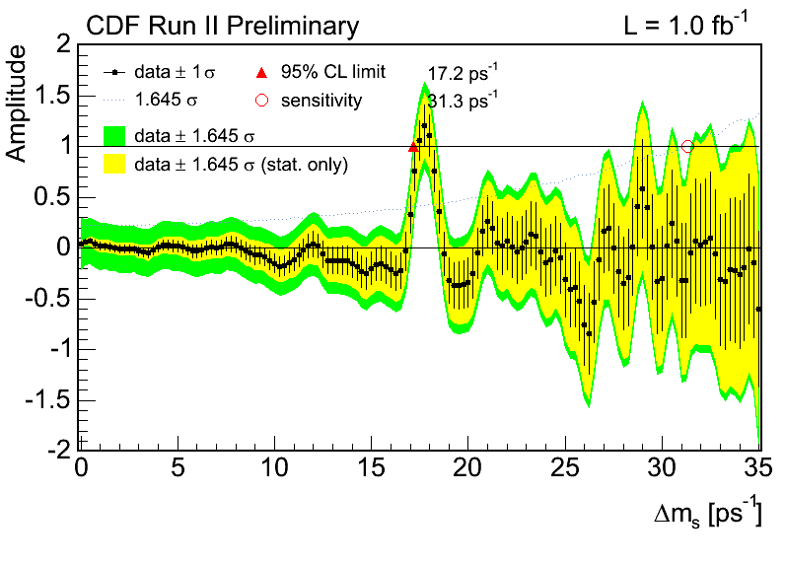
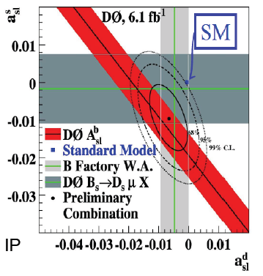
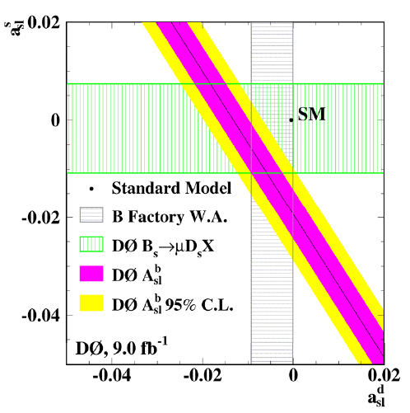
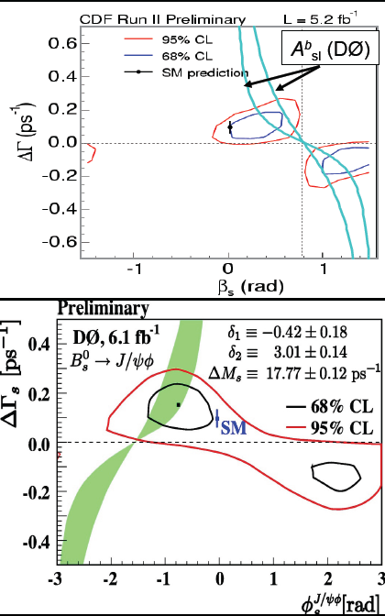
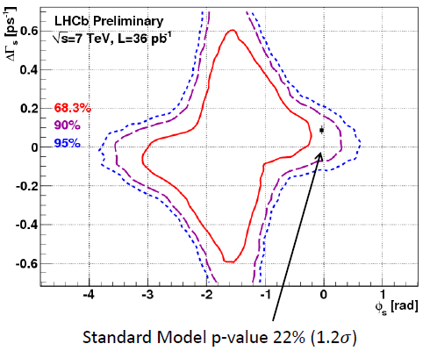
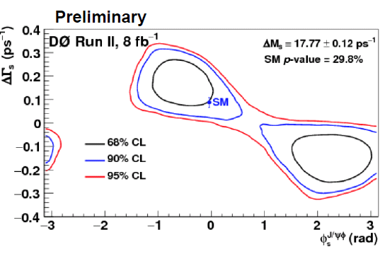
The Bs
Hadron colliders experiments have the lead.
  B_{s} mixing
  A_{sl}
  B_{s}J/ 
  bccs similar to B_{d}  J/K_{s}, but B  VV
  hence spin complexity.
  B_{s}J/ f⁰ more tractable.
Belle (and BABAR) ran above the Y(4S)
  f_{s}: B_{s} fraction in continuum (from semileptonic decays at BABAR),
  B_{s}J/ f⁰ (seen at Belle)

Slide 34
Summary and outlook
The wealth of the B factory results were key to establish the CKM model as the dominant mechanism of all observed CP-violation.
CP and CKM related results are only one part of the B factory harvest.
e+e- clean environment enables to perform quite involved analyses.
There are still many analyses in progress
  BABAR and BELLE collaborate to produce the PBF book to document ‘legacy’ analyses,
  LTDA effort developped to keep BABAR dataset usable in the (far) future.
Now is the time for b physics at hadron colliders.
What ‘New Physics’ at the energy frontier (if any…), or above?
  What impact on the flavor problem?
  Current phenomenology implies a non generic NP flavor sector.
New e+e- colliders are approved to collect datasets 50-100 bigger.

Slide 35
Backup slides

Slide 36
BABAR TopCite 100+ References (May 2010)
The BABAR Physics Book SLAC-R-504 (1998)
BABAR detector: Nucl.Instrum.Meth.A479:1-116,2002
HFAG: http://www.slac.stanford.edu/xorg/hfag/
CPV in B decay:
  Discovery Phys.Rev.Lett.87:091801,2001 (BABAR), - 091802 - (Belle)
  Long paper Phys.Rev.D66:032003,2002.
Charmless 2-body: Phys.Rev.Lett.89:281802,2002.
Ds0*(2317)^{+:} Phys.Rev.Lett.90:242001,2003.
Polarization puzzle in B→VV: Phys.Rev.Lett.91:171802,2003.
B ---> X(s) l+ l- :Phys.Rev.Lett.93:081802,2004.
B ---> X(c) l nu and |V(cb)|: Phys.Rev.Lett.93:011803,2004.
B- ---> X(3872) K- : Phys.Rev.D71:071103,2005.
Direct CP in B0 ---> K+ pi-: Phys.Rev.Lett.93:131801,2004.
Ambiguity-free measurement of cos 2beta: Phys.Rev.D71:032005,2005.
X(4260): Phys.Rev.Lett.95:142001,2005.
τ→e,μ+γ:Phys.Rev.Lett.96:041801,2006, Phys.Rev.Lett.95:041802,2005.
D mixing: Phys.Rev.Lett.98:211802,2007.

Slide 37




http://www-public.slac.stanford.edu/babar/Poster/slac_nobel_poster_2008.pdf

Slide 38

Amplitude structure in the SM
T
P
EWP
Cabibbo and color suppression
λ⁴
λ²
A_{ccs} ~ V_{cb} V_{cs}* T_{ccs} + V_{ub} V_{us}* P_{s}
A_{sss} ~ V_{cb} V_{cs}* P + V_{ub} V_{us}* P
A_{ccd} ~ V_{tb} V_{td}* P + V_{cb} V_{cd}* T_{ccd}
A_{uud} ~ V_{tb} V_{td}* P + V_{ub} V_{ud}* T_{uud}
(T_{cus} + T_{ucs}) common D decay modes
Charmonium K_{S,L} β
ΦK_{S} β
D⁺D⁻ β+φ
π⁺ π⁻ α_{eff}
GOLDEN
eff
λ³
DK γ

Slide 39
b → qq-bar s (penguin)
s
Loop diagrams with same weak phase as ccbar s in SM
new physics in loops ?
New results available, in particular from amplitude analyses

Slide 40

Experimental Technique
Exclusive
B Meson Reconstruction
B-Flavor Tagging
(flavor eigenstates) lifetime, mixing analyses
(CP eigenstates) CP analysis

Slide 41


The angle gamma (ADS)
Phys. Rev. D 84, 012002 (2011)

Slide 42

ϕ₃/γ results (GGSZ)
PRL 105, 121801 (2010)
D→ Ks π⁺ π⁻
D→ Ks K⁺ K⁻
DK
D*K
D*→D⁰π⁰
s-
D*K
D*→D⁰γ
DK*
mES
ΔE
s−
s+
mES
ΔE
s−
s+

Slide 43


GGSZ
PRL 105, 121801 (2010)
2ϕ3
2ϕ3
2ϕ3
Phys. Rev. D 81, 112002 (2010)

Slide 44


Summary on angles
CP violation established
the angles alone bring a significant constraint on the UT apex
γ/φ3: more precision needed to bring a constraint

Slide 45


Summary on sides
CP conserving
w/o τν
sl and τν separately
Vub averaged

Slide 46
Methods
R. Kowalewski Beauty 11
q
ν
Semileptonic inclusive and exclusive B decays
  Well established analyses
  Can use recoil samples (hadronic or semileptonic tags)
  Inclusive: b→q lν + QCD corrections+OPE (α_{s}, Λ/m_{b})
  also relevant for b→ s γ
  Exclusive: form factor(s) describing B → lν hadron – LQCD
  Systematic trend where the inclusive results are higher than exclusive ones.
l
b
W⁻
c or u
V_{cb} or V_{ub}
h/X
u,d
Purely leptonic B decays (B →τν)
  Theory more straightforward, still LQCD for f_{B}
  Underconstrained events → tagged samples
  Very hard measurements
ν_{τ}
l(τ)
b
W
V_{ub}
u

Slide 47

B Kππ⁰

Slide 48

B Kππ⁰

Slide 49


Slide 50

Rare radiative decays

Slide 51

τ Ks π ντ

Slide 52


Slide 53


Slide 54


