Slide 1
Testing astrophysical models for the PAMELA positron excess with cosmic ray nuclei
Philipp Mertsch
Rudolf Peierls Centre for Theoretical Physics, University of Oxford
TeV PA, SLAC, 15 July 2009

Slide 2
slide by M. Cirelli

Slide 3
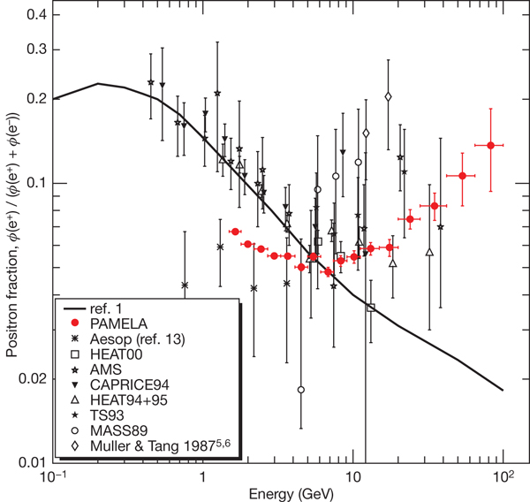
The PAMELA Anomaly
PAMELA has measured positron fraction,
Anomaly: excess above astrophysical background
Source of anomaly?
DM decay/annihilation
Pulsars
Other astrophysics
Adriani et al. Nature 458, 607-609 (2009)

Slide 4
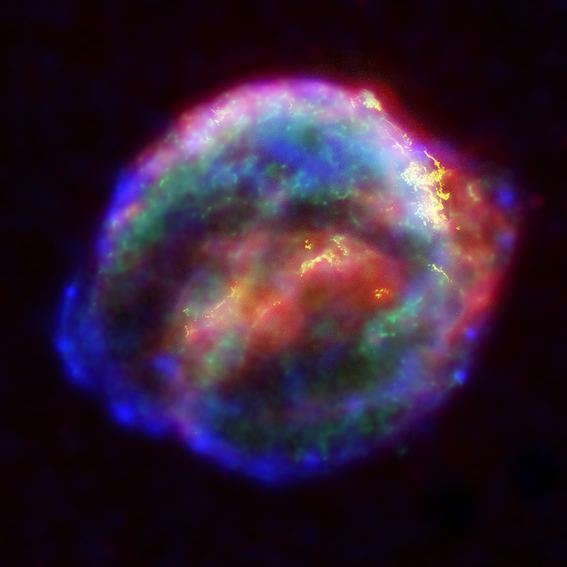
Secondary during Propagation
Interstellar Medium 90% H, 10% He
source of CR protons, e.g. SNR
…
…
…

Slide 5
The Simple Leaky Box Model
Cosmic rays confined in galaxy by tangled magnetic field but with small, constant escape probability
Exponential path length distribution
If the average column depth is energy/rigidity dependent,
one can explain:
nuclear secondary-to-primary ratios and
spectral index of ambient cosmic rays.
GALPROP which solves the full diffusion equation gives same results.

Slide 6
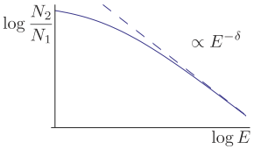
Nuclear Secondary-to-Primary Ratios
Transport equation in Leaky Box Model:
Primary spectrum: Secondary spectrum:
Secondary-to-primary ratio:

Slide 7
Propagation of .
Electrons and positrons loose energy by:
Inverse Compton Scattering on CMB
Synchrotron Radiation on galactic magnetic fields
Primary spectrum: Secondary spectrum:
Secondary-to-primary ratio:

Slide 8
Dark Matter as Source of .
Dark matter annihilation
Annihilation rate
Leads eventually to SM particles, e.g.
If WIMPs produced thermally, need astrophysical or particle physics boost factor
Nardi et al., JCAP 0901:043,2009
Dark matter decay
Similar, but decay rate
Lifetime ~10⁹ times age of universe from dim-6 operator suppressed by M_{pl}

Slide 9
Pulsars as Source of .
Hooper et al., JCAP 0901:025,2009
Combination of global, galactic contribution and two nearby mature pulsars, Geminga (157 pc) and B0656+14 (290 pc), could fit PAMELA excess
Parameters of pulsars, however, poorly known
FERMI could possibly find anisotropy of nearby B0656+14 pulsar after five years

Slide 10
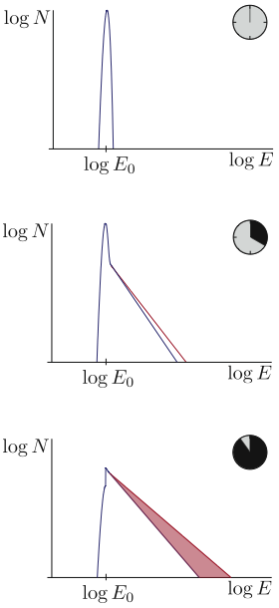
Astrophysical Source of .
Rise in positron fraction could be due to secondary positrons produced during acceleration and accelerated along with primary electrons
Blasi, arXiv:0903.2794
Assuming production of galactic CR in old SNR, PAMELA positron fraction can be fitted
This is a general feature of every stochastic acceleration process, i.e. if
D. Eichler, Astrophys. J. 237, 809 (1980)
R. Cowsik, ApJ 241, 1195 (1980)

Slide 11
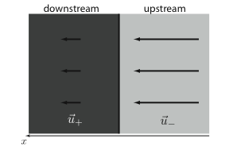
DSA with Secondaries
Acceleration determined by compression ratio:
Solve transport equation,
Solution:
where

Slide 12
Acceleration of Secondary .
Total electron + positron flux
primary electrons:
secondary from propagation:
secondary , accelerated in source:
Blasi, arXiv:0903.2794
Positron ratio

Slide 13
Explanations for PAMELA Excess
DM | ✓
Pulsars | ✓
Acceleration of Secondaries | ✓

Slide 14
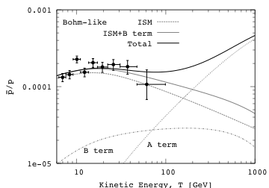
Antiproton-to-proton Ratio
DM | (✓)
Blasi, Serpico, arXiv0904.0871
Pulsars | ✗
Acceleration of Secondaries | ✓

Slide 15
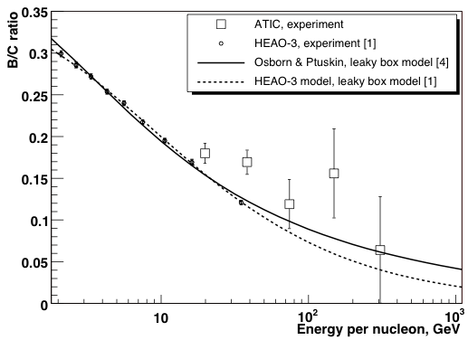
Nuclear Secondary-to-Primary Ratios
 | nuclei
DM | ✗
Pulsars | ✗
Nuclear secondary-to-primary ratios used for testing and calibrating propagation models
Panov et al. (ATIC), ICRC 2007
DM and pulsars do not produce nuclei!

Slide 16
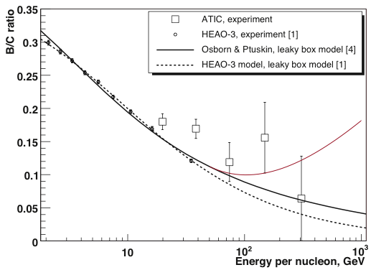
Nuclear Secondary-to-Primary Ratios
 | nuclei
DM | ✗
Pulsars | ✗
Acceleration of Secondaries | ✓
If nuclei are accelerated in the same sources as electrons and positrons, nuclear ratios must rise eventually
Panov et al. (ATIC), ICRC 2007
?
?
This would be a clear indication for acceleration of secondaries!

Slide 17
Calculation
Transport equation
with boundary condition
Solution:
where

Slide 18
Diffusion Coefficient
Diffusion coefficient not known a priori
Bohm diffusion sets lower limit
Difference parametrised by fudge factor
determined by fitting to one ratio, allows prediction for other ratio

Slide 19
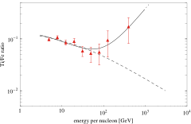
Titanium-to-Iron Ratio
PM and Sarkar, arXiv:0905.3152
ATIC-2 Zatsepin et al., arXiv:0905.0049
spallation during propagation only
spallation also during acceleration
Titanium-to-iron ratio used as calibration point for diffusion coefficient:

Slide 20
Boron-to-Carbon Ratio
PM and Sarkar, arXiv:0905.3152
HEAO-3
Engelmann et al., A&A 233, 96 (1990)
ATIC-2 Panov et al., ICRC 2007
CREAM
Ahn et al., Astropart. Phys. 30, 133 (2008).
spallation during propagation only
spallation also during acceleration
PAMELA is currently measuring B/C with unprecedented accuracy
A rise would rule out the DM and pulsar explanation of the PAMELA excess.

Slide 21
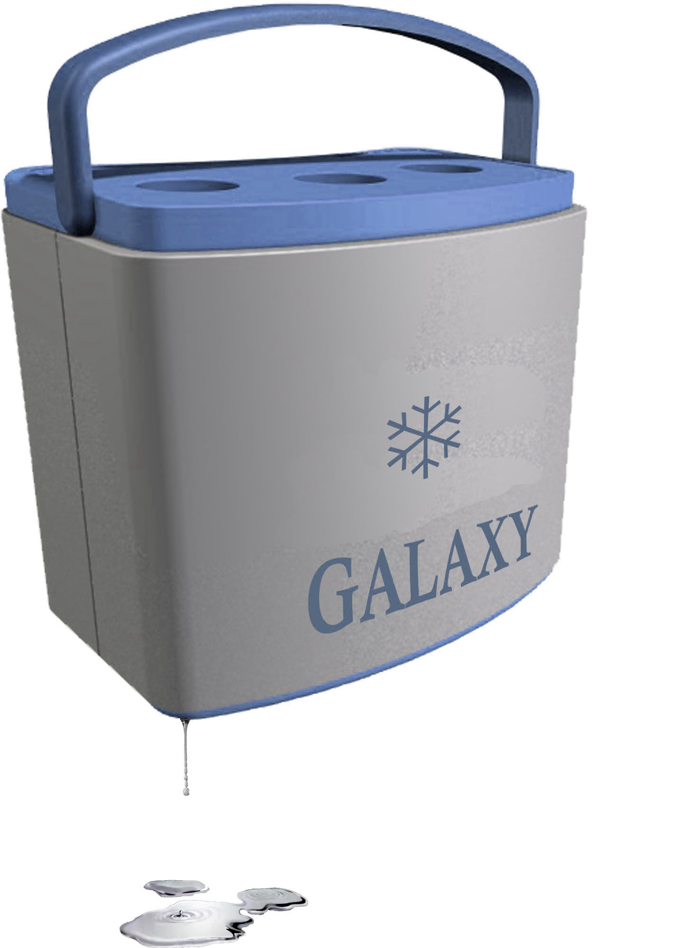
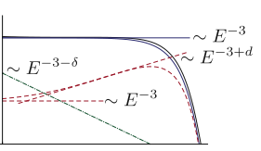
Summary
Background for secondary-to-primary ratios in Leaky Box Model
Model for acceleration of secondary positrons and electrons in source
Nuclear secondary-to-primary ratios as a unique test of these models

