Slide 1
Neutrino oscillation in Magnetized Gamma-Ray Burst Fireball
NISSIM ILLICH FRAIJA
This work (with collaborators Sahu et al) was accepted in PRD (arXiv: 0904.0138)

Slide 2
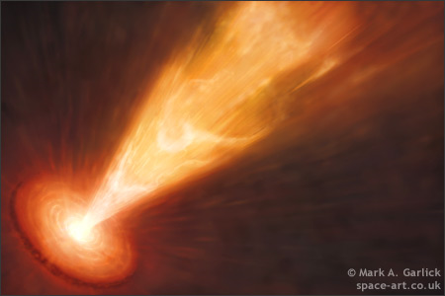
GRBs
We know :
The brighest explotions in the Universe ~10⁵³ erg
flashes of non-thermal bursts of low energy 100 keV- 1 MeV
high variability
Huge Optical depth due the process
distribution Isotropic
Cosmological distances.
There are two classes
(Short GRB less than 2 s – long GRB greater than 2 s).
Long GRB is related to Supernova
Short GRB is related to the Coalescing of compact binaries
.
e⁻e⁺

Slide 3
A generic GRB fireball (B. Zhang and Meszaros Int. J. Mod.Phys. A19, 2004 )
UV/opt/IR/radio
gamma-ray
central photosphere internal external shocks
engine (shocks) (reverse) (forward)
r~10⁷cm
T~10 MeV
t~10² s
r~10¹²cm
t~10³ s
r~10¹⁴cm
t~10⁶ s
r~10¹⁶cm

Slide 4
GRB fireball – Aproximate Inicial state
Progenitor
ν
γ
e±
n
Characteristics
p
Energy
Temperature
Inicial radium
Optical Depth
There is B~10⁴ G
Is thermalized
This MeV neutrinos are similar to the one produced by type II Supernova (SN1987A)

Slide 5
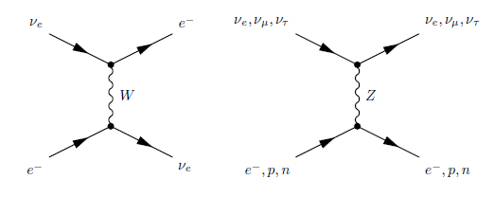
_{e}
if
,
neutrino test
Medium
particles

e⁻
e⁺
n
B (magnetic field)
p
^{P}

Slide 6
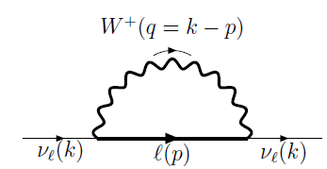
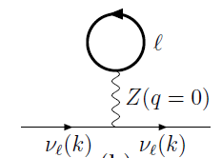
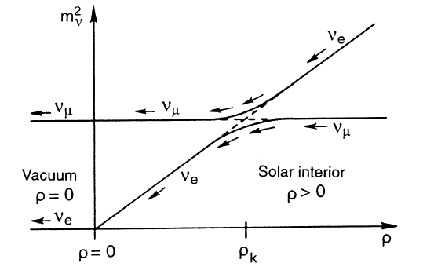
In the Fireball we have Baryons, e ± in a magnetized medium,
f
f
MSW Effect
where,
where,
Resonance condition

Slide 7
RESULTS

Slide 8
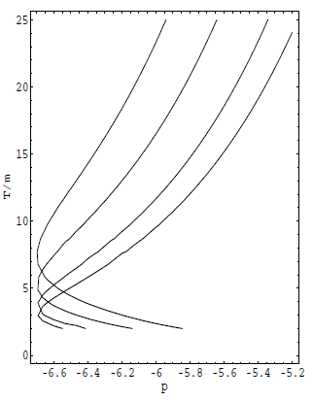
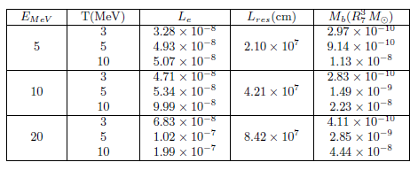
SNO (Sudbury Neutino Observatory):
parameters
6x10⁻⁵eV²< m²<10⁻⁴ eV² and 0.64<sin²2<0.96
m²~ 7.1 x 10⁻⁵ eV² sin²2~0.69
Resonance length
=10^{p} m

Slide 9
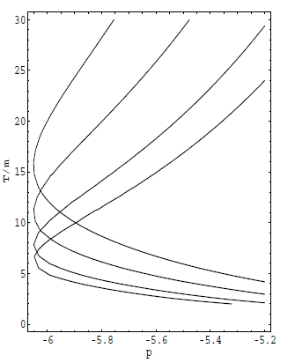
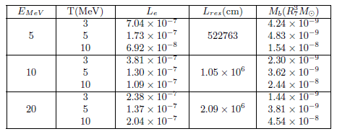
Super Kamiokande:
Parameters
1.9x10⁻³eV²< m²<3.0x10⁻³ eV² and 0.9<sin²2<1.0
m²~ 2.5 x 10⁻³ eV² sin²2~0.9
Resonance length
=10^{p} m

Slide 10
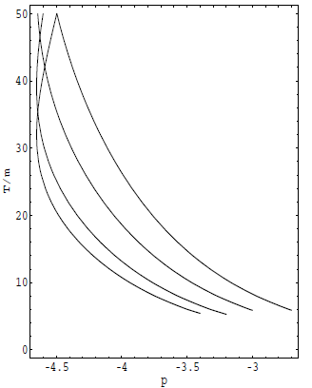
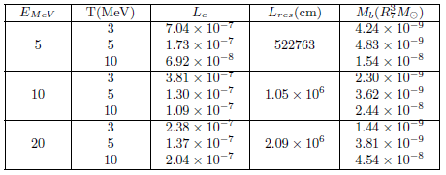
LSND (Liquid Scintillator Neutrino Detector) :
Parameters
0.45 eV²< m²<1 eV² and 2X10⁻³<sin²2<7X10⁻³
m²~ 0.5 eV² sin²2~0.0049
Resonance length
=10^{p} m

Slide 11
Conclusions
We have studied the possibility of resonant oscillation of _{e}, in GRB Fireball.
We calculate the potencial
For the fireball, we assume : It was sphere with radio ~100 – 1000 km, temperature ~ 3-10 MeV, electrically neutral charge L_{e}=L_{p} .
Resonance conditions
We use the parameters of the SNO, Super kamiokande and LSND.

Slide 12
With the potencial and the resonance condition - We calculate:
Barionic load
Leptonic asymmetry
Resonance Length
Due to GRB are of cosmological distance MeV neutrinos is very difficult to detect in this moment.

