Slide 1
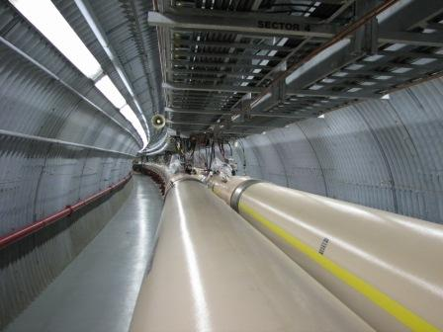
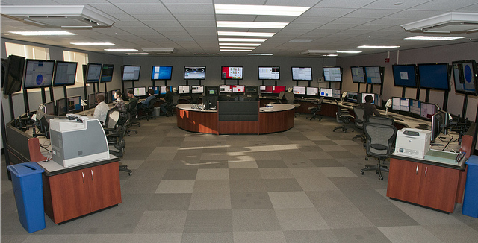
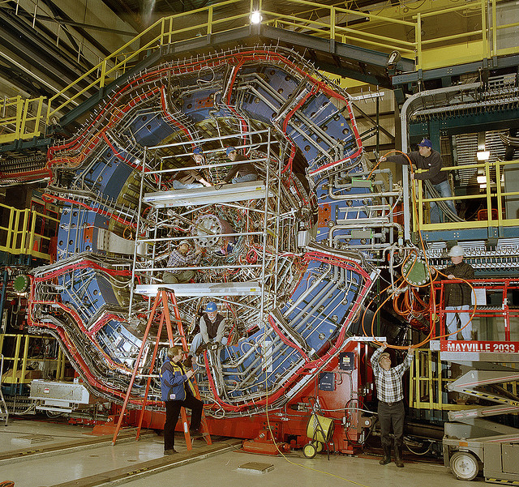
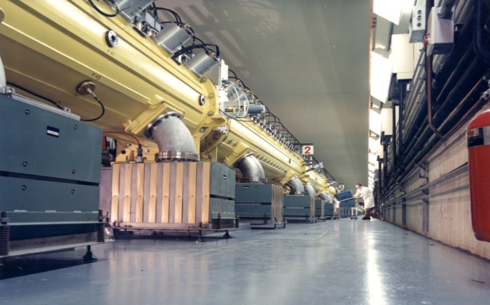
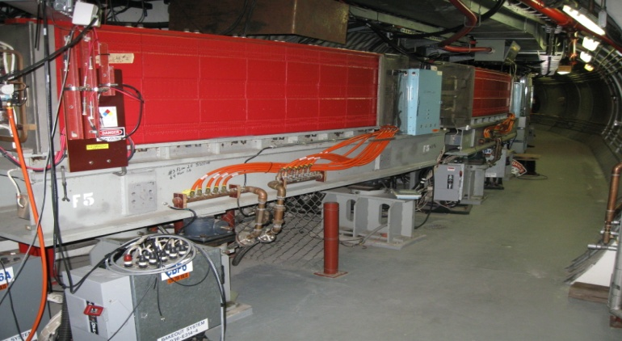
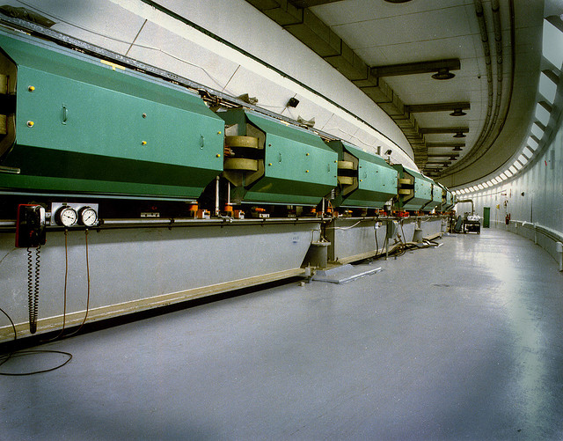
Automation Experience At THE RELATIVISTIC HEAVY ION COLLIDER
Christopher Zimmer
Brookhaven National Laboratory, Upton, NY USA

Slide 2
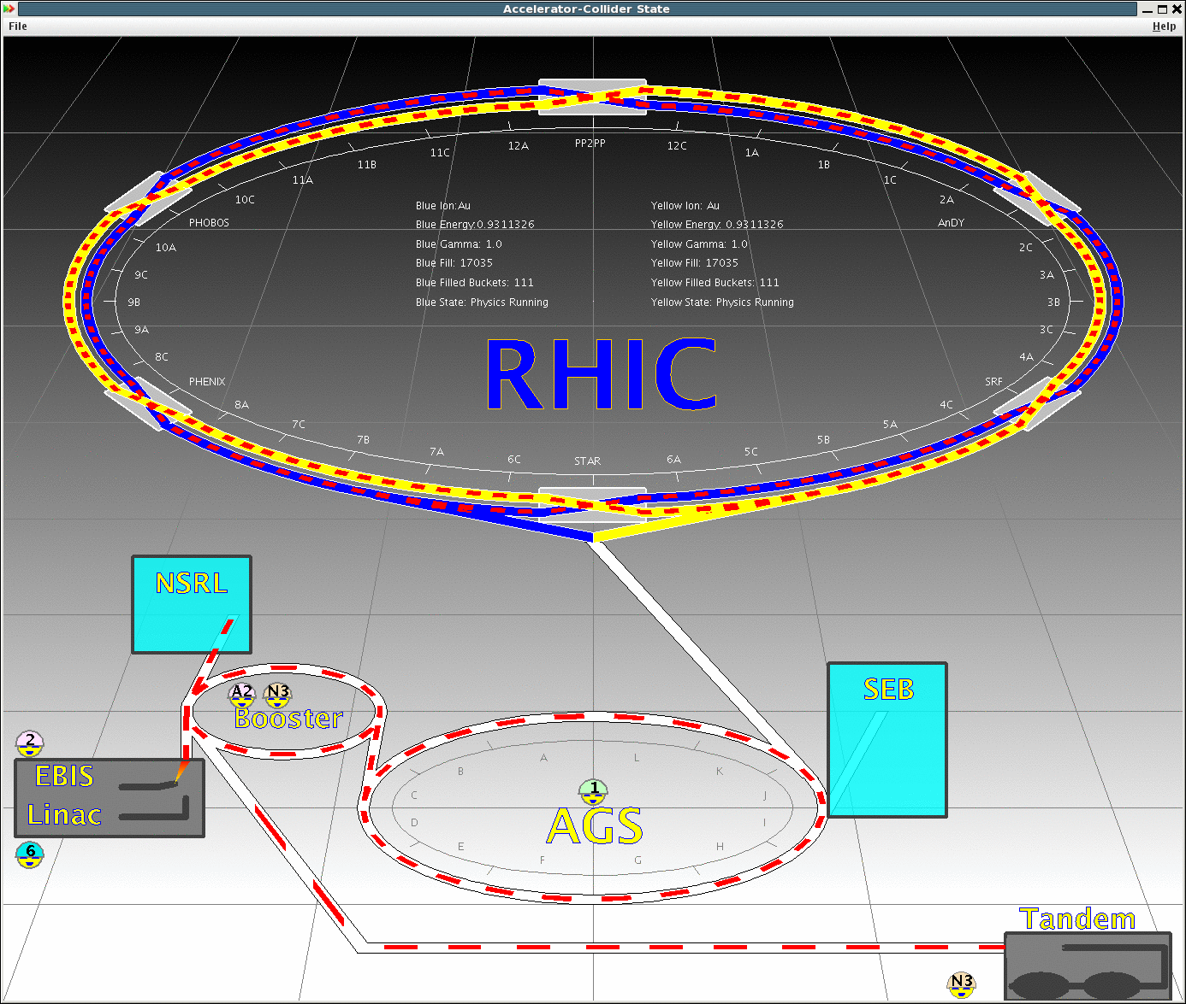
Outline
-Overview of the RHIC complex
-Examples of automation types
-Need for automation
-Reasons why our methods of automation have been successful
-Perils of having many automated systems
-Automation’s effect on the skills of operators
-Training and skill retention
-Summary

Slide 3
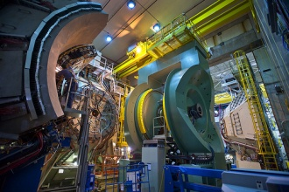
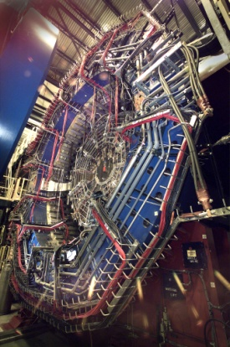
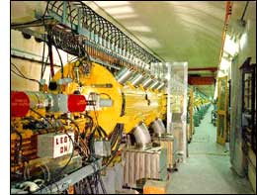
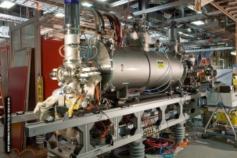
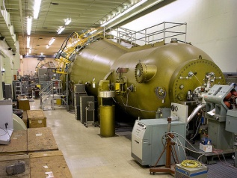
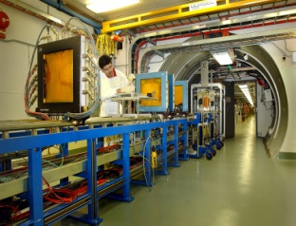
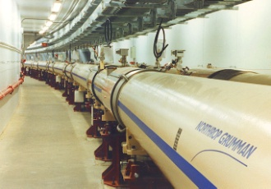
Overview of the RHIC Complex
-Two separate superconducting accelerators (‘blue’ and ‘yellow’ rings)
-2.4 miles in circumference (~3.8km)
-6 collision points, typically utilize 2
RHIC
PHENIX
STAR
EBIS
Booster
NSRL
LINAC
AGS
PHENIX
Tandems
STAR
LINAC
EBIS
Tandems
Booster
NSRL
AGS
RHIC

Slide 4
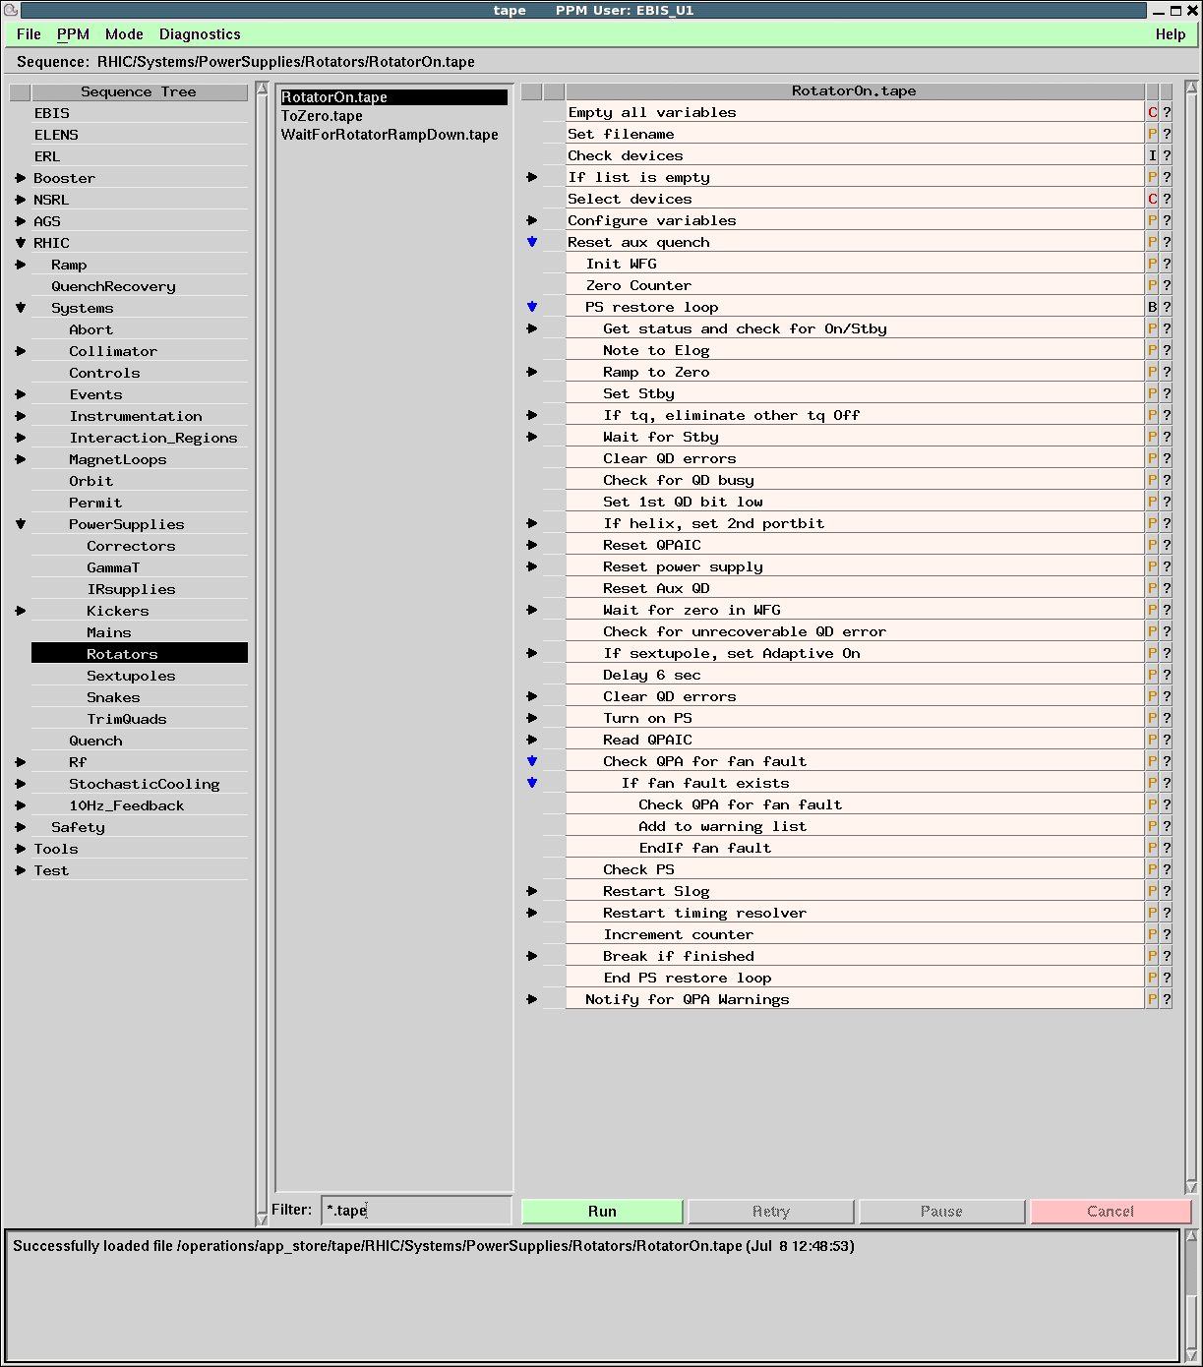
Sequenced Automation Using TAPE
TAPE program is extremely versatile and widely used in the operation of our accelerators
Generic automation tool
Sequencing using a graphical editor
Able to interact with controls devices, servers, applications and electronic log books
Incorporates many traditional programming tools (variables, conditional statements, loops, etc.)
Although the application is in essence simplistic, it is a highly effective/flexible tool
TAPE (Tool for Automated Procedure Execution)

Slide 5
Some Examples of TAPE Sequencer Usage
Preparation of RHIC for ramping (instrumentation, RF, power supplies, triggers, etc.)
Ramping RHIC to full energy
Also putting the beams into collision
Turning on/off hundreds of power supplies (access/power dip/quench)
‘Mode switching’
Changing species in the injectors
NSRL energy changes
Documentation of running conditions
General management over a large variety of systems
(with sequencing)

Slide 6
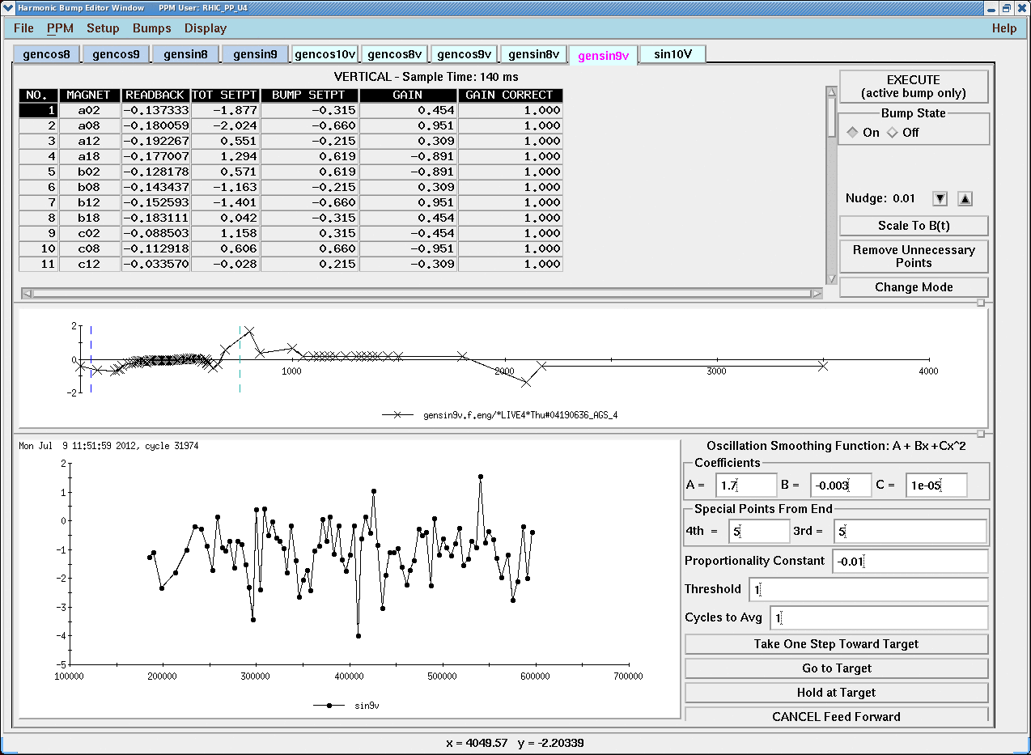
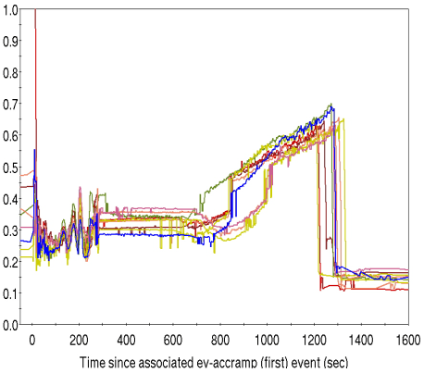
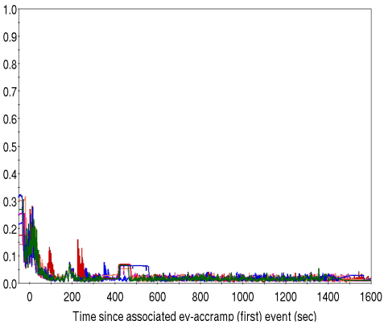
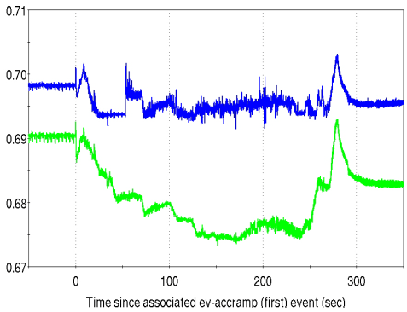
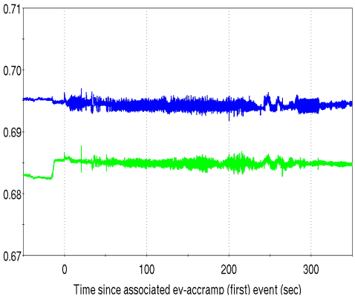
Hard-coded Beam-based Correction Schemes
Automatic orbit correction in AGS
Acquires an orbit and calculates the necessary correction
User applies correction by simply pushing a button
Orbit and tune feedback in RHIC
Continuous feedback loops that maintain the orbit/tunes at ideal values over the ramp duration
Feedbacks can run at injection (before filling RHIC) to quickly optimize beam lifetime
AGS Orbit Control Application
Yellow Ring Horizontal Orbit RMS (Millimeters) Versus Ramp Time
(Multiple Ramps Shown)
Orbit feedback off
Orbit feedback on
Yellow Ring Betatron Tunes Versus Ramp Time
Q_{x}
Q_{x}
Q_{y}
Q_{y}
Tune feedback off
Tune feedback on

Slide 7
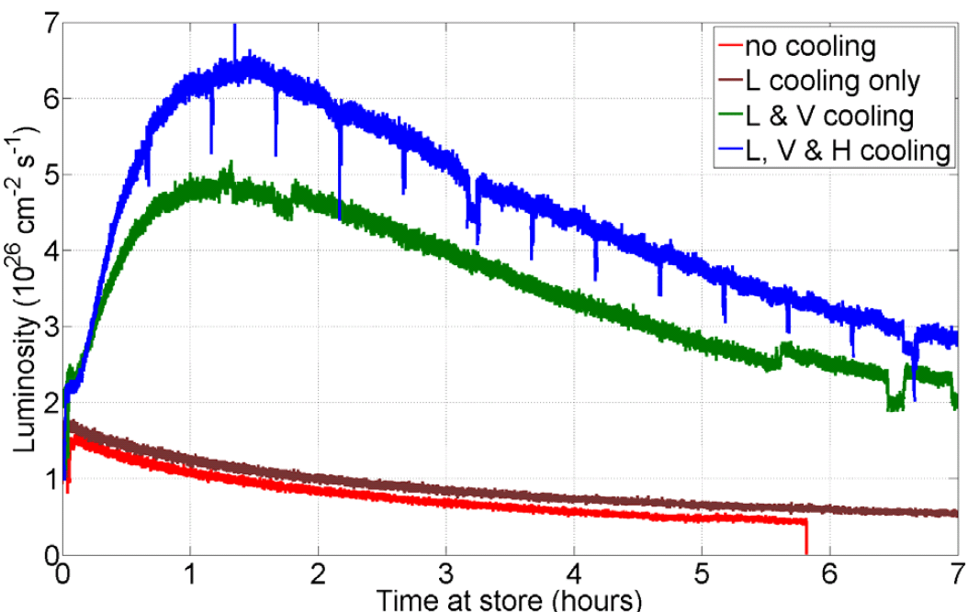
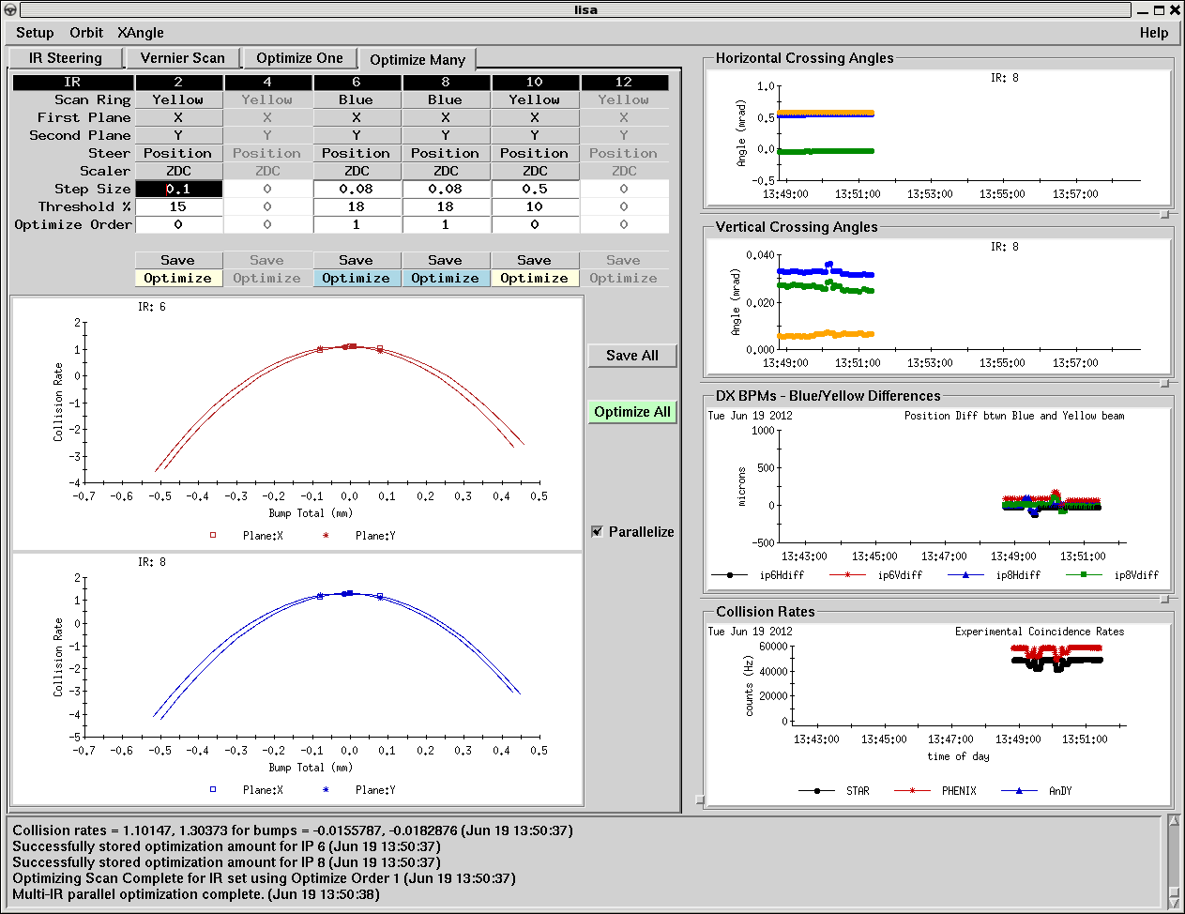
Other Code-driven Beam-based Corrections
Stochastic cooling in RHIC
Decreases the beam emittance in all three planes (H, V, L)
Uses a sophisticated pickup/kicker arrangement to measure and mitigate the diffusion of particles
Increases collisions by factor 2-5
Automated optimization of collision steering in RHIC
Implements minor steering adjustments using the collision rate as a figure of merit
Steers multiple interaction regions in parallel
Especially important with the advent of stochastic cooling
Collision Rate Versus Time (Uranium Beam)
Integrated collisions increased by factor of five!
lisa (Luminosity and IR Steering Application)

Slide 8
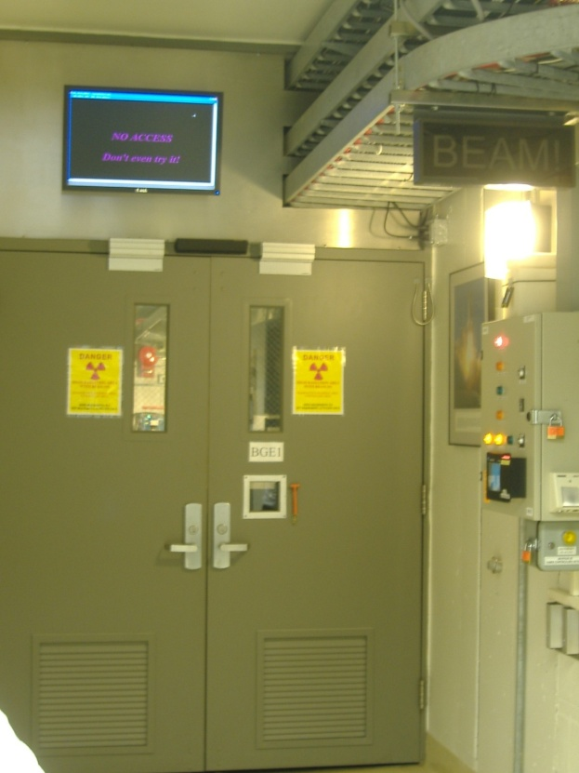
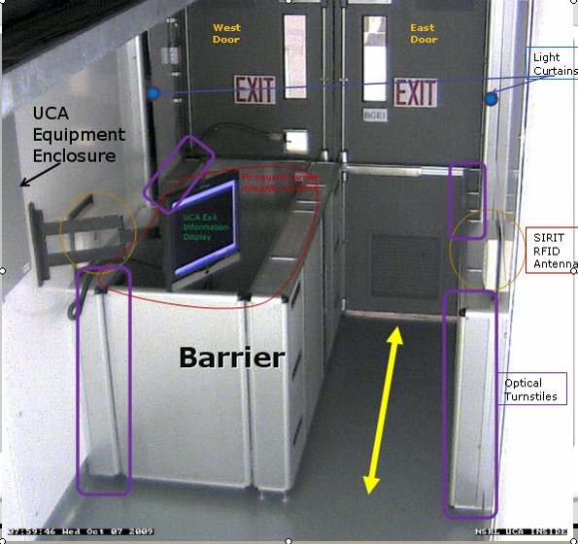
User Controlled Access at NSRL
Fully automated access system
Controls entry/exit from the target exposure room
MCR operators used to perform this task
When an entrance is requested, system places area into a controlled access state and prevents the delivery of beam
User obtains an RFID key from iris scanner
System accounts for entry/exit of each person using an arrangement of optical turnstiles and RFID antennas
Restores the beam after access
UCA Interface
Outside entrance gate to target exposure area
Interior of entrance gate with automated personnel accounting equipment

Slide 9
Automation is Necessary!
Preparing for and executing a RHIC ramp necessitates hundreds of verifications/initializations/triggers
Impractical and susceptible to human error
Mode switching sequence provides quick (~2 minutes!) and reliable reconfiguration of the injector chain for running different species
NSRL has a need for rapid and consistent energy changes
Controlling hundreds of power supplies easily managed with TAPE
Orbit/tune feedback has a profound effect on RHIC setup time
Only takes 1-2 test ramps to reach full energy with a new species
Enables running of several species, increases time in collision
Stochastic cooling provides an incredible benefit, but is complex
User Controlled Access for NSRL has been a huge success, and has freed operators from performing a very menial and repetitive task

Slide 10
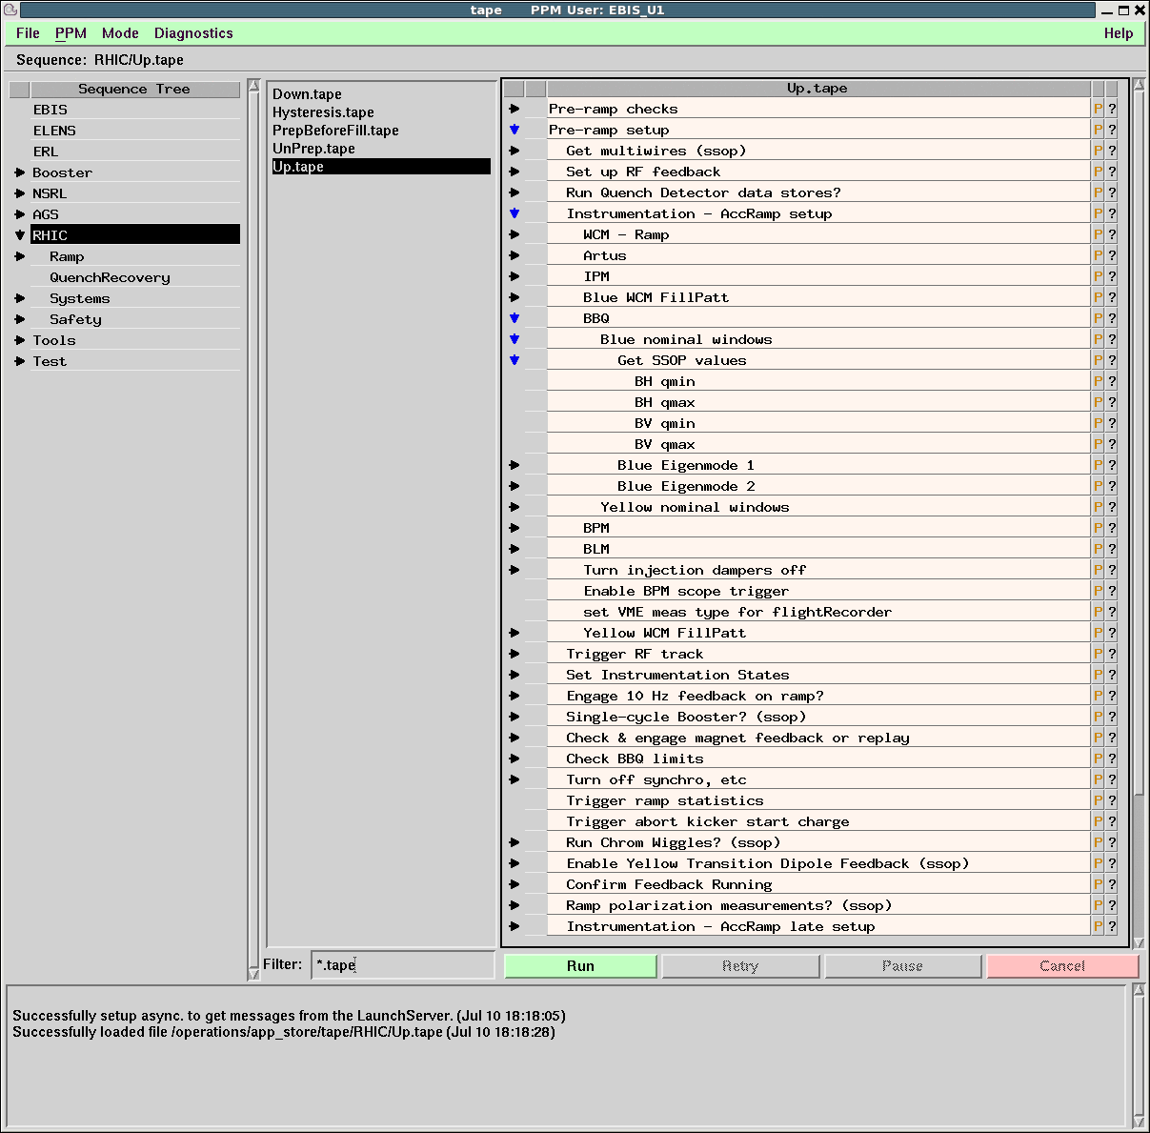
Our Sequenced Automation Method Works Well
The simplicity of our sequencing application is a key to its success
The barrier for understanding, creating and modifying automation schemes using TAPE is low
Steps are clearly laid out
Anyone can understand the steps
Proficiency in code-writing not required to create or modify scripts
Almost any repetitive task can be automated using TAPE

Slide 11
Issues With Sequenced Automation
Steps can and do fail. The error messages given by the application are at times arcane
Error messages could be more informative
If the application freezes/crashes, there can be confusion as to what steps were executed
Every step is logged which aids in diagnosis, but the abnormal machine state can be tricky
Ease of running a sequence (single button click) can lead to inadvertently running the wrong sequence
Operators must exercise caution

Slide 12
Issues With Other Automation Types
RHIC beam-based feedback systems were implemented by a single person, and are only understood by that person
Single point of failure
We rely on these systems heavily, they have become essential
Stochastic cooling is another black box
Very few people understand how the system works
It also occasionally gets into a bad state, increases emittance
User Controlled Access at NSRL
Susceptible to hardware faults, coding errors and loose wires
Multiple issues when system first brought online, better now
Necessary byproducts of commissioning

Slide 13
Does Automation Hurt the Operators?
The consensus among our group is that automation, when properly executed, does not by virtue significantly deteriorate operational skills
Automation undoubtedly gives the operators less tasks to execute, but…
Many automated tasks are monotonous and require little skill
Automating tedious tasks improves quality of life for operators

Slide 14
Does Automation Hurt Operators (2)?
Our sequencing utility improves operator creativity/skills
Encourages improvement of automation schemes
Application is a window to the controls system
Large majority of tuning and troubleshooting still done by hand
Proficient operators will usually understand what automation of skilled tasks accomplishes and can execute those tasks
Assuming that the automation is transparent

Slide 15
Necessary Supplements to Automation
Automation certainly fosters an environment where it can be more difficult to obtain/retain certain skills
As automation encroaches more upon skilled (typically human-driven) accelerator troubleshooting and tuning activities, the negative effects will become more pronounced
Accelerators that tune and fix themselves?
Negative effects on operator competency seem to correlate with an opaque automation scheme and/or a lack of accompanying education/training
Automation must be supplemented with regimented training and hands on experience

Slide 16
Imparting and Retaining Skills
We administer lecture-styled training on a variety of topics
Our group also requires the passing of ‘practical exams’
Hands on test of troubleshooting ability
Sr. operator ‘breaks’ machine(s), jr. operator fixes problems with machine(s)
Some practicals involve demonstrating competency in an automated task
NSRL energy change

Slide 17
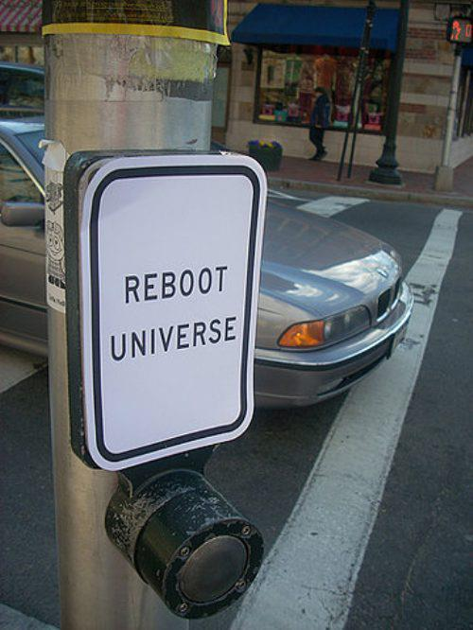
Skill Retention With Automation
We could do better to ensure understanding of automated tasks
Limited number of practical exams
No mode switching practical, no recertification exams
Formal training courses are lacking; we rely more on informal training while on shift
“Push the magic button and call me if it fails” needs to be avoided
Instead of fielding calls when system breaks, teach operators about system

Slide 18
Summary
Any task that can be reliably automated should be
Leads to more efficient operation and reduces human error
We have yet to see a glaring example of too much automation
Automation works quite well for us, with a few caveats
Automation needs to be as transparent as possible
Not every automation scheme can be perfectly transparent
Better dissemination of information in those cases
Use of automation should ideally be accompanied (even preceded) by a demonstration that the user understands the fundamentals of the task and is able to execute the task
Don’t give a child a calculator to divide numbers without first teaching them long division; they need to be able to divide by hand if the calculator breaks!
A solid foundation of training along with continuing education is a necessary supplement to automation
Operators and support personnel can proactively minimize the possible negative effects of automation

