Slide 1
Superconductivity in the BEPCII Performance
Q. Qin (秦 庆)
Institute of High Energy Physics

Slide 2
Outline
Introduction on the BEPCII
Why we chose superconducting stuffs
How superconducting affects operation
What we benefit from superconducting
Summary

Slide 3
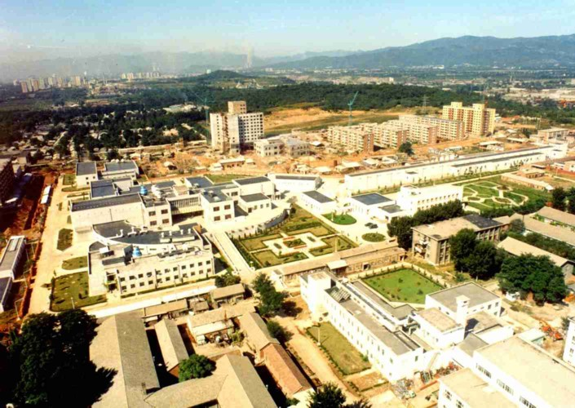
Linac
Storage ring
BESIII
BSRF
Beijing Electron Positron Collider (BEPC)

Slide 4
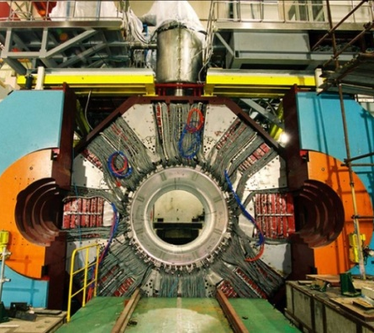
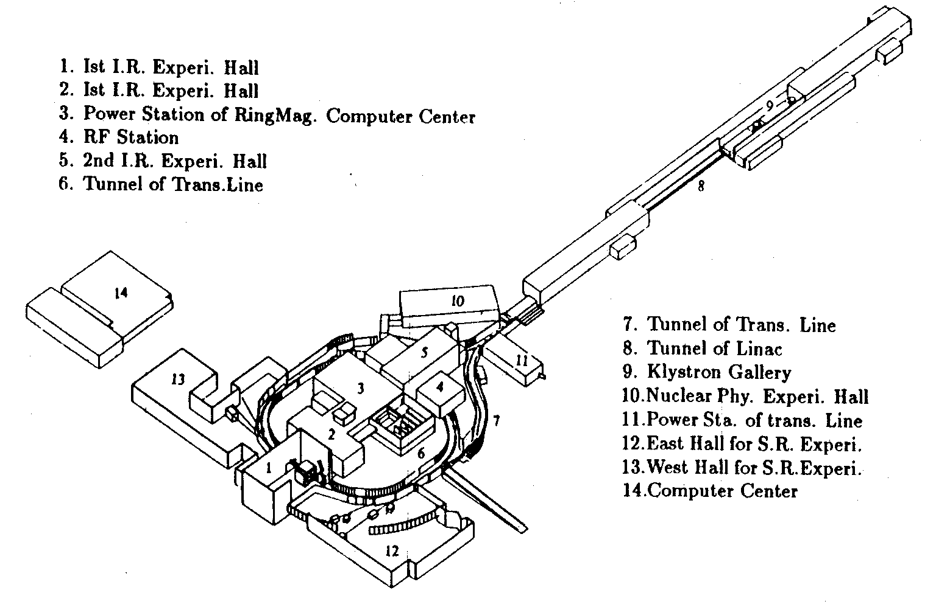
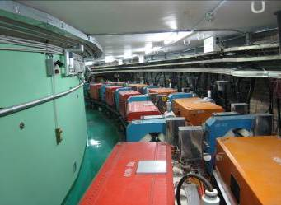
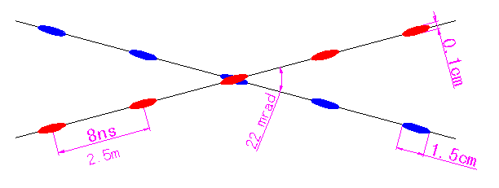
1. Introduction on BEPCII
BEPCII — An upgrade project of BEPC
— A double-ring factory-like machine
— Deliver beams to both HEP & SR
4

Slide 5
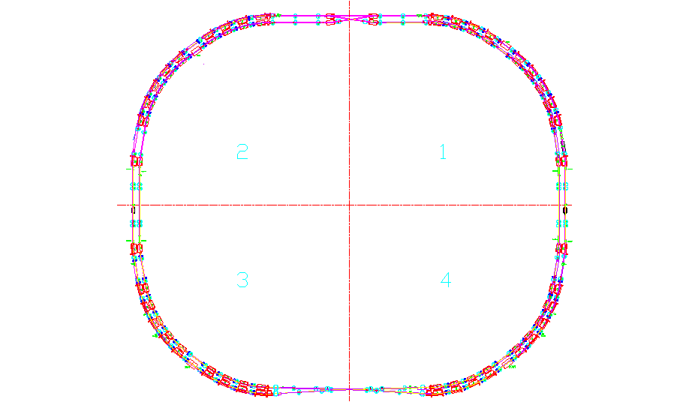
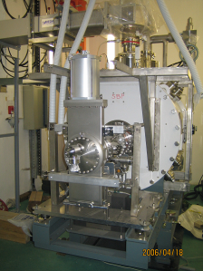

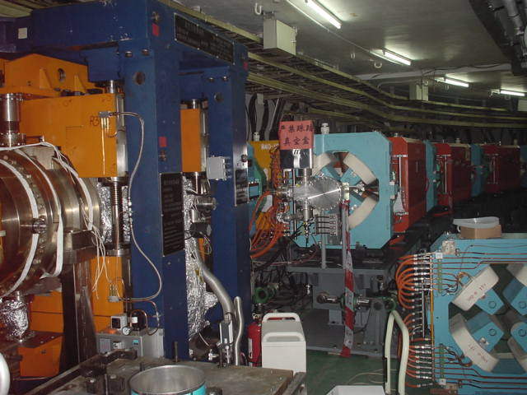
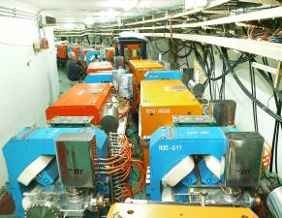
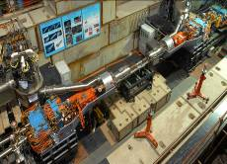
3-ring structure
+
Notes:
5

Slide 6
Design Goals of BEPCII
Collision
  Beam energy range 1-2.1 GeV
  Optimized beam energy 1.89 GeV
  Luminosity 1×10³³ cm⁻²s⁻¹ @1.89 GeV
  Full energy injection 1-1.89 GeV
Synchrotron radiation
  Beam energy 2.5 GeV
  Beam current 250 mA
  Keep the existing beam lines unchanged
BEPCII: One-machine, Two-purpose (HEP, SR)

Slide 7
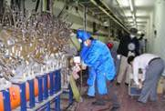
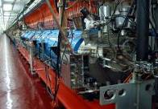
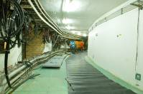
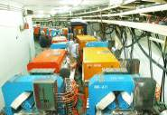
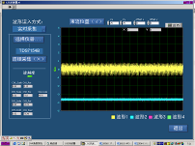
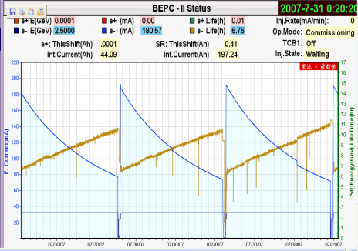
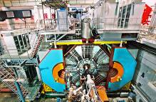
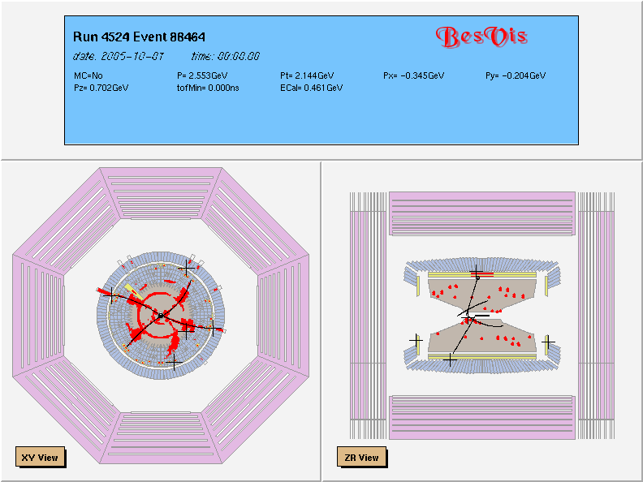
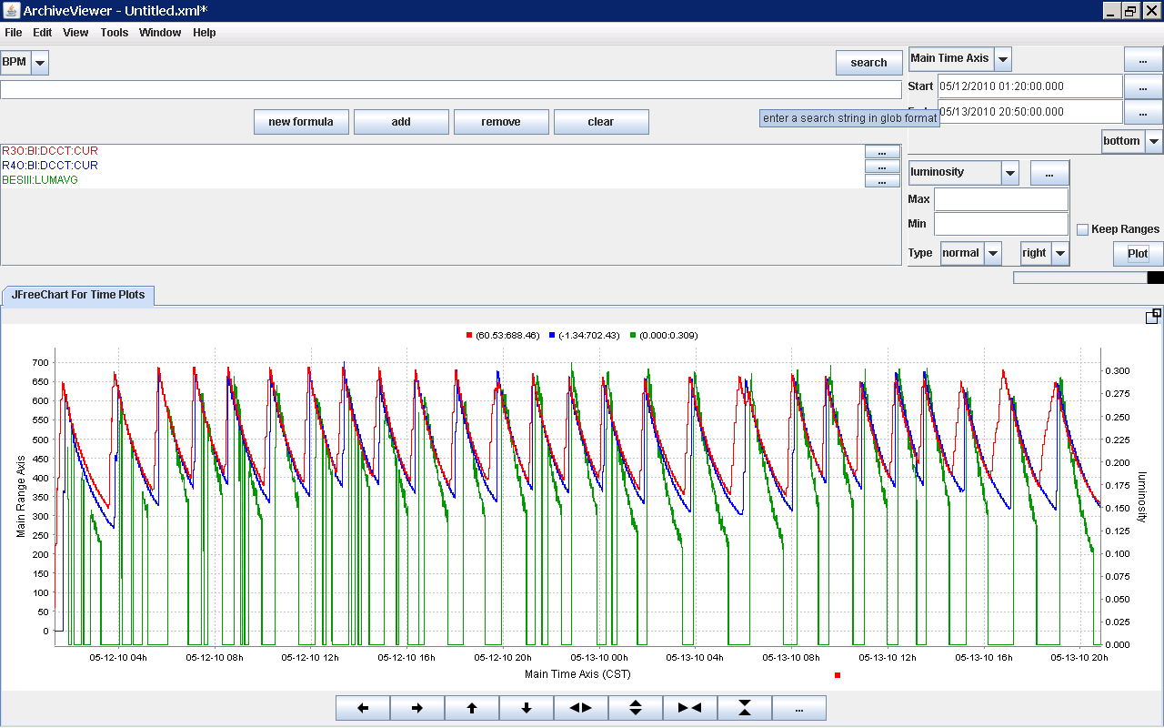
The Milestones
7
May 2004
Sep. 2004
Oct. 2005
Oct. 2006
Nov. 2006
July 2007
Oct. 2007
May 2008
2010–2011
July 2008
May 2009
May 2010

Slide 8
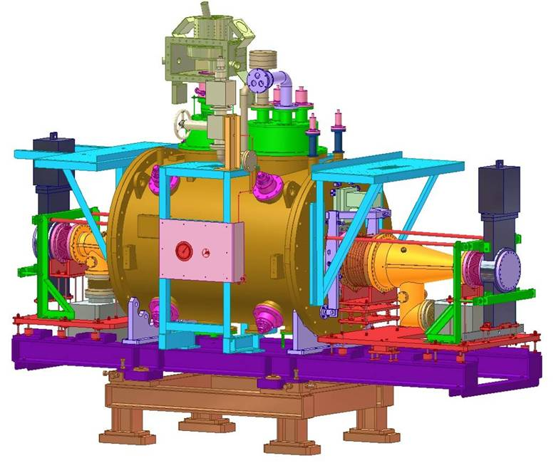
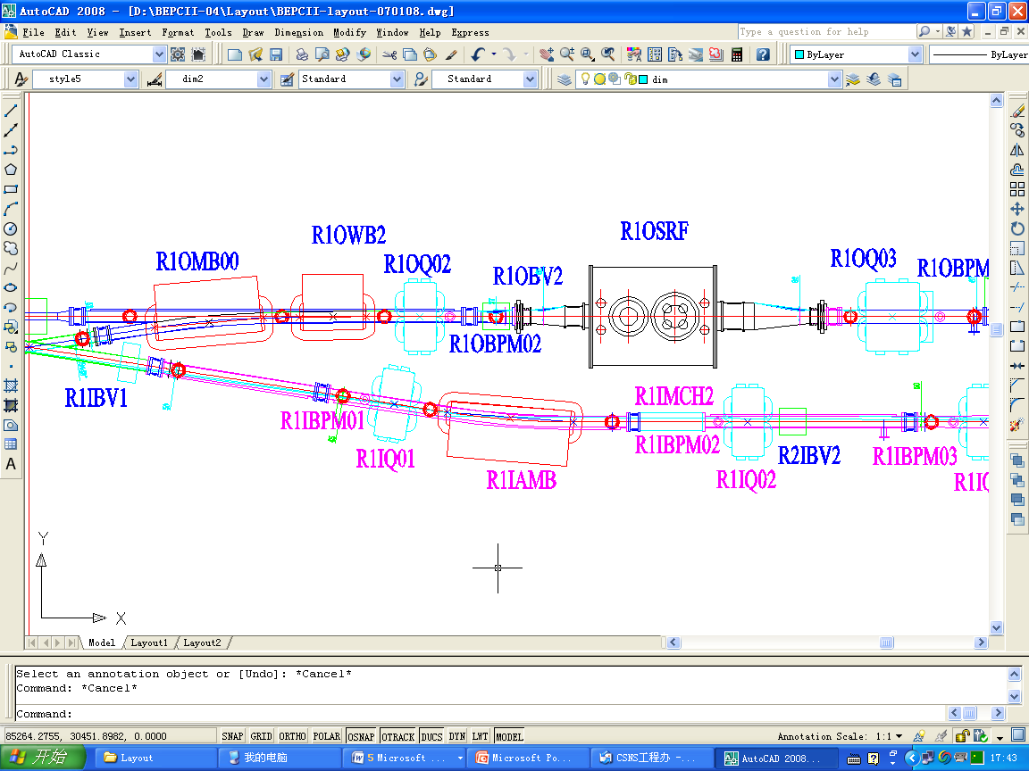
2. Why we chose superconducting items
In the BEPCII, there are
Two SC RF cavities (SRF)
— one cavity/ring

Slide 9
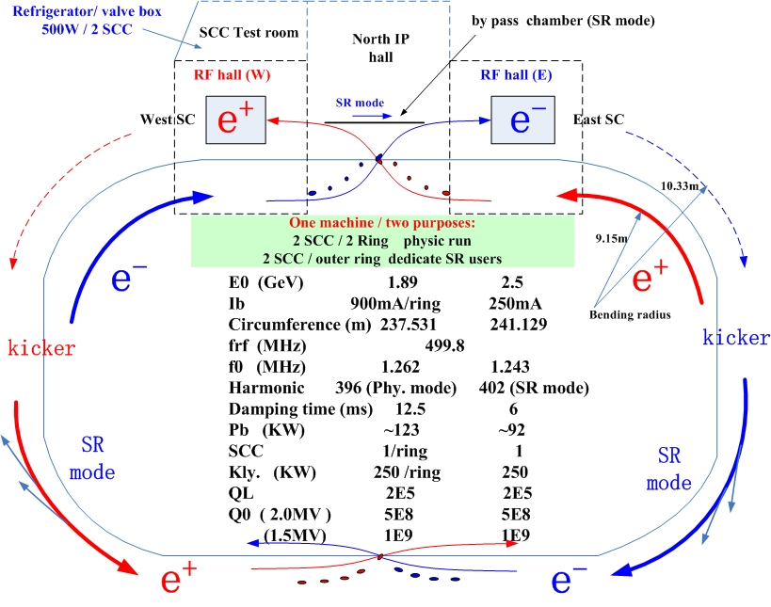
SC RF

Slide 10
In the CD0, 3 NC RF cavities were used instead of 1 SRF each ring, providing energy to beams with a reasonable bunch lengthening.
To save the longitudinal space of each ring, and develop the technology of SC RF, we decided to use SC RF cavity in the BEPCII

Slide 11
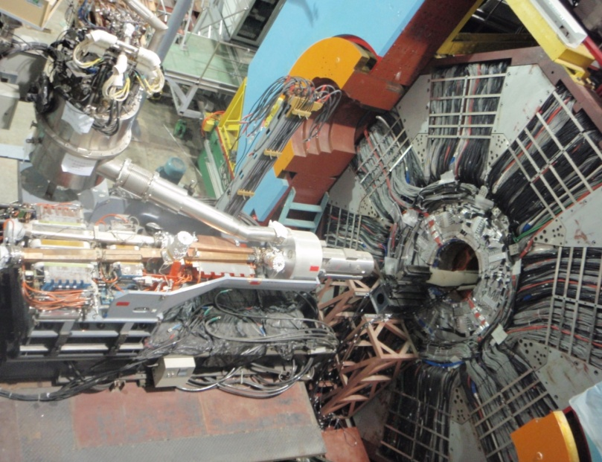
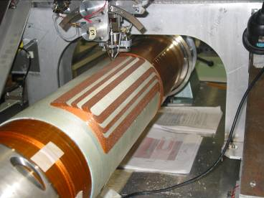
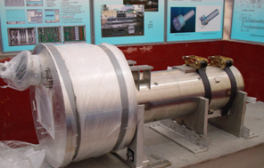
Two SC quad/multipolar insertion magnets (SIM) near the interaction point
— one SIM/ring

Slide 12
A compact multipole-coil designed to squeeze β_{y}* , compensate coupling caused by the detector solenoid, bend beam to outer ring in SR mode, tune orbit and coupling by corrector and skew quad coils.
SIM used for above aim, saving the space in IR, increasing the strength of quad.
A scheme of permanent squad near IP was also considered, but not as good as SC scheme.

Slide 13
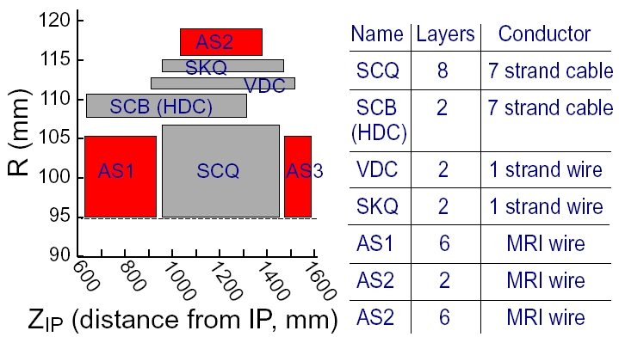
Coil winding layout of SC IR magnet (SIM)

Slide 14
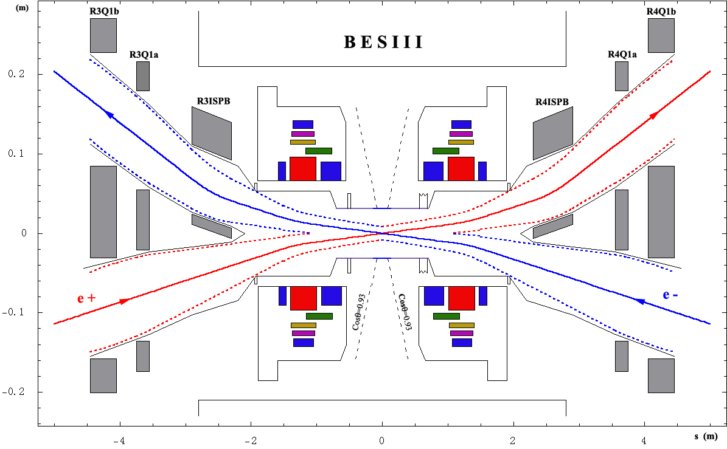
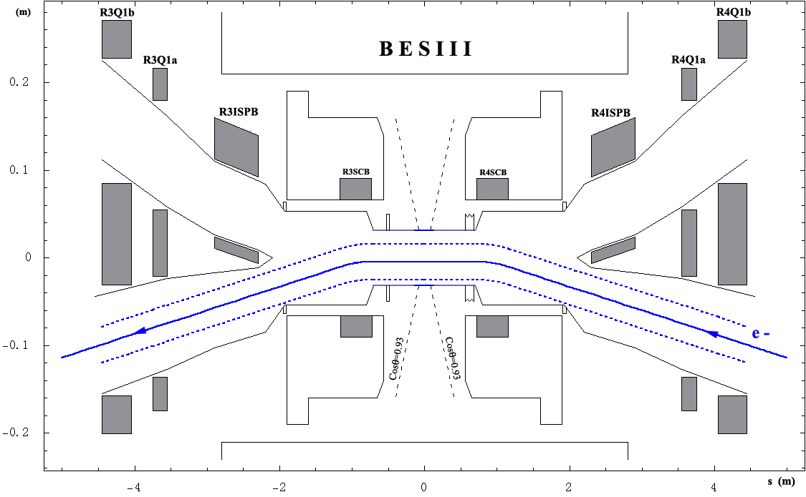
SCQ
ISPB
IP
Interaction region for the collision mode
SCB
SCB
Interaction region for the dedicated SR mode

Slide 15
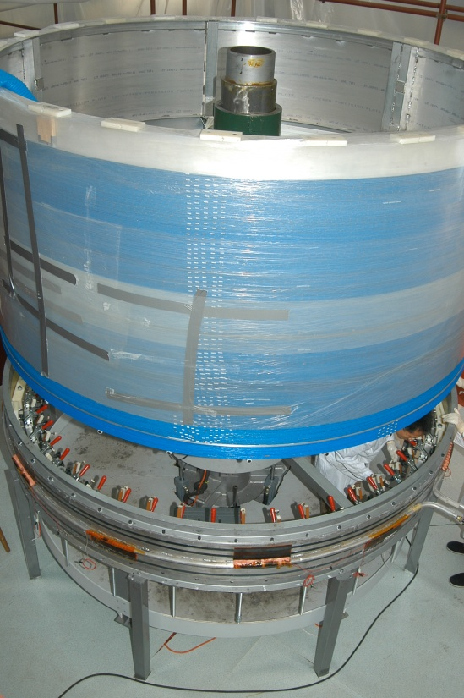
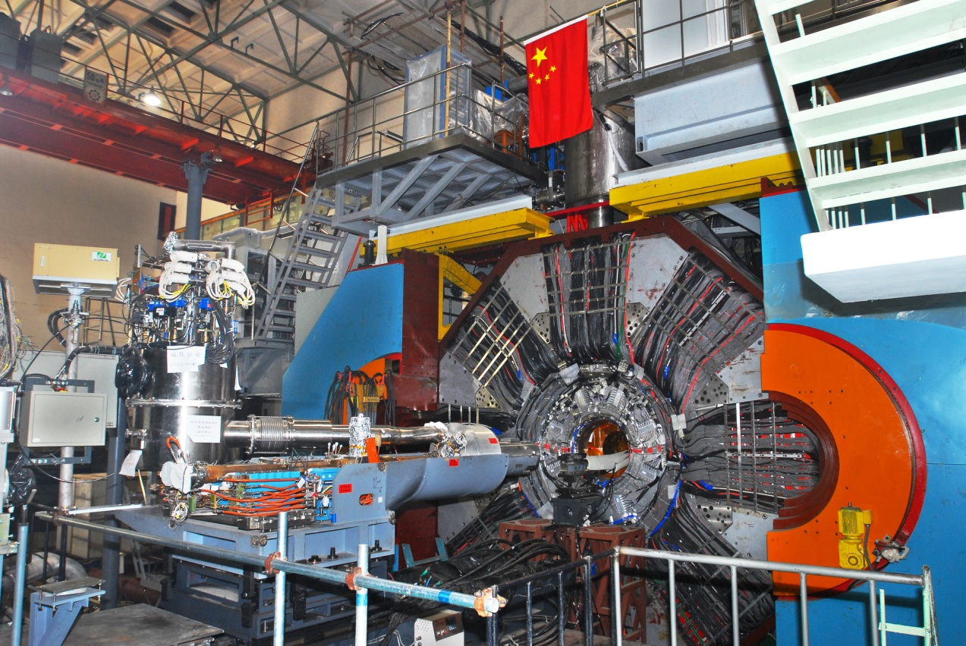
One SC solenoid magnet (SSM) in the detector of BES III
— Higher solenoid field (1.0 Tesla) compared to BES I
and BES II (0.4 Tesla), having better resolution.

Slide 16
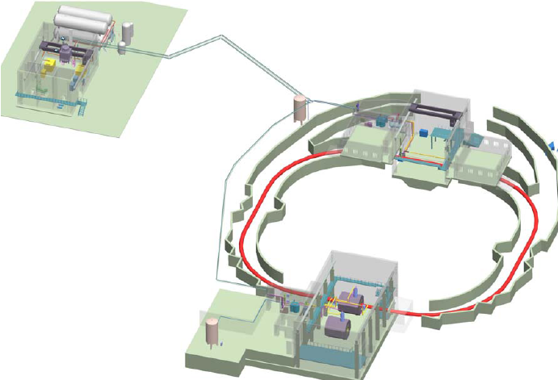
Cryogenic system of BEPCII
Cryogenics Hall for RF
SC RF cavity
Cryogenics Hall and gas
tank farm
SC solenoid
Cryogenics Hall for
SC magnets
SC magnets

Slide 17
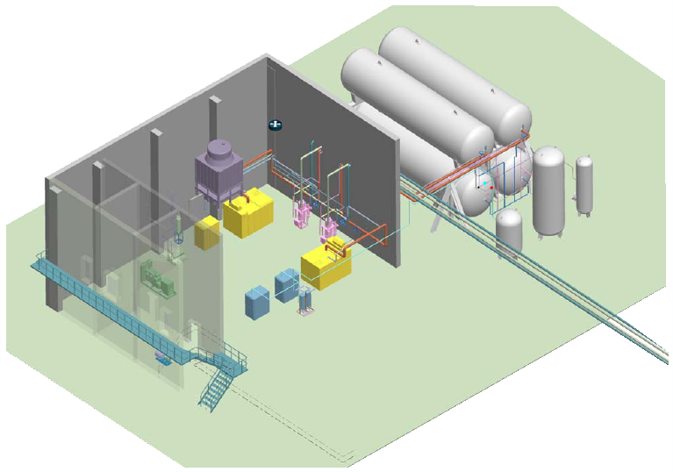
Cryogenic hall and gas tank farm
Contains:
He compressor systems, VFDs, air compressor, air drier, ORS, cooling-water system, spare power engine, gas tank farm, control system
Tank farm
Two 130m³ ,1.45Mpa
Two 130m³ ,0.73Mpa
One 30m³ ,0.08Mpa
One 5m³ ,6Mpa
One 10m³ ,0.73Mpa

Slide 18
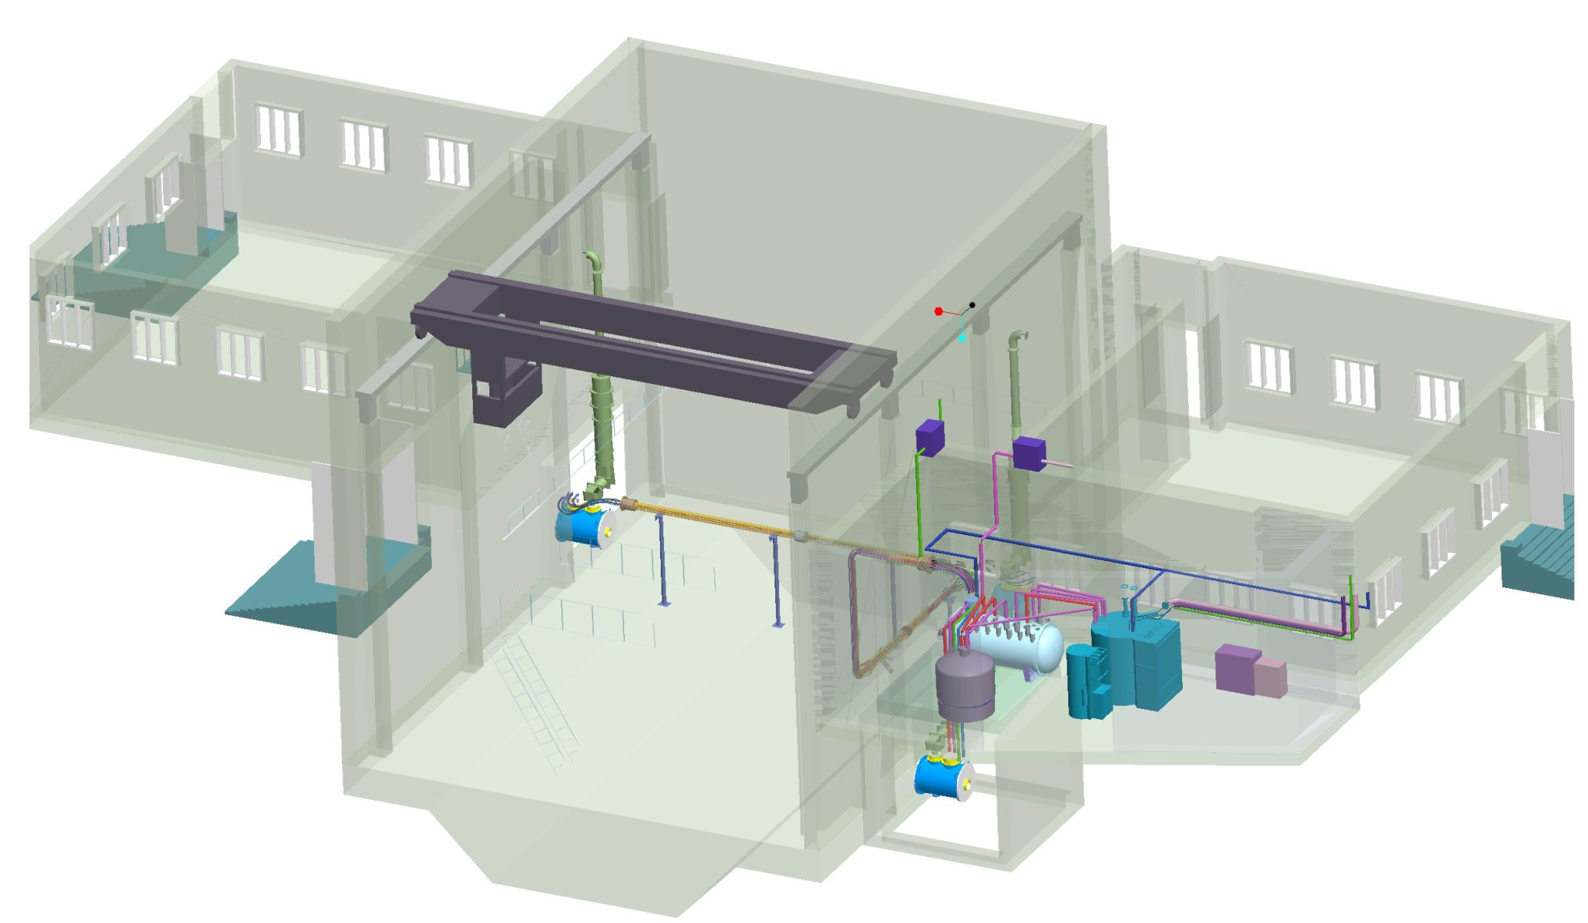
BEPCII north crossing point region
Heater
Waveguide
SRF quench line
LN2 transfer line
UPS
SRF Cavity
PLC rack
500W refrigerator
LHe dewar
SRF valve box
Multi-channel
transfer line
SRF Cavity
(Spare one)

Slide 19
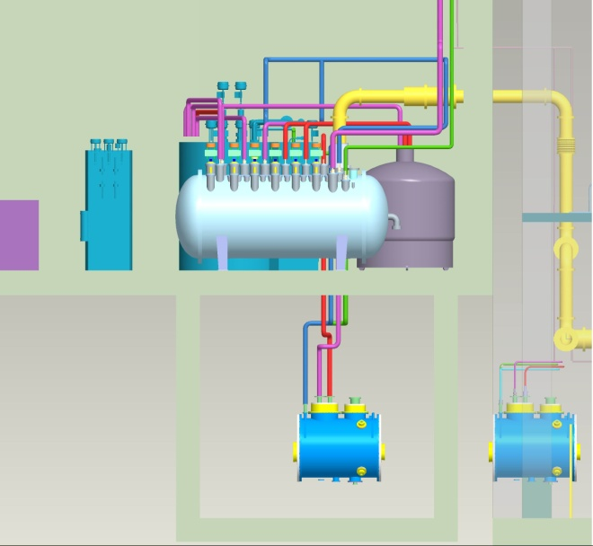
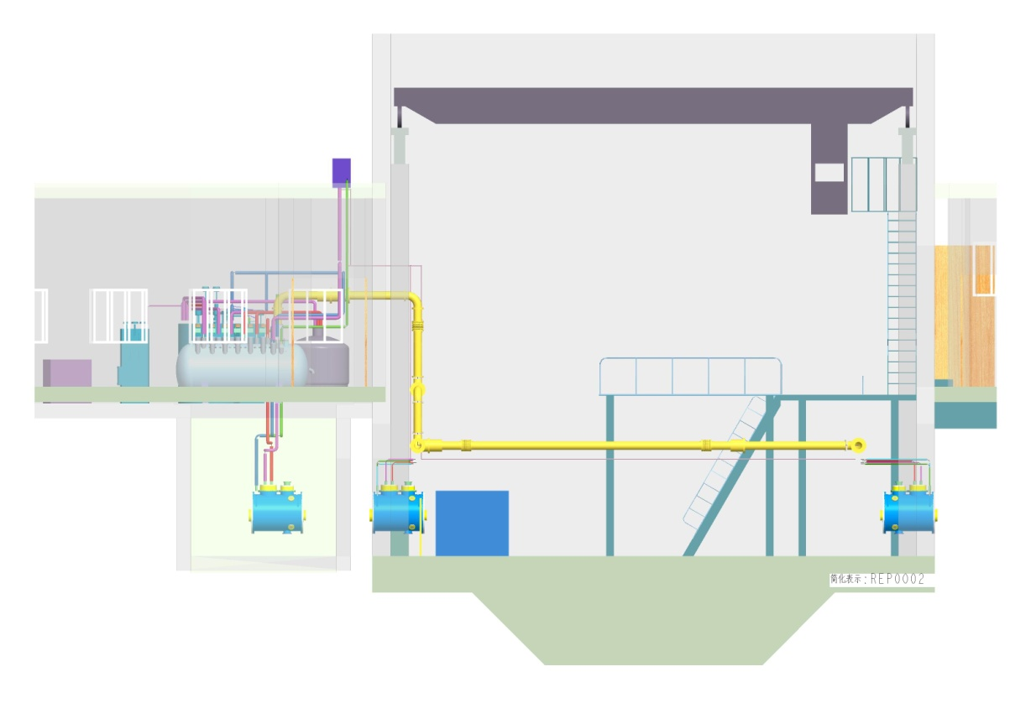
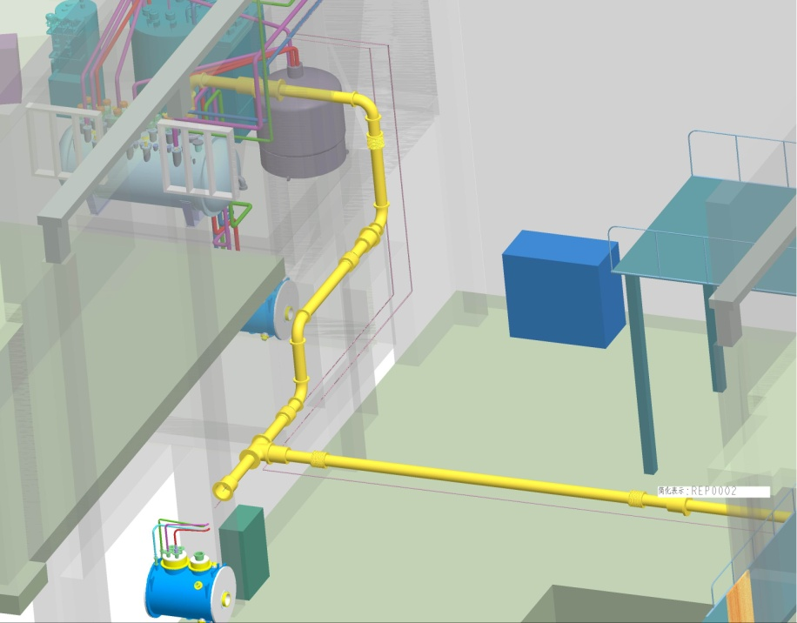
NCP hall and cryogenics facilities
Cryogenic transfer line

Slide 20
The total cooling capacity of the cryogenic system of BEPCII is 1kW/4.5K, with the power supply requirement of 800kW.
Two independent refrigerator systems, each with a cooling capacity of 500W/4.5K, are adopted to cool the SC magnets and SC RF cavities.
Possible area to set up all the cryogenic system with He transport lines, is the base of adopting SC technology at the BEPCII

Slide 21
3. How superconducting affects operation
Both superconducting and cryogenics system were new to us at the beginning of the commissioning in 2006.
Vertical and horizontal tests of SC RF cavities were finished in May 2006, and ready for operation.
SC magnets and solenoid were not ready, so a NC scheme was first adopted to run the machine, called phase 1.
SIM was installed in 2007, and commissioned as phase 2. SSM and detector were rolled in IR in 2008, commissioned as phase 3.
This helped us to get experiences of SC and cryogenic stuffs step by step during operation.

Slide 22
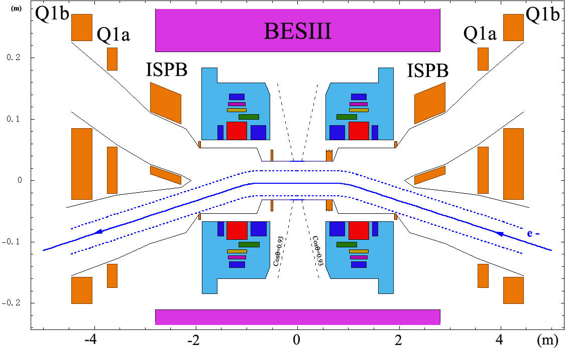
No BESIII detector
IR in phase 1
PEP-II dipole
BEPC quad
BEPC quad

Slide 23
3-phase of BEPCII storage ring commissioning
Oct. 2006, Installation completed with NIM at IR
Nov 18, 2006 First beam stored
Mar 26, 2007 First collision
May 14, 2007 Luminosity reached that of BEPC
Oct. 2007, Installation completed with SIM at IR
Oct. 24, 2007 First beam stored
Nov. 18, 2007 First collision
Jan. 29, 2008 Luminosity > 1×10³²cm⁻²s⁻¹
2008 June. Installation completed with BESIII in the IR
July 19, 2008 First hadron event got with BESIII
April 8, 2009 Luminosity reached 2.3 ×10³²cm⁻²s⁻¹
May19, 2009 Luminosity reached 3.3 ×10³²cm⁻²s⁻¹
Phase 1
Phase 2
Phase 3

Slide 24
Main problems we met
Quench – SRF & SC magnets
Quench protection systems were setup to analyze the reason of quench – SC items problem or due to cryogenic system problem, hardware or software problems, etc.
Recover the SC devices carefully after getting the reason of quench in detail.
Quench of SIM happened frequently at the beginning of commissioning, and now decreased gradually.
Very few quench happened to SSM of detector.

Slide 26
Cryogenic system failures
Abnormal data of control system
The purification problem of He gas (should be better than 99.99%), which can cause the ability of refrigerator lower
Electrical device failures, such as switcher, etc.
Aging of main parts, such as turbo of refrigerator
Other uncontrolled force, such electricity down or fluctuation, thunder storm, strong wind, etc.

Slide 27
Among all the fault time of cryogenic system, about 80% are abnormal data of control system and impure of He gas
Features of cryogenic system:
Long time to recover SC status if failed due to any reason
“Fragile” due to environment
A spare compressor was added last summer shutdown, and improved the performance this year.

Slide 28
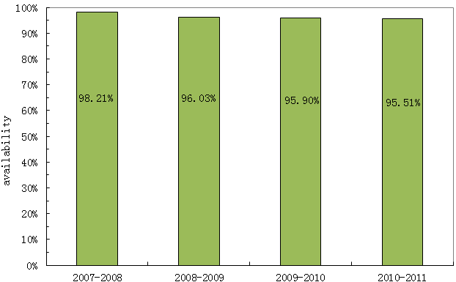
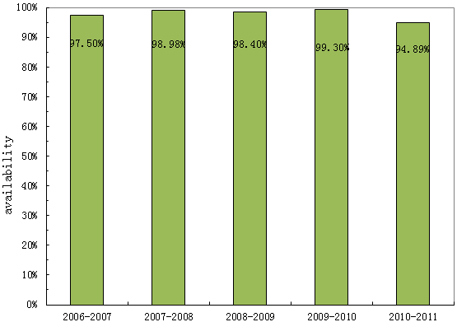
Availability of BEPCII Cryogenics system
Availability of 1# cryogenic system
(for superconductive magnets)
Availability of 2# cryogenic system
(for superconductive cavity)
higher than 95.5%
higher than 94.8%
TBF
TBF: Time between failures
Availability(%) =
×100%
TBF+TTR
TTR: Time to repair and restoration system

Slide 29
4. What we benefit from superconducting
Help the machine to get to its design goal in such a small ring tunnel
Introduce SC to accelerator in main land China
Master the accelerator related SC technology gradually
Setup the first and biggest cryogenics system for large scientific facility in main land China
Get experiences on SC and cryogenics performance, operation gets more and more smooth…

Slide 30
From 2008, we started to study and manufacture the SC RF cavity, including cavity, HOM damper, high power coupler, cryo-module, etc., by ourselves.
A spare SC RF cavity has been finished last year. Vertical and horizontal measurements were done in IHEP, and the main parameters are good enough. Now, it is on the tunnel site as a spare part.
R&D of SC quad is being carried on in IHEP.

Slide 31
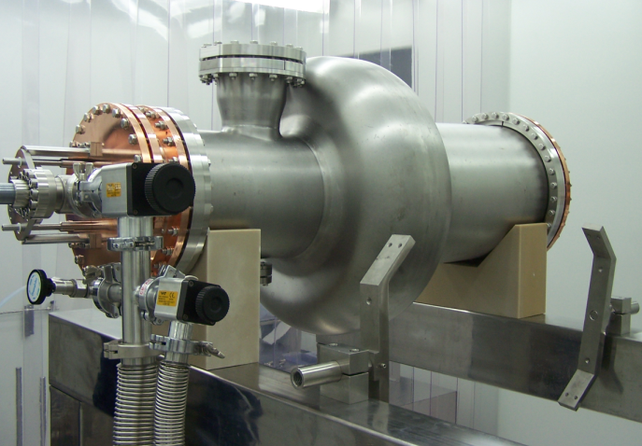
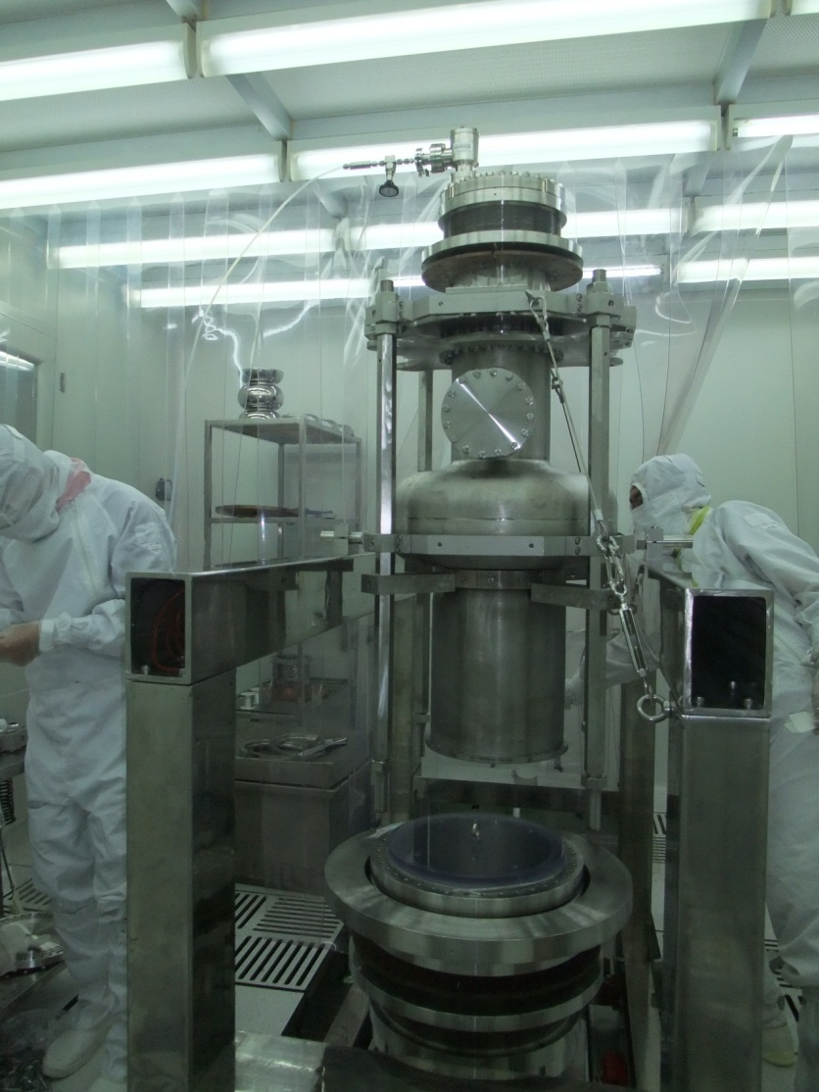
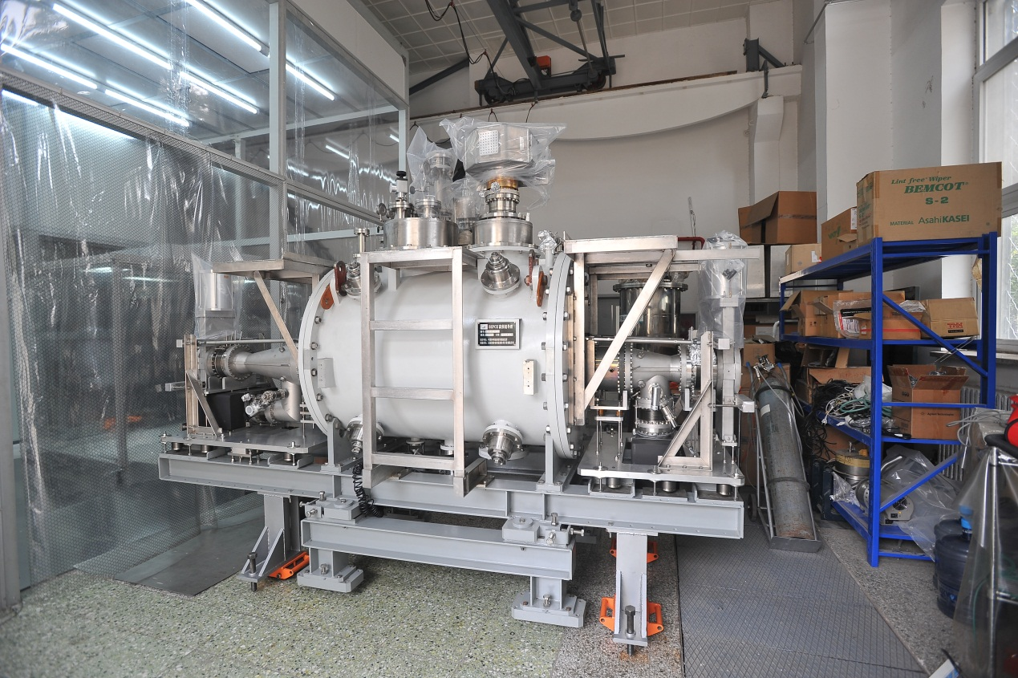

Slide 32
Summary
SC technology used in BEPCII brought the SC application to accelerator in main land China.
SRF and SC magnets run well in BEPCII, with design parameter of the hardware, and helped the whole machine to reach its design goal.
Operation with SC and cryogenics is getting experienced, though they are sometimes vulnerable.
SC benefits us not only on the machine itself, but the technology development.

Slide 33
Thanks for your attentions!

