Slide 1
SLAC workshop 7-10 July 2009 WP1: microwave-based accelerators Progress towards a new standard X-band high-power flange
G. Riddone, 08.07.2009
(contribution from C. Garion)

Slide 2
Outline
General requirements
Recall of existing design from SLAC
Presentation of the new design
Program

Slide 3
Requirements
Reliable joint - high sealing performance
Smooth flange-gasket-flange transition (RF performance)
Simple shapes and preferably symmetrical joint
Easy assembly
Cheap production
Needs
X-band test stands (few hundreds): needs for CERN and for several other test stands (eg. PSI. Elettra,..)
CLIC - about 500 000 units

Slide 4
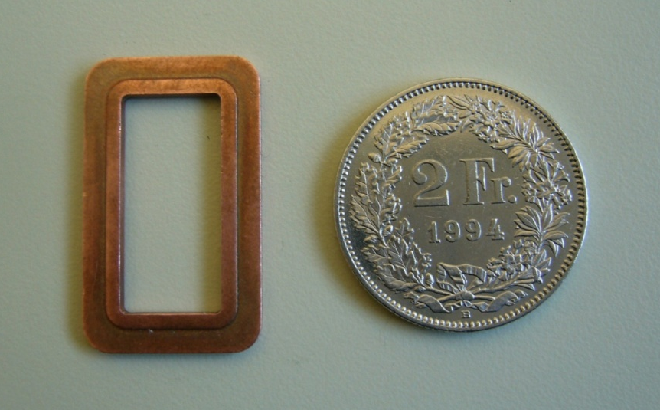
SLAC design
Parts
Two different flanges - 2 stainless steel WR90 flanges (AISI316LN)
1 OFE copper gasket
Observations:
- Not symmetrical gasket cross-section
- Main sealing mechanism comes from shearing not compression
flanges clamped with 8 bolts
flange
gasket
flange
Flanges
Gasket

Slide 5
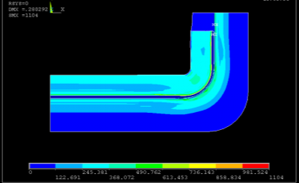
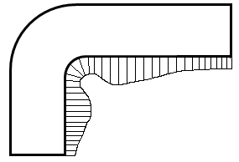
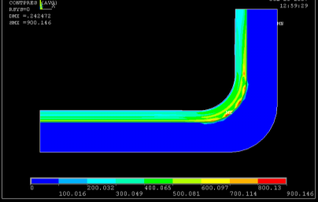
Some remarks on SLAC design
Large and non constant displacements into gasket aperture
Sealing
Trapped volume
No sealing
Contact pressure between upper gasket surface and flange
0.25
0.25
Lateral profile of the maximum inner displacements
Different contact pressure distribution for upper and lower surface of the gasket
Trapped volume
Sealing
No sealing
Contact pressure between lower gasket surface and flange

Slide 6
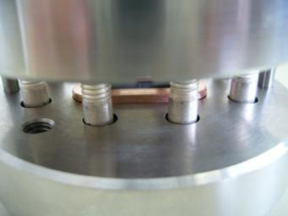
CERN design proposal
Same flanges
Rectangular cross section OFS copper gasket
Symmetrical, “knife” based design
Initial gasket position away from flange/flange plane
AISI316LN flanges with 6 bolts and 2 centering pins
Assembled joint
flange
gasket
Symmetry
New CLIC design concept

Slide 7
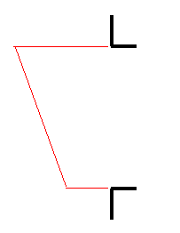
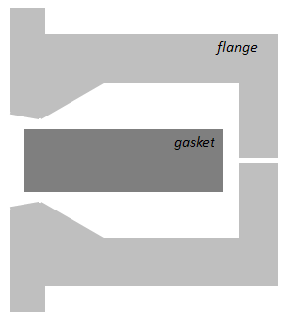
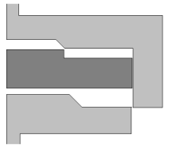
Some advantages on CERN design proposal
Homogeneous contact pressure –symmetric type joint
Cheaper production – simple and easy to machine gasket shape and one type of flange only
Easier assembly – symmetric, self-placed gasket with additional pins centering joint system
Better properties – smooth flange-gasket-flange transition
SLAC design
New proposal
0.25 mm
Flange
Flange
1)
self-placed
gasket
1)
self-placed
gasket
+
Pins centering
joint system
< 0.1 mm
2)
2)
Gasket
Gasket
3)
1)
Female flange
Gasket with moderate shape
Male flange
One type of flange
Gasket with simple shape
NO SYMMETRY
Flange
SYMMETRY
Flange
0.15 mm

Slide 8
CERN design optimization
Optimization of the joint geometrical parameters based on FE models:
Flange: knife (α,β), thickness, diameter, type and number of bolts
Gasket: thickness, width
Interface: imprint depth, initial position
flange
β (Q₂)
α (Q₁)
Criteria:
Leak rate (<10⁻¹² mbar·l/s)
P = contact pressure, w= contact width, A, R = parameters as a function of roughness
Plastic strain in the flanges
Cost
gasket
Initial
position
thickness
Geometrical parameters

Slide 9
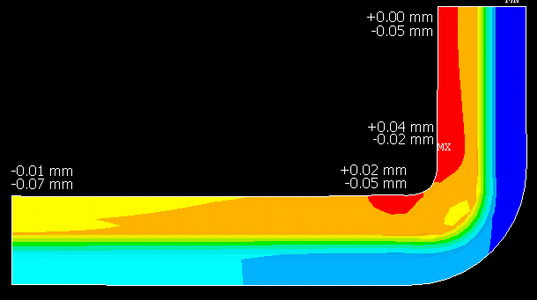
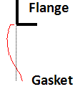
CERN design optimization
Displacement into the aperture
The displacement into aperture is an input for future RF calculations

Slide 10
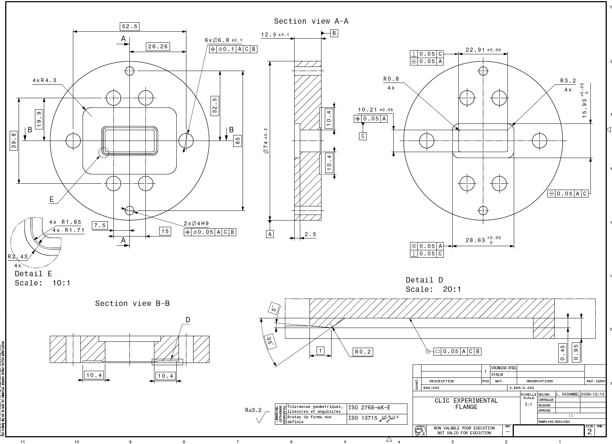
CERN Proposal Flange Drawing

Slide 11
Program
Circular gasket design: leak rate measurements
Final design: 5 full units (CINEL) available at CERN as well as gaskets
Dimensional control ➔ conform
Leak-rate measurement as a function of torque (promising results)
Realization of the tooling for centering the gasket (done)
Displacement as a function of torque
Low-power RF tests at CERN
Preparation for high-power testing at SLAC of two units: Sept 09

