Slide 1
Possible improvement of the CLIC accelerating structure.
From CLIC_G to CLIC_K.
2.07.2009
Alexej Grudiev
CERN

Slide 2
Outline
Current CLIC accelerating structure: CLIC_G
Compact coupler design with damping
Comparison of rounded and not rounded cell geometry
New type of waveguide damping for lower pulsed surface heating – a ridged waveguide damping
Constant Sc structure as an optimally tapered accelerating structure

Slide 3
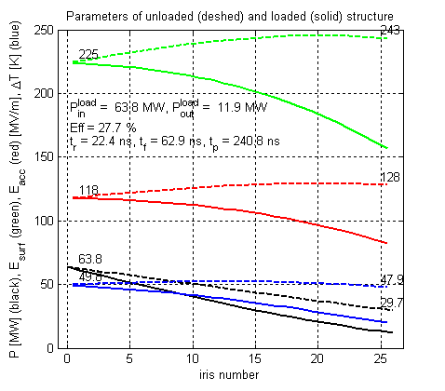
Parameters of CLIC_G
Structure | CLIC_G
Frequency: f [GHz] | 12
Average iris radius/wavelength: <a>/λ | 0.11
Input/Output iris radii: a_{1,2} [mm] | 3.15, 2.35
Input/Output iris thickness: d_{1,2} [mm] | 1.67, 1.00
Group velocity: v_{g}^{(1,2)}/c [%] | 1.66, 0.83
N. of reg. cells, str. length: N_{c}, l [mm] | 24, 229
Bunch separation: N_{s} [rf cycles] | 6
Luminosity per bunch X-ing: L_{b×} [m⁻²] | 1.22×10³⁴
Bunch population: N | 3.72×10⁹
Number of bunches in a train: N_{b} | 312
Filling time, rise time: τ_{f} , τ_{r} [ns] | 62.9, 22.4
Pulse length: τ_{p} [ns] | 240.8
Input power: P_{in} [MW] | 63.8
P_{in}/Ct^{P}_{p}^{1/3}[MW/mm ns^{1/3}] | 18
Max. surface field: E_{surf}^{max} [MV/m] | 245
Max. temperature rise: ΔT^{max} [K] | 53
Efficiency: η [%] | 27.7
Figure of merit: ηL_{b×} /N [a.u.] | 9.1

Slide 4
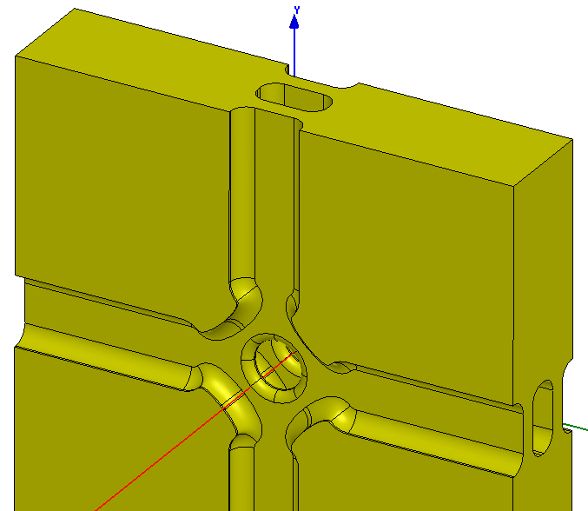
WDS cell geometry
Waveguide Damped Structure
(WDS) 2 cells
Minimize E-field
Minimize H-field
Provide good HOM damping
Provide good vacuum pumping

Slide 5
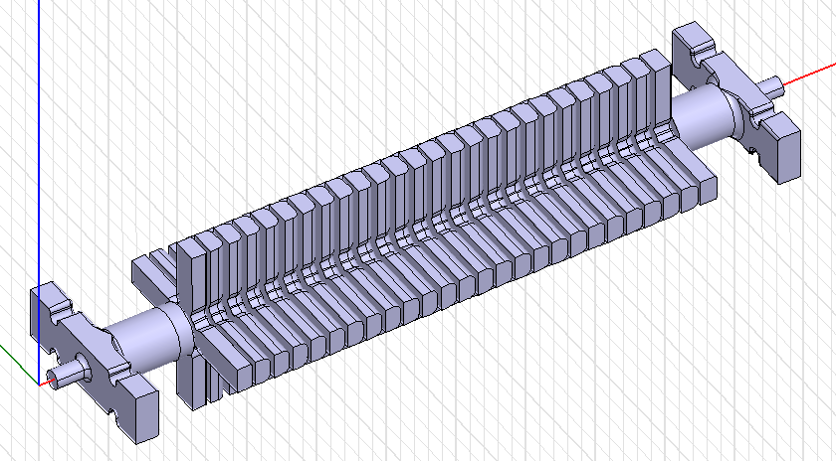
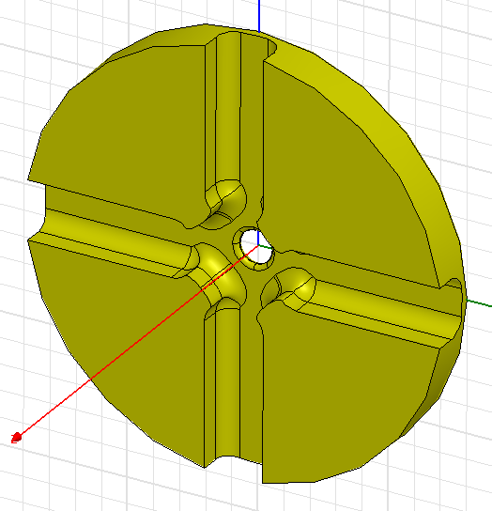
TD24_vg1.8_disk

Slide 6
TD24_vg1.8_disk transverse wake

Slide 7
Parameters of TD24_vg1.8_disk
Structure | CLIC_G | TD24
Frequency: f [GHz] | 12 | 12
Av. iris radius/wavelength: <a>/λ | 0.11 | 0.11
In/Output iris radii: a_{1,2} [mm] | 3.15, 2.35 | 3.15, 2.35
In/Output iris thickness: d_{1,2} [mm] | 1.67, 1.00 | 1.67, 1.00
Group velocity: v_{g}^{(1,2)}/c [%] | 1.66, 0.83 | 1.62, 0.81
N. of reg. cells, str. length: N_{c}, l [mm] | 24, 229 | 24, 229
Bunch separation: N_{s} [rf cycles] | 6 | 6
Lumi. per bunch X-ing: L_{b×} [m⁻²] | 1.22×10³⁴ | 1.22×10³⁴
Bunch population: N | 3.72×10⁹ | 3.72×10⁹
Number of bunches in a train: N_{b} | 312 | 312
Filling time, rise time: τ_{f} , τ_{r} [ns] | 62.9, 22.4 | 64.2, 23.1
Pulse length: τ_{p} [ns] | 240.8 | 242.7
Input power: P_{in} [MW] | 63.8 | 66.0
P_{in}/Ct^{P}_{p}^{1/3}[MW/mm ns^{1/3}] | 18 | 18.6
S_{c}^{max} [MW/mm²] | 5.4 | 5.6
Max. surface field: E_{surf}^{max} [MV/m] | 245 | 240
Max. temperature rise: ΔT^{max} [K] | 53 | 62
Efficiency: η [%] | 27.7 | 26.5
Figure of merit: ηL_{b×} /N [a.u.] | 9.1 | 8.7
Parameters assuming coupler overhead

Slide 8
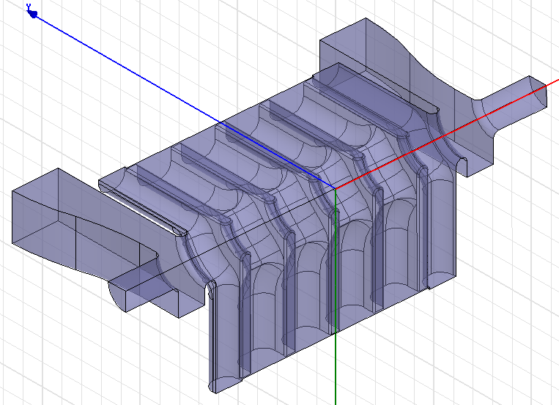
Electric field coupler

Slide 9
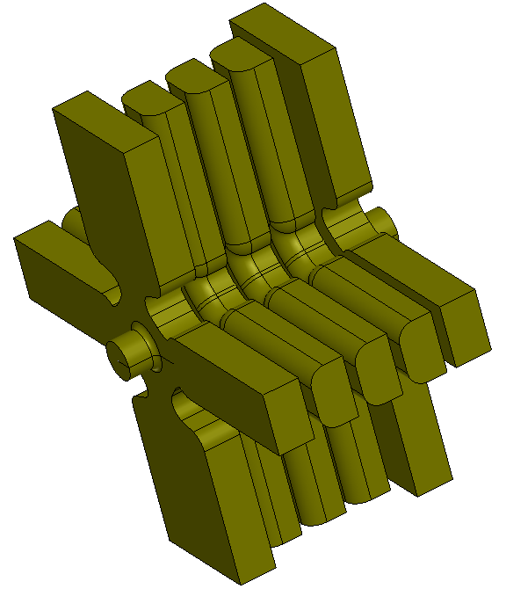
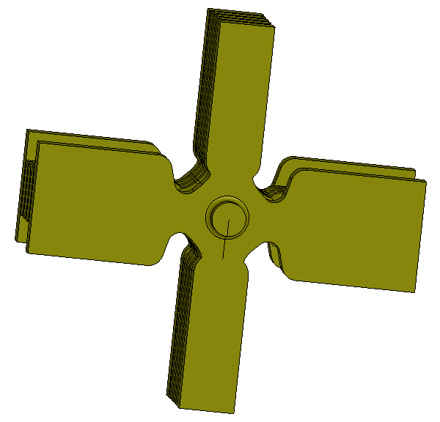
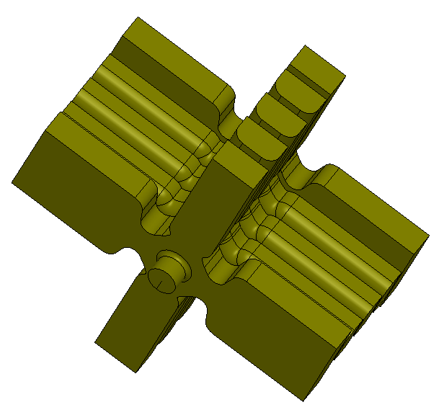
Magnetic field coupler with damping
compact coupler (CC)
Courtesy of
R. Zennaro

Slide 10
CLIC_G + compact coupler
CLIC_G
CLIC_GCC
Prototype is under design

Slide 11
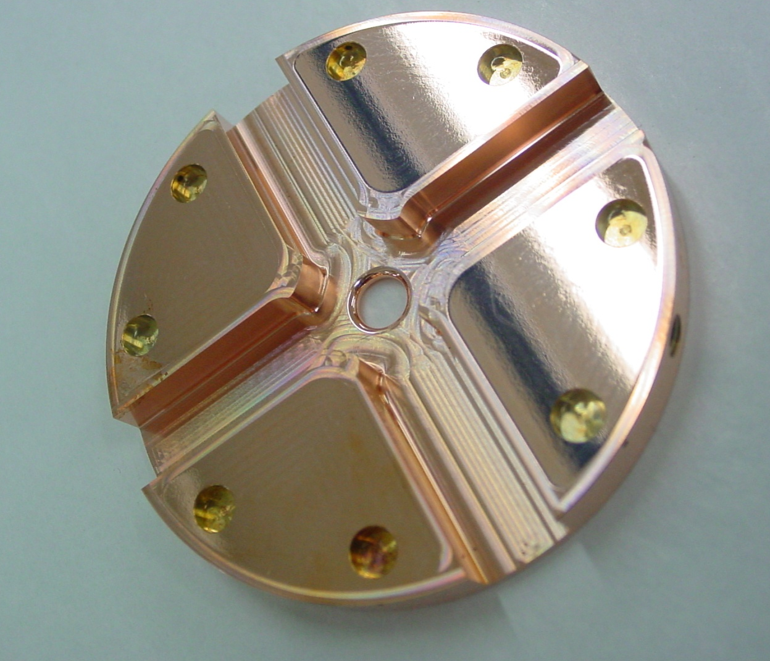
Rounded and non-rounded damped cells
CLIC_G rounded
idw = 8.75 mm
adw = 11.25 mm
TD18 cell
CLIC_G non-rounded
idw = 8.2 mm
adw = 10.1 mm

Slide 12
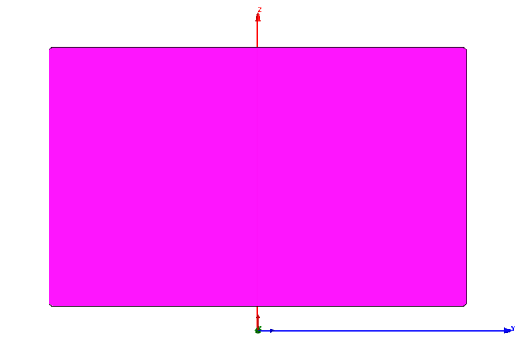
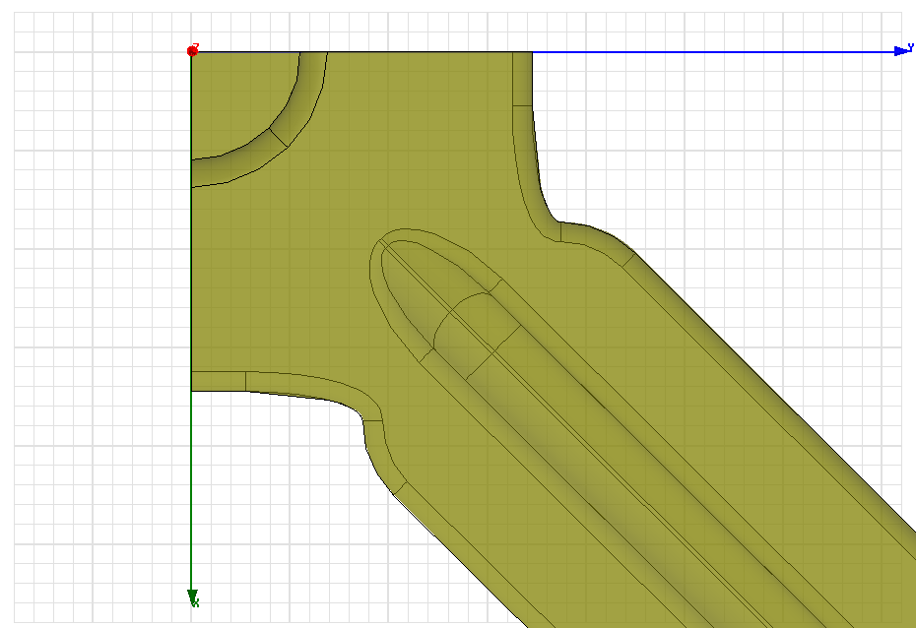
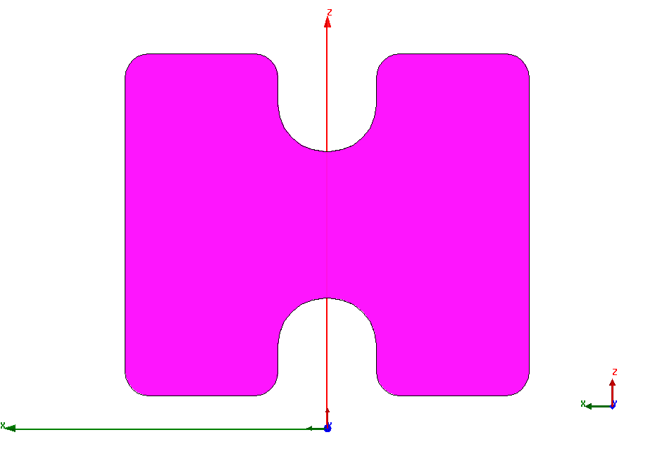
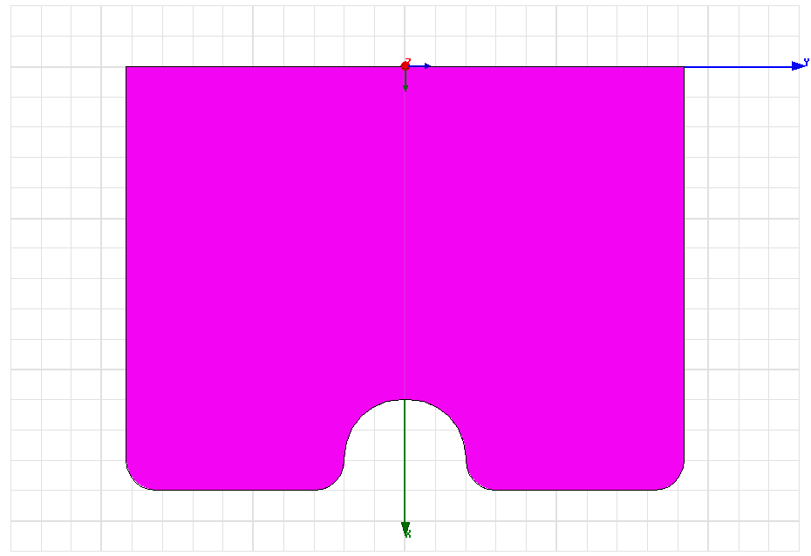
Ridged waveguide for HOM damping
Rectangular waveguide
CLIC_GLDT (low ΔT)
idw = 7.5 mm
adw = 9.25 mm
Double-ridged waveguide
idw
Ridged waveguide
adw

Slide 13
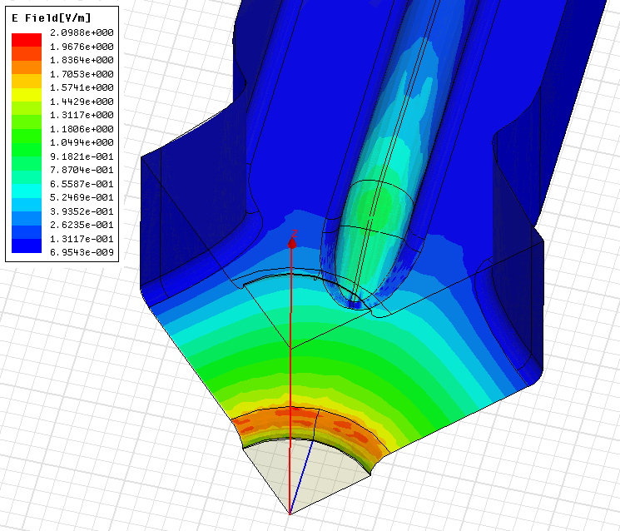
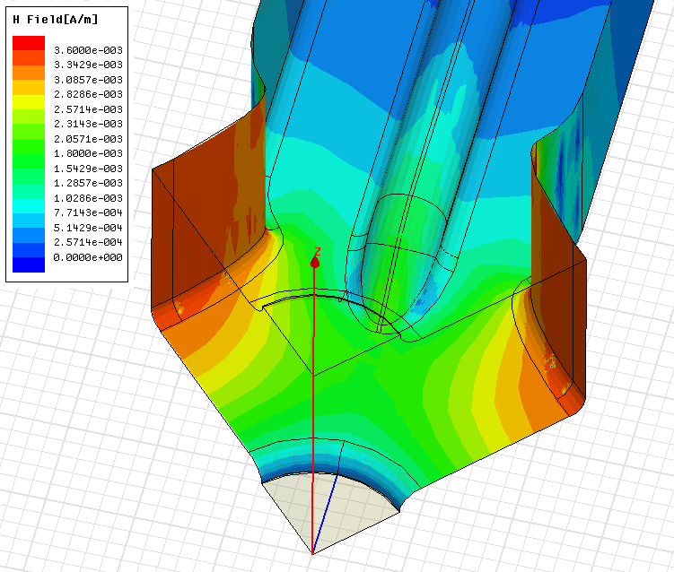
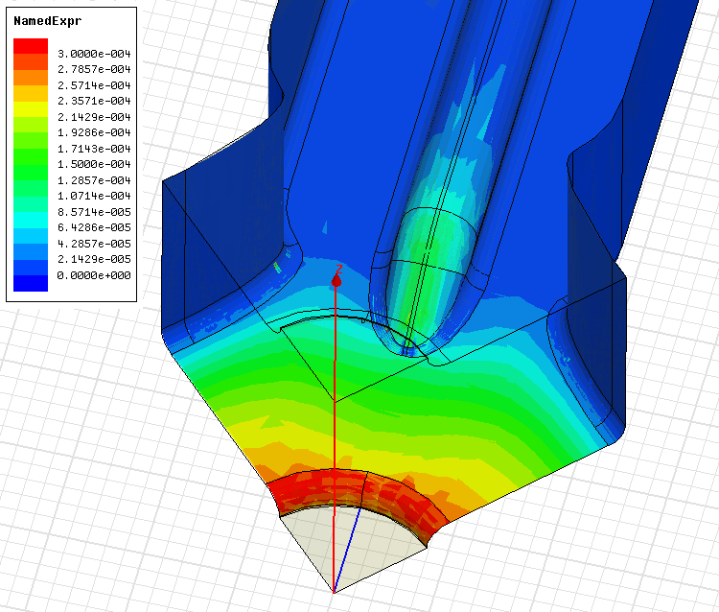
EM field configuration in RWDS
Electromagnetic field configuration on the surface of a
Ridged waveguide damped structure (RWDS) cell
Electric field
Magnetic field
Sc

Slide 14
Structures with ridged waveguide damping
CLIC_GLDT : a = 3.15 – 2.35 mm
CLIC_K : a = 3.3 – 2.35 mm

Slide 15
Wake field of proposed structures

Slide 16
Transverse impedance

Slide 17
Parameters of the structures
Structure | CLIC_G | CLIC_GCC | CLIC_GCC non-rounded | CLIC_GLDT | CLIC_K
Frequency: f [GHz] | 12 | 12 | 12 | 12 | 12
Average iris radius/wavelength: <a>/λ | 0.11 | 0.11 | 0.11 | 0.11 | 0.113
Input/Output iris radii: a_{1,2} [mm] | 3.15, 2.35 | 3.15, 2.35 | 3.15, 2.35 | 3.15, 2.35 | 3.3, 2.35
Input/Output iris thickness: d_{1,2} [mm] | 1.67, 1.00 | 1.67, 1.00 | 1.67, 1.00 | 1.67, 1.00 | 1.67, 1.00
Group velocity: v_{g}^{(1,2)}/c [%] | 1.66, 0.83 | 1.66, 0.83 | 1.67, 0.84 | 1.68, 0.86 | 1.97, 0.86
N. of reg. cells, str. length: N_{c}, l [mm] | 24, 229 | 25, 225 | 25, 225 | 25, 225 | 25, 225
Bunch separation: N_{s} [rf cycles] | 6 | 6 | 6 | 6 | 6
Luminosity per bunch X-ing: L_{b×} [m⁻²] | 1.22×10³⁴ | 1.22×10³⁴ | 1.22×10³⁴ | 1.22×10³⁴ | 1.28×10³⁴
Bunch population: N | 3.72×10⁹ | 3.72×10⁹ | 3.72×10⁹ | 3.72×10⁹ | 3.94×10⁹
Number of bunches in a train: N_{b} | 312 | 312 | 312 | 316 | 326
Filling time, rise time: τ_{f} , τ_{r} [ns] | 62.9, 22.4 | 64.7, 22.4 | 63.8, 22.0 | 63.0, 21.6 | 58.4, 21.6
Pulse length: τ_{p} [ns] | 240.8 | 242.6 | 241.4 | 242.1 | 242.5
Input power: P_{in} [MW] | 63.8 | 59.8 | 61.5 | 61.3 | 64.6 (65.2)
P_{in}/Ct^{P}_{p}^{1/3}[MW/mm ns^{1/3}] | 17.9 | 16.8 | 17.3 | 17.3 | 17.5
S_{c}^{max} [MW/mm²] | 5.4 | 5.1 | 5.3 | 5.2 | 5.1
Max. surface field: E_{surf}^{max} [MV/m] | 245 | 233 | 230 | 230 | 244
Max. temperature rise: ΔT^{max} [K] | 53 | 48 | 45 | 39 | 37
Efficiency: η [%] | 27.7 | 28.8 | 28.1 | 28.5 | 29.5 (29.2)
Figure of merit: ηL_{b×} /N [a.u.] | 9.1 | 9.4 | 9.3 | 9.4 | 9.6
(95% of Cu conductivity)

Slide 18
Proposal for new test structures
CLIC_GCC non-rounded: TD25_vg1.7_disk - an optimized version of TD24-type made in standard disk technology the same as TD18-type.
CLIC_GLDT: TD25_vg1.7_dLDT – structure with ridged waveguide damping
CLIC_K:
  T25_vg2_disk – non-damped structure with higher input group velocity and stronger tapering than CLIC_G
  TD25_vg2_disk – damped version

Slide 19
RF breakdown constraints
Constraints @ {200ns, BDR=10⁻⁶ bpp/m} ~ {180ns, BDR=3x10⁻⁷ bpp/m}

