Slide 1

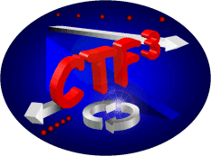
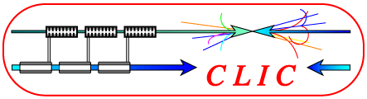
Recent 30 GHz results @ CTF2
M. Gerbaux, S. Döbert, Jan Kovermann, R. Zennaro

Slide 2
Outline
Introduction
30CNSDsbCu_speed-bump
Motivation
High power RF test results
Effect of the speed bump on the damages
TM₀₂₀ 3.5 mm structure
Motivation
High power RF test preliminary results
Conclusion and future plans

Slide 3
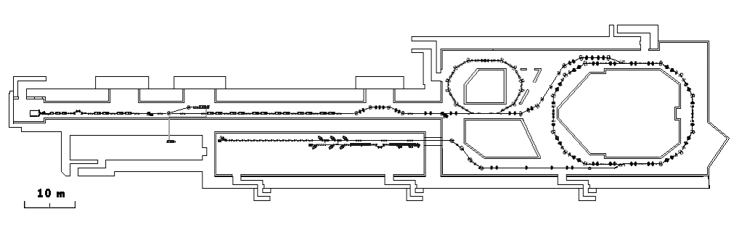
To set the stage…
Linac
Thermionic gun
CR
F
F
D
F
D
D
D
D
F
F
F
F
F
F
D
D
D
D
F
F
F
F
D
D
D
D
F
F
F
F
F
F
F
F
D
D
D
F
D
D
F
F
F
F
F
F
F
F
F
F
F
D
D
F
D
F
F
D
D
D
D
D
D
D
D
D
D
D
F
F
F
F
D
D
D
D
D
D
D
D
F
F
F
D
F
D
D
F
D
F
F
D
F
D
D
D
D
D
F
F
F
F
F
F
D
D
D
D
D
D
F
D
D
D
F
F
F
F
D
F
D
D
D
D
D
D
D
D
D
D
F
D
F
F
D
D
D
D
D
F
D
F
D
F
F
D
D
F
F
CLEX
CTF2
30 GHz production (PETS line)
and test stand
30 GHz activities :
Reminiscence of the time when CLIC operating frequency was not yet 12 GHz.
Now used to test scientific hypothesis.
The speed bump and TM₀₂ structures are based on the design of the older 3.5 mm diameter structure.

Slide 4
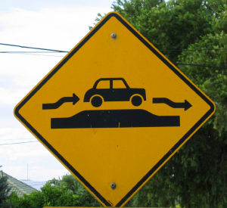
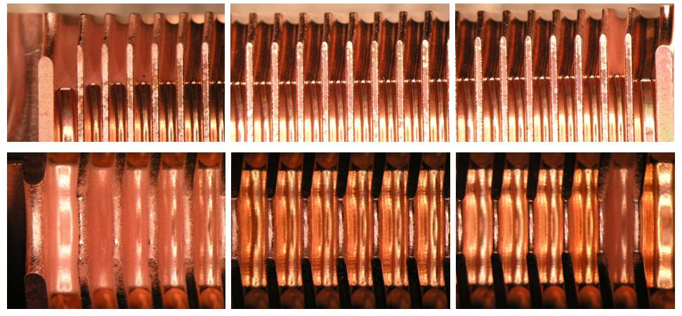
Why speed bump?
Courtesy of
Riccardo Zennaro
From Igor’s presentation at the X band workshop:
Very often we do observe, that after accelerating structure processing the most of the surface modifications take place in a few first cells. Also the number of cells involved is correlated with the group velocity, the less the Vg the fewer cells modified.
P_{INC}
P_{INC}
HDS 60 L
HDS 60 S
What we do certainly know, the breakdown ignition is a very fast process: 0.1 -10 ns. If so, one can propose the main difference between the “first” and “second” cell is accessible bandwidth.
And the lower group velocity the more the difference.
The first cell, if breakdown occurs is loaded by the input coupler/waveguide and is very specific in terms of bandwidth.
In other words, the first cell can accept “more” energy during breakdown initiation than the following ones.
We do not know the exact transient behavior of the breakdown and the structure bandwidth could play important role.

Slide 5
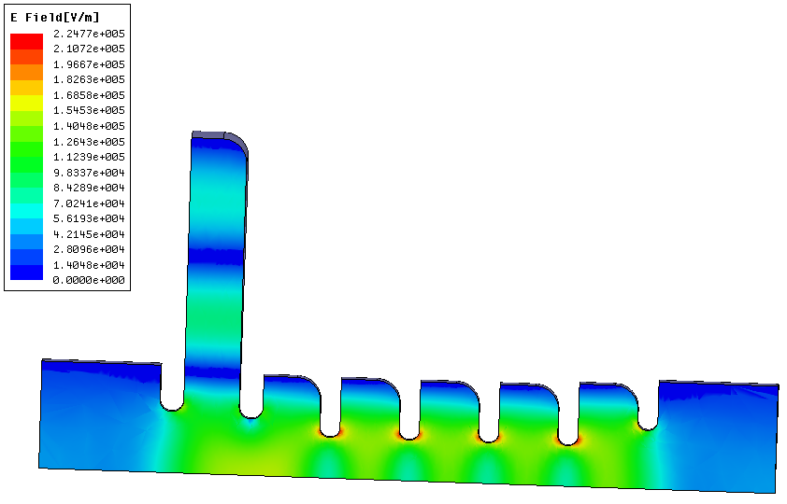
Speed bump (TM₀₃)
Courtesy of
Riccardo Zennaro
R=14.398 mm
Test structure in disks: 30 cell and identical mode launcher of the conventional “3.5 mm structure”
R_iris= 2.428 mm
Iris_thickness= 1mm
Goal : « protect » the structure by lowering V_{g} in the first cell (usually the most damaged).
Tested in both direction :
RF fed from the input (4.1×10⁶ pulses, 2186 breakdown) → the speed bump plays its role
RF from the output (1.7×10⁶ pulses, 501 breakdown) → the speed bump has no effect
→ Equivalent to 19 + 8 « SLAC hours » @ 60 Hz…

Slide 6
Breakdown rate calculation
OK

Slide 7
Breakdown rate vs gradient – speed bump structure
3.5 mm structures comparison
Vertical error bars calculated assuming an error of 1 on the breakdown number and 500 on the number of pulses.
Horizontal error bars : standard deviation of the measured gradient.
Red circles are upper limits (no breakdown recorded).
Fit doesn’t take into account these points.
-- Old 3.5mm structure
No effect observed on the breakdown rate : similar results in both directions and for the 3.5 mm structure (same design without speed bump).

Slide 8
Number of breakdowns in the two experiments

Slide 9
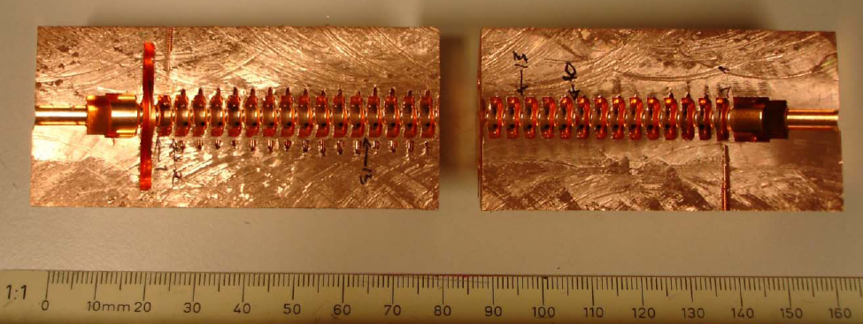
General view of the 30CNSDsbCu_speed-bump afer cutting
Speed bump
Iris 1
Iris 2
Iris -2
Iris -1
SEM inspection was performed on these irises

Slide 10
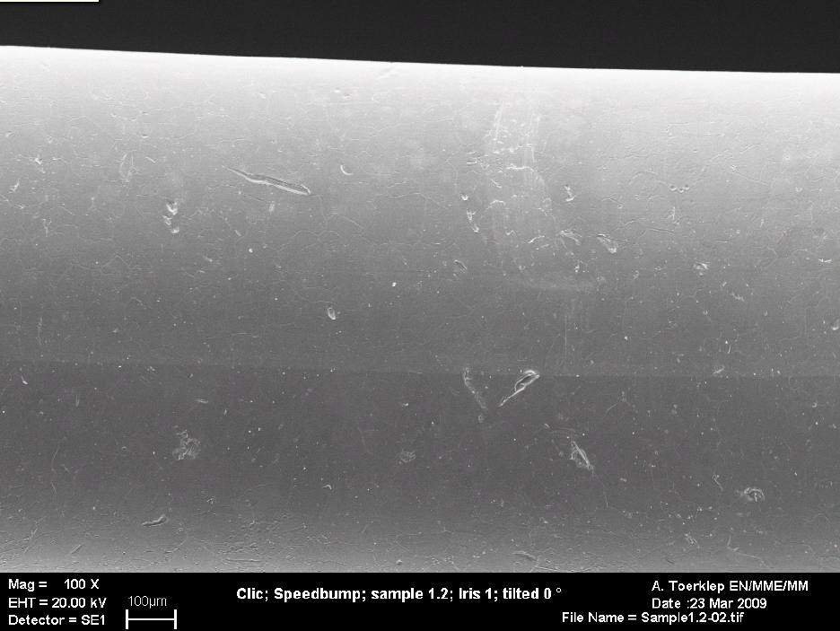
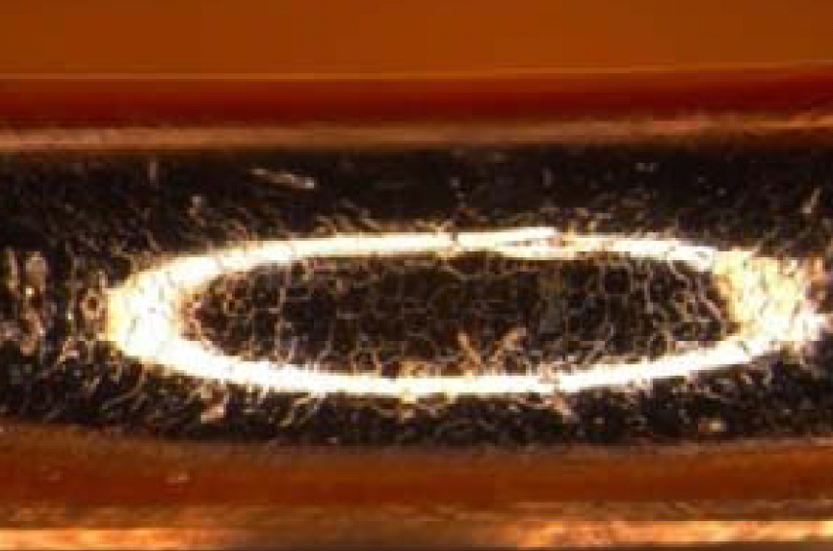
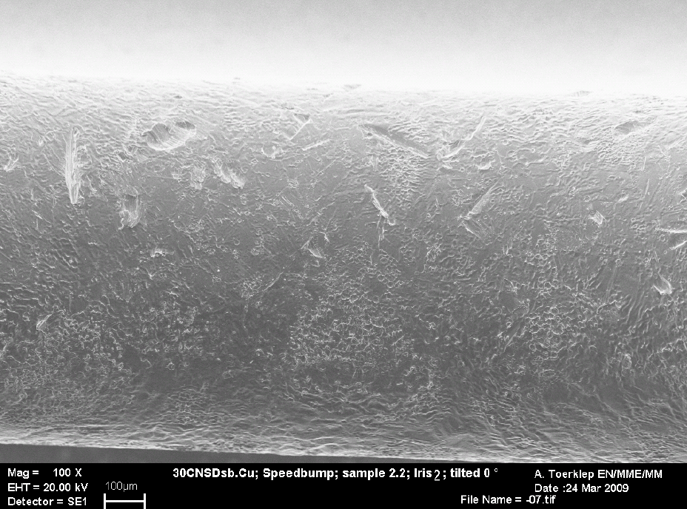
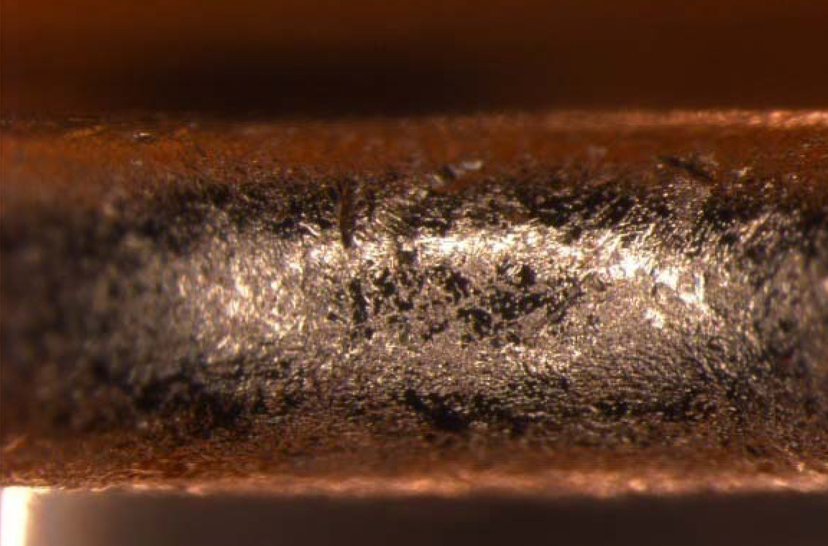
Damages
Iris 1
Iris -1

Slide 11
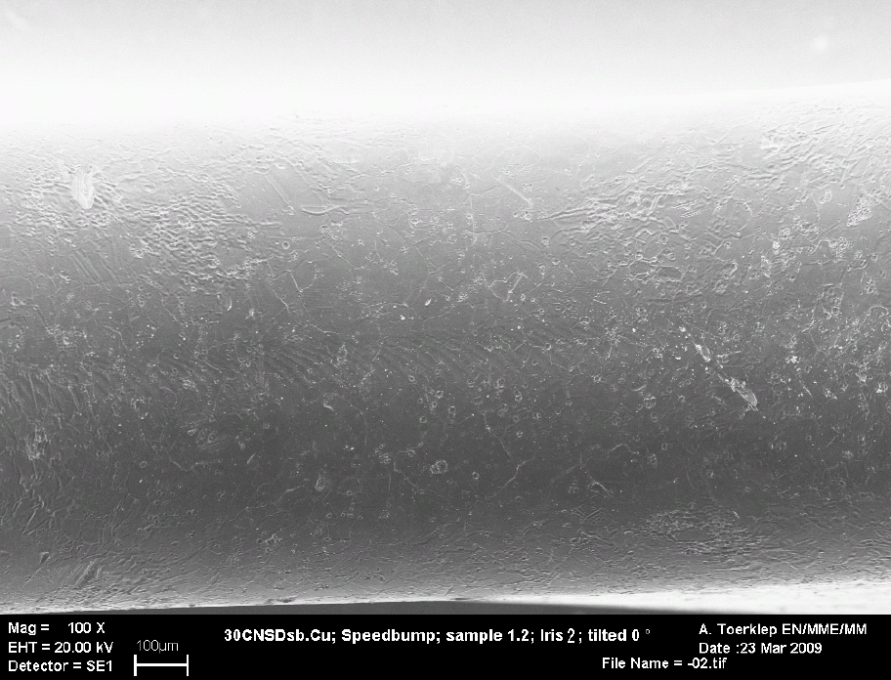
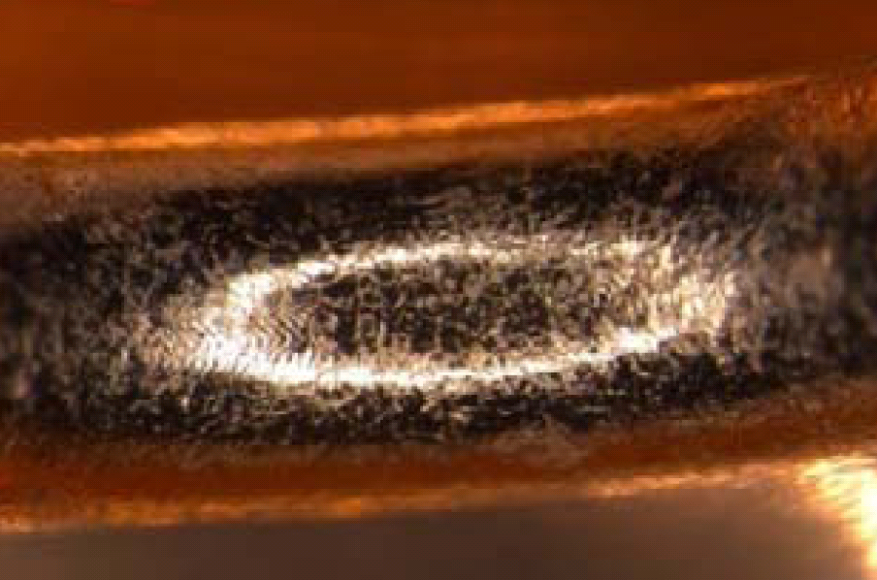
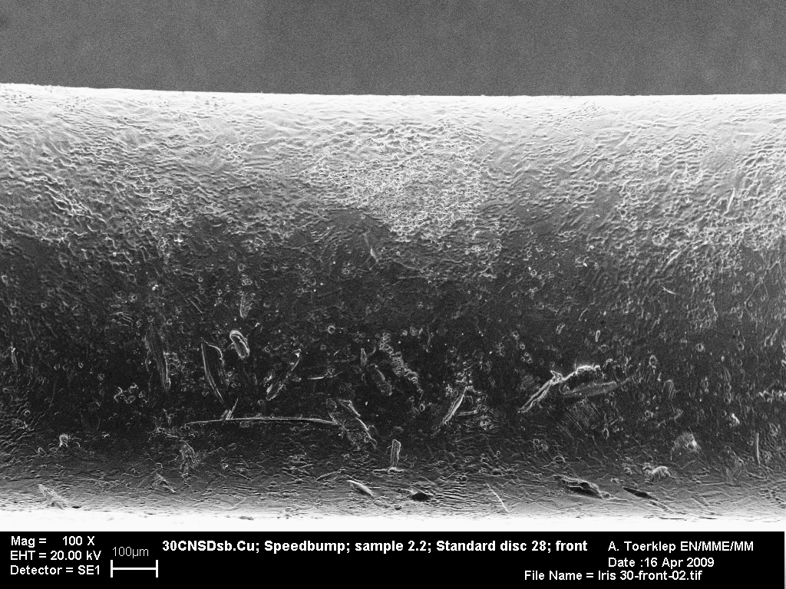
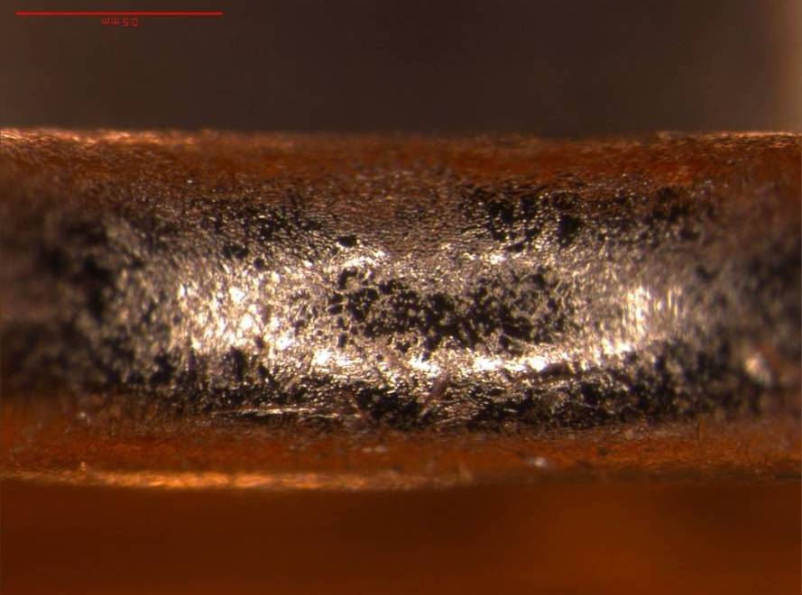
Damages
Iris 2
Iris -2

Slide 12
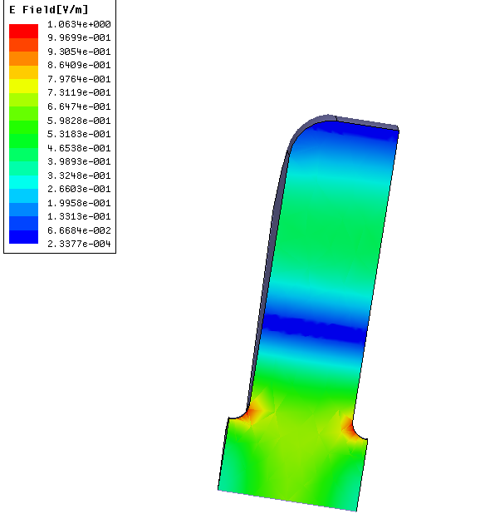
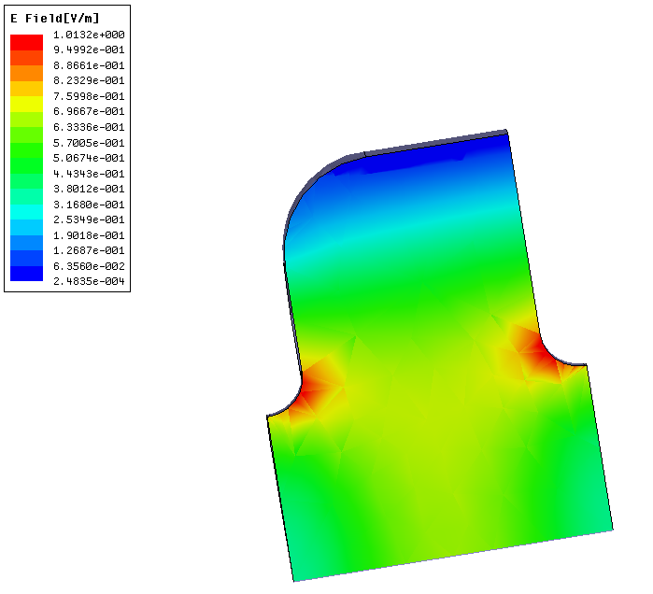
TM₀₂ structure
Is it possible to change some global parameter without changing local field distribution?
→ Only by changing the propagating mode
Courtesy of
Riccardo Zennaro
TM₀₁ regular cell “reference”
TM₀₂ regular cell
Same phase advance
Same P/c
Same aperture and iris shape
Same field configuration in the iris region
but
Different group velocity (4.7% vs 2%)
Different R/Q (29 kΩ/m vs 12 kΩ/m)
Test structure in disks : 30 cells, same mode launcher as the “conventional” 2π/3, Ø 3.5 mm.

Slide 13
TM₀₂₀ structure – preliminary results
3
4
27
2
25
11
30
29
12
24
28
5
7
1
20
26
14
10
15
17
23
8
19
13
9
6
22
21
18
16
At the moment, equivalent to ≈26 « SLAC hours »

Slide 14
TM₀₂₀ structure – preliminary results

Slide 15
Conclusion and future plans
The 30CNSDsbCu_speed-bump worked well and the speed bump seems to reduce the damages due to breakdowns.
This suggests to test a « speed bump » structure at 12 GHz.
The TM₀₂₀ structure is still under test (still conditioning ?) but the results are not very promising.
If v_{g} was the key parameter, the achievable gradient at a given BD rate should be higher than for the other 3.5 mm structures.
If it was rather surface field, the results should be more or less the same.
The experiment confirms neither one nor the other. Is this only due to fabrication issues or is there another key parameter?
It underlines the difficulty to draw conclusions with a single structure !

Slide 16
La réserve du chef

Slide 17
Direct comparison of V_{g}
Courtesy of
Riccardo Zennaro
Vg
TM01: 2π/3 Vg=4.7%
d
a
TM02: 2π/3 Vg=2.0%

Slide 18
C30-sb
In total :
4,101,250 pulses, mainly at 1 Hz corresponding to 18.99 SLAC hours at 60 Hz
2186 breakdowns
Weird things due to calibration problems
(now solved)
Mathias Gerbaux - CTF3 Collaboration Technical meeting - 27/01/2009

Slide 19
C30-sb-reversed
In total :
1,704,650 pulses, mainly at 1 Hz corresponding to 7.89 SLAC hours at 60 Hz
501 breakdowns
Weird things due to calibration problems
(now solved)
Mathias Gerbaux - CTF3 Collaboration Technical meeting - 27/01/2009

