Slide 1
T18_VG2.4_Disk_#2 processing summary
SLAC Workshop
090708-10
T. Higo and Nextef group

Slide 2
Whole history of T18_#2 processing
Installation in Oct. 2008
Steady-state run at 80MV/m in Dec. 2008
Higher field in Jan-Feb 2009
Breakdown rate meas. in Mar.-Apr. 2009
Longer pulse in latter half of Apr. 2009
Breakdown rate meas. May 2009
Various measurement in June 2009
Finish with 4000 hrs operation

Slide 3
Processing history for 9 months
Nextef startup and careful processing

Slide 4
Recovery pass in (T,P) space
SLAC
KEK
P
CERN
P
P
50%P, -20%T
T
T
20%P, 20nsT
T
αP, -1stepT
In case of number of BD’s even at lower power level than defined

Slide 5
Whole BD history of T18_VG2.4_Disk #2

Slide 6
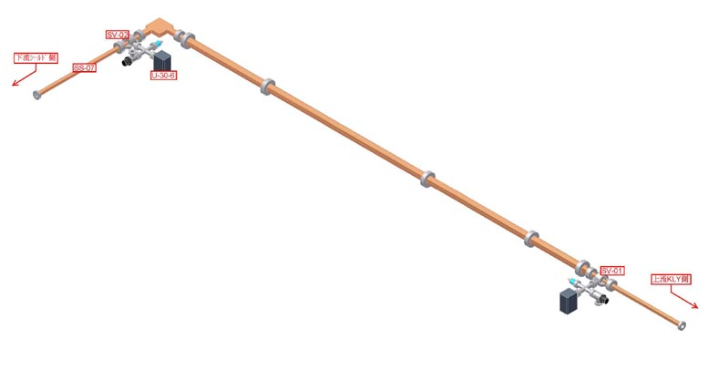
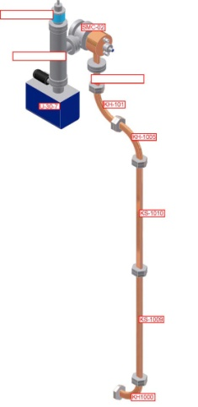
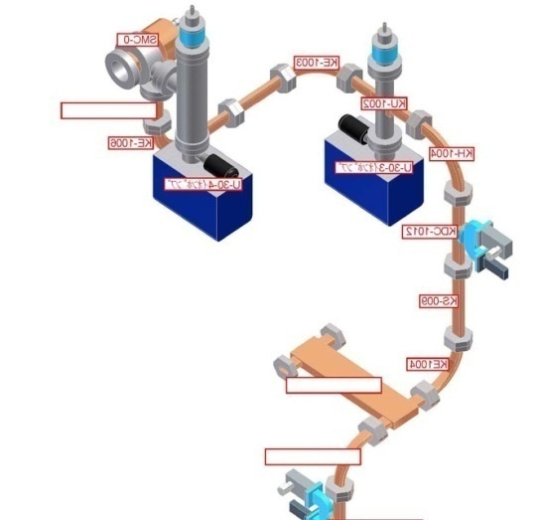
Nextef: RF monitors along waveguide
Low loss waveguide
Rs
ACC-IN
Ra
2-klystrons → 120MW, 300ns
klystron—3dB 2.3m
3dB— LLWG 1.5m
LLWG 5m
LLWG—ACC Str 5.0m
WR90 flanges ~36sets*7mm SUS
Loss Kly.→Str. ~23%
Delay ~ 50ns
Tr
N
S+N
ACC Structure
Two klystrons
S

Slide 7
Nextef: Monitors along beam axis
AM
PM
GV
PM
ACC str
GV
Qmass
FC-Mid
FC-UP
FC-DN

Slide 8
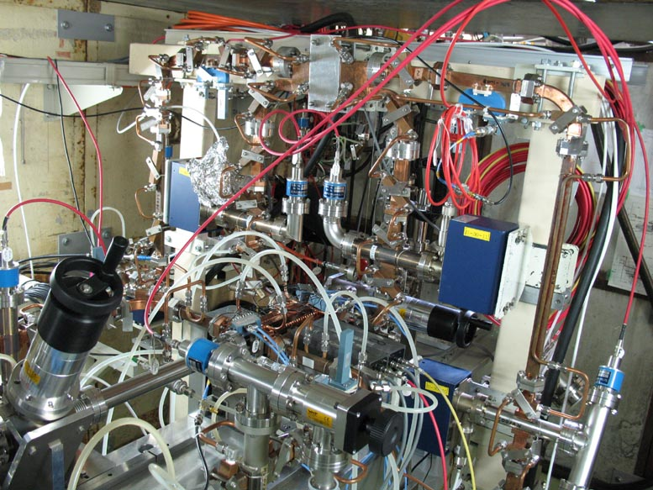
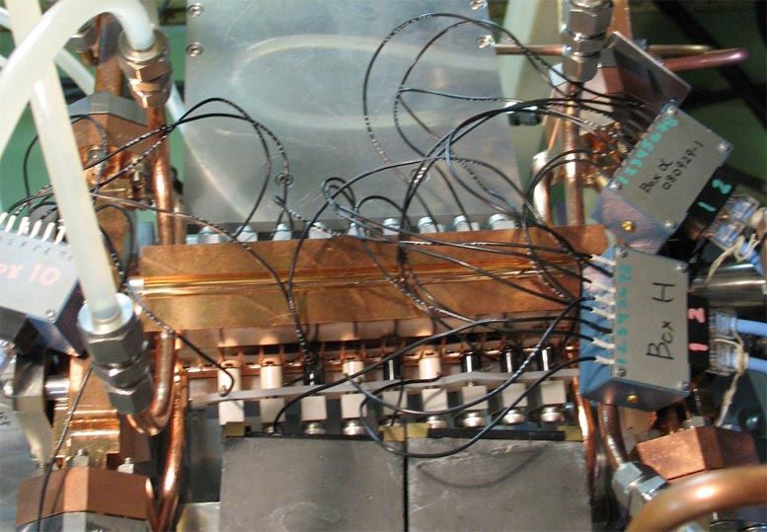
Now T18_VG2.4_Disk #2 has been processed since late October
GV
SLAC
3dB hybrid
Acoustic
sensors
Plastic scintilator
& PMT
FC
T18_VG2.4_Disk
(These are not used effecively.)

Slide 9
Big breakdown followed by a breakdown from the very first pulse
file number= 3 20081124_210211_1 Red=final, black=previous pulse and blue=-2nd pulse
Nominal BD
Rs
Ra
DPO1
Fs
Tr
Fs
DPO2
FC-UP
FC-Mid
1st pulse BD, following big BD
file number= 4 20081124_210301_1 Red=final, black=previous pulse and blue=-2nd pulse

Slide 10
Current burst toward upstream
Rs
Ra
Fs
Tr
Fs
FC-UP
FC-Mid
Rare event but need to understand the mechanism
One out of 100 breakdowns
Abrupt big burst in current only to upstream
no change in RF pulse shape

Slide 11
Power at BD’s and BDR during 27 days at 80MV/m (35MW) during RF-ON from 700 ~ 1200 hours since startup
Started at 10:00 on Nov. 28
Finished at 9:00 on Dec. 25
566 hrs run / 643 hrs
= 88% ON
BDR
~17 str. BD / 566 hr
~0.030 BD/hr/str
~0.75 x10⁻⁶ BD/Pulse/m

Slide 12
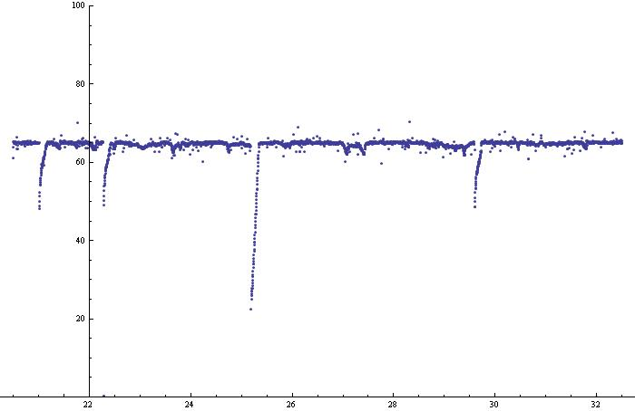
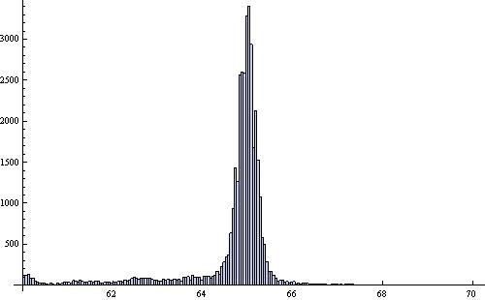
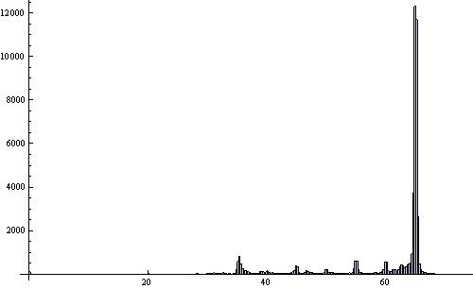
252ns, 65MW
Total operation hours >5MW = 140.6 hours
Period ACC-IN > 64 MW = 91.7 hours

Slide 13
Appearance of breakdowns at 65MW run

Slide 14
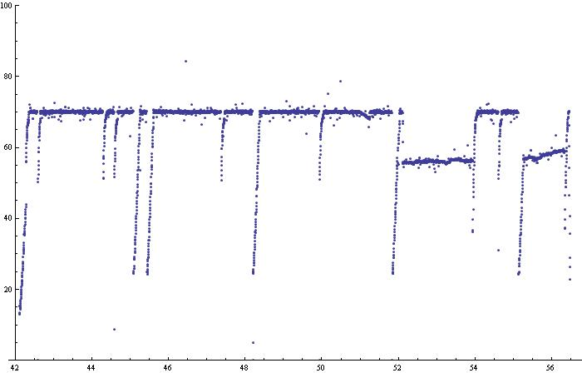
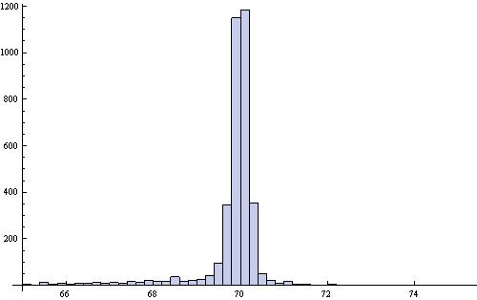
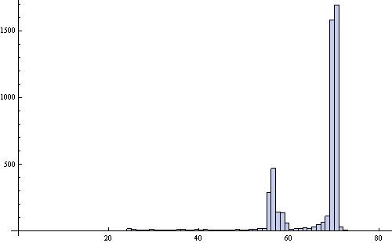
252ns, 70MW

Slide 15
Appearance of breakdowns at 70MW run

Slide 16
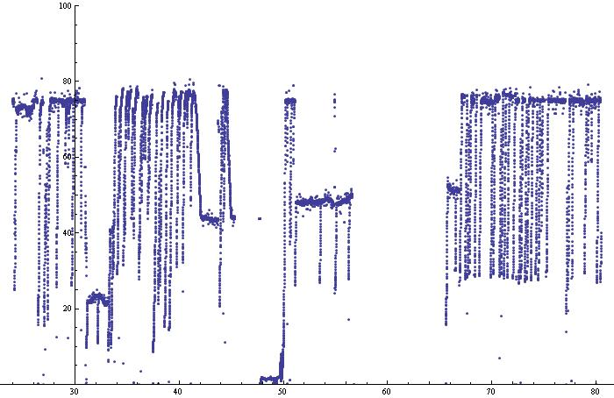
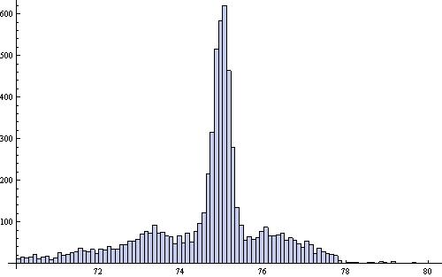
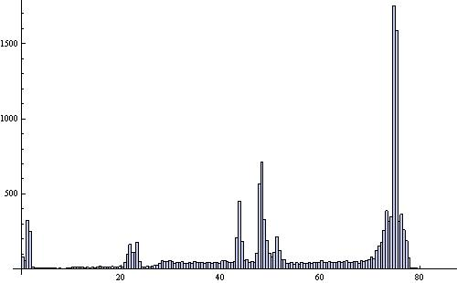
252ns, 75MW

Slide 17
Appearance of breakdowns at 75MW run

Slide 18
Typical processing / steady-state run
Breakdowns are
  mostly followed by a few to several successive breakdowns
  typically from the very first pulse at even lower power.
Spurious events exist
  with flush of current towards upstream occur from time to time

Slide 19
Breakdown rate evaluation
It is not so clear from this experiment that the breakdown rate decreases as function of “processing.”

Slide 20
Breakdown rate versus Eacc
Exponential fit.

Slide 21
Power fit.
Cannot discuss functional form due to large scatter.

Slide 22
R. Ruth at X-band workshop at CI, UK, Dec. 2009
RF Processing of the T18 Structure
RF BKD Rate Gradient Dependence for 230ns Pulse at Different Conditioning Time
RF BKD Rate Pulse Width Dependence at Different Conditioning Time
10
-4
After 250hrs RF Condition
G=108MV/m
After 500hrs RF Condition
10
-5
G=108MV/m
After 900hrs RF Condition
BKD Rate: 1/pulse/m
10
-6
G=110MV/m
After 1200hrs RF Condition
10
-7
100
150
200
RF Flat Top Pulse Width: ns
This performance maybe good enough for 100MV/m structure for a warm collider, however, it does not yet contain all necessary features such as wake field damping. Future traveling wave structure designs will also have better efficiencies

Slide 23
Breakdown rate versus width
Not enough to discuss functional form.
But it is evident that the longer pulse makes breakdown rate large with much more than linear dependence.

Slide 24
Summary of breakdown rate
Exponential slope as Eacc
  Data scattering band around a slope is by an order of magnitude
  Slope = an order of magnitude by 10 MeV/m
  Not enough to discuss about the functional form
Breakdown rate evolution
  Reduction of BDR was not seen in last 2000 hours

Slide 25
Breakdown position and timing
Still trying to analyze in detail.
At present, mainly refer to Steffen’s previous analysis
  More frequent at downstream

Slide 26
Analysis still on the way
137 examples of run24: 60MW, 400ns
Timing of Rs rise and Tr fall show correlation.
Two cases: those at the same time and those at 50ns later.
Position and time of the breakdown should be deduced from Rs and Tr.
FC current burst timing and amount should be integrated in the analysis.
Breakdowns from the very first pulse are missing; should be included in the analysis.

Slide 27
Steffen 090227
Breakdown position for 205 ns data
Red real cell timing, blue linear cell timing, 205 ns data

Slide 28
Dark current measurement
Setup
Amount and beta value of dark current versus processing time
Spectrum at RF-ON 2000hrs and 4000hrs
FC-UP
FC-Mid
AM
FC-DN
75cm
75cm
195cm

Slide 29
Amount of dark current
FC-Mid = 30μA
@100MV/m
FC-UP ~ FC-Mid/3
FC-DN ~ FC-Mid/4

Slide 30
Dark current evolution 252nsec
Measured at RF ON 700 – 1200 – 2100 – 3000 – 3400 hours
Decreased by a factor 2 between processing with max Eacc 80 → 110MV/m,
but no more suppression in the following steady-state run for more than 1000 hours

Slide 31
Dark current evolution 252nsec
Measured at RF ON 700 – 1200 – 2100 – 3000 – 3400 hours
No big change in shape nor slope (beta).

Slide 32
Deduction of the field enhancement factor
Fitting of modified F-N curve
Assuming Es/Eacc=2
actually T18_VG2.4_Disk
Es/<Eacc>~2.62 max
φ(Cu)=4.52eV

Slide 33
Width dependence
Upstream current behaves as linear on width
Downstream current has two components.

Slide 34
Dark current spectra in June
Dependence on power
Dependence on width
Actual field of analyzer magnet was checked.
The formula used up to now pc[MeV/m] = 1.646 x I [A] = 8.23xRef. Volt. [V] was confirmed.
Two peaks appear and higher for higher momentum one.
Less than ½ of full acceleration.
Little exists below 2.5MeV/m.

Slide 35
Dark current versus operation frequency
Increase as operation frequency increases.
Easy to be captured for both!?

Slide 36
Dark current behaviour
Amount
  to upstream << to downstream
  Divergent: 1/4 from Mid to DN
  Linear vs pulse width
Reduction of dark current
  By a factor 2~3 during first 2000 hrs
  No reduction after 2000 hrs
Beta value
  Stayed almost constant from 700hrs to 3300 hrs
  Not processed?
Spectrum
  Two peaks below half of full acceleration

Slide 37
Conclusion
Established a basic procedure of processing and evaluation
  Can proceed a series of structure tests
  Better to further develop a system in such as
    Phase measurement, missing energy evaluation, etc.
Breakdown rate was evaluated.
  Gross comparison with that of SLAC is consistent with each other.
  In order to precisely compare, power estimation and identification of breakdowns should be better.
Dark current
  Decreased during initial processing but stayed constant during a long-term run without higher field nor longer pulse processing.
  Energy is at most a half of full acceleration and little exists below a few MeV/c.
Breakdown pulse analysis
  Breakdown pulses are still to be analyzed carefully.

