Slide 1
CLIC RF structure master schedule and CERN production
10.07.2010

Slide 2
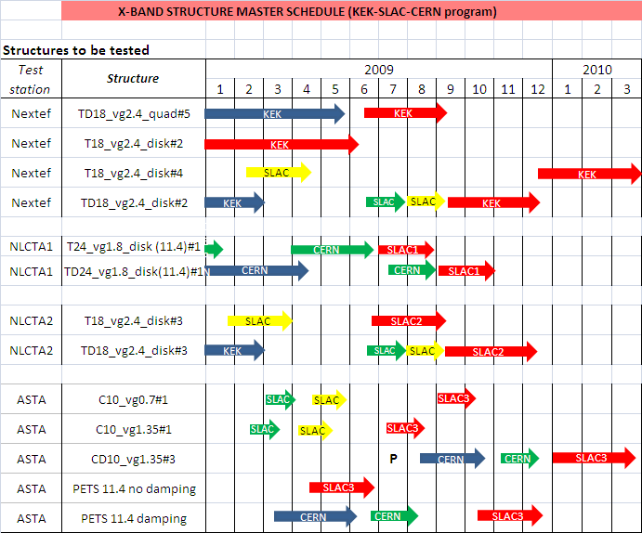
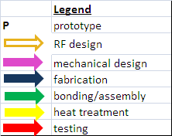
Structure master schedule
Installation started in cw27
Decision to cut a T18
#1, SFO on 23.06.2009 (tank version) #2 LT Ultra disks W27 (sealed version)
#1 non conform
#2 available
swapped
Cooling circuits shipped to SLAC
Bars at CERN
CD10
- Prototype phase (P) for 4 different material (Kugler, LT Ultra)
- Full structure in OFE at VDL

Slide 3
Structure master schedule
Fabrication at Kugler:
#1 received in April NC,
#2 required - prototype disk OK
disks at CERN CW28
Fabrication at VDL:
#1 and #2 disks finished
disks at CERN

Slide 4
Structures in the pipeline
Missed slot in ASTA, back to CERN?
Stand-by
SLAC/KEK technology,
KEK copper disks CW31

Slide 5
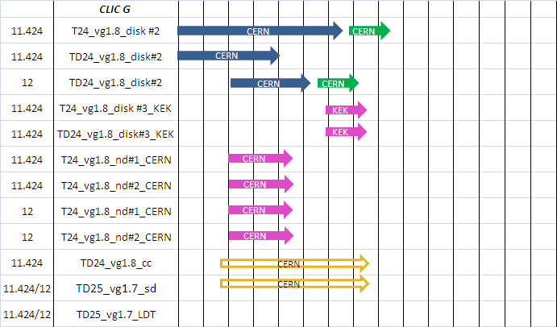
2nd unit, preparation in stand-by
Contract with KEK signed on 19.06, design started
T24 with smaller D and new tuning features
Under tendering
Compact coupler, asymm. disks
Ridged waveguides
Mode launcher coupler, symm. disks
J. Huopana, disks for brazing test cw28

Slide 6
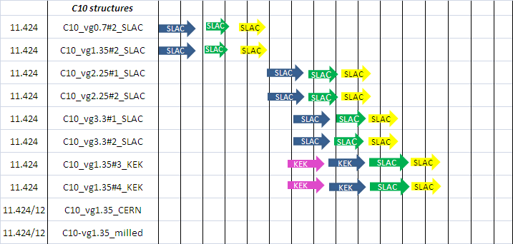
Mechanical design
started
Mechanical design
not started yet

Slide 7
Radial choke damping
Lower ΔT
Other structures:
x-band speed bump structure
CLIC K structures
500 GeV structures

Slide 8
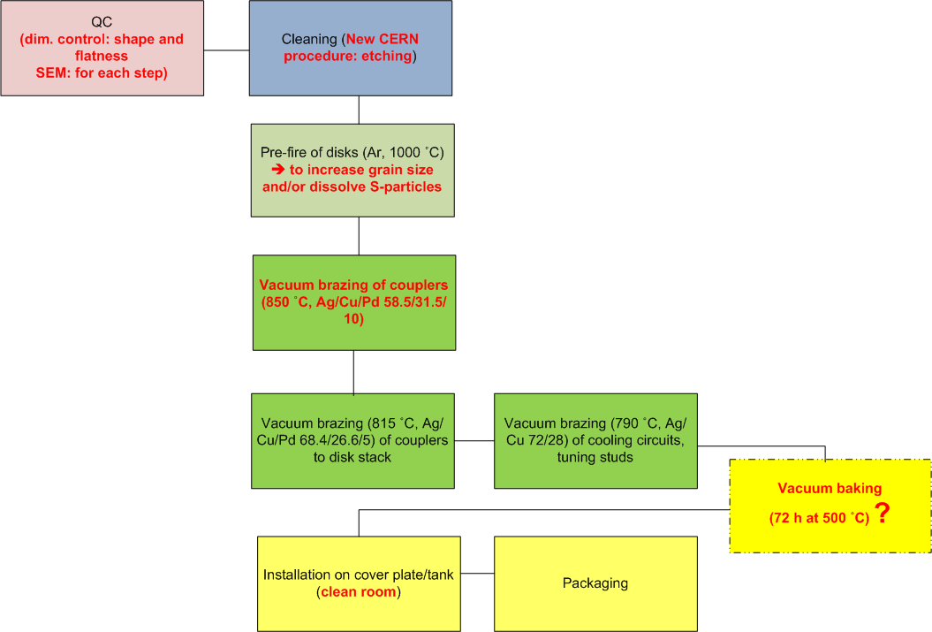
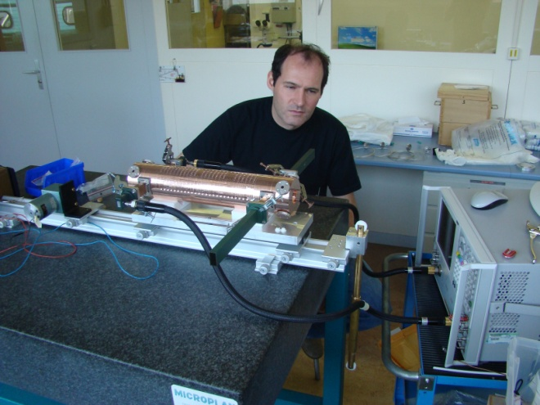
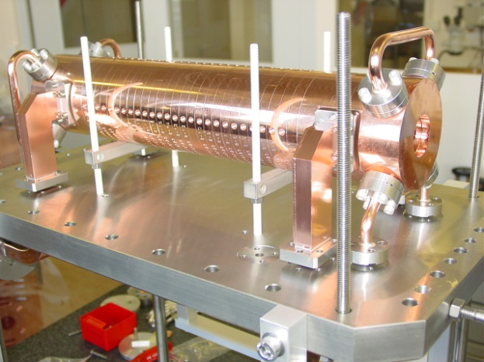
T24#1 (tank version)
Vacuum baking
4 h at 650 °C
Red: changes wrto previous assembly procedure

Slide 9
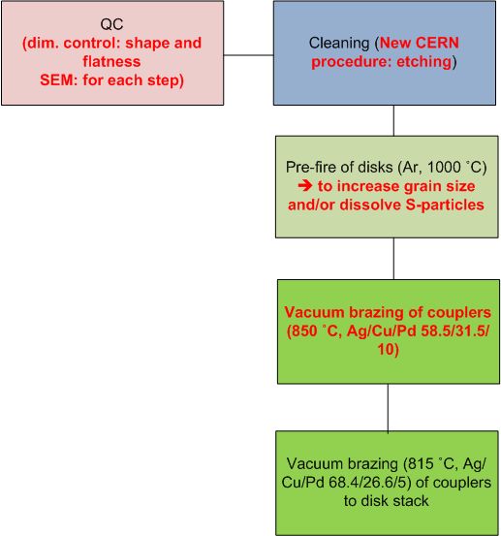
TD24 #1
RF check ➔ non conform
Inspection of all disks (see EDMS report: 10006094
Brazing material inside the disks
Launched program to qualify assembly procedure (aim bonding at 1000 C)
First results with pure bonding on two samples of 5 disks each seem to be promising

