Slide 1
SLAC workshop 7-10 July 2009 WP1: microwave based accelerators Status of CLIC X-band high-power components
G. Riddone, 08.07.2009
(contribution from A. Olyunin and I. Syratchev)

Slide 2
Overview
Areas | Type | Design | Supplier | Ordered
Conventional devices for several areas | 50 dB directional couplers 3 dB hybrid 3 dB H-plane splitter Dry stainless steel RF load Waveguide E/H bends RF flanges (CERN design) | Gycom CERN CERN CERN CERN CERN | Gycom CINEL, IHEP VDL VDL, CINEL, Heeze Several CINEL | 10 15 10 15 5
TBTS | Attenuator/splitter (0->1) RF phase shifter (360 °) | Gycom Gycom | Gycom Gycom | 3 1
Stand alone power source, PSI. | H10 -> H01 mode converter RF/vacuum valve (A. Grudiev) | Gycom/ SLAC SLAC | Both RF and mechanical design exist at 11.4 GHz | CEA/ Saclay
PETS on-off | 3 port waveguide junction (T-splitter) contact free high power movable short circuit tunable reflector RF network | CERN | Under design
CLIC Module | Choke mode flange | CERN | CERN | 2
Components needed for several collaborators: KEK and SLAC, as well as
PSI (XFEL), Trieste (Elettra), TERA foundation

Slide 3
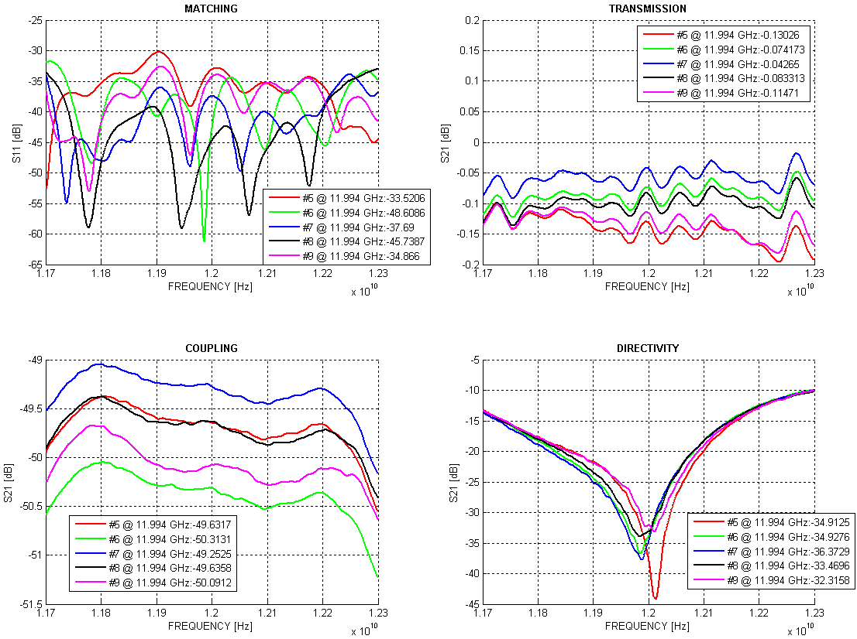
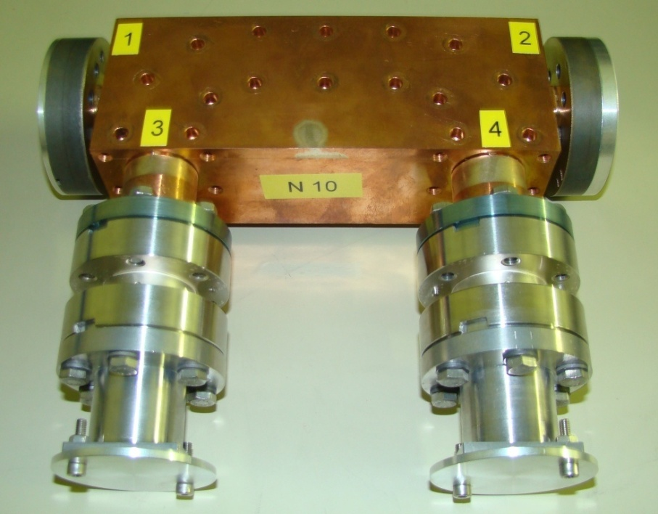
Directional couplers
First order completed (10 units)
New specification under preparation (aim at more compact design) for 5 additional units to covers needs from the collaborators

Slide 4
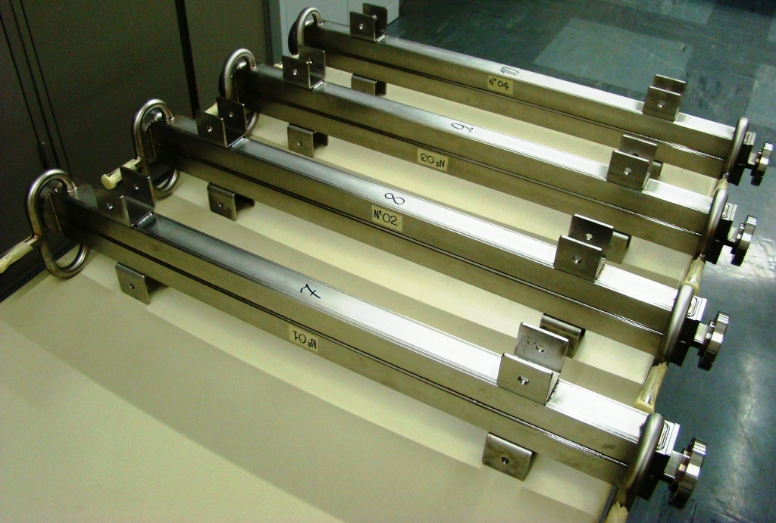
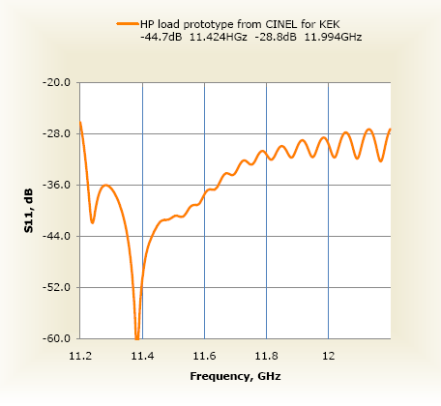
Dry stainless steel RF loads
The two halves of the load
10 loads received from CINEL and VDL (material AISI316LN)
To improve performance ➔ changed material magnetic stainless steel SS430 – 5 additional loads from CINEL and Heeze under fabrication (2 available at CERN for testing at KEK/SLAC)
3rd order will have to be foreseen for collaborators

Slide 5
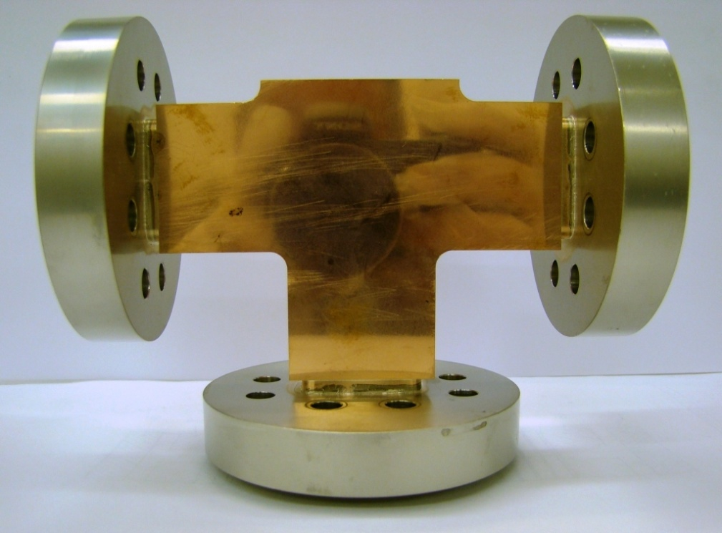
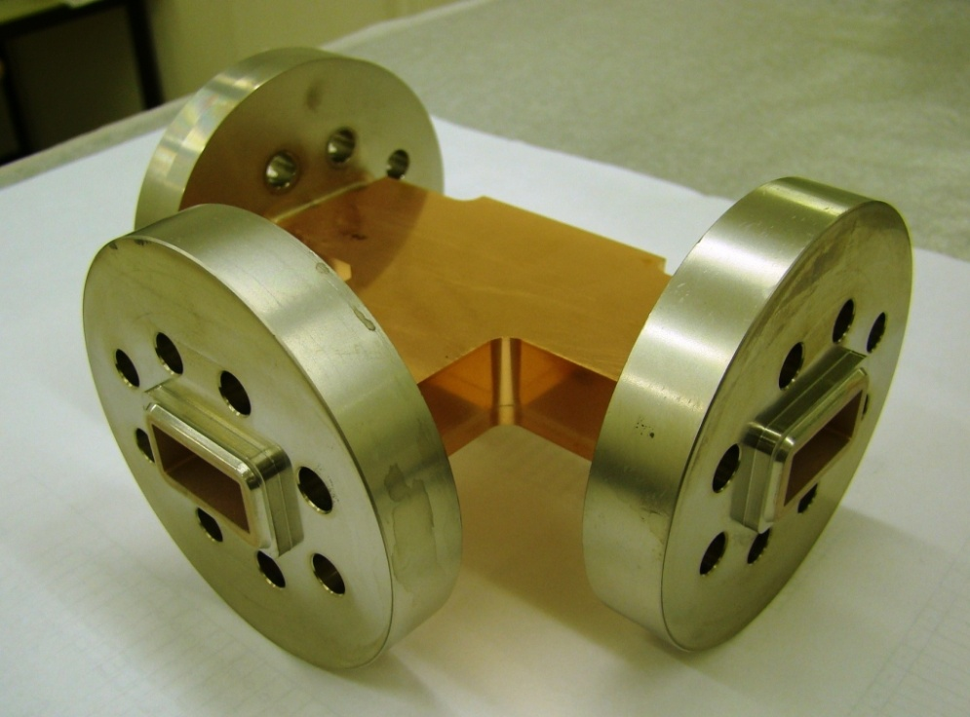
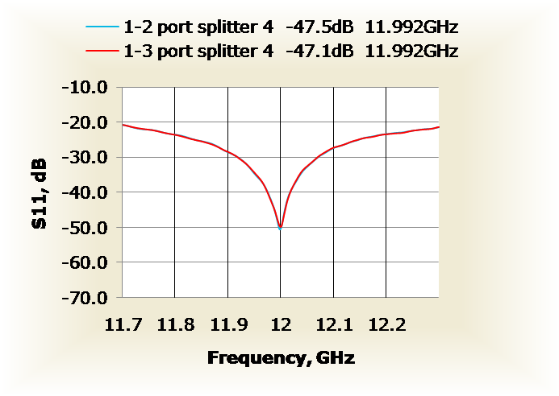
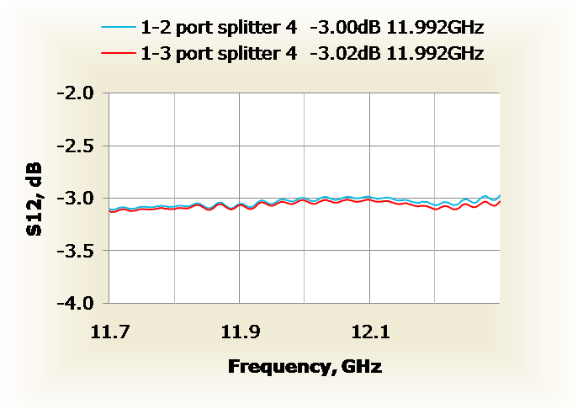
3 dB H-plane splitters
order completed (10 units)

Slide 6
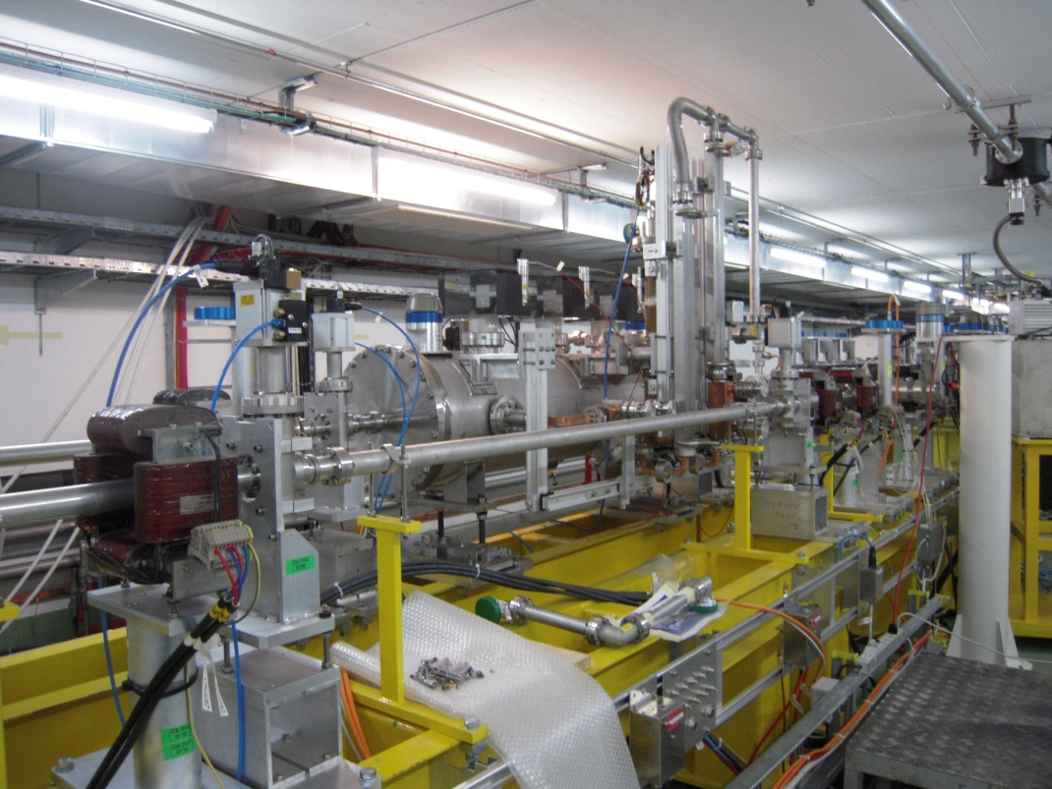
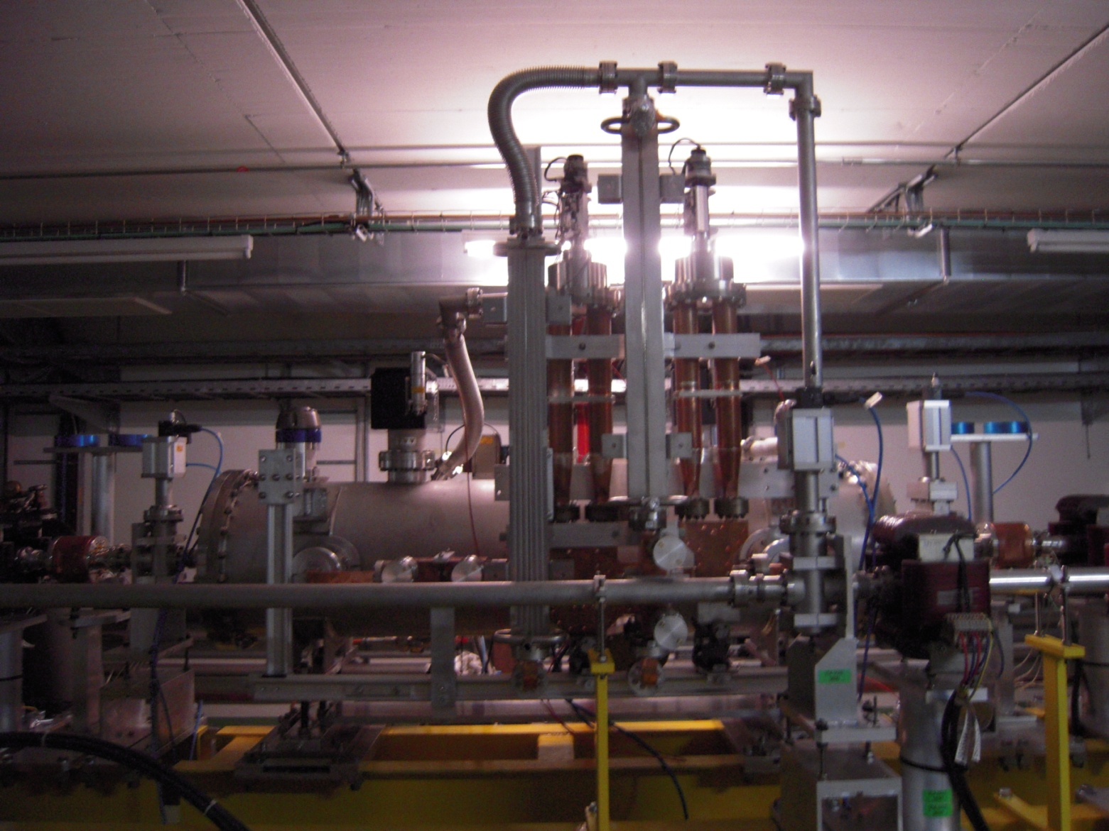
Two-beam test stand in CLEX
A number of RF components: directional couplers, loads, variable splitter and phase shifter have been installed and now under operation in the TBTS, CLEX at CERN
PETS tank

Slide 7
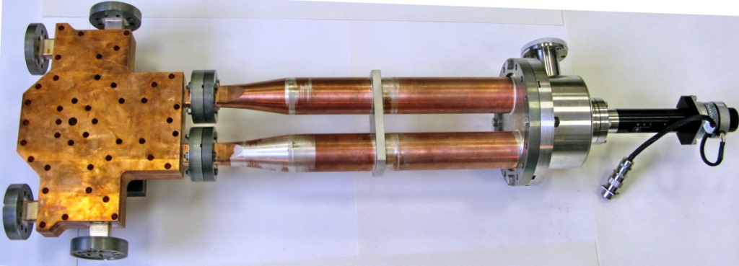
Attenuator/phase shifter
order completed (3 attenuators and 1 phase shifter)
S parameters at the position of the max (blue) and min (red) coupling
Attenuator (Variable high power RF power splitter)
Phase shifter (Variable high power RF phase shifter)

Slide 8
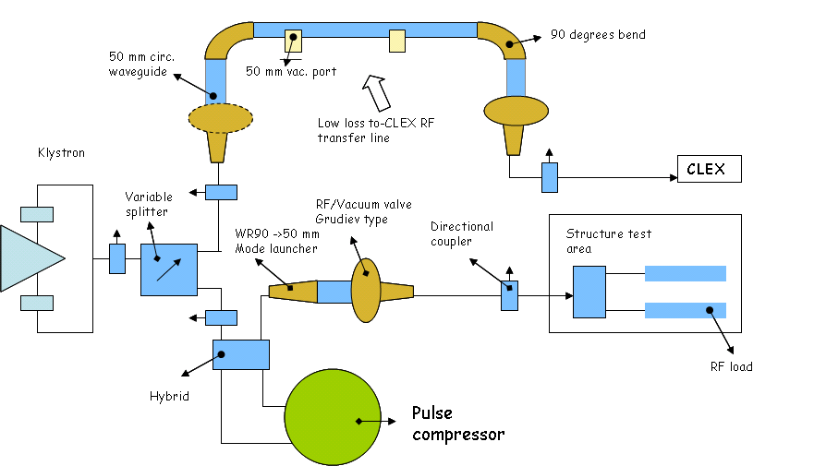
12 GHz stand alone RF power source waveguide network layout
I. Syratchev

Slide 9
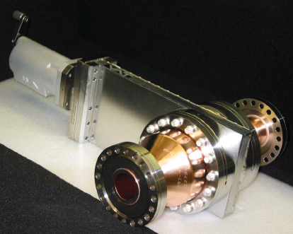
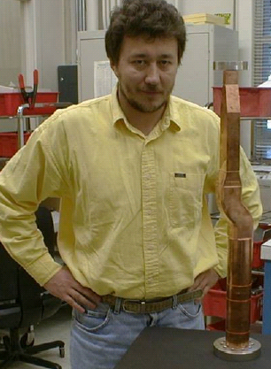
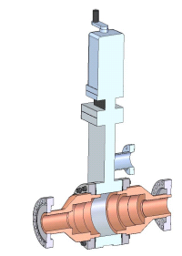
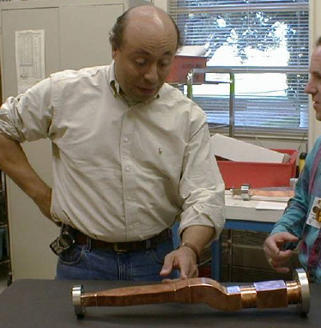
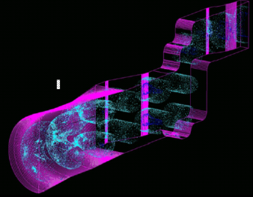
12 GHz stand alone RF power source waveguide network layout
11.4 H10 -> H01 mode converter
SLAC design
11.4 GHz Gate valve
(Grudiev type)
SLAC design – rescaled to 12 GHz
H10 -> H01 mode converter
CERN design (needed for PETS on-off)

Slide 10
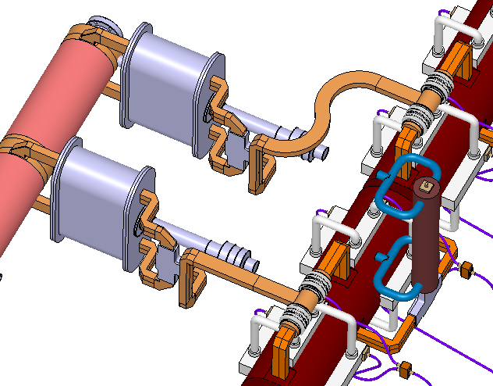
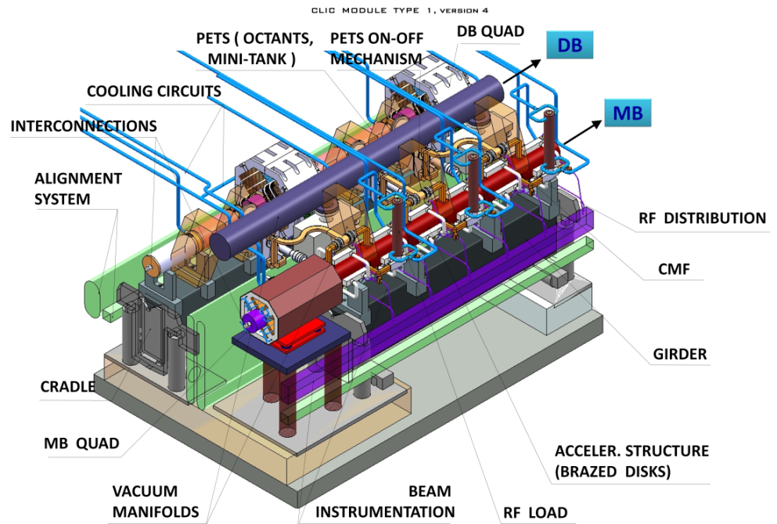
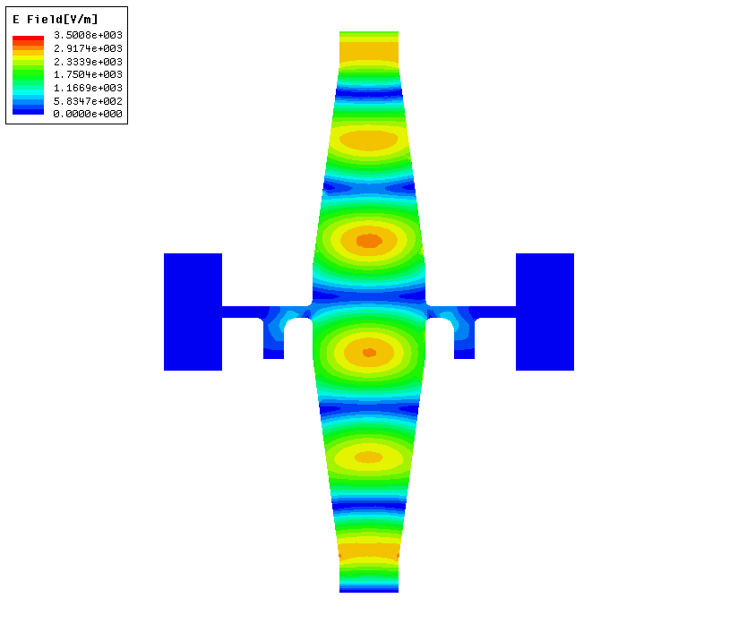
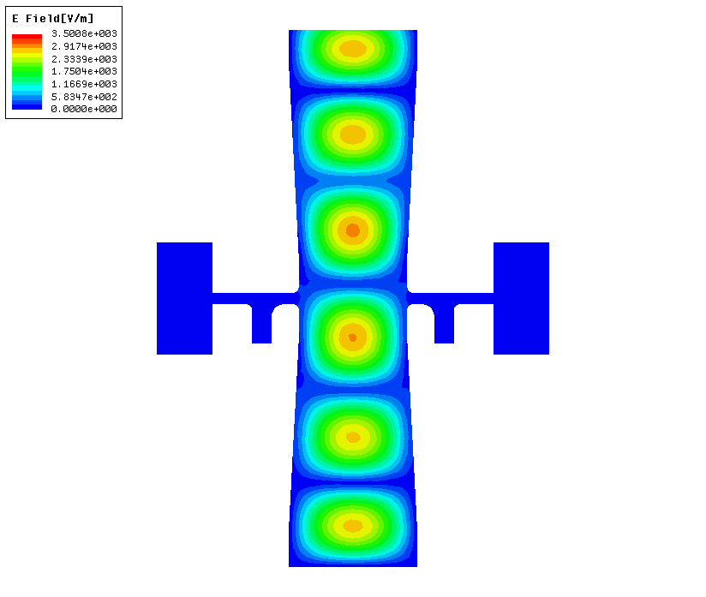
CLIC waveguide network
CLIC two-beam module
CMF
x
y
Dynamic range for the accepted performance (S11< -45 dB)
To allow the independent transverse alignment of the two linacs in CLIC, the special, contact-free choke mode flanges (CMF) are planned to be used
X – shift: ± 0.25 mm
Y – shift: ± 0.5 mm
Z – shift: ± 0.5 mm
Twist: < 5⁰

Slide 11
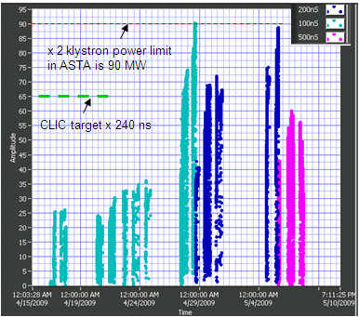
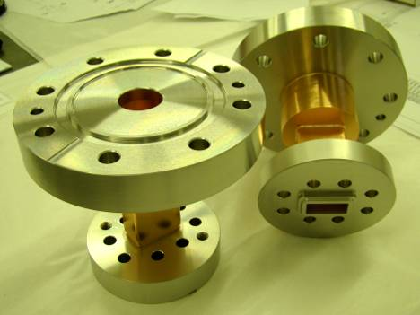
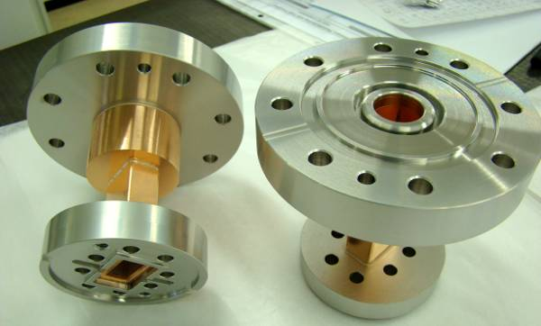
CLIC waveguide network
11.424 GHz choke mode flange prototype (2 units) – no adjustment capability
CMF high power tests at SLAC (April/May 2009)
Next step
11.424 GHz choke mode flange with adjustment capability is under design

Slide 12
Conclusions
An extensive program for X-band RF waveguides components development have been established in CERN.
We have designed, fabricated and received all the components necessary to start the high RF power operation of the TBTS and the first stage of the TBL. A number of them are already installed and are in operation.
First loads in SS43 for KEK and SLAC available in the coming weeks.
New simplified designed for the PETS on-off mechanism (based on proven components) is under way. The test in the TBTS is foreseen 1Q 2010
Recently, in Europe, the X-band activity has significantly grown. The number of Labs have expressed their interests in using the X-band technology for their needs. New orders have been launched to cover needs from different collaborators.

