Slide 1
Status of KEK production
July 11, 2008 at SLAC
KEK
T. Higo et al., Accelerator div.
T. Takatomi et al., Mech. Eng. Center

Slide 2
Contents
Quadrant
Assembly
Preparation for installation to Nextef
Disk-based structures in 2009
C10, CD10
T24, TD24
Other group to be involved

Slide 3
Quadrant production since CLIC08
Production of quadrants completed by Nov. 2008
Assembly
Tuning
Cleaning and final assembly
Installation into chamber
Vacuum evacuation
Present status and following schedule

Slide 4
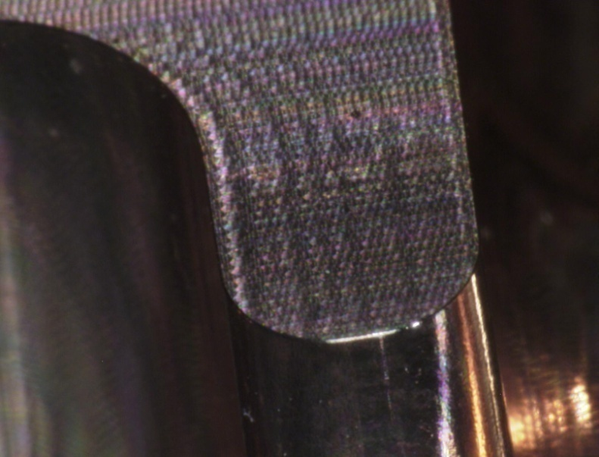
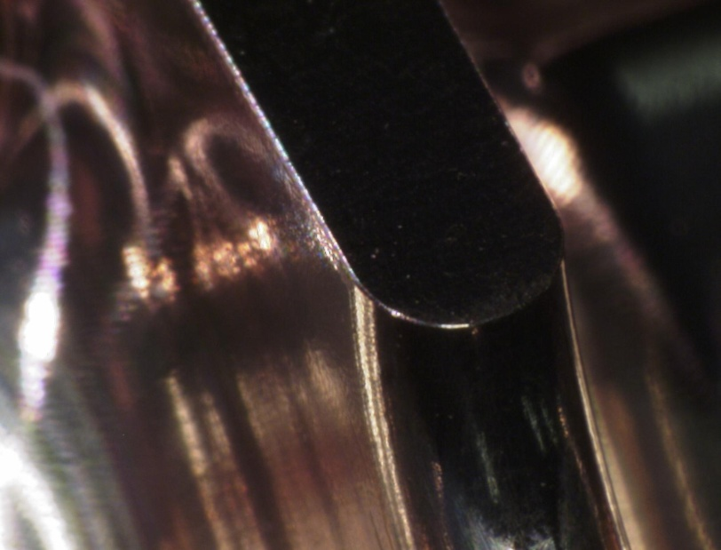
Milled surface view
50 micron rounding seems well produced.
Reference planes were formed by milling in a few micron level within the same chucking for shaping cells.
Assembly should be within ten micron level so that the steps between mating surfaces does not make any significant field enhancement.

Slide 5
Assembly experience of quadrants
Natural alignment error by balls is more than ten microns.
Ten micron level alignment was established by manually-forced final pressing procedure.
Bolt pressing is at 1Nm with M5 screw.
Stacking is reproducible in a few micron level.

Slide 6
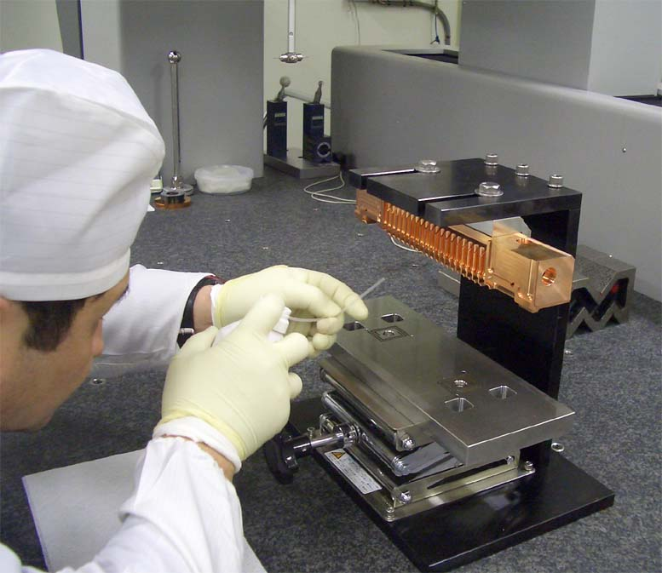
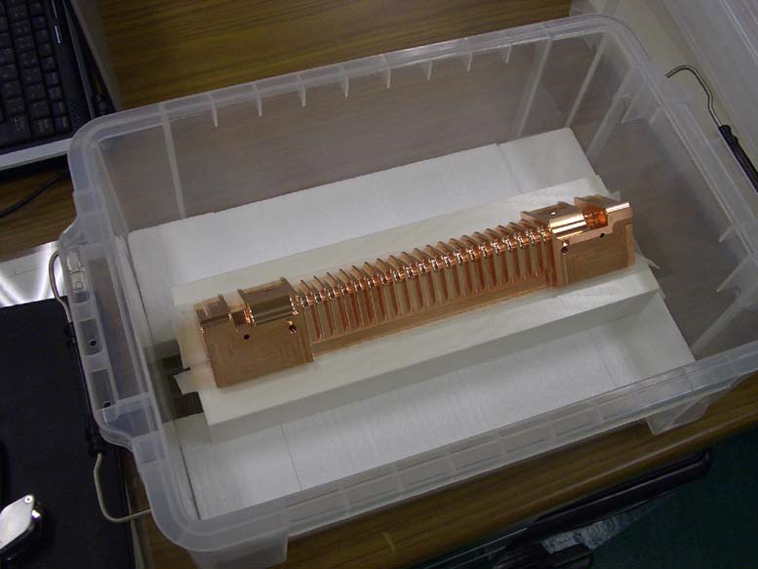
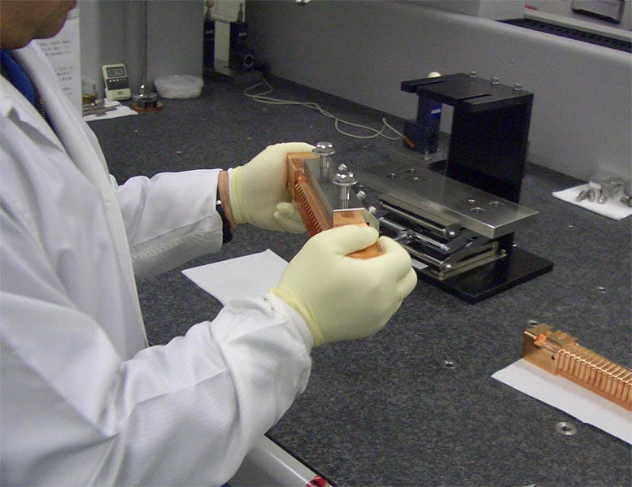
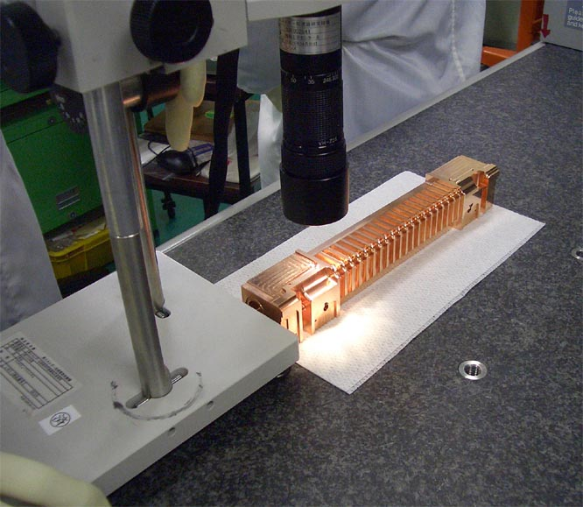
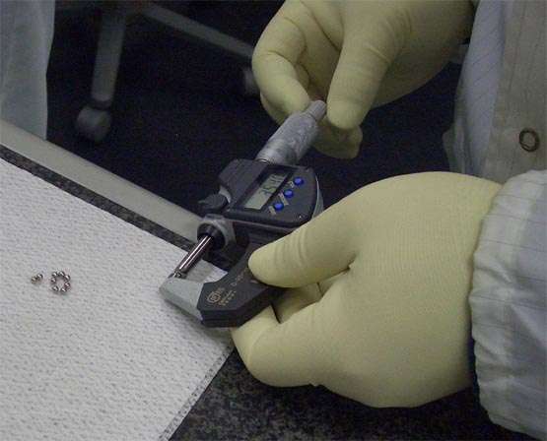
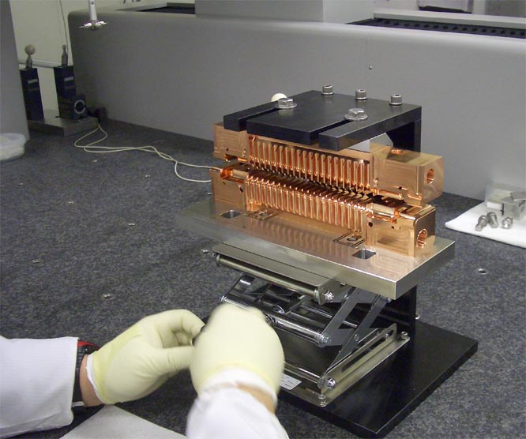
Carry and storage
First hanging
Prepare next quad approach
Edge inspection
Check ball diameter
Second hanging

Slide 7
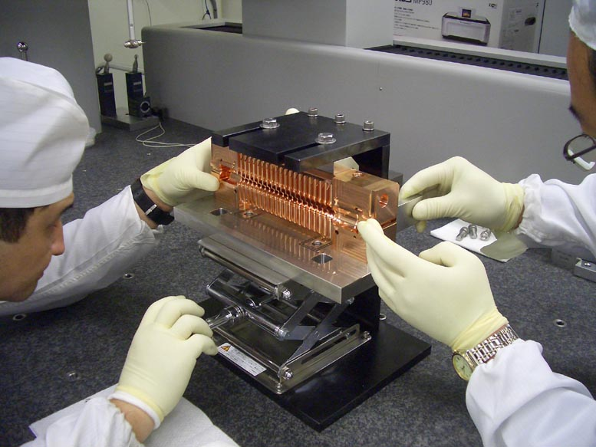
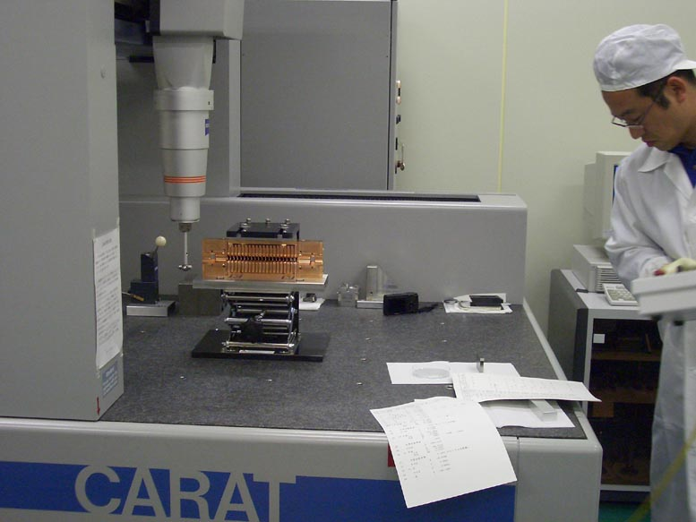
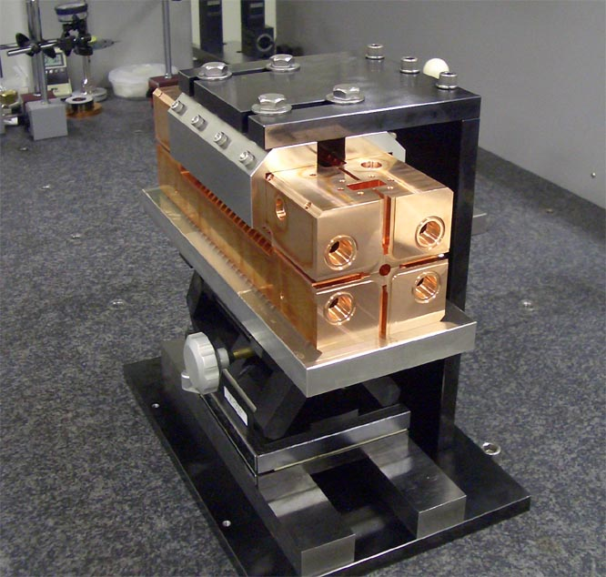
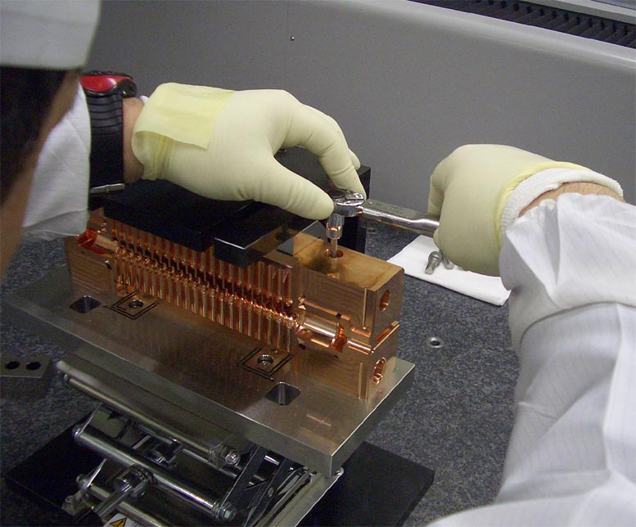
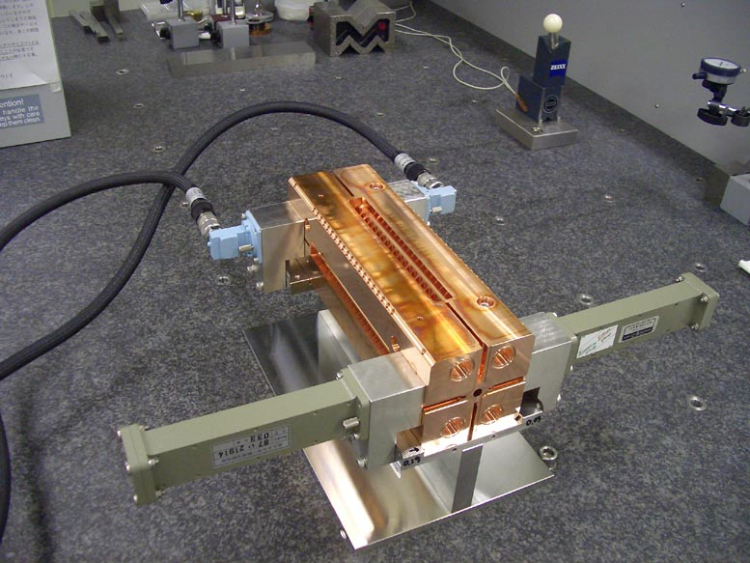
Fine adjustment
Alignment checking
Completion of stack
Fixing by bolt
RF setup

Slide 8
Tuning procedure
Elastic tuning: tuning screw is kept pressing
Takatomi measurement on test pushing
Actual tuning done with Higo’s hand tuning with maximum torque by watch screw driver

Slide 9
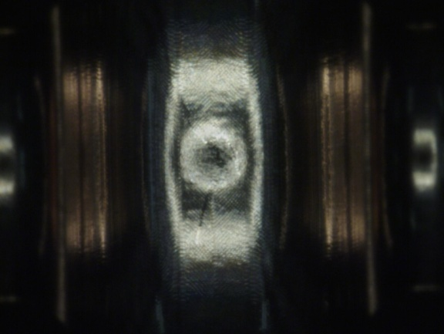
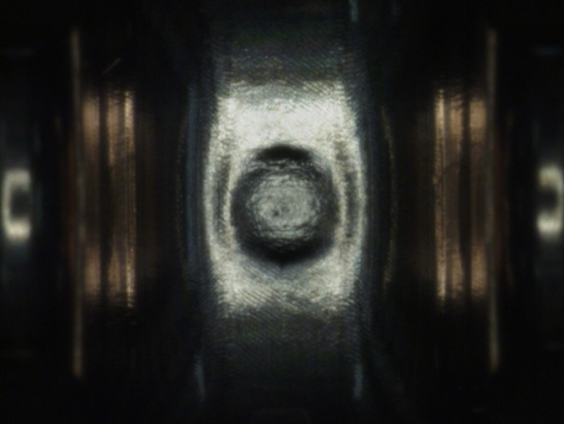
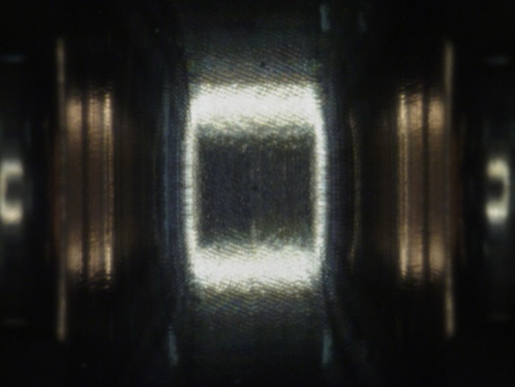
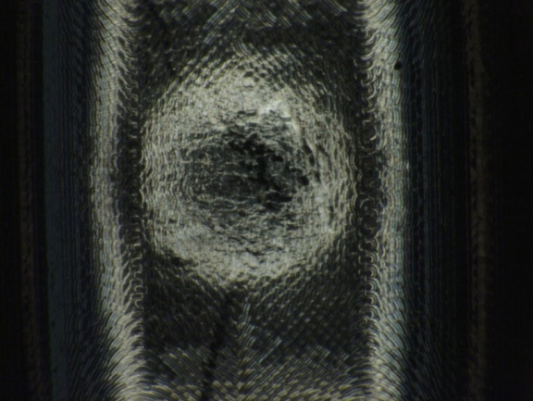
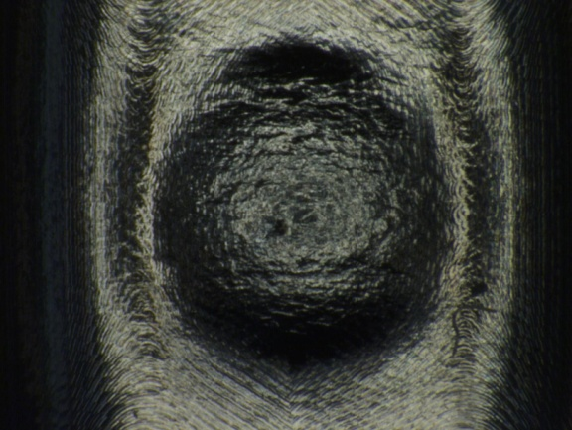
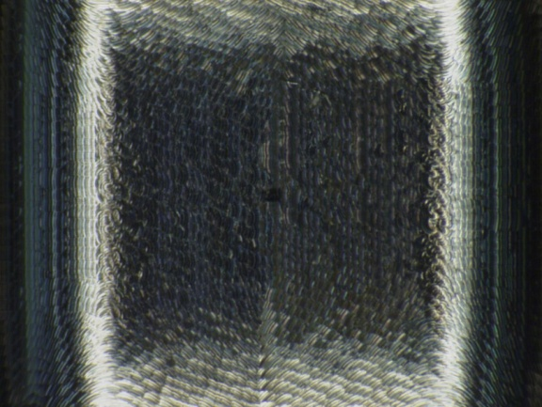
Tuning test with dummy quadrant
Cell 3(×35）
Cell 8(×35）
Cell 10(×35）
Cell 3(×100）
Cell 8(×100）
Cell 10(×100）
Cell3 deformation：0.053mm
Cell8 deformation：0.167mm
Cell10 no tuning

Slide 10
Little flatness change due to tuning
基準Ａ面
基準Ｂ面
Before tuning
After tuning

Slide 11
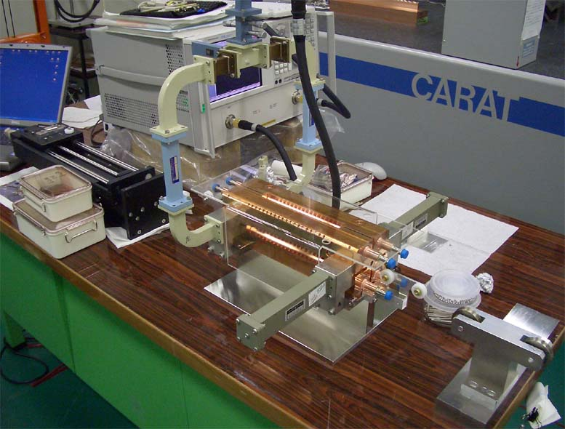
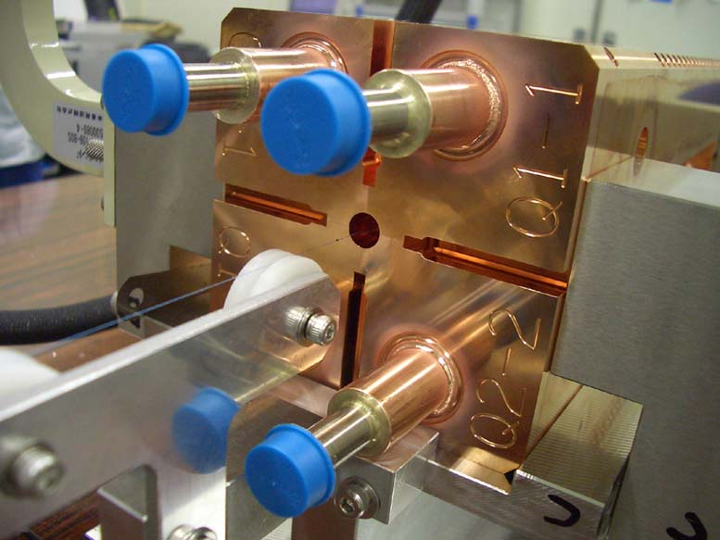
Tuning setup
Tuning setup:
Quad#5, bead string, linear stage driven by pulse motor, input divider, network analyzer
Quad assembly configuration seen from input side
Measurement was performed using SLAC LabVIEW program by courtesy of Jim Lewandowski

Slide 12
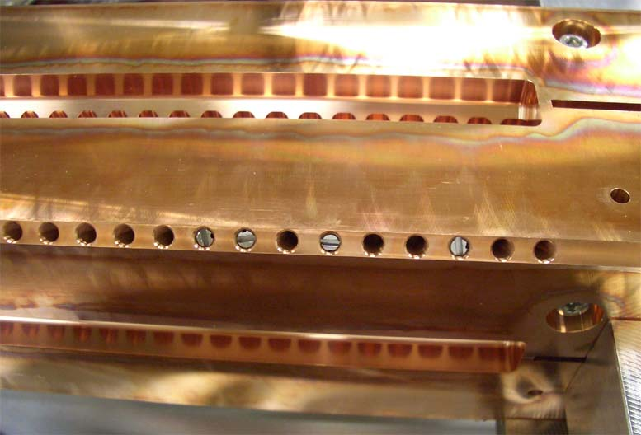
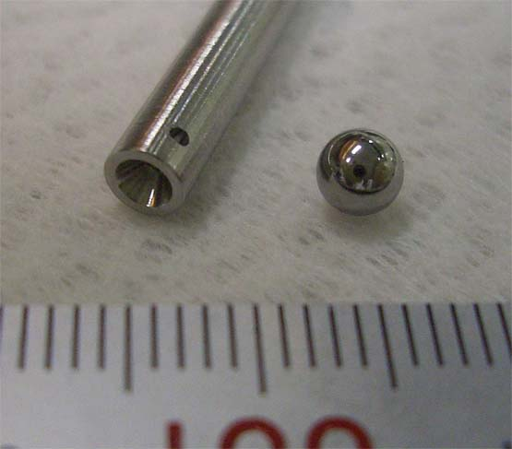
Tuning ball pushed by a rod
4mm stainless ball pushed by minus watch driver.
Pushing by turning with Higo’s hand full force.
Elastic deformation kept, meaning that the tuning pins are kept pushing the balls.

Slide 13
Tuning history
090202 S11 measured before tuning
BP14@11422 initial stage
BP20@11420 after tune up half of the cells
Flatten the Sim pattern, especially 9~16 area
BP-28@11420 after fine tuning
BP32@11420 after input match tune-2

Slide 14
Tuning in practice

Slide 15
Tuning in practice

Slide 16
Evolution of S11 near 11420MHz
090202
initial
090519
after cell tuning, BP-30
090519
after input match tuning

Slide 17
Input matching after tuning
|S11|= -32dB at 11422MHz, -35dB at 11420MHz
Operation at 11422MHz at 30C in vacuum is planned.
22C in air → 30C VAC makes 2MHz higher frequency.
So the input match should be -35dB, good enough.

Slide 18
Integration into chamber
Two 50liter/sec TMP’s in tandem.
Bare chamber was evacuated.
With pumping → 5x10⁻⁵Pa
With baking → 1x10⁻⁵Pa
Chamber with assembled quads was evacuated
With water pipes etc.
With only evacuation → 1x10⁻⁴Pa
After baking finally reached → ~1x10⁻⁶Pa

Slide 19
Quadrant chamber evacuation.

Slide 20
Installation into Nextef and plan
Installation trial
Gaskets sticked to flanges could not connect input waveguides.
Flanges were re-cut at their edges, removing gasket copper material and 0.14mm base stainless material.
Next schedule
Re-installed into chamber.
RF checked in input matching. No change!
Evacuation will start next week, July 6~.
Installed into Nextef after July 14~.
In-situ baking will made at Nextef.
Start processing from late July or mid August.

Slide 21
C10 and CD10 fabrication
Strategy
Take the same design and procedure as T18 and TD18.
Want to freeze the basic design with CERN/SLAC supervision this time.
Each two sets are made and tested.
Present status and plan
Started negotiation with our usual company.
Better machines will be used this time.
Thanks to the economical situation!?
New turning lathe, Moore, will be used.
New milling machine, Sodic, will be used.
Flatness and so on will be better.
Will be made by the end of Oct.
C10 will be earlier.
SLAC process
Basically we assume SLAC will pursue the bonding, tuning and baking process.
Need to establish a practical schedule this time.
Need to ask SLAC to make a set of mode launchers for test at KEK.

Slide 22
T24 and TD24 fabrication
Basically the same as C10 and CD10.
Strategy
Present status and plan
Will be made by the end of Dec.
T24 will be earlier.
Actual schedule should meet the strategy for testing T24, TD24 according to CERN-CLIC demand.
SLAC process
Should be confirmed this time.

Slide 23
Some other activities
A group
will make a trial fabrication of CD10 this year under KEK-Tohoku Univ. collaboration framework.
Multiple companies
are interested in machining quads, but KEK is thinking whether to further go or stick to disk-based design.
Basic studies
Materials and breakdown mechanism are to be studied at KEK.
Then, we hope to do more on basic material and preparation studies.

Slide 24
Conclusion
Quad structure
In progress, though encountered various problems. Want to evaluate by late Sep.
C10, CD10
Become precursor, in machining, for T24, TD24 and initiation of basic test for KEK.
T24, TD24
We understand the need to meet the required time frame for CLIC important step next year.

