Slide 1
T24_vg1.8_disk
11WNSDVG1.8
CLIC_G un-damped @ 11.424 GHz measurements versus simulations
Grudiev
CERN
1.07.2009

Slide 2
Acknowledgements
CERN:
M. Gerbaux
R. Zennaro
A. Olyunin
W. Wuensch
SLAC:
Z. Li

Slide 3
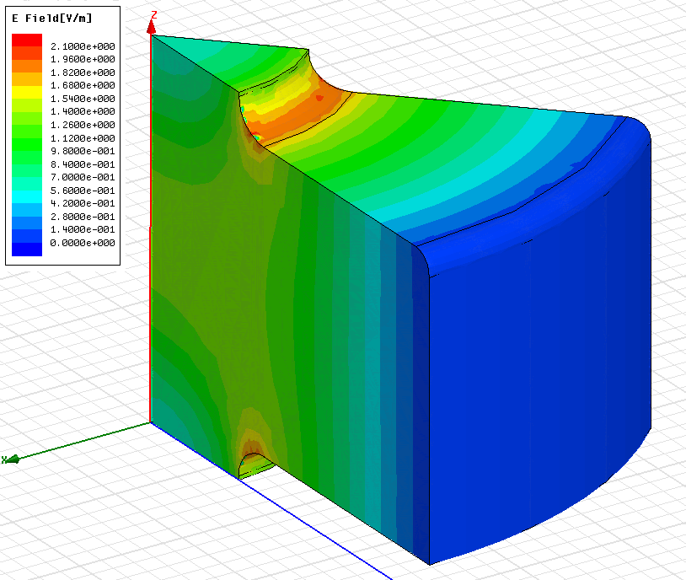
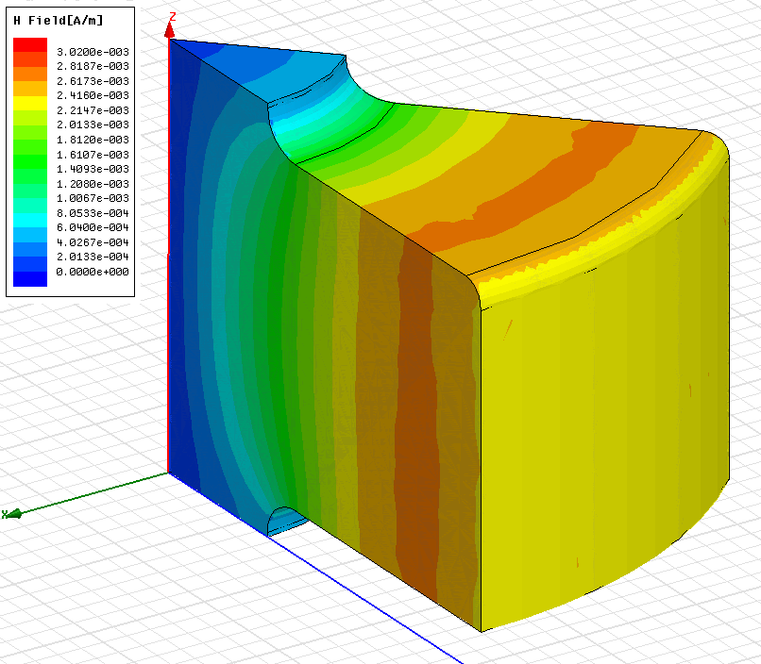
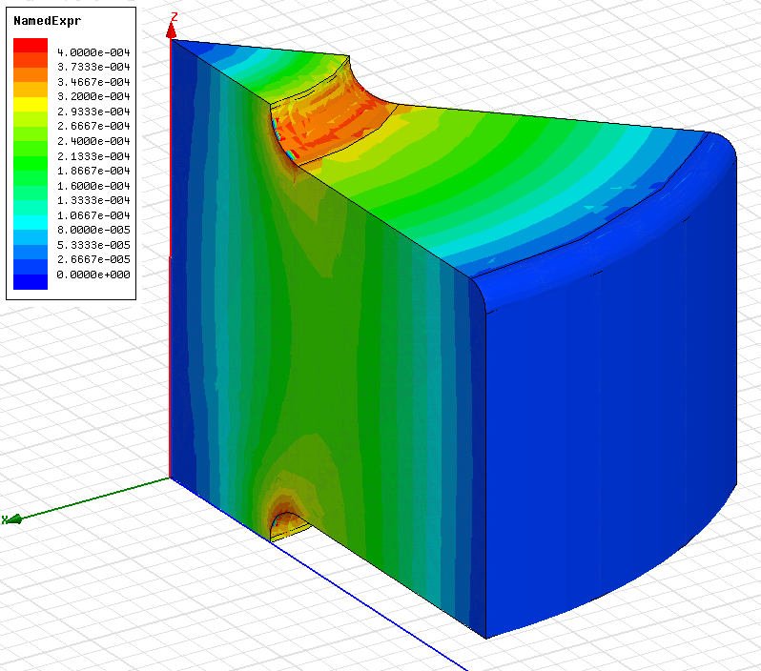
First cell
E_{s}/E_{a}
H_{s}/E_{a}
S_{c}/E_{a}²
a [mm] | 3.307
d [mm] | 1.753
e | 1.16
f [GHz] | 11.433
Q(Cu) | 6814
vg/c [%] | 1.83
r’/Q [LinacΩ/m] | 15198
Es/Ea | 1.95
Hs/Ea [mA/V] | 2.6
Sc/Ea² [mA/V] | 0.37

Slide 4
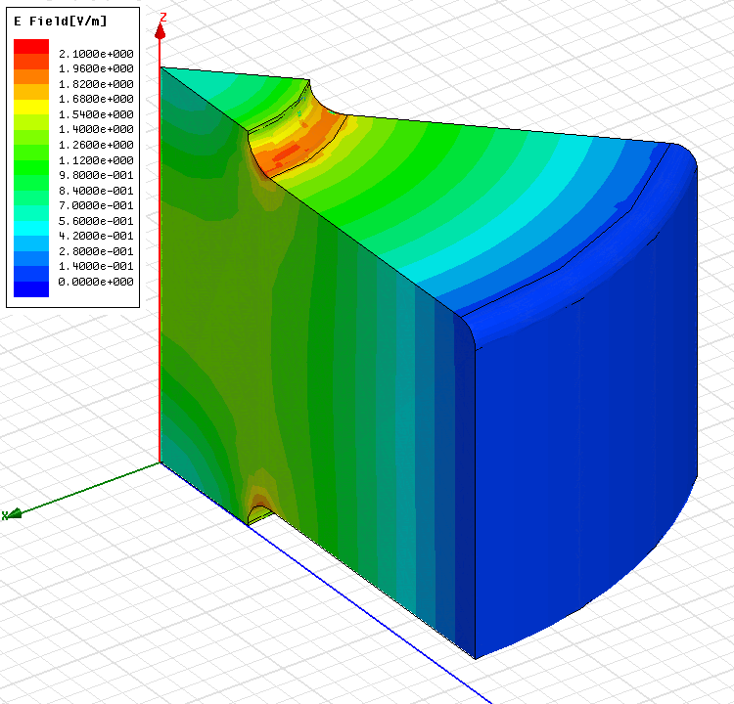
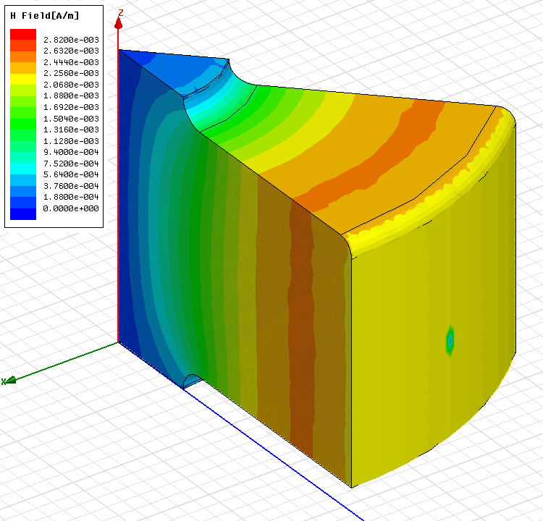
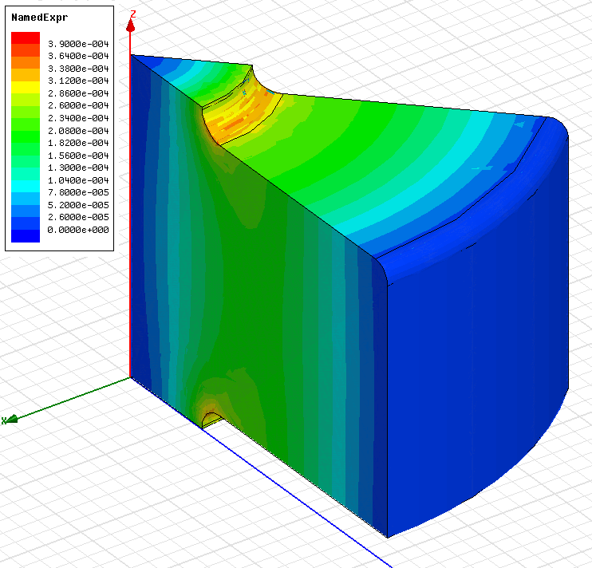
Middle cell
E_{s}/E_{a}
H_{s}/E_{a}
S_{c}/E_{a}²
a [mm] | 2.887
d [mm] | 1.402
e | 1.15
f [GHz] | 11.432
Q(Cu) | 6980
vg/c [%] | 1.33
r’/Q [LinacΩ/m] | 16960
Es/Ea | 1.95
Hs/Ea [mA/V] | 2.45
Sc/Ea² [mA/V] | 0.34

Slide 5
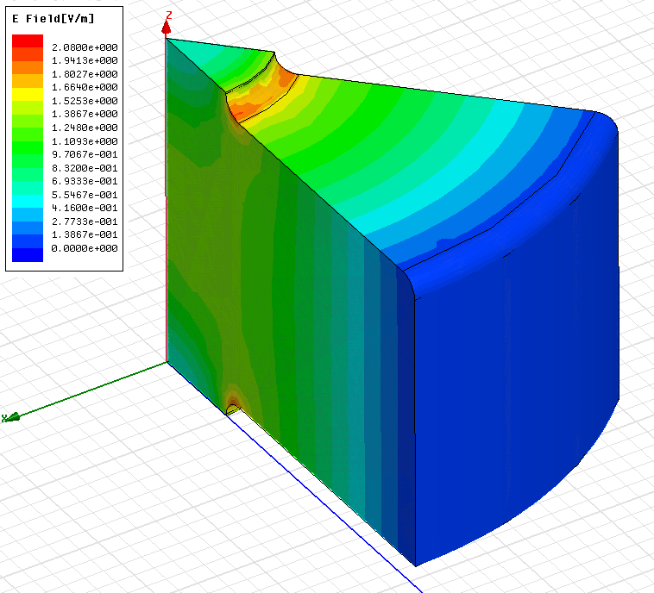
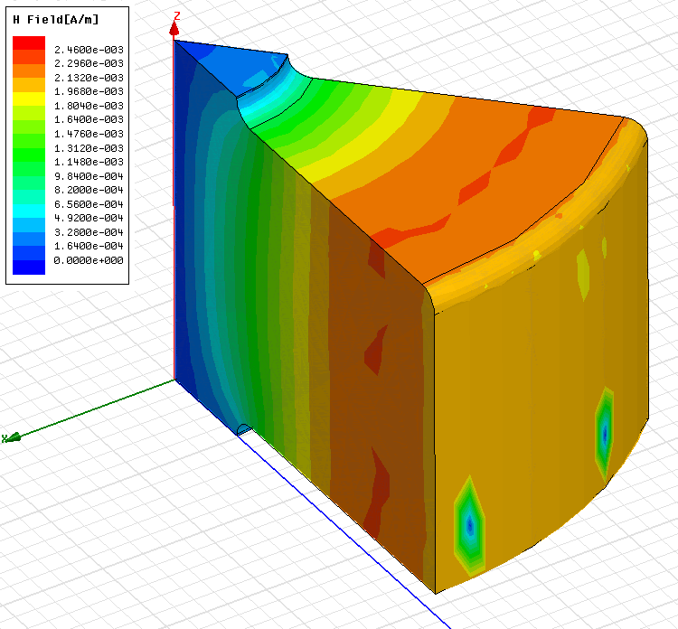
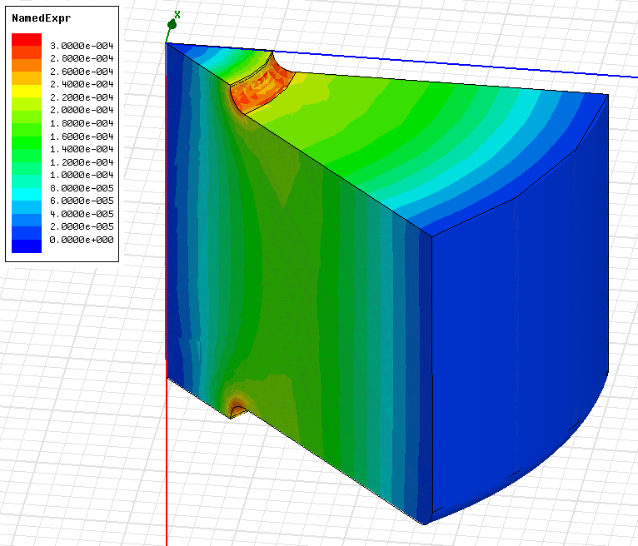
Last cell
E_{s}/E_{a}
H_{s}/E_{a}
S_{c}/E_{a}²
a [mm] | 2.467
d [mm] | 1.05
e | 1.13
f [GHz] | 11.426
Q(Cu) | 7157
vg/c [%] | 0.92
r’/Q [LinacΩ/m] | 18713
Es/Ea | 1.9
Hs/Ea [mA/V] | 2.3
Sc/Ea² [mA/V] | 0.28

Slide 6
Gradient in 24 regular cells
Average unloaded of 100 MV/m
Average loaded of 100 MV/m
Number of regular cells: Nc | 24
Bunch population: N | 3.72x10⁹
Number of bunches: Nb | 312
Bunch separation: Ncycl | 6 rf cycles

Slide 7
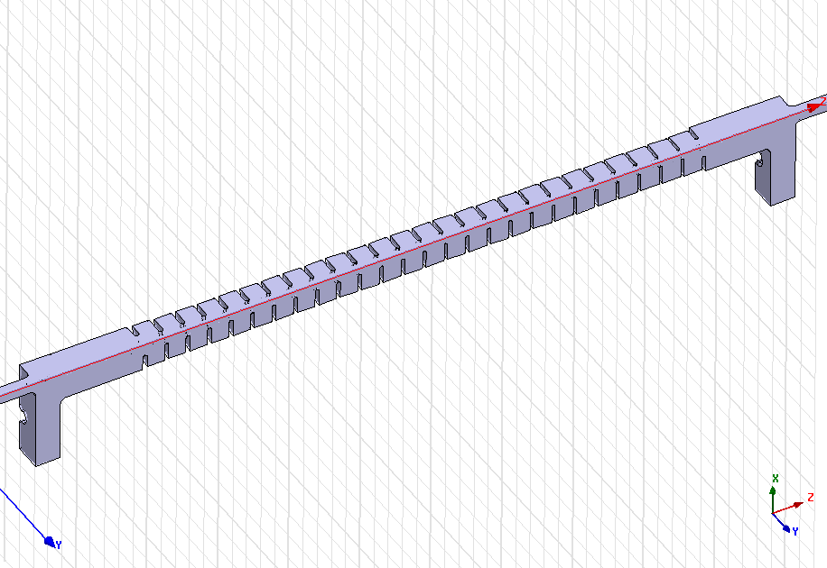
Simulation setup 1 & 2
HFSS-quad
HFSS simulation of ¼ of the structure:
Surface conductivity (Cu): 58e6 S/m
Surface approximation: ds=6 μm,
Total number of tetrahedra: Ntetr = 1170348
Mesh density: ~ 40000 tetr / ¼ cell
HFSS v10.1
S3P-quad
S3P simulation of ¼ of the structure made by Zenghai Li at SLAC-ACD
Surface conductivity (Cu): 57e6 S/m different

Slide 8
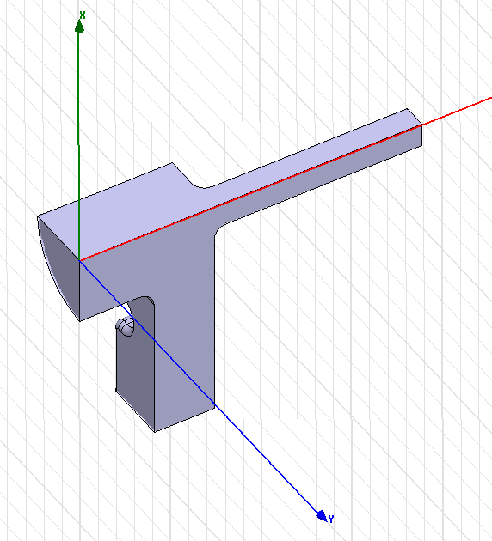
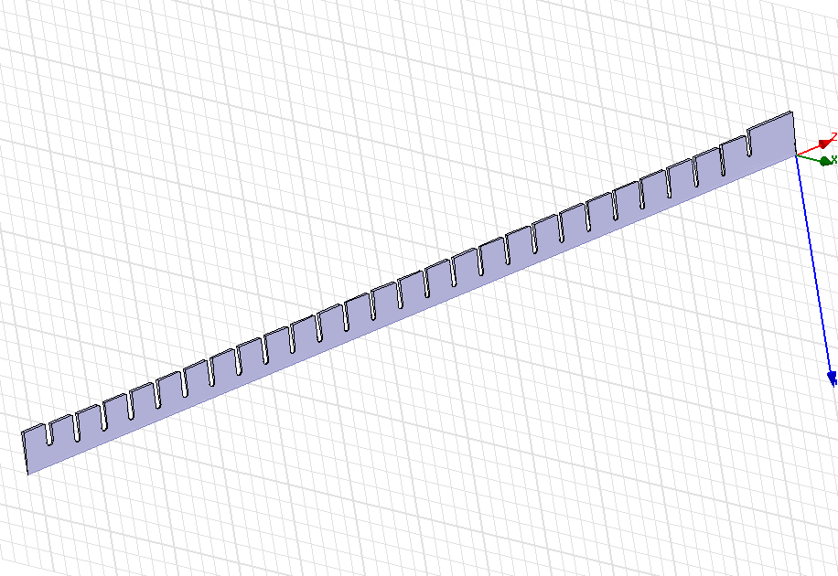
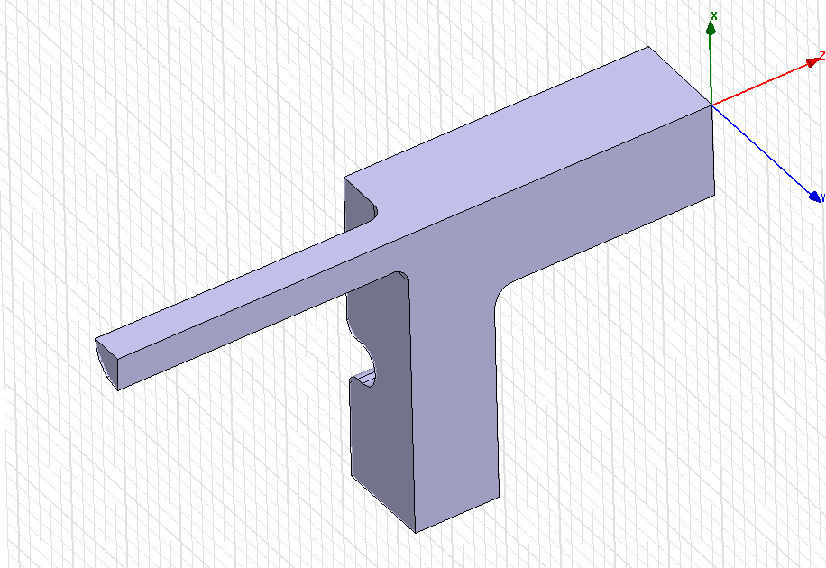
Simulation setup 3
HFSS-cells + couplers
HFSS simulation of ¼ of input coupler + segment of 5 deg. of the cells + ¼ of output coupler :
Surface conductivity (Cu): 58e6 S/m
Surface approximation: ds=1 μm,
Total number of tetrahedra for cells: Ntetr = 506075
Mesh density: ~ 350000 tetr / ¼ cell
(10 times higher than in HFSS-quad setup)
HFSS v11.1

Slide 9
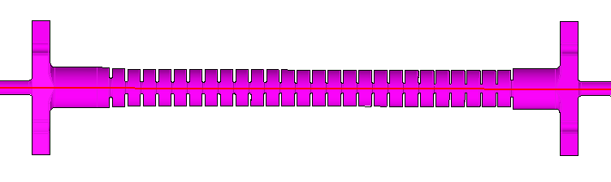
Measurement setup 1 (reflections)
VNA
port1
Perfect
load
1
4
2
3
Reflection = S11+S12
Perfect
load
VNA
port2
Frequency correction due to air (ε = 1.00059)
Frequency in vacuum: f’ = f*sqrt(1.00059) ≈ f + 3.5 MHz @ X-band

Slide 10
Reflection: comparison
There is very small (~1MHz) or no difference in frequency between simulations and the air corrected measurements

Slide 11
Measurement setup 2 (transmission)
VNA port1
Perfect load
1
4
2
3
Perfect load
VNA port2
Transmission = S13+S23
Perfect load
Perfect load
1
4
2
3
VNA port1
VNA port2

Slide 12
Transmission: comparison
There is small difference between HFSS and S3P simulation results due to different conductivity used in the simulations
Both simulation results show higher transmission than air corrected measurements by about 0.2 dB

Slide 13
Some useful equations
On the other hand
Finally

Slide 14
Transmission: comparing group delay
There is no difference between both HFSS and S3P simulations and the air corrected measurements

Slide 15
Transmission: comparing Q-factor
There is no difference in Q-factor (~7000) between HFSS and S3P simulations.
The measured Q-factor of about 6600 is lower than the simulated value by about 6 %.

Slide 16
Measurement setup 3 (bead pull)
VNA
port1
Perfect
load
1
4
2
3
E² ~ S11-<S11>
Perfect
load
VNA
port2

Slide 17
Bead pull in complex plane
Measurements: S11-<S11>
HFSS-cells: E

Slide 18
Bead pull: field magnitude
Measurements: |sqrt(S11-<S11>)|
HFSS-cells: |E|

Slide 19
Field distribution at different frequencies
120º rf phase advance per cell frequency
11.424 GHz
Best match frequency
11.420 GHz

Slide 20
RF phase advance per cell at different frequencies
120º rf phase advance per cell frequency: 11.424 GHz
Best match frequency:
11.420 GHz

Slide 21
Summary table for T24_vg1.8_disk
 | S12 | Pout/Pin | τ=0.5ln (Pout/Pin) | tf=dφ/dω [ns] | tf=W0/Pin [ns] | Q=ωtf/2τ | Q=ωW /(Pin-Pout) | Q=ωW /Ploss | Pin100 24 cells [MW]
Measurements (Vac) | 0.715 | 0.511 | 0.336 | 60.9 | - | 6600 | - | -
HFSS ¼ | 0.732 | 0.536 | 0.312 | - | 58.4 | 6720 | 7010 | 7010
HFSS InCoup OutCoup Cells 24+2 | 0.731 0.99875 0.99889 0.733 | 0.534 0.9975 0.9978 0.537 | 0.313 0.0013 0.0011 0.311 | 60.7 <- <- 59.9 | 59.8 0.46 0.36 59.0 | 6960 12700 11800 6910 | 6940 13000 12300 6880 | 6640 13200 12300 6580 | 42.2
3-cells model |  | 0.569- 0.533 | 0.282- 0.315 | - | 54.8- 59.37 | 6974- 6764 | 6980 |  | 41.1
S3P (SLAC) | 0.730 | 0.533 | 0.315 | 60.8 |  | 6927(σ=57e6) 6988(σ=58e6) |  |  | 42.4

Slide 22
Summary on comparison
Simulation results of HFSS and S3P show very good agreement
Q-factor
  All 3 different ways of calculating Q-factor: S3P, HFSS-S-parameter solver and HFSS-eigenmode solver give very close values of about 7000
  The measurements of the T24_vg1.8_disk structure made at CERN show 6 % lower Q-factor of 6600
RF phase advance
  Both HFSS and S3P simulations and air corrected measurements simulations show 120º rf phase advance frequency of 11.424 GHz which is the design frequency
  Good agreement (± 0.5 MHz) between simulations and measurements demonstrates extremely high (sub-micron) precision of machining. For example, it is equivalent to ± 0.6 μm tolerance on the outer wall radius RF phase advance
Structure matching
  There is a design error in structure matching of about 4 MHz. The match frequency is 11.420 GHz . To some extent this is also in agreement with the measurements

Slide 23
HFSS S-par solver: v10.1 versus v11.1

Slide 24
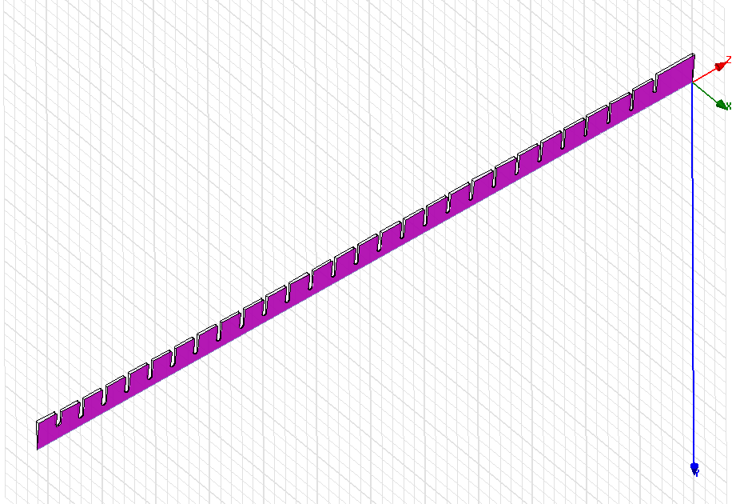
Simulation setup 4
HFSS-cells + couplers
HFSS simulation of ¼ of input coupler
+ segment of the cells made in HFSS by 5 deg. Sweep (3D geometry created in HFSS)
+ ¼ of output coupler :
Surface conductivity (Cu): 58e6 S/m
Surface approximation: ds=1 μm,
HFSS v11.1
versus
HFSS v10.1

Slide 25
Reflection
4 MHz
4 MHz

Slide 26
Transmission
4 MHz

Slide 27
Group delay and Q-factor

Slide 28
RF phase advance per cell
HFSS v10.1
HFSS v11.1

Slide 29
Summary on HFSS
It seems that there is a bug in HFSS v11.
The results of the simulations using HFSS v11 are shifted up in frequency by 4 MHz with respect to the results of the simulations using HFSS v10 or S3P
Use HFSS-S-parameter solver VERSION 10 or S3P

