Slide 1
Experimental breakdown studies – breakdown diagnostics
Linking simulation and experiment
Jan W. Kovermann, CERN, RWTH Aachen
SLAC workshop 8 -10 July 2009

Slide 2
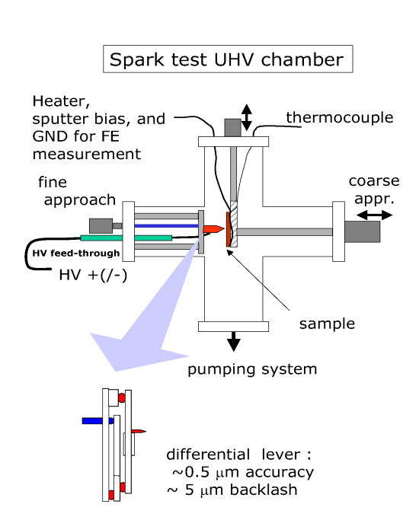
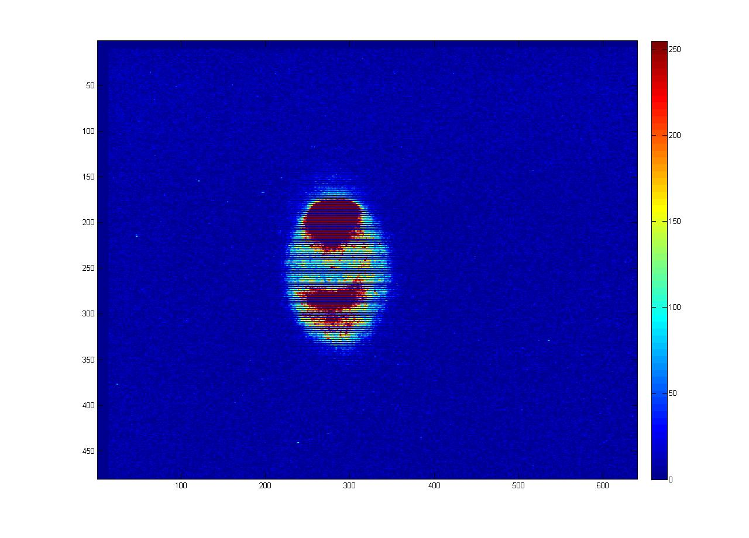
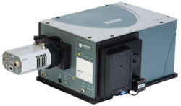
The connection between simulation and experiment
Emitted currents
Dark current spectrum
OTR
X-rays
Trigger mechanism
Missing energy
Breakdown rate
Ion currents
Fowler-Nordheim distribution
Plasma characteristics
-Time structure
-Physical dimension (imaging)
-Ion species (opt. spectroscopy)
-Ion currents
-Vacuum behavior
Surfaces
-Crater morphology
-Material diagnostics
-Fatigue process
Breakdown diagnostics Jan W. Kovermann

Slide 3
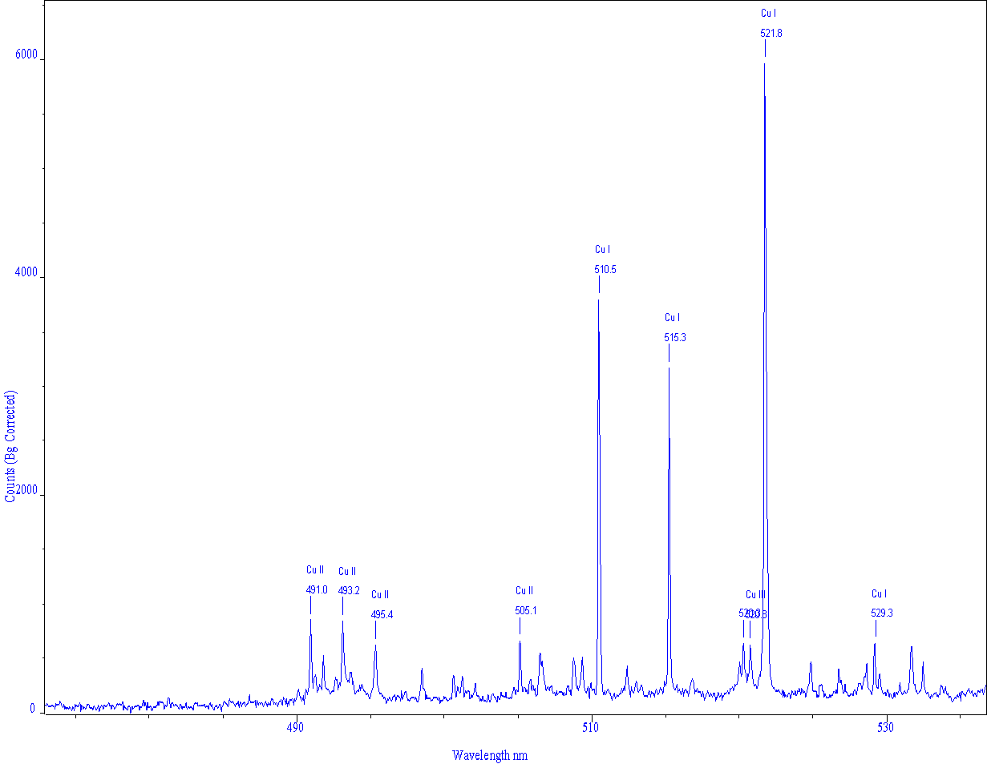
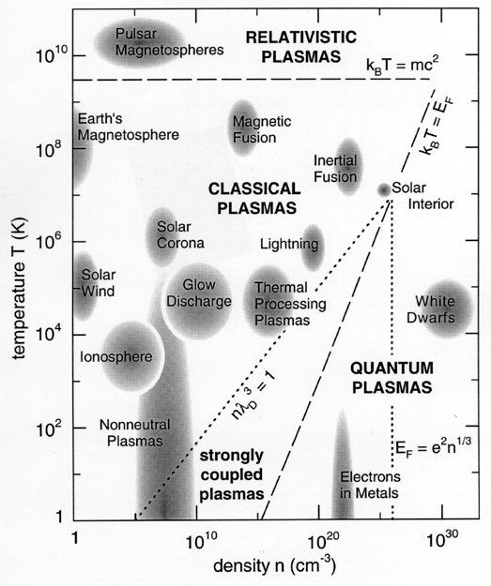
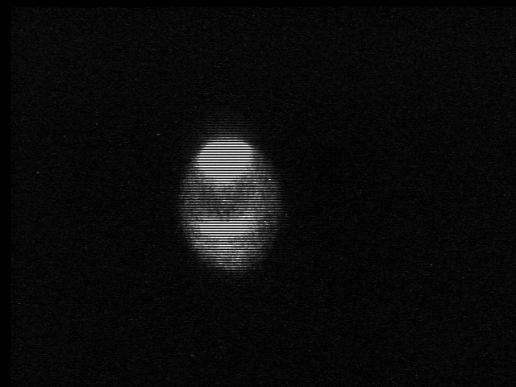
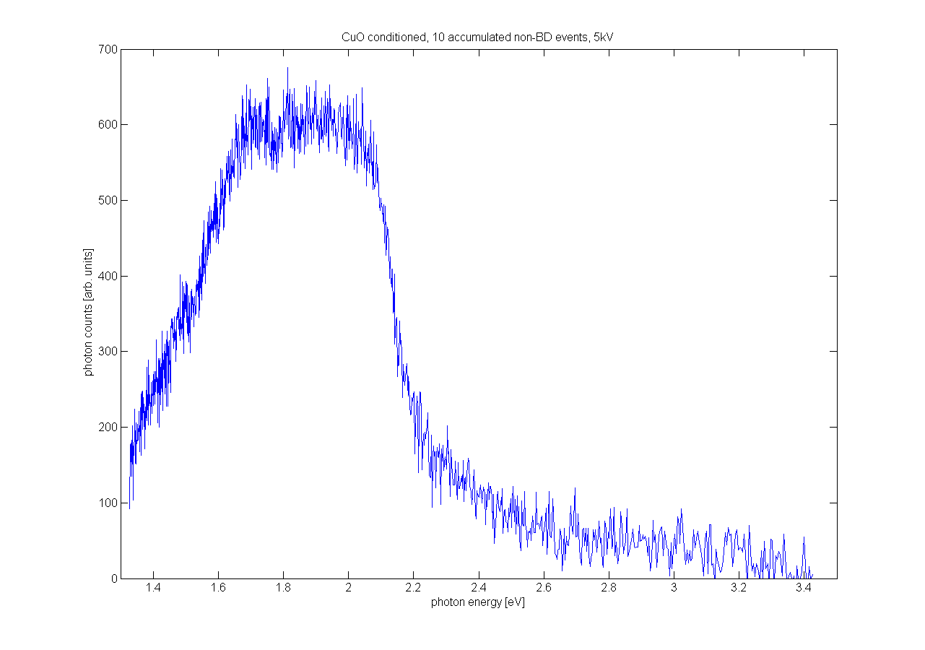
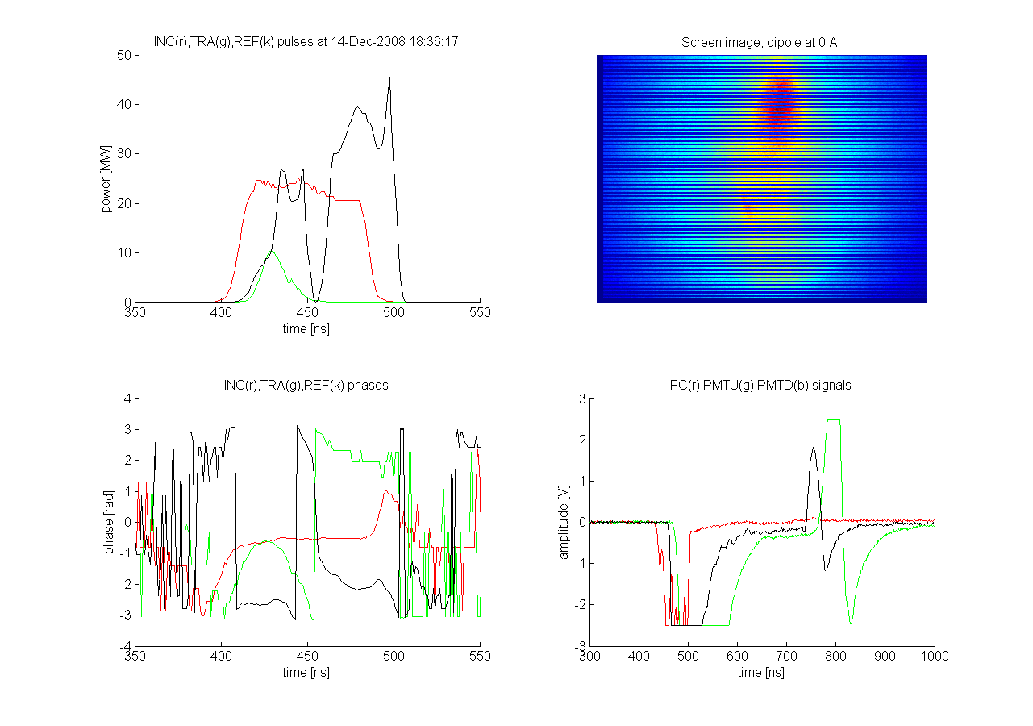
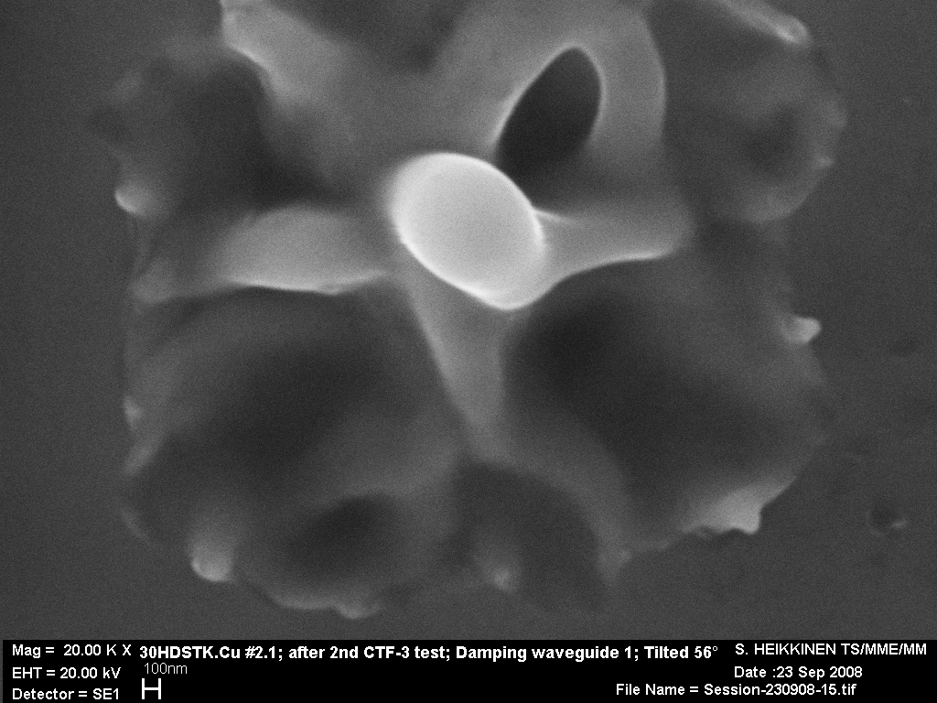
Plasma composition➔ simulation and mat.sci. input
Plasma size/position ➔ simulation and design input
Plasma density ➔ simulation input
Spectroscopy
BREAKDOWN
DIAGNOSTICS
RF measurements, FC, XRAY ➔ simulation and design input
Missing energy ?
OTR in nominal pulses ➔ simulation and machine parameter input
SEM ➔
simulation and design input
Breakdown diagnostics Jan W. Kovermann

Slide 4
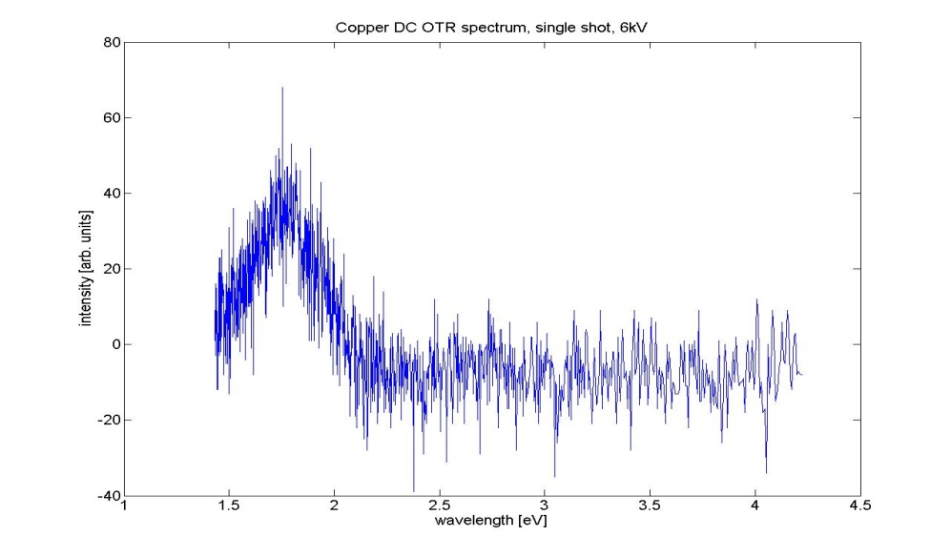
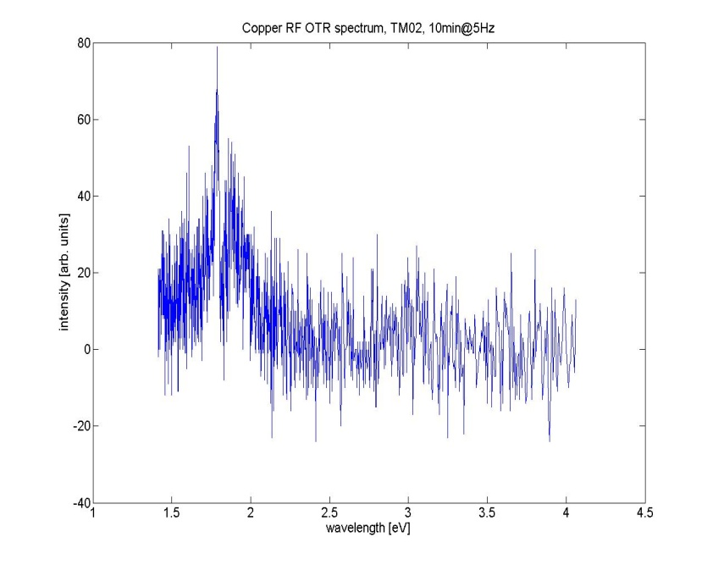
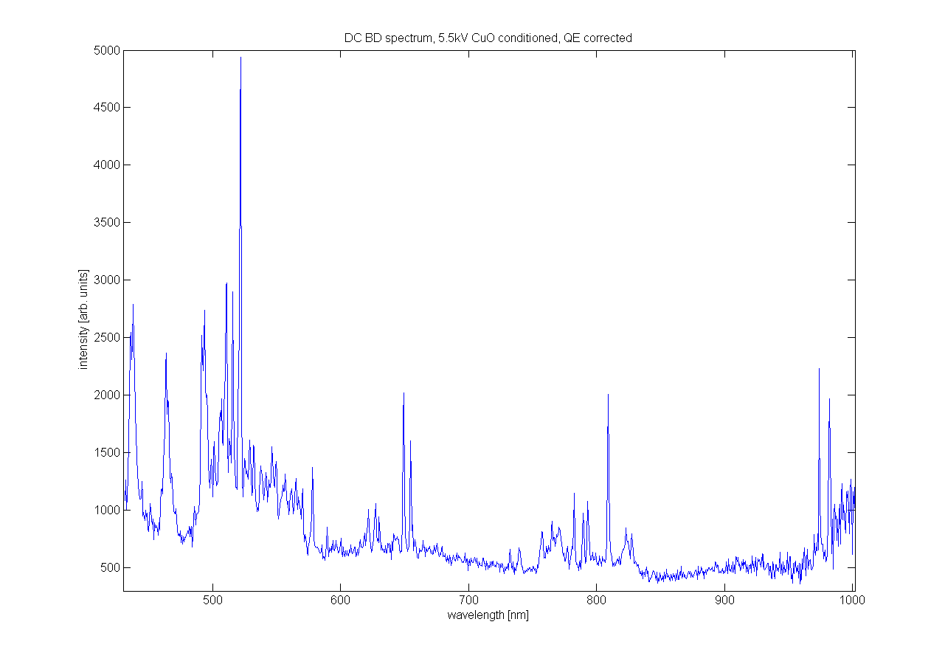
Breakdown diagnostics: some results
DC
RF
OTR (Copper)
Found Cu I, Cu II, Cu III ions
Will be measured soon at
Opt. spectroscopy
Breakdown diagnostics Jan W. Kovermann

Slide 5
Breakdown diagnostics: some results
Spectrum typical for OTR in Cu (interband transition @ 2.1eV)
Beta measurements possible close to the breakdown limit (~105)
OTR sometimes seems to rise before a breakdown
Oxide layers suppress OTR
An estimation of the energy absorbed by electrons in 30GHz structures: 0.1MW @ 14MW RF input power
OTR (Copper)
found very little traces of O,H, probably no contribution to the breakdown physics
Estimated temperature from two-line-method: 1-5eV, but Cu III (T>35eV) seen, plasma is a non-LTE plasma!
Intensity waveform for different lines highly non-reproducible (clusters? Different plasma?
density measurement under planning
Found Cu I, Cu II, Cu III ions
Opt. spectroscopy
Breakdown diagnostics Jan W. Kovermann

Slide 6
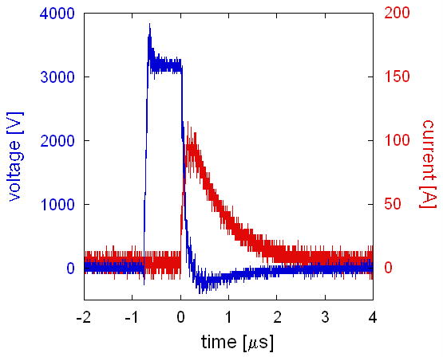
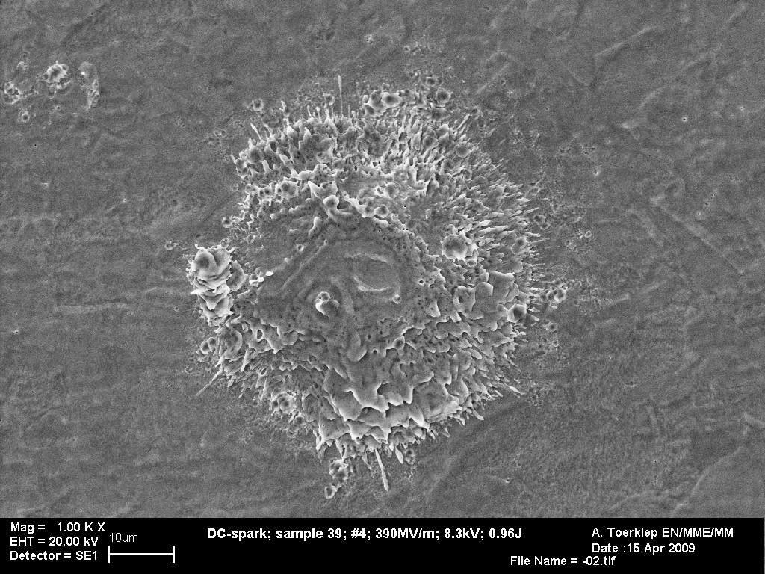
Breakdown diagnostics: further measurements
RF
DC
RF (I,Q), Xray, FC @30GHz
Current, voltage and delay
?
SEM of single breakdowns
Breakdown diagnostics Jan W. Kovermann

Slide 7
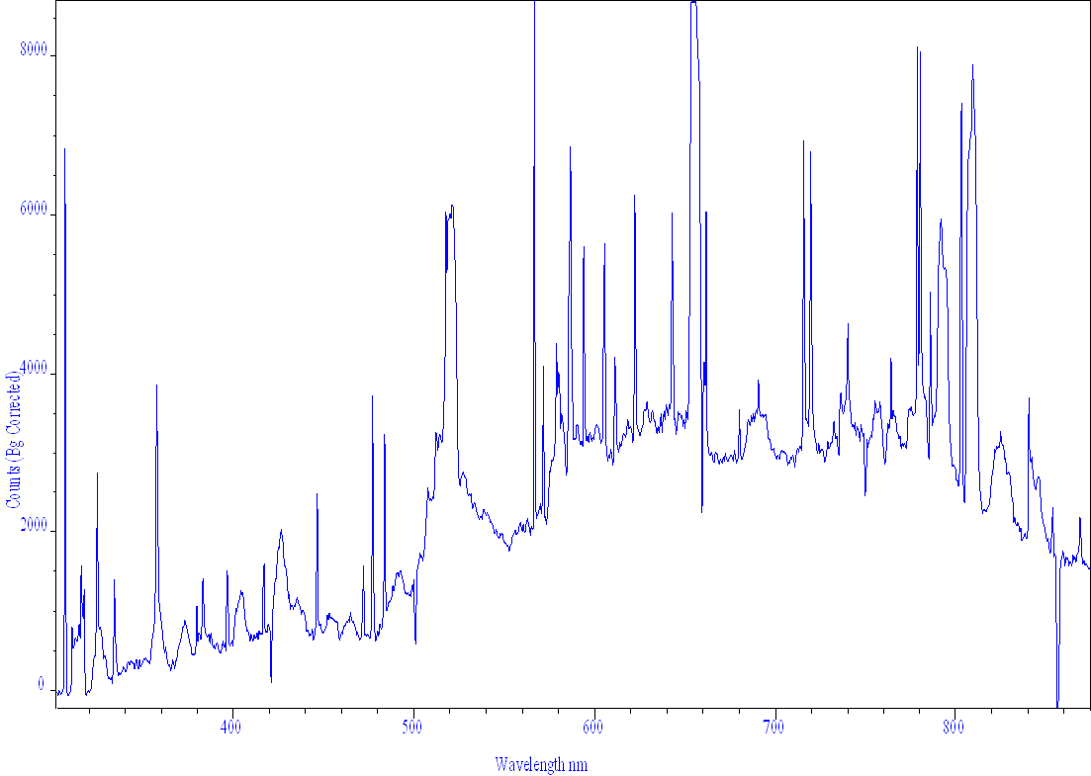
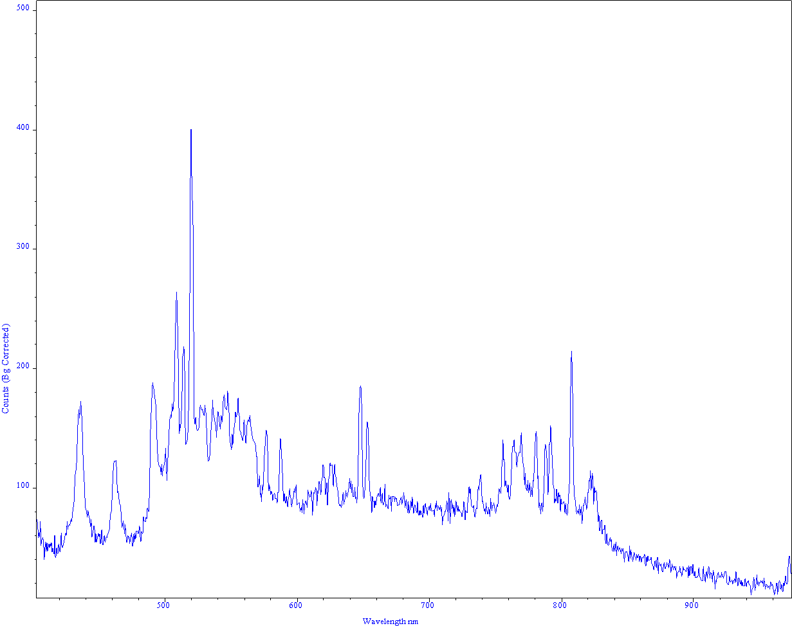
New measurements Raw data from today!
RF
C10
40ns
40MW
2min integration
DC
Copper
conditioned
4.8kV
Breakdown diagnostics Jan W. Kovermann
Notes:
7

Slide 8
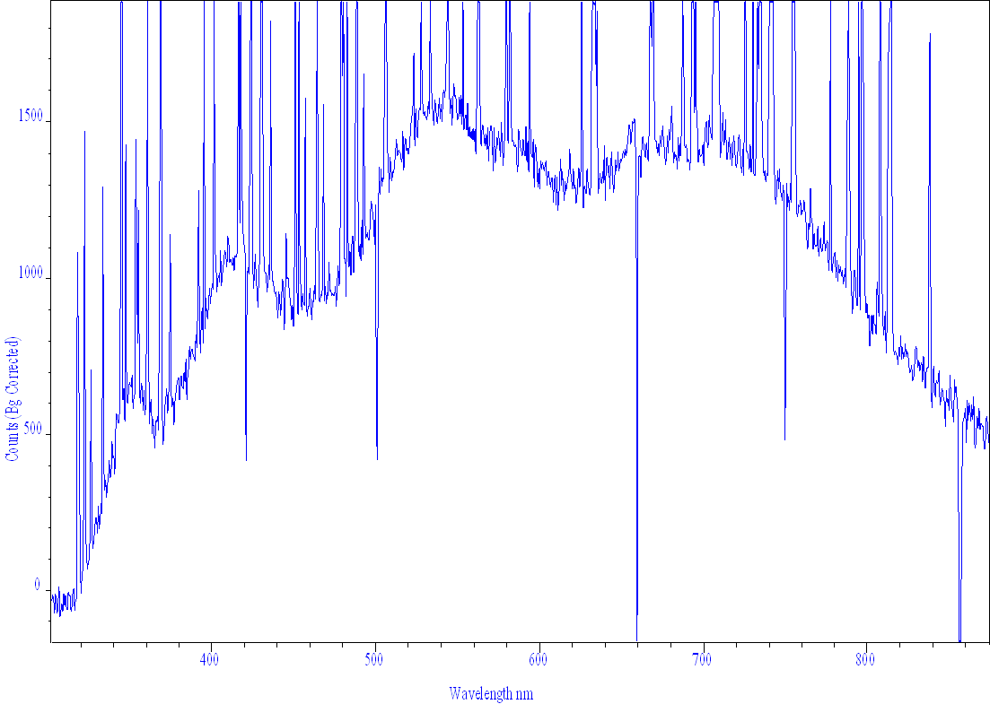
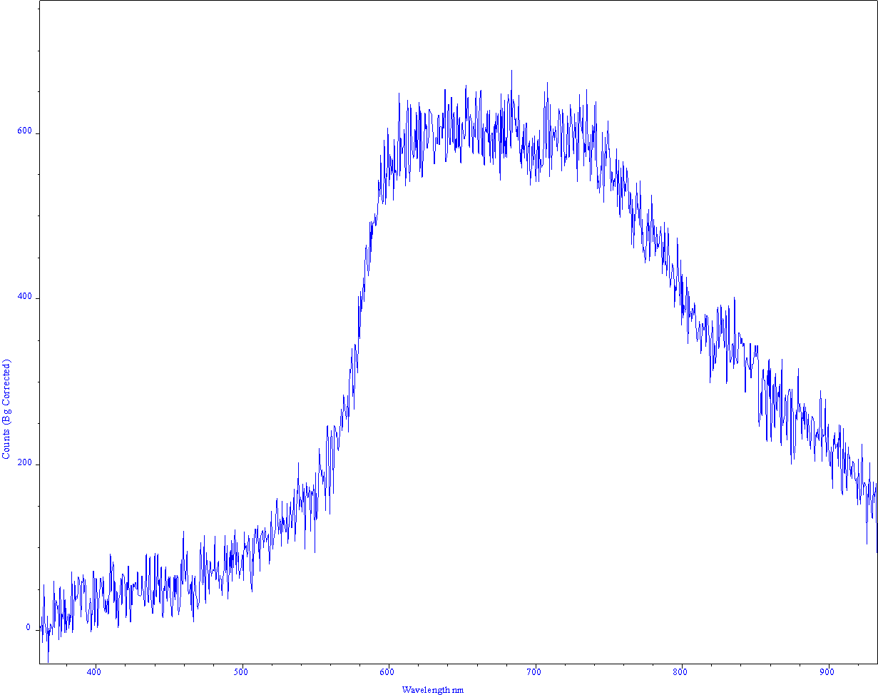
New measurements Raw data from today!
RF
DC: OTR spectrum
Breakdown diagnostics Jan W. Kovermann
Notes:
8

Slide 9
Conclusion
High resolution optical spectroscopy in DC and RF almost done
Time resolved measurements will follow
There are differences in the continuum background for DC and RF
C10 does not show OTR like expected, have to check 30GHz TM02 again
Traces of oxygen and hydrogen have been seen during multipaktor events
Breakdowns seem to emit less line-like radiation and more continuum background than multipaktor
Interpretation of the data is ongoing…
THANK YOU!
Breakdown diagnostics Jan W. Kovermann
Notes:
9

