Slide 1
News from structure production task force – T18_CERN
G. Riddone on behalf of the
task force team
20.03.2009

Slide 2
Content
Introduction and task force motivation
T18_CERN: Fabrication history and results from CERN investigations
Differences from other CERN/SLAC/KEK/Fermilab structures
Actions for future structures
Conclusions

Slide 3
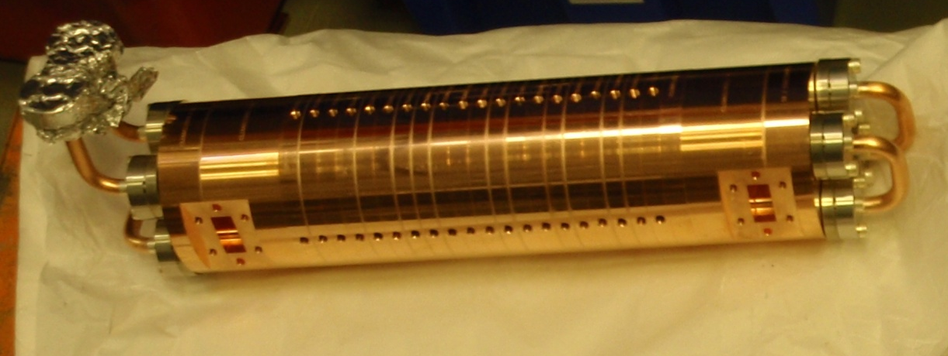
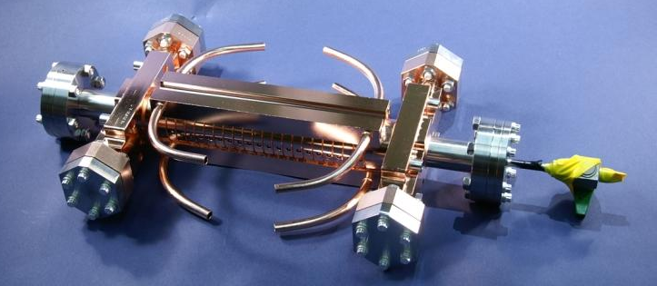
Introduction to T18
T18 structures: 5 manufactured
  4 KEK/SLAC (2 tested: 1 at SLAC and 1 at KEK)
  1 CERN (tested at SLAC)
All T18 have the same RF design
It is the first time that the test results of a CERN structure can be compared with those from the same structure made at KEK/SLAC
T18_KEK/SLAC
T18_CERN

Slide 4
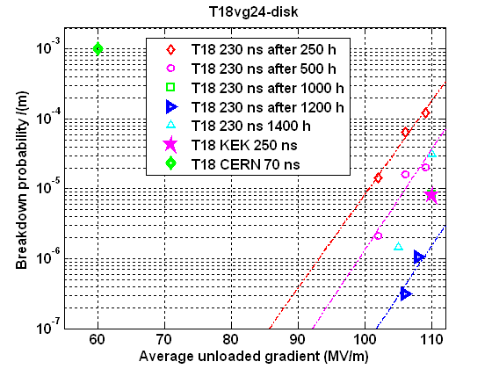
T18 high power test results
Breakdown distribution of
T18Disk_SLAC (red, last 500hrs),
210~230 ns,110~120 MV/m
T18Disk_CERN (Blue,40hrs).
180 ns,45~49 MV/m
‘Hot’ cells 13 +15
C. Adolphsen, S. Doebert

Slide 5
Task force program
Following the test results of the T18_CERN a “Task Force” has been set-up to understand the cause (isolated problem or general problem of CERN structures) and to define the actions for the future structures.
Program
  Review the fabrication and preparation of the T18_CERN
  Cut and inspect the T18_CERN
  Compare the T18 preparation other structures made at CERN, KEK, SLAC and Fermilab and identify the differences
  Define actions for future structures
Participants: C. Adolphsen (SLAC), G. Arnau Izquierdo, S. Atieh, S. Calatroni, S. Doebert, M. Gerbaux, A. Grudiev, T. Higo (KEK), T. Pieloni, G. Riddone, M. Taborelli, R. Zennaro, I. Syratchev, W. Wuensch
Contributions from C. Achard, M. Aicheler, A. Cherif, J. Kovermann, M. Polini, A. Toerklep, …

Slide 6
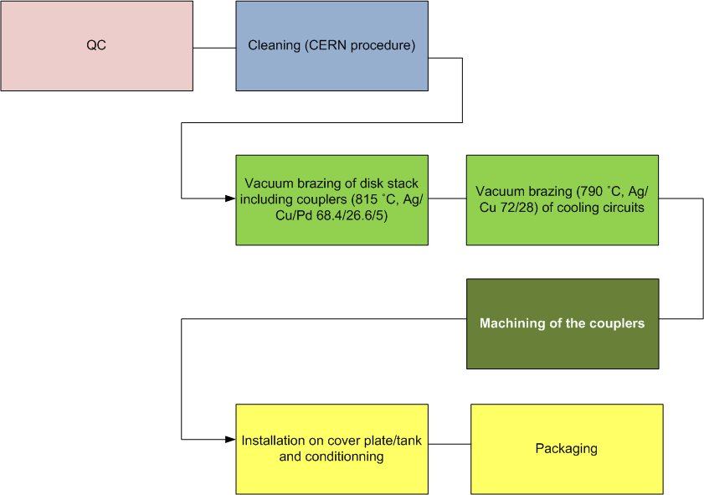
CERN assembly cycle

Slide 7
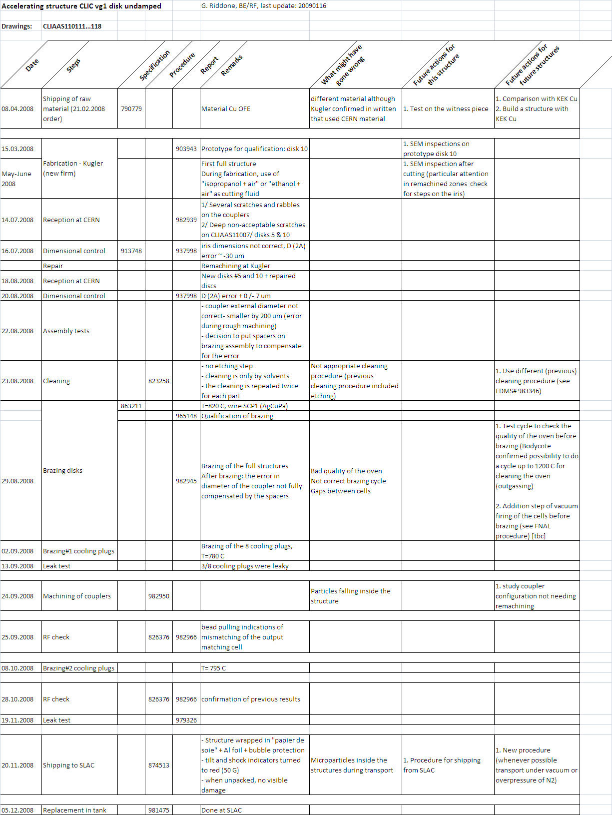
T18_disk_CERN
Fabrication history
Fabrication NC (ID, OD) ➔ remachining needed
3 brazing cycles
(1 additional)
T18_CERN followed the nominal CERN assembly cycle
Mismatch output matching cell
No special packaging

Slide 8
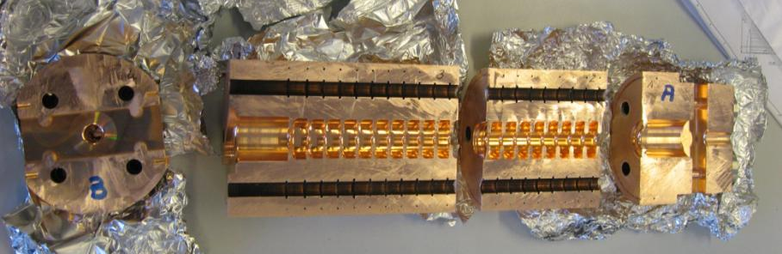
CERN investigations
Cutting of the structure (S. Atieh)
Material analysis (A. Toerklep)
SEM inspections (A. Toerklep, G. Arnau): focus on brazing joints and presence of craters
No visible damage
Photo S. Atieh

Slide 9
Analysis of raw material supplied to Kugler
See report EDMS 988683.
A. Toerklep
Material property and impurity content within the specification

Slide 10
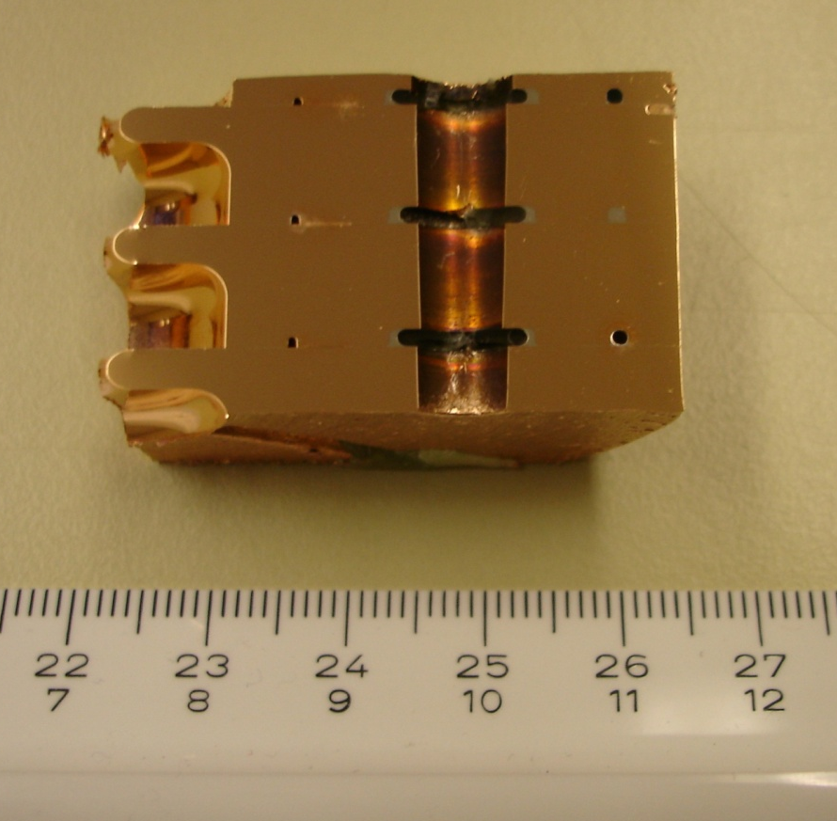
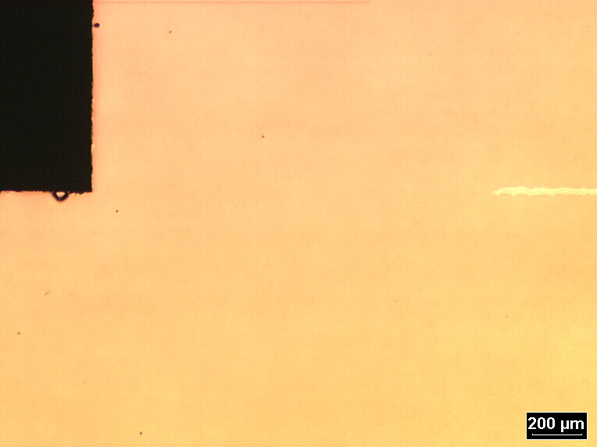
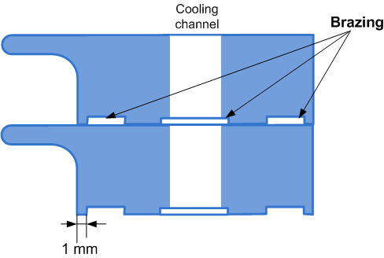
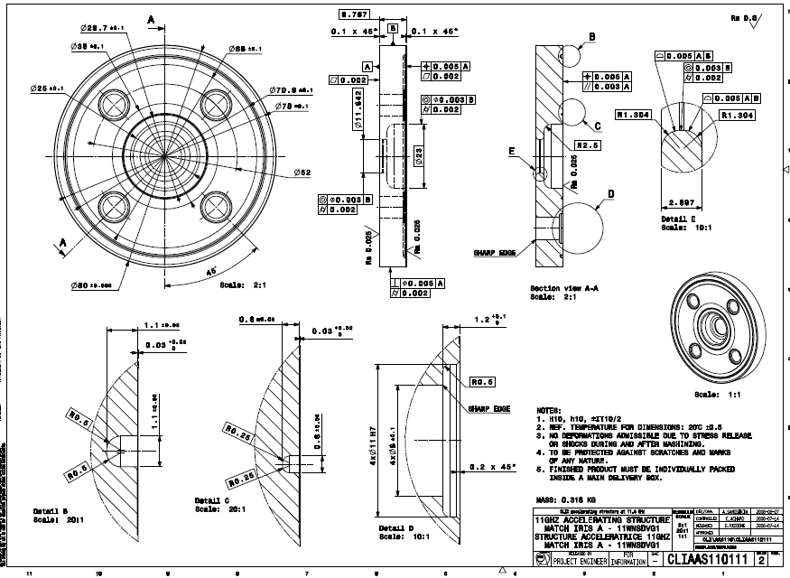
Inspection of brazing joints
1-1
1-1
1-2
1-3
1-4
Cavity
2-1
2-2
2-3
2-4
3-1
3-2
3-3
3-4
Good bonding without gaps

Slide 11
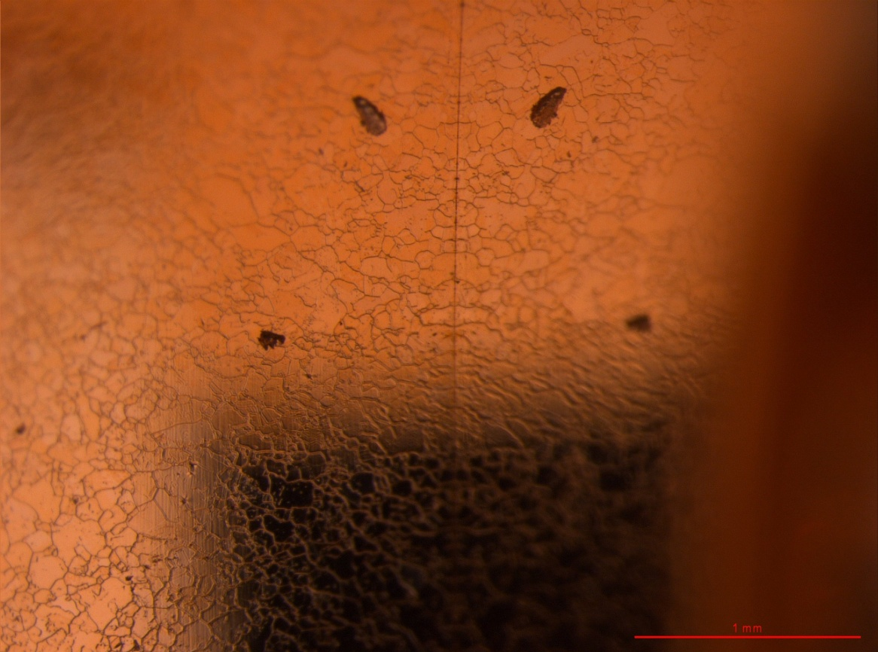
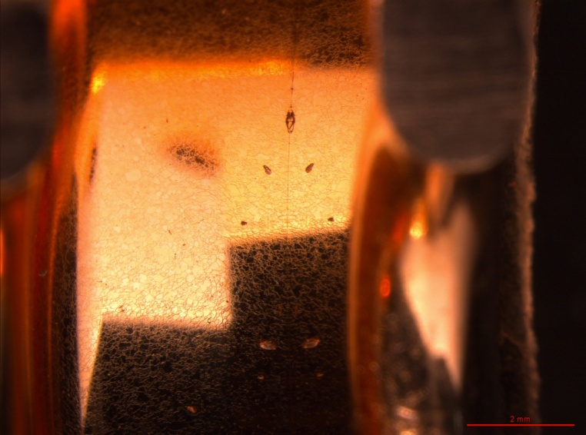
Inspection of brazing joints
Joint
No brazing alloy coming inside the cells

Slide 12
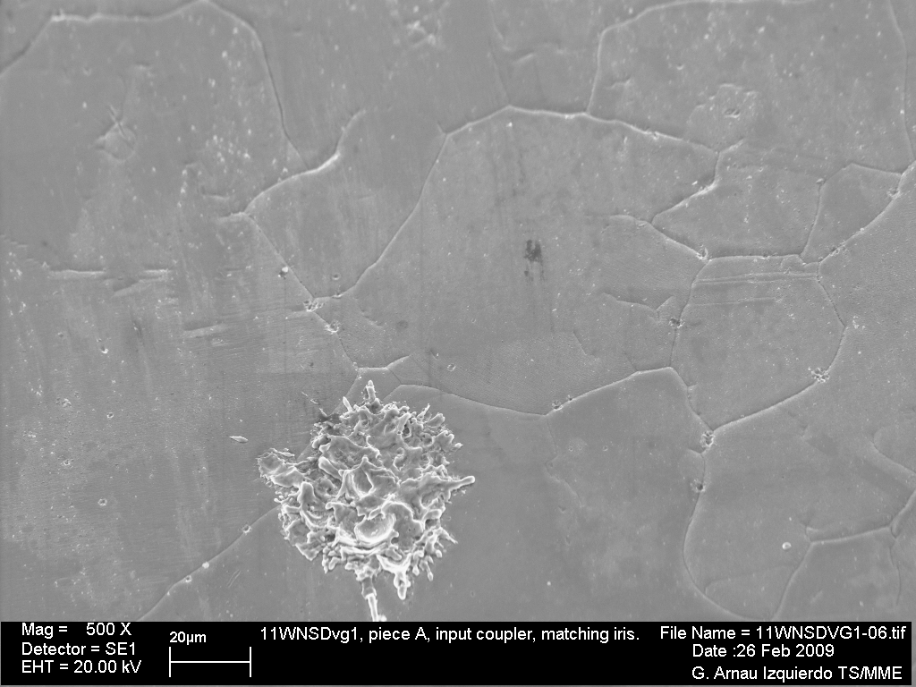
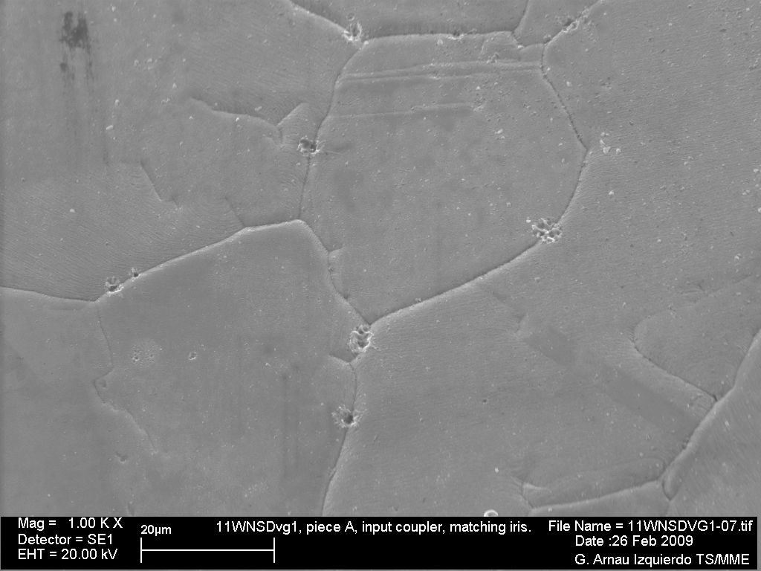
Craters at grain boundary
Piece A, input coupler, matching iris
Piece
- Frequent small craters
- Question on grain size (interesting to cut other T18 and compare)

Slide 13
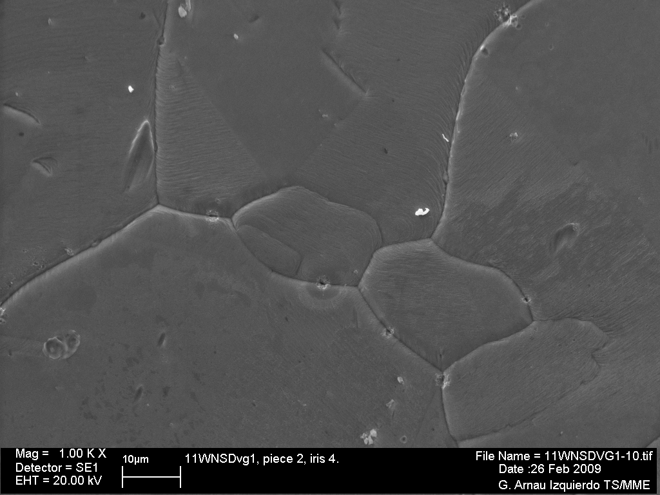
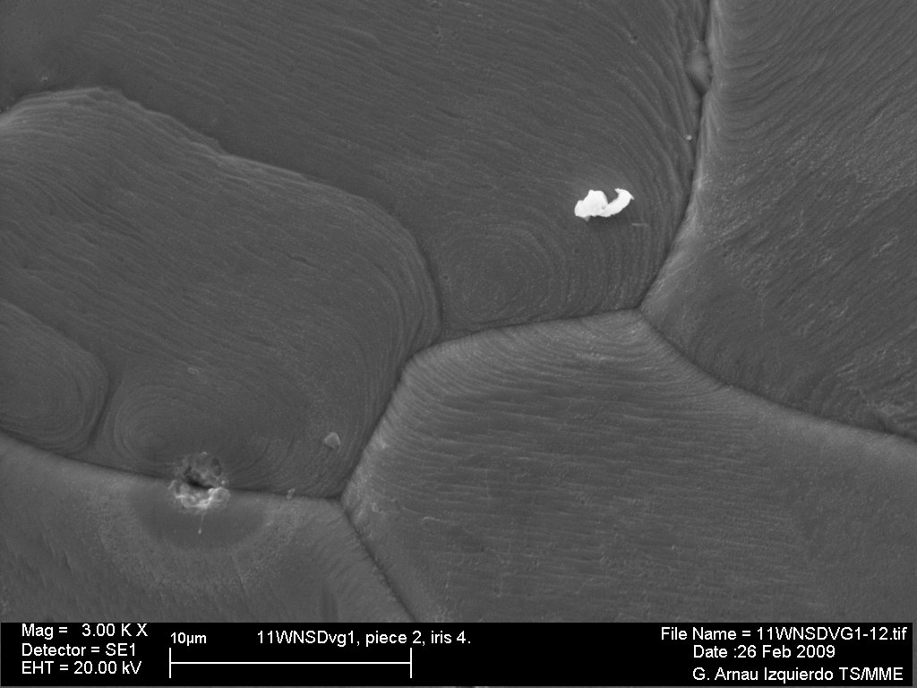
Craters at grain boundaries
Piece 2, Iris 4
Presence of small craters ➔ association with soft breakdown
➔ S-residue in some craters

Slide 14
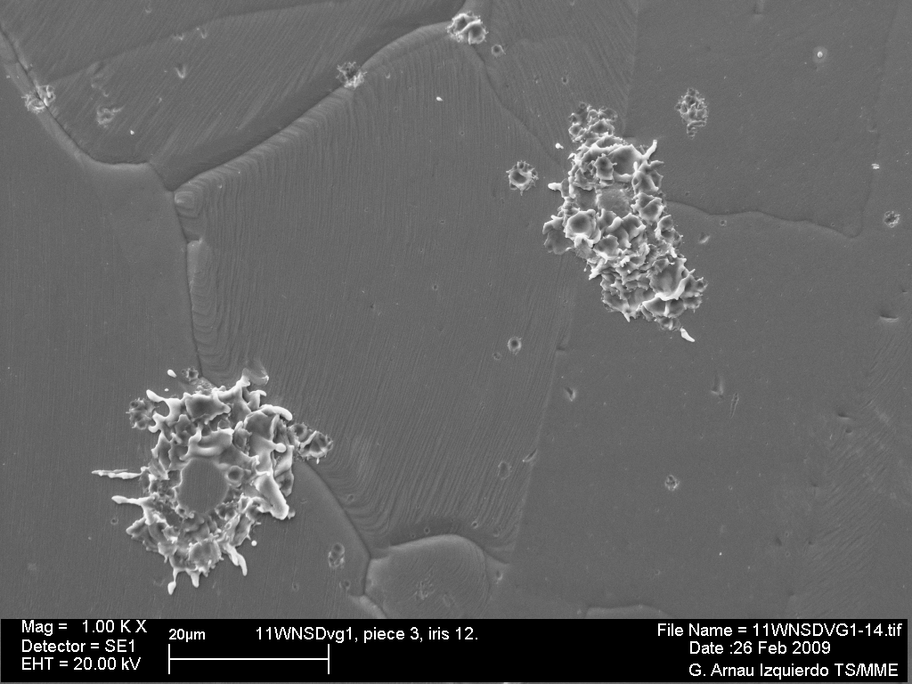
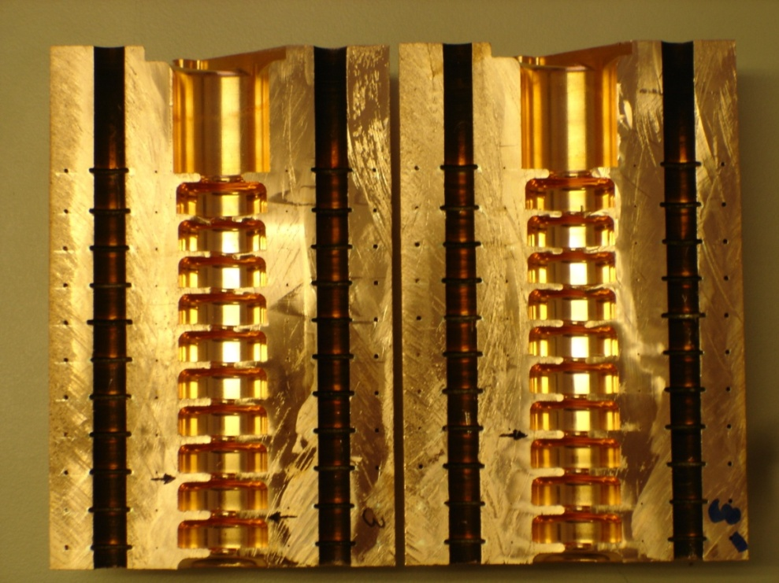
Inspection on iris 12
Piece 3, Iris 12
Breakdown clusters

Slide 15
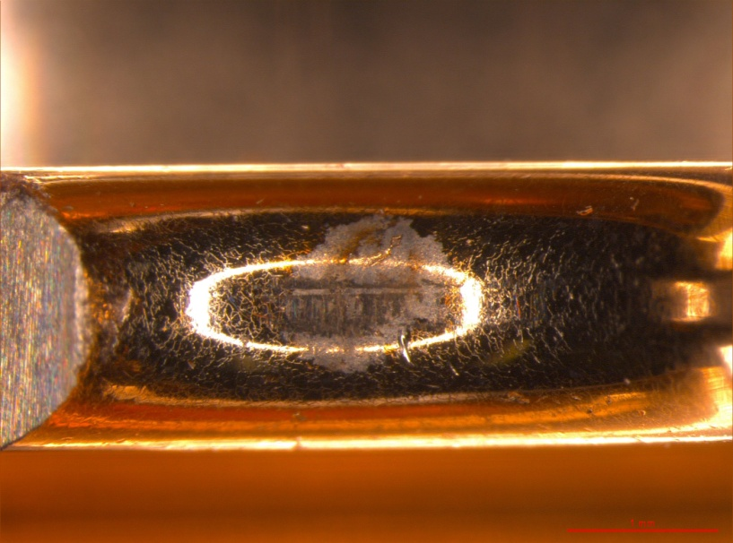
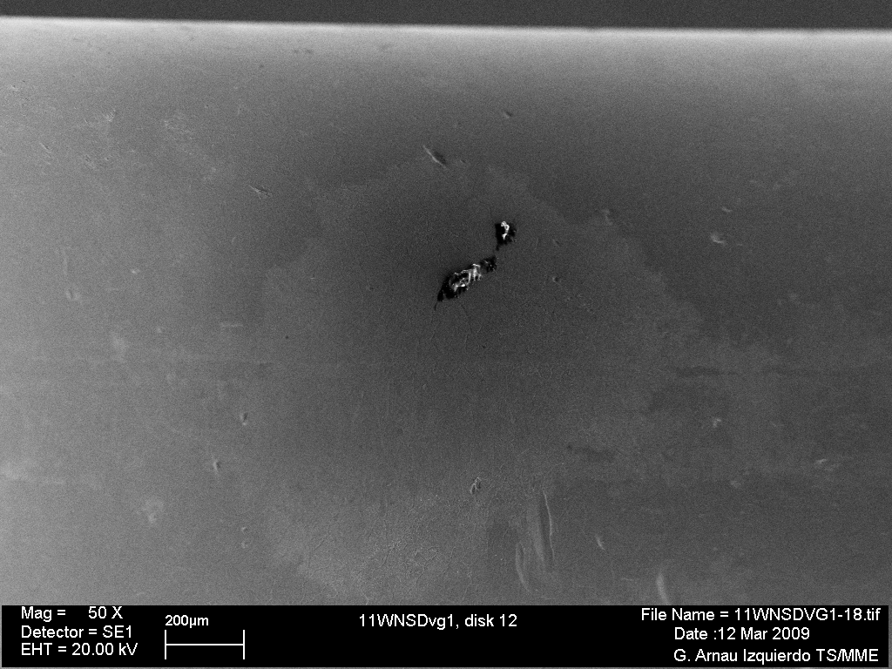
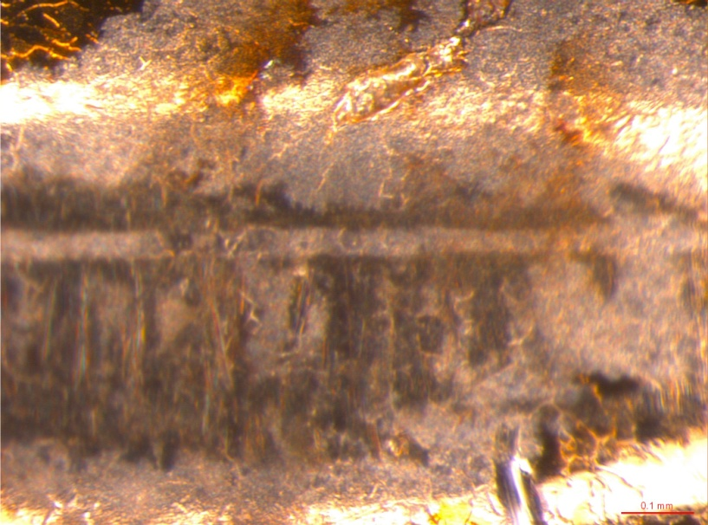
Inspection on iris 12 (special case)

Slide 16
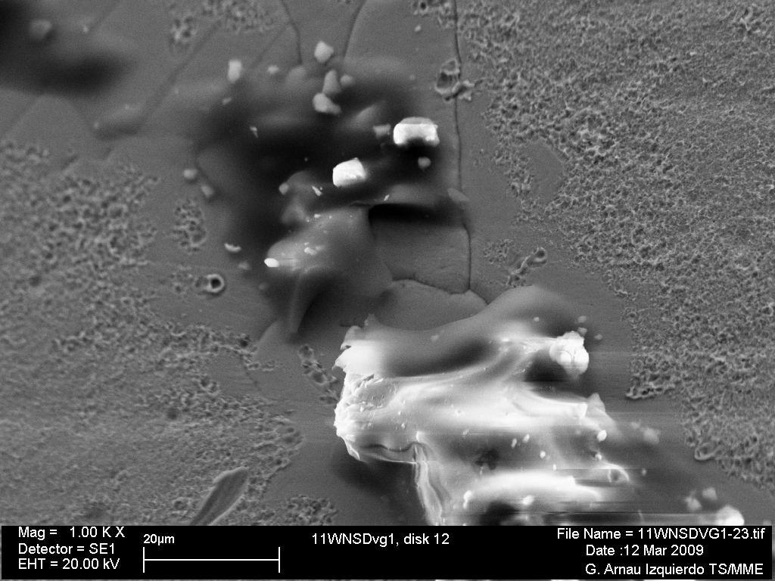
Inspection on iris 12
Contamination between brazing and testing
C
Ca
C

Slide 17
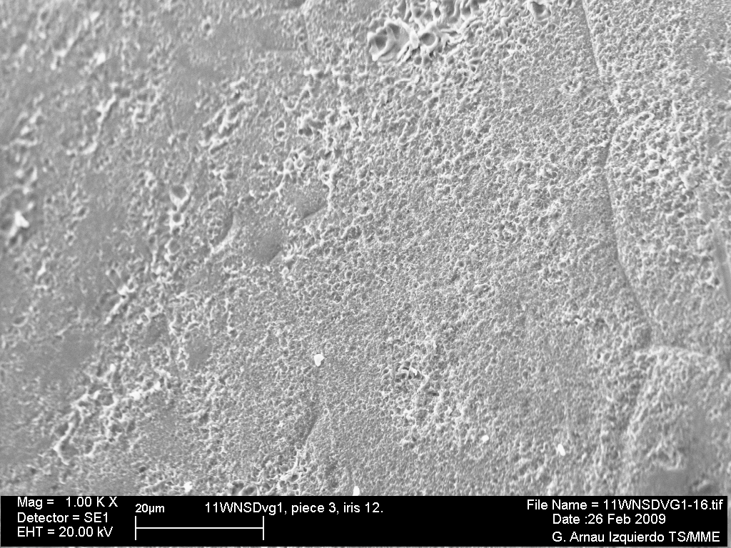
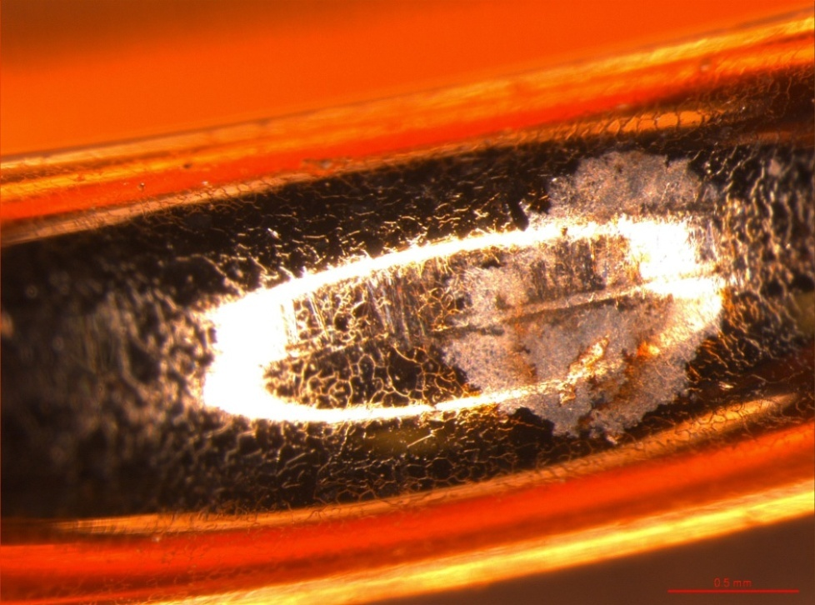
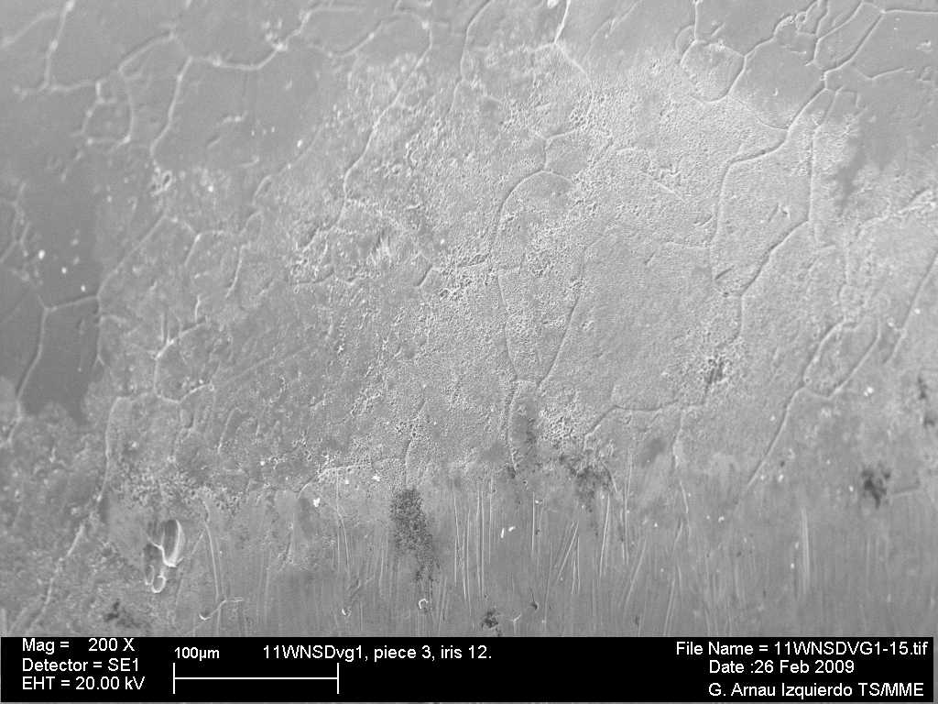
Inspection on iris 12
Piece 3, Iris 12
Region of craters

Slide 18
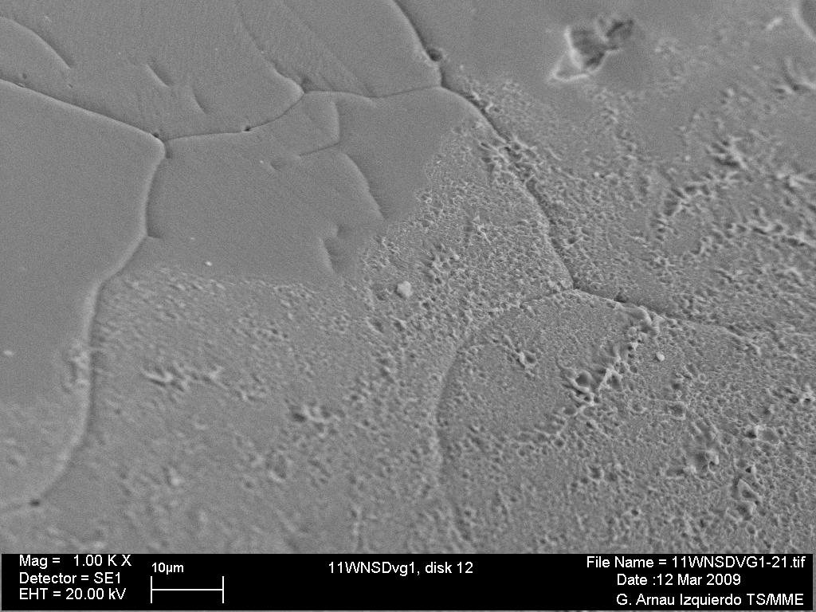
Inspection on iris 12

Slide 19
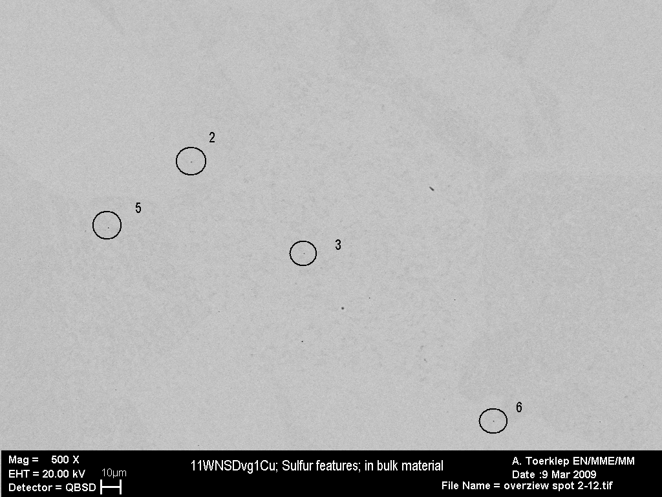

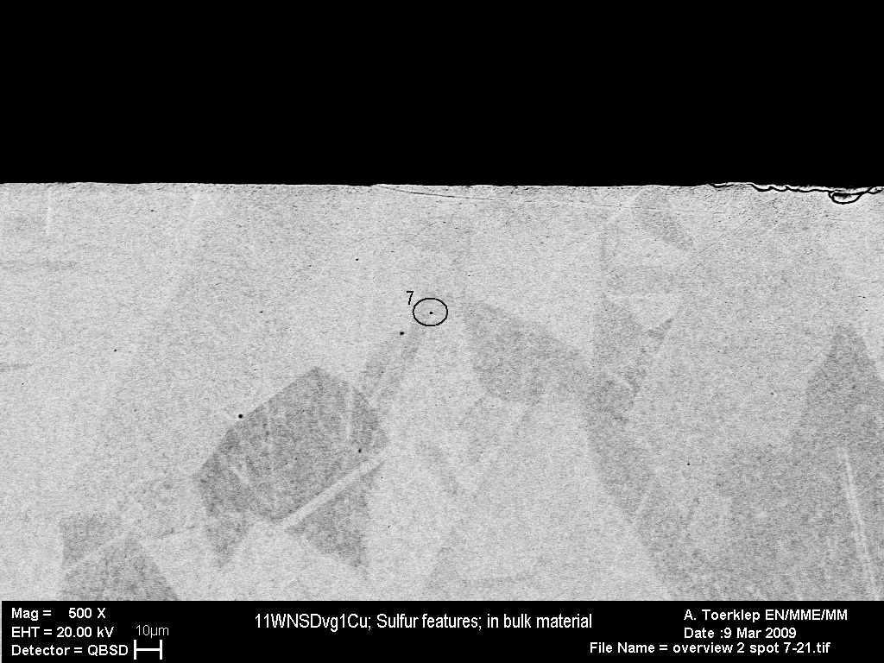
Sulfur features also
in bulk material
PICTURE 1
In agreement with technical
specification
S

Slide 20
Summary of observations
Material composition according to CERN specification
No sign of defects or activities in brazing region
Frequent small craters in the grain boundaries
S-rich particles in the grain boundaries
  S-residue found in craters
S-rich particle also in bulk
Grain size raises questions, but issue to be followed in future
Special case, iris 12
  Region of iris 12 with intense activity, evidence of contamination ➔ coherent with test results

Slide 21
What we learned
S-rich particles in the grain boundaries
  association with soft breakdown
  S can be present in Cu-OFE up to 18 ppm
  ➔ completely soluble above 750 °C but
  in equilibrium – slow cooling – forms Cu₂S
  at room temperature
Grain size could be an issue
Dedicated program with heat treatments and material origin
Comparison with assembly cycles at
KEK/SLAC and Fermilab
Cleaning/handling procedures shall be improved
Additional steps on dimensional control and SEM are required during preparation

Slide 22
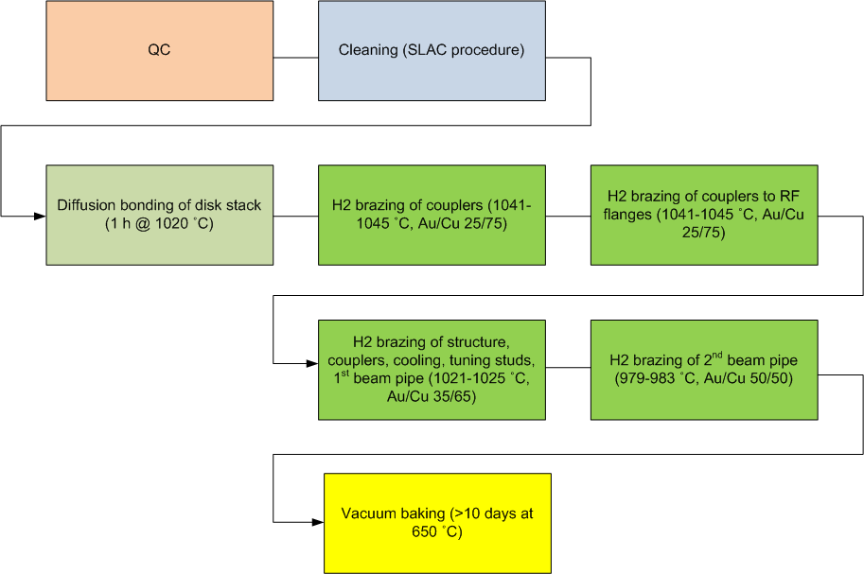
SLAC/KEK assembly cycle

Slide 23
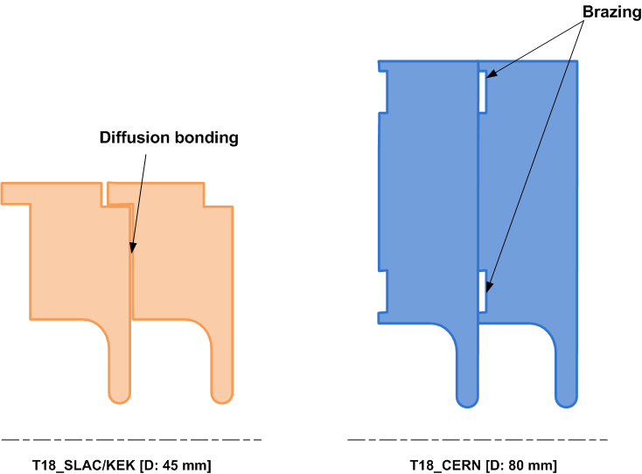
CERN and SLAC/KEK bonding

Slide 24
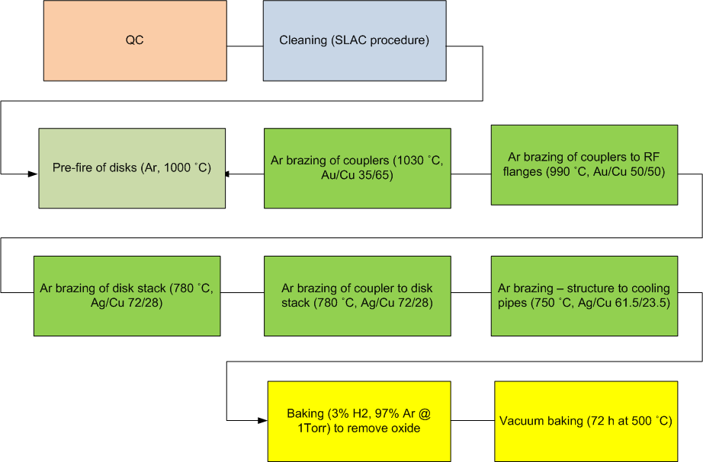
Fermilab assembly cycle

Slide 25
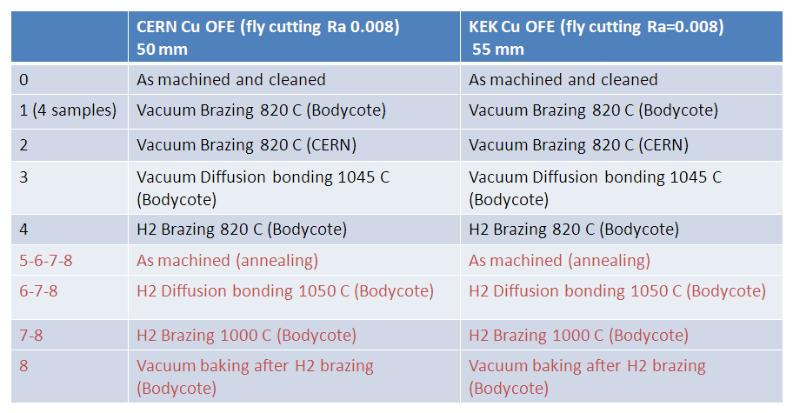
Investigation on S-presence and grain size
SEM inspections after each step

Slide 26
Future short-term structures
T24 undamped (disks for tank version at CERN) ➔ new assembly procedure
T24 undamped x2 ➔ fabricated by KEK/SLAC
T24 undamped D = 45 mm (under mechanical design) x2 ➔ new design and new assembly procedure
T18 KEK/SLAC design x2 (under tendering) ➔ SLAC/KEK assembly procedure
TD18 (already brazed) ➔ cleaning

Slide 27
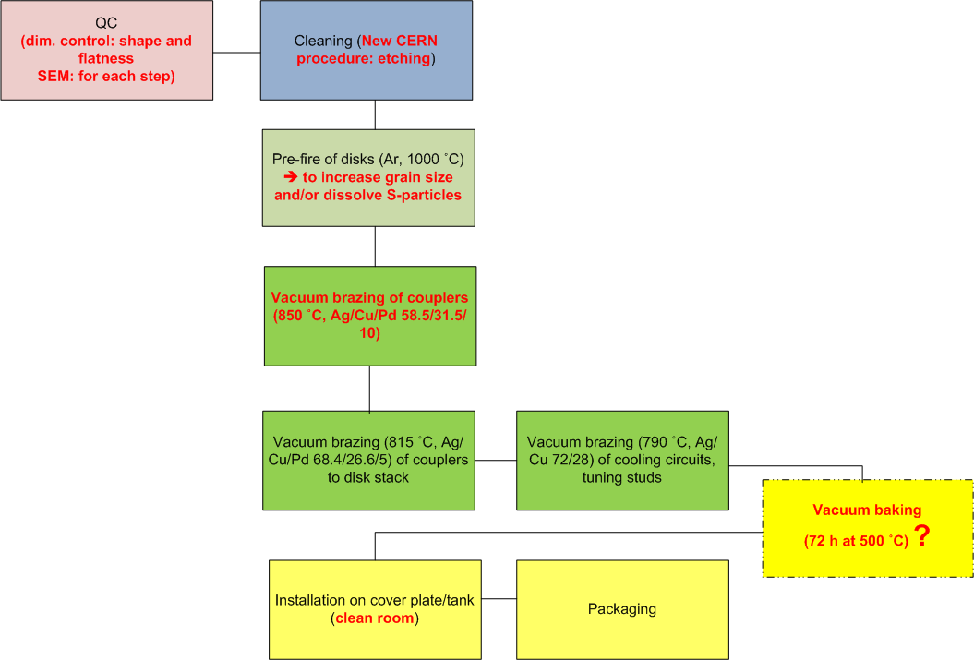
CERN new assembly cycle
- Intermediate transport in dedicated boxes
- Intermediate assembly work under laminar flow atmosphere (portable device under evaluation)

Slide 28
Dimensional control
Present situation
  Machine with an accuracy of +/- 3 um ➔ insufficient with respect to needs ➔ subcontrating to outside institutes
  General rule for machine accuracy: 3-4 times better than required accuracy on pieces
  Serious problem of probe: too high forces ➔ marks on pieces
  Machine Veeco: good for roughness and topography measurement
  Room adapted for this machine and required tolerance
To be improved
  Low force probe: 15 kCHF
  New machine +/- 0.3-0.4 um (3 suppliers) [High Priority ]
    Needed personnel
    Needed adaptation of existing room
Meeting S. Atieh, A. Cherif, M. Polini, G. Riddone 06.03.2009

Slide 29
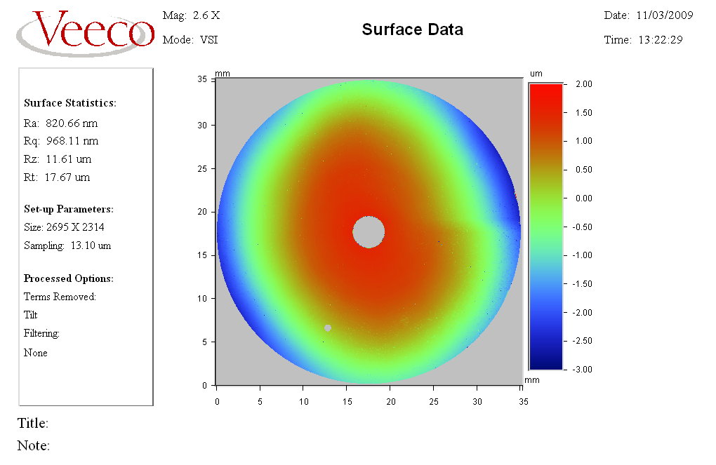
PLANEITE MESUREE SUR CELLULE 35 mm SUR MACHINE VEECO
A. Cherif

Slide 30
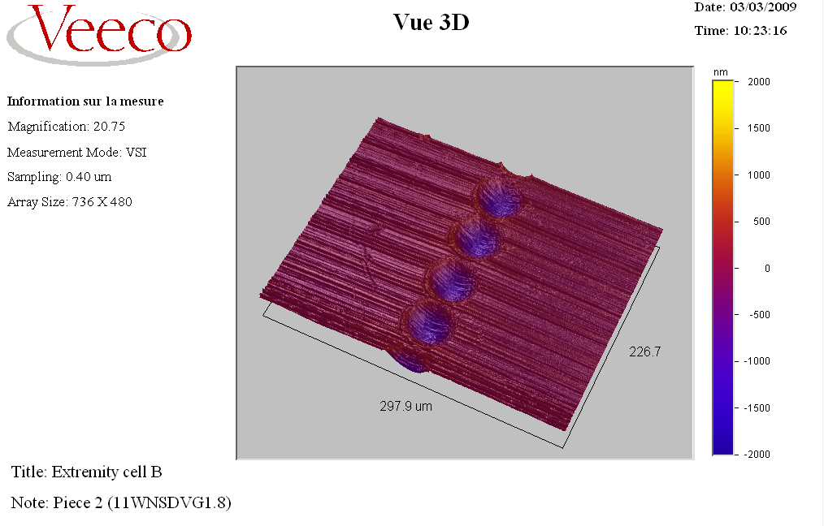
Marques dues au palpeur
A. Cherif

Slide 31
Fabrication
Present situation
  VDL, Kugler (only turning)
  LT Ultra under qualification
  Promising Kaleido, Engineering and TNO
To be improved
  New firms in Europe
  New firms in Japan
  New firms in USA
  Development work in collaboration with firms (very difficult with VDL) and other institutes
  Procurement of combined machine at CERN [prototyping phases, special pieces, pre-qualification for series, fall-back solution]
    qualified people (1 Eng. + 1 Tech) to be trained [Priority 2]
Meeting S. Atieh, A. Cherif, M. Polini, G. Riddone 06.03.2009

Slide 32
Conclusions
T18_CERN showed bad test results (same structures made at KEK/SLAC showed good results, demonstrating nominal CLIC performance)
Investigations on T18_CERN, showed that iris 12 is a special case: contamination and evidence of high activity region
Program to investigate S-presence and grain size launched
New assembly procedure established: pre-fire at 1000 °C, cleaning procedure, separate preparation of RF couplers
Additional QC steps identified
Fabrication of T18 with SLAC/KEK design launched

Slide 33
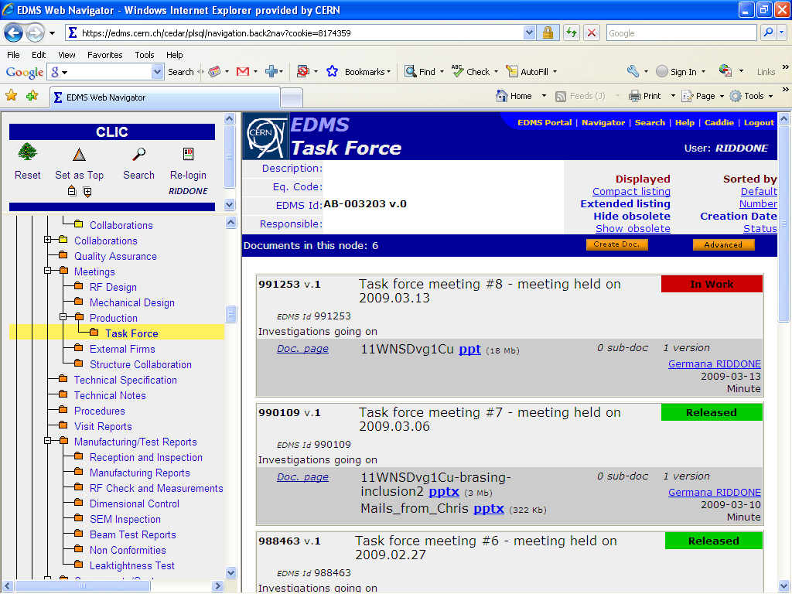
Detailed information can be found in EDMS

Slide 34
Extra slides

Slide 35
T18_CERN

Slide 36
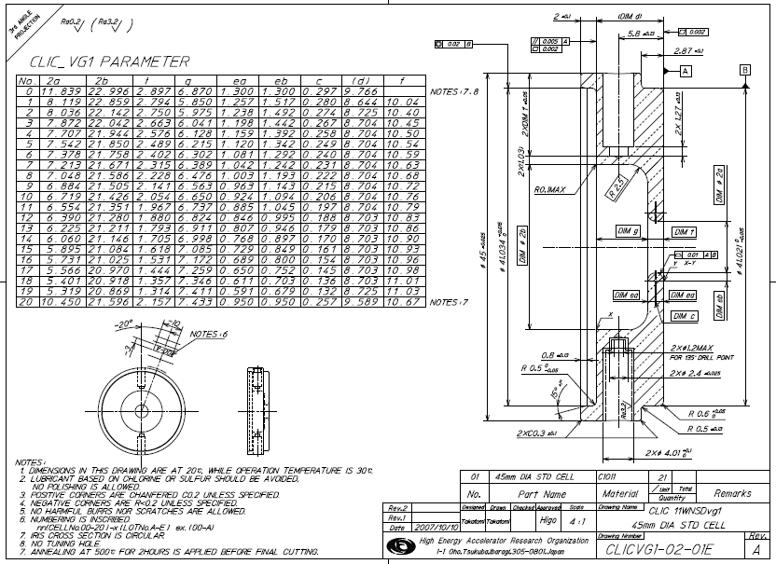
T18_SLAC/KEK

Slide 37
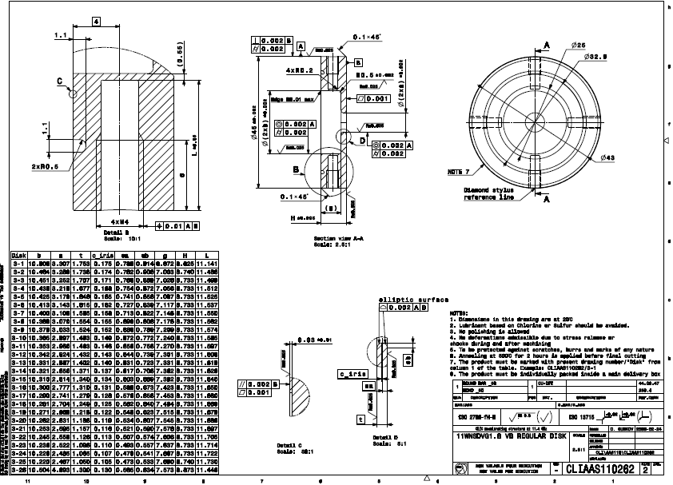
T24 undamped D = 45 mm

Slide 38
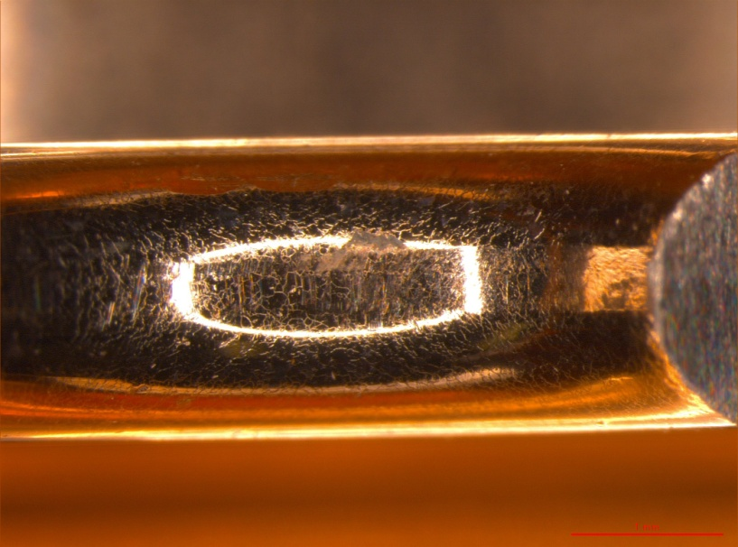
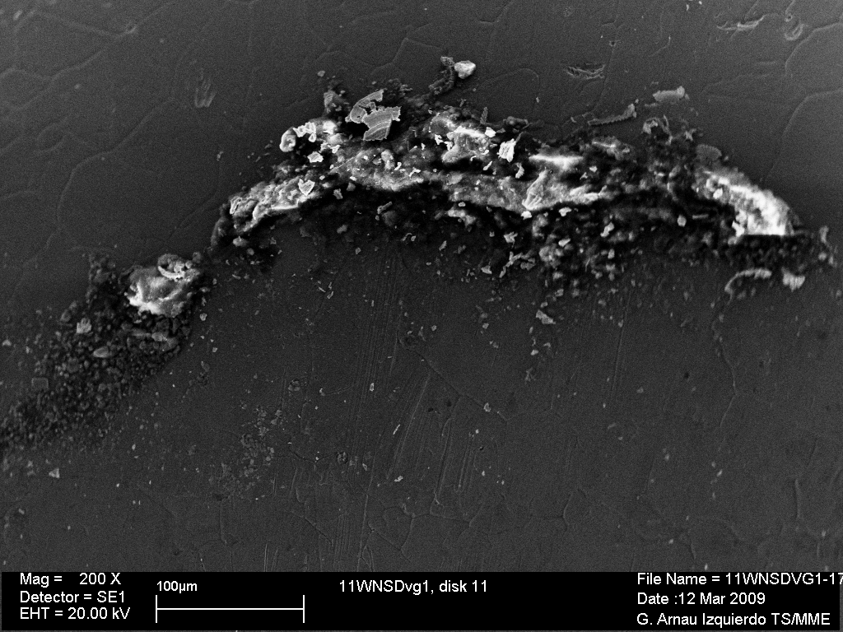
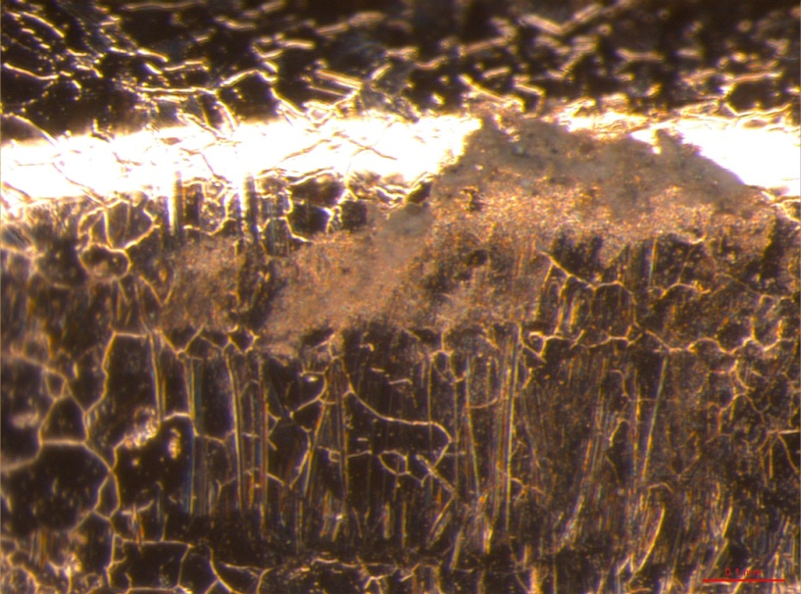
Inspection on iris 11
Dirty region which came after the test

Slide 39
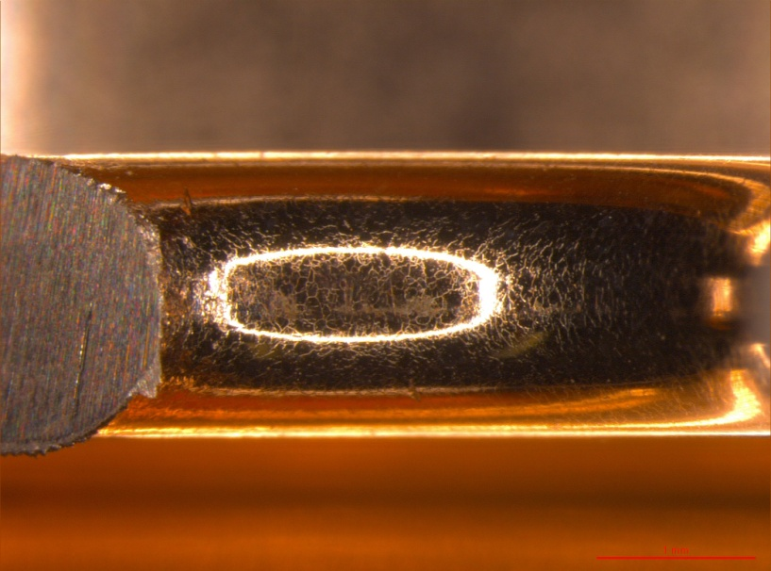
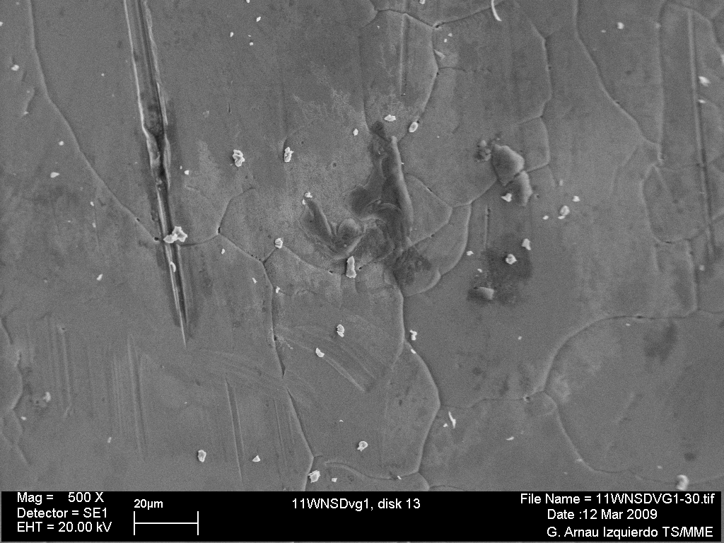
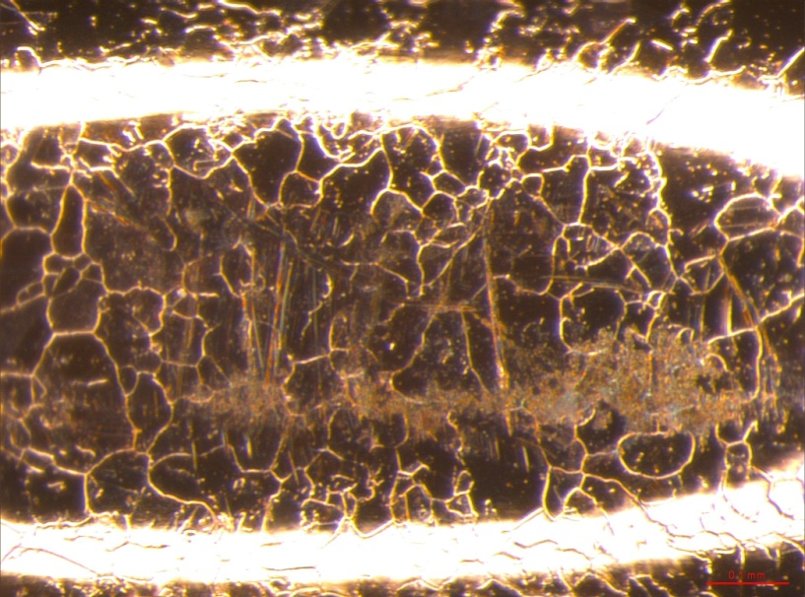
Inspection on iris 13
Dirty particles which came after the test

Slide 40
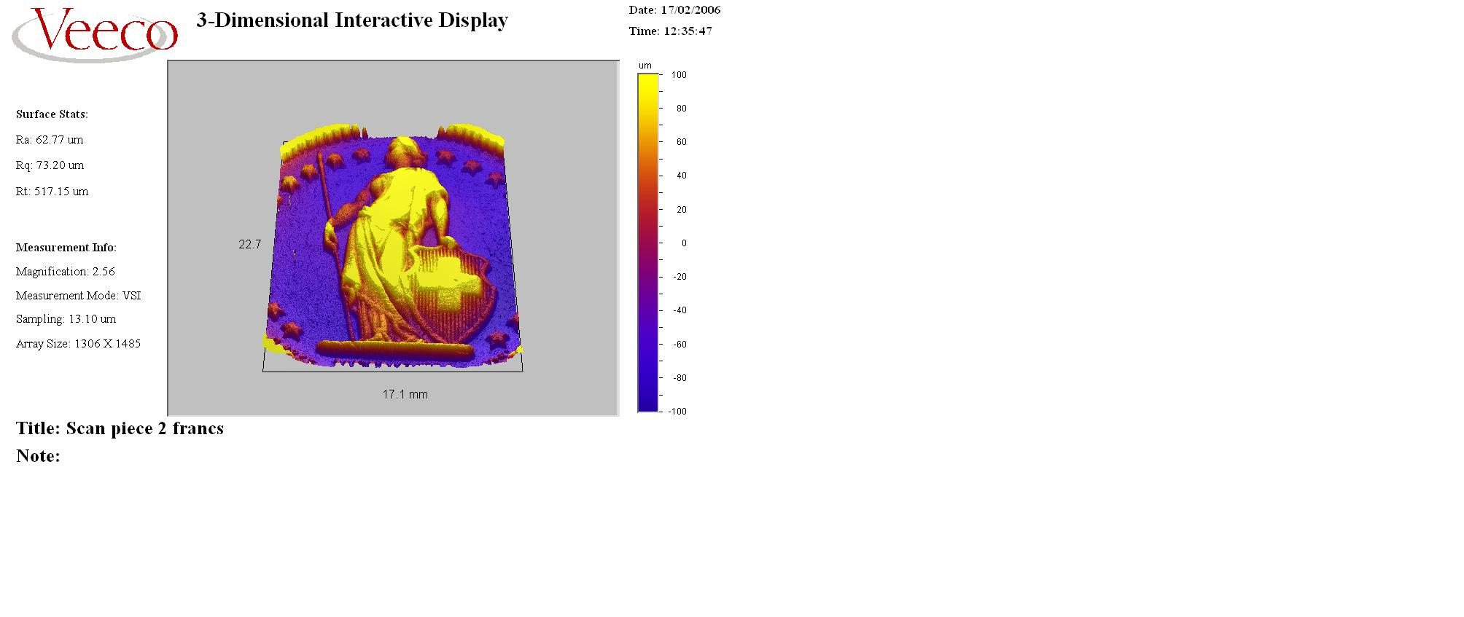

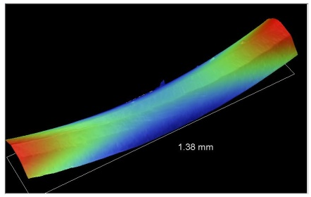
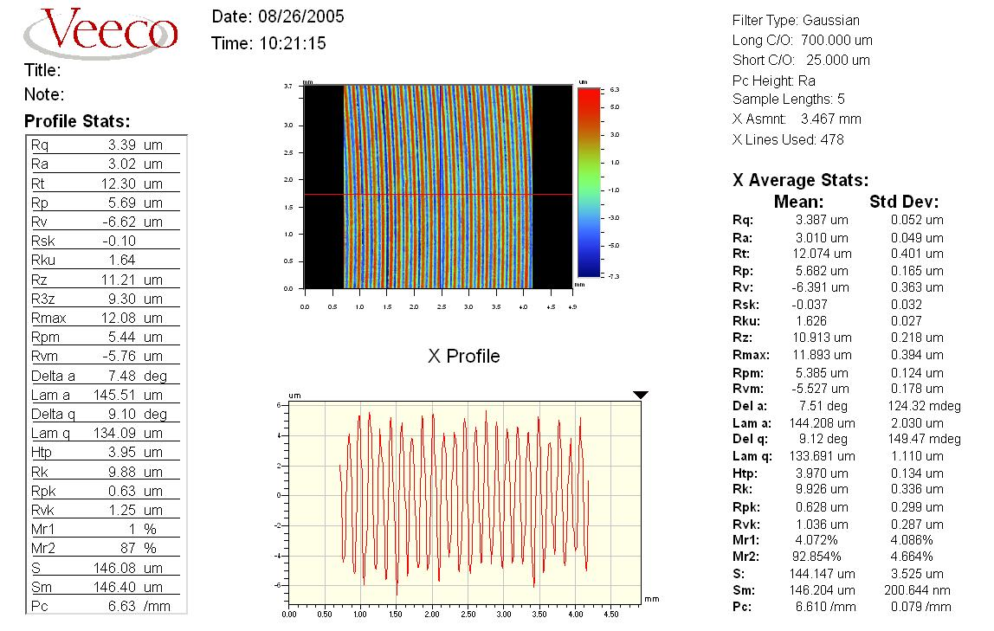
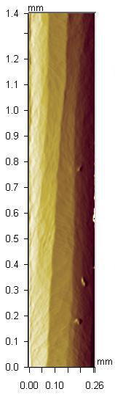
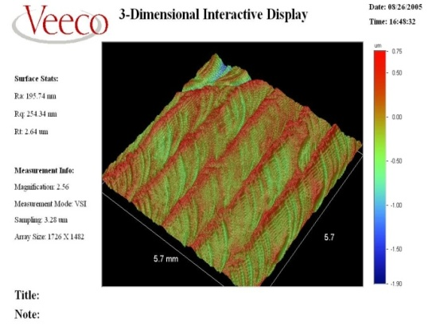
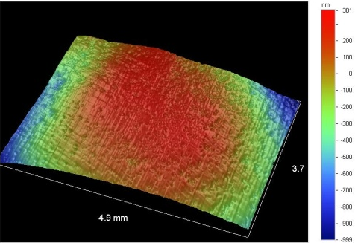





Rugosimètre – profilomètre optique VEECO NT3300
CLIC
Pièce de 2 CHF
CMS
200x
LHCb
5µm
8 cm
Ø25µm
A. Cherif

Slide 41

VUE 3D
A. Cherif

Slide 42

A. Cherif

Slide 43

Marques dues au palpeur
A. Cherif

