Slide 1



Longitudinal Bunch Profiling at FACET using Smith Purcell Radiation
The cheap and cheerful way of profiling
R. Bartolini, N. Delerue, G. Doucas, S. Hooker, C. Perry, A. Reichold

Slide 2
Outline
Introduction and motivation
  Our goal
  What is Smith Purcell Radiation
  How can it be used for bunch profiling
Our Apparatus
Very Preliminary Data
What we learned from commissioning run
  About our apparatus
  About FACET
Wish list for the user run
  Beam Parameters
  Scheduling
  Organisation

Slide 3
Motivation (I)
High brightness linacs or LPWAs driving X-rays FELs (or colliders) naturally produce ultra-short electron bunches
high brightness linacs
short pulses (100’s to few fs)
possibly low charge (100’s to few pC)
Laser Plasma Wakefield Accelerators (or beam driven PWA)
short pulses (down to 10’s fs)
charge (1 nC to 100’s pC)

Slide 4
Motivation (II)
Diagnostics for ultra short (10s fs or below) bunches measurements are needed
Streak cameras
Transverse deflecting cavities (LOLA type)
Electro Optical Sampling
Coherent radiative processes (e.g. Smith Purcell, TR)
Possible problems among these techniques
invasive, complex hardware, non single shot, difficult to extend to below 10’s of fs, unproven

Slide 5
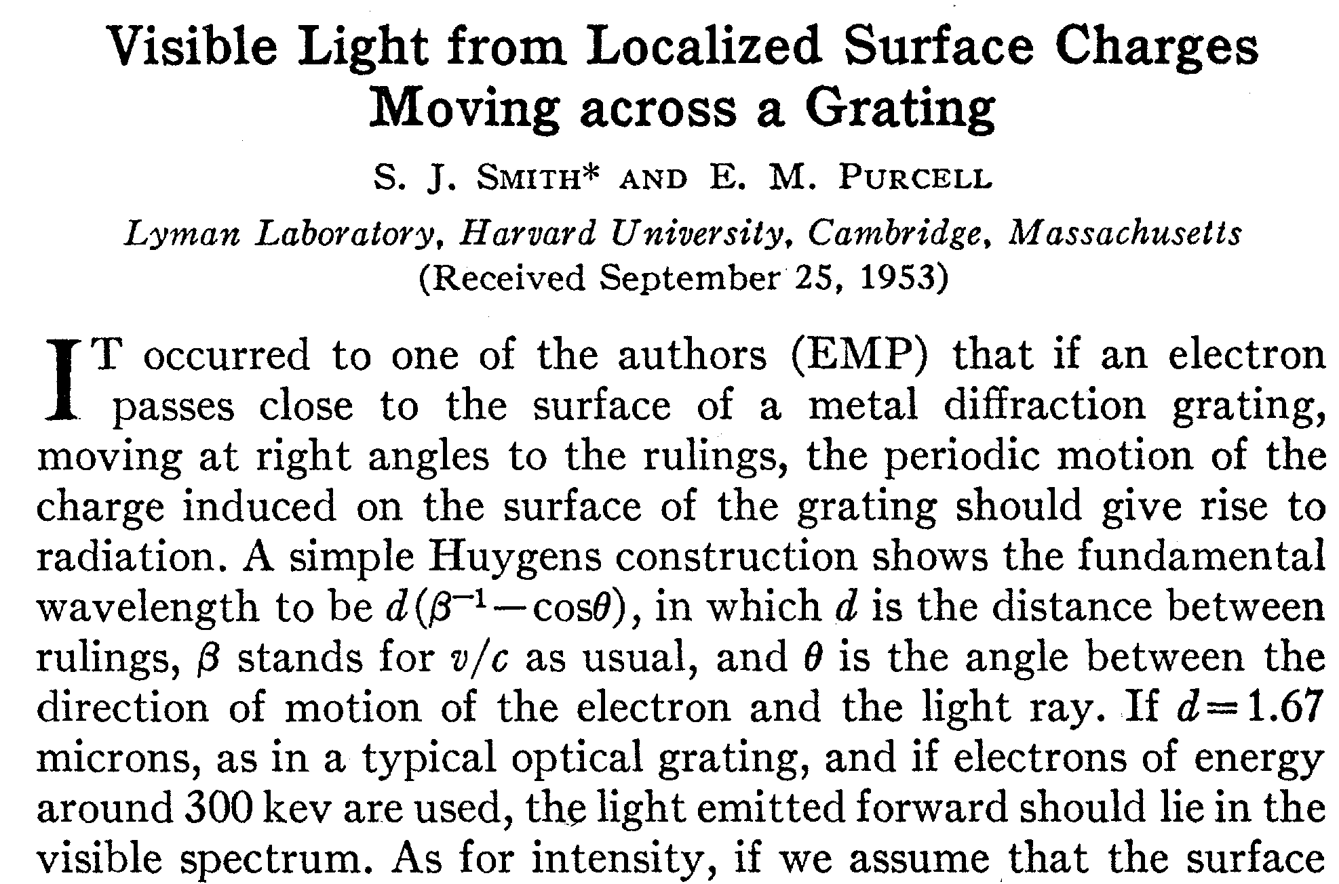
What is Smith-Purcell radiation (I)
(an old hat!)
S.J. Smith and E.M. Purcell, Phys. Rev. 92, pg. 1069, (1953)
300 keV electrons to emit in the visible wavelengths (d = 1.67 um)

Slide 6
Smith-Purcell radiation (II)
An electron bunch grazing a metallic corrugated surface emits radiation
Within the surface current model, the emission of radiation is due to the acceleration of the surface charge induced on the grating surface
Bunch
Blazed profile
Surface charge

Slide 7
Smith-Purcell radiation (III)
The grating has a dispersive effect: the angular distribution of the wavelength is given by
At 90 degrees in first order the wavelength is equal to the period ℓ of the grating
Θ
x₀
R: coupling strength
of grating to radiation
The angular distribution of the power emitted by a single electron is computed from the radiation integral
Infinite grating:
Evanescent wavelength:

Slide 8
Coherent Smith-Purcell radiation
Two electrons will emit in phase over the wavelengths which are longer than their separation in the longitudinal direction
The power radiated by a bunch of electrons is given by
F(ω) is the form factor of the electron bunch, i.e. the square modulus of the Fourier transform of the longitudinal bunch distribution
For a bunch length
the form factor
is different from zero up to
50 ps ⇒ λ coherence >15 mm microwaves
50 fs ⇒ λ coherence > 15 μm FIR

Slide 9
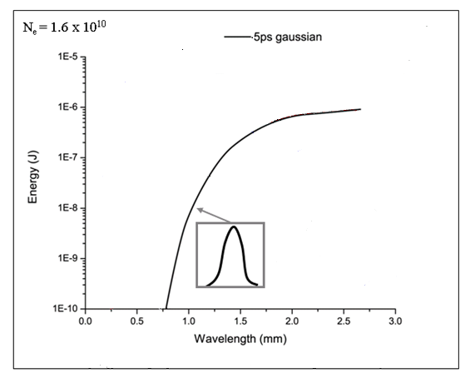
Smith-Purcell radiation: a diagnostic tool (I)
SP Radiation is emitted away from beam direction (i.e. out of the beam pipe).
Wavelengths are emitted over a large angular spread. Different SP wavelength at each observation angle!
Different bunch profiles = different radiation distributions.
Measuring emitted energy relates back to the bunch form factor hence to the bunch profile.
Can measure multiple angles at once for a single-shot measurement.

Slide 10
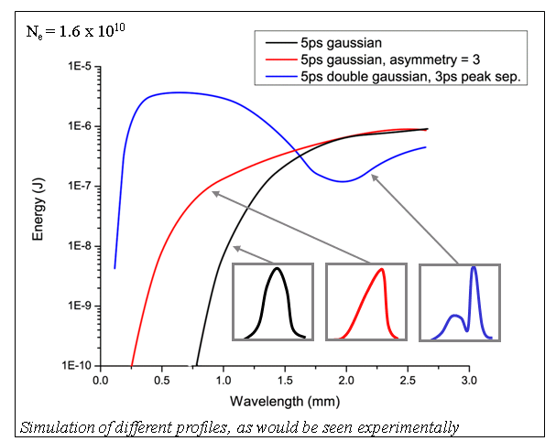
Smith-Purcell radiation: a diagnostic tool (II)
Coherent enhancement of Smith Purcell radiation gives information
not only on the bunch rms length but also on the beam profile

Slide 11
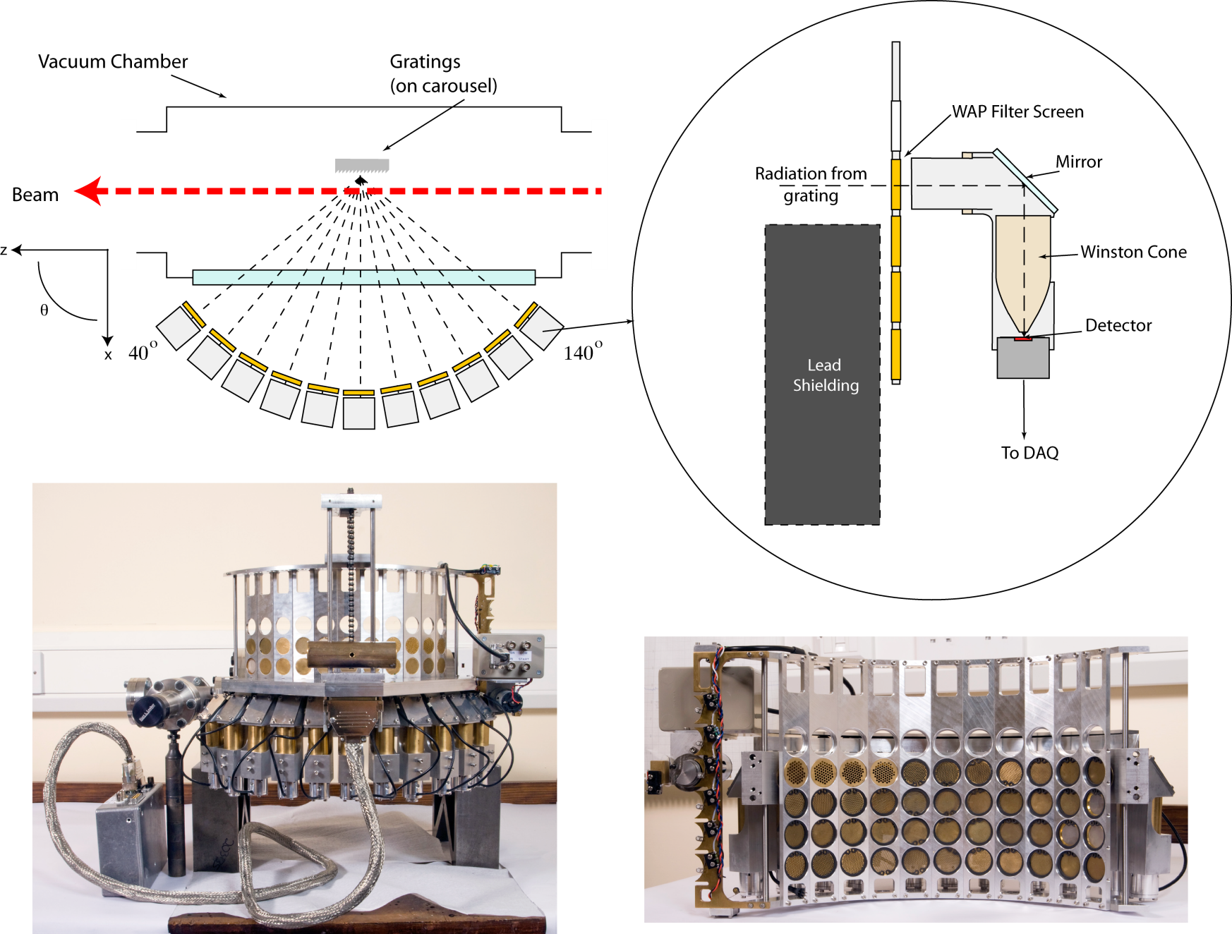
Experimental apparatus (schematic)

Slide 12
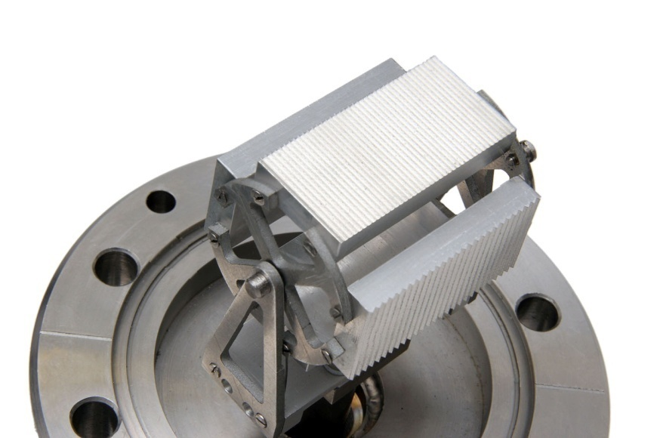
Generation of FIR SP radiation (II)
3 gratings (0.05, 0.25, 0.5mm)
1 blank piece of aluminium
Beam direction
Expected SP radiation at FACET
in the wavelength range
10 μm to 1 mm
A carousel can rotate and offer three different gratings or one blank to the beam. Rotation is controlled remotely but position is not registered
For a true single shot measurements the gratings should be located in series.

Slide 13
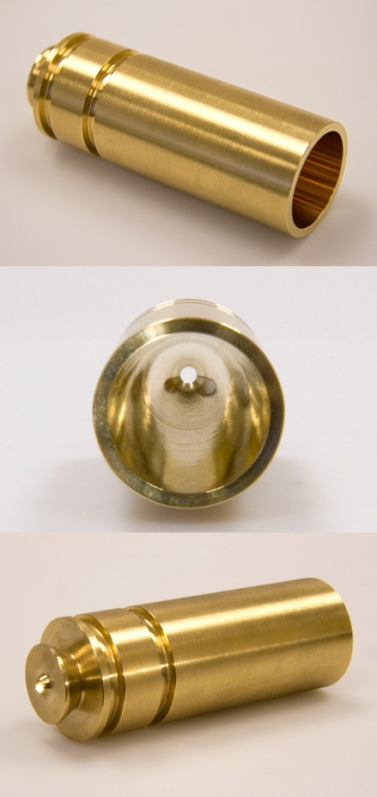
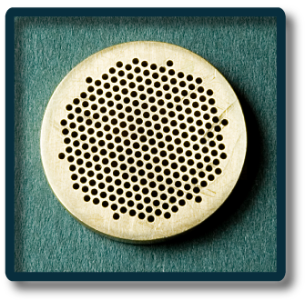
Detection of FIR SP radiation (III)
Filters of many varieties remove background radiation. Suitable filters for each grating are moved in front of the silicon windows
Winston cones collect the radiation toward the pyroelectric detectors and provide additional filtering
~70mm
Solid aluminium – absolute
background measurement.
No filter
Filters for different
gratings & orders
  Wire mesh: 117 µm, 175 µm; Δλ = 10-20 µm
  Wave guide array plates: 175 < λ < 1000;
  Mylar based thin films: 20 < λ < 117; Δλ = few µm
  Silcion based thin films : 10 < λ < 20; Δλ = few µm

Slide 14
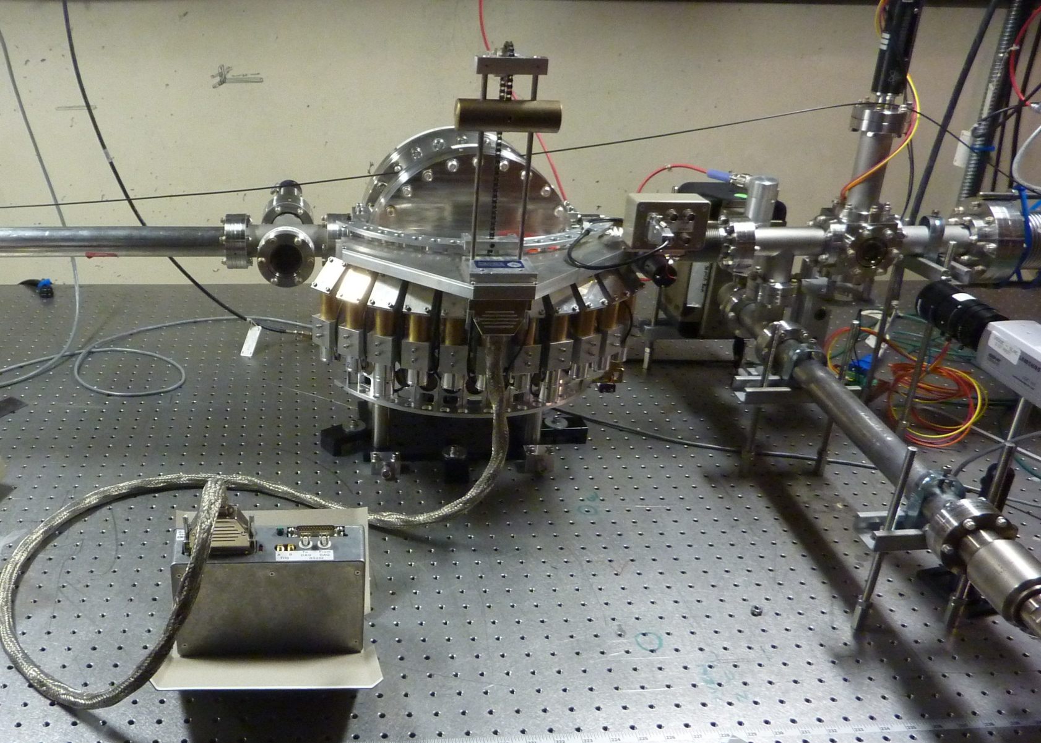
Before lead shielding installation

Slide 15
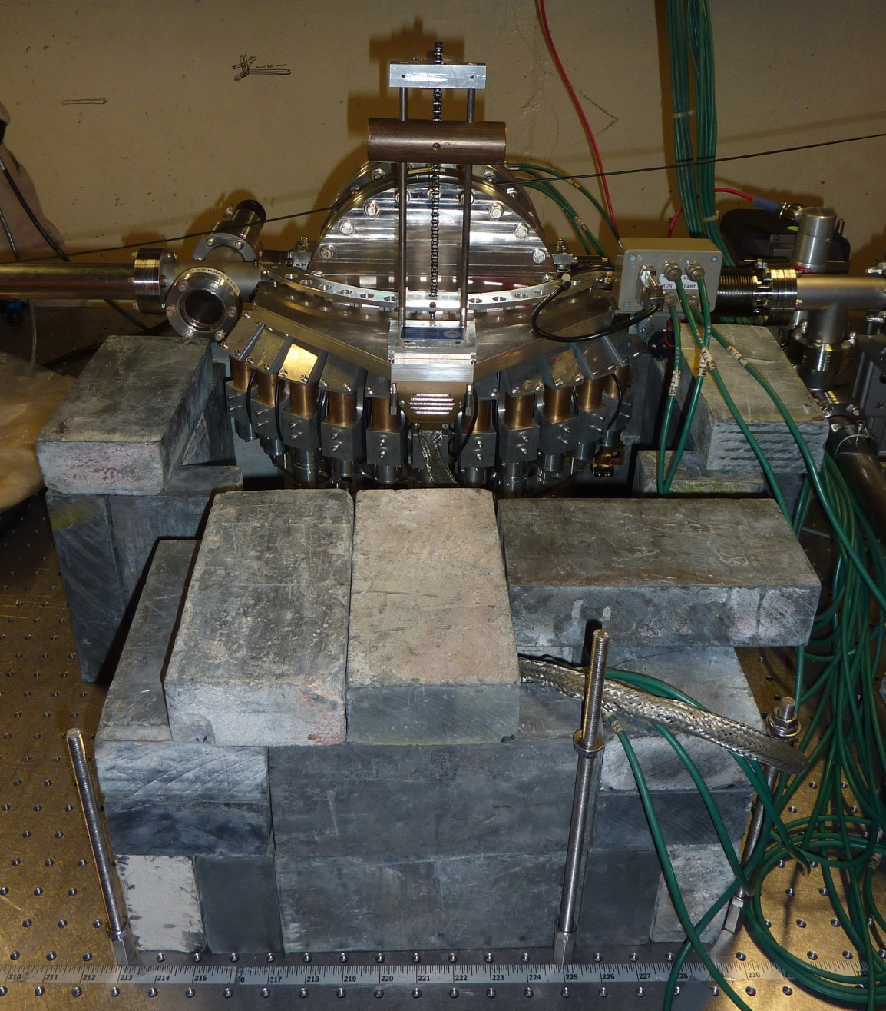
After lead shielding installation

Slide 16
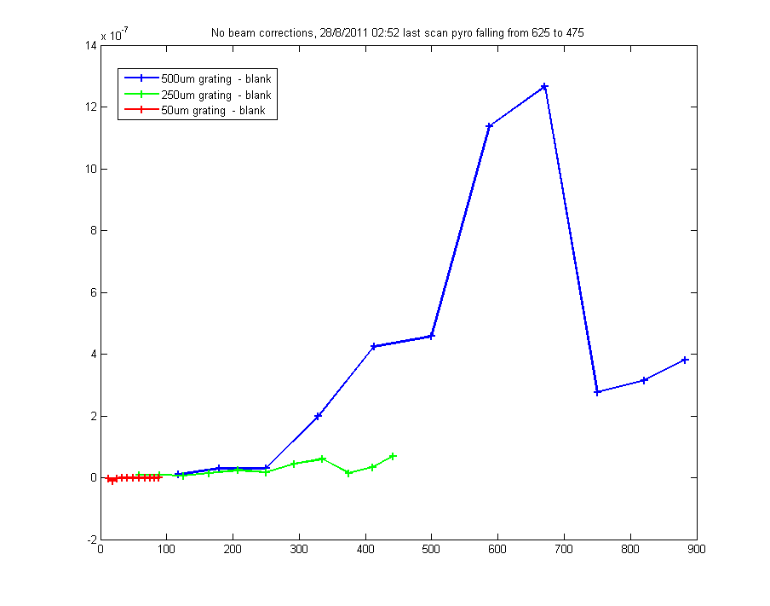
Very Preliminary Data
Uncorrected Smith Purcell Spectrum from all gratings

Slide 17
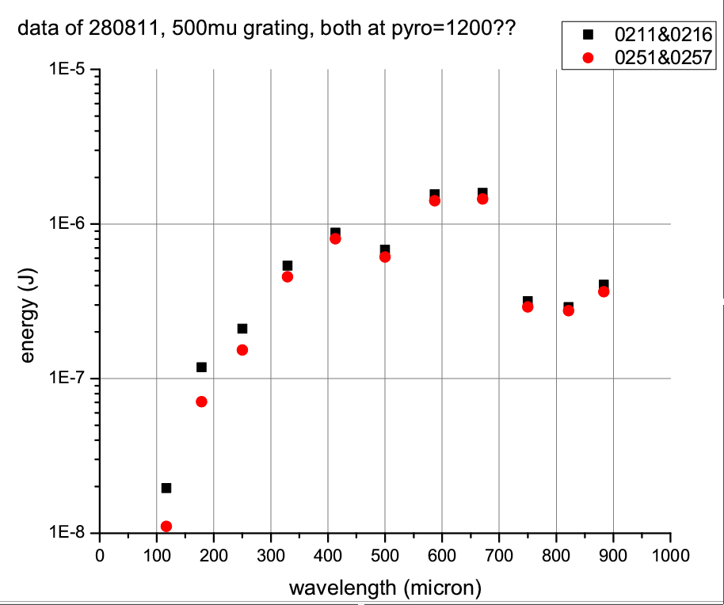
Very Preliminary Data
Partially corrected Smith Purcell Spectrum (500 µm grating only)
Data Times
Grating – blank
02:51 – 02:57 : Pyro=1041 ± 21
02:11 – 02:16 : Pyro=1130

Slide 18
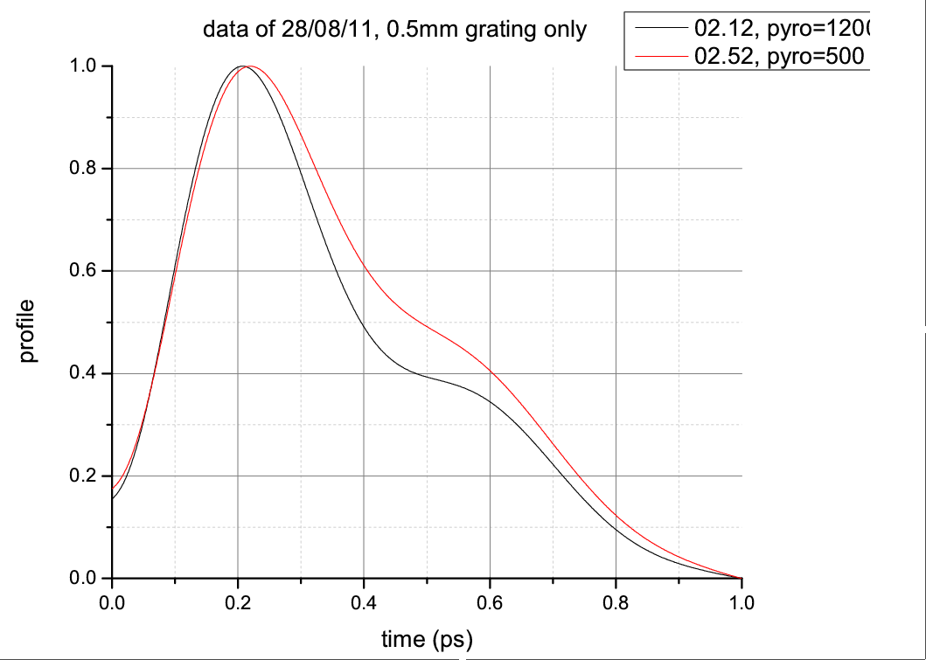
Very Preliminary Data
Reconstructed temporal profile (KK method)
Data Times
Grating – blank
02:51 – 02:57 : Pyro=1041 ± 21
02:11 – 02:16 : Pyro=1130
Note:
Pyro = AO007 from EPICS archive
In archive 007 varies less than 009 but using camonitor this seems to be the other way round. Which to use?
FWHM
310 fs = 93 µm
FWHM
420 fs = 126 µm

Slide 19
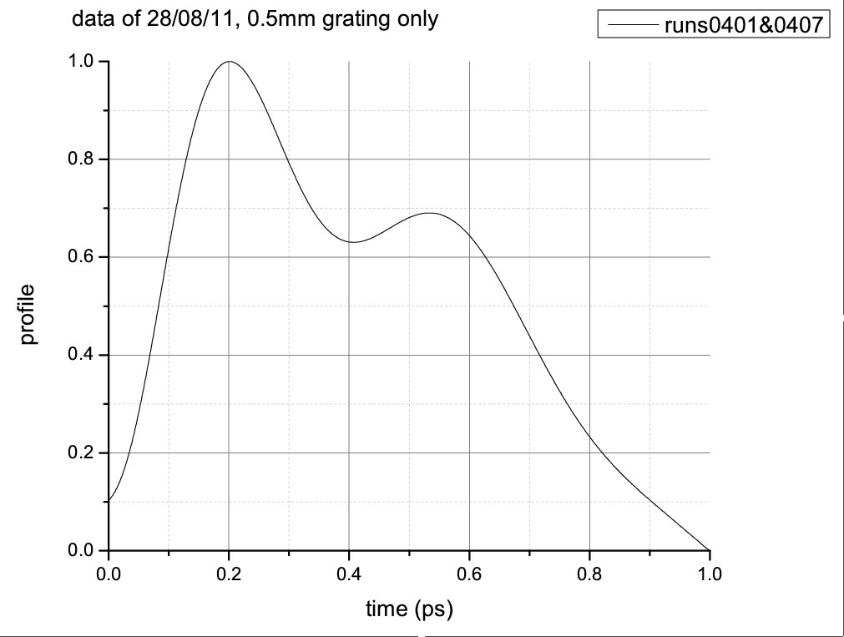
Very Preliminary Data
Reconstructed temporal profile (KK method)
Data Times
Grating – blank
04:01 – 04:07 : Pyro=585
FWHM
590 fs = 177 µm

Slide 20
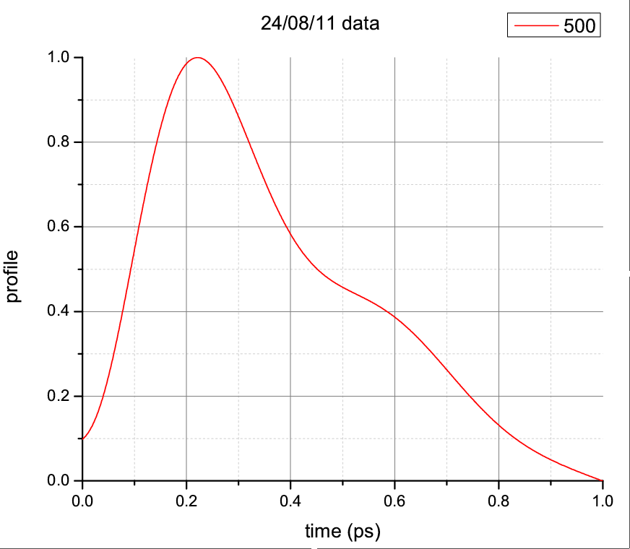
Very
Preliminary Data
pyro avg 1016.24 rms 19.4326
toro avg 1.60117e+10 rms 5.41115e+08
BPM3156_TMIT avg 3.03436e+10 rms 6.53761e+08
BPM3265_TMIT avg 1.77558e+10 rms 2.87037e+08
Reconstructed temporal profile (KK method)
Data Times:
01:36 – 01:31 = 250
01:52 – 01:29 = 50
02:21 – 01:32 = 500
FWHM
350 fs = 105 µm

Slide 21
Very Preliminary Data
FWHM
Pyro A007 reading | FWHM from SP spectrum
590 | 177 microns
1016 | 105 microns
1041 | 126 microns
1130 | 93 microns
Pyro Reading

Slide 22
Lessons from Commissioning (I)
About the apparatus
  Grating drive mechanism bent during transport (➔ lead screw lost lots of brass during operation, motor jammed)
  Cannot automatically determine which grating is in the beam (must check with filters in presence of beam) ➔ lost two shifts worth of data due to wrong grating choice
  DAQ process is very manual and labour intensive
    Grating position potentiometer not read automatically
    Filter position potentiometer not read automatically
    Relies a lot on correct log book taking and manual data set compilation
  50 micron grating produces no radiation ➔ bunches too long for this configuration
  A lot of IR background radiation in this section
  Guarded access worked very well for us

Slide 23
Lessons from Commissioning (II)
Analysis is complex:
  Difficult access and synchronise beam conditions data with experimental data
  Analysis has many steps
    Raw data association for apparatus status
    Raw data association with beam conditions
    Multitude of efficiencies and pass bands (windows, air, filters, cones, detectors, gratings, etc.)
    Multiple corrections of signal (bunch charge, bunch position, bunch transverse profile)
    Complex phase estimation algorithms

Slide 24
Wish list for FACET for user run (I)
Accelerator:
  much shorter bunches (15 microns FWHM)
  If bunches can not be that short need estimate of what is achievable so that we can tune our gratings and possibly change the 50 microns
  Stable operation over 30 min segments (enough to take two SP scans on a good day)
  If affordable reduction of IR backgrounds (absorptive coating on pipe segments, fewer windows, cupped windows, further away from apparatus, fewer foils)
  Reduced beam halo (was better during last shift)
  Stable transverse shape, preferably symmetric
  Ability to rapidly change bunch length over wide range with minimal changes in other beam conditions (15 – 150 microns)

Slide 25
Wish list for FACET for user run (II)
Instrumentation, operation, data handling:
  Reliable and calibrated beam data (BPM TMIT’s vary among themselves and from toroids)
  Clear written instructions which instruments give reliable data, how to access them and what their calibration is or how it can be found
  Toroid data should be available in EPICS and EPICS archive
  Access to EPICS archive from outside SLAC (so far only via facet-srv01)
  Users should not write their own beam data logging system. This should be central EPIC archive
  Access routines to EPICS archives from user code (not just from interactive tool such as FACET home)
  Beam profiles in LI20 taken under user control and archived

Slide 26
Wish list for FACET for user run (III)
Administration / Organisation
  Fix times for experimental runs very early (>3 months before the event, buy tickets arrange teaching)
  Keep experiments in short blocks of as few days as possible (minimise travel costs)
  Try to stick to 8h of data taking shifts per day (this is special for us as we are a very small group)
  Fix times for shifts in the blocks right at the start of each block (1 week planning) to allow stable shift patterns to evolve
  Coffee in B244

Slide 27
Resumee
This has been a remarkably useful and productive period for us
We learned a lot about our equipment and the facility
We got a lot of data even tough this was only a commissioning run
We are looking forward to the user run
Thanks a lot for having us !

