Slide 1
SLAC Accelerator Research and Introduction to SAREC
Tor Raubenheimer
FACET Users Meeting
August 29th - 30th, 2011

Slide 2
SLAC Accelerator Research
SLAC has a strong accelerator-based research program
SLAC accelerator research is key to the future of the laboratory
SLAC Accelerator R&D is focused on advancing operating facilities and next generation of HEP and BES accelerators
World-class research in Accelerator Science & Tech
High gradient acceleration: microwave structures, direct laser acceleration, plasma wakefield acceleration
High brightness sources: Beam physics and computing
Technology programs to translate research into operations
Laboratory has unique facilities
Experimental facilities for accelerator R&D
Technical support and fabrication capabilities to implement results
Notes:
2

Slide 3
SLAC Accelerator Research Experimental program Committee (SAREC)
Committee Members:
Andrei Seryi (Chair, JAI)
Uwe Bergmann (SLAC)
Eric Esarey (LBL)
Jie Gao (IHEP)
Kathy Harkay (ANL)
Carsten Hast (SLAC, Scientific Secretary)
Gerry Dugan (Cornell)
Sergei Nagaitsev (FNAL)
Vitaly Yakimenko (BNL)
Kaoru Yokoya (KEK)
Frank Zimmermann (CERN)
The charge to the SAREC committee is:
Evaluate the merit of proposed R&D in SLAC’s experimental accelerator research facilities for advancing world-class accelerator science or accelerator technology
Evaluate the feasibility of proposed R&D in SLAC’s accelerator research facilities
Review the progress of existing R&D in SLAC’s accelerator research facilities

Slide 4
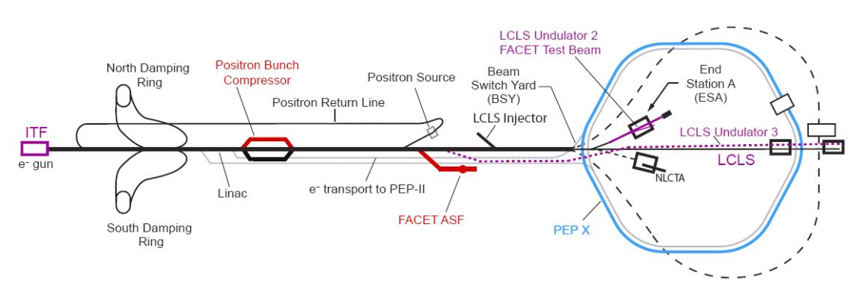
Experimental Accelerator R&D Facilities
Existing and upgraded accelerator R&D facilities
ASTA – rf test facility (50 MeV capability)
NLCTA – X-band linac (300 MeV capability)
End Station Test Beam – LCLS Linac (14 GeV)
FACET – SLAC Linac (23 GeV)
Range in capability is critical to support breadth of accelerator R&D
Developing integrated plan for future experimental studies
Also planning for a possible future Cathode Test Facility (CTF) and/or Injector Test Facility (ITF)
CTF would support high brightness source R&D and LCLS upgrades
ITF would support R&D on high brightness beam generation as well as beam manipulation
LCLS Undulator 2
End Station Test Beam
PossibleLCLS-III Injector
LCLS-II Injector
LCLS Expansion
FACET Experimental Region
Notes:
CTF at ASTA; ITF likely using the SLAC linac; ITF would support 2 GeV beam manipulation studies

Slide 5
BES-related Accelerator R&D
Three main programs:
LCLS operational support
Beam optics and modeling
FEL physics and collective effects
Cathode development program
LCLS-II design
Support for CDR
Injector design development
Development of seeding approaches
Accelerator R&D
Echo Enabled Harmonic Generation experiment (Echo-7)
Future R&D on rf guns and high brightness beam dynamics
Other radiation sources (THz, PEP-X, …)

Slide 6
HEP-related Accelerator R&D
Three main programs:
Accelerator research
Novel acceleration concepts (laser and plasma)
High gradient microwave research
Beam physics and computing
Accelerator development
Accelerator design for Super-B, CLIC, PEP-X, …
LHC support and LARP
X-band rf development
ILC (primarily SCRF power sources)
Small engagement in Muon Collider and Project-X

Slide 7
Novel & High Gradient Acceleration
Accelerators have been primary tool to advance HEP frontiers
But accelerators have continued to increase in size and cost and appear to be approaching the limit that can be supported
Need new approaches to particle acceleration
Many paths towards high gradient acceleration
RF source driven metallic structures
Beam-driven metallic structures
Laser-driven dielectric structures
Beam-driven dielectric structures
Laser-driven plasmas
Beam-driven plasmas
Major focus at SLAC with 4 approaches having different risks and timescales
FACET will enable research on the three beam-driven approaches
~100 MV/m
~1 GV/m
~10 GV/m

Slide 8
FACET Operation
FACET designed to operate for 4 months a year
Facility funding shared by BES and HEP
BES covers minimal maintenance and HEP covers operations
Developing bottom’s up estimate for FY11
Believe that 6M$ should cover 2 months operation & commissioning
Planning for 2 months operation starting in July, 2011
Efforts begin two months earlier with hardware check-out and fixes
Need to still understand longer-term staffing needs
Estimating FY12 costs for 4 months operation
Considering different operating scenarios: single or multiple blocks
Concerned that it will be difficult to support program on 6M$/year

Slide 9
Charge 1st SAREC Mtg (January, 2011)
There are currently 9 proposals and one letter of intent
Mixture of novel acceleration concepts, diagnostics development, materials research and radiation generation
The current round of FACET proposals should be evaluated as candidates for both the pre-CD4 commissioning run during the summer of 2011 and the first scheduled FACET run in 2012.
The summer 2011 run of user assisted commissioning will be roughly two months long but there will be limited access to the accelerator tunnel and FACET will likely operate with detuned beam parameters.
Having robust experiments will be important for first runs

Slide 10
Preliminary Charge 2nd SAREC Mtg (winter, 2012)
Progress of the current round of experiments should be evaluated in terms of efficient use of beamtime, scientific potential and benefit to the broader community
Propose improvements to experiments and FACET to advance the experimental program
The new round of FACET proposals should be evaluated as candidates for the next runs during 2012/2013.
The detailed run schedule has not yet been determined
Goal is to review proposals ~1 year in advance of running
The committee will also likely be asked to consider the experimental program at the NLCTA as it fills the full charge
Feedback on SAREC process would be appreciated

