Slide 1
Electromagnetic instabilities
and
Fermi acceleration
at ultra-relativistic shock waves
Martin Lemoine
Institut d’Astrophysique de Paris
CNRS, Université Pierre & Marie Curie
M. Lemoine, G. Pelletier, B. Revenu, 2006, ApJ 645, L129
G. Pelletier, A. Marcowith, M. Lemoine, 2009, MNRAS 393, 587
M. Lemoine & G. Pelletier, arXiv:0904.2657

Slide 2
Fermi acceleration at ultra-relativistic shock waves
e.g. Bednarz & Ostrowski 98; Gallant & Achterberg 99; Kirk et al. 00; Achterberg et al. 01; M. L. & Pelletier 03; Ellison & Double 04, Keshet & Waxman 05; Niemiec & Ostrowski 05; Niemiec et al. 06; M.L. et al. 06, Spitkovsky 08
A crucial difference with non-relativistic shock waves: ¯_{sh}» 1
z
particle upstream
light cone
ultra-relavistic shock wave is always
trailing right behind the ultra-relativistic particle…
Γ_{sh} = 100 ) β_{sh} = 0.99995...
particle
downstream
z = v_{sh} t
shock front
Consequences:
time
no spatial diffusion: particle cannot turn around upstream, it is overtaken by the
shock front on timescale r_{L}/¡_{sh}c
) energy gain ¢E/E » 1 (except at 1st cycle) Gallant & Achterberg 99
) growth of instabilities strongly inhibited by advection Milosavljevic & Nakar 06
downstream: advected away from the shock at speed c/3 ) large escape probability
superluminal nature and anisotropy: shock wave is superluminal unless £_{B} < 1/¡_{sh}
) Fermi acceleration inhibited in generic conditions (Begelman & Kirk 90,
Niemiec, Ostrowski & Pohl 06, M.L., Pelletier, Revenu 06)
) efficiency and spectral index?

Slide 3
Inhibition of Fermi acceleration
Superluminal effects:
assume r_{L} ¿ ¸_{B} , ¸_{B} coherence length of magnetic turbulence
(in GRB external shocks on ISM: r_{L,min} . 0.1 pc, ¸_{B} » 10-100 pc)
solve trajectory up to 1st order in field line curvature: the particle cannot undergo
more than 1.5 Fermi cyle : up ! down ! up ! down, it is advected away
B (upstream)
z
B (downstream)
y
shock front
x
) Fermi acceleration requires parallel shock waves or a magnetic field that is
strongly amplified on small spatial scales ¿ r_{L}
in agreement with Monte Carlo simulations of Niemiec, Ostrowski & Pohl 06
GRB afterglows: synchrotron from e⁻ accelerated at external shock with Γ_{sh} = 300 ! 1
requires downstream amplification of ISM magnetic field by 4 orders of magnitude
X-ray afterglow also requires amplification of upstream magnetic field by
2 orders of magnitude (Li & Waxman 2006)
... a connection between theory and observations … ?

Slide 4
Fermi acceleration and small scale turbulence
Conditions for successul Fermi acceleration at ultra-relativistic shock waves:
assume both large scale (coherence length ¸_{B}) and small scale (¸_{± B}) homogeneous
isotropic turbulence
Fermi acceleration can occur if noise associated with motion in the small scale turbulent
magnetic field overcomes the unperturbed trajectory in the large scale coherent
magnetic field:
) restricted range of Larmor radii:
upstream
downstream
or
turbulence on
small scales
º _{scatt,± B} / r_{L}⁻² (inefficient scattering
at large r_{L} in short scale turbulence)
allows to explain results of Monte Carlo simulations of Niemiec, Ostrowski & Pohl 06
Implications:
in terms of magnetisation: if »_{e.m.} of shock energy is transferred to short scale
electromagnetic fields,

Slide 5
Origin of small scale electromagnetic fluctuations
Two stream instabilities :
n
incoming upstream
beam
downstream
precursor
upstream
amplification of the upstream field can occur through the interaction of shock reflected
and shock accelerated particles with the upstream plasma:
a unidirectional unmagnetized beam of Lorentz factor ¡ _{sh}²
main limitation: advection, as the distance between the shock front and the particles
l » l_{u} / ¡ _{sh}² with l_{u} length traveled upstream (» r_{L}/¡ _{sh} if there is a background field)
MHD regime: Bell non-resonant instability, in parallel configuration
(Milosavljevic & Nakar 06, Reville, Kirk & Duffy 07, Riquelme & Spitkovsky 09)
or oblique configuration (Pelletier, M.L., Marcowith, 09)
smaller scales: various instabilities (Bret 09); dominant modes in ultra-relativistic regime:
Weibel/filamentation (Lyubarsky & Eichler 06, Wiersma & Achterberg 04, 07, 08;
Medvedev & Zakutnyaya 08, M. L. & Pelletier 09)
Cerenkov resonance with proper plasma modes:
oblique two stream !_{p} = k_{x} v_{beam} (unmagnetized approximation)
Whistler waves !_{Wh} = k_{x} v_{beam}

Slide 6
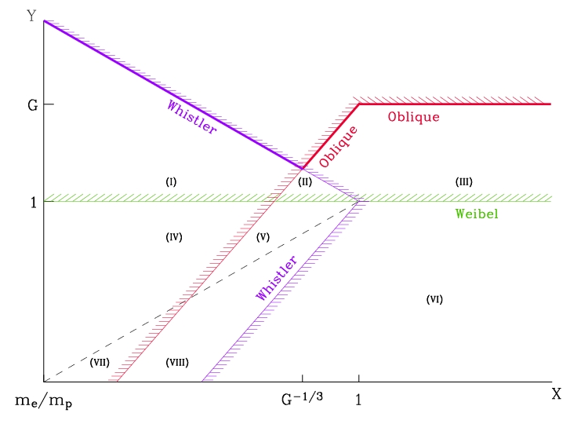
Micro-instabilities at relativistic shock waves
large magnetisation
) short precursor
) no growth
Sironi & Spitkovsky 09
(pair shock, ¡_{sh} ' 20,
no growth at ¾_{u} > 0.03)
¡_{sh}² ¾_{u} »_{cr}⁻¹
pulsar winds
G = »_{cr} ^{-1/3} (m_{e}/m_{p})^{-1/3}
GRB ext. shock
in W-R wind
Oblique:
Im(!) = (!_{p,b}² !_{p})^{1/3}
Whistler mode
dominant
oblique mode
dominant
Whistler:
Im(!) = (!_{p,b}² !_{Wh})^{1/3}
Weibel:
GRB ext. shock
in ISM
Im(!) = !_{p,b}
¡_{sh} m_{e}/m_{p}
Note: instabilities are generated upstream but the wave velocities < ¯_{sh}, therefore the waves
are transmitted downstream (transmission?)

Slide 7
Discussion & Summary
Fermi acceleration may occur in (generic) oblique configurations at ultra-relativistic shock
waves provided the magnetisation is small enough so that small scale instabilities can
develop
if waves can develop , one also needs to satisfy the following in order for Fermi
acceleration to be operative:
(A)
(B)
if (A) holds, scattering is governed by short scale turbulence upstream and downstream
if (B) holds (e.g. GRB external shock on ISM), scattering occurs in large scale field upstream,
and short scale turbulence downstream
as Fermi cycles develop, higher energy particles can stream farther ahead and provide
more amplification (e.g. Keshet, Spitkovsky, Waxman 09)
PIC simulations need to reach low magnetisation regime in order to probe the limit
between Fermi / no Fermi and study transmission of electromagnetic modes to
downstream
note: no generic limit of magnetised vs non-magnetised shock wave: for ex., oblique
mode can be efficiently excited (unmagnetized limit) but scattering may take place
in the background magnetic field upstream...

