Slide 1
Search for neutrino point sources with the IceCube Neutrino Observatory
Juan Antonio Aguilar
University of Madison
for the IceCube collaboration
Menlo Park, California TeVPA 2009
IceCube 40
Point Source Analysis
Results
Conclusions

Slide 2
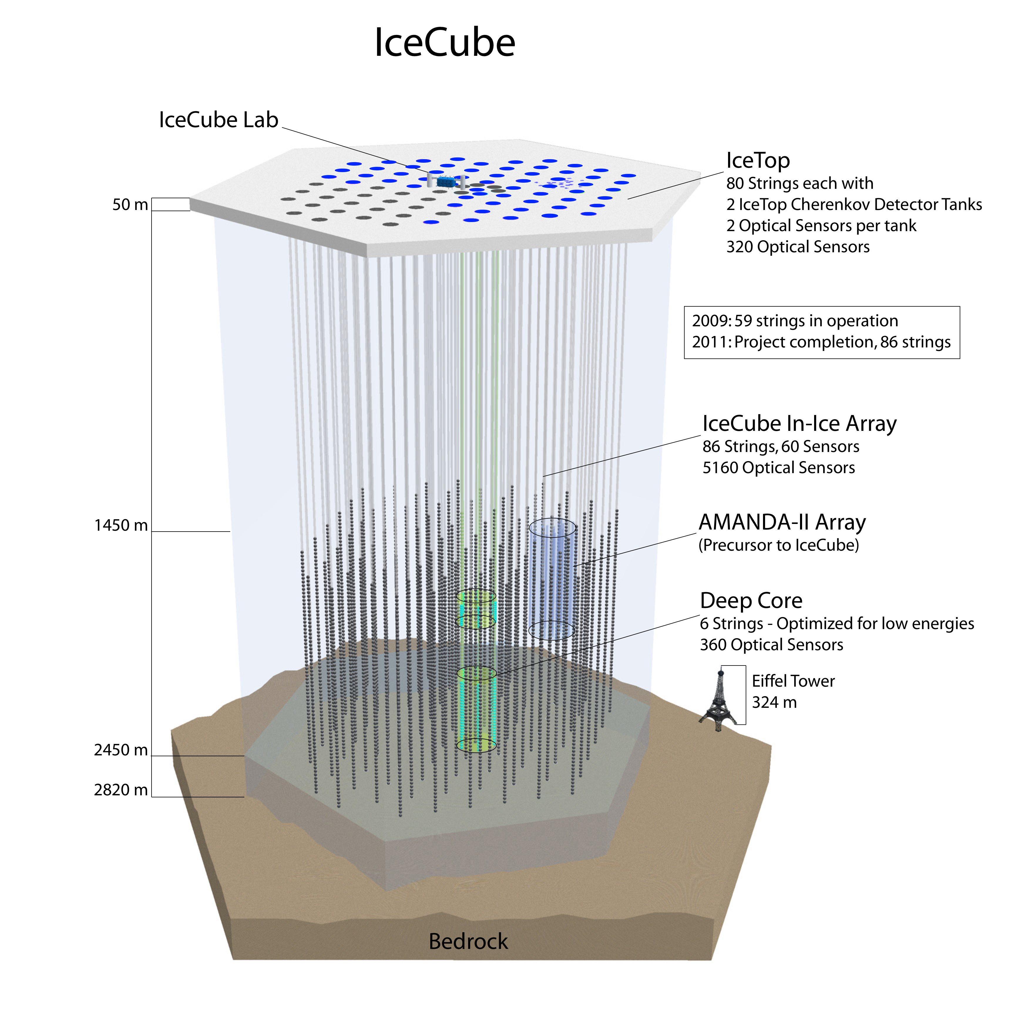
IceCube 40-string configuration
IceCube 80
Completion with 80 (+ 6) strings by January 2011
IceCube 59 (2009)
IceCube currently running with 59 strings deployed
IceCube 40 (2008-9)
IC-40 has approx. 2 x effective area of the previous IC-22
First half (~6 months) of IC40 data has been analyzed for point sources.
IceCube 40
Point Source Analysis
Results
Conclusions

Slide 3
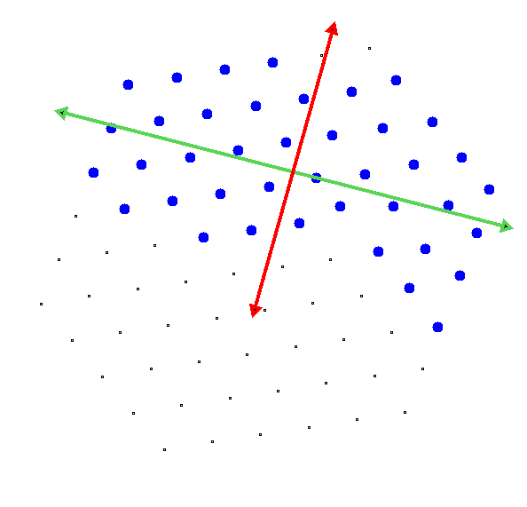
IceCube 40-string layout
Top view
IceCube 40:
More fully contained strings than in IC22.
Short direction: angular resolution comparable to IceCube 22.
Long direction: angular resolution comparable to full IceCube 80 configuration.
Long Direction
Short Direction
IceCube 40
Point Source Analysis
Results
Conclusions

Slide 4
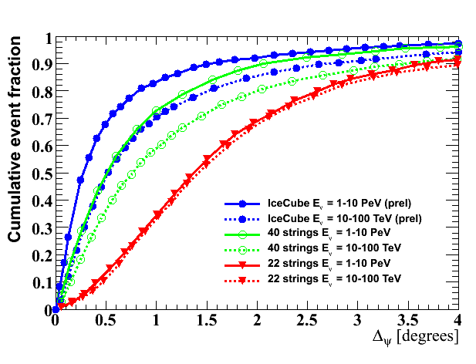
Angular Resolution
Cumulative distribution of the Point Spread Function for different IceCube configurations.
50% angular resolution
The main improvement wrt to the IC22 configuration is the different track reconstruction algorithm.
IceCube 40
Point Source Analysis
Results
Conclusions

Slide 5
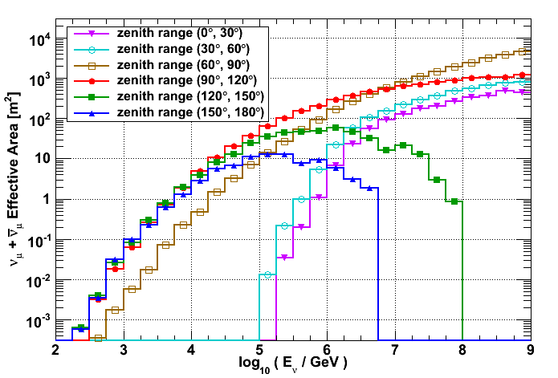
Effective area
Solid-angle averaged neutrino effective area for reconstructed events in 2 degrees.
The smaller the zenith, the more sensitive to higher energies.
0-30
30-60
South Pole
60-90
120-90
159-120
180-150
IceCube 40
Point Source Analysis
Results
Conclusions

Slide 6
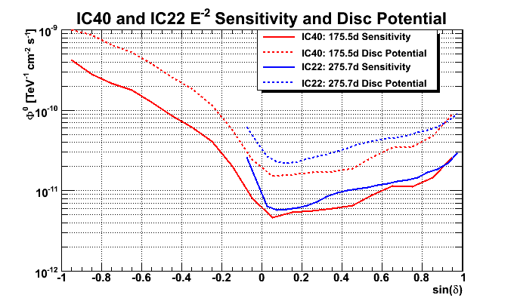
Sensitivity and Discovery Potential
Preliminary
Factor of 1.1in sensitivity
Factor of 1.5 in discovery potential
- A comparison to the IC22 point source analysis
- IC40 with only 6 months is already a slight improvement over IC22
IceCube 40
Point Source Analysis
Results
Conclusions

Slide 7
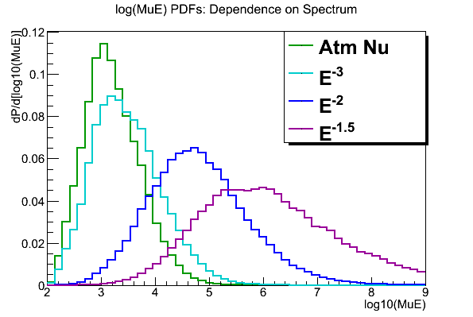
Likelihood and Density Functions
Likelihood:
Signal pdf:
Background pdf:
Taken from real data.
Likelihood ratio:
A final significance is evaluated by scrambling the data in r.a. and repeating the analysis.
IceCube 40
Point Source Analysis
Results
Conclusions

Slide 8
IC40 Data Set
IC40 data from July to December 2008:
6 months of IC40 have been analyzed (six remaining months still to be analyzed).
175.5 days livetime (98%) after selecting good runs.
The likelihood analysis has been applied in both the northern and southern sky. (Two different regimes):
Two different set of cuts to discriminate the background for the upgoing events and the downgoing events (see next slide).
17777 events after cuts.
Perform a point source search using:
List of 39 a priori source candidates.
All sky search form -85° to +85° declination.
IceCube 40
Point Source Analysis
Results
Conclusions

Slide 9
Background
Northern sky (upgoing events):
Earth is used as a filter for atmospheric muons.
Atmospheric neutrinos-induced muons upgoing events.
Quality cuts reject the misreconstructed muon background.
PS search is sensitive over a large range in energy, >~TeV
Southern sky (downgoing events):
Large amount of downgoing atmospheric muons background.
Cuts based on energy cuts to reject muon background.
PS search is primarily sensitive to a neutrino signals >~PeV
Flux of atmospheric muons and neutrinos at a depth of IceCube:
Atmospheric
Neutrinos
Downgoing muons
Northern Sky
Southern Sky
IceCube 40
Point Source Analysis
Results
Conclusions

Slide 10
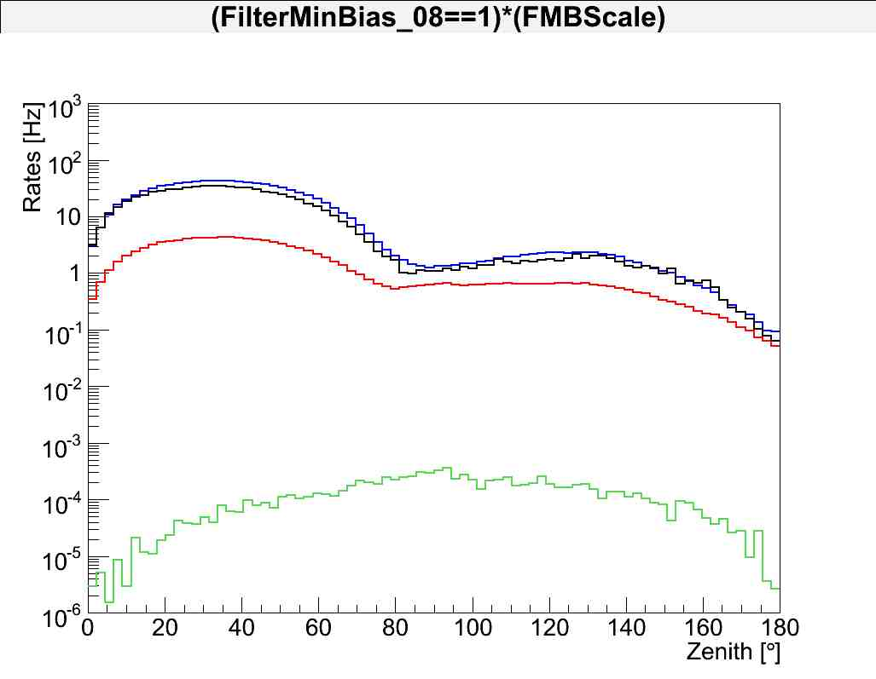
Background Rejection Cuts.
Trigger level
A rate of 929 Hz at trigger level mainly due to atmospheric muons.
Final cut level
Final cut level
After the final cut level 17777 events remain in the sample:
6796 in the Northern sky (Zenith > 90°)
10981 in the Southern sky (Zenith < 90°)
IceCube 40
Point Source Analysis
Results
Conclusions

Slide 11
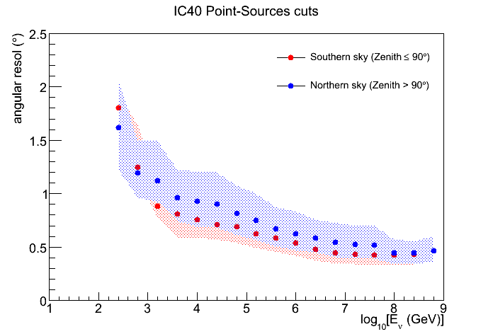
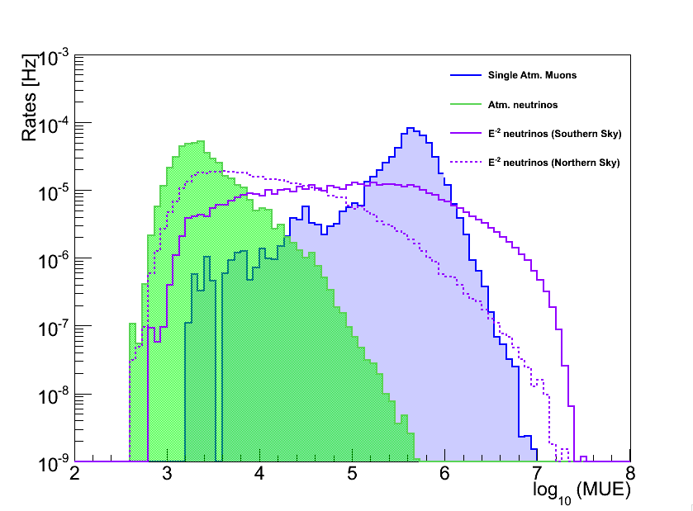
Final cut level:
Northern sky
Southern sky
The Southern sky (downgoing events) has a better angular resolution due to the strong cut requirement. Also the energy range of downgoing events (mostly atmospheric muons) is higher than the energy range of upgoing atmospheric neutrinos.
IceCube 40
Point Source Analysis
Results
Conclusions

Slide 12
Differential Discovery Potentials
Arbitrary Scaling (E² dϕ/dE)
δ = +30°
δ = +60°
δ = +6°
Northern sky
40-string Differential 5σ Discovery Potentials
Northern Sky
IceCube 40
Point Source Analysis
Results
Conclusions

Slide 13
Differential Discovery Potentials
Arbitrary Scaling (E² dϕ/dE)
δ = +30°
δ = -8°
δ = -30°
δ = -60°
δ = +60°
δ = +6°
Northern sky
Southern sky
40-string Differential 5σ Discovery Potentials
Northern and Southern Sky
IceCube 40
Point Source Analysis
Results
Conclusions

Slide 14
Last year: 22-string all-sky results
+75°
+60°
+45°
Atm. neutrinos
-log₁₀ p
+30°
+15°
24h
Hottest spot found at r.a. 153.4° , dec. 11.4°
Post-trials p-value of analysis is ~ 1.34% (2.2 sigma)
Paper accepted by ApJL http://arxiv.org/abs/0905.2253
IceCube 40
Point Source Analysis
Results
Conclusions
Juan A. Aguilar

Slide 15
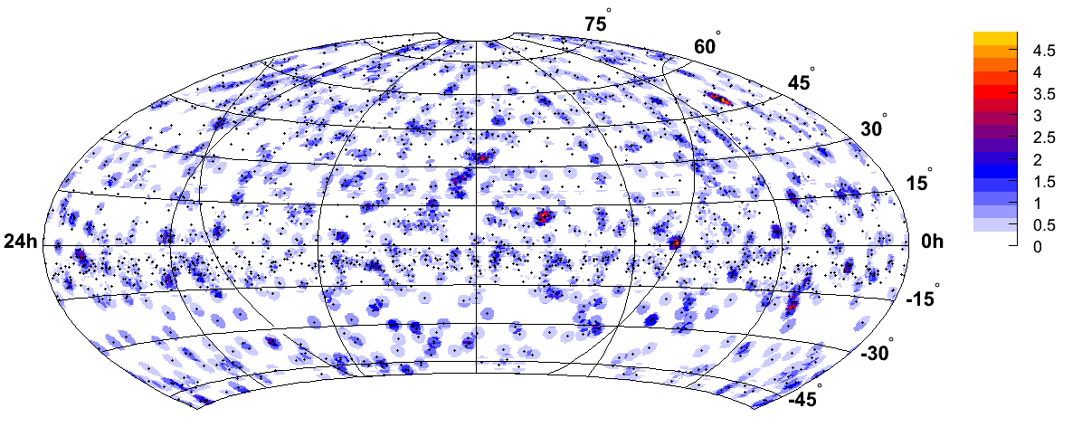
Last year: 22-string all-sky results
+75°
+60°
+45°
Atm. neutrinos
-log₁₀ p
+30°
+15°
24h
0h
-15°
Atm. muons
-log₁₀ p
-30°
-45°
Analysis extended to -50° dec
First IceCube search for point sources above the horizon optimized for higher energies
R. Lauer,
Heidelberg Workshop, Jan09
arXiv:0903.5434
IceCube 40
Point Source Analysis
Results
Conclusions
Juan A. Aguilar

Slide 16
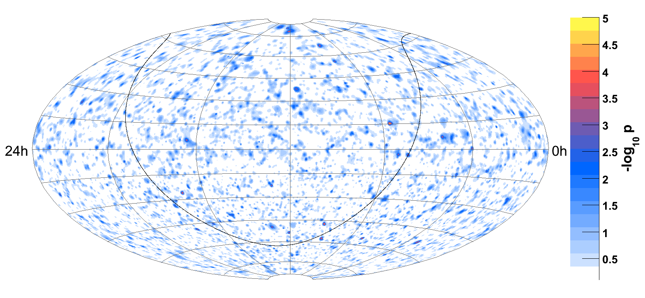
Results for IC40: All sky
Atm. neutrinos
Atm. muons
IceCube 40
Point Source Analysis
Results
Conclusions

Slide 17
Results for IC40: All sky
Hottest location in the all-sky search is: r.a.=114.95°, dec.=15.35°
Pre-trial -log₁₀(p-value) = 4.43
Atm. neutrinos
Atm. muons
IceCube 40
Point Source Analysis
Results
Conclusions

Slide 18
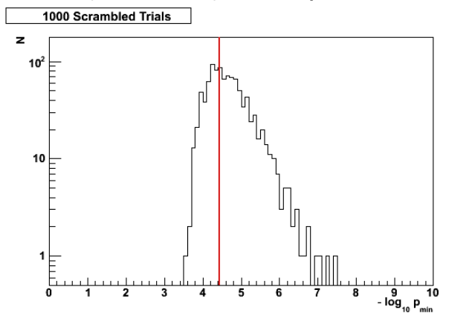
Results: All sky
The distribution of results for 1000 scrambled skymaps.
611 out of 1000 scrambled experiments had a p-value lower than that of the data (61%).
All-sky p-value = 61%
Number of trials
IceCube 40
Point Source Analysis
Results
Conclusions

Slide 19
Results: All sky
The distribution of results for 1000 scrambled skymaps.
611 out of 1000 scrambled experiments had a p-value lower than that of the data (61%).
All-sky p-value = 61%
No excess found!
Number of trials
IceCube 40
Point Source Analysis
Results
Conclusions

Slide 20
Results: Source list (Northen sky)
Source Name
Cyg_OB2
MGRO_J2019+37
MGRO_J1908+06
Cas_A
IC443
Geminga
Crab_Nebula
1ES_1959+650
1ES_2344+514
3C66A
H_1426+428
BL_Lac
Mrk_501
Mrk_421
W_Comae
1ES_0229+200
M87
S5_0716+71
M82
3C_123.0
3C_454.3
4C_38.41
PKS_0235+164
PKS_0528+134
PKS_1502+106
3C_273
NGC_1275
Cyg_A
IC-22_maximum
Ra , Dec (deg)
(308.083, 41.510) :
(305.220, 36.830) :
(286.976, 6.269) :
(350.850, 58.815) :
( 94.179, 22.529) :
( 98.476, 17.770) :
( 83.633, 22.014) :
(299.999, 65.149) :
(356.770, 51.705) :
( 35.673, 43.043) :
(217.136, 42.672) :
(330.680, 42.278) :
(253.468, 39.760) :
(166.114, 38.209) :
(185.382, 28.233) :
( 38.202, 20.287) :
(187.706, 12.391) :
(110.473, 71.343) :
(148.967, 69.680) :
( 69.268, 29.671) :
(343.491, 16.148) :
(248.815, 38.135) :
( 39.660, 16.620) :
( 82.735, 13.532) :
(226.104, 10.494) :
(187.278, 2.052) :
( 49.951, 41.512) :
(299.868, 40.734) :
(153.375, 11.375) :
p-value
0.47834
---
---
---
---
---
---
---
---
0.36423
---
---
0.42203
0.32724
---
0.34695
---
---
---
---
---
0.47002
---
---
0.27947
---
---
---
---
Northern Sky Sources:
P-values ≥ 0.5 (under-fluctuations) are given as “---”
Probability of 27 under-fluctuations in 39 sources is 10%
22-string hottest spot is now a under-fluctuation
IceCube 40
Point Source Analysis
Results
Conclusions

Slide 21
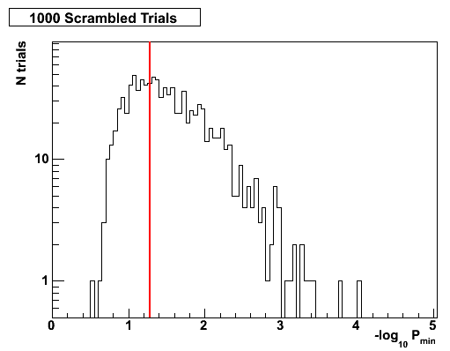
Results: Source list (Southern sky)
Southern Sky Sources:
Source Name
Sgr_A*
PKS_0537-441
Cen_A
PKS_1454-354
PKS_2155-304
PKS_1622-297
QSO_1730-130
PKS_1406-076
QSO_2022-077
3C279
Ra , Dec (deg)
(266.417, -29.008) :
( 84.710, -44.086) :
(201.365, -43.019) :
(224.361, -35.653) :
(329.717, -30.225) :
(246.525, -29.857) :
(263.261, -13.08) :
(212.235, -7.874) :
(306.420, -7.640) :
(194.050, -5.790) :
p-value
0.50000
---
0.34066
---
0.20422
0.05233
0.25087
---
---
---
Highest significance from list of 39 sources comes from PKS 1622-297
p-value = 62%
Pretrial p-value of 5.2% or less for any of the 39 sources happens in 618/1000 scrambled skymaps
Source list final p-value is 62%, not significant
Number of trials
IceCube 40
Point Source Analysis
Results
Conclusions

Slide 22
Results: Source list (Southern sky)
Southern Sky Sources:
Source Name
Sgr_A*
PKS_0537-441
Cen_A
PKS_1454-354
PKS_2155-304
PKS_1622-297
QSO_1730-130
PKS_1406-076
QSO_2022-077
3C279
Ra , Dec (deg)
(266.417, -29.008) :
( 84.710, -44.086) :
(201.365, -43.019) :
(224.361, -35.653) :
(329.717, -30.225) :
(246.525, -29.857) :
(263.261, -13.08) :
(212.235, -7.874) :
(306.420, -7.640) :
(194.050, -5.790) :
p-value
0.50000
---
0.34066
---
0.20422
0.05233
0.25087
---
---
---
Highest significance from list of 39 sources comes from PKS 1622-297
p-value = 62%
Pretrial p-value of 5.2% or less for any of the 39 sources happens in 618/1000 scrambled skymaps
Source list final p-value is 62%, not significant
No excess found!
Number of trials
IceCube 40
Point Source Analysis
Results
Conclusions

Slide 23
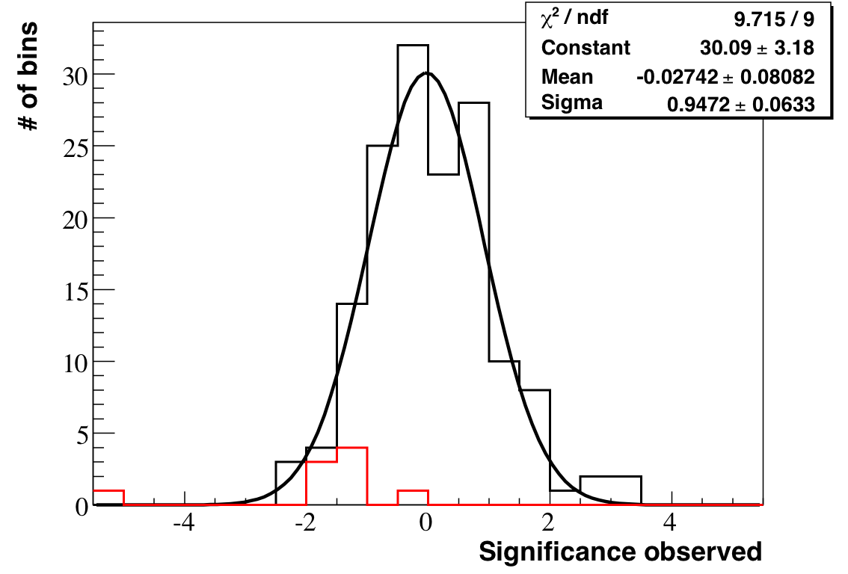
IC40 results of the moon shadow
Cosmic rays blocked by the moon lead to a point-like deficit in the distribution of down-going muons in the detector.
Lee & Ma significance
Moon shadow observed as a deficit in CR muon rate using 8 months of IC40 data.
Deficit of 5σ (~900 events of ~28000) consistent with expectation.
Important verification of angular resolution and absolute pointing.
IceCube 40
Point Source Analysis
Results
Conclusions

Slide 24
IC40 results of the moon shadow
Cosmic rays blocked by the moon lead to a point-like deficit in the distribution of down-going muons in the detector.
Lee & Ma significance
Moon shadow observed as a deficit in CR muon rate using 8 months of IC40 data.
Deficit of 5σ (~900 events of ~28000) consistent with expectation.
Important verification of angular resolution and absolute pointing.
IceCube 40
Point Source Analysis
Results
Conclusions

Slide 25
Summary and conclusions
The 40-string configuration of IceCube recently finished taking ~1 yr of data
A search for point sources of neutrinos over the entire sky was developed and unblinded using 6 months of the data.
No evidence is found for a point source signal in these 6 months.
Analysis of the first half of the IC40 dataset already provides better neutrino limits than IC22.
Remainder of the data will be unblinded in the coming months providing a factor 2 improvement on the IC22 sensitivity.
The moon shadow has been observed (5σ) with 8 months of IC40. Higher statistics will make possible to measure the angular resolution.
IceCube now has 59 strings of the planned 86 strings deployed and taking data.
IceCube 40
Point Source Analysis
Results
Conclusions

Slide 26
Backup slides

Slide 27
Model Sensitivities
Preliminary
MGRO J1852+01 at dec = +0.5° E⁻²up to 40 TeV
Gonzalez-Garcia, Halzen, Mohapatra, arXiv:0902.1176 discovery x 21, exclusion x 6
IceCube 40
Point Source Analysis
Results
Conclusions

Slide 28
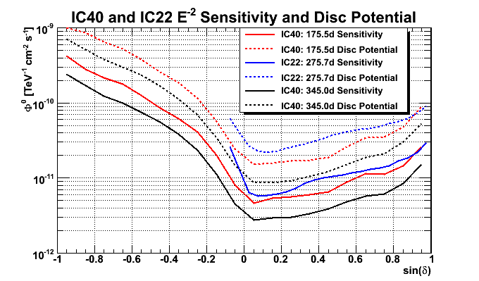
Sensitivity and Disc Potential
Preliminary
- There will still be a substantial improvement when the remainder of the 40-string dataset is added

Slide 29
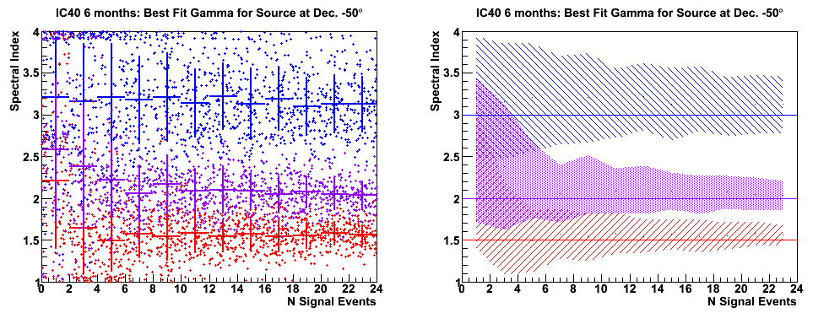
Spectral index study

Slide 30
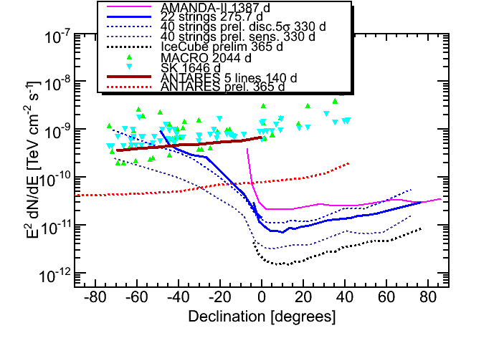
E⁻² Sensitivity: Past, Present, Future
Preliminary
40-string Discovery Potential: 5σ in 50% of trials
SK
MACRO
IC22
40-string Sensitivity: Flux excluded at 90%cl
AMANDA-II 7 yr
arXiv:0809.1646
ANTARES
80-string Sensitivity:
Based on 40-string analysis
IceCube 40
Point Source Analysis
Results
Conclusions

Slide 31
Effective area
Solid-angle averaged neutrino effective area for reconstructed events in 2 degrees.
The smaller the zenith, the more sensitive to higher energies.
IceCube 40
Point Source Analysis
Results
Conclusions

Slide 32
