Slide 1
Time-resolved x-ray scattering from phonons
David A. Reis
PULSE Institute
SLAC National Accelerator Laboratory
Depts. Photon Science and Applied Physics
Stanford University

Slide 2
what are phonons
Quantized Normal vibrational modes of a harmonic crystal (analogous to photons).
In 3D, 3nN modes for N units cells of n atoms.
Only 3n per allowed wavevector (wavelength)
Details depend on structure/symmetry and nature of forces.
Couple to electrons, other phonons, …

Slide 3
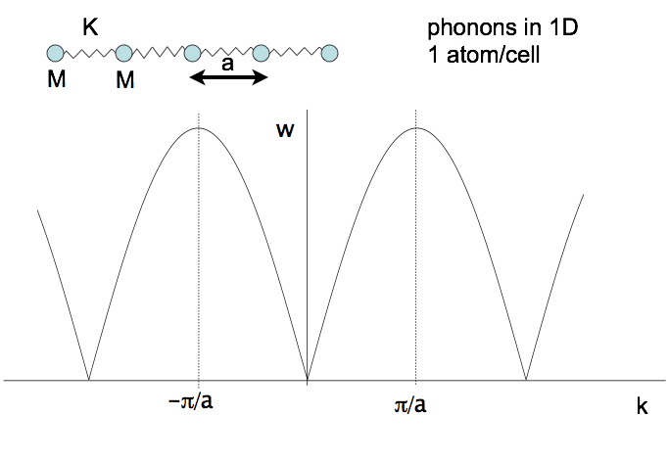
What are phonons?
Nearest neighbor forces

Slide 4
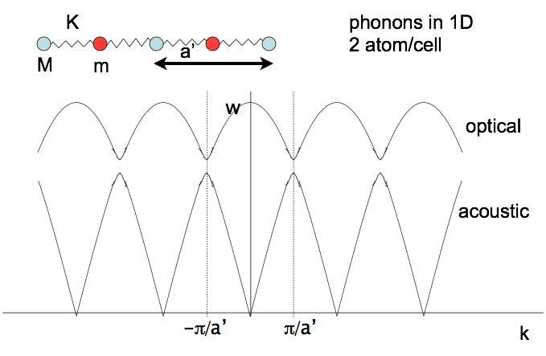
What are phonons?
Note only need –π/a – π/a to uniquely determine (Brillouin Zone). Quiz: Why?

Slide 5


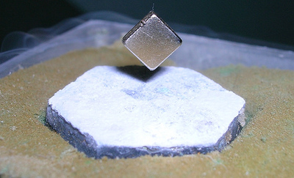
phonons play defining role in materials properties
Thermoelectrics
Photovoltaics
Superconducttors…
their structure and dynamics…and their limitations
Phonon spectroscopy especially challenging for short wavelength, low energies, and for anharmonic coupling
Notes:
Thermal transport in nanostructures, phonons are relevant in nanoscale heat conduction, in particular, little is known in the regime where the structures are the size of the phonon mean free path
Acoustic phonon engineering: constructing heterostructures to control high frequency acoustic waves similar to what is done with light has attracted much attention
In Ferroelectrics the polarization appears due to a displacement of charges in the unit cell. P is coupled with phonons , can lead to interesting physics and possibility of controlling P
Superconductivity. In BCS (conventional) phonons give electrons an effective attractive interaction. Not clear whether this is the case in high-Tc.
Other complex materials have strong interactions between phonons, charge and spin degrees of freedom with interesting physics. Particularly this coupling is evident when a particular phonon mode softens to zero leading to a static distortion of the lattice (CDW).

Slide 6
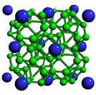
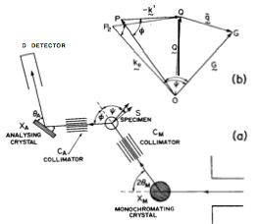
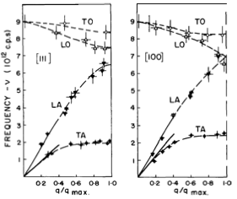

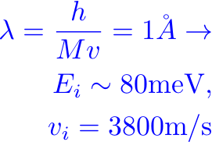


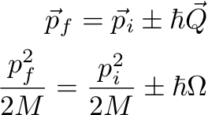
Inelastic neutron scattering from phonons

Slide 7
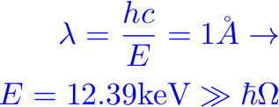

Quiz
Why is it hard to do with x rays?
…still it’s possible

Slide 8
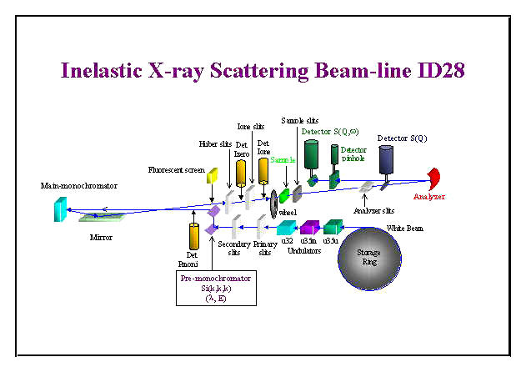
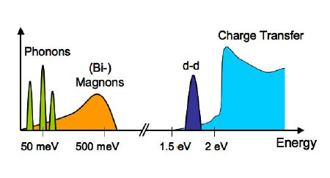
Inelastic x-ray scattering from phonons
Some advantages,
small crystals (high/low T, high P, films...)
Q determined by geometry (and good resolution)
energy res. ~meV
Compatible with low v-sound systems
Challenges,
still just meV resolution comparable to INS
low throughput (as is INS)
scaling to ultrafast and nonequilibrium?

Slide 9
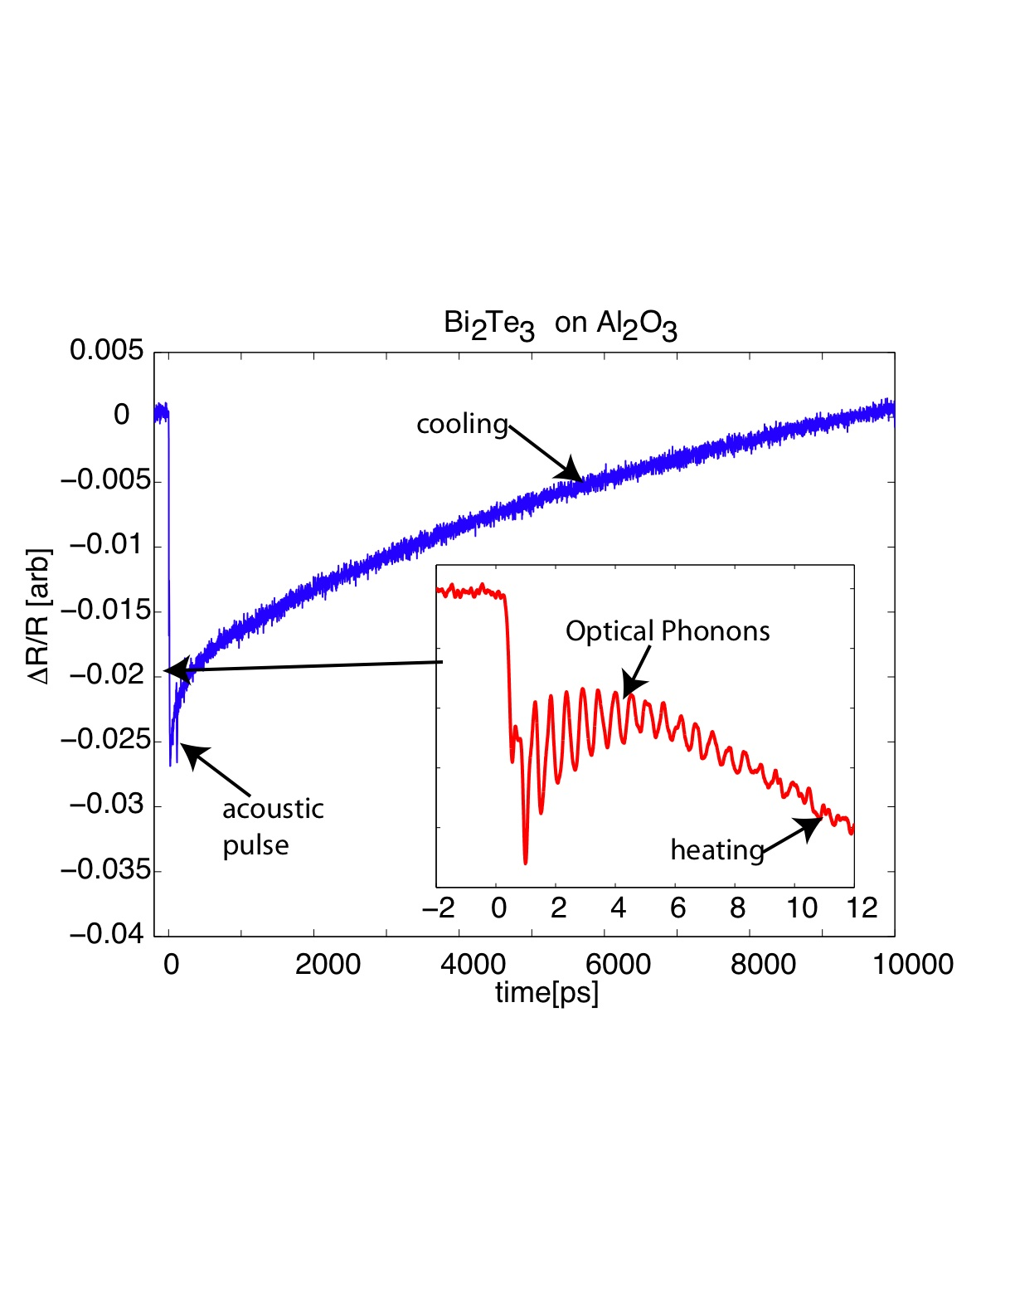

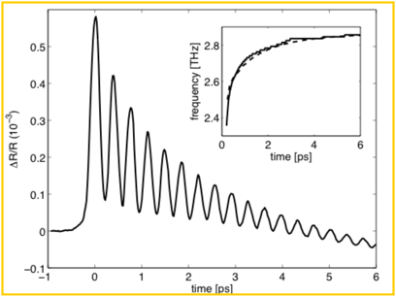
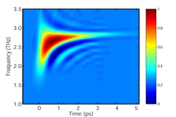

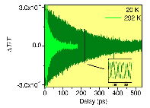
Advantages of time-domain
…separation of time-scales
…sometimes just plain resolution!
Sheu et al. unpublished
…Excited State Dynamics
f=(2.9787 ± 0.0002) THz
1/Γ= (211 ± 7) ps @ 5K
a
a
a
Murray et al. PRB 72, 060301 (R) 2005.
C. Aku-Leh, et al. PRB 71, 205211 (2005)
Notes:
-(222) reflection time-resolved diffracted intensity measured following photoexcitation at 515 nm, 1.28 MHz.
-Important material as a thermoelectric – exhibits topological insulator behavior…

Slide 10
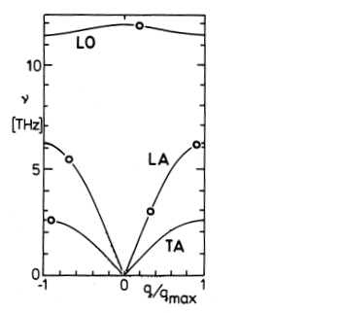
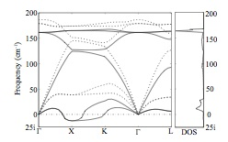
Time- and momentum-resolved phonon spectroscopies
n(q,t)
ω(q,t)
Unobserved!
…would allow investigations of phonon-phonon and electron-phonon coupling, evolution of interatomic forces, phase transitions...
Notes:
Take home message, these type of measurements can only be done with x-rays.

Slide 11
Quiz
Why do x rays “see” phonons?
i.e. from where do they scatter?
And what should it look like…

Slide 12



The Scattering vector
Note we pick up a phase factor in the scattered field
While this phase cancels out in the intensity for a single electron, it is critical to keep track for the coherent scattering from many electrons

Slide 13
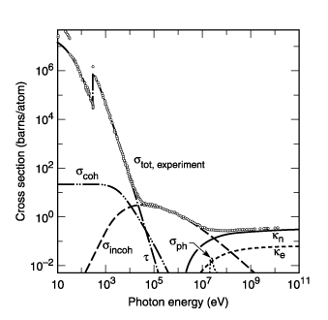


Scattering cross-sections
Fig. 3-1. Total photon cross section in carbon, as a function of energy, showing the contributions of different processes: τ, atomic photo-effect (electron ejection, photon absorption); σ_{coh} , coherent scattering (Rayleigh scattering—atom neither ionized nor excited); , σ_{incoh}incoherent scattering (Compton scattering off an electron); κ_{n}, pair production, nuclear field; κ_{e} , pair production, electron field; , σ_{ph} photonuclear absorption (nuclear absorption, usually followed by emission of a neutron or other particle). (From Ref. 3; figure courtesy of J. H. Hubbell.)
adapted from xdb.lbl.gov/

Slide 14




X-ray scattering and structure
k-k₀
k
k₀
Scattered Field is 3D Fourier
Transform* of charge density!
(far from resonance)
r
origin
*of course, don’t measure E but |E|²

Slide 15
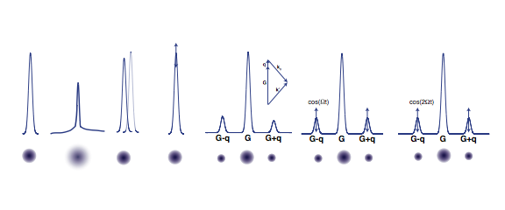
Bragg
Thermal
Debye-
Waller
Lattice
Expansion
Coherent
Phonon
(zone-
Center)
Incoherent
Phonons
(diffuse at
Particular q)
Coherent
Phonon
sidebands
Squeezed
Phonon
sidebands

Slide 16
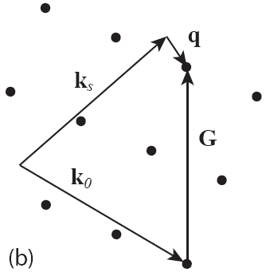
Phase matching

Slide 17
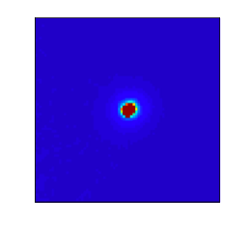
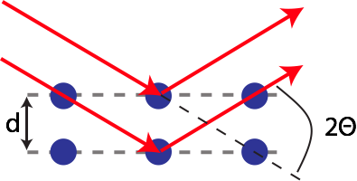
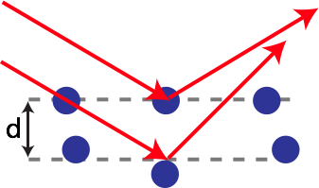
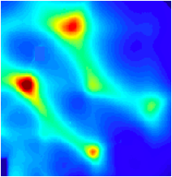
X-ray scattering
Bragg Scattering
Bragg peak
strong peak in
defined direction
Diffuse Scattering
weak signal
“in between” Bragg peaks
(in reciprocal space)
need high-brilliant X-ray source, but can use parallel detection

Slide 18
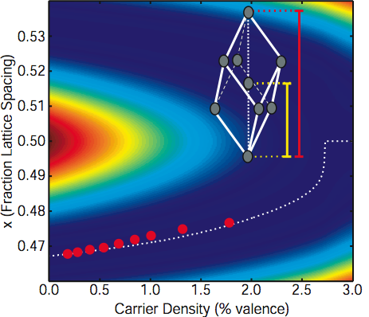
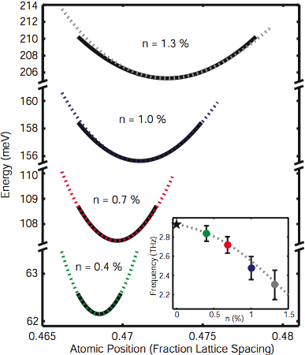
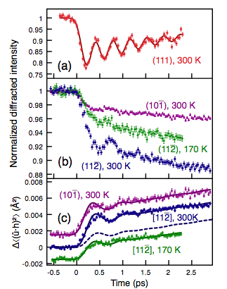
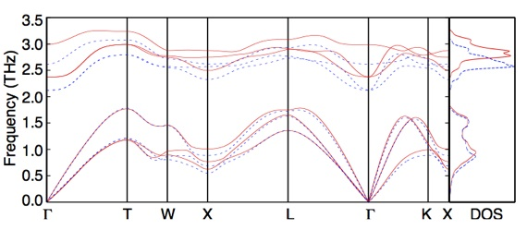
Electronic softening in photoexcited bismuth: fs x-ray diffraction
D. M. Fritz et al. Science 315, 2007.
DFPT calculation
0% e-
}
Optical
Modes
1% e-
?
}
Johnson et al. PRL 2009.
Acoustic
Modes
Murray et al. PRB 75 2007.

Slide 19
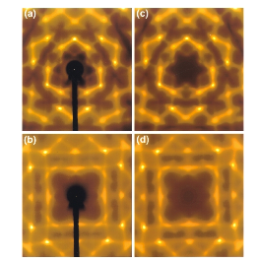
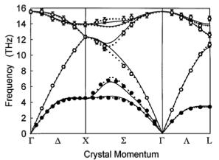

Phonon Dispersion from TDS and limitations
?
2d
x-ray
Joynson, Phys. Rev. 94, 851 (1954)…
…M. Holt et al., PRL 83, 1999.
TDS: Limited to simple cases (# fit parameters low) and have a constraint (assumes Bose-Einstein distribution)
Notes:
Need Q-info Can we do with diffuse scattering. TDS limits. Coherence & Speckle @ LCLS. Will show for nonequilibrium can see in just time-domain.

Slide 20
Quiz
What will time-domain give us? And what are its limitations.

Slide 21
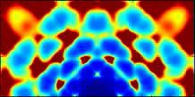
Simulation of InP impulse softening of TA by 20%
Movie

Slide 22
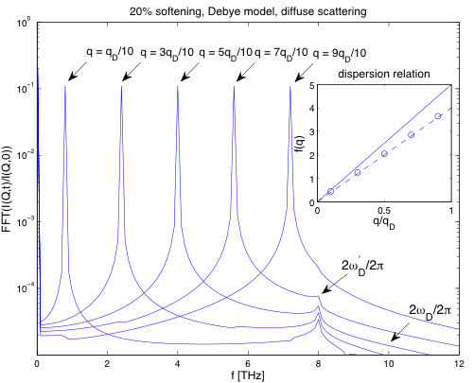
Fourier transform of I(q,t) yields phonon dispersion
(excited state)
Hillyard, Reis and Gaffney PRB 77, 195213 (2008).
Notes:
Very simple model (equivalent to what used to describe InSb melting except with imaginary freq. )

Slide 23
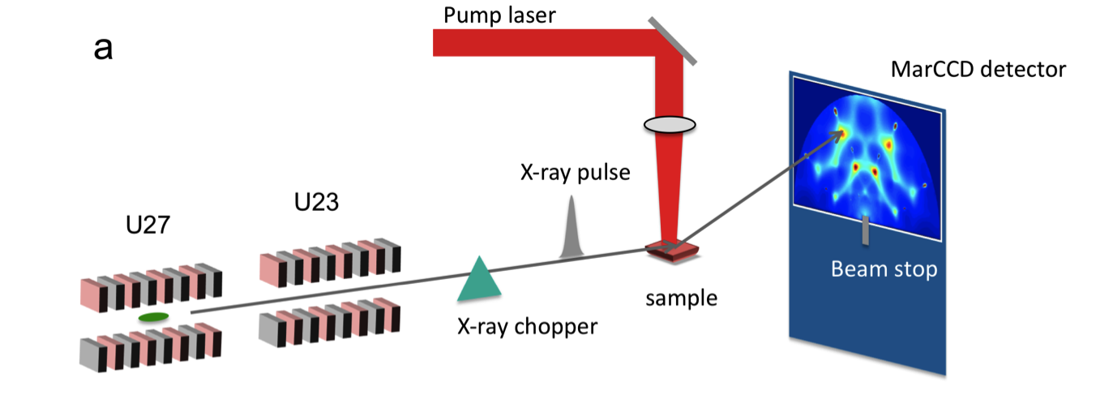
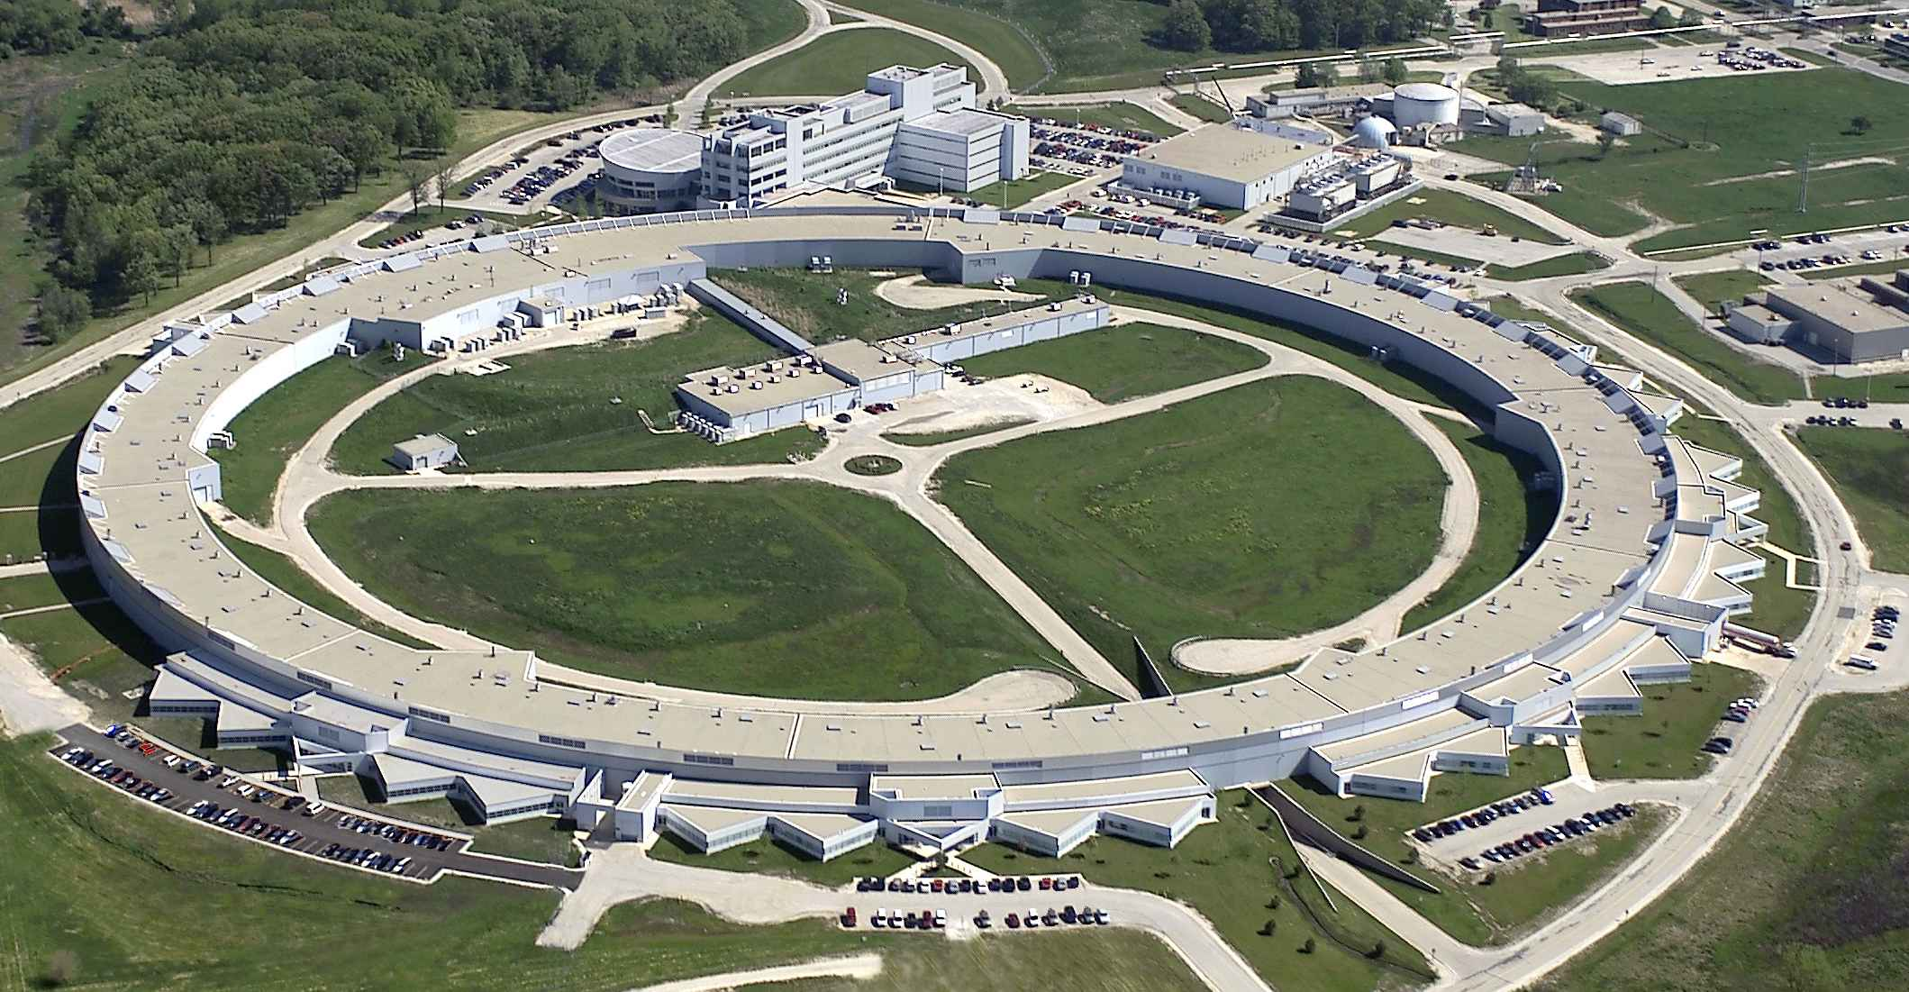
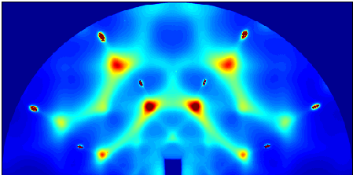


Benchmark experiments at APS
Advanced Photon Source
InP, 300K
15 keV x-rays
~ 100 single x-ray
Pulses
Equivalent to a single LCLS shot!
…Except few % BW and 100 ps pulses
Trigo et al. Phys. Rev. B, 82(23):235205, 2010.

Slide 24
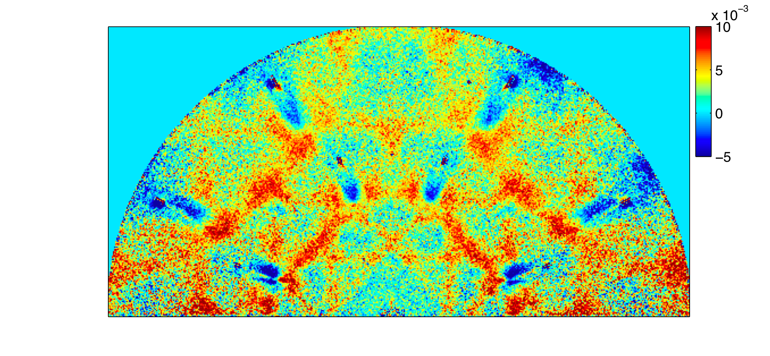


Nonequilibrium phonons—more than just heating
Differential change: [ I(400ps) −I(100ps) ] / I(oﬀ)
0.01
0.005
0
-0.005
If processes were only thermal,
Trigo et al. Phys. Rev. B, 82(23):235205, 2010.
Notes:
To understand the time evolution we look at differences between time frames (differential intensity).
Consider the following argument : if dynamics were due to temperature, differential intens. (proportional to the change in population) would be proportional to the temp raise and therefore constant. But image is far from just a constant!
This is indicative of more interesting non-equilibrium dynamics in the phonon populations

Slide 25
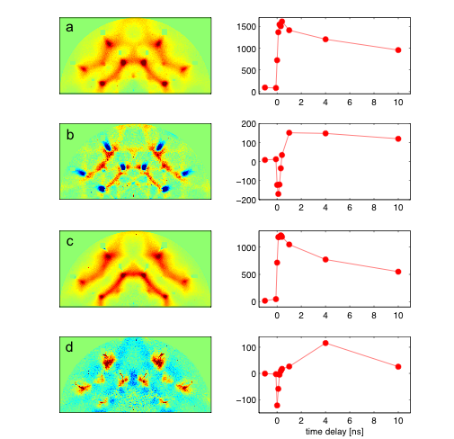
Singular Value Decomposition on differences
U
SV^{T}
Similar to equilibrium image
Sharp raise + exponential decay
Positive and negative differential scattering
Delayed
time delay [ns]
Complex dynamics in the phonon populations due to the anharmonic coupling between modes
Trigo et al. Phys. Rev. B, 82(23):235205, 2010.

Slide 26
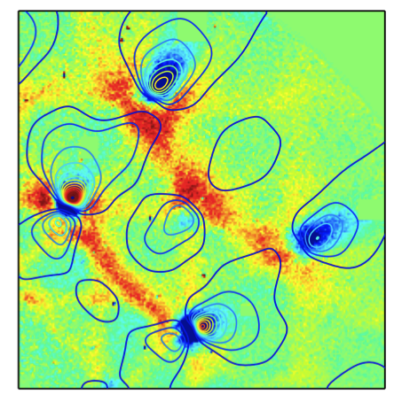
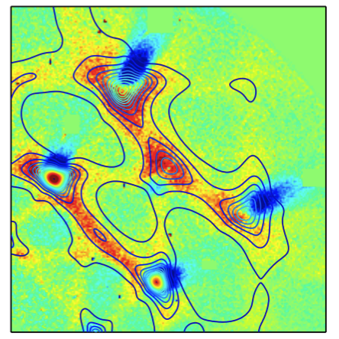
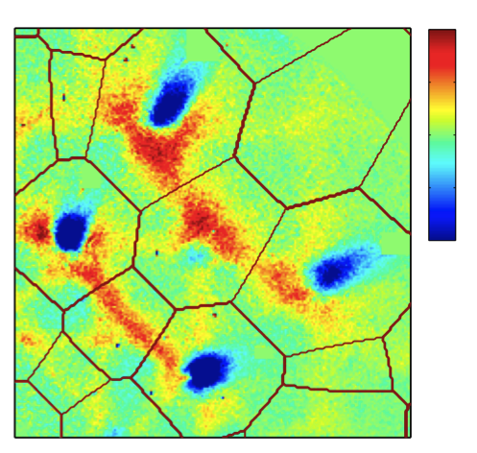
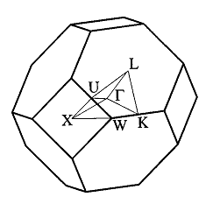
Contribution from acoustic phonon branches
LA
TA
Brillouin
zone
Trigo et al. Phys. Rev. B, 82(23):235205, 2010.

Slide 27
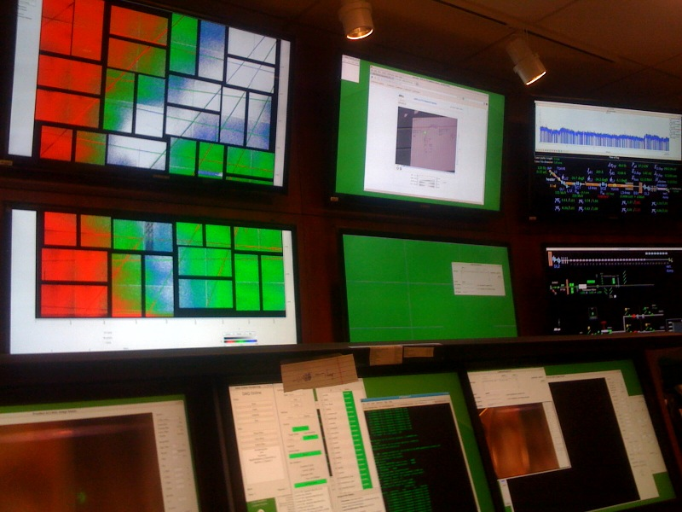
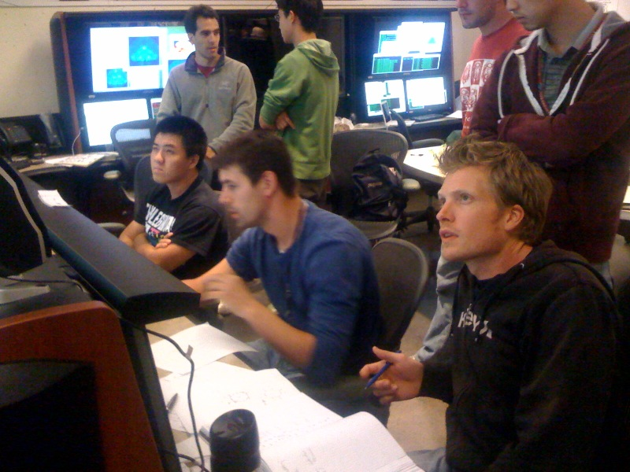
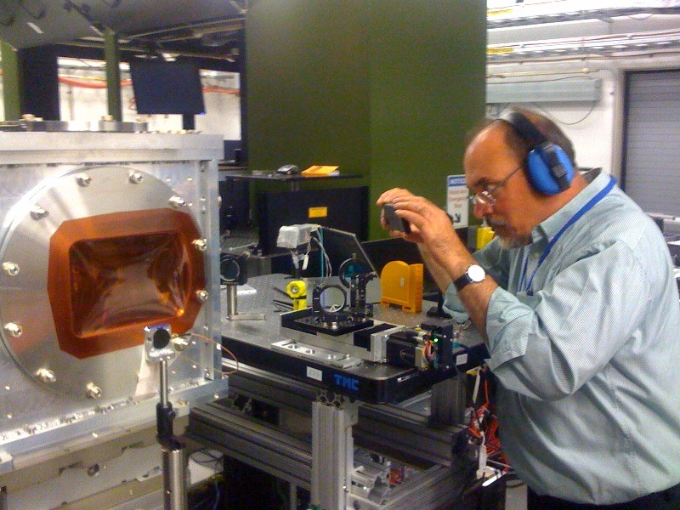
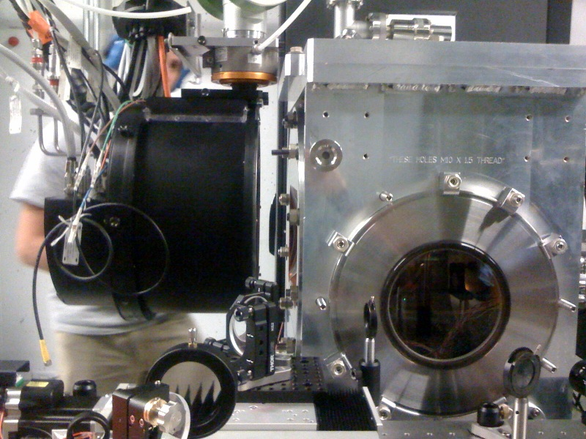
L362 and L367 collaboration:
Ultrafast imaging of nonequilibrium phonons and lattice instabilities
PLEASE NOTE:
Everything that follows is unpublished and preliminary

Slide 28
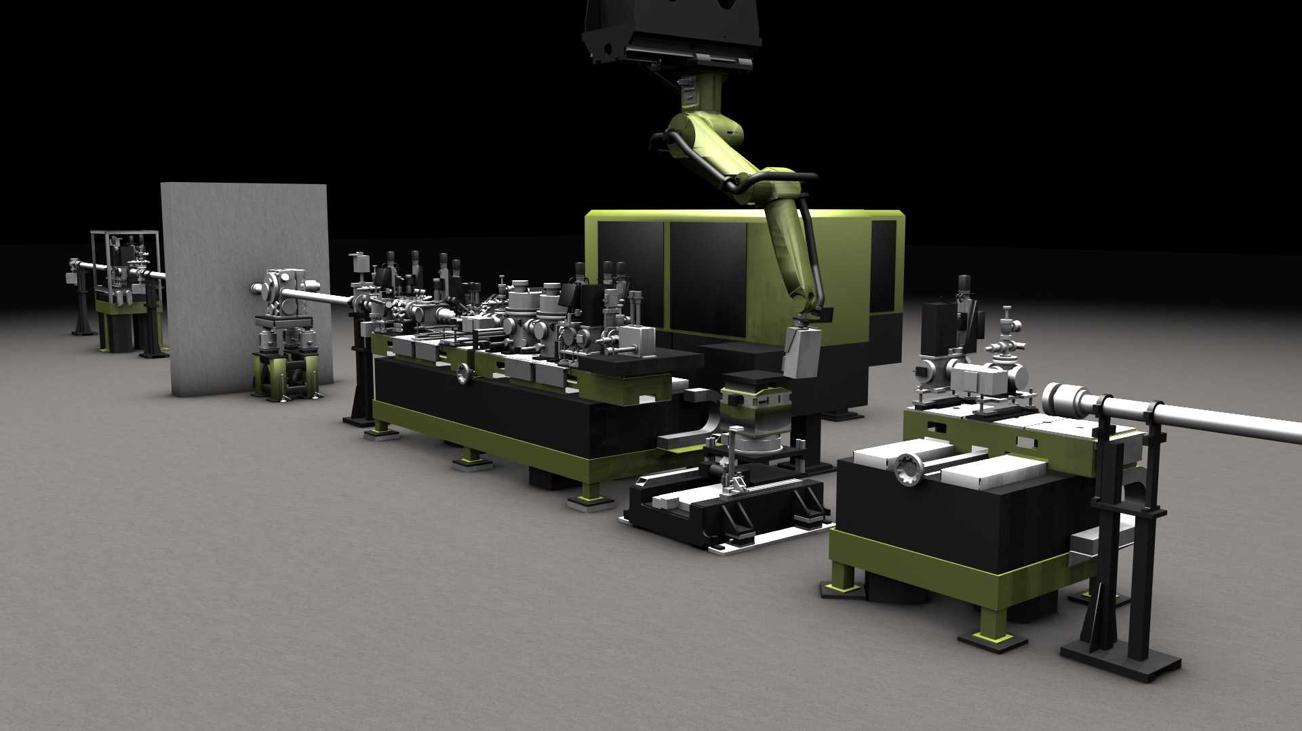
The XPP Instrument on LCLS
Hutch 2
Hutch 3
Courtesy David Fritz

Slide 29
Experimental Layout
1.5eV, <10mJ, 50fs, 60x400µm², 120Hz, near collinear
Slits, Be lenses, Intensity Monitors
Optical reflectivity (timing probe)
2MPixel array, 120Hz readout
+2 fixed diodes
Hutch 2
10 keV, <0.2mJ, 50fs, 20x250µm²,120 Hz
Sample Mount
(on rotation and translation stages)
Sample in vacuum to minimize parasitic scattering
Grazing incidence (~0.5°) to match laser and x-ray penetration depth
Drop 2pps x-ray, 5-10 pps laser
Measure everything can on single shot basis
Powder (LaB6 to callibrate Q)
Hutch 3

Slide 30
Preliminary Data Removed

Slide 31
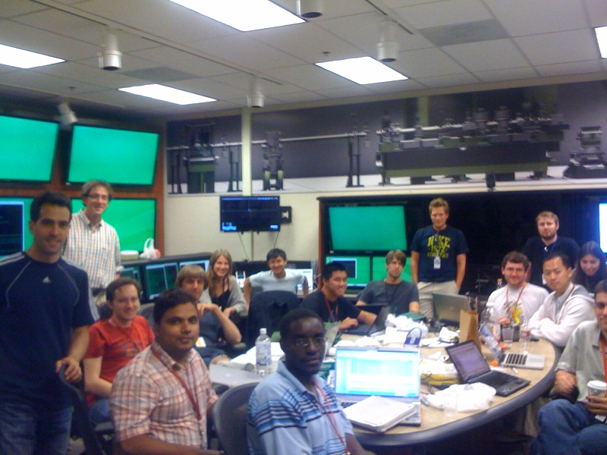
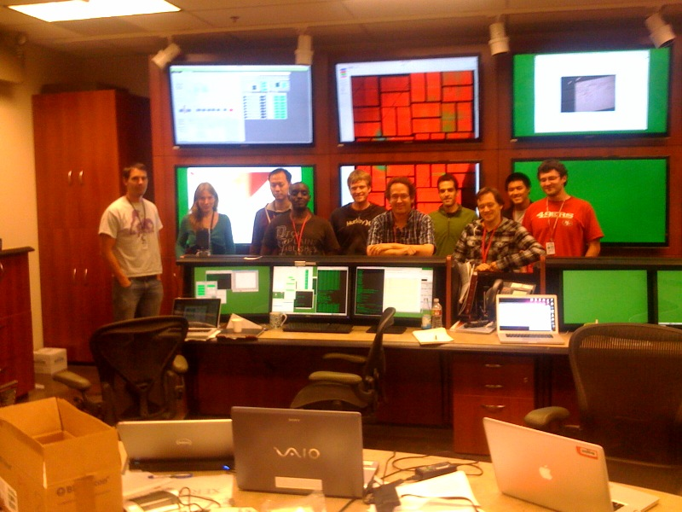
Just getting started…
September 1, 2011 (ca. 2:00pm)
September 12, 2011 (ca. 9:30am)
Mariano Trigo, Jian Chen, Matthias Fuchs, Mason Jiang, Mike Kozina, Shambhu Ghimire,
Georges Ndabashimiye and Vinayak Vishwanath, Aaron Lindenberg, Kelly Gaffney, DAR
Stanford PULSE Institute, SLAC National Accelerator Laboratory
David Fritz, Marco Cammarata, Henrik Lemke, Diling Zhu
XPP, LCLS, SLAC National Accelerator Laboratory
Stephen Fahy (Cork); Eamonn Murray (Davis); Tim Graber, Robert Henning (CARS, U. Chicago) Yu-Miin Sheu (LANL); Klaus Sokolowski-Tinten, Florian Quirin (Essen); Steve Johnson, Tim Huber (ETH); Jorgen Larssen (Lund); Justin Wark, Andy Higginbotham (Oxford); Ctirad Uher, Guoyu Wang (Michigan); Gerhard Lapertot (CEA); Faton Karsniqi (MPQ/ASG) et al.
Supported by the U.S. Department of Energy, Office of Basic Energy Science

Slide 32
improvements
Detectors are getting better all of the time. Easier analysis, weaker scattering, more complex systems.
Shorter pulses (x-ray and IR/vis/uv) and single shot timing diagnostics. High freq. response.
Wavelength and energy stability, means fewer things to bin. Narrower bandwidth, better resolution and can get closer to peaks.
More compact data. More complete scanning of reciprocal space.
Great for nonequilibrium. Would really like high-rep-rate machine for equilibrium.
xpcs, x-ray pump, x-ray probe…

