Slide 1


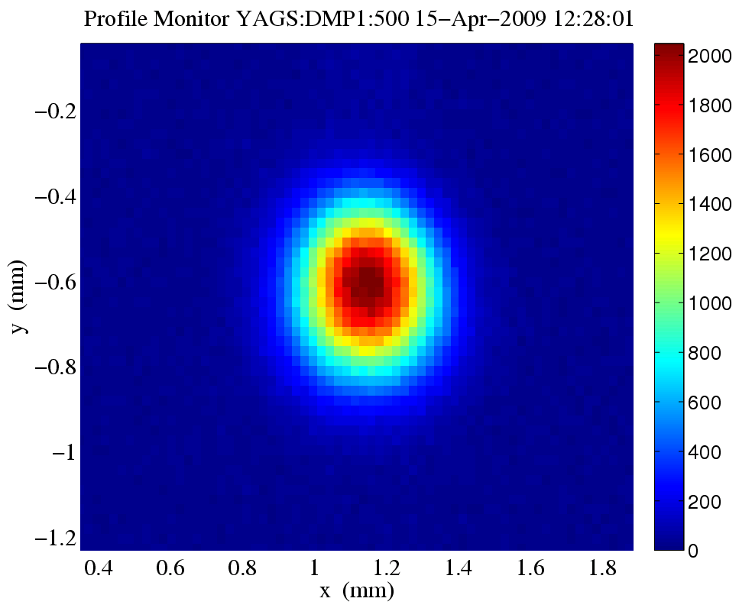
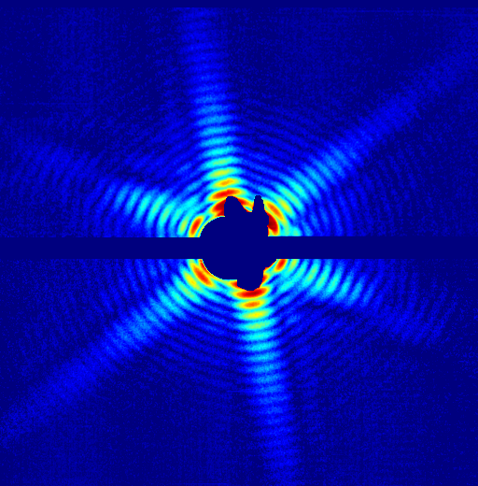

X-ray Free Electron lasers
Zhirong Huang

Slide 2
Lecture Outline
XFEL basics
XFEL projects and R&D areas
Questions and Answers

Slide 3
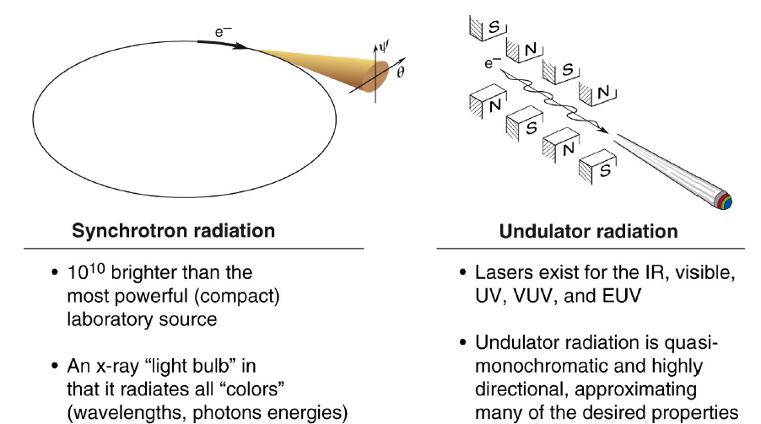
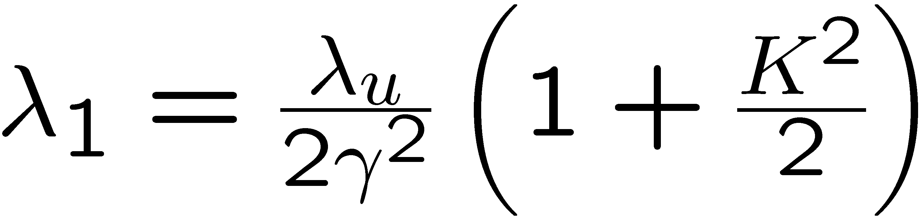
Bright light sources from relativistic electrons
Synchrotron radiation
Undulator radiation
Electrons emit with random phase ➔ radiation intensity ∝ N
(γ is Lorentz factor, N is number of electrons ~10⁹)

Slide 4
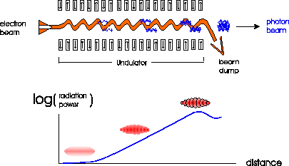
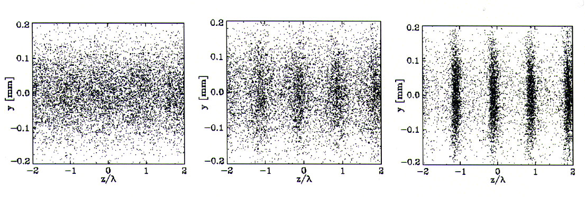
Free Electron Laser (FEL)
Produced by resonant interaction of a relativistic electron beam with EM radiation in an undulator
electron beam
photon beam
undulator
e⁻ beam dump
λ₁
Radiation intensity ∝ N²
Tunable, Powerful, Coherent radiation sources

Slide 5
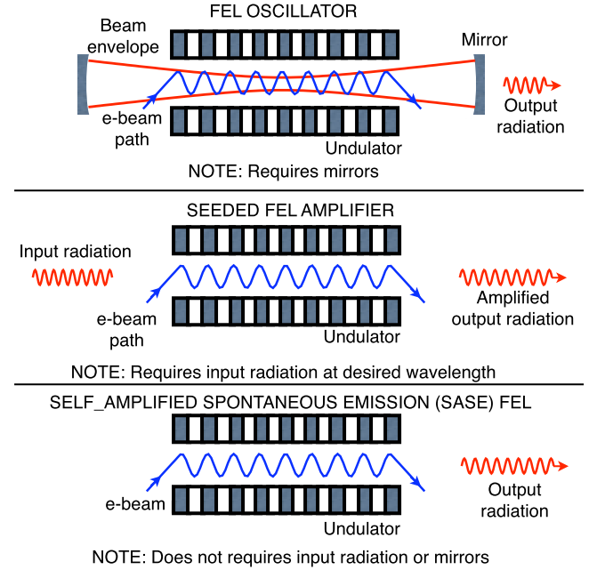
Three FEL modes

Slide 6
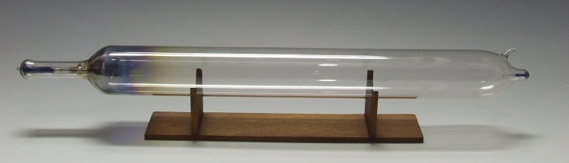
Light Source Brightness (Brilliance)
10 orders of
magnitude!

Slide 7
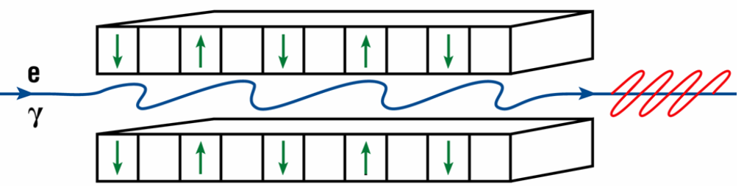
Undulator Radiation
λ₁
λ_{u}
forward direction radiation
(and harmonics)
undulator parameter K = 0.94 B[Tesla] λ_{u}[cm]
LCLS undulator K = 3.5, λ_{u} = 3 cm, e-beam energy
from 3 GeV to 15 GeV to cover λ₁ = 30 Å to 1.2 Å
Can energy be exchanged between electrons and co-propagating radiation pulse?

Slide 8
Resonant Interaction of Field with Electrons
Electrons slip behind EM wave by λ₁ per undulator period (λ_{u})
x
+
−
+
−
+
−
+
K/γ
λ_{u}
λ₁
x-ray
z
e⁻
v_{x}E_{x} > 0
v_{x}E_{x} > 0
v_{x}E_{x} > 0
v_{x}E_{x} > 0
v_{x}E_{x} > 0
P. Emma
−
+
−
+
−
+
−
Due to sustained interaction, some electrons lose energy, while others gain ➔ energy modulation at λ₁
e⁻ losing energy slow down, and e⁻ gaining energy catch up ➔ density modulation at λ₁ (microbunching)
Microbunched beam radiates coherently at λ₁, enhancing the process ➔ exponential growth of radiation power
E
t
E
t

Slide 9
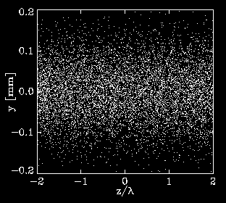
FEL Micro-Bunching Along Undulator
electron beam
photon beam
undulator
e⁻ beam dump
S. Reiche
log
(radiation power)
distance

Slide 10
What is SASE?
Shot noise originates from discrete nature of electrons
… .. . ..
SASE
Δz
electron arrival time t is random ➔ spontaneous emission
amplified by FEL interaction
quasi-coherent x-rays

Slide 11
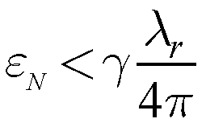
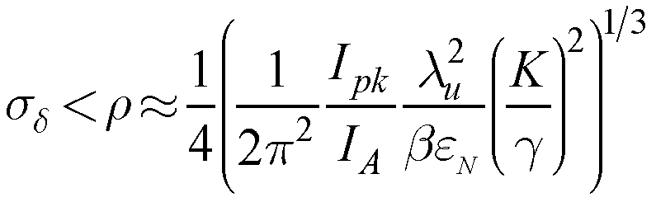
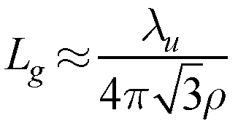
SASE FEL Electron Beam Requirements
radiation wavelength (e.g., 1 Å)
transverse emittance:
ε_{Ν} < 1 µm at 1 Å, 15 GeV
peak current
undulator period
FEL parameter
relative energy spread:
<0.04% at I_{pk} = 3 kA, K ≈ 3, λ_{u} ≈ 3 cm, …
beta function
undulator ‘field’ = 0.93∙Bλ_{u}
FEL gain length:
18L_{G} ≈ 100 m for ε_{Ν} ≈ 1.5 µm
We must increase peak current, preserve emittance, and maintain small energy spread so that power grows exponentially with undulator distance, z,
P(z) = P₀ ∙ exp(z/L_{G})
FEL power reaches saturation at ~18L_{G}
SASE performance depends exponentially on e⁻ beam quality ! (challenge)

Slide 12
Slippage leads to coherence length and spiky structure
Due to resonant condition, light overtakes e⁻ beam by one radiation wavelength λ₁ per undulator period (interaction length = undulator length)
+
−
+
−
+
−
+
z
~1 µm
e⁻
x-rays
Νλ₁
P. Emma
−
+
−
+
−
+
−
Slippage length = λ₁ × Ν undulator periods: (at 1.5 Å, LCLS slippage length is: l_{s} ≈ 1.5 fs << 100-fs pulse length)
Each part of optical pulse is amplified by those electrons within a slippage length (an FEL slice)
Coherence length is slippage over ~2L_{G} (l_{c} ≈ l_{s}/10)
Μ_{L} ≈ Δz/l_{c} independent radiation sources (modes)
slippage
length
Δz

Slide 13
SASE temporal characteristics
E(t)=∑_{j} E₀(t-t_{j}), t_{j} is the random arrival time of j^{th} e⁻
N_{u} λ
E₀: wave packet of a single e⁻
l_{c} ~ 500 λ₁ = 200 as (LCLS 1.5 Å)
Sum of all packets ➔ E(t)
bunch length Δz

Slide 14
Statistical intensity fluctuation determined by number of longitudinal modes
Due to noise start-up, SASE is chaotic light with M_{L} coherent modes (i.e., spikes in intensity profile):
Longitudinal phase space is M_{L} larger
than Fourier Transform limit
SASE energy fluctuation is…
M_{L} is not constant – reduced by increased coherence during exponential growth, and increased with reduced coherence after saturation
LCLS near saturation (~50 fs): M_{L} ≈ 200 ➔ ΔW/W ≈ 7 %
z = 50 m
temporal spikes appear
← 50 % of X-Ray Pulse Length →

Slide 15
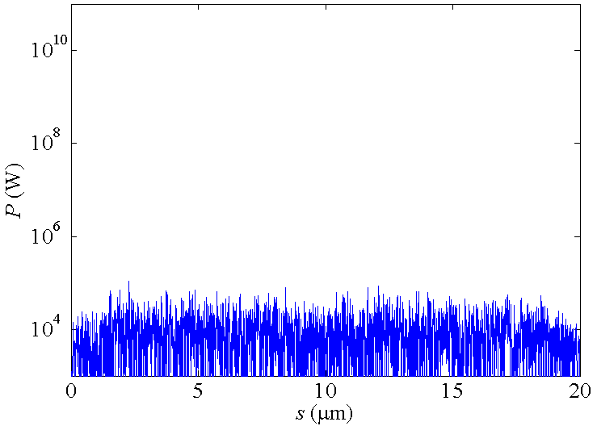
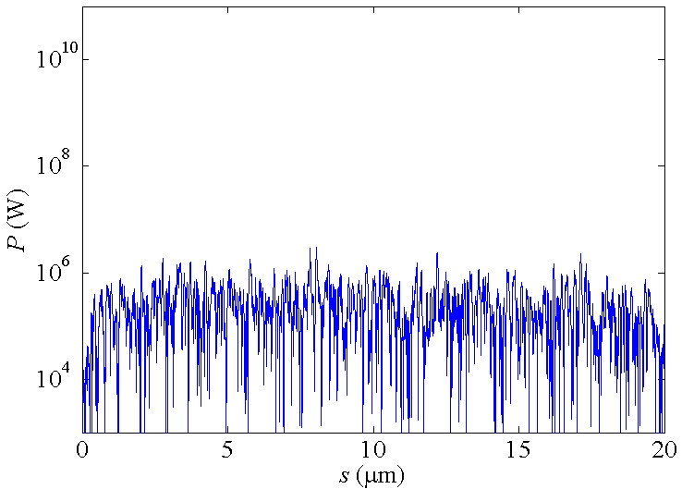
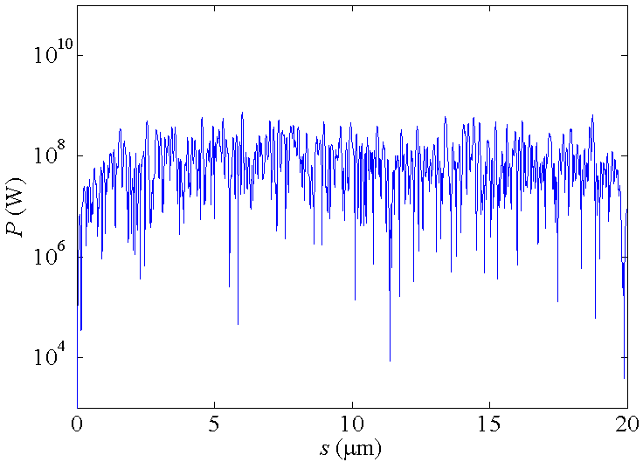
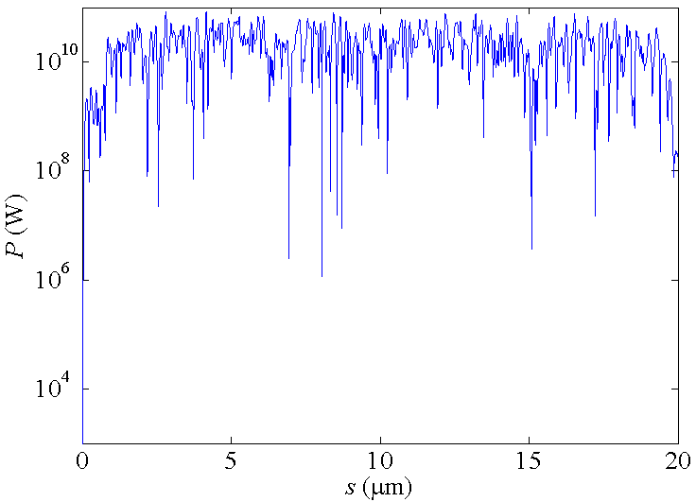
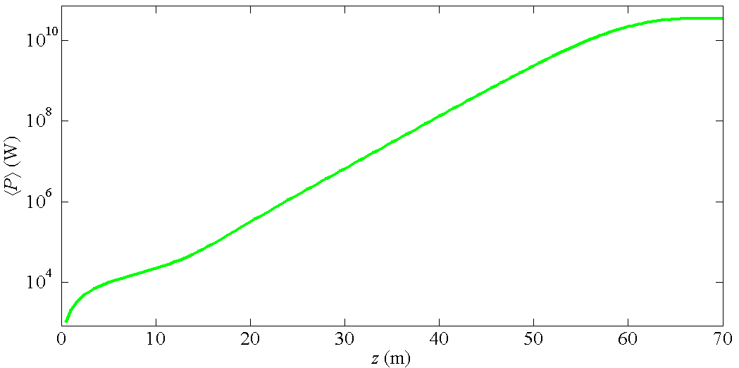
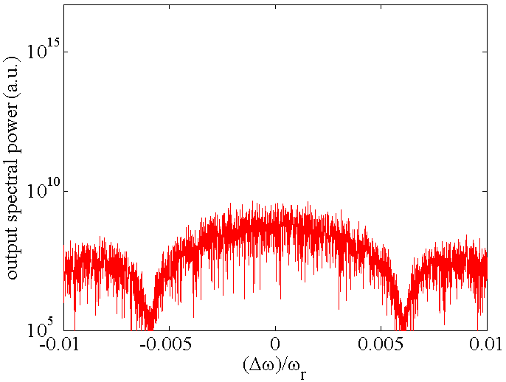
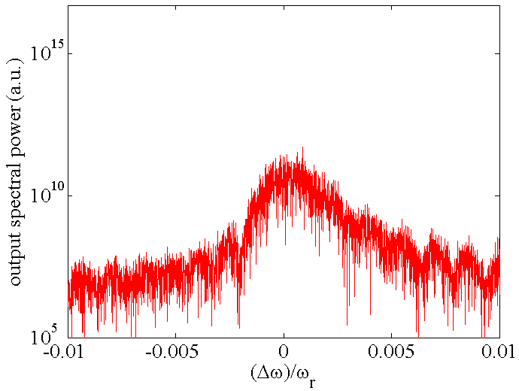
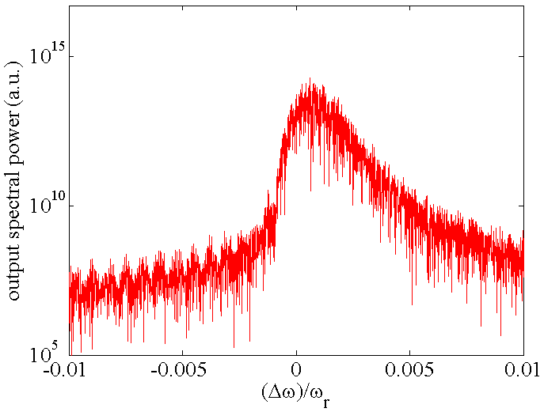
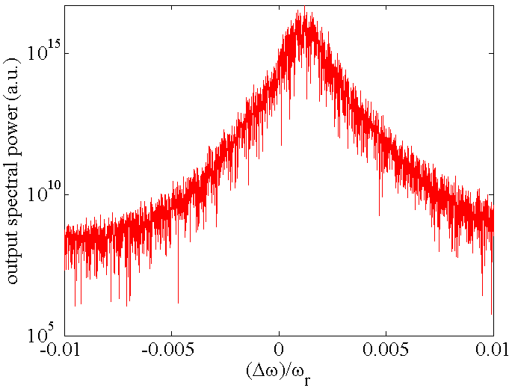
FEL startup from e⁻ beam noise
~10 kW
~1 MW
~0.1 GW
spiky temporal structure
~10 GW
All vertical axes are log scale
BW = 0.6%
BW = 0.15%
BW = 0.10%
narrow
band-
width
BW = 0.08%

Slide 16
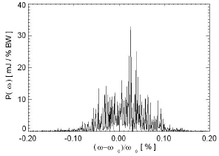
FEL Bandwidth set by FEL Parameter, ρ (∼10⁻³)
LCLS spectrum
Spectral properties are similar to temporal domain, except that everything is inverted…
spike width
~ λ₁/(2Δz)
Bandwidth
∼ 2ρ
Example, LCLS relative spectral spike width:
Δz = 50 fs bunch length: width = 5×10⁻⁶
Δz = 5 fs bunch length: width = 5×10⁻⁵
Δz = 0.5 fs bunch length: width = 5×10⁻⁴

Slide 17
SASE 1D Summary
3.5 m
Power gain length:
Exponential growth: P(z) = P₀ exp(z/L_{G})
Startup noise power: P₀ ≈ ρ ²γ mc³/λ₁ (spontaneous radiation in two gain lengths)
Saturation power: P_{sat} ≈ ρ × e-beam power
Saturation length: L_{sat} ≈ λ_{u}/ρ ≈ 18L_{G}
FWHM bandwidth at saturation: ≈ 2ρ
Coherence length at saturation: l_{c} ≈ λ₁/(πρ)
1.5 kW
20 GW
60 m
0.1%
0.2 fs

Slide 18
Transverse coherence
S. Reiche
Z=25 m
Z=37.5 m
Z=50 m
Z=62.5 m
Z=75 m
Z=87.5 m m
Single mode dominates ➔ close to 100% transverse coherence

Slide 19
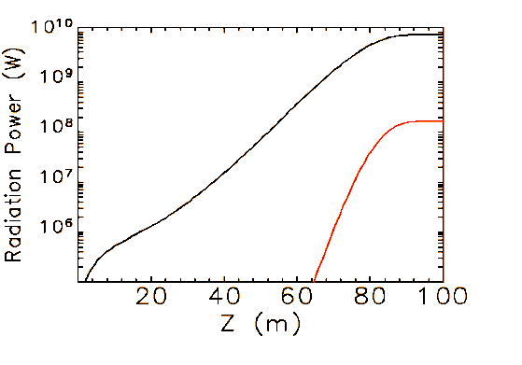
Harmonic Radiation also Generated: λ_{n} = λ₁/n
FEL gain creates e⁻ energy and density modulation at λ₁
Near saturation, strong bunching at fundamental wavelength also produces rich harmonics
For example, ~1% of fundamental power in 3rd harmonic
λ
λ
E
E
t
t
linear regime,
before saturation
non-linear regime,
near saturation
λ₁
LCLS may produce up to 25 keV in 3rd harmonic photons at ~100 MW
λ₃

Slide 20
Peak Brightness Enhancement From
Storage Ring Light Sources To SASE
#of photons
(Ω_{i}- phase space area)
B =
Ω_{x} Ω_{y} Ω_{z}
Enhancement Factor
Undulator in SR
SASE
# of photons
αΝ_{e}
αΝ_{e}N_{lc}
N_{lc}~10⁶ to 10⁷
Ω_{x}Ω_{y}
(2πε_{x}) (2πε_{y})
Ω_{Z}
compressed
B
10²³
10³³
10¹⁰
to 10¹¹
N_{lc}: number of electrons within a coherence length l_{c}

Slide 21
XFEL accelerator system
emittance
corrector
Linac
Linac
Linac
SASE Undulator
rf photocathode
gun
Pulse compressors
Photocathode rf gun ε_{x}^{n} ~ 1 μ m, I_{p} ~ 100A
Bunch compression I_{p} ~ 2-5 kA, Δτ ~ 1-100 fs
Acceleration 3–20 GeV, λ ∼ λu/(2γ²)
adiabatic damping ε_{x} ~ ε_{x}^{n}/γ ∼ λ/4π, σ_{γ}/γ < ρ ~ 10⁻³
Undulator 100-m long, segmented, a few μm tolerance
Projects undertaken at US, Germany, Japan, Korea, Swiss, Italy…

Slide 22
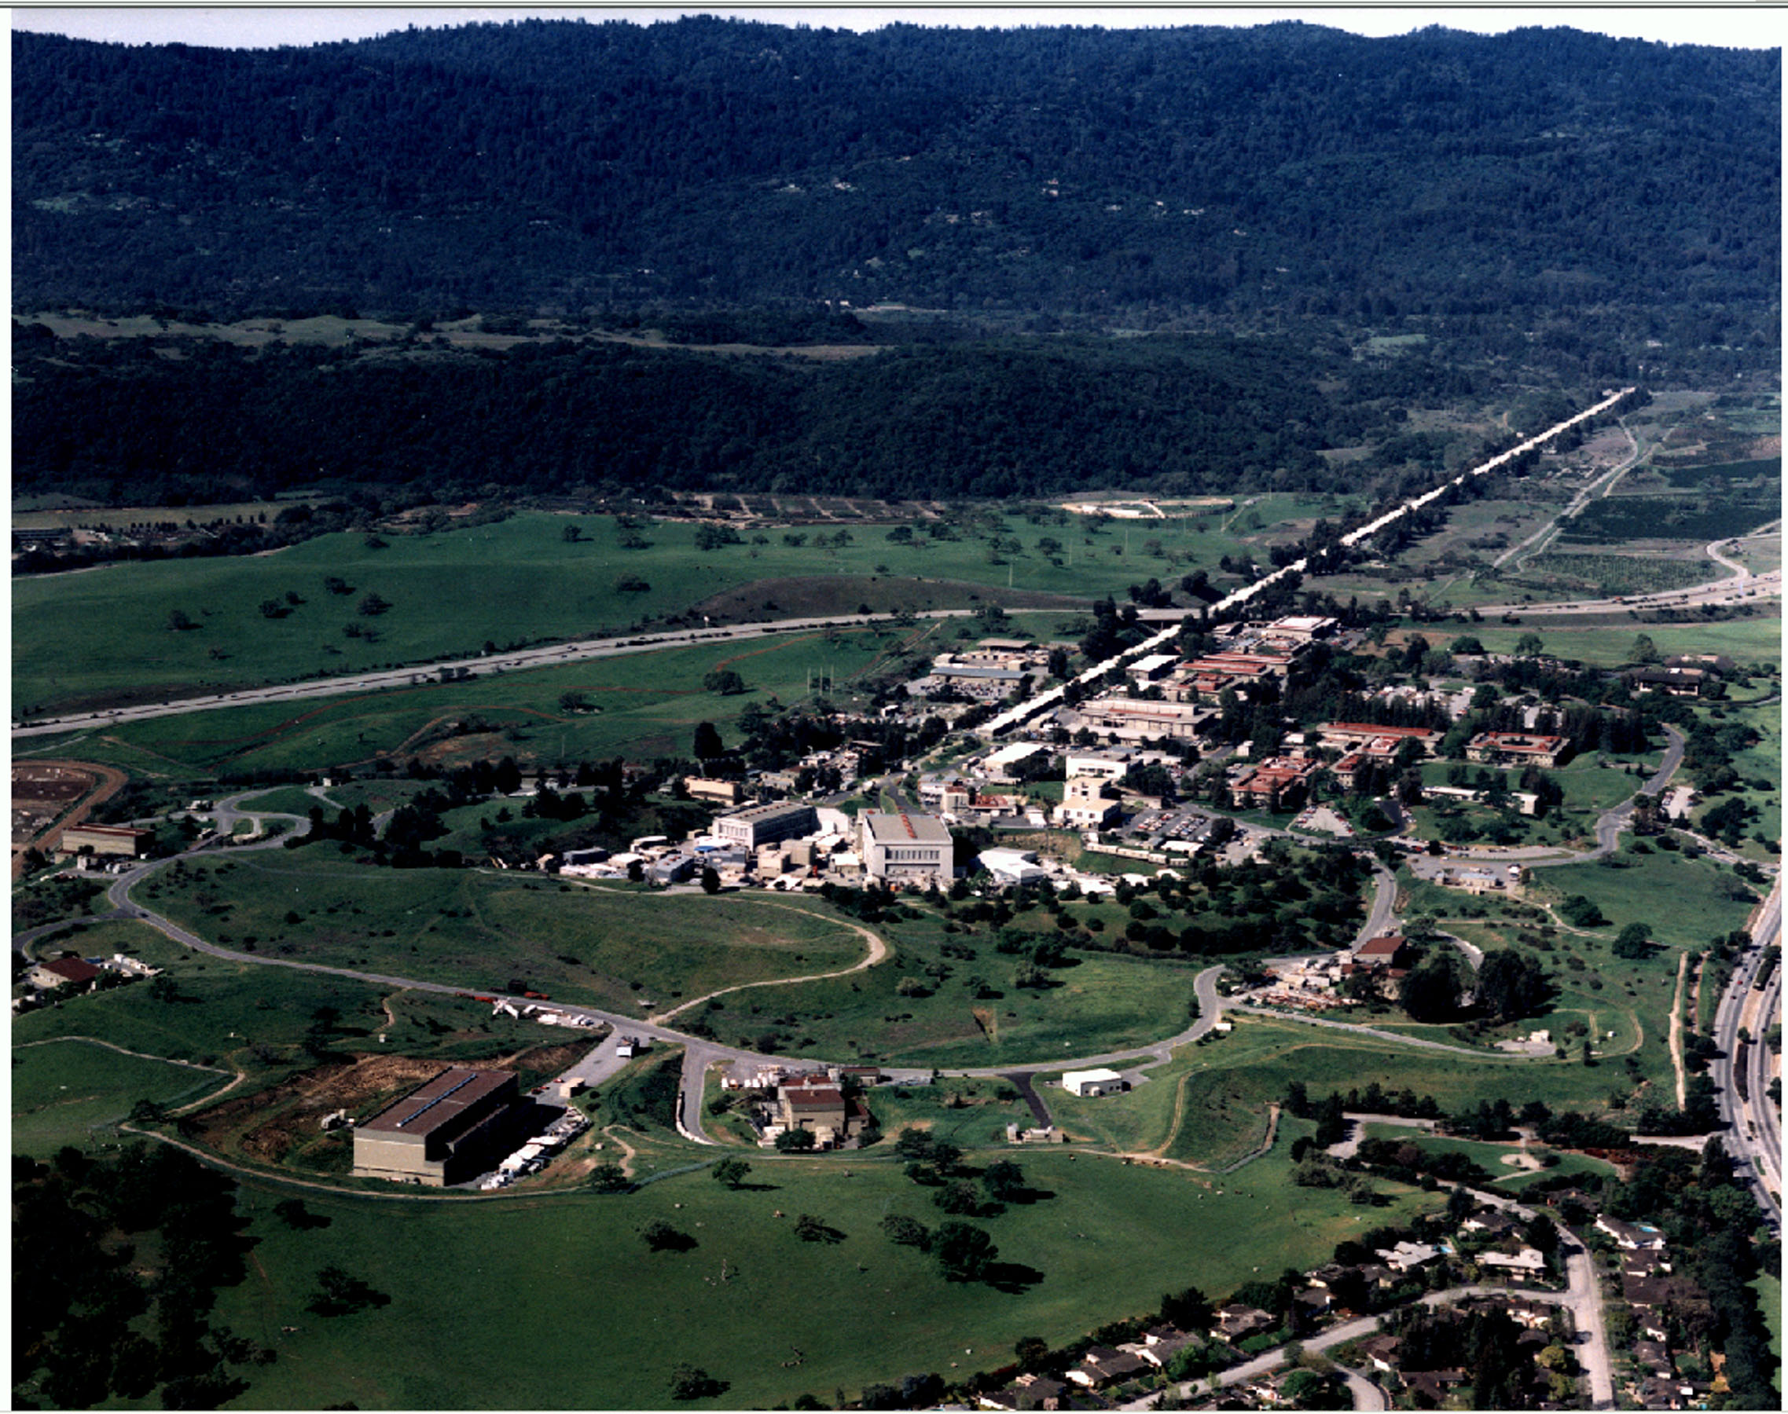

Linac Coherent Light Source (LCLS) at SLAC
X-FEL based on last 1-km of existing 3-km linac
1.5-15 Å
(14-4.3 GeV)
Proposed by C. Pellegrini in 1992
Injector (35º)
at 2-km point
Existing 1/3 Linac (1 km)
(with modifications)
New e⁻ Transfer Line (340 m)
X-ray Transport Line (200 m)
Undulator (130 m)
Near Experiment Hall
Far Experiment
Hall

Slide 23
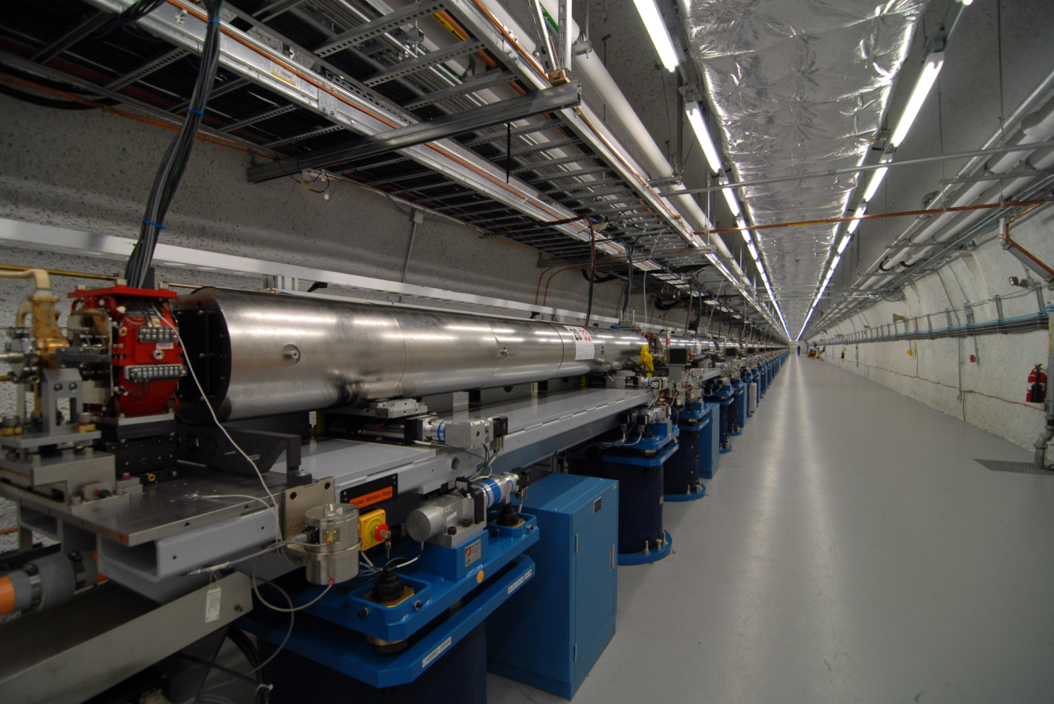
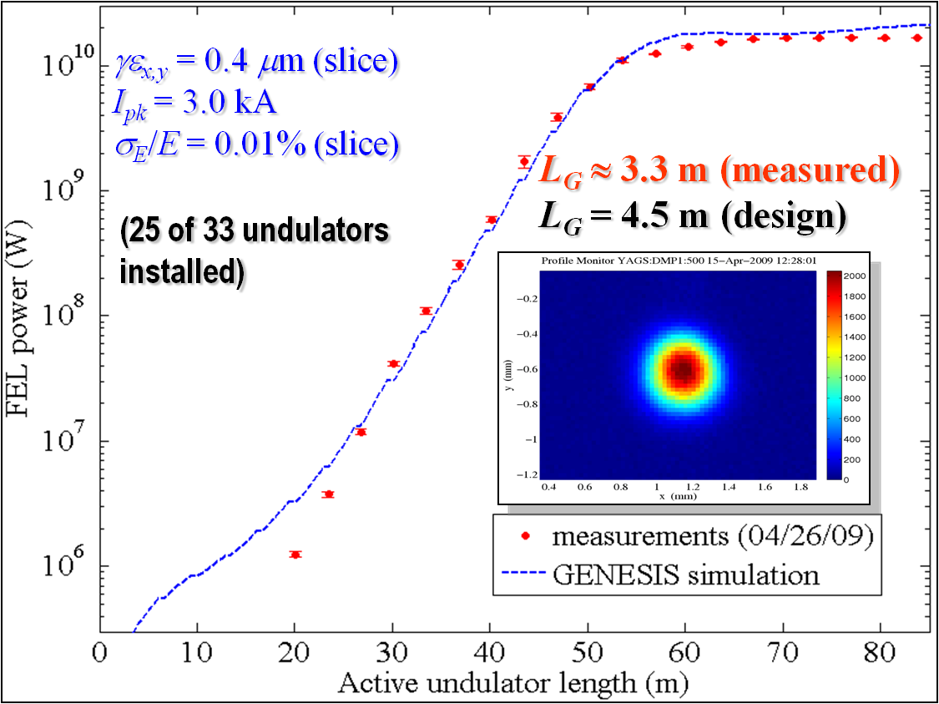
LCLS: world’s first hard x-ray FEL
1.5 Å
SASE wavelength range: 30 – 1.2 Å
Photon energy range: 0.4 - 10 keV
Pulse length FWHM 5 – 100 fs (5- 500 fs for SXR only)
Pulse energy up to 4 mJ
~95% accelerator availability

Slide 24
Smaller charge, shorter x-rays
gun
TCAV0
L1X
old
screen
4 wire
scanners +
4 collimators
L0
3 wires
2 OTR
4 wire
scanners
3 OTR
vert.
dump
heater
L1S
3 wires
3 OTR
σ_{z1}
σ_{z2}
μ wall
L2-linac
L3-linac
DL1
BC1
stopper
TCAV3
BSY
DL2
undulator
BL signal
Low charge mode developed by J. Frisch et al.
Simulations* suggest a few fs electron and x-ray pulse duration.
A 3-pC bunch is capable of generating attosecond FEL, but diagnostics is very challenging
FEL signal
20 pC, photon energy @ 840 eV
* Y. Ding et. al, PRL 2009

Slide 25
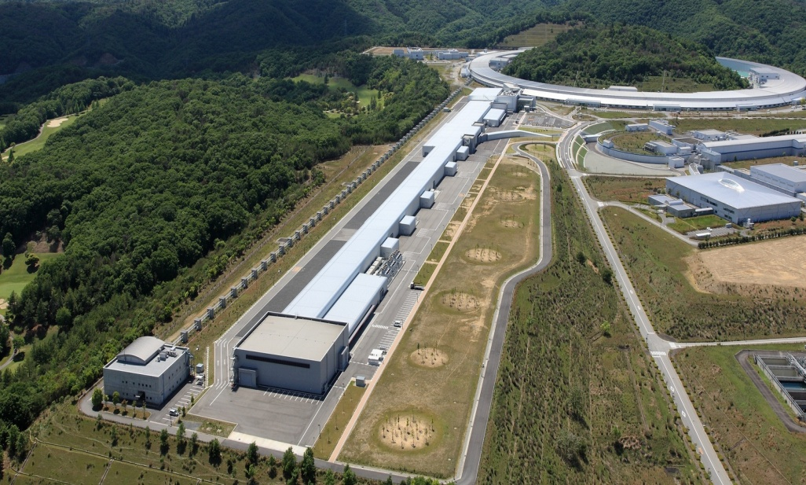
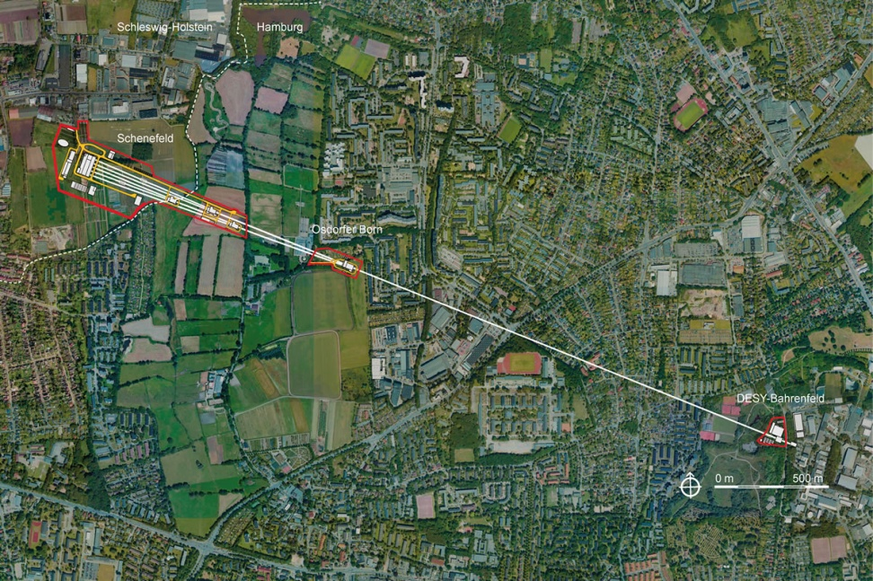
More to come
Spring-8 SACLA
2011
SASE Wavelength range: 3 – 0.6 Å
Photon energy range: 4 - 20 keV
Pulse length (10 fs FWHM)
Pulse energy up to 1 mJ
more to come:
PAL-XFEL (2015)
SwissFEL (2016)
LCLS-II (2018)
…
European XFEL ~ 2015

Slide 26
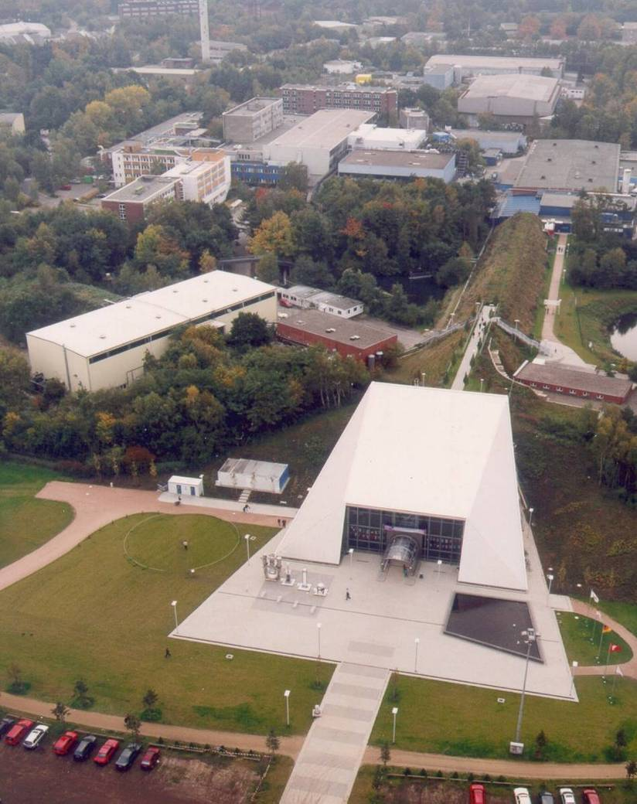
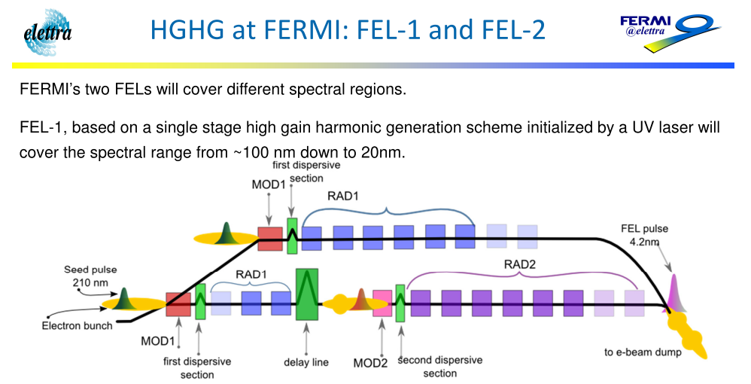
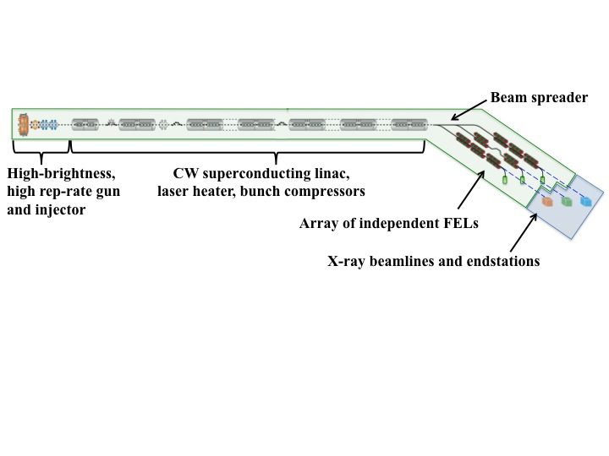
Also for soft x-ray FELs
FLASH @ DESY
Operates down to 4 nm
Next-Generation Light Source (NGLS), LBL

Slide 27
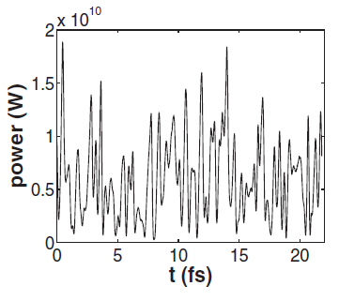
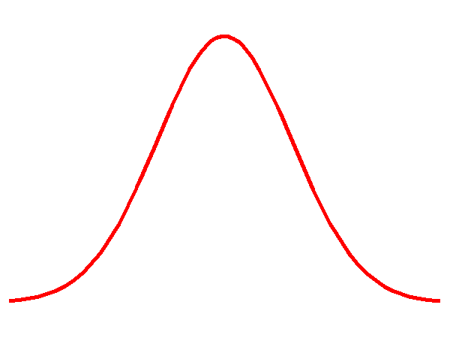
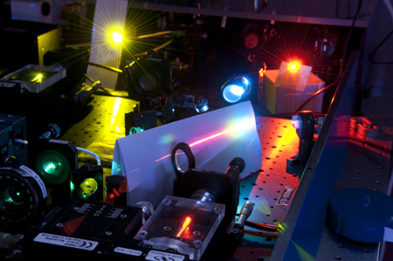
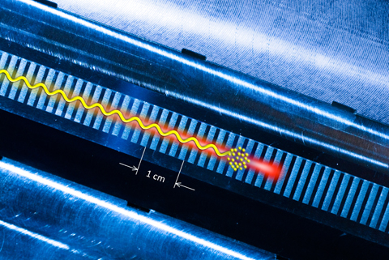
What comes next for XFELs?
SASE temporal coherence can be drastically improved by seeding (self or external seeding)
SASE
seeded
Precise control x-ray properties similar to optical lasers
Compact coherent sources

Slide 28


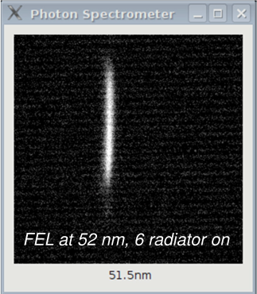
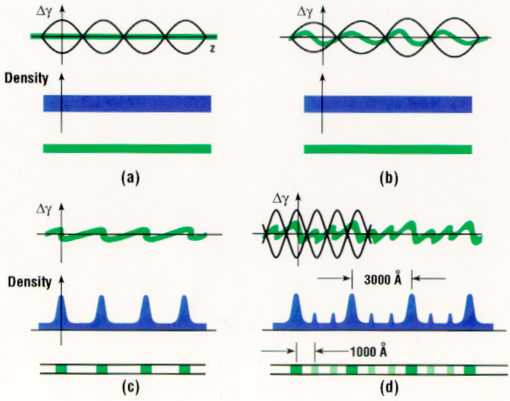
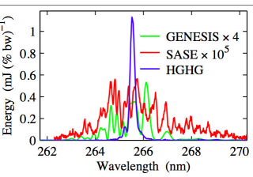



Harmonic generation for seeding
High Gain Harmonic Generation (HGHG)
L.-H. Yu, PRA, 1991
chicane
BNL 2003
FERMI FEL, 2011
Echo Enabled HG
G. Stupakov, PRL, 2009
seed laser 1
seed
laser 2

Slide 29
Self-Seeding^{1,2}
  First undulator generates SASE
  X-ray monochromator filters SASE and generates seed
  Chicane delays electrons and washes out SASE microbunching
  Second undulator amplifies seed to saturation
chicane
1st undulator
2nd undulator
grazing mirrors
slit
SASE FEL
Seeded FEL
grating
  Long x-ray path delay (~10 ps) requires large chicane that take space and may degrade beam quality
  Reduce chicane size by using two bunches³ or single-crystal wake monochromator⁴.
1. J. Feldhaus et al., NIMA, 1997.
2. E. Saldin et al., NIMA, 2001.
3. Y. Ding, Z. Huang, R. Ruth, PRSTAB, 2010.
4. G. Geloni, G. Kocharyan, E. Saldin, DESY 10-133, 2010.

Slide 30
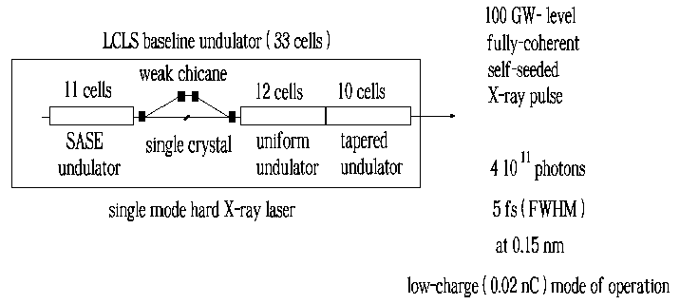
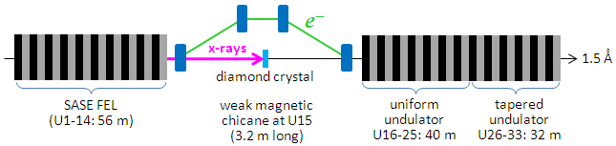
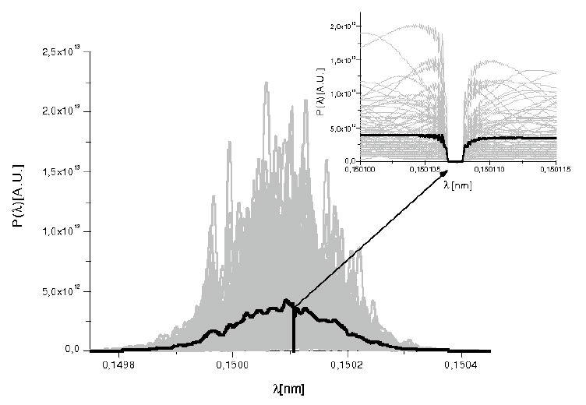
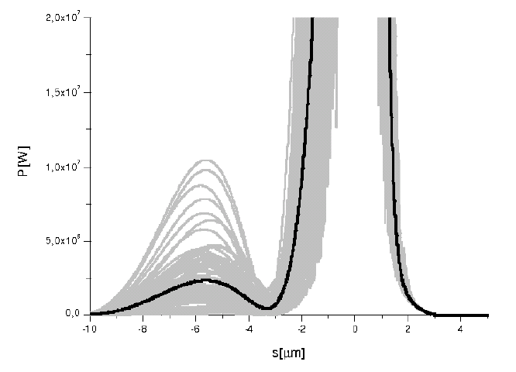
Hard x-ray self-seeding @ LCLS
1 GW
25 GW
15
51
16
17
31
Geloni, Kocharyan, Saldin (DESY)
FEL spectrum after diamond crystal
Power dist. after diamond crystal
Wide-band power
Self-seeding of 1-μm e⁻ pulse at 1.5 Å yields 10⁻⁴ BW with low charge mode
Monochromatic seed power
10⁻⁵
5 MW
6 μm ≈ 20 fs

Slide 31
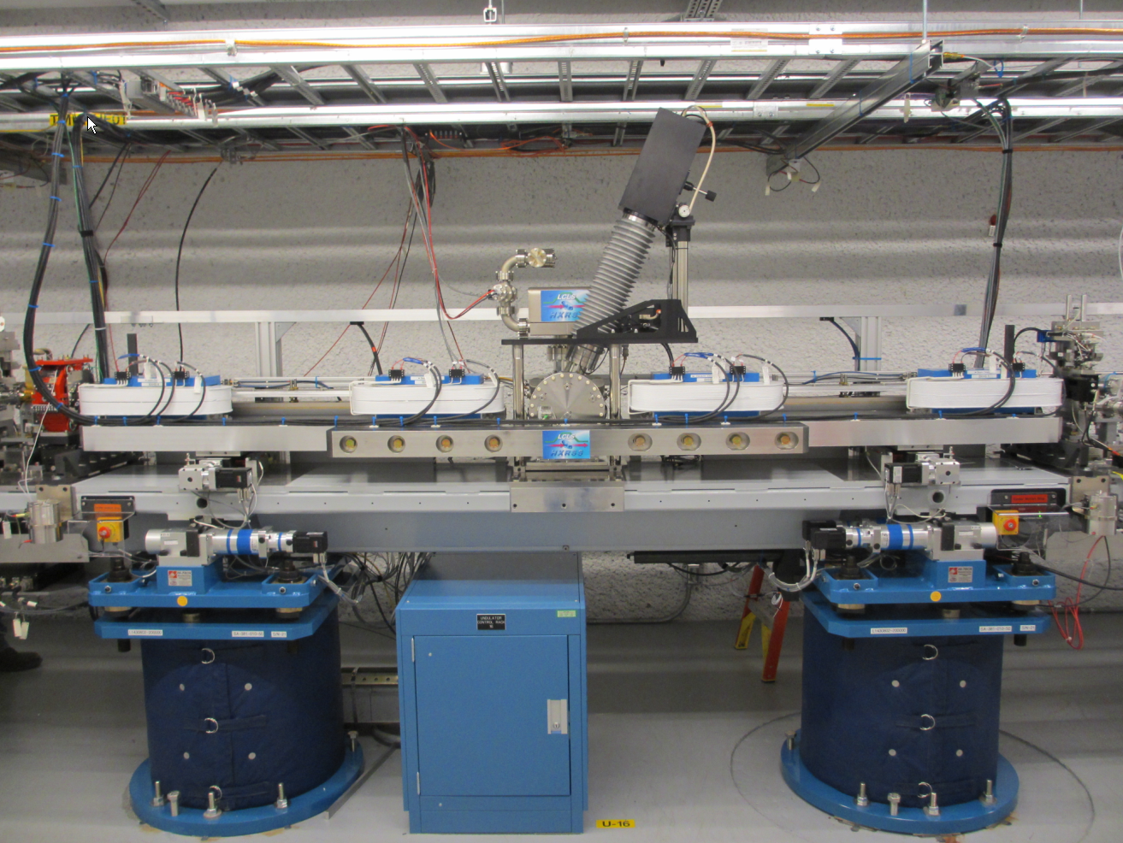



HXRSS at LCLS (replacing U16)
Bragg diagnostic with camera
Chicane
magnet
X-rays
Diamond mono chamber
J. Amann, P. Emma (LBL)

Slide 32
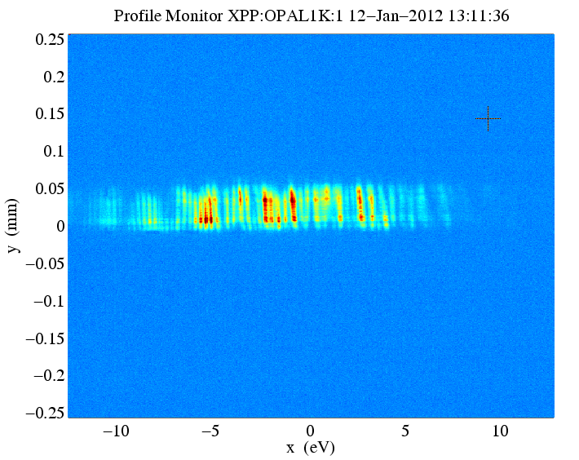
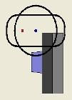
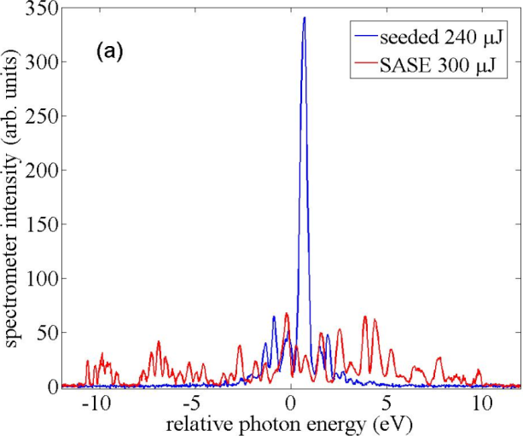
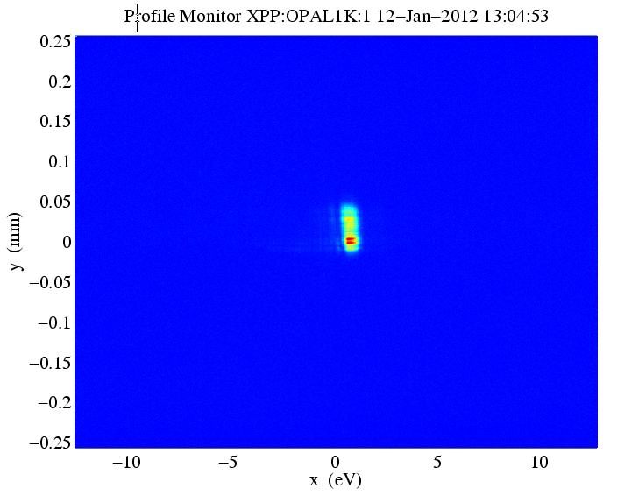
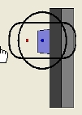
8.3 keV
SASE spectrum (diamond OUT)
20 eV
Seeded
SASE
0.45 eV
(5×10⁻⁵)
chicane OFF
insert diamond & turn on chicane
SASE
diamond IN
A well seeded pulse (not typical)
Fourier Transform limit is 5 fs
0.45 eV
chicane ON
Submitted to Nature Photon., 2012
seeded
Factor of 40-50 BW reduction

Slide 33
Soft X-Ray Self-Seeding (SXRSS)
Compact grating monochromator and chicane that fit in one undulator section (4m)
QU07
(existing quad)
QU08
(existing quad)
Grating
(toroidal
VLS)
B2
-0.9°
B3
-0.9°
M3
( plane mirror)
B1
+0.9°
B4
+0.9°
18 mm
3.85 mm
beam direction
M1
Slit
M2
= 500 – 1000 eV
Bandwidth ~2×10⁻⁴
Δt_{chicane} ~ 700 fs
SXRSS
HXRSS
DELTA
U1-7
U9-15
U17-32 (add 5 more in future?)
D. Cocco, Y. Feng, J. Hastings et al.,
in collaboration with NGLS (LBL)

Slide 34
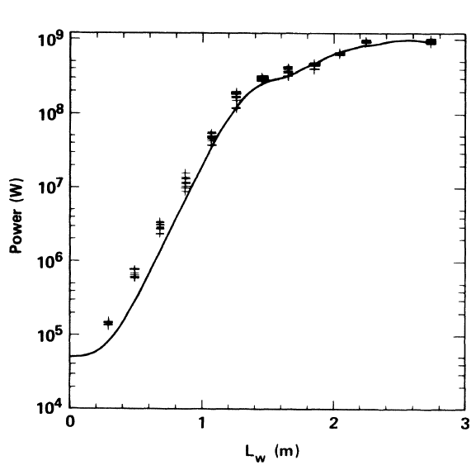

Taper to enhance FEL efficiency
FEL saturates due to significant E-loss
Tapered undulator keeps FEL resonance and increase power
e-beam
x-rays
Taper works much better for a seeded FEL than SASE
400 GW
Taper seeded
Taper SASE
Notaper SASE
LLNL microwave FEL
T. Orzechowski et al. PRL (1986)
W. Fawley, Z. Huang et al. NIMA (2002)

Slide 35


Self-seeding + Aggressive Taper ➔ TW FEL
  LCLS-II simulation
  8.3 keV -- 1.5 Å (13.64 GeV)
  4 kA, 0.3 um emittance
  LCLS low charge parameters
  Optimized tapering starts at 16 m with 13 % K decreasing to 200 m
1.3 TW over 10 fs
~10¹³ photons
1.0 x 10⁻⁴
FWHMBW
After self-seeding crystal
W. Fawley, J. Frisch, Z. Huang, Y. Jiao, H.-D. Nuhn, C. Pellegrini, S. Reiche, J. Wu, FEL2011

Slide 36


C. Schroeder, FLS2012
Laser Plamsa Accelerator (LPA)

Slide 37





Transverse gradient undulator (TGU)*
FEL resonant condition
By canting the undulator poles, generate a linear field gradient
N
Sort e-beam energy by dispersion η so that
y
γ+
γ−
x
S
Resonance can be satisfied for all energies if
* T. Smith et al., J. Appl. Phys. 1979

Slide 38


Compact XFELs driven by LPA
1GeV, 10kA, 10 MeV energy spread;
0.1um emittance; 5 fs (50 pC)
5-m SC undulator λ_{u} = 1 cm, a_{u} = 1.41 (G. Fuchert, NIMA 2012)
Radiation wavelength λ₁ = 3.9 nm
For TGU, dispersion η = 0.01 m, σx = 100um, σy = 15um
cFLASH (compact FLASH)?
Z. Huang, Y. Ding, C. Schroeder, submitted to FEL2012

Slide 39


Compact XFEL with TGU (3.9 nm)
Single-shot spectrum
1 GW
TGU
TGU
no TGU
no TGUx100
TGU is insensitive to energy jitters (energy jitters ➔ transverse position jitters), no change in λ₁.
Good for laser plasma accelerators (currently at a few % energy jitters)
Good for a seeded FEL when wavelength is fixed

Slide 40
Summary
Driven by development of accelerator science and technology, fourth-generation x-ray source based on FEL mechanism has become a reality
LCLS is opening up a new world of ultrasmall and ultrafast.
The high demands from the x-ray community will drive continuous growth of such sources and innovative R&Ds.
Thank you for your attention!

Slide 41

Quiz 1
An experimenter places a monochromator with 1 eV bandwidth centered at 10 keV photon energy after the LCLS beam. If the SASE pulse length is estimated to be 10 fs fwhm. What is the expected rms intensity fluctuation for the filtered radiation?

Slide 42
Quiz 2
How many 10 keV photons per pulse for 2 mJ hard x-ray FEL?
Assuming SASE has 100% transverse coherence, the fwhm pulse duration is 50 fs. What is the number of photons per mode (the degeneracy parameter)?
In this context, discuss what is the benefit of seeding?

