Slide 1
Re-commissioning the Recycler Storage Ring at Fermilab
Martin Murphy, Fermilab
Presented August 10, 2012 at
SLAC National Laboratory for the Workshop on Accelerator Operations
The Fermi National Accelerator Laboratory is a U.S. Department of Energy (DOE) research laboratory, operated under DOE contract by Fermi Research Alliance (LLC), a joint partnership of the University of Chicago and the Universities Research Association (URA).

Slide 2
Outline
Introduction & Physical Geography
Original design & function of Recycler Ring
Motivation for Re-purposing
Decommissioned systems
Upgrades & new hardware
Impact on & roles of Accelerator Ops

Slide 3
Aerial View of Fermilab

Slide 4
Original Recycler Ring (RR) Design
Shared tunnel with the Main Injector synchrotron
Designed to be an 8.8 -GeV antiproton storage ring comprised primarily of permanent magnets 2.5-miles in circumference.
Powered dipoles, quad, and sextupoles for control over closed orbit, tunes, & chromaticity.

Slide 5
Original RR Design
Employed four 5-KW, 2.5-MHz RF cavities for beam capture/manipulation.
Employed stochastic and electron cooling systems for longitudinal and transverse cooling.
Beam tube vacuum ~10⁻¹¹ Torr maintained by ion pumps and titanium sublimation pumps.

Slide 6
Original RR Design
Two beam transfer lines comprised of permanent and powered bend/focus elements.
BPMs resonant at 2.5-MHz.
Transverse and longitudinal beam damper systems were employed.

Slide 7
With the end of Tevatron collider physics came the end of the RR as an antiproton storage ring.

Slide 8
Tunnel View
Recycler physically above the Main Injector – the green magnets.
The Main Injector is a 120 GeV synchrotron – the cyan and red magnets on floor stands.

Slide 9
Motivation for Re-Purposing
NOνA: A high power neutrino program ~ 750 KW beam power on target.
Existing FNAL proton front end limits operation Main Injector to ~350 KW due to duty cycle (~8 Hz) limitations.

Slide 10
Motivation for Re-Purposing
Historic operation of PS & MI used 11 fills from Booster at ~4.3 E12 per fill.
The MI cycle time was 2.2 seconds.
0.75 seconds was spent on proton injection process.
Incorporating the RR will allow us to raise beam power on target without increasing the intensity of the PS.

Slide 11
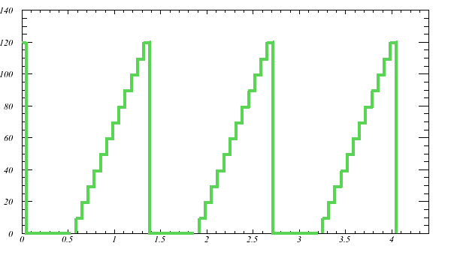
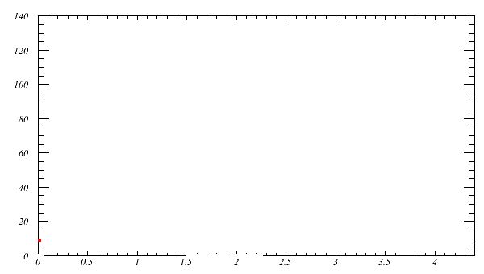
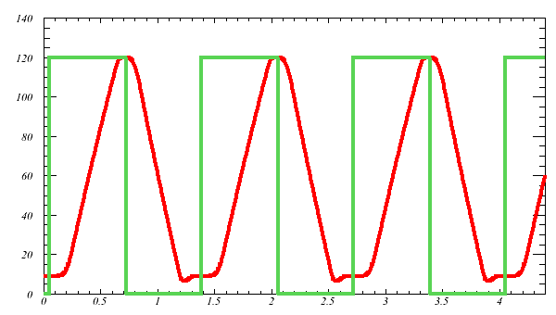
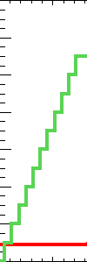
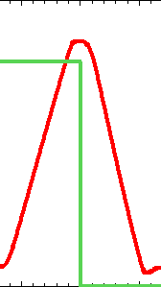
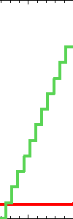
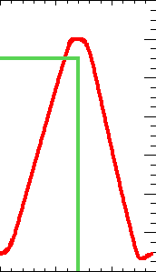
Motivation for Re-Purposing
120-GeV ramp time ~1.3 seconds
PS duty cycle of 66 mS (15 Hz)
12 proton batches from PS injected into MI takes 0.8 sec.
Almost double MI duty cycle by using RR for proton injection!
Beam power -> 350 KW to 700 KW.
Recycler
Main Injector

Slide 12
Decommissioning RR
Electron and stochastic cooling systems.
Existing transfer lines removed.
High & Low Level RF systems
Diagnostics: BPMs, BLMs, schottky pick-ups, ect.
Timing scenarios, beam synchronization, etc.

Slide 13
Decommissioning RR Electron Cooling
5 MeV electrons were injected parallel to the stored pbars.
Pbars exchanged momentum with much cooler electrons, thus cooling the stash.
Electrons were returned from the RR to the Pelletron, where they were decelerated and collected.

Slide 14
Decommissioning e-Cool Budgets are tight, so…

Slide 15
The last slide was joke. The Pelletron is not for sale on eBay.

Slide 16
Scope of Shutdown Jobs

Slide 17
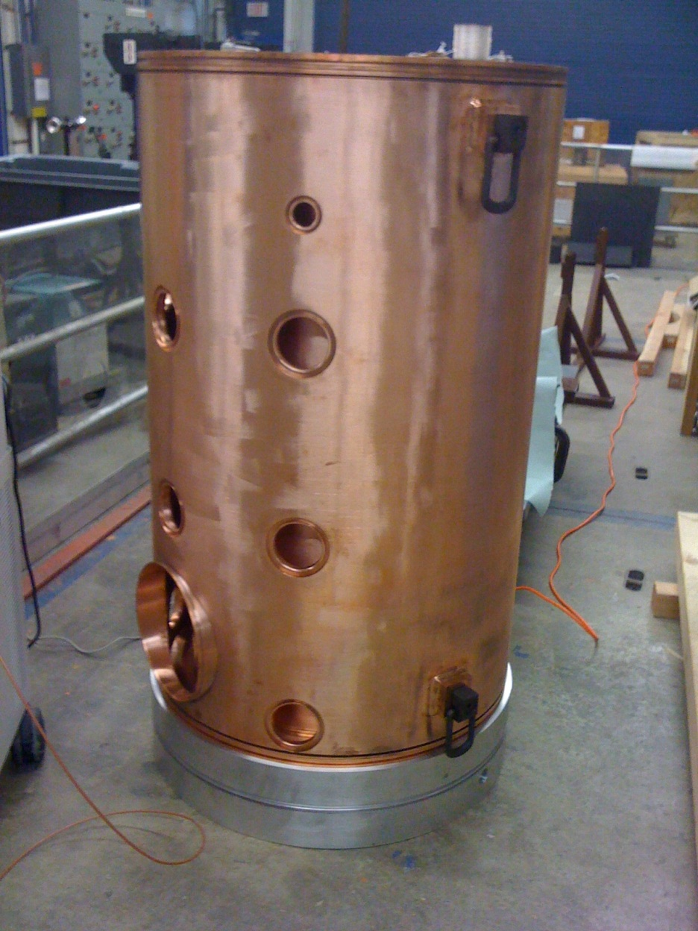
Completely New RF Installation
Original RR RF was a low power 2.5 MHz system.
NOvA era RF will be (compariatively) high power 53 MHz system.
Slip stacking will take place in the Recycler.
New LLRF, Anode Supply, Modulators & Power Amplifiers.
Old RF will be used as transverse & longitudinal dampers.

Slide 18
Converting RR to Proton Storage Ring
New 8-GeV injection line directly from the Booster.
Three new 53 MHz RF cavities (original 2.5 MHz RF cavities will serve as longitudinal and transverse dampers).
New extraction line to Main Injector.
Injection gap clearing kickers (reduce losses during injection process).

Slide 19
Converting RR to Proton Storage Ring
New BPM system: Dual 2.5 & 53 MHz boards to support NOνA and Muon Rings operation (g Minus 2 & μ-to-e experiments)
New beam loss measurement process – how do you differentiate loss from MI & RR?
New Diagnostics: e.g. Ion Profile Monitors
New time-line paradigm.

Slide 20
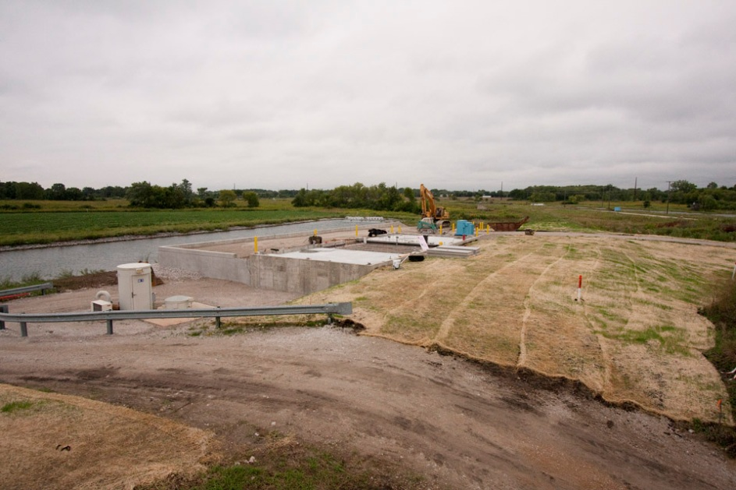
New Service Buildings
MI14 – Injection Kicker Power Supplies & controls
MI39 – Gap Clearing Kickers

Slide 21
3D Draft of New Injection Line: Booster to RR

Slide 22
RR-8 Line Magnet Installation

Slide 23
Impact on Operations
Some operators on loan to other groups during shutdown (e.g. Alignment, Instrumentation, etc.)
Brand new operating paradigm.
Constant supply of high power protons in MI/RR tunnel -> Beam Envelope & radiation safety (shielding!) considerations.
Many new applications to be written and learned.

Slide 24
Operator involvement
Writing new console applications.
Building new utilities – e.g. Electronic Logbook.
Maintain skeleton crews during shutdown.
Tunnel work –
Removal of obsolete instrumentation
Alignment
Terminating new BPM cables

Slide 25
Other Upgrades of Note
New H⁻ ion source!
Renovation the Booster RF cavities and modulators.
Two additional RF cavities will be installed in the Main Injector.
New targets for neutrino production.
New slow extraction septa for switchyard programs.

Slide 26
Summary
Fermilab’s mission has shifted from the “Energy Frontier” to the “Intensity Frontier.”
We need to double power onto the NuMI target without significantly increasing the Proton Source output.
To meet this goal we’re converting the Recycler to a proton storage ring and upgrading many other systems.

Slide 27
Thanks for your attention.
Questions?
The Fermi National Accelerator Laboratory is a U.S. Department of Energy (DOE)research laboratory, operated under DOE contract by Fermi Research Alliance(LLC), a joint partnership of the University of Chicago and the Universities Research Association (URA).

