Slide 1
Operations at TRIUMF
How we do Business
Workshop On Accelerator Operations 2012
Eric Chapman 520MeV Operations TRIUMF

Slide 2
Site Information
Where are we?
Consortium of Canadian Universities
TRI University Meson Facility
Partners with MDS Nordion
Located on UBC campus Vancouver, BC
Total staff of ~400
Financing
National Research Council of Canada
5 year plans approved by federal government of Canada
Additional from grants and private revenue

Slide 3
Arial View of TRIUMF

Slide 4
Accelerators On Site
Cyclotron Operations
520MeV Cyclotron, 200-250uA in high current mode
300kV ion source
Soon to be added photo fission E-LINAC
ISAC Operations
ISAC I Drift tube LINAC, 1.5MeV/u
ISAC II Superconducting LINAC, 20MeV/u
8 cryo modules housing 40 SC RF cavities
TR-13 Cyclotron for PET, and 2 TR-30 Cyclotrons in Nordion

Slide 5
520 MeV Cyclotron

Slide 6
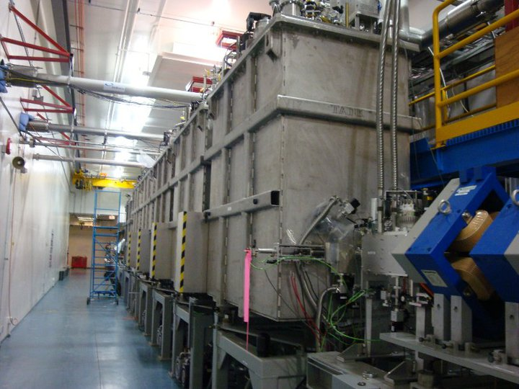
ISAC II Superconducting LINAC

Slide 7
Beamlines
Cyclotron
300kV injection line
BL1A, 483MeV, 200uA, Meson production
BL1B, 483MeV, NIF, ~400counts
BL2A, 480MeV, 100uA, ISAC spallation target(s)
BL2C4, 100MeV, 80uA, soon 110MeV, 100uA
BL2C1, 70MeV-116MeV, PIF, 10nA
BL4, soon to be ‘4N’, 480MeV, 100uA
ISAC
Secondary (R)IB beamlines to TUDA, DRAGON, 8Pi, EMMA &TITAN
ISAC II Superconducting LINAC, 20nA limit to EMMA and TITAN

Slide 8
Operations Staffing and Shifts
Cyclotron Operations
5 shifts of 3 operators per shift (min of 2)
One Supervisor per shift
3, 8 hour shifts per day starting 07:00 15:00 and 23:00
Main Control Room manned 24hrs, 365 days a year
Shuffle semi-annually
Weeks split into 4,3 with 35 day rotation

Slide 9
Operations Staffing and Shifts
ISAC Operations
5 shifts of 2 operators per shift (min of 1)
3, 8 hour shifts per day
Weeks split into 2,2,3, Starting on Monday
Off shift during Shutdown
10 week rotation
Supervises beam delivery in ISAC
LINAC operations
RIB tuning

Slide 10
Main Control Room
OpenVMS 8.3-1H1, X Windows environment
Proven reliable, fast and secure
Dedicated screens yield reproducible ergonomics

Slide 11
ISAC Control Room
More common EPICS interface
Linux based environment

Slide 12
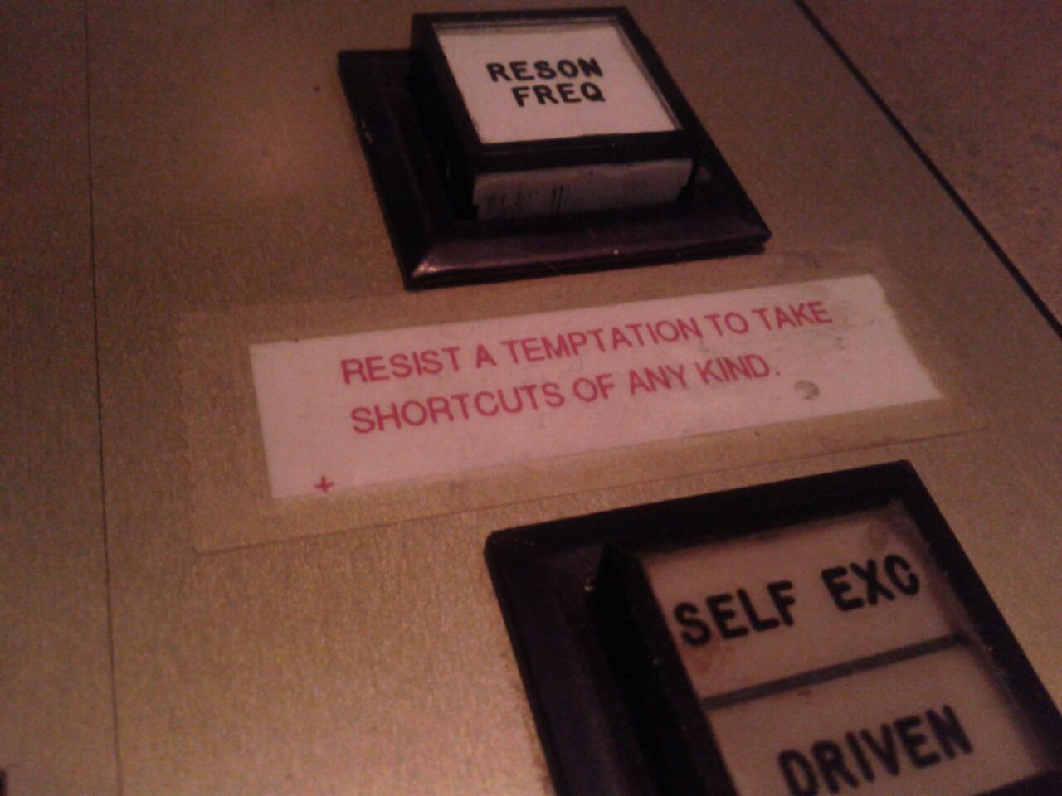
Reliability
Cyclotron 2011 availability achieved 93.7%. Goal >90%
ISAC Rare Isotope Beam delivery:
2011 RIB hrs projected:~2550 (successful year)
2010 RIB hrs: 1730

