Slide 1

Diagnostic tools at TLS and some case studies on failure analysis
Yi Chih Liu
Operation group / Light source division
NSRRC
WAO 2012, 7 August
Notes:
Good morning!
I am Yi Chih Liu from Taiwan light source

Slide 2
Outline
Introduction
Diagnostic tools
Some case studies on failure analysis
Notes:
In this talk, I will give an introduction about TLS storage ring and its upgrades, and then the revolution of developing diagnostic. In the end, I will talk about some case studies on failure analysis.

Slide 3
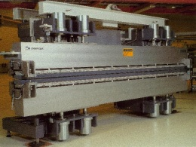
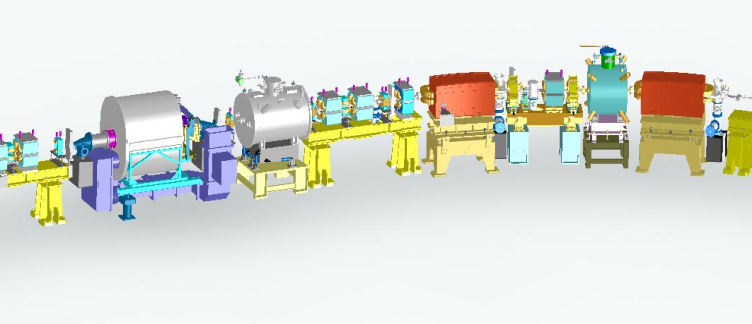
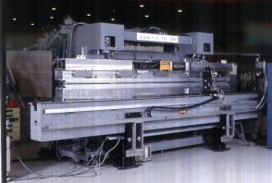
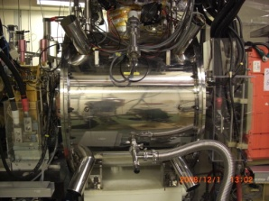
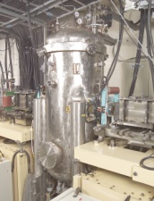
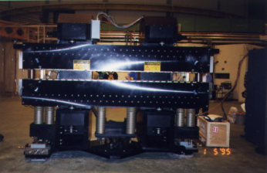
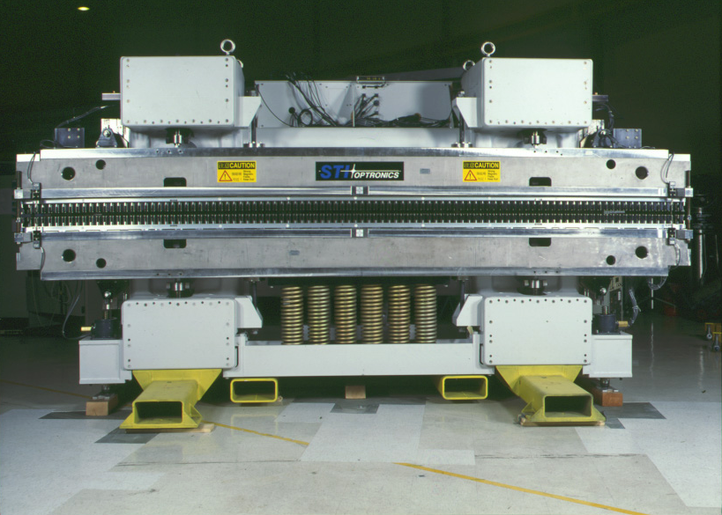
Layout of TLS accelerators
EPU56
U50
BM2
SRF & SW60
U50
SRF & SW60
EPU56
W200
SWLS
U90
IASW60
Injection
Transfer line
IASW60
SWLS
U90
W200
Notes:
The circumference of TLS storage ring is 120 meter with 6-fold symmetry. Every six-meter-long straight section is occupied by an insertion device. To accommodate the increasing demands over beam time and higher brilliance by the growing number of NSRRC users. Three identical superconducting wigglers have been built; all are installed at the location between the first two dipole magnets of 2nd, 4th and sixth TBA cell respectively.

Slide 4
History of TLS machine upgrades
Notes:
The purposes of installing SRF cavity are raise the stored beam current and eliminate the beam-induced high order mode in the Doris cavity. For developing a proper diagnostic tool, it is crucial to understand the major different between decay mode and top-up mode operation, the difference between SRF cavity and Doris cavity, and the difference between conventional insertion devices and superconducting insertion devices.

Slide 5
Evolution of diagnostic tools
Failure analysis was used a ‘history’ program to trace the information from 0.1 Hz or 10 Hz database – no kicker waveform information, no booster information
Monitor kicker waveform and linac parameters every injection
Monitor all parameters of superconducting insertion device using data acquisition recorder
Monitor the parameters of SRF and record the data after trip using data acquisition recorder
Implement 96 channel digitizer to monitor the slow and fast signals simultaneously
Implement real time spectrum analyzer to monitor transient tune shift
Notes:
In the early days of decay mode operation, an archive program can fulfill the majority requirement of failure analysis.
We that the evolution of developing diagnostic tool is a process for improving failure analysis at TLS

Slide 6
Classification rule for diagnostic tools
0.1 Hz/10 Hz data archive, trip of storage ring power supply (OP)
A 16 bits digitizer with 96 channels, superconducting insertion device quench and interlock (instrument & control)
96 channel digitizer and with access program, SRF quench and interlock (RF)
Oscilloscope, real-time spectrum analyzer with access program, kicker waveform and tune measurement (OP)
Voltage sag recorder (Utility)
Notes:
The diagnostic tools can be divided in several groups, depends on developing by which group
To find out the failure cause must combine diagnostic tools sometimes

Slide 7
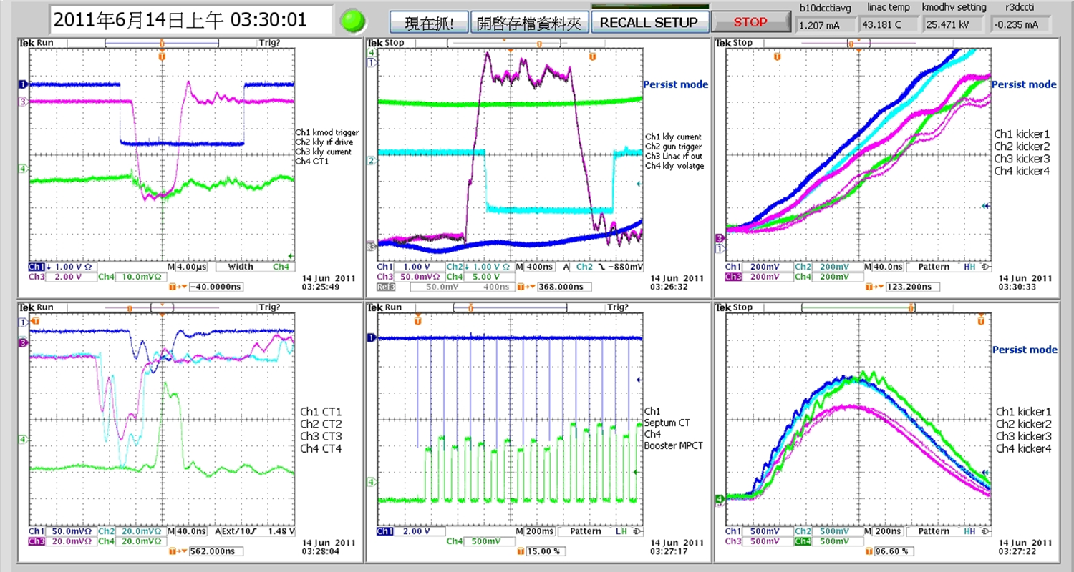
Waveforms capture
Linac modulator monitor
Linac klystron monitor
Kicker waveform monitor
Linac performance monitor
Booster current monitor
Notes:
This is a snapshot of waveforms capture from oscilloscopes, which used to monitor Linac performance, booster current stability, kicker pulse jitter

Slide 8
MATLAB-based analyzer
1
2
Notes:
This MATLAB application interface is developed by I&C group, which was used to identify the time of occurrence between the trip of power supply and quench of superconducting insertion device

Slide 9
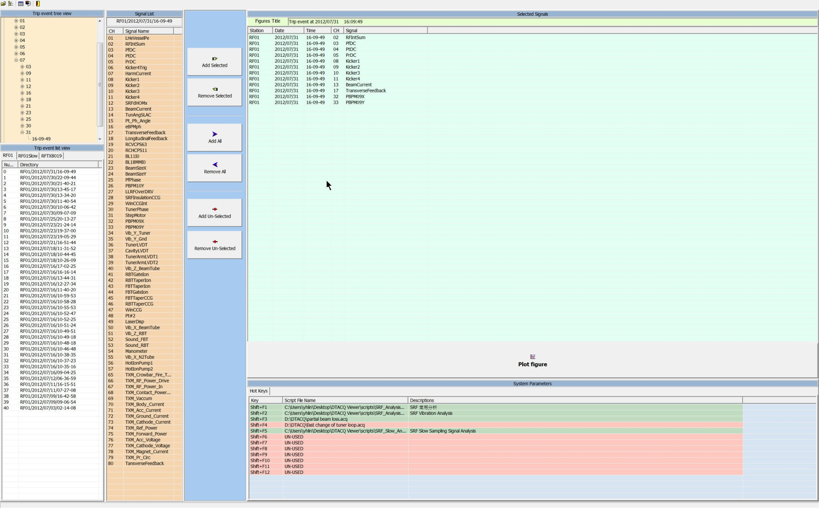
D-TACQ data analyzer
Notes:
This D-TACQ data analyzer is developed by RF group, which is used to identify the time of occurrence between the trip event of stored beam and quench event of SRF cavity

Slide 10
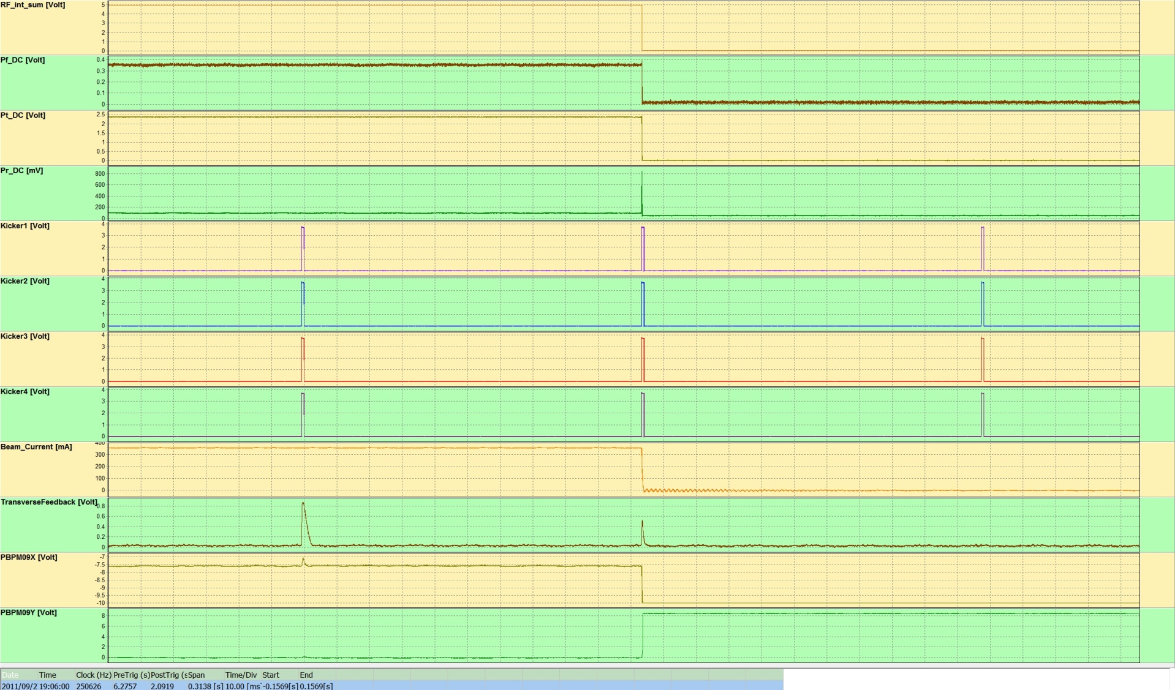
Failure analysis – case 1
Notes:
The beam loss occurred during injection

Slide 11
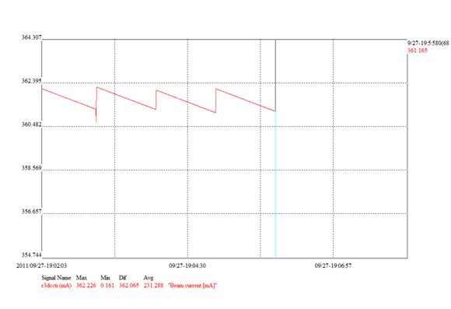
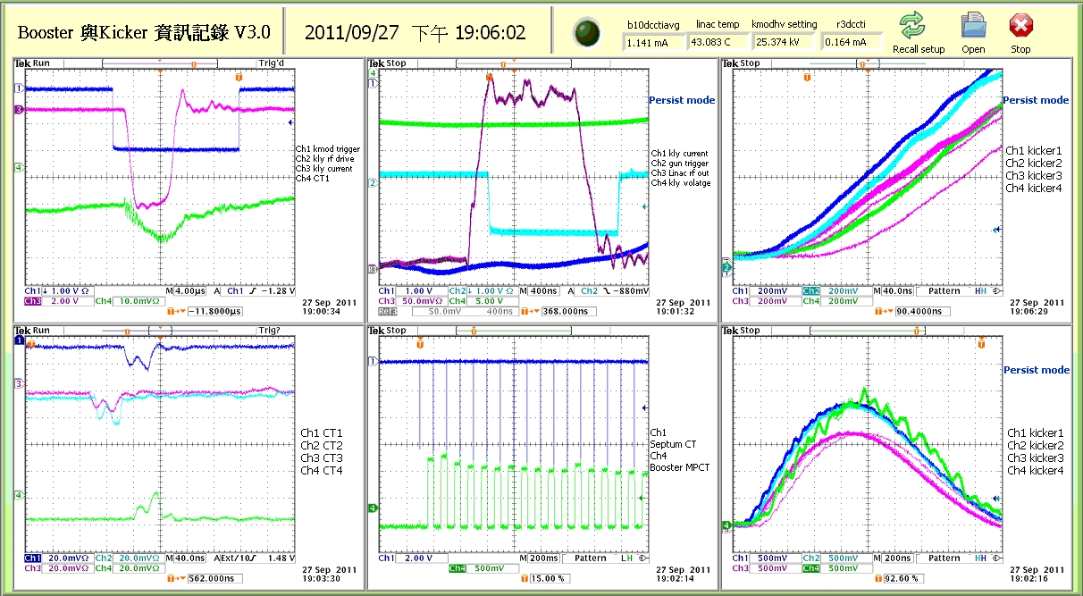
Failure analysis – case 1 kicker waveform shifted during injection
Stored beam current
Time
Notes:
The beam loss was caused by k3 waveform shifted during injection

Slide 12
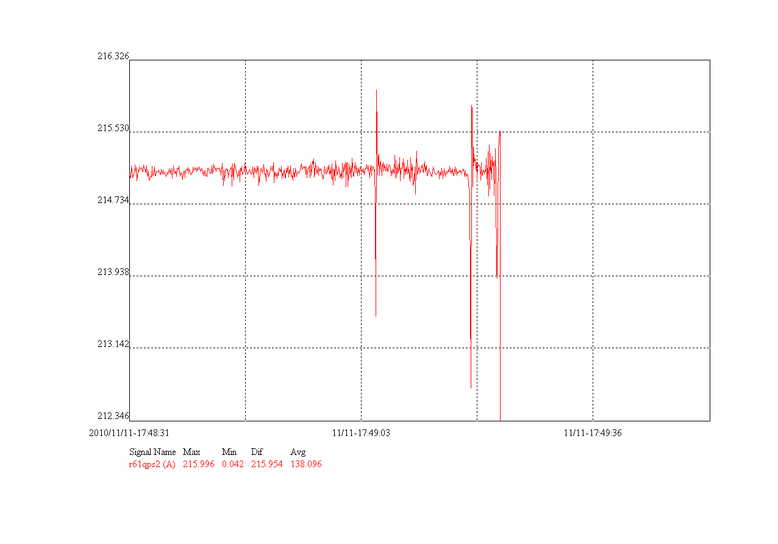
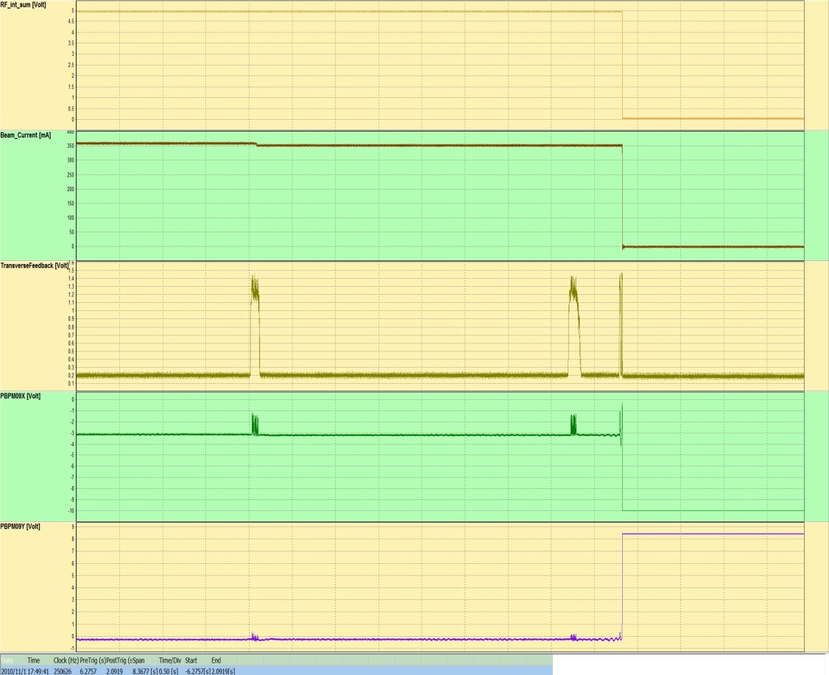
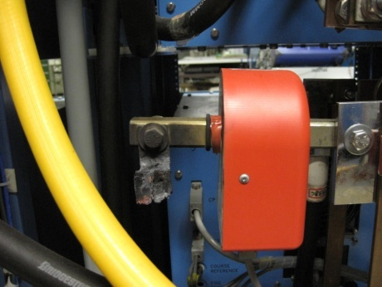
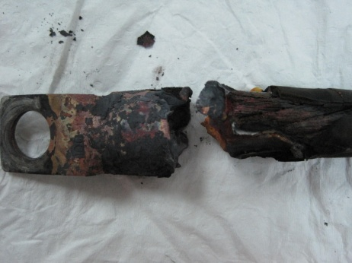
Failure analysis – case 2
Broken of power supply connector
Quadrupole current
Output power of TFB
Time
Notes:
By combining the archive data with data analyzer we found that the spikes of output power of TFB were caused by the spikes of quadrupole current ,and of course the spikes of quadrupole current resulted from a broken connector

Slide 13
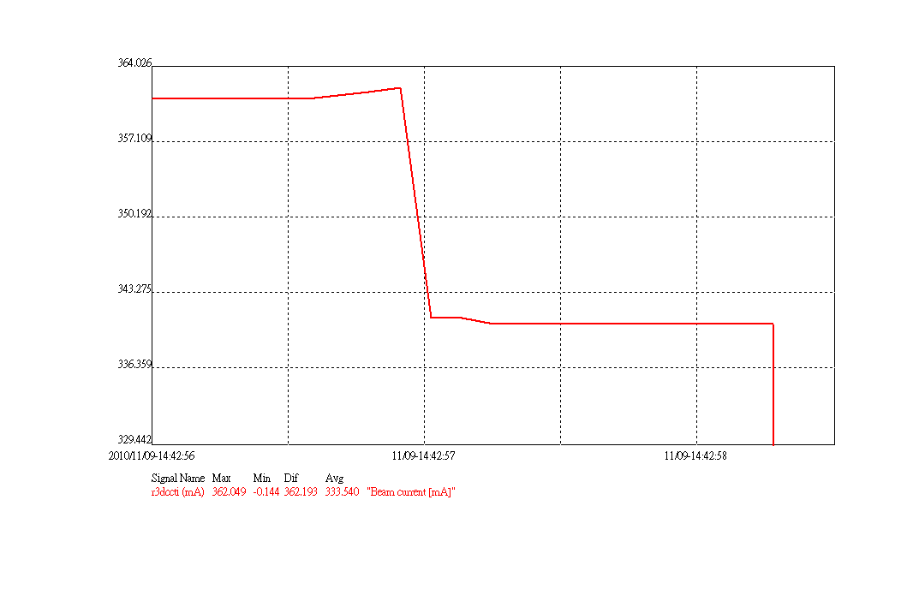
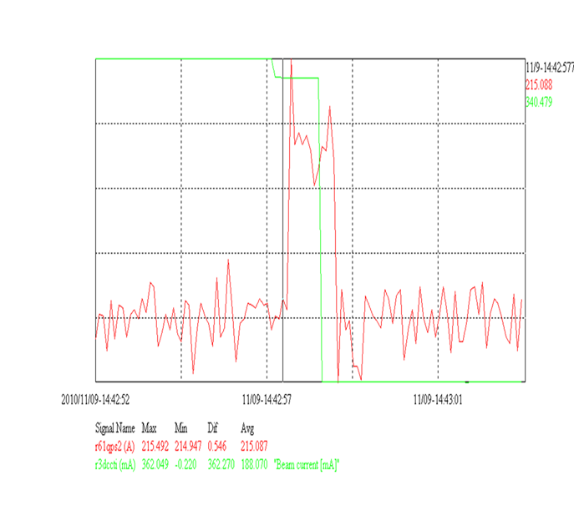
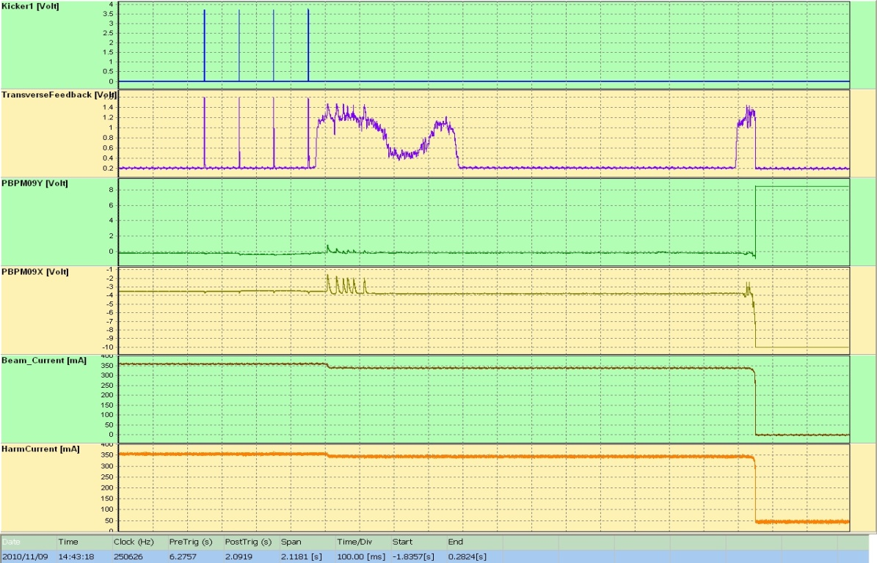
Failure analysis – case 2
When the connector started breaking
Beam current vs. quadrupole current
Notes:
Compared to the similar failure patterns, We found there was another trip event caused by the broken connector. It seemed to be that the connector of quadrupole power supply started breaking and induced the applied quadrupole current change, the a partial beam losses occurred subsequently

Slide 14
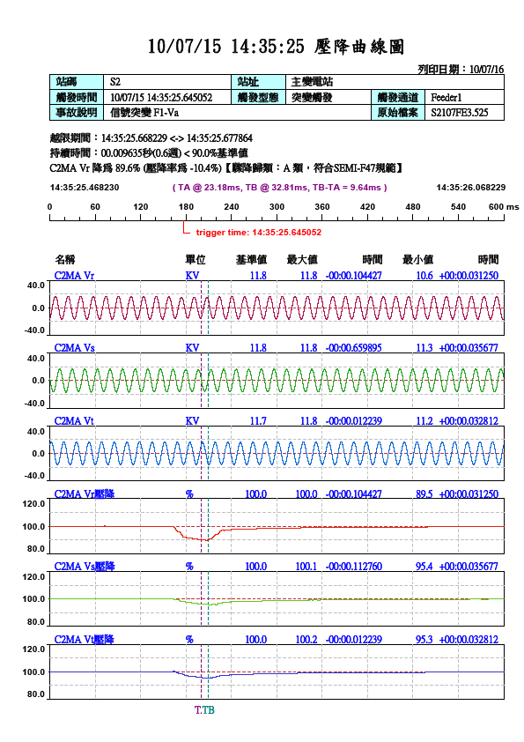
Failure analysis – case 3 Voltage sag
Notes:
This is an example of combination of several diagnostic tools to look at what was going on when a voltage sag event of Tai-power. occurred

Slide 15
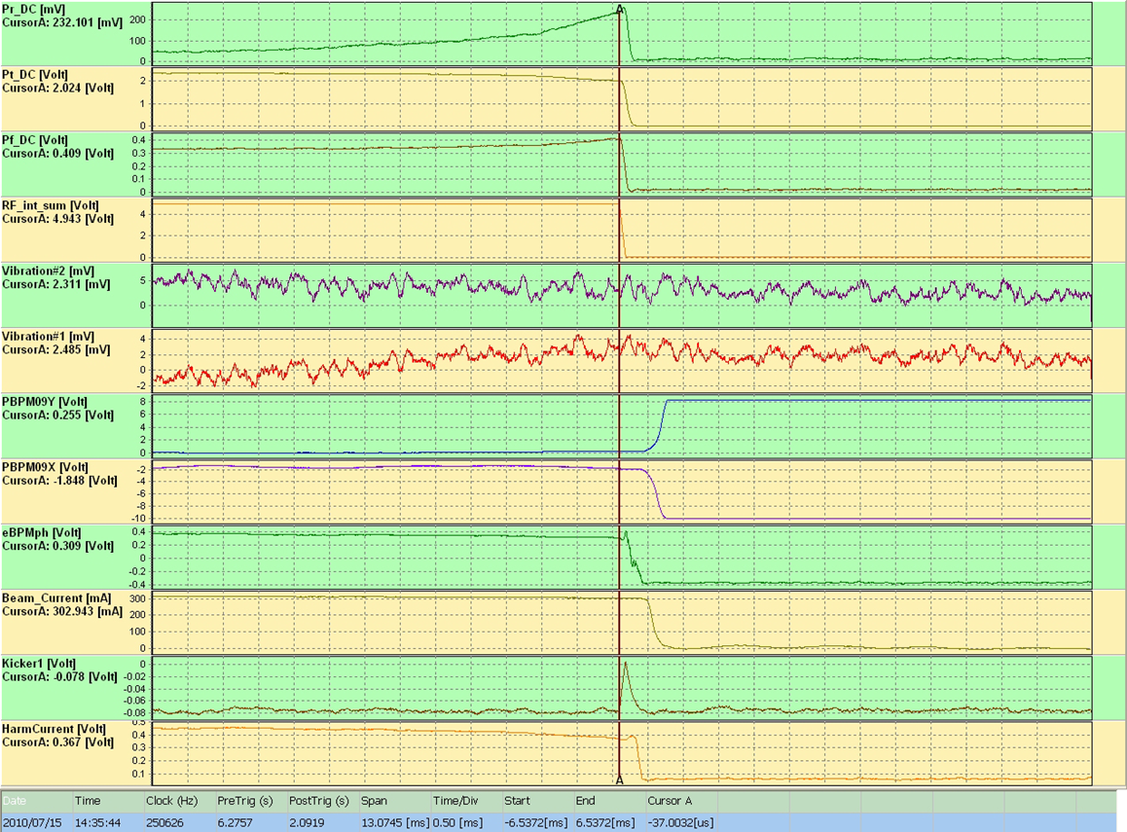
Failure analysis – case 3
The SRF interlock sum was triggered by continuous loss of stored beam

Slide 16
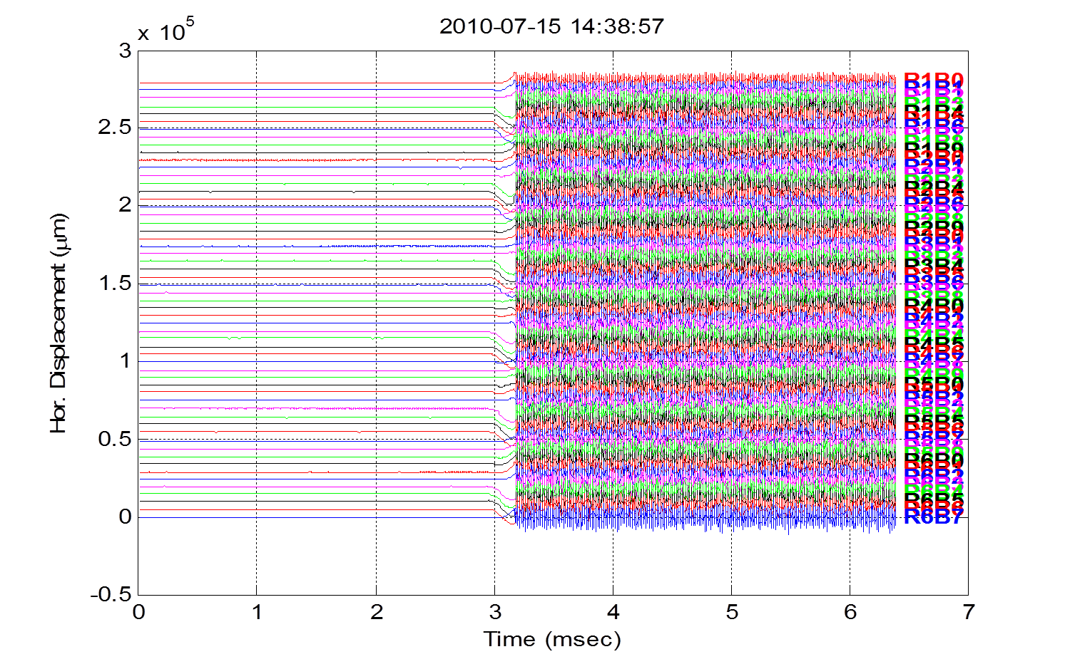
Failure analysis – case 3
Turn-by-turn BPM signals
Notes:
Form turn-by-turn BPM signals, we found that the SRF high voltage was terminated before stored beam was lost.

Slide 17
Failure analysis – case 3
Voltage sag event occurred
Notes:
There was occurrence of voltage sag event

Slide 18
Failure analysis – case 3
Observed vertical beam instabilities
Notes:
Observed occurrence of vertical beam instability

Slide 19
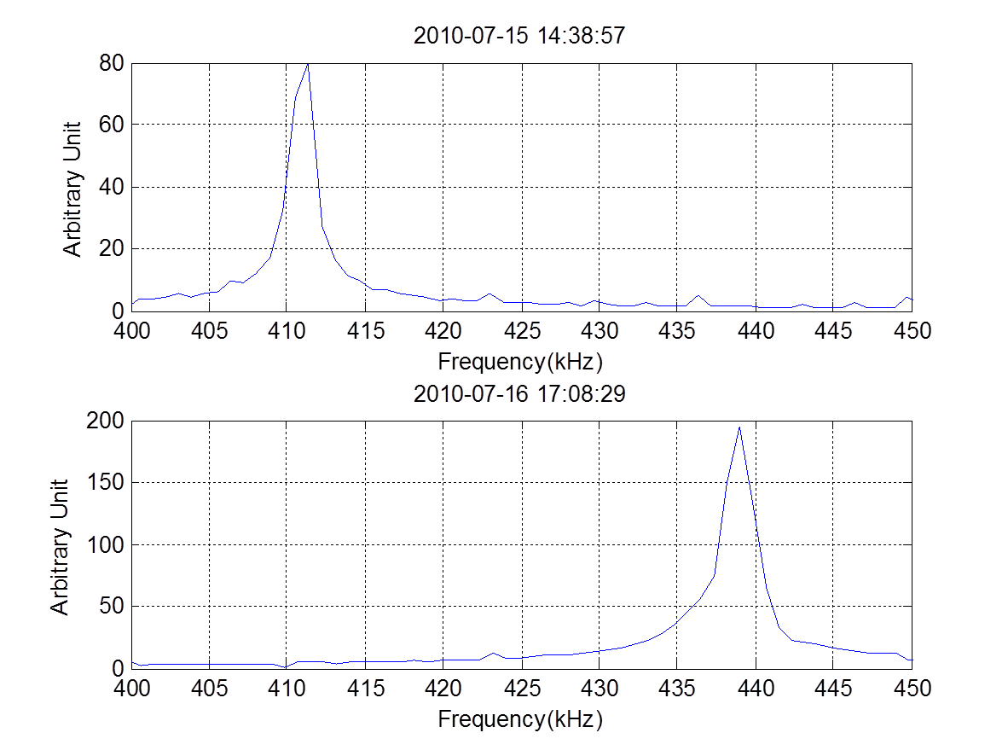
Failure analysis – case 3
Abnormal fractional vertical tune
Normal fractional vertical tune
Notes:
The vertical beam instability was caused by vertical tune change during termination the SRF gap voltage

Slide 20
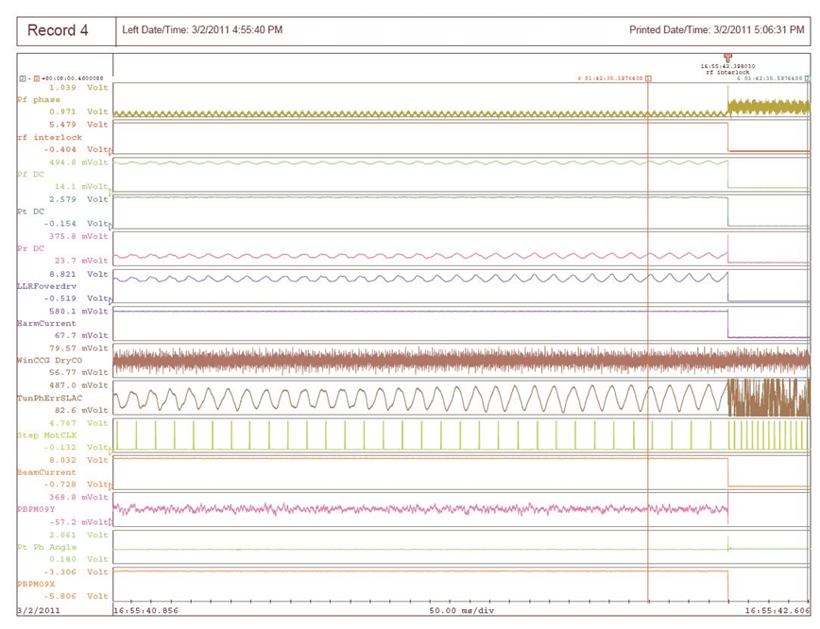
Failure analysis – case 4
Pr, Pf, tuner phase oscillated
Notes:
The amplitude overdrive interlock was triggered by unstable tuner phase oscillation

Slide 21
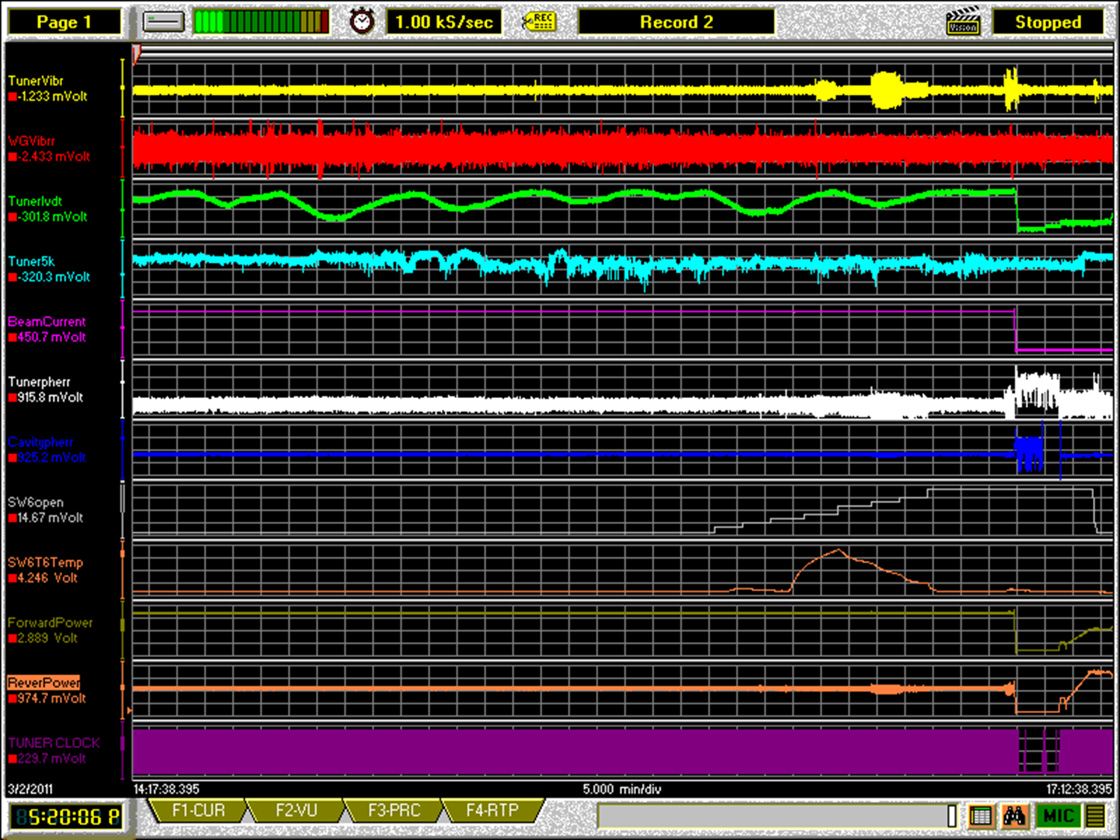
Failure analysis – case 4
It correlated to LHe valve open of SW60
Notes:
It seemed that the tuner phase oscillation was driven by a tube vibration of SW6 when LHe valve was partial opening. The beam pipe started vibrated when warm He gas impinged on it.

Slide 22
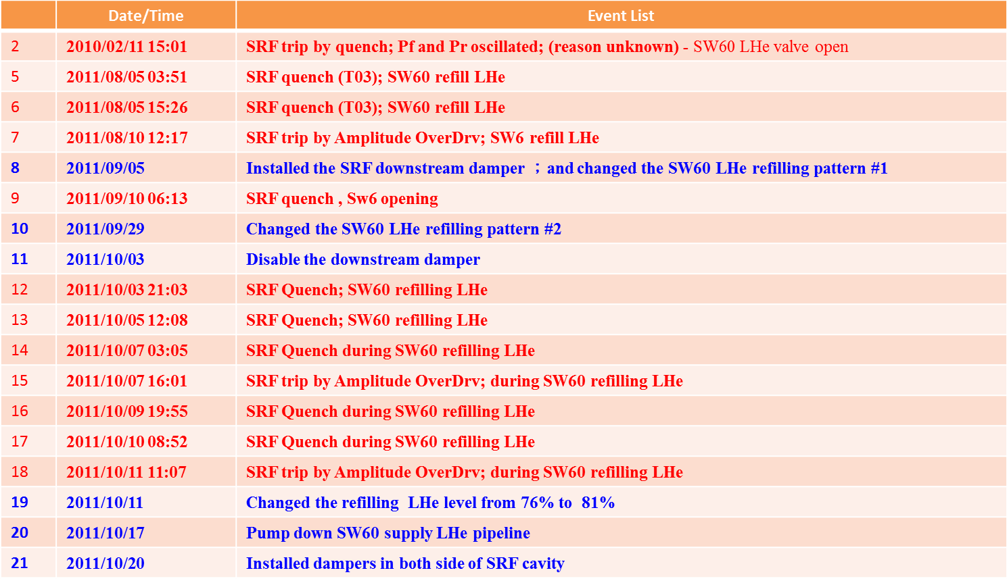
Failure analysis – case 4 event list and action items
Notes:
Several actions had been done. We believed that the problem was solved by raising the LHe level of SW6

Slide 23
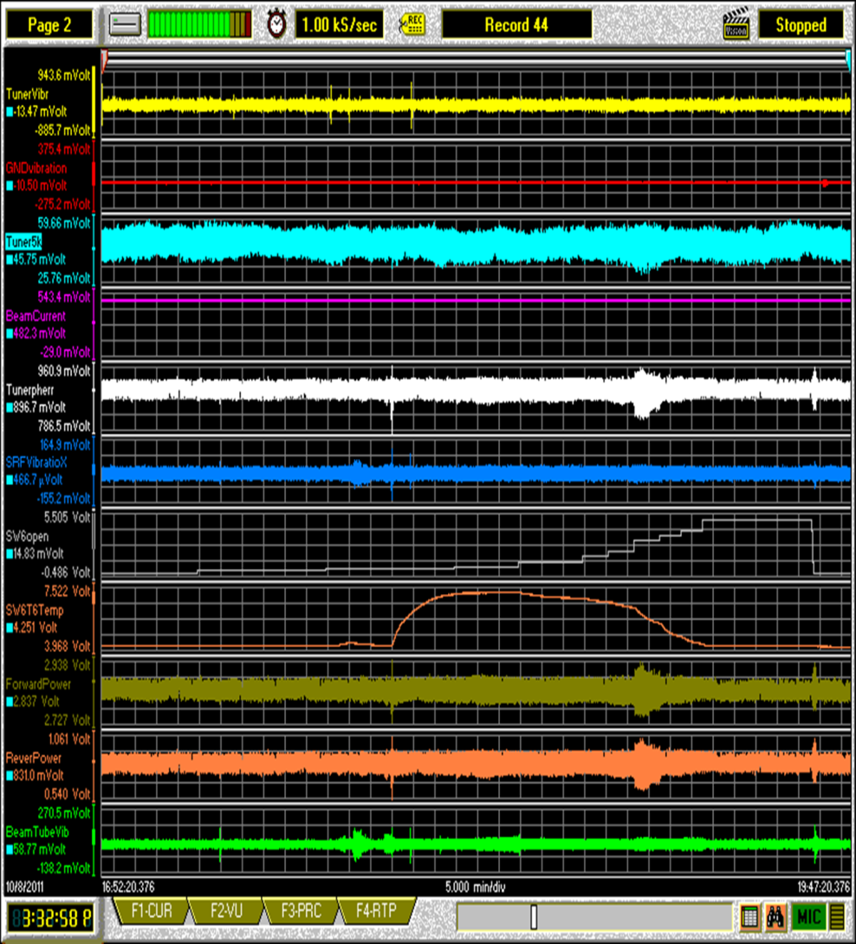
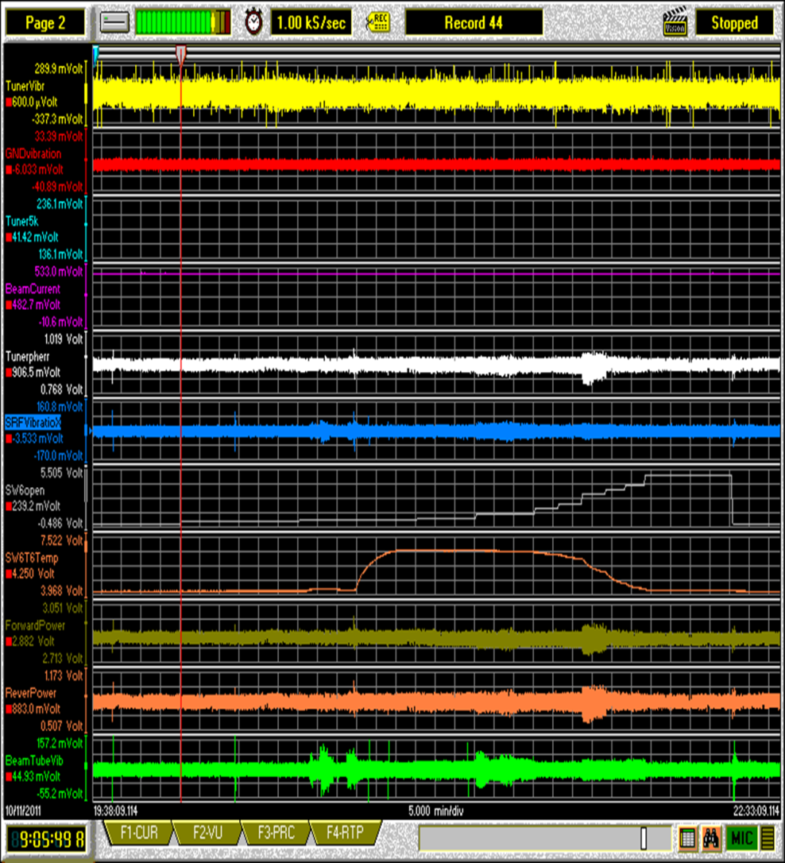
Failure analysis – case 4
Comparison between before and after actions
Notes:
The vibration decreased due to less increment of temperature when raised the refilling LHe level

Slide 24
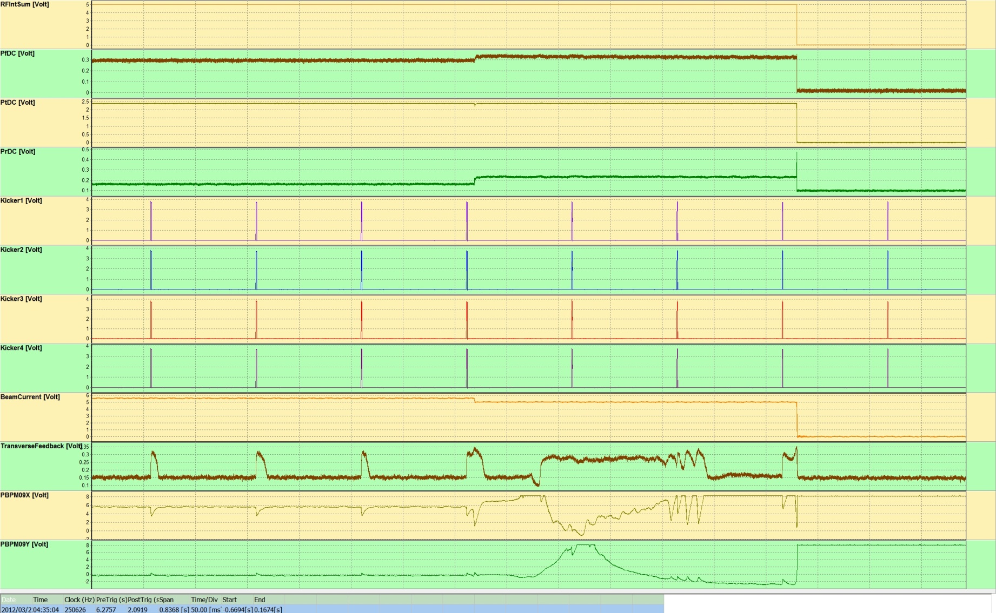
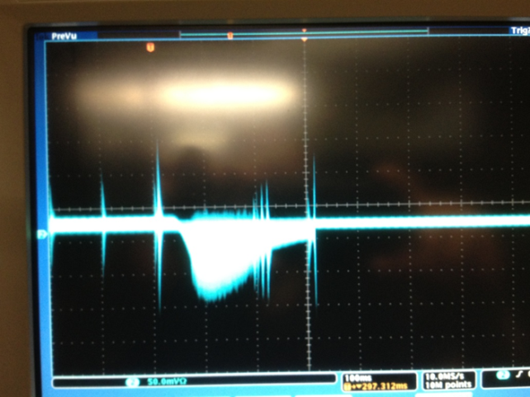
Failure analysis – case 5
TFB was unstable during injection
Beam instability from turn-by-turn BPM
Notes:
The last example show the transverse bunch-by-bunch feedback system was unstable during injection

Slide 25
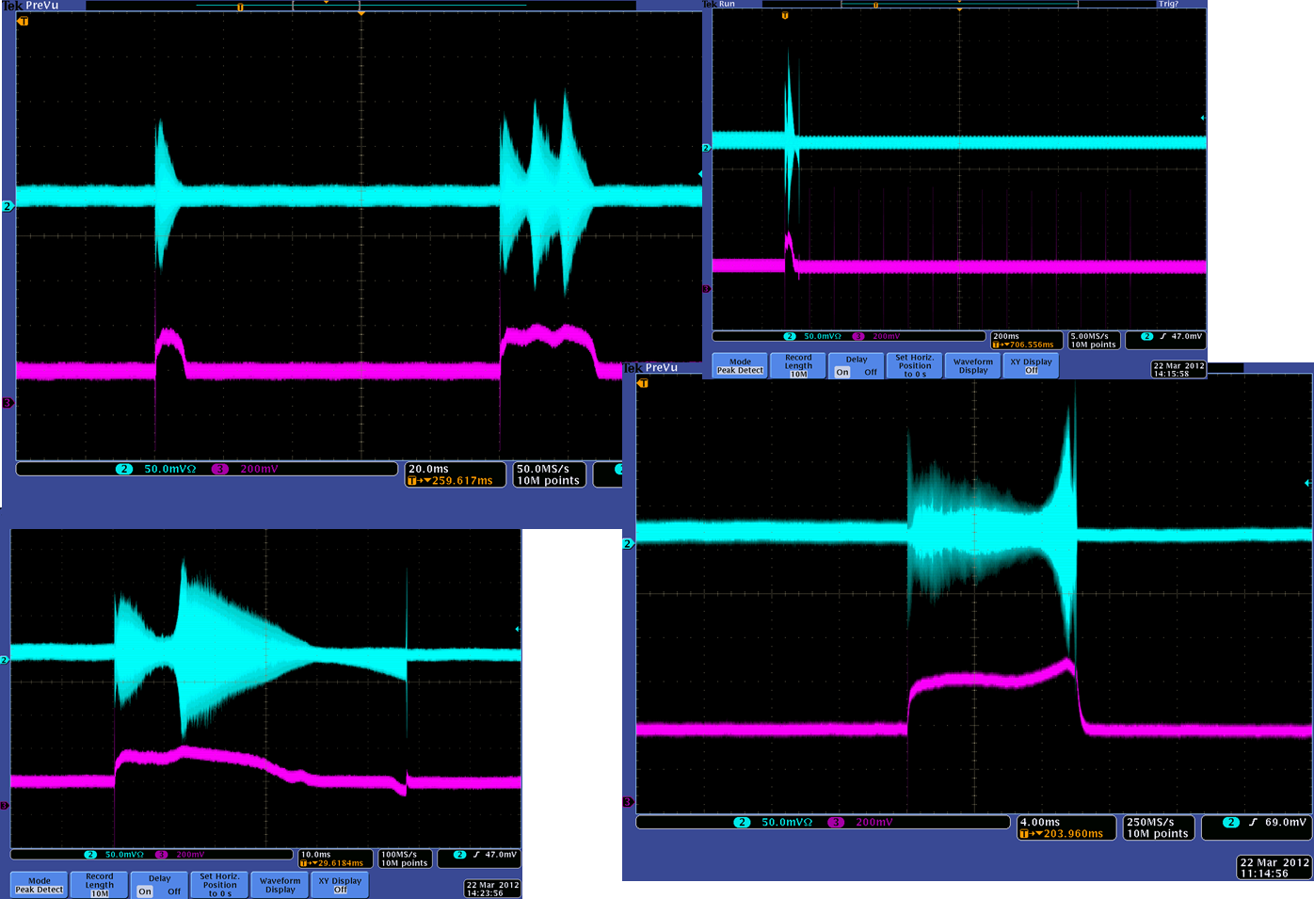
Failure analysis – case 5 some examples
Notes:
The accelerator physicists say that these phenomena were interesting, we should study the beam instabilities and find where are these come from
The feedback experts say that the growth rate is large than damping rate of feedback system, we need increase the power

Slide 26
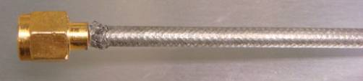
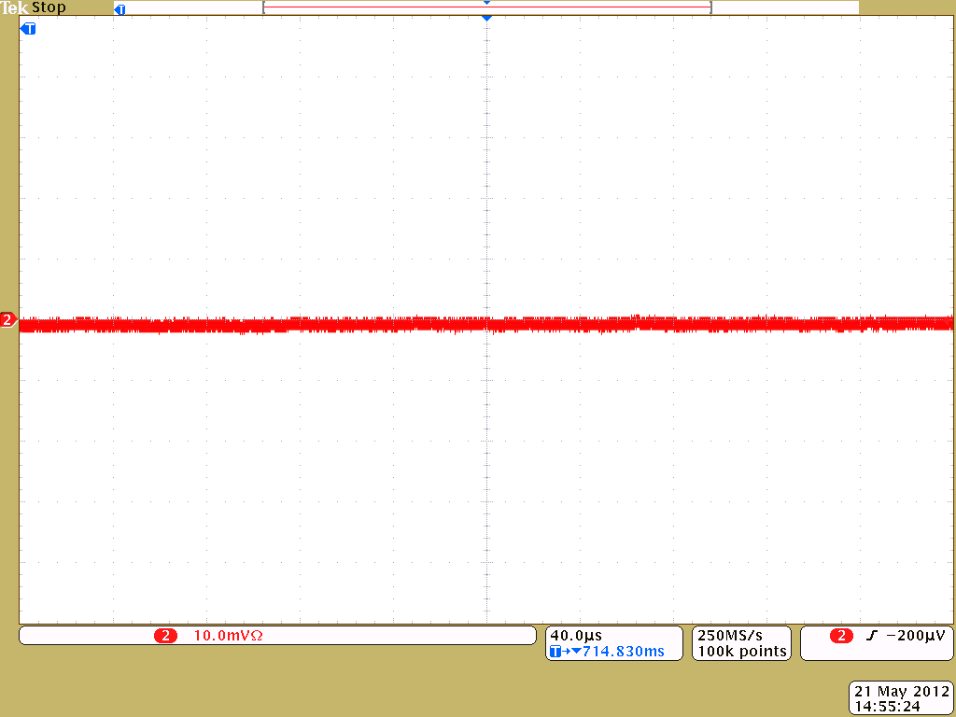
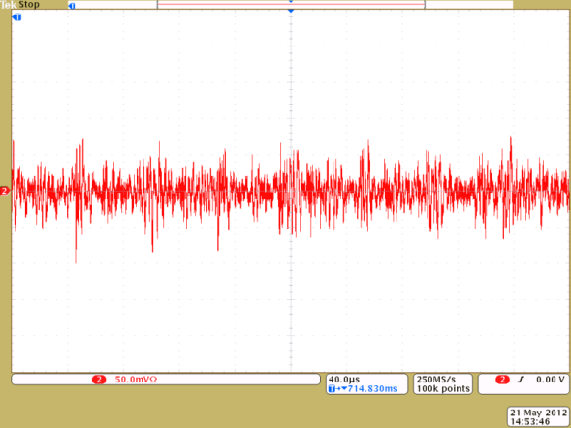
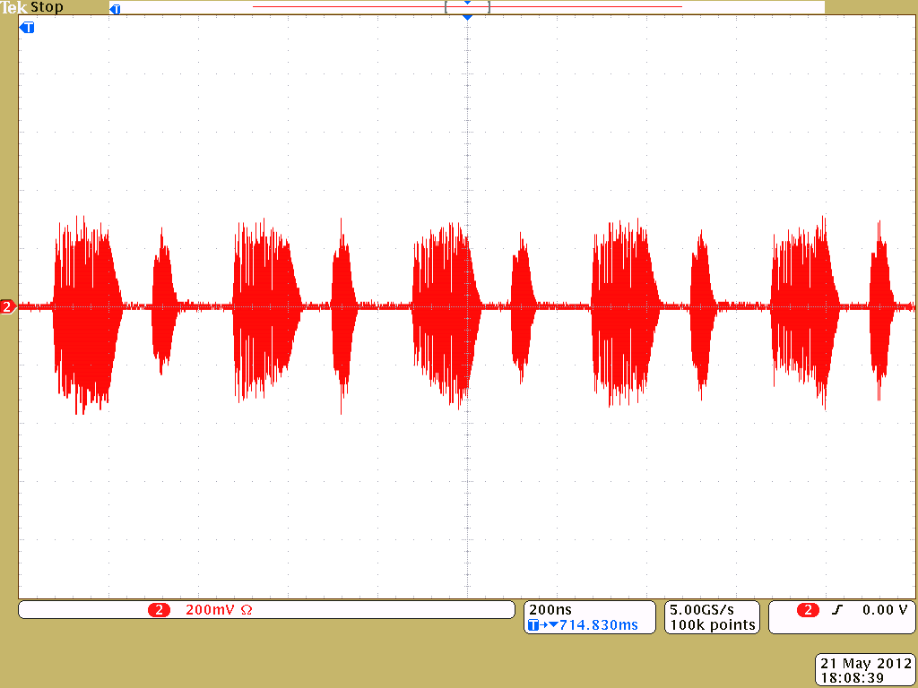
Failure analysis – case 5 the cause – a broken connector
Hybrid Network
Δ
TFB
Correct signal without beam
incorrect signal without beam
correct signal with 140 mA stored beam
Notes:
The feedback could not work well due to an incorrect delta signal, which was caused by a broken connector

Slide 27
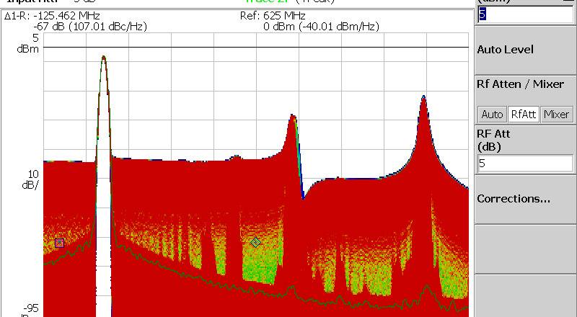
Failure analysis – case 5
The missing part

Slide 28
Conclusion
Communication is the only problem
No common language no communication
Diagnostic tools can help us communicate with machine and people
If communication is still a problem, there will exist a missing information
Improve the diagnostic tool again

Slide 29
Thank you for your attention!

