Slide 1
Benefits of Beam Development Shifts
Paving the Way for 500uA Extraction from the
TRIUMF 520MeV Cyclotron
Eric Chapman
WAO 2012

Slide 2
Introduction to the Cyclotron
6 sector pinwheel Design
Maximum Operating Energy of 523MeV (0.77c)
Tank is 56’ across
Main RF frequency of 23.06000MHz
Main Magnet 5600Gauss (14.7kAmps DC)
Accelerates 278keV “Bunched” H- particles from 300kV ion source
First beam full energy beam in 1974
Maximum current achieved 420uA in 1988 (@ 50% duty cycle)
Variable energy and current output

Slide 3
Introduction to the Cyclotron

Slide 4
Typical Conditions
3 high current beam lines: 1A, 2A and 2C4
Can run independently or all at once
1A and 2A @ 480MeV
2C4 @ 100MeV, 110MeV soon
Cyclotron Spills <1.5%, Transmission ~65%
Time of flight, 340uS without RF booster
Main RF @ 92kV
Tank Vacuum 4E-8T
High current operation of 200-250uA

Slide 5
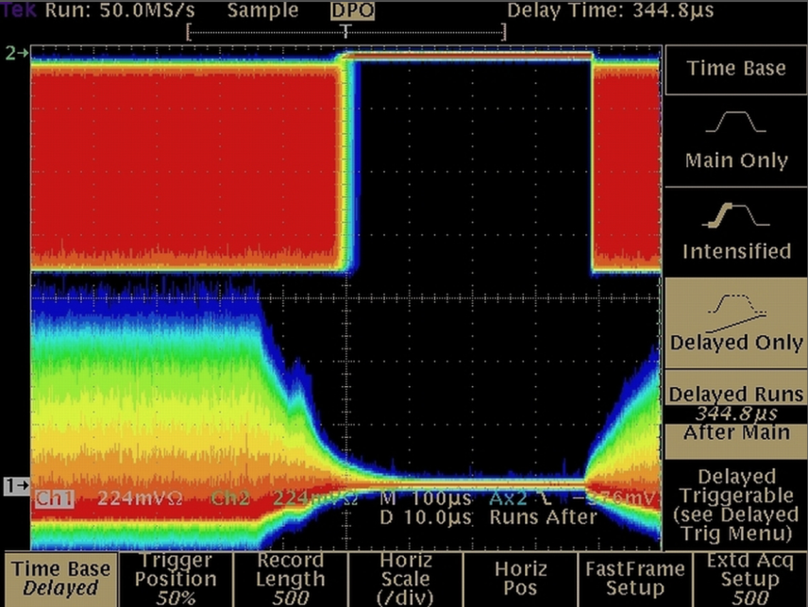
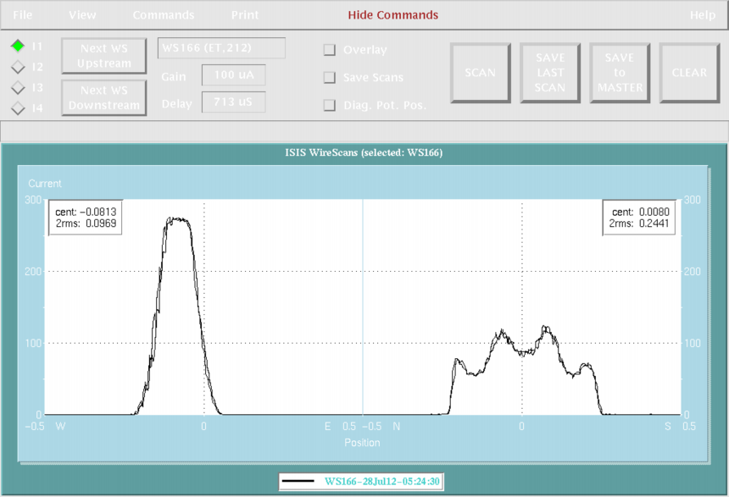
Standard Tuning Procedures
- ISIS buncher tuning
Correction Plates
‘Main’ Bz Coils 0/5/15/25/35/45 for minimum Time of flight
Inflector/deflector adjustment
RF Booster Phase
Always watch spills, Cyclotron Transmission and NBIF ratio
Watch thermocouples to avoid tank or equipment irradiation

Slide 6
Future Operational Demands
Go from 3, to 4 high current beamlines
Recommissioning of BL4 from 10uA max to 100uA for Advanced Rare IsotopE Laboratory (ARIEL)
2C4 upgrade increases current from 80uA to 100uA
Increase total available output from 250uA to ~440uA (1/5MW beam power)
Increase beam stability to reduce wear on ISAC spallation targets

Slide 7
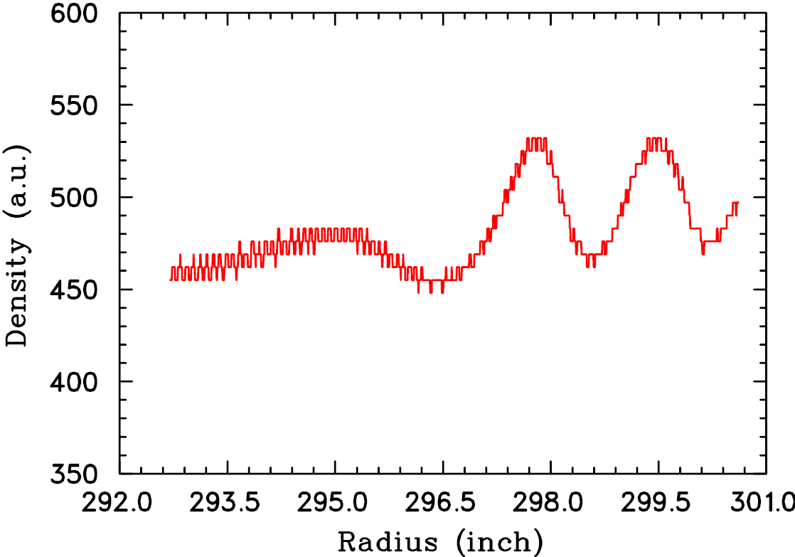
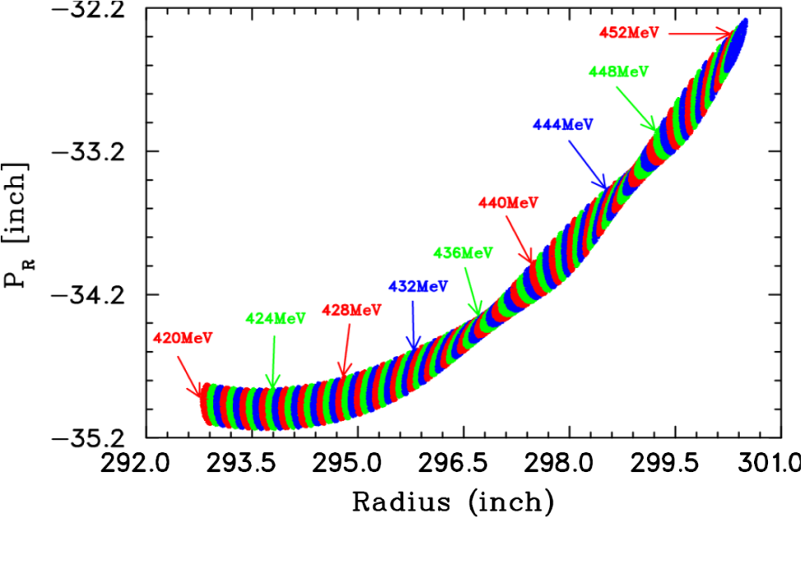
Vr=3/2 Resonance
First discovered in early 1980s
Caused by field errors violating the symmetry of the main magnet
Most noticeable in the 3rd harmonic of the magnetic field
Induces beam density fluctuations and rotation of beam past 428MeV (R=296”)
Drastically effects current stability in BL1, BL2A and BL4
Was sometimes difficult to tune “around” causing large swings in extracted current when tuning

Slide 8
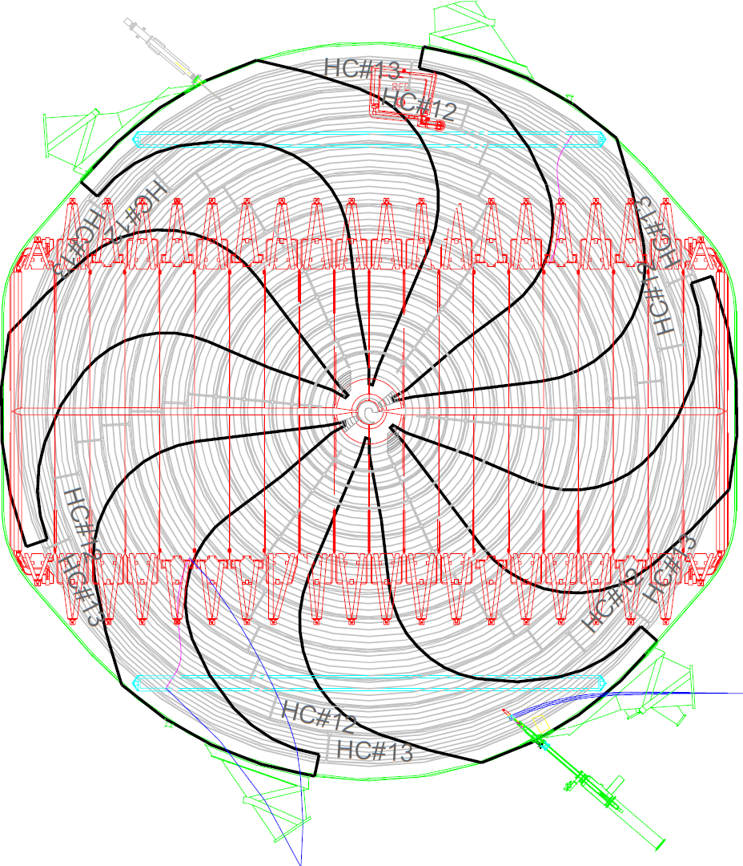
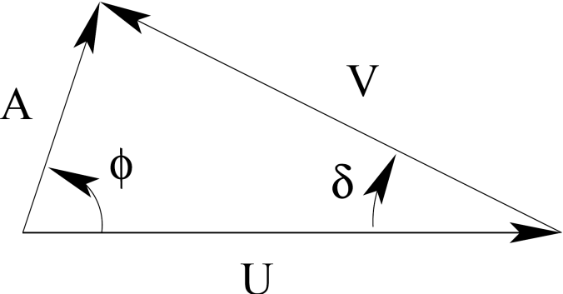
Resonance Correction
Partial correction with HC#13
Full correction with HC#12 and HC#13
Harmonic coils originally designed to correct for errors of 1st harmonic
Azimuthal offset between HC12 and HC13 allowed for 3rd harmonic component to be created and fully correct the resonance

Slide 9
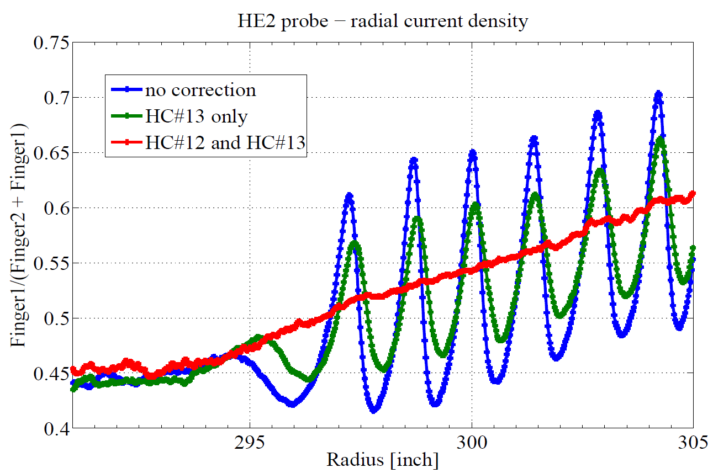
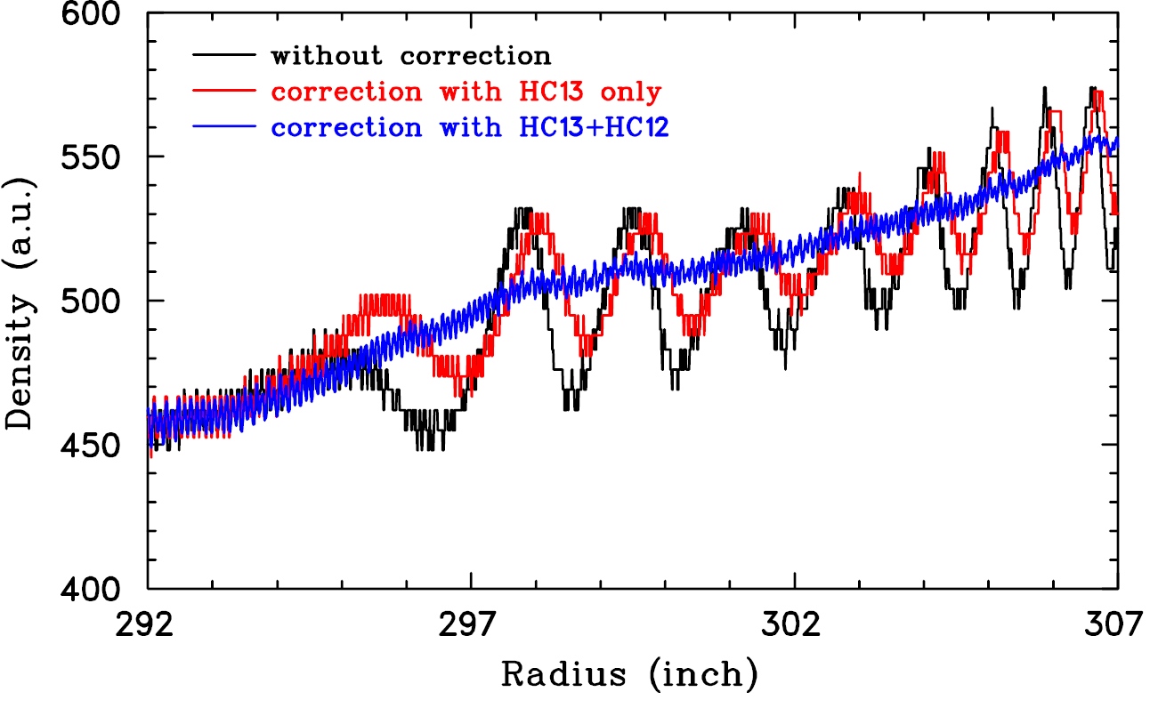
Resonance Correction
Correction superimposed on existing HC12 1st harmonic correction
Works beautifully, stability is now VERY good
Cyclotron is now much easier to tune at high current
Solution found by our beam physicists and implimented during development shifts

Slide 10
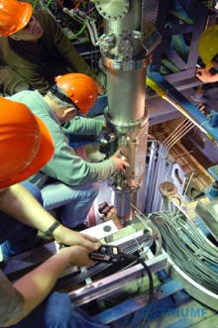
VIB Replacement
Entire Vertical Injection Beamline Replaced
New electrostatic optics design
Provision for 3rd Bunching system (re-buncher)
Designed to be capable of 22pC space charge density H- transport (double the old line)
2 years of successful use
Optics proven easier to tune than old injection line

Slide 11
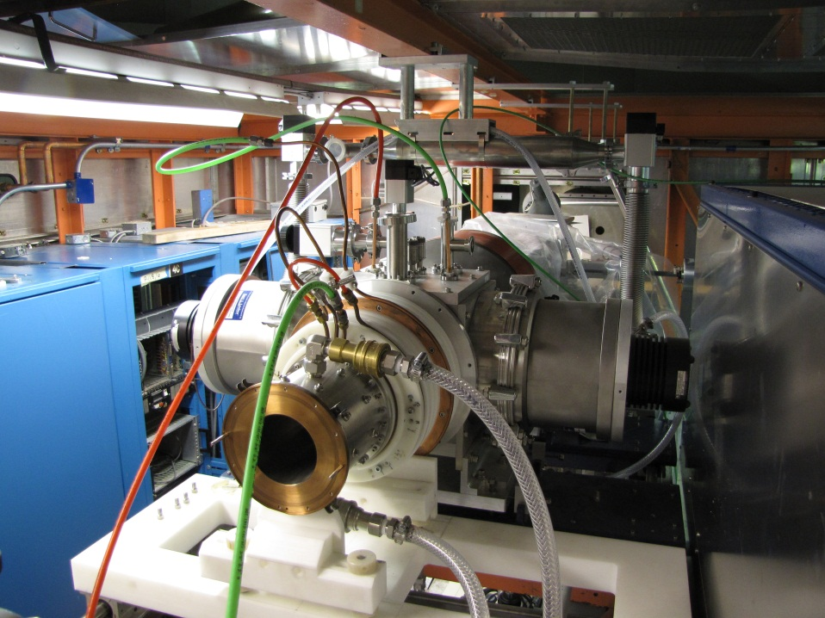
I3 Source Refurbishment
Current I1 CUSP source limited to ~600uA
I3 being gutted and replaced with new optics and CUSP Source
Will allow the CUSP source to run at full voltage
Goal of 1mA injection with lower emittance

Slide 12
Tank Contamination
7Be T1/2 = 53.29days
22Na T1/2 = 2.6088 years
BL1A and BL2A extraction energy lowered from 500MeV to 480MeV without definitive results
Suspect coming from EX1 probe housing
Probe raised after resonance corrected
X1Z raised from 0.350” to 0.450”
Check counts next shutdown in January

Slide 13
High Current Tuning
extraction >250uA
Open ISIS slits 125 &126 far as possible
Tune 1st buncher amplitude for transmission (check 2nd and main phase too)
Check optics at the end of the injection line
Ensure ISIS beamline matching is good
Peak Bz0 for transmission, checking main Bz’s with emphasis on 15, 35 and magic triplet
Tune outer Br coils(>43) for spills watching tank thermocouples
Watch spills, transmission, NBIF and thermocouples
Do it again and again…and then again
Can attain 300uA+ with 60% transmission, low spills

Slide 14
Conclusion
Cyclotron tuning is complex and demanding
Development shifts allow dedicated time for problem solving and idea testing
Having set procedure as in our “standard tuning” reduces stress on operators and mitigates potential damage
Tuning takes skill, experience, knowledge and patience
Complex or high risk tuning problems best worked out in meetings or by committee
Accelerator operations is ultimately a team effort, more heads the better

Slide 15
Acknowledgments
[1] T. Planche , Y.-N. Rao, R. Baartman, “Correction Of r = 3/2 Resonance in TRIUMF Cyclotron”, Vancouver, BC 2012
[2] Y.-N. Rao, R. Baartman, G. Dutto, and L. Root, “Studies of the r = 3=2 Resonance in the TRIUMF Cyclotron”, PAC’09, Vancouver, BC, May 2009, TH6PFP09, p. 3940–3942.
[3] R. Baartman, G.H. MacKenzie, and M.M. Gordon, “Amplitude growth from the rapid traversal of a half-integer resonance”, 10th Int. Conf. on Cyclotrons and their Applications, East Lansing, MI, April 1984, p. 40–43, http://cdsweb.cern.ch/record/152883
[4] R. Baartman, “Optics design of the ISIS Vertical Section Replacement” Vancouver, BC, September 2009.

Slide 16
Thank You

